Slide 1
Dual Failure Resiliency on Single Failure Protected Packet Optical Integrated Networks
Zhicheng Sui¹, Victor Yu Liu²
Huawei Technologies Co., Ltd.
¹Shenzhen, China, ²Santa Clara, CA, USA

Slide 2
Contents
Motivations:
Dual-Failure Restorability on Existing Two-Layer Networks
Existing Protection Techniques for Single and Dual Failures
Dual-Failure Resiliency Simulation on Single Failure Protected Two-Layers
Result Analysis
Future works

Slide 3
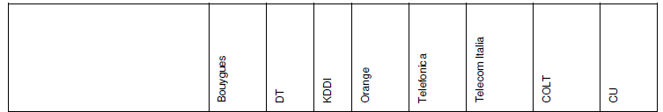
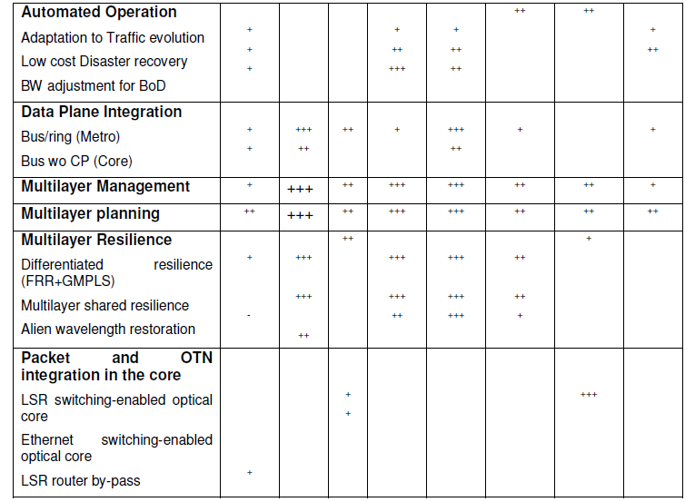
Motivations
What Restorability on Dual Failures on Two-Layer Networks
Why Enhanced Service Reliability
Single failure might not be enough
Dual Failures, disaster recovery, etc.
Need Two-Layer Protection Coordination?
Source: J. P. Fernandez-Palacios, et. al., IP and Optical Convergence: Use Cases and Technical Requirements, Jan. 31, 2014.

Slide 4
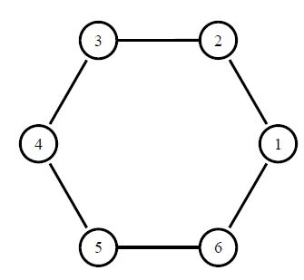
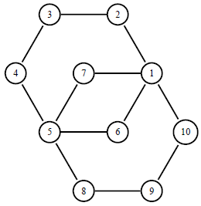
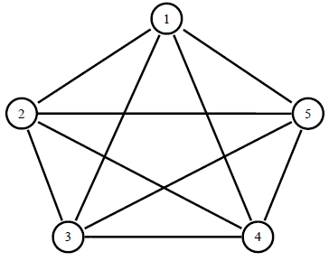
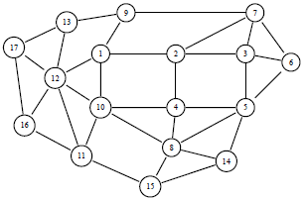
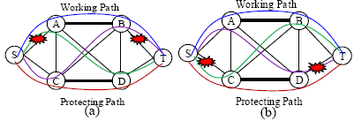
Topology Connectivity for single or dual failure
Protect single failure is commonly available
bi-connected topology
Ring, multi-ring
Protect dual failure
Tri-connected topology
full-mesh, partial-mesh
Dual failure best-effort disjoint
partial tri-connect with cut-pairs
more than 1 backup paths

Slide 5
Protection and Restoration
Working path
Dedicated Protection
Pre-plan path and resource, 1+1/1+1+1
Fast recovery upon failure, e.g. 50ms
Shared Backup Path Protection (SBPP)
Reduces capacity used by sharing among backup paths
Slower recovery than dedicated protection, 1:1/1:1:1
Dynamic Restoration
Dynamic calculate path and resource after failure
not guaranteed path or resource, IP dynamic convergence
Backup path
Protection
Working path
Shared Capacity
Backup path
Working path

Slide 6
Protection of Dual Fiber-Cuts – SBPP
SBPP – Two backup paths protect one working path
Three paths: mutually link disjoint
Topology: tri-connected
Minimize capacity by sharing among dual-failure cases
Working path
Primary backup path
Secondary backup path
1
1
2
2
3
2
4
1
3
6
4
5

Slide 7
Protection of Dual Fiber-Cuts – Benefit
Significantly reduced redundancies
Protection | Primary Backup Path | Secondary Backup Path | Redundancy
1+1+1 | Dedicated | Dedicated | 313–400%
1+1:1 | Dedicated | Shared | 187–310%
1:1:1 | Shared | Shared | 96–180%
1+1 | Dedicated | n.a. | 130-200%
1:1 | Shared | n.a. | 33-50%
Source: V. Y Liu, D. Tipper “Spare capacity allocation using shared backup path protection for dual link failures,” Computer Communications, special issue on reliable network services, vol. 36, no. 6, March 15, 2013, pp. 666-677. http://dx.doi.org/10.1016/j.comcom.2012.09.007.

Slide 8
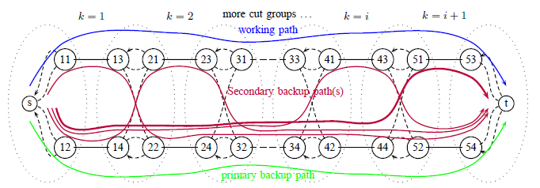
Protection of Dual Fiber-Cuts – SBPP Partial Disjoint Paths
Problem – Lot of backup paths, with shared spare capacity
Results: Overall redundancy does not increase much
Source: V. Y. Liu, D. Tipper, “Spare Capacity Allocation Using Partially Disjoint Paths for Dual Link Failure Protection.” In 9th International Workshop on the Design of Reliable Communication Networks (DRCN), Budapest, Hungary, pp. 171-178, March 4-7. 2013.

Slide 9
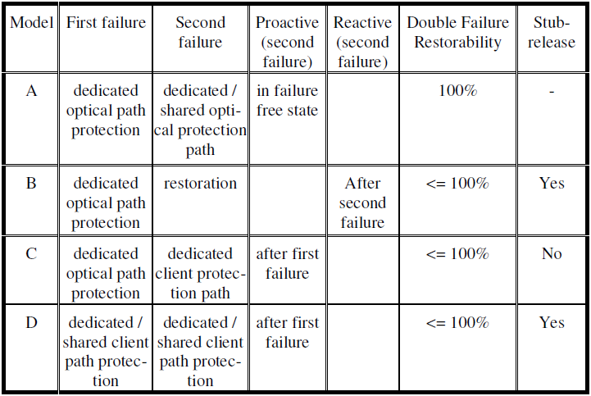
Multi-Layer Protection
Various Combinations
Single Layer Scheme
Two Layer Coordination
Single Layer Scheme with SRLG disjoint needs
Source: R.G. Prinz, A. Autenrieth, and D.A. Schupke, “Dual failure protection in multilayer networks based on overlay or augmented model,” in International Workshop on Design of Reliable Communication Networks (DRCN), Island of Ischia, Naples, Italy, Oct. 16–19 2005.

Slide 10
Simulation Study for Two Single-Failure Protected Layers
what are the dual failure resiliency level on current single failure protected two-layer networks?
Are there any way to improve dual failure resiliency and how about the redundancy?
1. Traffic Demand Matrix
2. Packet Topology Planning
Packet Topology SHAPE & rough packet capacity of minimal Packet CAPEX
Optical Topology
3. Packet Link Mapping
SURVIVABLE Packet Topology Minimize both Packet & Optical CAPEX
Failure scenario
4. What-if Analysis
Simulate scenarios impacted by failures & analyze the results
Enough capacity in each packet link for the traffic flows, so minimize the packet links number and optical channel number

Slide 11
Packet Topology Planning & Link Mapping
2. Packet Topology Planning
3. Packet Link Mapping
Traffic Demand Matrix
Packet Topology
Optical Topology
Packet Topology Planning
Packet Link Mapping
Determine TRUNK packet links by traffic matrix
Check the connectivity of packet topology
0 or 1 or 2 connectivity topology
Augment to 2-connect packet topology with minimal packet CAPEX
Minimize Packet CAPEX
Traffic grooming for minimal packet CAPEX (PHY, VLAN)
packet link mapping to optical topology & modify for survivability
Packet topology mapping using SMART algorithm in [7].
Minimize Packet & Optical CAPEX
1+1 path protection for all packet links
Find packet topology SHAPE & rough capacity
Minimize packet CAPEX
Get minimal CAPEX SURVIVABLE packet topology
Source: [7] M. Kurant and P. Thiran, “Survivable Routing of Mesh Topologies in IP-over-WDM Networks by Recursive Graph Contraction,” IEEE Journal on Selected Areas in Communications, vol. 25, no. 5, June 2007
Notes:
背后的客户理解的逻辑: 输入输出—约束—原则—追求的目标—grooming产生的结果
1、输入是初始的物理拓扑、流量矩阵，输出的是初始IP拓扑。
2、IP拓扑Planning的目的是：根据业务矩阵与物理拓扑规划满足客户要求的最优IP拓扑/IP links

Slide 12
Survivable Packet Topology Mapping
Topology mapping is shown in the interlayer information matrix H
Links/nodes are indexed numerically/alphabetically
1 indicates the upper link has its path over the lower link
Survivable Topology Mapping is to optimize H to
Guarantee the upper layer connected under any single lower failures
Minimize total capacity used at the lower layer
Columns are indexed by lower layer links
Rows are indexed by upper layer links
Source: Eytan Modiano and Aradhana Narula-Tam, "Survivable lightpath routing: a new approach to the design of WDM-based networks," IEEE Journal of Selected Areas in Communication, May 2002.

Slide 13

Packet Survivable topology mapping for single fiber failure
Island cut set
Still connected
Lone Island
Topology constraint but not capacity constraint is considered
Cut-pair dual-failure scenario is ignored
Packet
Flows were restored on residual packet layer topology after two fiber cuts under (1) or (2)
1+1
1+1
Optical
Two packet link protection schemes in optical topology: (1) no protection or restoration; (2) 1+1 path protection;

Slide 14
4. What-if Analysis
Failure scenarios
Packet-Optical Topology& resources
What-if analysis
Identify input failure objects: nodes/Ports/Fibers/SRLGs
Single failure or multiple failures combination
Simulate traffic/packet links passing the objects & check if succeed
Get Interrupted and restored packet Links/traffics
Output failed traffic & Packet links affected by failure objects
The packet topolgy disconnection by dual fiber-cuts will cause partial flows fail to restore in that scenario
Notes:
六、What If 分析
1、输入是IP+光拓扑和故障网元或链路，输出的是中断的/恢复的业务和链路信息。
2、what if分析的主要目的是：对整个网络进行简易的故障模拟及分析。

Slide 15
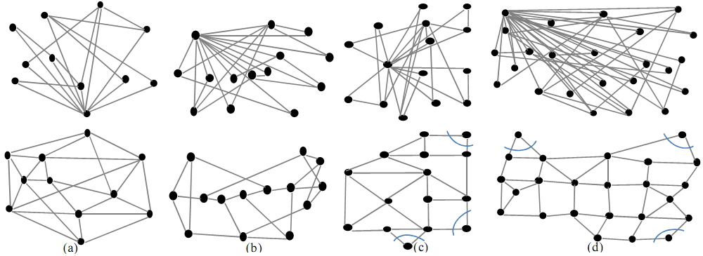
Optical topology & IP topology
Generated packet topologies
Optical topologies

Slide 16
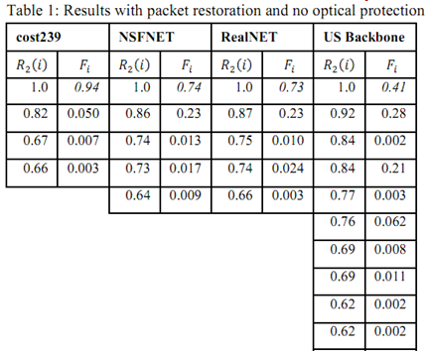

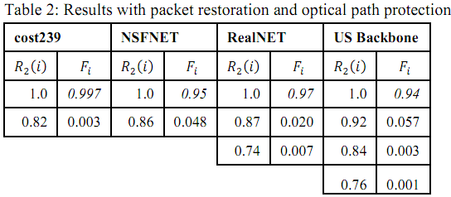
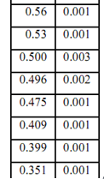
Simulation results - Two Layer Networks with Single Failure Protections
Protection Coordination | Top Layer Single Failure Protection | Bottom Layer Single Failure Protection | Dual Failure Restorability | Comments
None | Enabled | None | 41%-94%
None | Enabled | Enabled | 94%-99.7%
1+1≤2

Slide 17
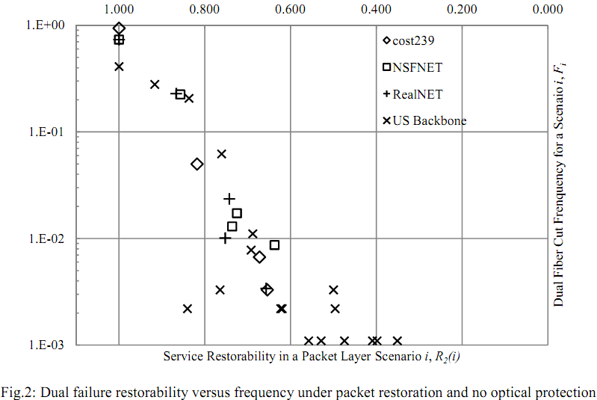
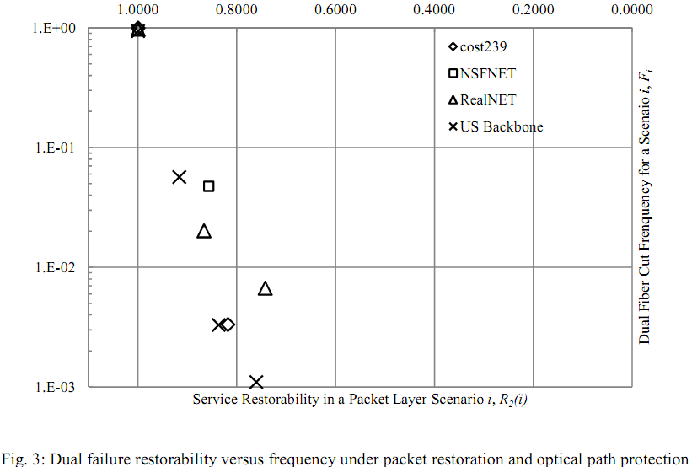
No optical protection vs. Optical path protection
Fig. 2: the majority of the incompletely restorable scenarios will still have a large number of flows that are not restorable. The restoration on packet layer alone is not adequate for the dual failure protection;
Fig. 3: the small number of incompletely-restorable scenarios has large ratios on the service restorability. These values could help to evaluate the benefits of extra effort for protection coordination across layers;
Protection coordination: V. Liu, “Protection Coordination for Dual Failure on Two-Layer Networks,” in 11th Intl. Conf. on Design of Reliable Communications Network (DRCN), Kansas City, MO, USA, March 25-27, 2015.

Slide 18
Future work - Multilayer coordinate protection
The capacity limitation on the dual failure resiliency
The capacity comparison of multilayer vs. two single-layer protection
Additional constraints for protection coordination across layers

