Slide 1


Spare Capacity Allocation Using Shared Backup Path Protection for Dual Link Failures
Victor Yu Liu
David Tipper
Network Research Department
Telecommunications Program
victor.liu@huawei.com
tipper@tele.pitt.edu
HUAWEI TECHNOLOGIES, USA
UNIVERISTY OF PITTSBURGH, USA
Paper on DRCN 2011, October 10-12, Krakow, Poland www.drcn2011.net

Slide 2
Content
Literature review indicates current solution on spare capacity sharing for dual failures has a scalability issue
Previous models for Shared Backup Path Protection (SBPP) for single failures
New model of SBPP for dual link failures with a better scalability
Numerical study on 1+1+1, 1+1:1, 1:1:1; with active/passive spare capacity sharing

Slide 3
Literature Review (I)
Clouqueur, Doucette, & Grover/U Alberta [8-11] For networks resilient single failure, study their dual failure recovery probabilities, or study relationships between survivability and redundancy using local protection
Choi & Subramaniam/GWU [12], Srini/U AZ[13] Using local protection, design protection path for each link to reach mutual exclusion for dual link failure protection
Zhang et al & Mukherjee/UC Davis[14], Ruan/Iowa[15] Using restoration for second failure, less than 100% restorability for dual link failure, but with very high percentage
Prinz, Autenrieth & Schupke [16]; Huawei’s Synergetic Protection[17] Use protection schemes on IP and optical together, to achieve coordinated protection, such as for dual failures

Slide 4
Literature Review (II)
He & Somani / Iowa State Univ. [2] Path-Based Protection for Surviving Double-Link Failures in Mesh-Restorable Optical Networks, in IEEE Globecom 2003
Accurately modeled the spare capacity sharing, aka backup multiplexing
Based on the sharing opportunities between any two backup paths → limited scalability
This problem has been indicated as a difficult problem, i.e., [9][16]
Other effort to simplify this problem [15]
A road block for accurate/efficient dual failure protection

Slide 5
2001: Computing Shared Spare Capacity
For single link failures:
1. Use the working and backup paths, compute G= Q^{T} P
2. From G, compute highest watermarks s = maxG
s
G
Q^{T}
P
Q: when link 2 fails, how much capacity on link 1? A: G₁₂=2

Slide 6
Computing Shared Spare Capacity II
P indicates all working paths. Each row represents a path of a flow. Each column shows a link usage on these paths.
Q is the backup paths matrix. Same as above.
Assume each flow has one unit demand.
G = Q^{^T} P , ^{^T} is the matrix transpose operation → called Spare Provisioning Matrix (SPM)
Elements of G, g_{i,j} indicates the required spare capacity on link i when another link j fails
s = max G indicates element s_i takes the maximum value in the i-th row of G
To meet 100% survivability requirement, the maximum spare capacity across all failure scenarios is needed on link i

Slide 7
Accumulate Single Flow Information in G
Another way to compute SPM
G = Σ_{r} G_{r} , where G_{r} = q_{r}^{T} p_{r} and p_{r}, q_{r} are the working and backup paths of flow r
This is a scalable way to compute shared spare capacity from individual flows
No need to store large amount of flow paths
Only needs G and G_{r} on related nodes
G
Links
Failures
G₁
G₂
Q
P
…
Flows
G_{R-1}
G_{R}

Slide 8

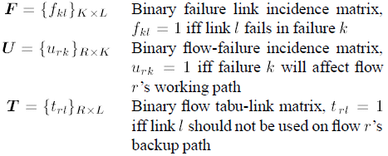
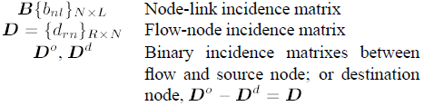
Computation for Node Failures and SRLG
Treat node failure as a failure of all adjacent links
Using a failure matrix F = B,
Replace working path matrix P with failure matrix U in G = Q^{^T} U
Elements u_{r, k} indicates weather a failure k will break working path of flow i
The failure matrix U :
It derives the tabu link matrix T
SRLG is similarly formulated
Links
G
Failures
U
Q
P
…
Flows
F^{T}

Slide 9
Why and How to Protect Dual Link Failures
Why?
Single Failures are well studied
Dual Link Failures such as dual fiber cuts did happen under
Scenarios where frequent network changes occur
Scenarios where reduced reliability on network facility & equipment
Scenarios where intentional sabotage cannot be avoided
How?
Provide and plan extra resource such as secondary backup path, spare bandwidth, connectivity
Design restoration schemes to identify and restore traffic upon dual failures
Both global and local protection schemes can be considered

Slide 10
Shared Backup Path Protection to Protect Dual Link Failures
Each flow has three disjoint paths:
Working path: carrying traffic
Primary backup path: protect first link failure
Secondary backup path: protect dual link failure
Sharing spare capacity among different flows, i.e.:
Three primary backup paths can share 2 unit of bandwidth on the overlap segment when the working paths are mutually disjoint
Two secondary backup paths can share on their overlap segment when their working and primary backup paths are mutually disjoint;
2
1
2
1
1
2
3
2
4
3
5
6
4

Slide 11
How to Capture Dual Link Failures
Each dual link failure can be identified by two links i & j
Number of all dual link failures is where L is number of links
All dual link failures can be captured in a L×L matrix
For two disjoint paths that can be disrupted by a dual failure
All working paths P ={p_{r}} = {p_{ri}}, where p_{ri} = 1 iff working path of flow r uses link i.
All primary backup paths Q = {q_{r}} = {q_{ri}}
All secondary backup Paths Z = {z_{r}} = {z_{ri}}
Dual link failures that disrupt

Slide 12
Failure Vectors u_{r} for Flow r
The primary backup path will carry traffic when
One link failure i is on the working path; and
Another link failure j is NOT on the primary backup path
i.e. when
or the first failure vector for flow r, has value 1 on position k
The secondary backup path will carry traffic when
One link failure i is on the working path; and
Another link failure j is on the primary backup path
i.e. when
or the second failure vector for flow r, has value 1 on position k

Slide 13
Spare Provision Matrix for Dual Link Failures
For both backup paths, compute their G¹, G²
Use G¹ and G² in 1:1:1; Use G² for 1+1:1
Links
G^{[1]}
G^{[2]}
Failures
G₁^{[1]}
G₁^{[2]}
Flows
Q
G₂^{[1]}
Q
P
Q
Z
G₂^{[2]}
U^{[2]}
U^{[1]}
…
…
P
q_{i}
G_{R-1}^{[1]}
G_{R-1}^{[2]}
…
p_{i}
…
G_{R}^{[1]}
G_{R}^{[2]}
…
…

Slide 14
Solution Approach
Original model is not linear
Solve ILP models sequentially
Find all primary backup paths first
Find all secondary backup paths next
Other tweaks:
Changed the first failure vector
From
To
Reduce the chance of capacity sharing among primary backups
Advantages:
Remove non-linear constraints; and speed up to get results
Disadvantages:
Loss of optimality

Slide 15
Various Protection Schemes
Whether backup paths use dedicated or shared resource
“+1” or “1+” for dedicated resource; “:1” or “1:” for shared resource
M:N means M backup protects N working → discussion
Whether capacity sharing occur during or after routing
Scheme | Primary Backup Path | Secondary Backup Path
1+1+1 | Dedicated | Dedicated
1+1:1 | Dedicated | Shared
1:1:1 | Shared | Shared
Scheme | Passive | Active
Routing | First | Same time
Capacity Sharing | Second | Same time
Simplicity | Simple | Complicated
Redundancy | Low | Lowest

Slide 16
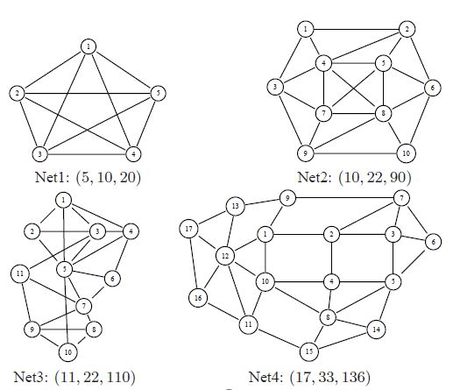
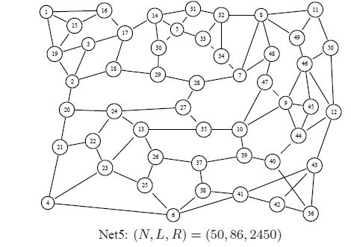
Networks for Numerical Study
Five networks
All tri-connected
Link capacity unlimited → Reduce interferences from capacity

Slide 17
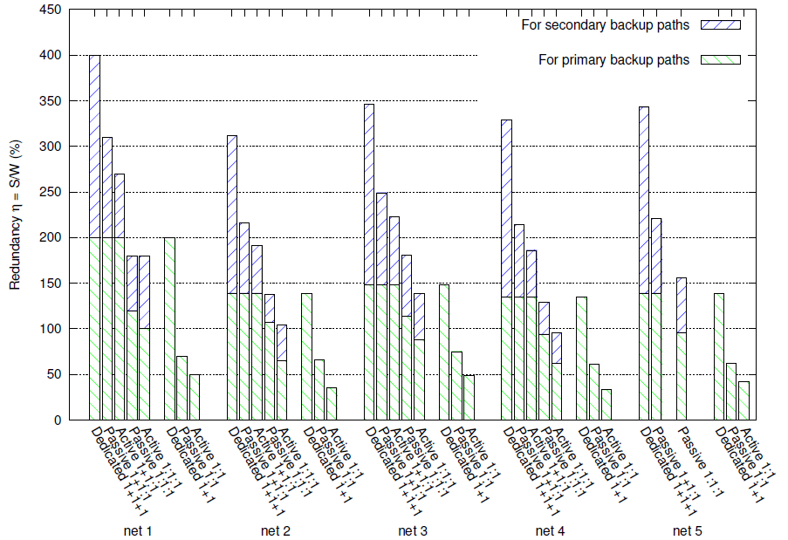
Numerical Results

Slide 18
Observations
Redundancy can be reduced by increased complexity
From 1+1+1, 1+1:1, to 1:1:1
The active approach always has lower redundancy than the passive approach
12% reduction on Net 2-4 for 1+1:1 and
25% reduction on Net 2-4 for 1:1:1
The secondary backup paths use less spare capacity than the primary backup paths
Much more redundancy to protect 100% dual link failure than single link failures

Slide 19
Conclusion
This paper answers two important questions, for SBPP against dual link failures:
How to compute the spare capacity sharing
How it can reduce redundancy
Contributions:
A scalable method to compute spare capacity sharing
Removal of a roadblock on dual link failure protection

