Slide 1
Redis is a
networked, in-memory key-value store.

Slide 2
Memory
FAST
Memory – some nanoseconds
Spinning disk – some milliseconds
1 000 000 times difference

Slide 3
Unlike memory Redis has
Features – persistence, replication, clustering, numerous datatypes, etc
But - never enough. So – extension modules.

Slide 4
How module looks?
redismodule/
Makefile
src/
redismodule.h
implementation.c

Slide 5
Run make
Get rertree.so
Run Redis
redis-server --loadmodule /path/to/rertree.so

Slide 6
int RedisModule_OnLoad(RedisModuleCtx *ct) {
RedisModule_Init(
ctx,
RTMODULE_NAME,
RTREE_VERSION,
REDISMODULE_APIVER_1);

Slide 7
static RedisModuleTypeMethods typeprocs = {
.rdb_load = RtRdbLoad,
.rdb_save = RtRdbSave,
.aof_rewrite = RtAofRewrite,
.free = RtFree,
};// acc. to code not implemented?
RtreeType = RedisModule_CreateDataType(
ctx, "ReRtree--",
ENCOD_VERSION, &typeprocs);

Slide 8
static void RtRdbSave(
RedisModuleIO *io, void *obj) {
…
RedisModule_SaveUnsigned(io, count);
for (size_t i = 0; i < count; ++i) {
RedisModule_SaveUnsigned(io, I[i]);

Slide 9
static void *RtRdbLoad(
RedisModuleIO *io, int encver) {
if (encver > RT_VERSION)
return NULL;
…
RedisModule_LoadUnsigned(io);

Slide 10
Redis Append Only Files (AOF)
We can just log commands but – overhead:
redis> SET mykey "Hello"
"OK"
redis> SET mykey "Hello"
"OK"
redis> SET mykey "Hello"
"OK"
redis> SET mykey "Hello"
"OK"

Slide 11
static void RtAofRewrite(
RedisModuleIO *aof,
RedisModuleString *key, void *value) {
…
RedisModule_EmitAOF(aof, "SET", "slb",
key, value);

Slide 12
RedisModule_CreateCommand(
ctx,
"rtree.find",
RtFind_RedisCommand,
"readonly", 1, 1, 1);

Slide 13
static int RtFind_RedisCommand(
RedisModuleCtx *ctx,
RedisModuleString **argv, int argc) {
RedisModule_AutoMemory(ctx);
if (argc != 4) {
RedisModule_WrongArity(ctx);
return REDISMODULE_ERR;
}

Slide 14
RedisModuleKey *key =
RedisModule_OpenKey(ctx, argv[1],...);
int type = RedisModule_KeyType(key);
ptree = RedisModule_ModuleTypeGetValue(key);

Slide 15
RedisModule_ReplyWithLongLong(ctx, *val);
RedisModule_ReplyWithSimpleString(
ctx, "OK");
return REDISMODULE_OK;

Slide 16
Order
1 2 3 4 5 6 7 8 9 10 11 …
search for [5-9)
Attacks – dateranges
search for intersections
[1483228800, 1483238800)

Slide 17
With ranges linear order is useless.
(1, 10000) (2, 3) (3, 6) (5, 6) …. (9000, 9001)

Slide 18
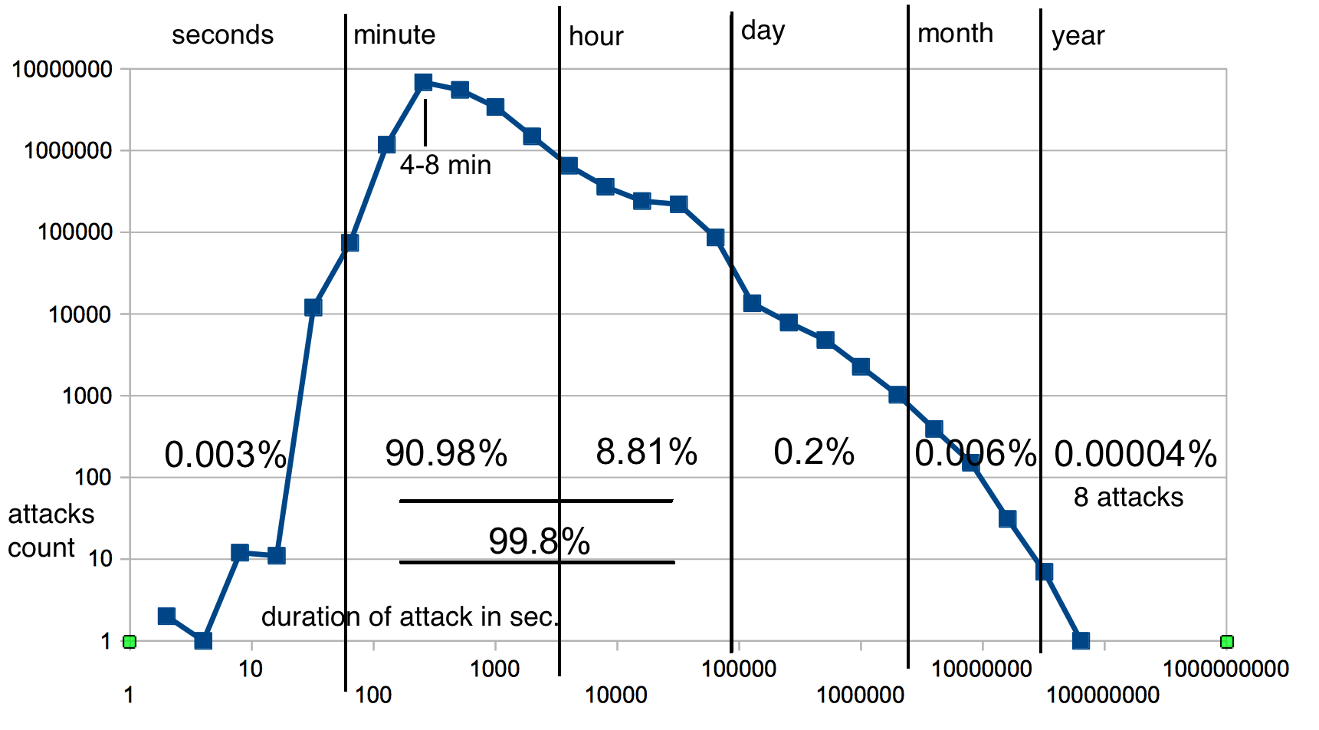
Beware - Log-Log scale

Slide 19
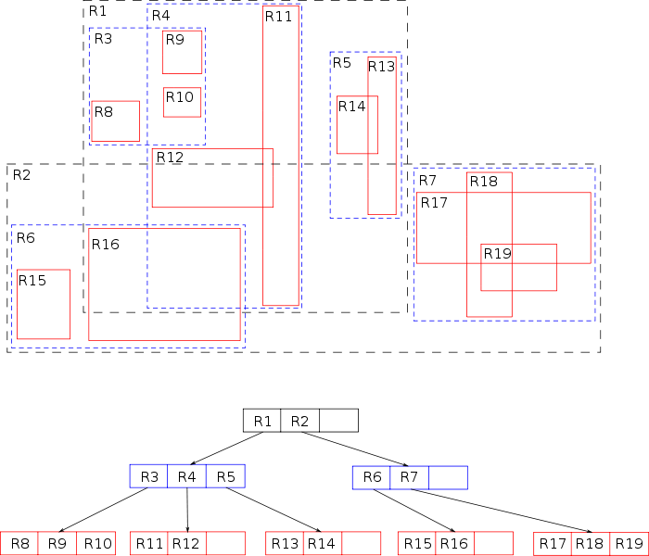
R-trees – spatial indexing

Slide 20
(1, 1000) (2, 3) (8, 9) (1000, 2000) ...
R-tree
(1-2000)
(1, 1000) (1000, 2000)
(2, 3) (8, 9)

Slide 21
Memory is FAST
And now, with R-tree we can just put all attacks in memory and run any timerange query(packetloop/rertree).
1h range of attacks query – 0.3 msec
Spinning disk does not even move r/w head so fast. With SSD Postgress runs queries like this in 0.1 of second – 300 times slower!

Slide 22
If it fits on disk – it is not BigData

Slide 23
If it fits on disk – it is not BigData
If it fits in memory – it is not data, it's variables

