Slide 1
Endpoint Discovery Script

Slide 2
Brownfield Migration Scenario
A site needs to be migrated to SDA as part of network transformation project
A mixture of of old catalyst and nexus switches as layer 3 and layer 2
Server farms
A wide range of endpoints – workstations, phones, cameras, vms
Some endpoints have static IP addresses
No ISE, No CMDB, Netflow or any endpoint mapping tool
Migration requirement
Refresh all old platforms with new CAT9K
Retain existing subnets
All critical endpoints working before the migration should be working post-migration

Slide 3
endpoint-discovery script
The script tries to achieve the following objective
Discover endpoints in the network pre-migration
Map out an accurate layer2/layer3 topology of the network
The data can then be used to
Predict the size of the network
Predict ISE policies
Consolidate ports/switches
Create MOPs for SDA migration
Perform pre and post migration ping sweeps

Slide 4
Install
Step 1. Use git to pull the repo from internal Cisco github
Step 2. Install the required python libraries

Slide 5
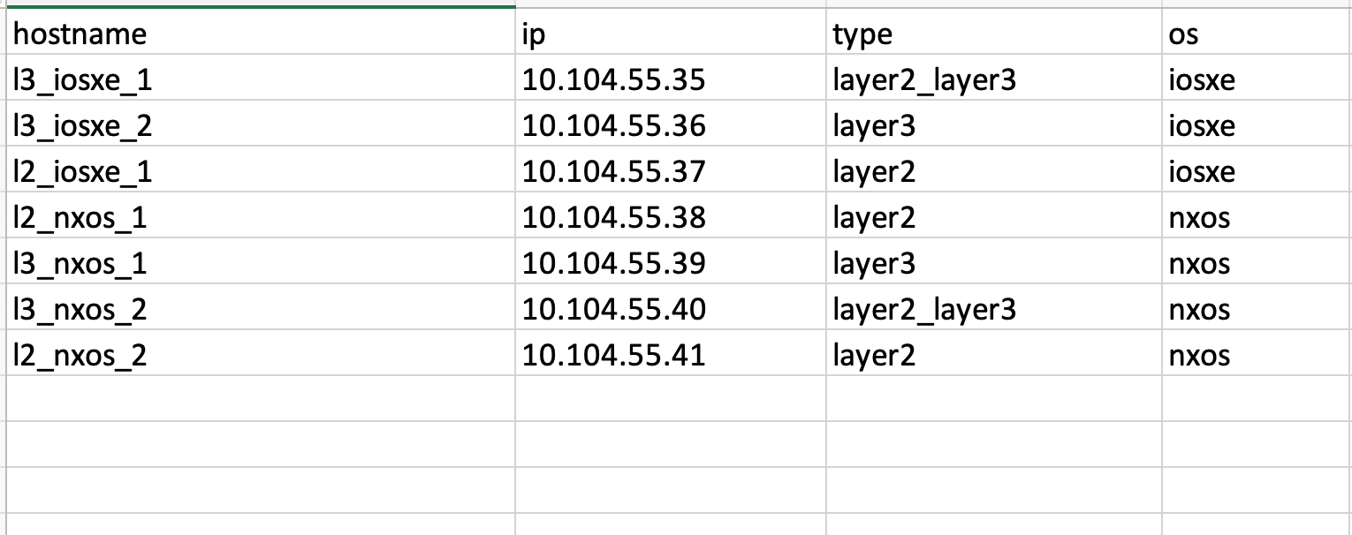
Input File
Use the above format
The file extension should be .xlsx

Slide 6
Run
umahar@UMAHAR-M-YYT9 endpoint-discovery % python3 discover.py -h
usage: discover.py [-h] --site SITE --file FILE [--webex WEBEX] [--ssh_options SSH_OPTIONS] [--offline]
options:
-h, --help show this help message and exit
--site SITE Site name
--file FILE Input filename
--webex WEBEX Webex file for publishing
--ssh_options SSH_OPTIONS SSH Options for old ciphers
--offline Offline sites

Slide 7
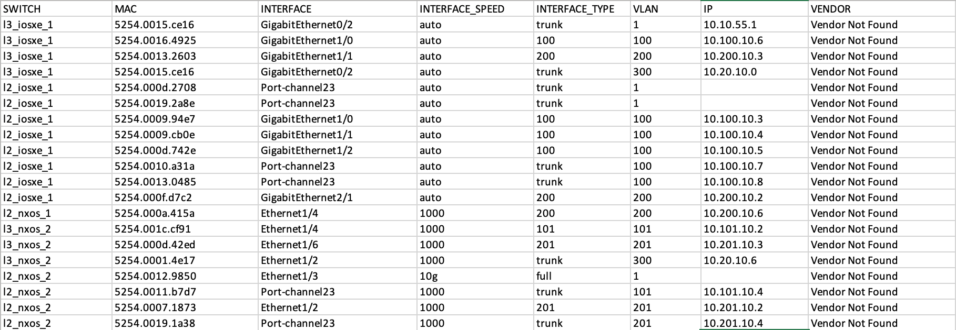
Example 1 – SSH available to all the switches
python3 discover.py --site cml_lab --file cml_lab_seed.xlsx
Endpoint Report

Slide 8
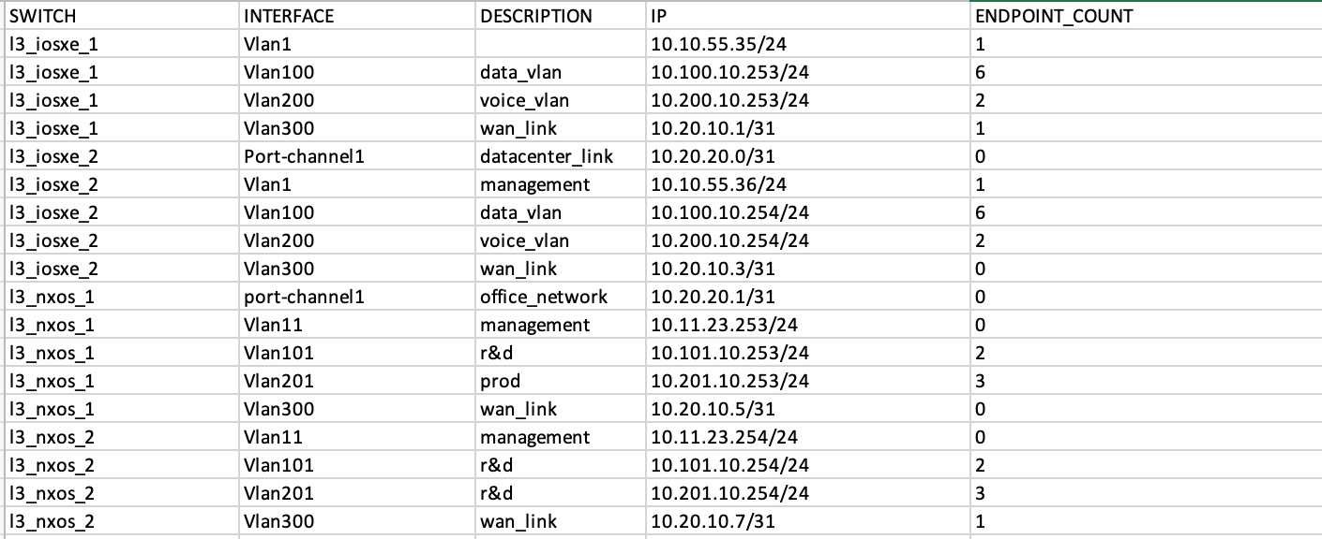
Example 1 – SSH available to all the switches
L3 Interface report

Slide 9
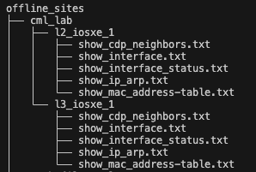
Example 2 – Script can’t be deployed in the network
python3 discover.py --site cml_lab --file cml_lab_seed.xlsx --offline

Slide 10
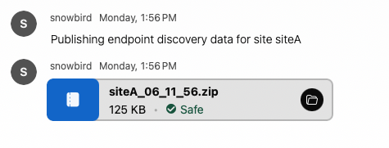
Example 3 – Use Webex integration to publish reports
python3 discover.py --site cml_lab --file cml_lab_seed.xlsx --webex webex.yaml

Slide 11
Example 4 – For devices with old ciphers
python3 discover.py --site test_site --file test_lab.xlsx --ssh_options " -o KexAlgorithms=+diffie-hellman-group-exchange-sha1,diffie-hellman-group14-sha1,diffie-hellman-group1-sha1 -o HostkeyAlgorithms=+ssh-rsa"
Find a combination which works for you with trial and error
The above combination was required to connect to nexus and ios devices in CML

Slide 12
Deep Dive

