Slide 1
Endpoint Discovery Script

Slide 2
endpoint-discovery script
The script tries to capture outputs from network devices

Slide 3
Scenario
A site needs to be migrated to SDA as part of network transformation project

Slide 4
Install
Step 1. Use git to pull the repo from internal Cisco github git clone https://wwwin-github.cisco.com/umahar/endpoint-discovery.git
Step 2. Install the required python libraries
python3 -m venv endpoint-discovery
source endpoint-discovery/bin/activate
pip3 install -r requirements.txt

Slide 5
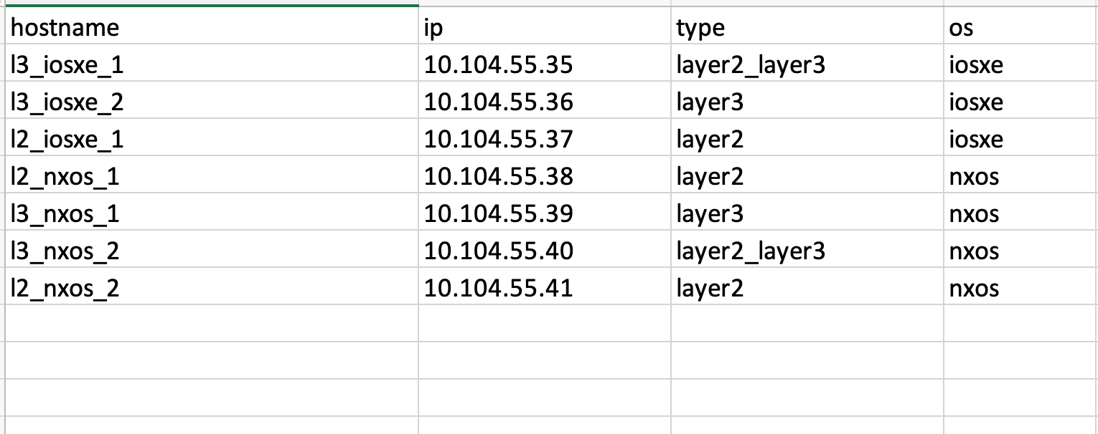
Input File
Use the above format
The file extension should be .xlsx

Slide 6
Run
umahar@UMAHAR-M-YYT9 endpoint-discovery % python3 discover.py -h
usage: discover.py [-h] --site SITE --file FILE [--webex WEBEX] [--ssh_options SSH_OPTIONS] [--offline]
options:
-h, --help show this help message and exit
--site SITE Site name
--file FILE Input filename
--webex WEBEX Webex file for publishing
--ssh_options SSH_OPTIONS SSH Options for old ciphers
--offline Offline sites

Slide 7
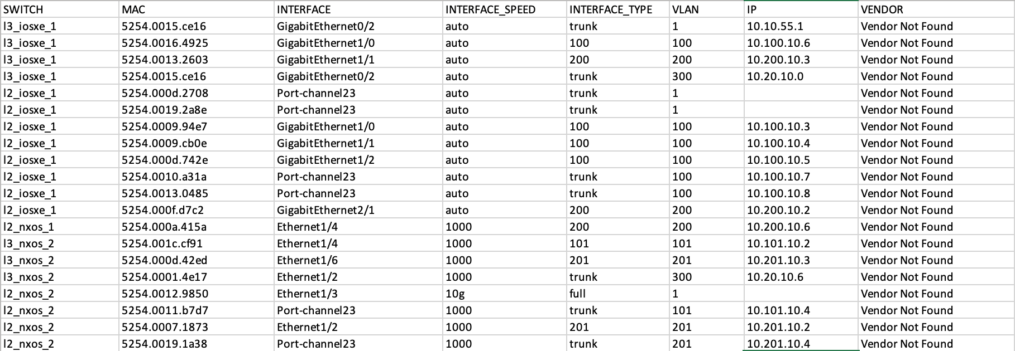
Example 1 – SSH available to all the switches
python3 discover.py --site cml_lab --file cml_lab_seed.xlsx
Endpoint Report

Slide 8
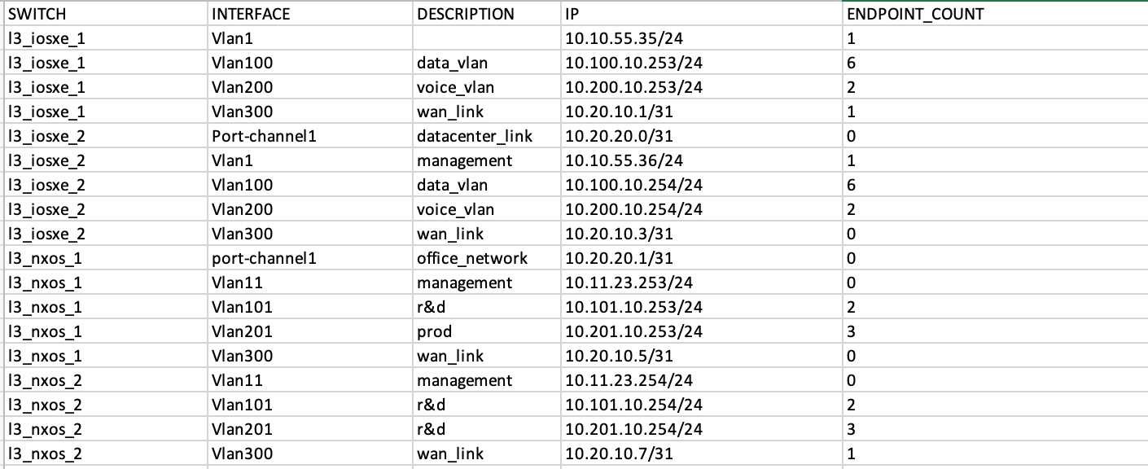
Example 1 – SSH available to all the switches
L3 Interface report

Slide 9
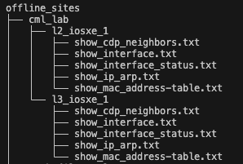
Example 2 – Script can’t be deployed in the network
python3 discover.py --site cml_lab --file cml_lab_seed.xlsx --offline

Slide 10
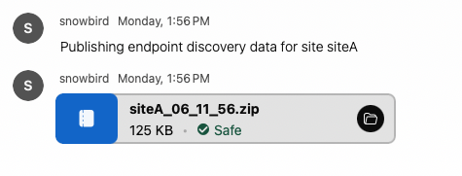
Example 3 – Use Webex integration to publish reports
python3 discover.py --site cml_lab --file cml_lab_seed.xlsx --webex webex.yaml

Slide 11
Example 4 – For devices with old ciphers
python3 discover.py --site test_site --file test_lab.xlsx --ssh_options " -o KexAlgorithms=+diffie-hellman-group-exchange-sha1,diffie-hellman-group14-sha1,diffie-hellman-group1-sha1 -o HostkeyAlgorithms=+ssh-rsa"
Find a combination which works for you with trial and error
The above combination was required to connect to nexus and ios devices in CML

