Slide 1
Project
GROUP-

Slide 2
Team Members
Rachit Manglik-915895
Diya Maheshwari-
Aishwarya Singh-
Vivek Garg-
Muskan-

Slide 3
Project Title: BookMyShow
1. Find the sports activities in your city for coming weekend, with lowest charges on top; Display the Name of the sports along with date. 2. Extract all the languages for movies and store in a List; Display the same 3. Try to 'Sign In' with google, give invalid account details & capture the error message (Suggested Site: bookmyshow.com however you are free to use any other legitimate site)

Slide 4
Detailed description
Verify invalid Google login on BookMyShow login page
Fetch the languages available in the filter section of BookMyShow movies page
Fetch the Sports detail for the upcoming weekend and sort them according to their prices.

Slide 5
Tools and Technologies Used
Java – High level Programming Language.
Selenium – Java libraries for automating actions on Web UI.
Eclipse – Integrated Development Environment for various ‘Languages’.
TestNG – Open source testing framework.
Maven – Software and project Management Tool.
POM – Concept to Modularise Objects and Actions in a repository design pattern.
Jenkins – An open source automation server for continuous integration.
Selenium Grid – Tool use to distribute test to run test in parallel on multiple browser and machines
Apache Poi- Open source Java library to handle data from Excel Sheets
Extent Report- Open source Libraries to create customized HTML test Report

Slide 6
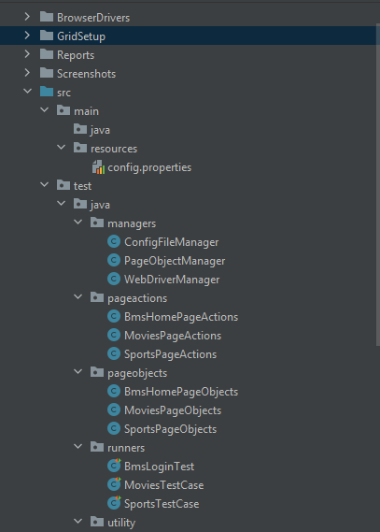
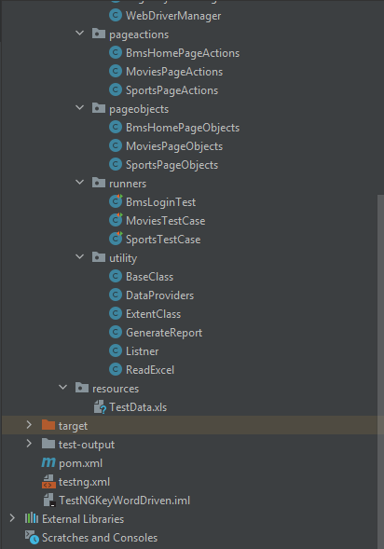
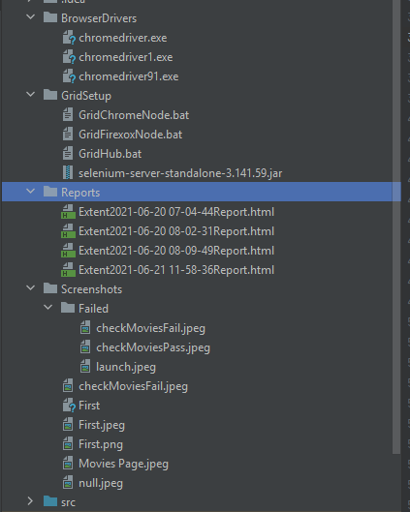
Project structure

Slide 7
Package- managers
This Package contains all three classes which help us in managing other classes in the framework as below:
ConfigFileManager:
It helps us in getting data from config.properties file and manage all the getProperty methods in a single place.
WebDriverManager:
It help us in creating the desired driver and get the driver all across the framework by using getDriver() method.
PageObjectManager:
This class manages all the PageObject and PageAction classes which help us in removing redundant POM objects in our framework.

Slide 8
Package- pageactions
This package contains all the pageaction classes in our framework. These page action classes contains all the reusable method(actions) written for any webpage. This contains below classes:
SportsPageActions
MoviesPageActions
BmsHomePageActions

Slide 9
Package- pageobjects
It contains the classes which stores the web elements in any specific webpage and these webelements can be re used multiple time anywhere in side the framework. This also significantly decreases the maintenance timing.
Classes are:
BmsHomePageObjects
MoviesPageObjects
SportsPageObjects

Slide 10
Package runners
This package contains all the TestNG test cases. These classes enables us to run any specific test case at a time.
Contains:
BMSLoginTest
MoviesTestCase
SportsTestCase

Slide 11
Package utility
This contains all the supporting classes required for our Test cases. The classes are:
ReadExcel
This handles the read and write operations on excel files using apache POI libraries.
GenerateReport
This class handles the logging of test status, info text and screenshot in the HTML Reports.
BaseClass
This class is the super class of all the runner classes and does the setup before the test and clean up and closing activities after the test.
Listners
This class catches all the events fired by TestNG tests and its results and implements the reporting according to the events.

Slide 12
Other Files
Pom.xml : It helps us in setting up maven for our project.
Testng.xml: It helps Us in running the creating test suite according to our needs.
Test.xlx: It contains all the TestData of our Test.
Grid folder: Contains grid server and batch files to setup hub and nodes.
BrowserDrivers folder: This contains drivers for different browsers.
Screenshot: Contains screenshot of the execution.
Reports: Contains HTML reports for past Executions.

Slide 13
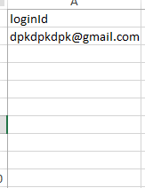
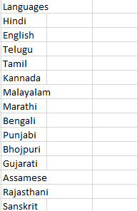
Excel File
Input Sheet
Output Sheet

Slide 14
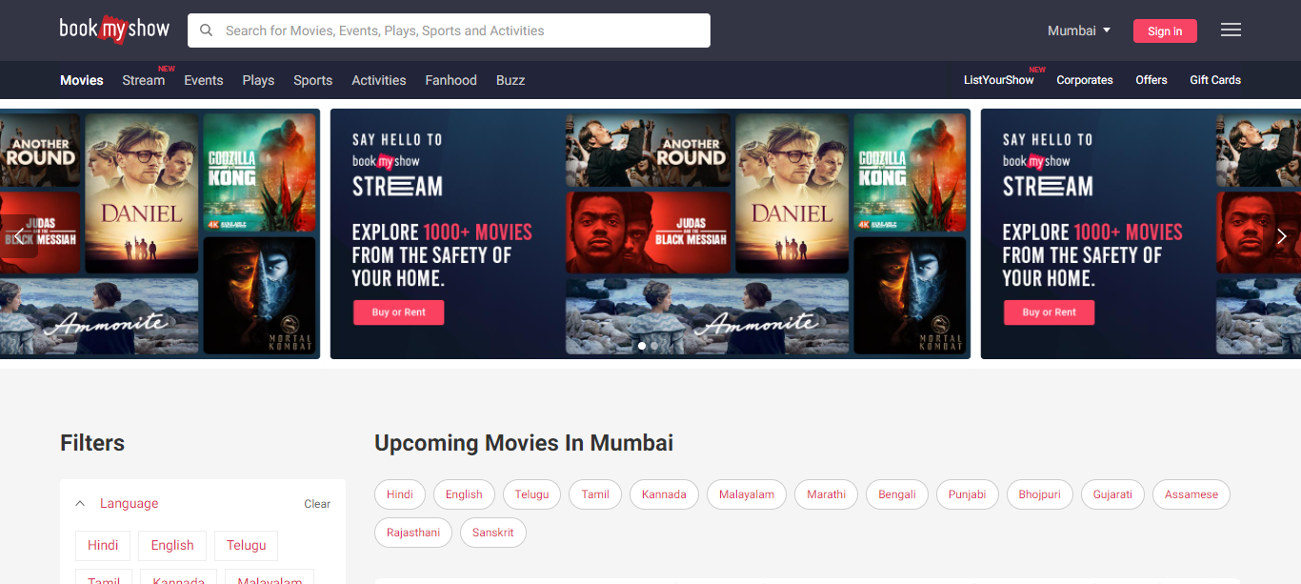
Real Time Screenshot

Slide 15
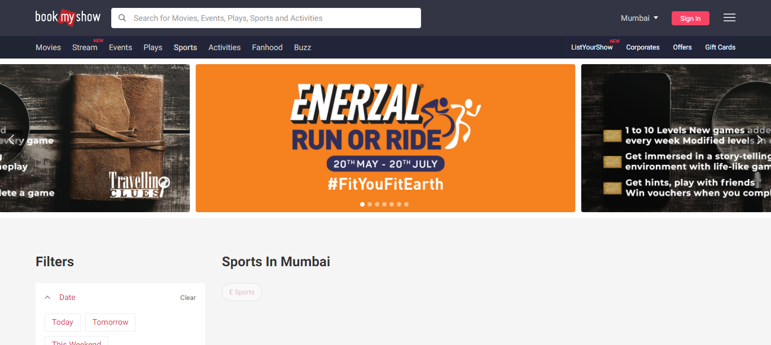
Real Time Screenshot

Slide 16
THANK YOU

