Slide 1
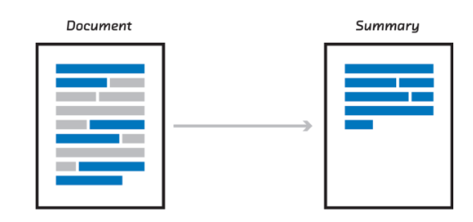
Extractive Text Summarization Using Neural Networks
Sourab M
14CSE1024

Slide 2

Outline
Introduction
Definition
Types
Importance
Related Work
Proposed Methods
Datasets
CNN based Model
SVM based Model
RNN based Model
Results
Conclusion

Slide 3
INTRODUCTION

Slide 4
What is Text Summarization?
Text summarization is the process of shortening a text document and generating a summary using some software.
The summary generated by the software must contain all the main points of the original document.
Two approaches:
Extractive Text Summarization
Abstractive Text Summarization

Slide 5
Extractive Text Summarization
Idea: Selecting a subset of given data such that the selected subset contains all the important information of the entire original data.
Popular for image collection summarization and video summarization.
Single Document Extractive Text Summarization:
Selecting the most informative sentences from a given text document and generating a representative summary of the original document.

Slide 6
Abstractive Text Summarization
Building an internal schematic representation of the document and then use natural language generation techniques to generate the representative summary of the original document.
Such a summary might have verbal innovations.
Research till date shows much work in Abstractive Text Summarization( generating summaries similar to summaries generated by humans) as opposed to Extractive Text Summarization.

Slide 7
Original Text: Alice and Bob took the train to visit the zoo. They saw a baby giraffe, a lion, and a flock of colorful tropical birds.
Extractive Summary: Alice and Bob visit the zoo. saw a flock of birds.
Abstractive Summary: Alice and Bob visited the zoo and saw animals and birds.

Slide 8
Importance
We are drowning in information and starving for knowledge – Rutherford D. Roger
Some Applications:
Summary of books, reports etc
News Highlights
Summary of Research papers, Magazines etc
Search Engines
Some examples:
Surgeon treating a patient with a rare disease.
Lawyer working on a peculiar and important case.
It has applications that will have profound impacts on the human lifestyle.

Slide 9
Related Work

Slide 10
Focus and Approaches
Focus: Single Document Extractive Text Summarization.
Approaches:
Unsupervised Learning Methods
Supervised Learning Methods
Recent Advances is in the domain of unsupervised learning methods.
Focus: Supervised Learning Methods

Slide 11
Unsupervised Learning Methods
Graph Based Approach
Concept Based Approach
Fuzzy Logic Based Approach
Latent Semantic Analysis Method

Slide 12
Supervised Learning Methods
Requires Training Data
Sentence Level Classification: Each sentence labelled either “summary sentence” or “non-summary sentence”
Challenge: Classification of Sentences for creating training data
Some Approaches:
Bayes Rule based Approach
Neural Networks based Approach
Conditional Random Fields
Focus: Neural Networks Based Approach

Slide 13
Proposed Methods

Slide 14
Datasets
CNN Dataset:
Number of documents in training data folder: 83567
Number of documents in validation data folder: 1220
Number of documents in test data folder: 1093
Average number of words per sentence: 24
Average number of sentences per article:30
Vocabulary Size: 222436
Number of words in sentence after padding: 60
Labels for each sentence:
Extractive summary sentence: 0
Non-Extractive summary sentence: 1
Ambiguous sentences: 2

Slide 15
Dailymail Dataset:
Number of documents in training data folder: 193981
Number of documents in validation data folder: 12147
Number of documents in test data folder: 10346
Average number of words per sentence: 29
Average number of sentences per article: 27
Vocabulary Size: 397505
Number of words in sentence after padding: 60
Labels for each sentence:
Extractive summary sentence: 0
Non-Extractive summary sentence: 1
Ambiguous sentences: 2

Slide 16
Cases Considered
Following cases for generating training, validation and test data:
CASE 1: Sentences labelled 2 will be relabelled as 1. In other words, sentences labelled 2 are not included in extractive summary but will be part of article.
CASE 2: Sentences labelled 2 will be retain that label. In other words, this is a classification problem with 3 classes.
CASE 3: Sentences labelled 2 will be excluded from the article. In other words, sentences labelled 2 will not even be part of article.
Each document also has an human generated summary which will be referred to as abstractive summary or gold summary

Slide 17
Convolutional Neural Network (CNN) Based Model
Each sentence is represented as a Matrix. Each row is a word2vec word embedding of a word.
We will use filters that slide over the full rows of the input matrix(words).
The heights, or region sizes, that have been used for the proposed CNN model are 3, 5, 7 and 9.
Sentence Classification Problem – Each sentence with a label. Based on labels, sentences are selected to form extractive summary.
Assumption – Sentences are independent of each other.

Slide 18
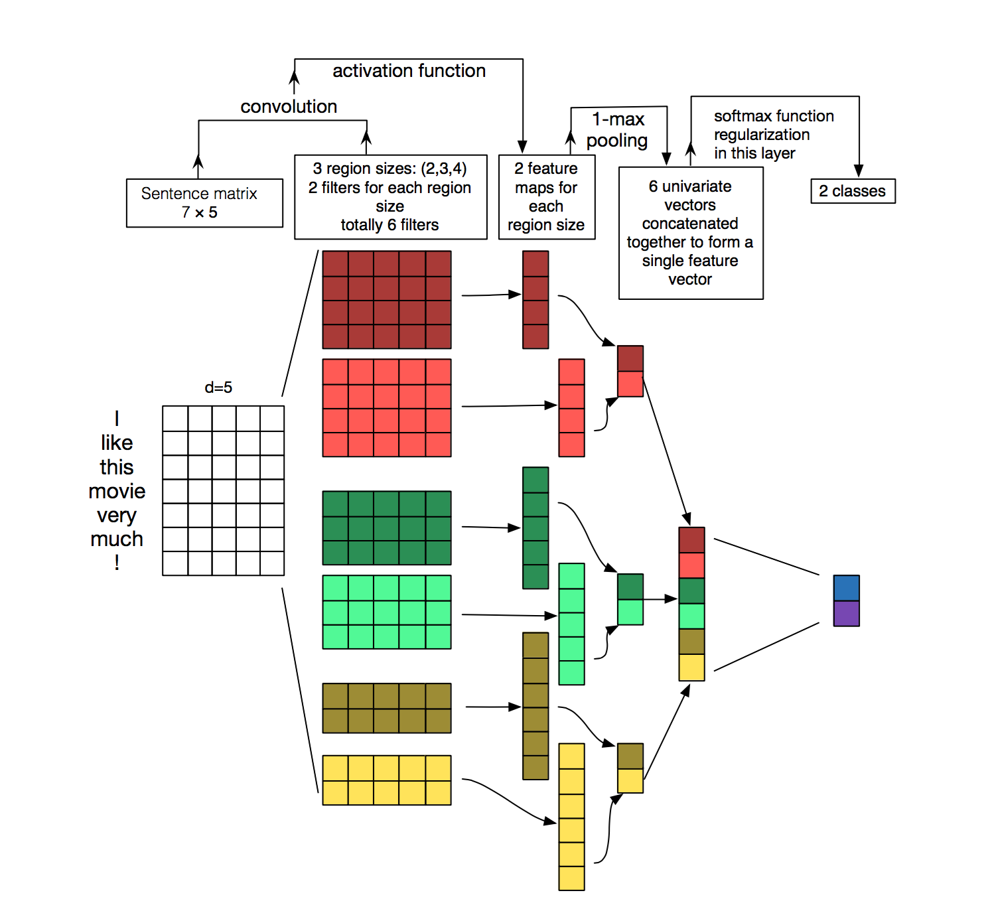

Slide 19
Linear Support Vector Machine (SVM) Based Model
Feature Vectors are generated by CNN Model in the penultimate layer.
These Feature Vectors are used as input for linear SVM and it is trained for different C values.
“sklearn.svm.LinearSVC “ is used because it can scale to large number of training examples.

Slide 20
Recurrent Neural Network (RNN) Based Model
Uses Feature Vectors generated by CNN model as input.
Model – Multi-Layer Bidirectional Sequence-to-Sequence using LSTM cells.
Each Feature Vector – Fixed length representation of a sentence.
Models dependency between sentences by considering left and right contexts of a sentence.
Output quality is dependent on quality of Feature Vectors.

Slide 21
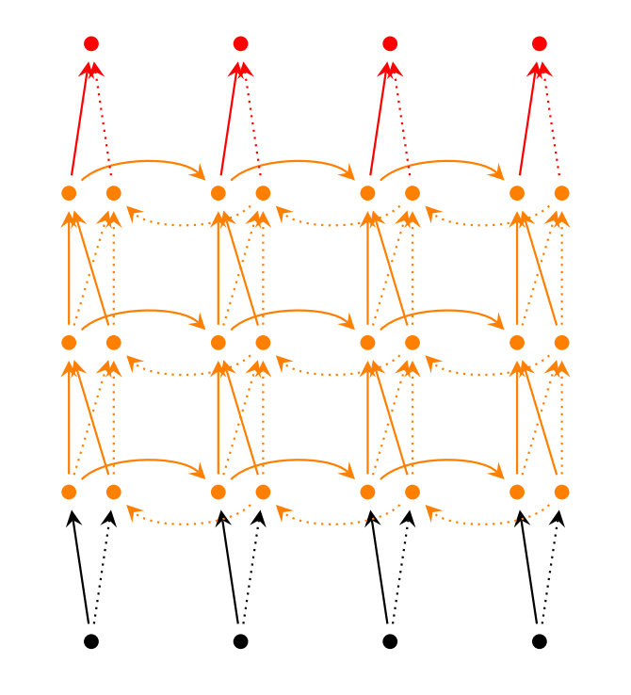

Slide 22
Results

Slide 23
ROUGE – Evaluation Measure
ROUGE - Recall-Oriented Understudy for Gisting Evaluation
The metrics compare an automatically produced summary or translation against a reference or a set of reference (human-produced) summaries or translation.
Types- ROUGE-1, ROUGE-2,…, ROUGE-N, ROUGE-L, ROUGE-S
Measures Used – ROUGE-1 and ROUGE-L, because verbosity is considerable for both system and reference summaries.

Slide 24
CNN Dataset
CNN Based Model :
Original Extractive vs Predicted Extractive Summaries:
ROUGE-1 Score: 75.7±2.2 (Obtained for CASE-2)
ROUGE-L Score: 75.0±2.2 (Obtained for CASE-2)
Original Abstractive vs Predicted Extractive Summaries:
ROUGE-1 Score: 60.9±2.1 (Obtained for CASE-2)
ROUGE-L Score: 56.9±2.1 (Obtained for CASE-2)

Slide 25
SVM Based Model :
Original Extractive vs Predicted Extractive Summaries:
ROUGE-1 Score: 76.2±2.2 (Obtained for CASE-2)
ROUGE-L Score: 75.4±2.2 (Obtained for CASE-2)
Original Abstractive vs Predicted Extractive Summaries:
ROUGE-1 Score: 60.7±2.2 (Obtained for CASE-2)
ROUGE-L Score: 56.7±2.2 (Obtained for CASE-2)

Slide 26
RNN Based Model :
Original Extractive vs Predicted Extractive Summaries:
ROUGE-1 Score: 73.8±2.5 (Obtained for CASE-2)
ROUGE-L Score: 73.1±2.5 (Obtained for CASE-2)
Original Abstractive vs Predicted Extractive Summaries:
ROUGE-1 Score: 56.9±2.1 (Obtained for CASE-2)
ROUGE-L Score: 53.0±2.1 (Obtained for CASE-2)

Slide 27
Dailymail Dataset
CNN Based Model :
Original Extractive vs Predicted Extractive Summaries:
ROUGE-1 Score: 77.8±0.8 (Obtained for CASE-2)
ROUGE-L Score: 77.1±0.8 (Obtained for CASE-2)
Original Abstractive vs Predicted Extractive Summaries:
ROUGE-1 Score: 56.0±0.7 (Obtained for CASE-2)
ROUGE-L Score: 52.3±0.7 (Obtained for CASE-2)

Slide 28
SVM Based Model :
Original Extractive vs Predicted Extractive Summaries:
ROUGE-1 Score: 75.8±0.9 (Obtained for CASE-2)
ROUGE-L Score: 75.2±0.9 (Obtained for CASE-2)
Original Abstractive vs Predicted Extractive Summaries:
ROUGE-1 Score: 54.3±0.7 (Obtained for CASE-2)
ROUGE-L Score: 50.7±0.7 (Obtained for CASE-2)

Slide 29
RNN Based Model :
Original Extractive vs Predicted Extractive Summaries:
ROUGE-1 Score: 78.8±0.7 (Obtained for CASE-2)
ROUGE-L Score: 78.1±0.7 (Obtained for CASE-2)
Original Abstractive vs Predicted Extractive Summaries:
ROUGE-1 Score: 54.9±0.7 (Obtained for CASE-2)
ROUGE-L Score: 51.1±0.7 (Obtained for CASE-2)

Slide 30
Conclusion

Slide 31
We got really good values for ROUGE-1 and ROUGE-L in all cases. For both the datasets considered, we got an improvement of around 8-10% in ROUGE scores in comparison with current state-of-the-art results.
All the three proposed models perform more or less the same.
We have got the highest ROUGE scores for the CASE 2 for both the datasets and for all the proposed model.
ROUGE scores are higher when references are original extractive summaries rather than original abstract summaries.

Slide 32
Thank You

