Slide 1

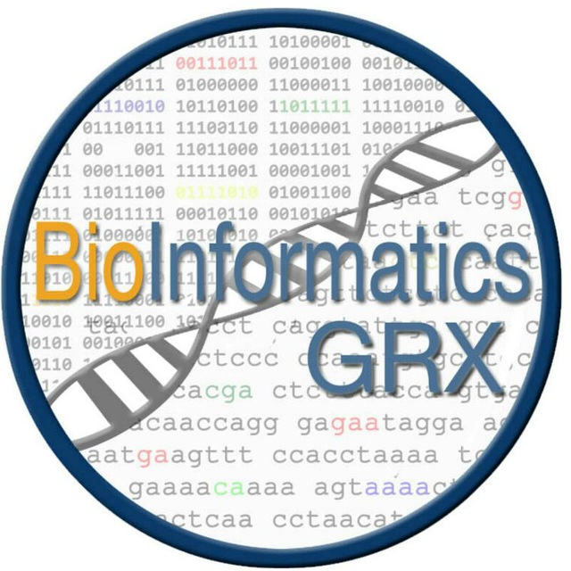
Deep Learning para diagnosticar Alzheimer usando imágenes de resonancia magnética
Francisco Carrillo Pérez
8 de Marzo 2018

Slide 2
Index
Introduction
Goals
Methods
ADNI Database
Experiments
Results
Conclusions

Slide 3
Introduction: Alzheimer
47 million people suffer from demencia in the world, and 9.9 million new cases are registered each year.
Alzheimer disease is the primary cause of dementia, gathering between 60% and 70% of all the cases.
Early diagnosis can cause major improvements in patients daily lives and life expectancy.

Slide 5
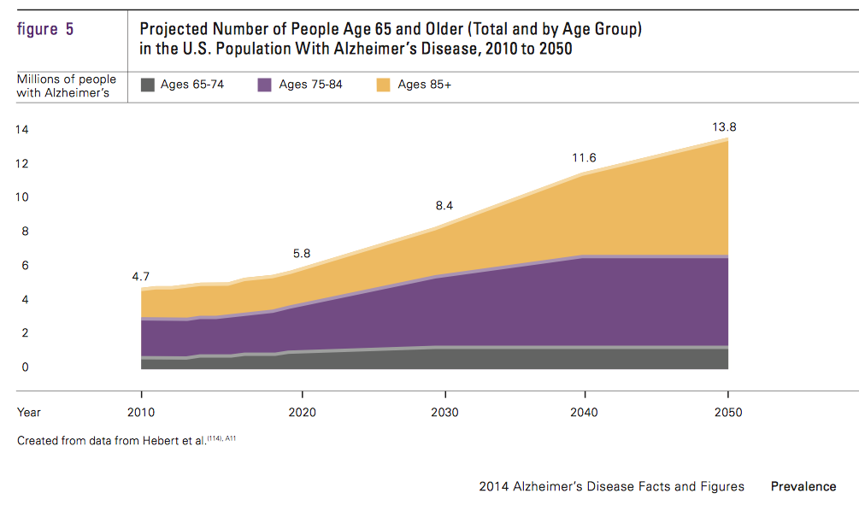
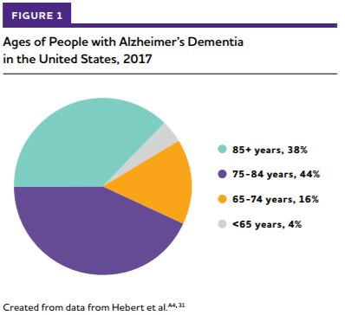

Slide 6
Previous works
Manually detecting of brain mass deterioration: Neuronal loss and consequent brain atrophy causes widening of the sulci, thinning of the gyri and dilatation of the ventricles with a significant reduction in brain weight. Many studies have focused on quantifying focal atrophy in the temporal lobe (Scheltens, et al., 2003) and even exist visual scales to quantify the degree of atrophy, which are quick and easy to use.
Automatic methods: volumetric and shape features together with PCA and SVM were used to classify MRI images as having the disease or not (Lee, et al., 2009).
Deep Learning: using 3D Convolutional Neural Networks for classification. (Korelev 2017).

Slide 7
Goals
Analysis and processing of images.
Analysis and selection of a Convolutional Neural Network Architecture.
Neural Network optimization and methods for model selection.
Analysis of results.

Slide 8
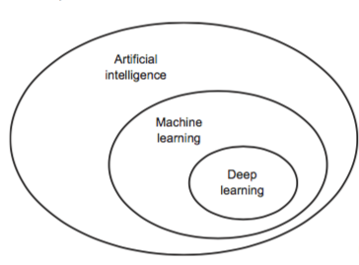
Methods
Machine Learning: is a field of statistics and computer science that gives computer systems the ability to "learn" (i.e. progressively improve performance on a specific task) with data, without being explicitly programmed.
Supervised Learning: The computer is presented with example inputs and their desired outputs.
Deep Learning: subfield inside machine learning in which algorithms,
mainly neural networks, have a considerable amount of hidden layers
and highly computing cost.

Slide 9
Methods
Artificial Neural Networks (ANN): Artificial neural networks are computing systems trying to imitate the behaviour of biological neural networks in our brain when they are learning about an specific phenomenon.
Notes:
Aquí redes neuronales

Slide 10
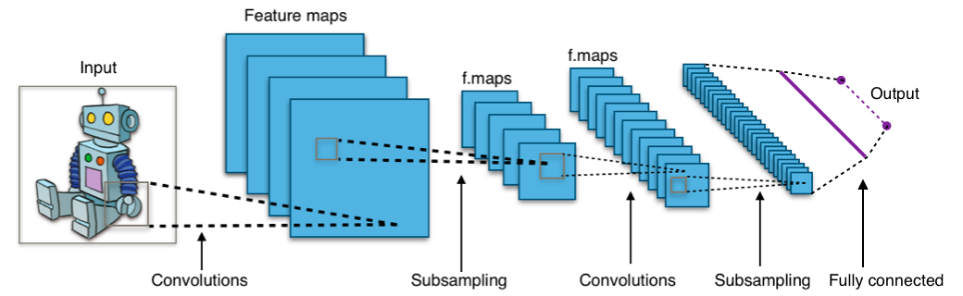
Methods
Convolutional Neural Networks (CNN): type of deep neural networks, which means they have a considerable number of hidden
layers, using as a main operator the convolution operator. They has successfully been applied to analyzing visual imagery.

Slide 11
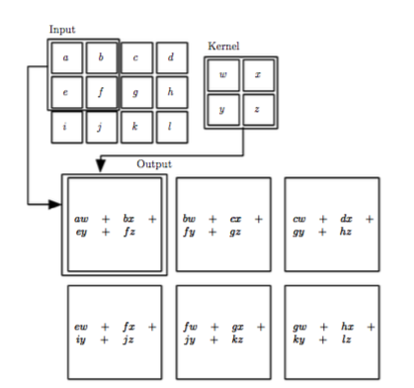
Methods
Convolution Operator: In its most general form,
convolution is an operation on two functions
of a real- valued argument. Convolution leverages
three important ideas that can help improve a
machine learning system: sparse interactions,
parameter sharing and equivariant representations.
Notes:
Se aprenden unos filtros que se activan dependiendo de le entrada. Por ejemplo un filtro puede ser para detectar esquinas. Esto antes se debía hacer de forma manual mientras que ahora se realiza de forma automática.

Slide 12
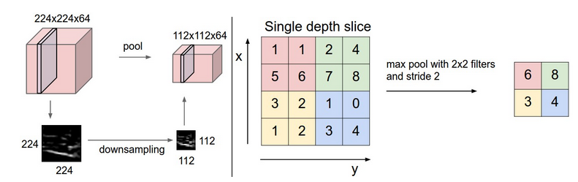
Methods
Pooling Operator: A pooling function replaces the output of the net at a certain location with a summary statistic of the nearby outputs. There are several operators but one broadly used is the max pooling operator.
Notes:
Se hace una media de los pixeles adyacentes, lo que nos permite tener una representación y un transpaso de información de una capa a otra.

Slide 13
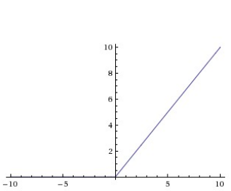

Methods
Activation functions: the activation function of a node defines the output of that node given an input or set of inputs.
ReLU
Softmax

Slide 14
Methods
Model evaluation methods
K-Fold Cross Validation:
Leave-One-Out Cross Validation: Particular case of k-Fold Cross Validation in which K is equal to the number of samples in the dataset.
In this work, not including different images of the same patient both in training and test sets has been guaranteed.
Notes:
(decir que se espera que sea más robusto en nuestro caso) (decir sobreajuste en lugar de filtración de información)

Slide 15

ADNI Database
Alzheimer’s Disease Neuroimaging Initiative (ADNI): widely-used database for Alzheimer disease studying. This database presents clinical data of patients such as MRI and PET images, genetic reports, cognitive tests and blood biomarkers. There are four types of patientes: Healthy,Alzheimer and two middle-states (LMCI and EMCI).

Slide 16
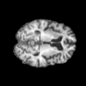
ADNI Database
An ADNI subset of images has been used. The following preprocessing
steps have been applied:
Spatial Normalization: the same pixel correspond to the same
physical position in both images.
Masked: delete cranial surface and bones.
N3 correction: image intensity correction.
Example of image used for learning

Slide 17
Experiments
Devices used for experiments
MacBook Air 2016: CPU, 1,6 GHz Intel Core i5. RAM,8 GB 1600 MHz DDR3. Used for MRI images preprocessing.
Server: CPUs, 2 Intel(R) Xeon(R) CPU E5645 @ 2.40GHz. GPU, 2 Tesla C2050 / C2075. Used for network training and testing
Framework and library for Deep Learning algorithms and NIFTI images processing
Keras (Keras): Framework for Deep Learning algorithms.
Nibabel (Nibabel): Python library for NIFTI images processing.
Hyperparameters for the network
Loss function: Categorical cross-entropy, N of iterations: 70, Batch size: 10,
Learning-rate: 27*10^-6

Slide 18
Experiments
Analysis and images processing
Whe have used brain slices from 10 to 100 jumping 5 to 5, therefore having 19 different slices. With Nibabel and Matplotlib libraries we were able to obtain each slice as a 2D image and save it in PNG format.
Images from slice 55 Images from slice 10 up to 100

Slide 19
Experimentos
CNN architecture
Final architecture was based on VGG architecture used in (Korolev,2017).
Input 3x110x110
Conv2D, 8, (3x3) ReLU
Pool2D, (2x2)LU
Conv2D, 8, (3x3)ReLU
Conv2D, 16, (3x3)ReLU
Pool2D, (2x2)
Conv2D, 16, (3x3)ReLU
Conv2D, 32, (3x3)ReLU
Conv2D, 32, (3x3)ReLU
Pool2D, (2x2)
Conv2D, 64, (3x3)ReLU
Conv2D, 64, (3x3)ReLU
Pool2D, (2x2)
FullyConnected, 128
ReLU
BatchNorm, Dropout p=0.7
FullyConnected, 64
ReLU
FullyConnected, 2
Softmax
Notes:
Hablar de las distintas arquitecturas que hemos utilizado. Diciendo que al inicio se utikizó una base de datos distinta, y que los primeros experimentos no se han añadido para limitar la extensión del trabajo. Dos de ellas del trabajo citado y otra externa.

Slide 20
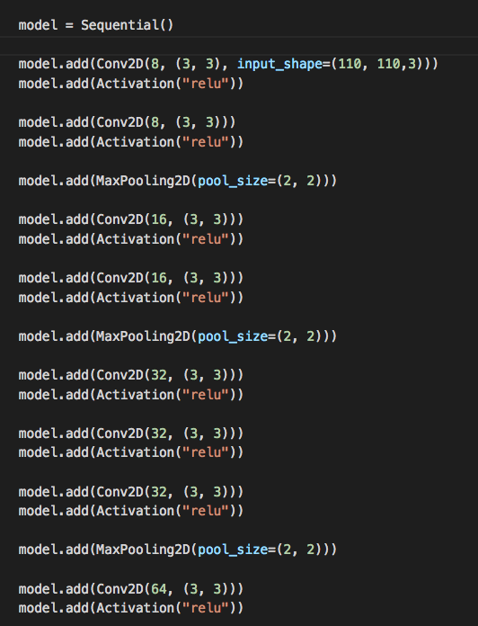
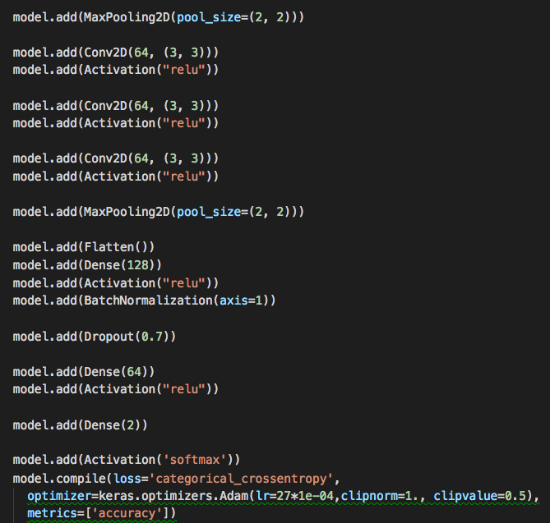

Slide 21
Experiments performed
First experiments: 5-fold Cross Validation with slice 55 in small database(only one image per pacient) and complete database (all pacients images).
Selection of best 2D slices: 5-fold Cross Validation to validate which slice is the best for classification.
Validation of previous results using LOO: Leave-one-out Cross Validation per patient using best slices.

Slide 22
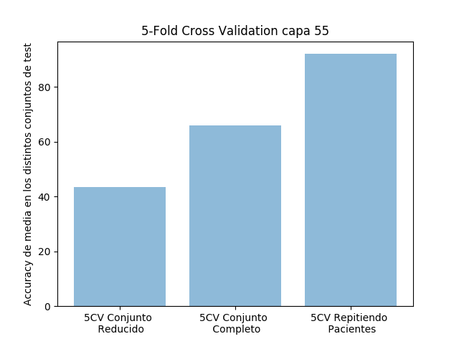
Results: 5-fold Cross Validation with slice 55 in the reduced and complete dataset
Previous experiments | Results
5-fold Cross Validation using the reduced dataset (just one image per patient) with slice 55 | 43’5%
5-fold Cross Validation using the complete dataset (all the patient images) with slice 55 | 65’9%
5-fold Cross Validation using the complete dataset with slice 55 without preventing repetition | 92%

Slide 23
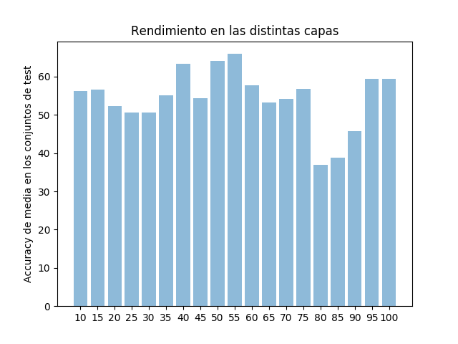
Results: 5-fold Cross Validation to test which is the best slice
Slice | Result
10 | 56'3%
15 | 56’6%
20 | 52’3%
25 | 50’7%
30 | 50’7%
35 | 55’2%
40 | 63’3%
45 | 54’4%
50 | 64’1%
55 | 65’9%
Slice | Result
60 | 57’7%
65 | 53’3%
70 | 54'1%
75 | 56’7%
80 | 36’9%
85 | 38’8%
90 | 45’8%
95 | 59’4%
100 | 59’4%

Slide 24
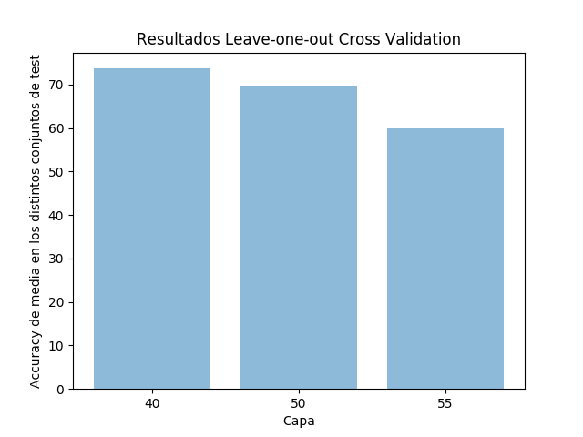
Results: Leave-one-out Cross Validation per patient with the best slices
Slice | Result
40 | 73’7%
50 | 69’7%
55 | 60%

Slide 25
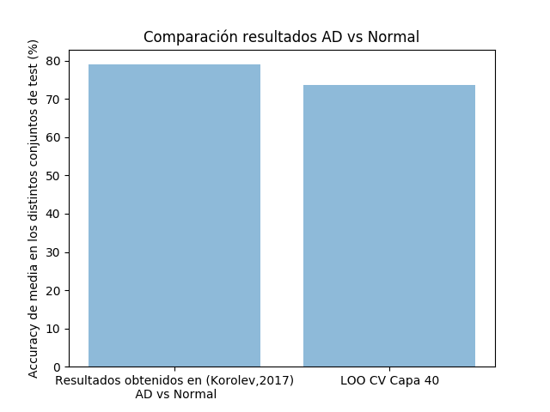
Results
Result in (Korolev,2017) for AD vs Normal | LOO CV Slice 40
79% +- 0.8 | 73’7 %
Notes:
Poner los datos centrados (en todos) QUITAR LOS DECIMALES EN TODOS. Hablar d eesta parte de forma más profana. Hablar de una forma en que los experimentos se entiendan

Slide 26
Conclusions
We have observed that proper results can be obtained using 2D images, which has not been performed before in literature.
2D images requiere less computational power, therefore using this approach in an hospital could be easier.
Some slices work better tahn other, as observed in experiments.
More images means better results.
Nowadays there are a lot of information about Deep Learning and anyone can do amazing things.
If I’ve done it you also can, because I’m not even smart.

Slide 27
Bibliography
(Korolev,2017): Residual and Plain Convolutional Neural Networks for 3D Brain {MRI} Classification, Sergey Korolev and Amir Safiullin and Mikhail Belyaev and Yulia Dodonova, IEEE International Symposium on Biomedical Imaging 2017.
(Simonyan,2014): Very Deep Convolutional Networks for Large-Scale Image Recognition, Karen Simonyan and Andrew Zisserman, CoRR 2014
(ADNI): ADNI Webpage, http://adni.loni.usc.edu
(Keras): Keras Webpage, https://keras.io
(Nibabel): Nibabel Webpage, http://nipy.org/nibabel/
(FreeSurfer): FreeSurfer Software Webpage, http://freesurfer.net

Slide 28
Bibliography
http://www.wvha.org/getattachment/fc969f18-37b5-49db-be2a-9d59cd41b43e/alzheimers.JPG.aspx
https://techcrunch.com/2017/04/13/neural-networks-made-easy/
https://ncrad.iu.edu/images/logos/adni3.png
http://www.imada.sdu.dk/~marco/DM825/animation.gif
https://upload.wikimedia.org/wikipedia/commons/6/63/Typical_cnn.png
http://themindbodyshift.com/wp-content/uploads/2015/03/projections-of-us-population-developing-alzheimers-disease.png?w=660
http://immersive.healthcentral.com/alzheimers/d/LBLN/how-alzheimers-disease-changes-the-brain/assets/a/img/Cerebellum_GIF.gif

Slide 29
Bibliography
https://cs231n.github.io/convolutional-networks/#pool
https://fr.wikipedia.org/wiki/Fichier:Twitter_Bird.svg
https://commons.wikimedia.org/wiki/File:Octicons-mark-github.svg
https://www.shareicon.net/route-top-view-routes-straight-street-road-road-icons-transport-roads-streets-683588
http://themetapicture.com/media/picture.jpe

Slide 30



You can follow me on
@pacocp9
pacocp
Don’t follow me down the street, you creepy audience

Slide 31
Thanks for your attention

