Slide 1
Implementing an Auditable Access Control Strategy Using Cluster Certificate Authority Rotation
Tyler Lisowski- IBM Kodie Glosser - IBM

Slide 2
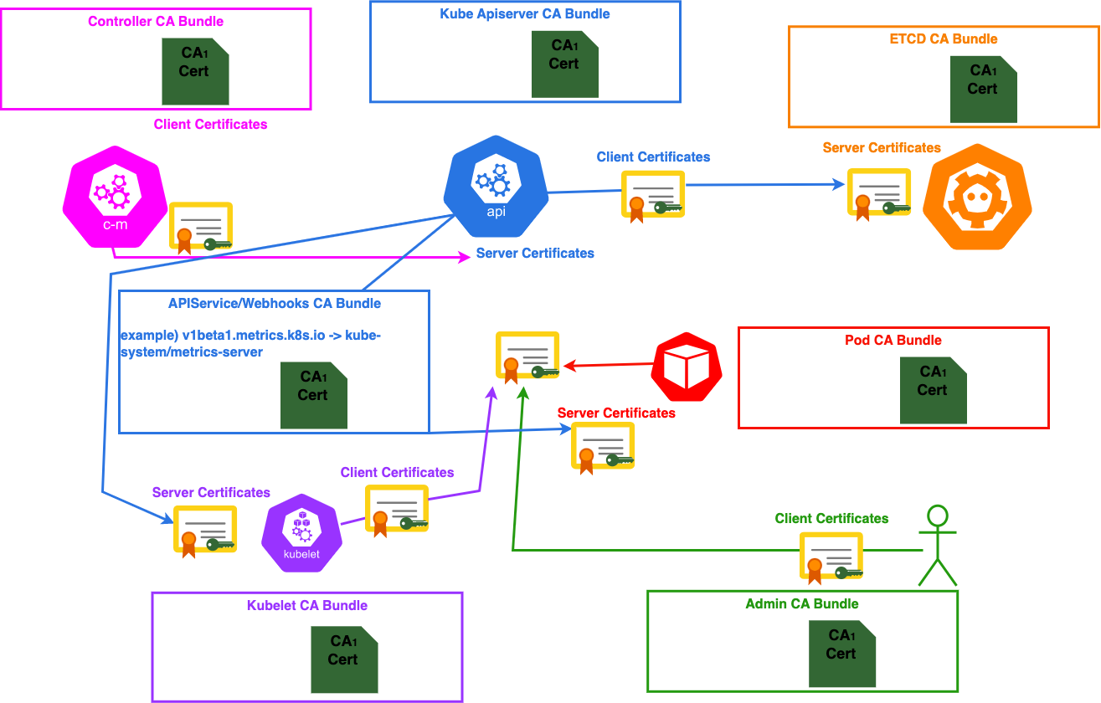
Initial State

Slide 3


Goals Solution
Access control updates in response to employment changes
Secret rotation compliance requirements
Incident response requirements
CA Rotation
cross-sign
How are we going to execute the rotation with zero downtime?
CA Addition, CA Cross Signing, and then CA Revocation

Slide 4
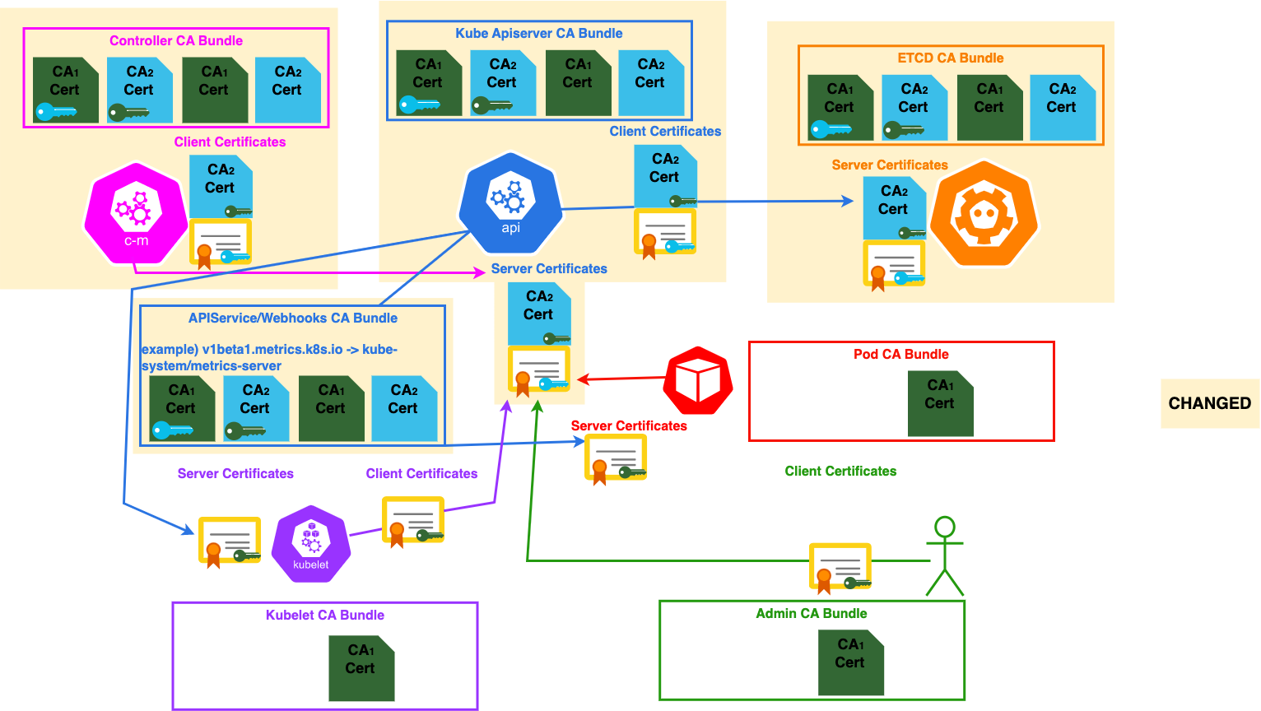
CA Addition: Server Side

Slide 5
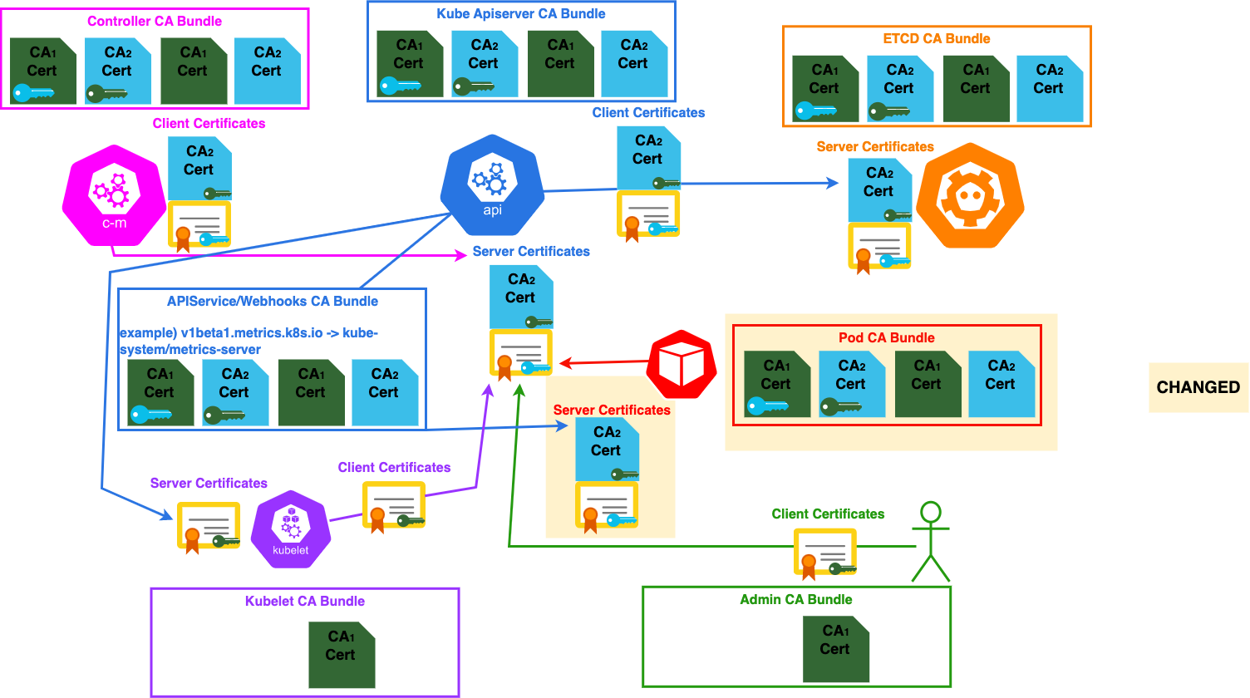
CA Addition: Pod Sync

Slide 6
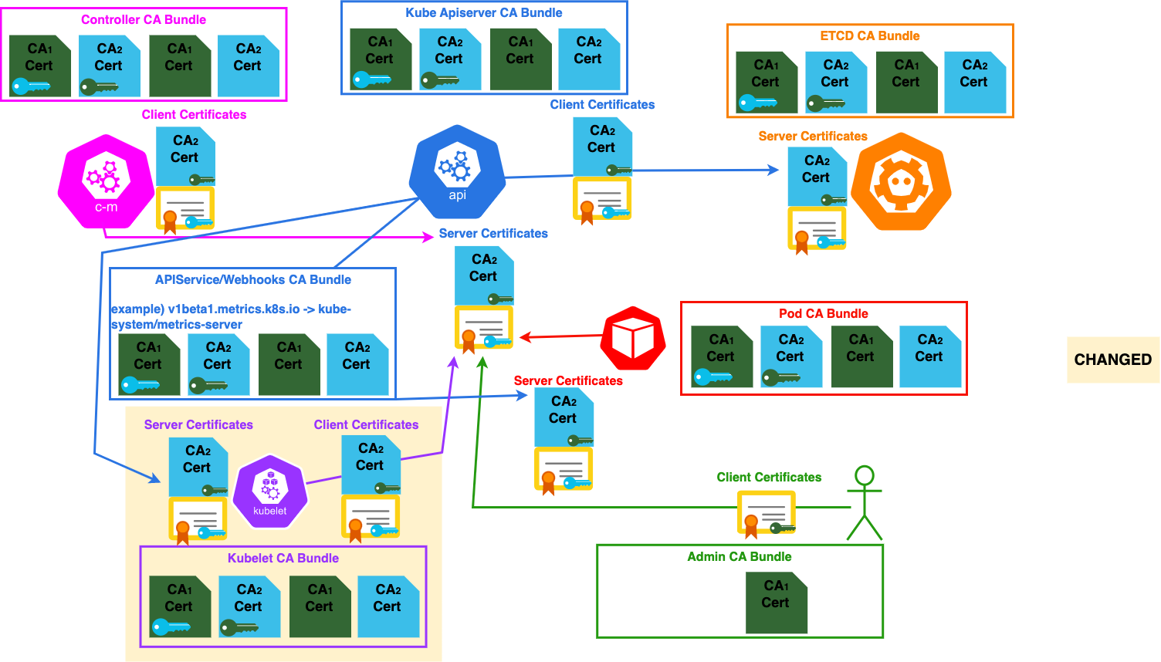
CA Addition: Node Sync

Slide 7
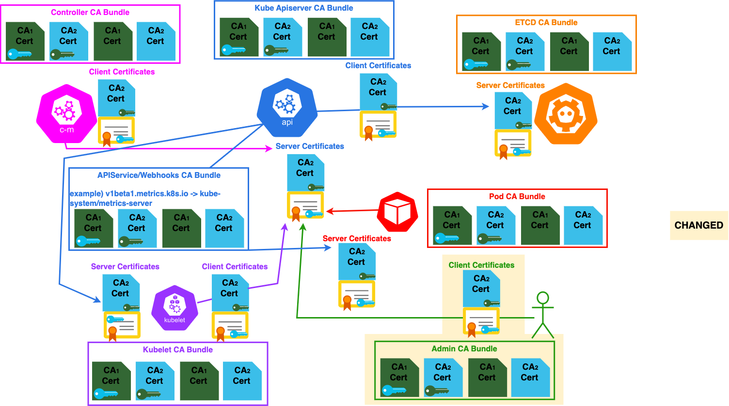
CA Addition: Admin/Automation Sync

Slide 8
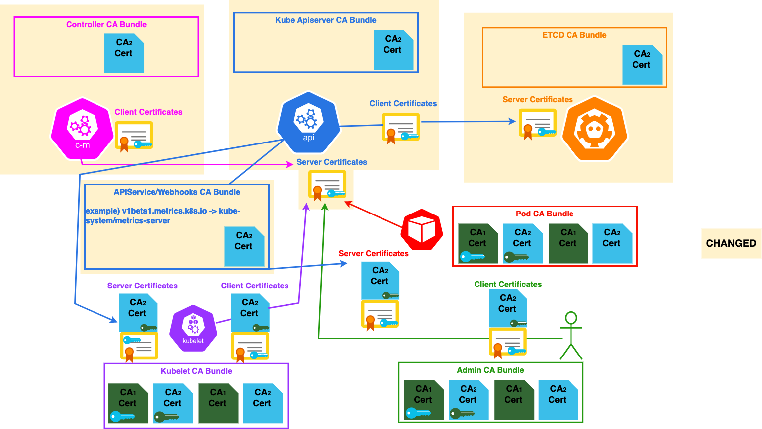
CA Revoke: Server Side

Slide 9
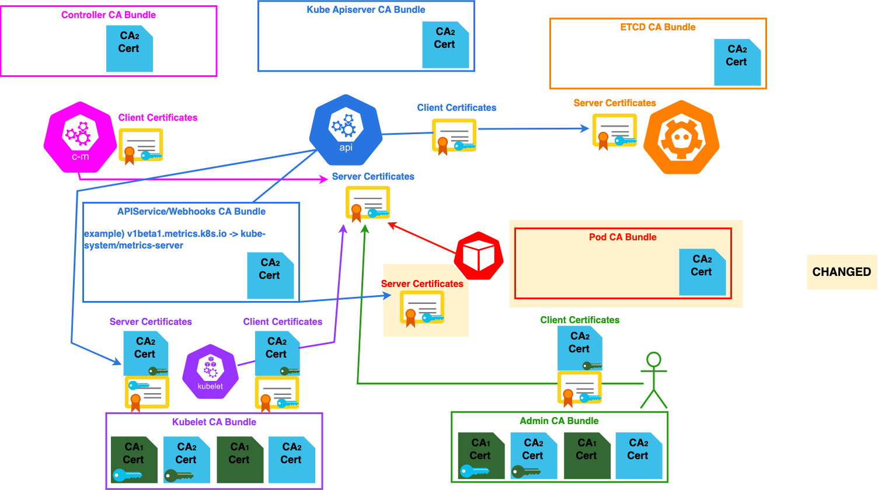
CA Revoke: Pod Sync

Slide 10
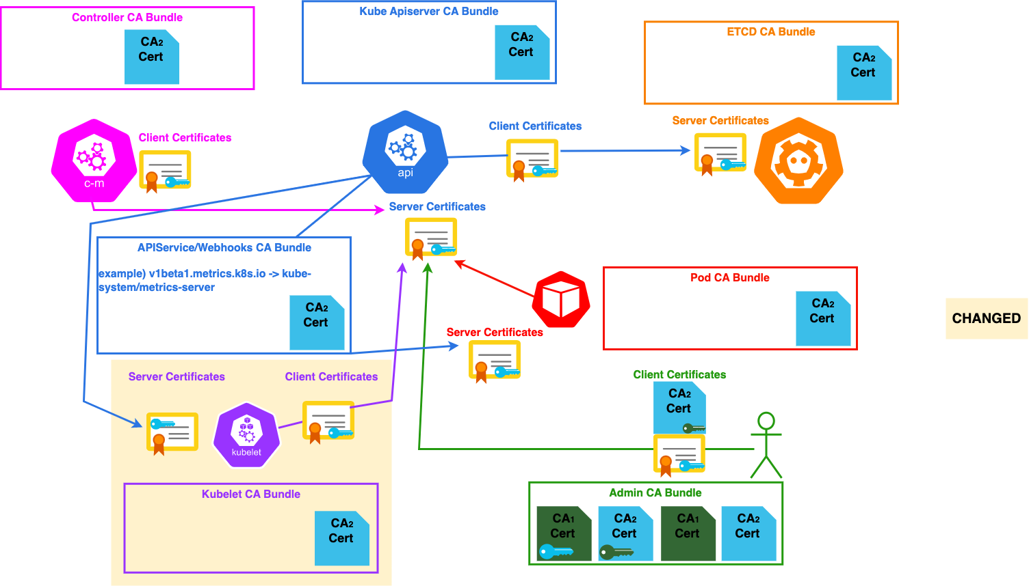
CA Revoke: Node Sync

Slide 11
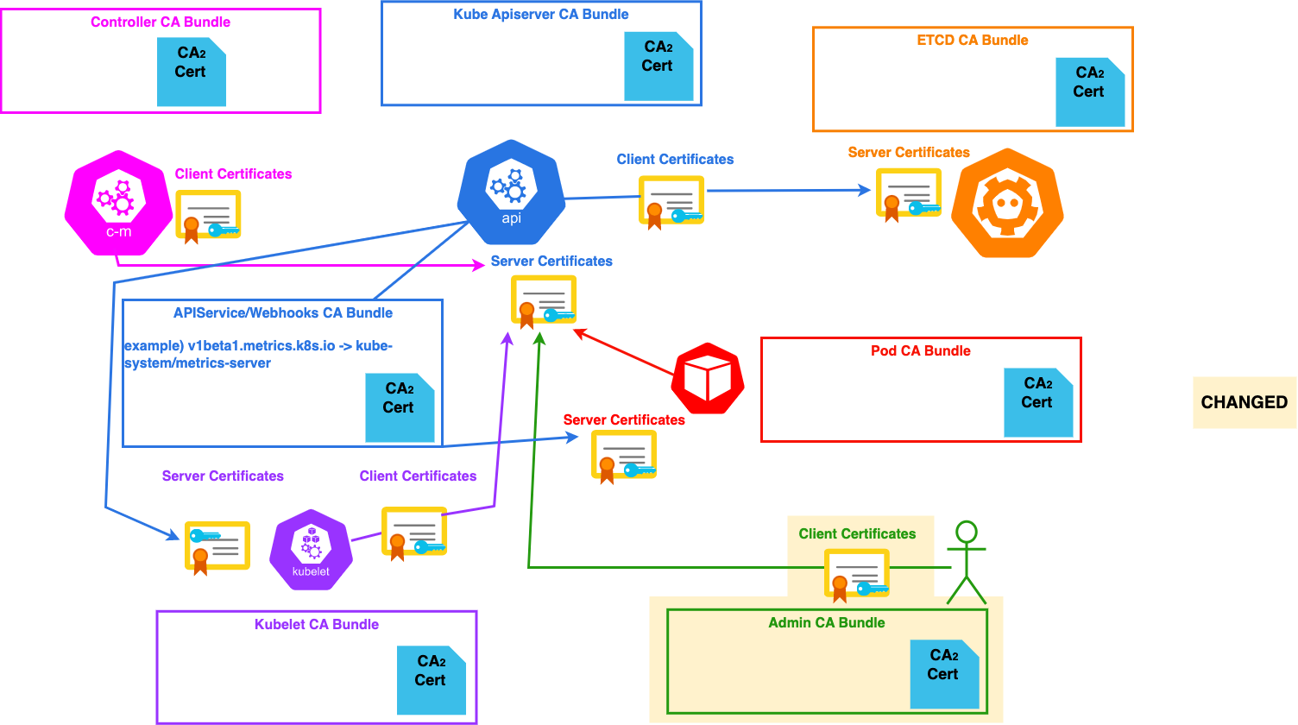
CA Revoke: Admin/Automation Sync

Slide 12
Considerations & Challenges
Non automatic certificate reloads in Go applications
Webhooks with hard failure policy can cause cascading failures
Ad-Hoc Automation dependent on stored kubeconfigs that are run infrequently (disaster recovery automation)
Network isolation after a security event before CA rotation performed
Service Account Token keys can follow similar path
Bound service account token volume mechanism automates rotation

Slide 13

Sponsor Shout-Out!
Thank you to our Session Recording Sponsor:

Slide 14

Please scan the QR Code above
to leave feedback on this session

