Slide 1
Keeping the lights on and the bugs away
SIG Testing update KubeCon 2023
Patrick Ohly, Intel GmbH

Slide 2
SIG Testing
Responsible for tools used by the project (prow, tide, ...)
Assists other SIGs with writing and deploying tests
End-to-end (E2E) testing

Slide 3

E2E Testing
Testing with real components and clusters
E2E suite acts as client of apiserver
Kubernetes: based on Ginkgo and Gomega
sigs.k8s.io/e2e-framework: based on Go unit tests
Thanks Onsi Fahkouri!

Slide 4
Overall Architecture in Kubernetes
Test suites
test/e2e
test/e2e_kubeadm
Tests
test/e2e/storage
test/e2e_node
Helpers
test/e2e/framework/pod
Framework
test/e2e/framework
...
...
Notes:
At the moment, the framework is used in-tree for testing against a cluster
(`test/e2e`), testing kubeadm (`test/e2e_kubeadm`) and kubelet
(`test/e2e_node`). The goal is to make the core `test/e2e/framework` a package
that has no dependencies on internal code and that can be used in different E2E
suites without polluting them with features or options that make no sense for
them. This is currently only a *technical* goal. There are no plans anymore to
actually move the code into a staging repository.
The framework acts like a normal client of an apiserver and thus doesn't need
much more than client-go. Since [the sub-package
refacoring](https://github.com/kubernetes/kubernetes/pull/112043), additional
sub-packages like `test/e2e/framework/pod` depend on the framework, not the
other way around. Those other sub-packages therefore can still use internal
code. The import boss configuration enforces [these
constraints](https://github.com/kubernetes/kubernetes/pull/115710).
What's left to clean up is that the framework contains a `TestContext` with
fields that are used only by some tests or some test suites. The [configuration
for `test/e2e_node`](https://github.com/kubernetes/kubernetes/blob/330b5a2b8dbd681811cb8235947557c99dd8e593/test/e2e/framework/test_context.go#L237-L263)
is the last remaining dependency on internal code. Such settings should get
moved into the different test suites and/or tests. The advantage besides
avoiding such dependencies will be that they will only show up in the command
line of a suite when the option really has an effect.

Slide 5
Debuggability
A good failure message:
Identifies the test failure.
Has enough details to provide some initial understanding of what went wrong.
Is allowed to be long – triage tools can handle that.

Slide 6


Debuggability: Failure Messages
Use Gomega directly, except for framework.ExpectNoError
Choose suitable checks:
Bad: gomega.Expect(strings.Contains(actualStr, expectedSubStr)). To(gomega.Equal(true))
Good: gomega.Expect(actualStr). To(gomega.ContainSubstring("xyz"), "checking log output")
May call ginkgo.Failf directly
import "github.com/onsi/gomega/format"
if !someCustomCheck(abc) {
ginkgo.Failf("check xyz failed for object:\n%s", format.Object(abc))
}
Notes:
It is good practice to include details like the object that failed some
assertion in the failure message because then a) the information is available
when analyzing a failure that occurred in the CI and b) it only gets logged
when some assertion fails. Always dumping objects via log messages can make the
test output very large and may distract from the relevant information.
Dumping structs with `format.Object` is recommended. Starting with Kubernetes
1.26, `format.Object` will pretty-print Kubernetes API objects or structs [as
YAML and omit unset
fields](https://github.com/kubernetes/kubernetes/pull/113384), which is more
readable than other alternatives like `fmt.Sprintf("%+v")`.

Slide 7
Recovering from test failures and interrupts
Must: delete cluster-scoped resources
Recommended: delete namespaced resources
Use ginkgo.DeferCleanup
podClient := f.ClientSet.CoreV1().Pods(f.Namespace.Name)
pod, err := podClient.Create(ctx, testPod, metav1.CreateOptions{})
framework.ExpectNoError(err, "create test pod")
ginkgo.DeferCleanup(framework.IgnoreNotFound(podClient.Delete), pod.Name, metav1.DeleteOptions{})

Slide 8
Interactive debugging and interrupting tests
Early progress report: make _output/bin/ginkgo --poll-progress-after=30s \
./test/e2e
Debug with dlv: dlv test ./test/e2e -- -ginkgo.focus=MyTest
Interrupt with CTRL-C

Slide 9

Interrupting tests: under the hood
Ginkgo manages a context for each callback.
ginkgo.It("something", func(ctx context.Context) {
...
ginkgo.DeferCleanup(func(ctx context.Context){ … })
https://github.com/kubernetes/community/blob/master/contributors/devel/sig-testing/writing-good-e2e-tests.md#interrupting-tests

Slide 10
Polling and timeouts
Use pre-defined timeouts: f.Timeouts.PodStart, ...
Good code for polling
accepts a context for test timeouts
informative during interactive use, little to no output during a CI run except when it fails
full explanation when it fails: last observed state and errors
extension mechanism for writing custom checks
early abort when condition cannot be reached anymore
gomega.Eventually/Consistently framework.Gomega().Expect(…) for helper code with error returns as in test/e2e/framework/pods

Slide 11
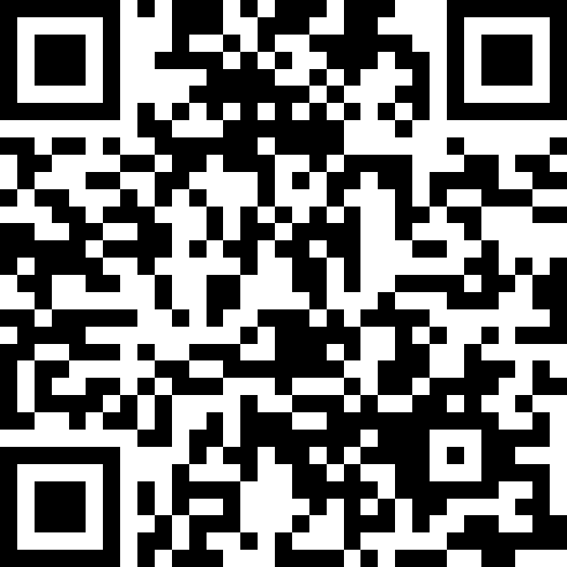
Next Steps
More information in blog post: https://www.kubernetes.dev/blog/2023/04/12/e2e-testing-best-practices-reloaded/
Enable linting
Update more sub-packages
Move into staging?!
Get involved: #sig-testing on Slack

Slide 12
Notices & Disclaimers
Intel technologies may require enabled hardware, software or service activation.
No product or component can be absolutely secure.
Your costs and results may vary.
Intel disclaims all express and implied warranties, including without limitation, the implied warranties of merchantability, fitness for a particular purpose, and non-infringement, as well as any warranty arising from course of performance, course of dealing, or usage in trade.
© Intel Corporation. Intel, the Intel logo, and other Intel marks are trademarks of Intel Corporation or its subsidiaries. Other names and brands may be claimed as the property of others.

