Slide 1
Biologically Inspired Artificial Intelligence Project
Traveling Salesman with Genetic Algorithm
Author: Piotr Paczuła Group: GKiO4

Slide 2
What is traveling salesman problem?
“Given a list of cities and the distances between each pair of cities, what is the shortest possible route that visits each city and returns to the origin city?“ ~ wikipedia.org
Brute force solution is n! complex, which is not what we want.
One of the fastest ways to get quite good solution is to use:
Genetic Algorithm

Slide 3
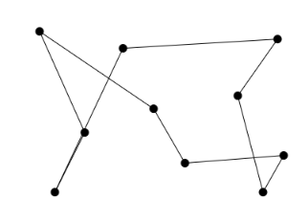
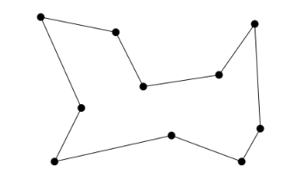
Example
One of the possibilities: Better solution:

Slide 4
Darwinian Natural Selection
Heredity – There must be a process in place by which children receive the properties of their parents.
Variation – There must be a variety of traits present in the population or a means with which to introduce variation.
Selection – there must be a mechanism by which some members of a population have the opportunity to be parents and pass down their genetic information and some do not. This is typically referred to as “survival of the fittest”.

Slide 5
Heredity
At first iteration algorithm is creating given amount of random children called population.
Then in every following iteration the next population is created based on the previous one.
Probability of inheriting parents’ genes depends on “fitness” parameter which will be discussed later.

Slide 6
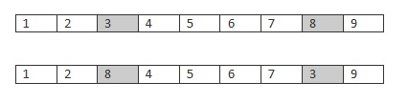
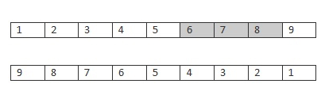
Variation
Algorithm implements two kinds of creating variation:
Mutation swaps two genes from a child with a given chance for example:
Ordered crossover algorithm uses two parents to create a child:
(Slices part of one parent and fills with what’s left from another one)

Slide 7
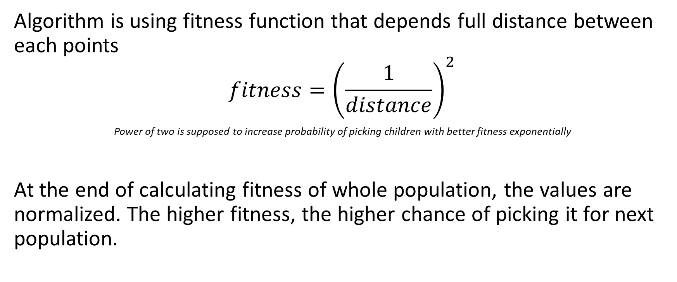
Selection
Algorithm is using fitness function that depends full distance between each points
$$fitness={\left(\frac{1}{distance}\right)}^{2}$$
Power of two is supposed to increase probability of picking children with better fitness exponentially
At the end of calculating fitness of whole population, the values are normalized. The higher fitness, the higher chance of picking it for next population.

Slide 8
Links
Github repository:
https://github.com/paczulapiotr/BIAI_TravelingSalesman
Demo:
https://salesman-biai.herokuapp.com

