Slide 1
SRM
INSTITUTE OF SCIENCE & TECHNOLOGY
21CSP302L – Minor Project
REVIEW - 2
CollabCodeHub
A Real-Time Multiplayer Workspace for Developers
Team Members :-
Tirumalasetti Devendhar (RA2311028010142)
Padala Rohit (RA2311028010183)
Department : NWC
Guide Details:
Dr .Stephen Dass A
Assistant Professor ,
Networking and Communication Department (NWC), SRMIST
CollabCodeHub
1

Slide 2
SRM
INSTITUTE OF SCIENCE & TECHNOLOGY
Table of Contents
• Abstract
• Introduction
• Literature Survey
• Inference from the survey
• Objective of the Project
• Techniques to implement
• Architecture diagram
• Project SDG
• Modules Description
• Plan of action
• References
CollabCodeHub
2

Slide 3
SRM
INSTITUTE OF SCIENCE & TECHNOLOGY
Abstract
CollabCodeHub is a browser-based real-time collaborative development platform designed to unify code editing, task management, communication, whiteboarding, AI assistance, and shared terminal execution within a single workspace.
The system leverages CRDT-based synchronization (Yjs), WebSocket communication, and PostgreSQL Row-Level Security (RLS) to ensure low-latency collaboration and secure multi-tenant isolation.
CollabCodeHub
3

Slide 4
SRM
INSTITUTE OF SCIENCE & TECHNOLOGY
Introduction
• Fragmentation in Modern Development Workflows
• Modern development teams rely on multiple disconnected platforms:
• • VS Code – Code Editing
• • Jira – Task Management
• • Slack – Communication
• • Miro – Whiteboarding
• • ChatGPT – AI Assistance
• Challenges Observed
• • Frequent context switching
• • Reduced productivity
• • Collaboration friction in remote teams
• • Environment inconsistencies
CollabCodeHub
4

Slide 5
SRM
INSTITUTE OF SCIENCE & TECHNOLOGY
Literature Survey
S.No | Ref / Author | Work Title | Findings
1 | Kleppmann (2017) | Conflict-free Replicated Data Types | Formalized CRDTs for sync without central lock.
2 | Microsoft | VS Code Live Share | Remote sync but requires heavy desktop installations.
3 | Liveblocks | Real-time Presence System | Managed infra for presence and shared storage.
4 | Sun et al. | Operational Transformation | Legacy sync used by Google Docs; complex conflicts.
CollabCodeHub
5

Slide 6
SRM
INSTITUTE OF SCIENCE & TECHNOLOGY
Inference from General Survey
• Need for a unified platform that combines all tools in the browser.
• Web-based IDEs are the future of collaborative development.
• Real-time sync must be reliable and conflict-free (CRDTs).
• AI integration is essential for modern developer workflows.
• Security (RBAC/RLS) is paramount for multi-tenant workspace isolation.
CollabCodeHub
6

Slide 7
SRM
INSTITUTE OF SCIENCE & TECHNOLOGY
Objective of the Project
• Primary Goal: Build a unified Multiplayer Workspace OS for software teams.
• Objectives:
• • Enable sub-50ms latency collaborative editing using CRDTs.
• • Integrate AI Agent for deterministic code generation and refactoring.
• • Centralize Kanban tasks, whiteboard, and real-time chat.
• • Ensure zero-trust security via PostgreSQL Row Level Security (RLS).
• • Eliminate context switching between fragmented development tools.
CollabCodeHub
7

Slide 8
SRM
INSTITUTE OF SCIENCE & TECHNOLOGY
Techniques to Implement
• Frontend: React 19 + Vite (Modern, high-performance SPA).
• Editor: Monaco Editor & CodeMirror 6 with Yjs extensions.
• Sync: Liveblocks SDK + Yjs (Conflict-free Replicated Data Types).
• Backend: Supabase (PostgreSQL, Realtime DB, Auth, RLS).
• Terminal: Node.js + Express + WebSockets + node-pty.
• AI: HuggingFace Inference API (Qwen2.5-7B-Instruct).
• Styling: Tailwind CSS (Utility-first responsive design).
CollabCodeHub
8

Slide 9
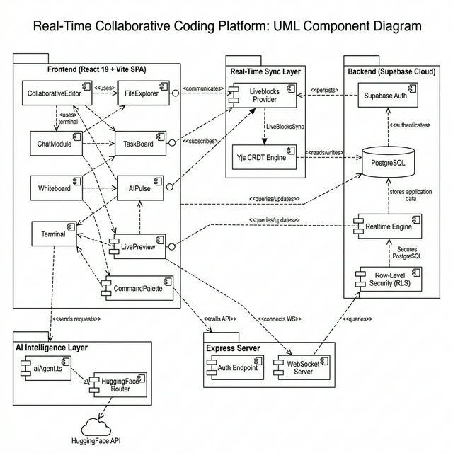
SRM
INSTITUTE OF SCIENCE & TECHNOLOGY
Architecture Diagram
CollabCodeHub
9

Slide 10
SRM
INSTITUTE OF SCIENCE & TECHNOLOGY
Project SDG
• SDG 4 (Quality Education): Remote pair-programming for labs.
• SDG 8 (Decent Work): Supporting remote work in startups and agencies.
• SDG 9 (Industry, Innovation & Infrastructure): Advancing IDE infra.
CollabCodeHub
10

Slide 11
SRM
INSTITUTE OF SCIENCE & TECHNOLOGY
Modules Description
• 1. Authentication Module: User registration and login via Supabase Auth.
• 2. Workspace Management Module: Creation and isolation of project rooms.
• 3. Code Collaboration Module: Real-time editing with Yjs & Liveblocks.
• 4. Task Management Module: Kanban board for sprint tracking.
• 5. Communication Module: In-room real-time chat with avatars.
• 6. AI Assistance Module: Context-aware code generation (Ctrl+I).
• 7. Execution Module: Shared terminal for code execution.
CollabCodeHub
11

Slide 12
SRM
INSTITUTE OF SCIENCE & TECHNOLOGY
Plan of Action
• Phase 1: Research, core UI, and Auth (Completed).
• Phase 2: Editor sync, Kanban board, and Chat (Completed).
• Phase 3: AI Pulse integration and Terminal proxy (In-Progress).
• Phase 4: SaaS features, bi-directional sync, and polish (Planned).
CollabCodeHub
12

Slide 13
SRM
INSTITUTE OF SCIENCE & TECHNOLOGY
Referral Patents
• GB2589325A (UK): Collaborative Code Editing with Real-Time Sync.
• CA3123456A1 (Canada): Cloud IDE with AI Assistance.
• IN202141029876A (India): Multi-User platform with integrated task tracking.
CollabCodeHub
13

Slide 14
SRM
INSTITUTE OF SCIENCE & TECHNOLOGY
Novelty & Innovation
• Sub-millisecond latency sync via local-first CRDTs.
• Context-aware AI that manipulates the full workspace natively.
• Unified workspace experience (VS Code + Slack + Jira in one).
• Zero-trust security enforced at the database level.
CollabCodeHub
14

Slide 15
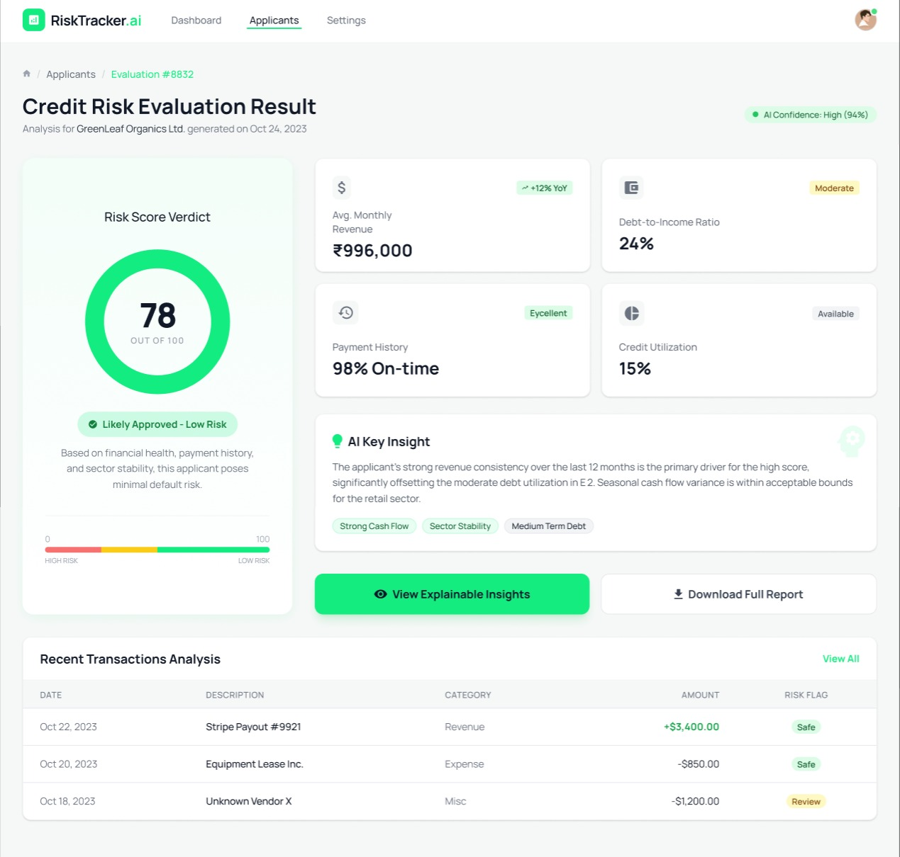
SRM
INSTITUTE OF SCIENCE & TECHNOLOGY
Screenshots of the Website
CollabCodeHub
15

Slide 16
SRM
INSTITUTE OF SCIENCE & TECHNOLOGY
References
• 1. Kleppmann, M. (2017). Conflict-free Replicated Data Types.
• 2. Liveblocks SDK Documentation. https://liveblocks.io
• 3. Supabase Technical Reference. https://supabase.com
• 4. Monaco Editor Documentation.
• 5. Yjs Network Providers.
CollabCodeHub
16

Slide 17
SRM
INSTITUTE OF SCIENCE & TECHNOLOGY
THANK YOU
Questions & Feedback
CollabCodeHub
17

