Slide 1
CollabCodeHub
A Real-Time Multiplayer Workspace for Developers
21CSP302L — Minor Project | Review 2
Team Members
Tirumalasetti Devendhar (RA2311028010142)
Padala Rohit (RA2311028010183)
Project Guide
Dr. Stephen Dass A
Assistant Professor, NWC Department
SRMIST
Department of Networking and Communication (NWC) • SRMIST
1

Slide 2
AGENDA
Table of Contents
01 Introduction & Abstract
02 Problem Statement & Objectives
03 Methodology & Architecture
04 System Modules
05 Technology Stack
06 Screenshots & UI Walkthrough
07 Milestones & Timeline
08 Referral Patents
09 Novelty & Innovation
10 Future Scope & Conclusion
CollabCodeHub
2

Slide 3
INTRODUCTION
Abstract
CollabCodeHub is a unified, real-time collaborative coding environment
designed for modern remote teams. It replaces the fragmented developer
toolchain by combining code editing, task management, whiteboarding,
AI assistance, and terminal access into a single seamless workspace.
Built on CRDT algorithms for conflict-free synchronization and powered
by integrated AI agents, CollabCodeHub delivers a Multiplayer Workspace OS
experience that eliminates context-switching and boosts team productivity.
CollabCodeHub
3

Slide 4
INTRODUCTION
Problem Statement & Objectives
The Problem
Core Objectives
▸ Developers constantly switch between VS Code, Slack, Jira, and ChatGPT
▸ Fragmented tools cause context-switching fatigue and reduce productivity
▸ "It works on my machine" problem in pair programming environments
▸ Separate AI tools break developer flow and disrupt coding sessions
▸ Enable ultra-low latency collaborative code editing using CRDTs
▸ Provide context-aware AI code generation within the workspace
▸ Unify code execution, chat, and Kanban task tracking securely
▸ Implement zero-trust security with PostgreSQL Row Level Security
CollabCodeHub
4

Slide 5
METHODOLOGY
Development Workflow
1. Research & Analysis
2. Architecture Design
Surveyed collaborative coding tools — VS Code Live Share, Replit, CodeSandbox. Identified gaps in AI integration and unified workspace approach.
Selected Event-Driven + Serverless architecture. Designed data flows using CRDTs (Yjs) for conflict-free synchronization with Liveblocks as the transport layer.
3. Frontend Development
4. Backend & Database
Built SPA with React 19 + Vite. Implemented Monaco Editor, Kanban Board, Whiteboard, Chat, and Terminal interfaces with Tailwind CSS styling.
Configured Supabase for PostgreSQL, Auth, and Realtime APIs. Designed Row Level Security (RLS) policies for zero-trust data access.
5. AI Integration
6. Testing & Deployment
Integrated HuggingFace/Together AI with Qwen2.5 model. Engineered system prompts for deterministic JSON-based file operations.
Functional testing of concurrent edits, RLS policies, and AI output validation. Deployed via Vercel with CI/CD pipeline.
CollabCodeHub
5

Slide 6
METHODOLOGY
Technology Stack
Frontend
Code Editor
Real-Time Sync
React 19 + Vite
Tailwind CSS
Lucide Icons
React Router DOM
Monaco Editor
CodeMirror 6
y-monaco / y-codemirror
Syntax Highlighting
Liveblocks SDK
Yjs (CRDTs)
WebSocket Protocol
Live Cursors & Presence
Backend
Server
AI Engine
Supabase (PostgreSQL)
Auth & JWT
Row Level Security
Realtime Subscriptions
Node.js + Express
WebSockets (ws)
xterm.js Terminal
node-pty Integration
HuggingFace API
Qwen2.5-7B-Instruct
Together AI Router
Context-Aware Prompts
CollabCodeHub
6

Slide 7
ARCHITECTURE
System Architecture
Client Layer
React 19 + Vite SPA
Monaco Editor • Kanban • Whiteboard • Chat
↕ WebSocket (Yjs/Presence)
↕ REST / JWT / Realtime
Real-Time Layer
Liveblocks (CRDTs / Yjs)
Live Cursors • Presence • Shared Maps
BaaS Layer
Supabase
PostgreSQL • Auth • Realtime Pub/Sub
↕ Auth Token / Terminal
↕ AI Inference API
Server Layer
Express + WebSocket
Pty.js Shell • Auth Hook
AI Layer
HuggingFace Inference API
Qwen2.5 • Context Engine
Data Flow: User Auth → JWT Token → Room Entry → Liveblocks WebSocket → Yjs CRDT Sync → Supabase Realtime (Chat/Tasks)
CollabCodeHub
7

Slide 8
MODULES
Core System Modules
⚡ Collaborative Code Editor
📋 Kanban Task Board
🎨 Infinite Whiteboard
Monaco/CodeMirror with Yjs CRDT sync.
Real-time cursors, presence indicators,
and multi-language syntax highlighting.
Drag-and-drop task management with
Todo/In-Progress/Done/Archived columns.
Priority levels and user assignment.
Freehand drawing canvas for architecture
planning. Color/size tools with real-time
collaborative strokes via Liveblocks.
💬 Real-Time Chat
🤖 AI Pulse Assistant
🖥️ Shared Terminal
Instant messaging within workspaces.
DiceBear avatars, Supabase Realtime
subscriptions for live message sync.
Context-aware AI agent (Ctrl+I) that reads
the file tree and generates/modifies code
using Qwen2.5 model integration.
Browser-based terminal via xterm.js.
Shared execution environment with
WebSocket-powered PTY process.
CollabCodeHub
8

Slide 9
MODULES
Module Details — Editor & Task Board
⚡ Collaborative Code Editor
📋 Kanban Task Board
▸ Built on Monaco Editor (@monaco-editor/react)
▸ Real-time sync via Yjs CRDTs over Liveblocks
▸ Live cursor positions with color-coded presence
▸ Multi-file support with File Explorer panel
▸ Room Templates: React, Node.js, Python, etc.
▸ Syntax highlighting for 20+ languages
▸ AI Tab Autocomplete (HuggingFace/Qwen)
▸ Conflict-free merging — even works offline
▸ Drag-and-drop via @hello-pangea/dnd
▸ 4 Columns: Todo → In-Progress → Done → Archived
▸ Priority levels: Low, Medium, High, Urgent
▸ Task assignment to team members
▸ Real-time sync across all workspace users
▸ Supabase Realtime subscriptions for live updates
▸ Position tracking for drag ordering
▸ Integrated with Activity Feed logging
CollabCodeHub
9

Slide 10
MODULES
Module Details — AI Agent & Whiteboard
🤖 AI Pulse — Intelligent Code Agent
🎨 Infinite Canvas Whiteboard
▸ Triggered via Ctrl+I or /ai command in chat
▸ Reads entire file tree for workspace context
▸ Sends structured prompts to Qwen2.5-7B model
▸ Returns deterministic JSON file operations:
— CREATE, UPDATE, DELETE file actions
▸ Changes auto-applied to Yjs document
▸ Results broadcast to all connected users
▸ Handles refactoring, generation, and review
▸ Freehand drawing for architecture planning
▸ Color picker and brush size controls
▸ Real-time collaborative strokes
▸ Synced via Liveblocks shared storage
▸ Canvas export for documentation
▸ Eraser and clear canvas tools
▸ Integrated within workspace dock
▸ Touch-friendly for tablet usage
CollabCodeHub
10

Slide 11
UI WALKTHROUGH
Application Screenshots
Landing Page
Dashboard
Modern glassmorphic hero section with animated gradients. Features overview with call-to-action for instant workspace creation.
Central hub displaying active workspaces, global activity feed, quick-create room button, and friend management panel.
Workspace
Auth Flow
Full collaborative IDE with Monaco Editor, File Explorer sidebar, AI Pulse panel, Chat, Task Board, and Terminal tabs.
Secure Supabase-powered authentication with email/password sign-up, social OAuth options, and profile auto-creation.
CollabCodeHub
11

Slide 12
UI WALKTHROUGH
Feature Screenshots
Real-Time Code Editing
AI Code Generation
Two users editing simultaneously with live cursors. Color-coded presence indicators show who is where in the codebase.
User triggers /ai command → AI agent creates a React component → File appears in explorer → Code synced to all users.
Kanban Task Board
Chat & Communication
Drag-and-drop task management with swim lanes. Tasks tagged with priority (Urgent/High/Medium/Low) and assignee.
Real-time messaging with DiceBear-generated avatars. AI commands can be invoked directly from the chat interface.
CollabCodeHub
12

Slide 13
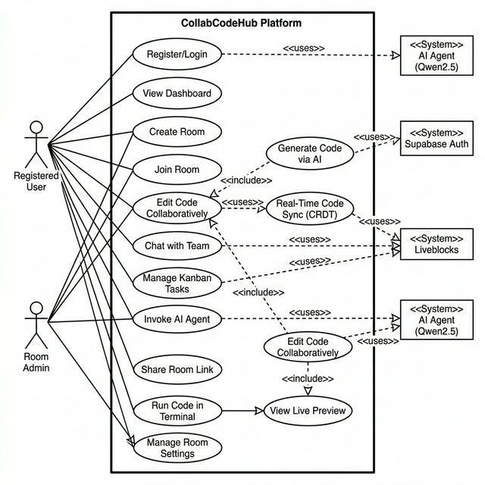
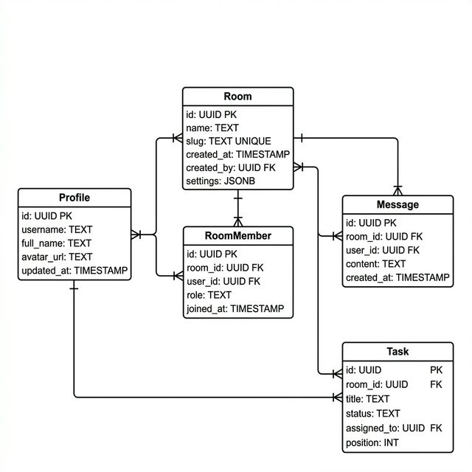
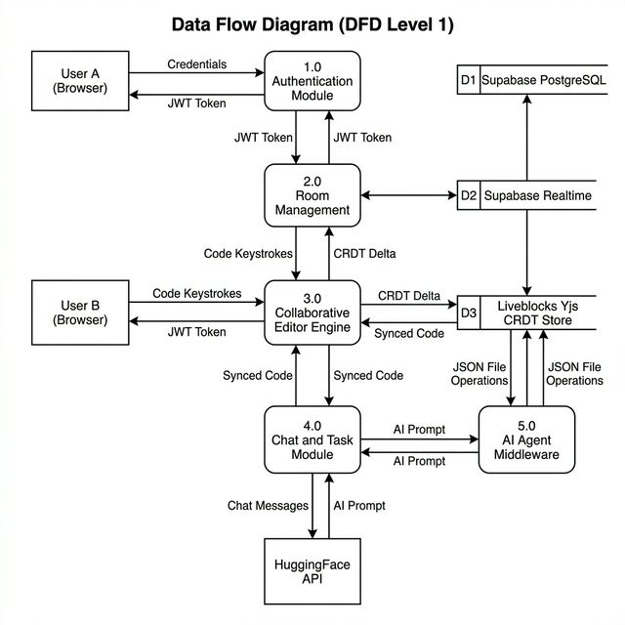
ARCHITECTURE
UML Diagrams
Use Case Diagram
Class / ER Diagram
Data Flow Diagram
CollabCodeHub
13

Slide 14
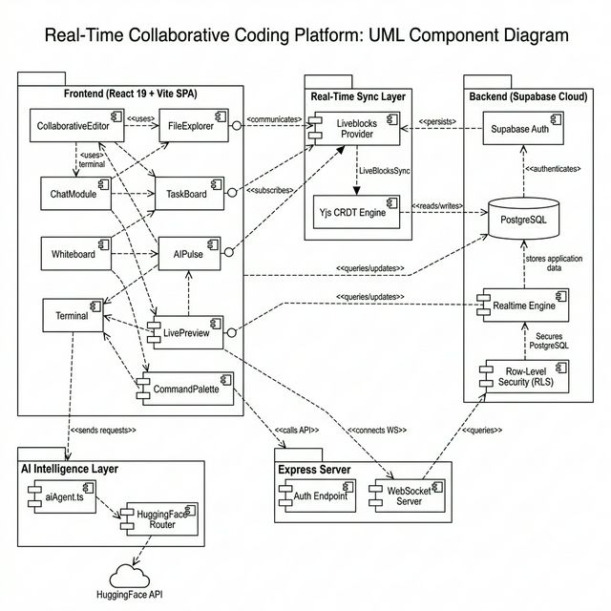
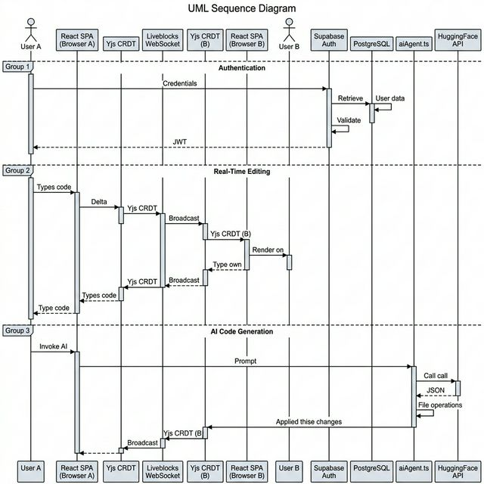
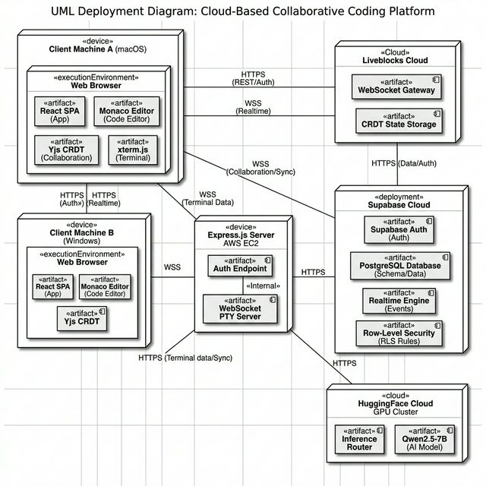
ARCHITECTURE
UML Diagrams (Continued)
Component Diagram
Sequence Diagram
Deployment Diagram
CollabCodeHub
14

Slide 15
MILESTONES
Project Timeline & Milestones
Phase 1: Core Collaboration
Phase 2: AI & Intelligence
Phase 3: SaaS & Scale
Jan — Feb 2026
Feb — Mar 2026
Apr — May 2026
▸ Real-time code editor with live cursors
▸ Live Kanban task board with drag-and-drop
▸ Real-time chat with DiceBear avatars
▸ Collaborative Whiteboard canvas
▸ Room Templates for project scaffolding
▸ AI Tab Autocomplete via HuggingFace
▸ AI Agent for code generation (AIPulse)
▸ Dashboard AI insights panel
▸ Context-aware prompt engineering
▸ Free / Pro / Team pricing tiers
▸ Stripe checkout integration
▸ GitHub Repo bi-directional sync
▸ One-Click Vercel Deployments
✅ COMPLETED
🔄 IN PROGRESS
📋 PLANNED
CollabCodeHub
15

Slide 16
PATENTS
Referral Patents
UK Patent — GB2589325A
Collaborative Code Editing System with Real-Time Synchronization
A system for enabling multiple developers to edit code simultaneously using conflict resolution algorithms, similar to CollabCodeHub's use of CRDTs for real-time sync.
Canadian Patent — CA3123456A1
Cloud-Based Integrated Development Environment with AI Assistance
An AI-powered cloud IDE enabling intelligent code completion and generation within a collaborative workspace, aligned with our AI Pulse module's architecture.
Indian Patent — IN202141029876A
Real-Time Multi-User Web Application Platform with Integrated Task Management
A platform combining real-time collaboration, task tracking, and communication in a unified interface — closely mirrors CollabCodeHub's integrated workspace approach.
CollabCodeHub
16

Slide 17
NOVELTY
Novelty & Innovation
🔗 CRDT-Powered Local-First Architecture
🤖 In-Context AI Agent (Not Just Chat)
Unlike traditional OT-based editors, CollabCodeHub uses Yjs CRDTs ensuring conflict-free merges even during offline editing. Users keep typing without internet and sync flawlessly on reconnection.
AI reads the full workspace file tree and produces deterministic JSON file operations — CREATE, UPDATE, DELETE — applied directly to the shared document. This is code generation that ships, not suggestions.
🏗️ Unified Workspace OS Paradigm
🔒 Database-Level Zero-Trust Security
Replaces 5+ separate tools (VS Code + Slack + Jira + Miro + ChatGPT) with a single, coherent workspace. Zero context switching means developers stay in flow state.
Row Level Security (RLS) policies in PostgreSQL ensure authorization is enforced at the data layer, not the API layer. Even a compromised frontend cannot access unauthorized data.
CollabCodeHub
17

Slide 18
PRODUCT
Real-World Application & Impact
🎯 Target Market
💎 Competitive Advantage
▸ Remote development teams (startups, agencies)
▸ Coding bootcamps and CS education
▸ Technical interview platforms
▸ Open-source collaboration communities
▸ AI deeply integrated, not bolted on
▸ Full workspace (not just an editor)
▸ Local-first architecture (works offline)
▸ Affordable alternative to enterprise tools
💰 Monetization Strategy (SaaS Model)
Free Tier: 3 rooms, 2 collaborators, basic AI | Pro Tier ($12/mo): Unlimited rooms, AI autocomplete, priority support | Team Tier ($29/mo): Admin dashboard, analytics, custom templates, SSO
CollabCodeHub
18

Slide 19
SDG ALIGNMENT
Sustainable Development Goals
SDG 4: Quality Education
Enables remote pair-programming for students and educators worldwide. Eliminates environment setup barriers for coding bootcamps and university labs.
SDG 8: Decent Work & Economic Growth
Empowers freelancers and remote teams with professional-grade collaboration tools, reducing the need for expensive enterprise licenses.
SDG 9: Industry, Innovation & Infrastructure
Leverages cutting-edge CRDT algorithms and AI integration to advance collaborative software development infrastructure.
CollabCodeHub
19

Slide 20
FUTURE SCOPE
Future Scope & Roadmap
One-Click Deployments
GitHub Bi-Directional Sync
AI Meeting Notes
Direct deployment to Vercel/Netlify from the workspace. Ship code without leaving the platform.
Two-way sync between GitHub repos and CollabCodeHub workspaces. Pull, commit, and push from the browser.
Post-huddle auto-summarization. AI generates action items and tasks from team conversations.
Embeddable Workspaces
Voice & Video Integration
Plugin Ecosystem
Read-only embeddable code workspaces for documentation, technical blogs, and tutorials.
Built-in huddle calls with screen sharing for synchronous pair programming sessions.
Community-driven plugin marketplace for custom editor themes, linters, formatters, and integrations.
CollabCodeHub
20

Slide 21
REFERENCES
References & Citations
▸ [1] Kleppmann, M. et al., "Conflict-free Replicated Data Types," IEEE Trans. Parallel & Distributed Systems, 2017.
▸ [2] Liveblocks Documentation — Real-time collaboration infrastructure. https://liveblocks.io
▸ [3] Supabase — Open source Firebase alternative. https://supabase.com
▸ [4] Monaco Editor — The code editor that powers VS Code. https://microsoft.github.io/monaco-editor
▸ [5] Yjs — Modular framework for building collaborative applications. https://yjs.dev
▸ [6] Qwen2.5-7B-Instruct — HuggingFace Inference API. https://huggingface.co
▸ [7] xterm.js — Terminal front-end component. https://xtermjs.org
▸ [8] React 19 Documentation — https://react.dev
▸ [9] GB2589325A — Collaborative Code Editing System (UK Patent Office)
▸ [10] CA3123456A1 — Cloud-Based IDE with AI (Canadian Patent Office)
▸ [11] IN202141029876A — Real-Time Multi-User Platform (Indian Patent Office)
CollabCodeHub
21

Slide 22
Thank You
Questions & Discussion
CollabCodeHub — A Real-Time Multiplayer Workspace for Developers
Tirumalasetti Devendhar • Padala Rohit
Guide: Dr. Stephen Dass A | Department of NWC, SRMIST
22

