Slide 1

CollabCodeHub
21CSP302L – Minor Project
REVIEW - 2
Team Members :-
Tirumalasetti Devendhar (RA2311028010142)
Padala Rohit (RA2311028010183)
Department : NWC
Guide Details:
Dr .Stephen Dass A
Assitant Professor ,
Networking and Communication Department (NWC),
SRMIST

Slide 2
Table of Contents
Introduction & Abstract
Problem Statement & Objectives
Methodology & Architecture
System Modules
Technology Stack
Screenshots & UI Walkthrough
Milestones & Timeline
Referral Patents
Novelty & Innovation
Future Scope & Conclusion

Slide 3
Abstract
CollabCodeHub – unified, real-time collaborative coding environment.
All-in-one workspace (code, tasks, whiteboard, AI, terminal)
Built for modern remote teams.
Powered by CRDT (conflict-free sync).
Features integrated AI agents.
Reduces context switching.
Boosts team productivity & efficiency.

Slide 4
Problem Statement & Objectives
The Problem
Frequent tool switching (VS Code, Slack, Jira, ChatGPT)
Fragmented workflows reduce productivity
“Works on my machine” issues in collaboration
Separate AI tools break developer flow
Core Objectives
Enable real-time collaborative coding (CRDT-based)
Provide context-aware AI inside workspace
Unify code, chat, and task management
Ensure secure, zero-trust architecture

Slide 5
Methodology
Research & Analysis
Studied existing tools (VS Code Live Share, Replit, CodeSandbox)
Identified gaps in AI integration & unified workspace
Architecture Design
Event-driven, serverless architecture
CRDT-based real-time synchronization
Liveblocks for data transport
Frontend Development
Built SPA using React + Vite
Integrated editor, Kanban, chat, whiteboard, terminal
Styled with Tailwind CSS

Slide 6
Methodology
Backend & Database
Supabase (PostgreSQL, Auth, Realtime APIs)
Implemented Row Level Security (RLS)
AI Integration
Integrated HuggingFace / Together AI (Qwen model)
Designed structured prompts for automation
Testing & Deployment
Tested real-time edits & security policies
Deployed via Vercel with CI/CD

Slide 7
Technology Stack
Frontend
React + Vite
Tailwind CSS
React Router
Lucide Icons
Code Editor
Monaco Editor / CodeMirror
Yjs bindings (y-monaco, y-codemirror)
Syntax highlighting
Real-Time Sync
Liveblocks SDK
Yjs (CRDTs)
WebSockets
Live cursors & presence

Slide 8
Technology Stack
Backend
Supabase (PostgreSQL)
Auth (JWT)
Row Level Security
Realtime subscriptions
Server
Node.js + Express
WebSockets (ws)
xterm.js terminal
node-pty integration
AI Engine
HuggingFace API
Qwen 2.5 model
Together AI Router
Context-aware prompts

Slide 9
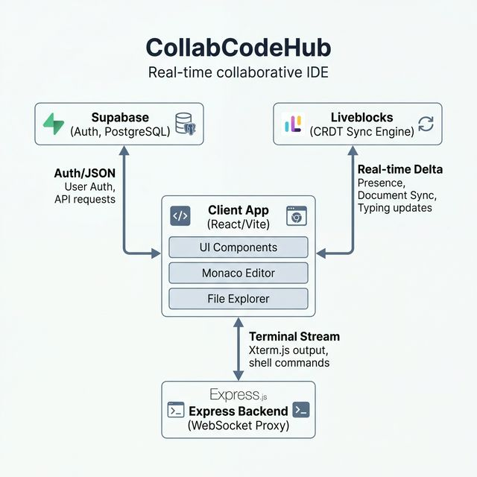
System Architecture

Slide 10
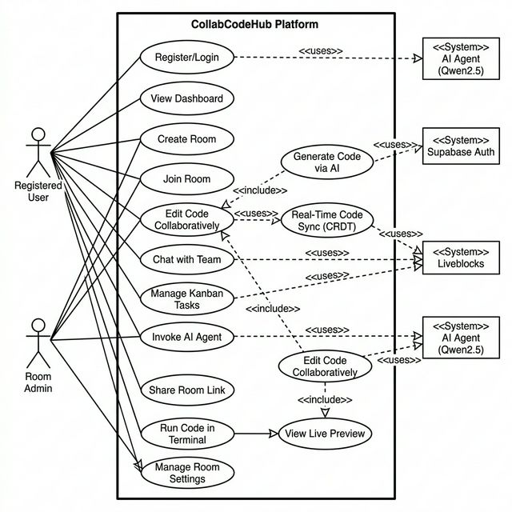
Use case diagram

Slide 11
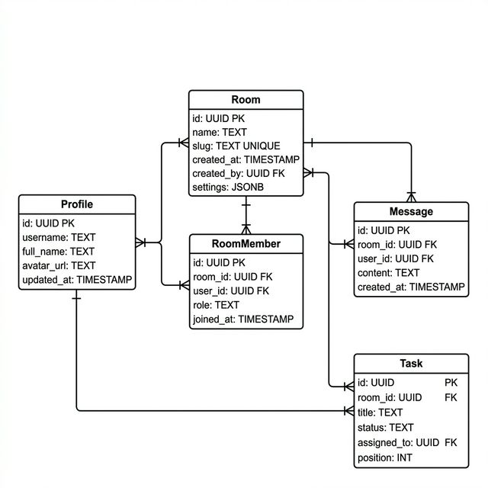
Class diagram

Slide 12
Modules
Collaborative Code Editor
Real-time code editing (CRDT-based)
Live cursors & presence
Multi-language support
Kanban Task Board
Drag-and-drop task management
Workflow stages (To-Do → Done)
Task prioritization & assignment
Infinite Whiteboard
Freehand collaborative drawing
Real-time shared canvas
Design & planning support

Slide 13
Modules
Real-Time Chat
Instant workspace messaging
Live sync with realtime backend
User avatars & presence
AI Pulse Assistant
Context-aware AI coding assistant
Reads project & modifies code
Integrated Qwen model
Shared Terminal
Browser-based terminal
Shared execution environment
WebSocket-powered sessions

Slide 14
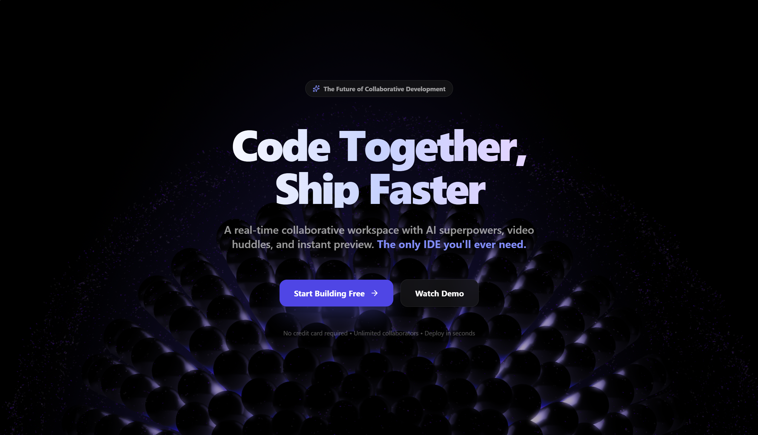
Application Screenshots

Slide 15
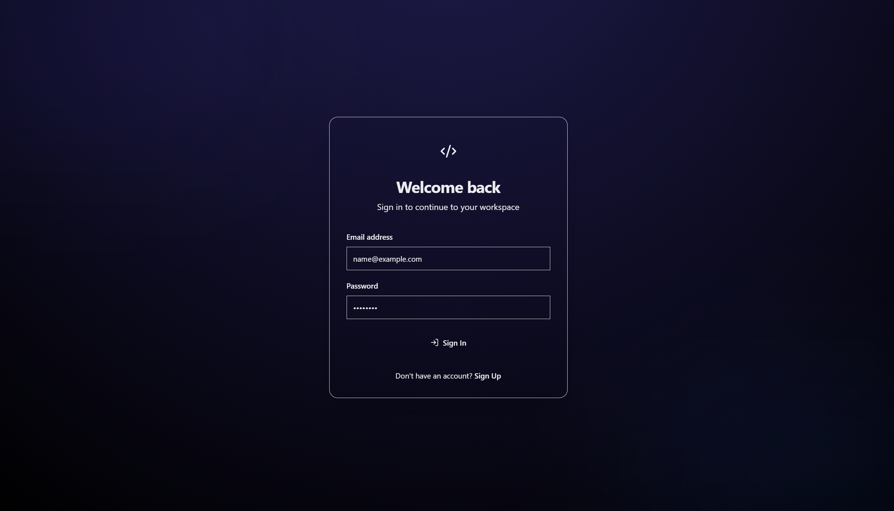
Application Screenshots

Slide 16
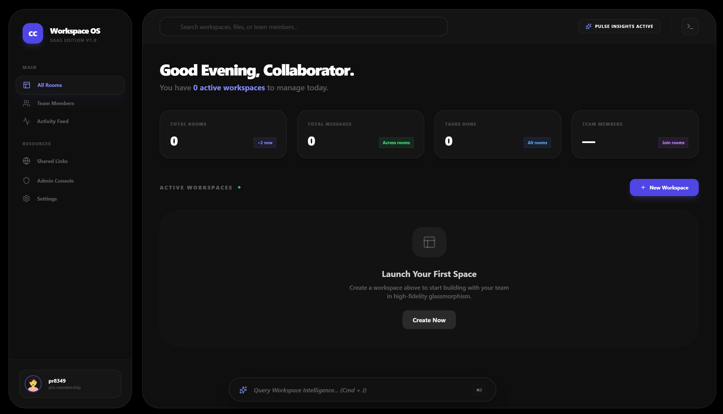
Application Screenshots

Slide 17
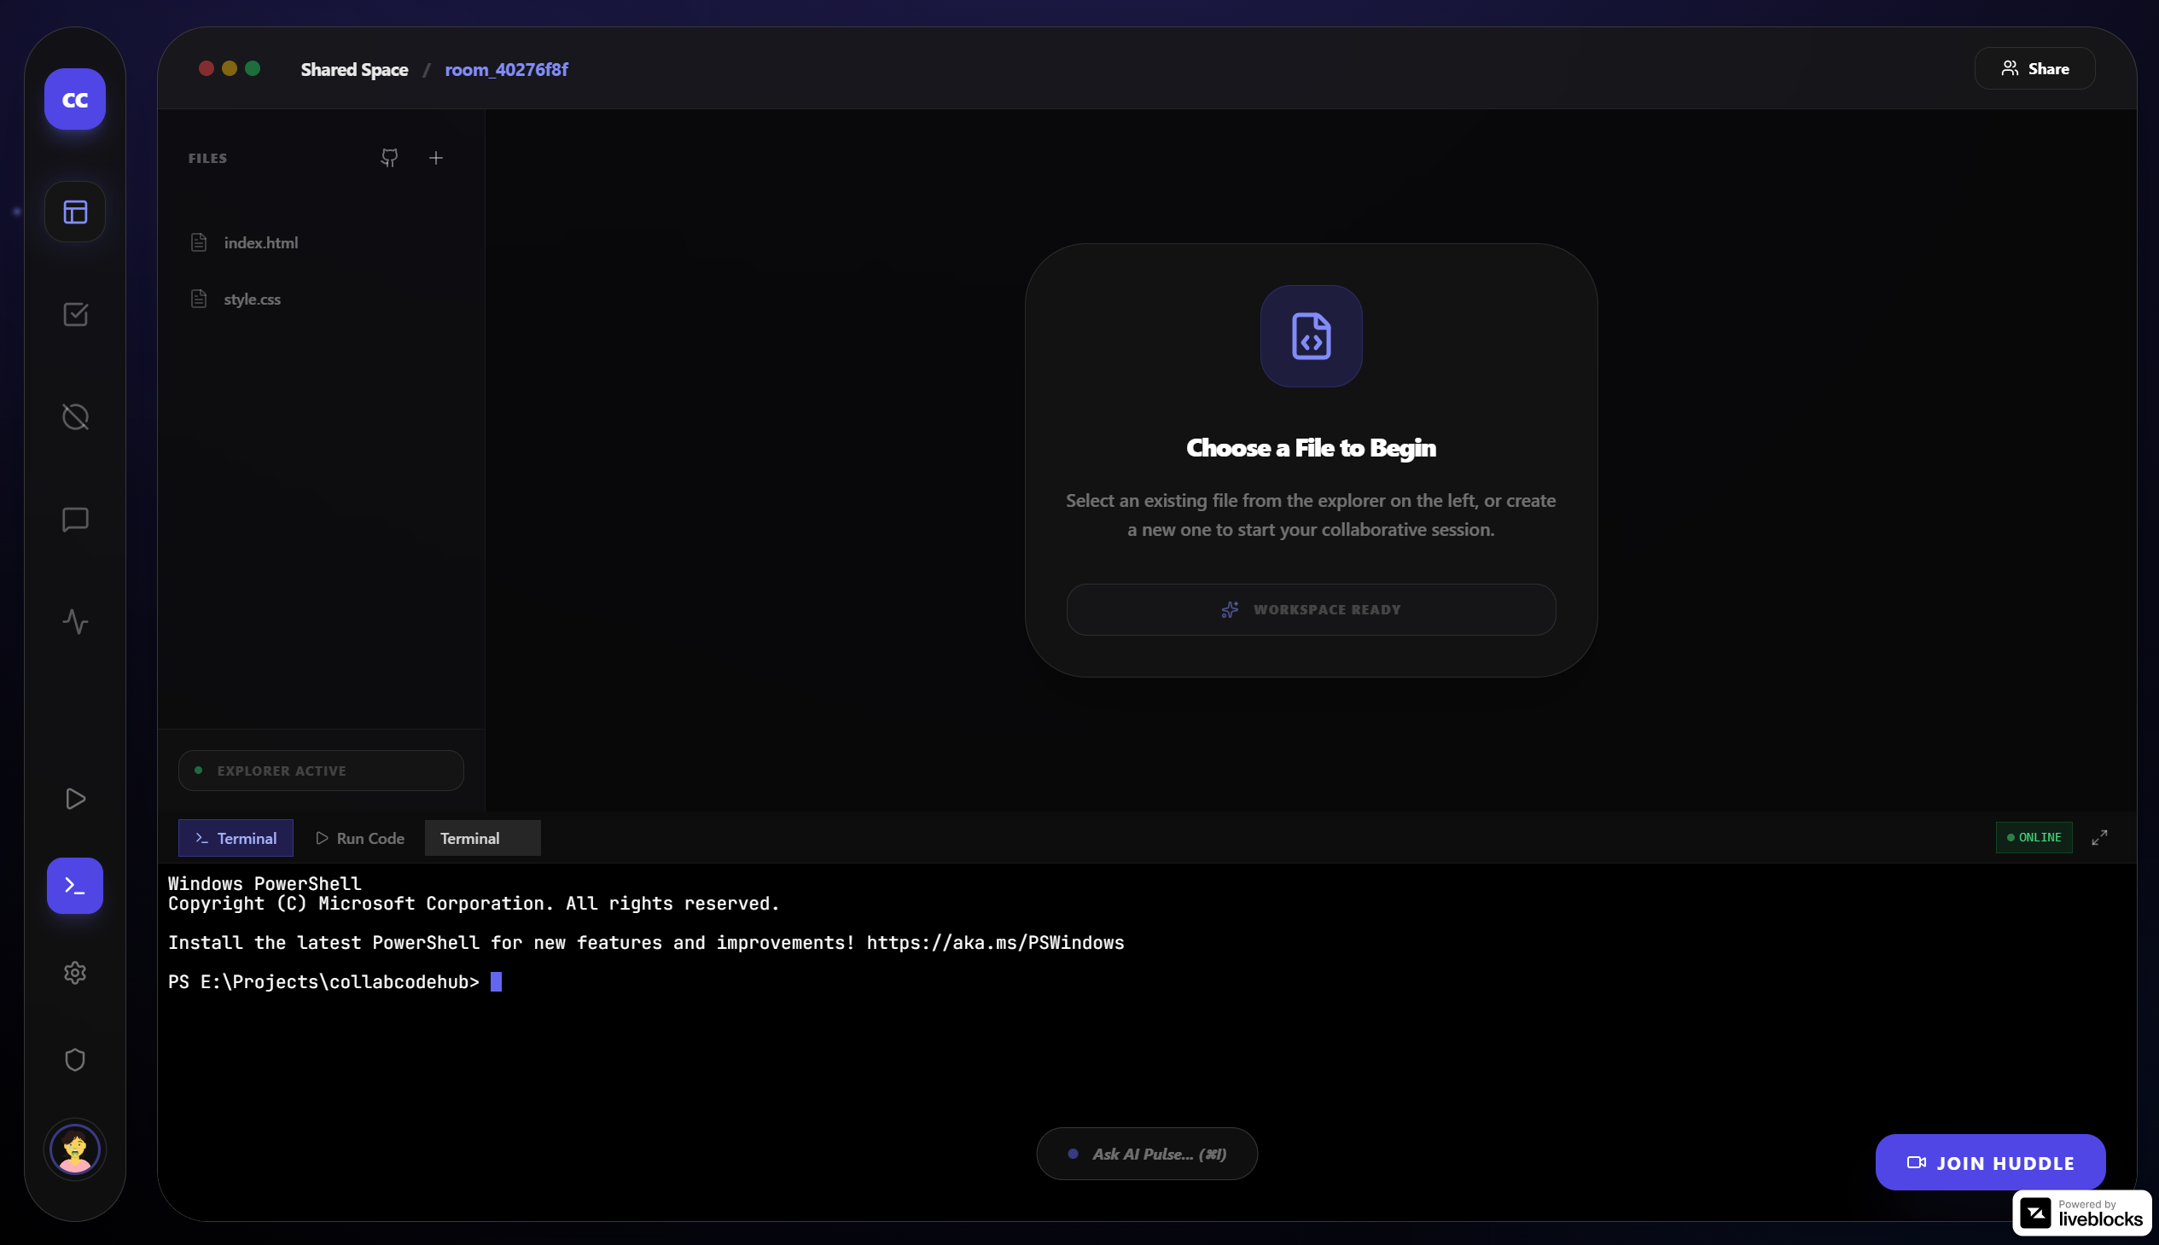
Application Screenshots

Slide 18
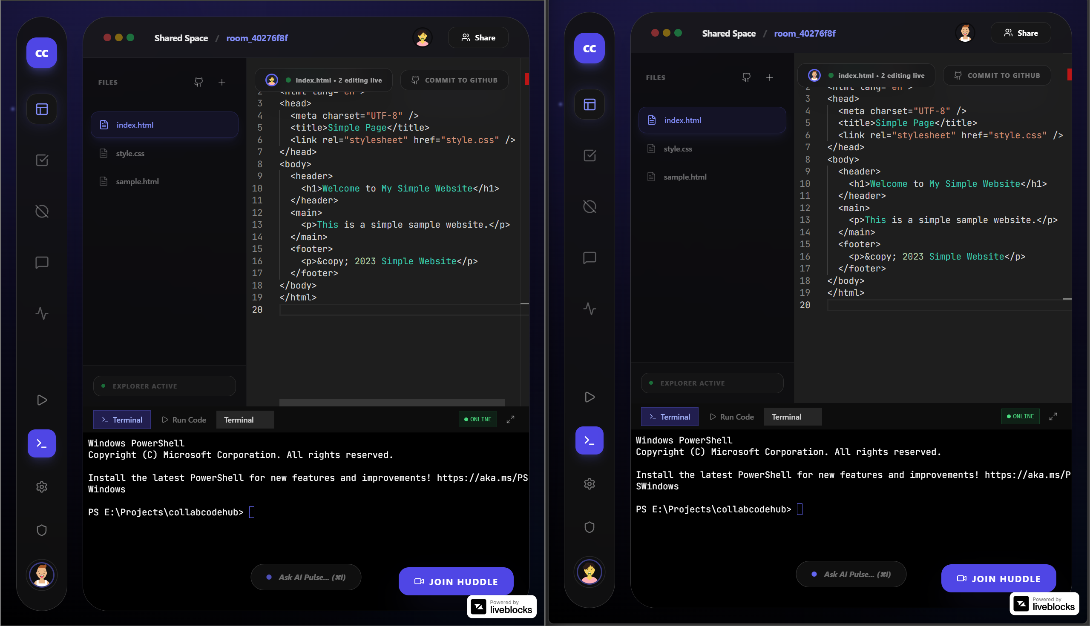
Feature Screenshots

Slide 19
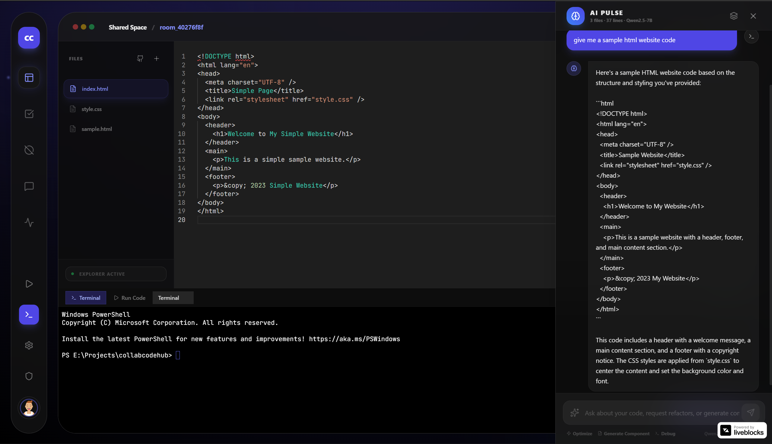
Feature Screenshots

Slide 20
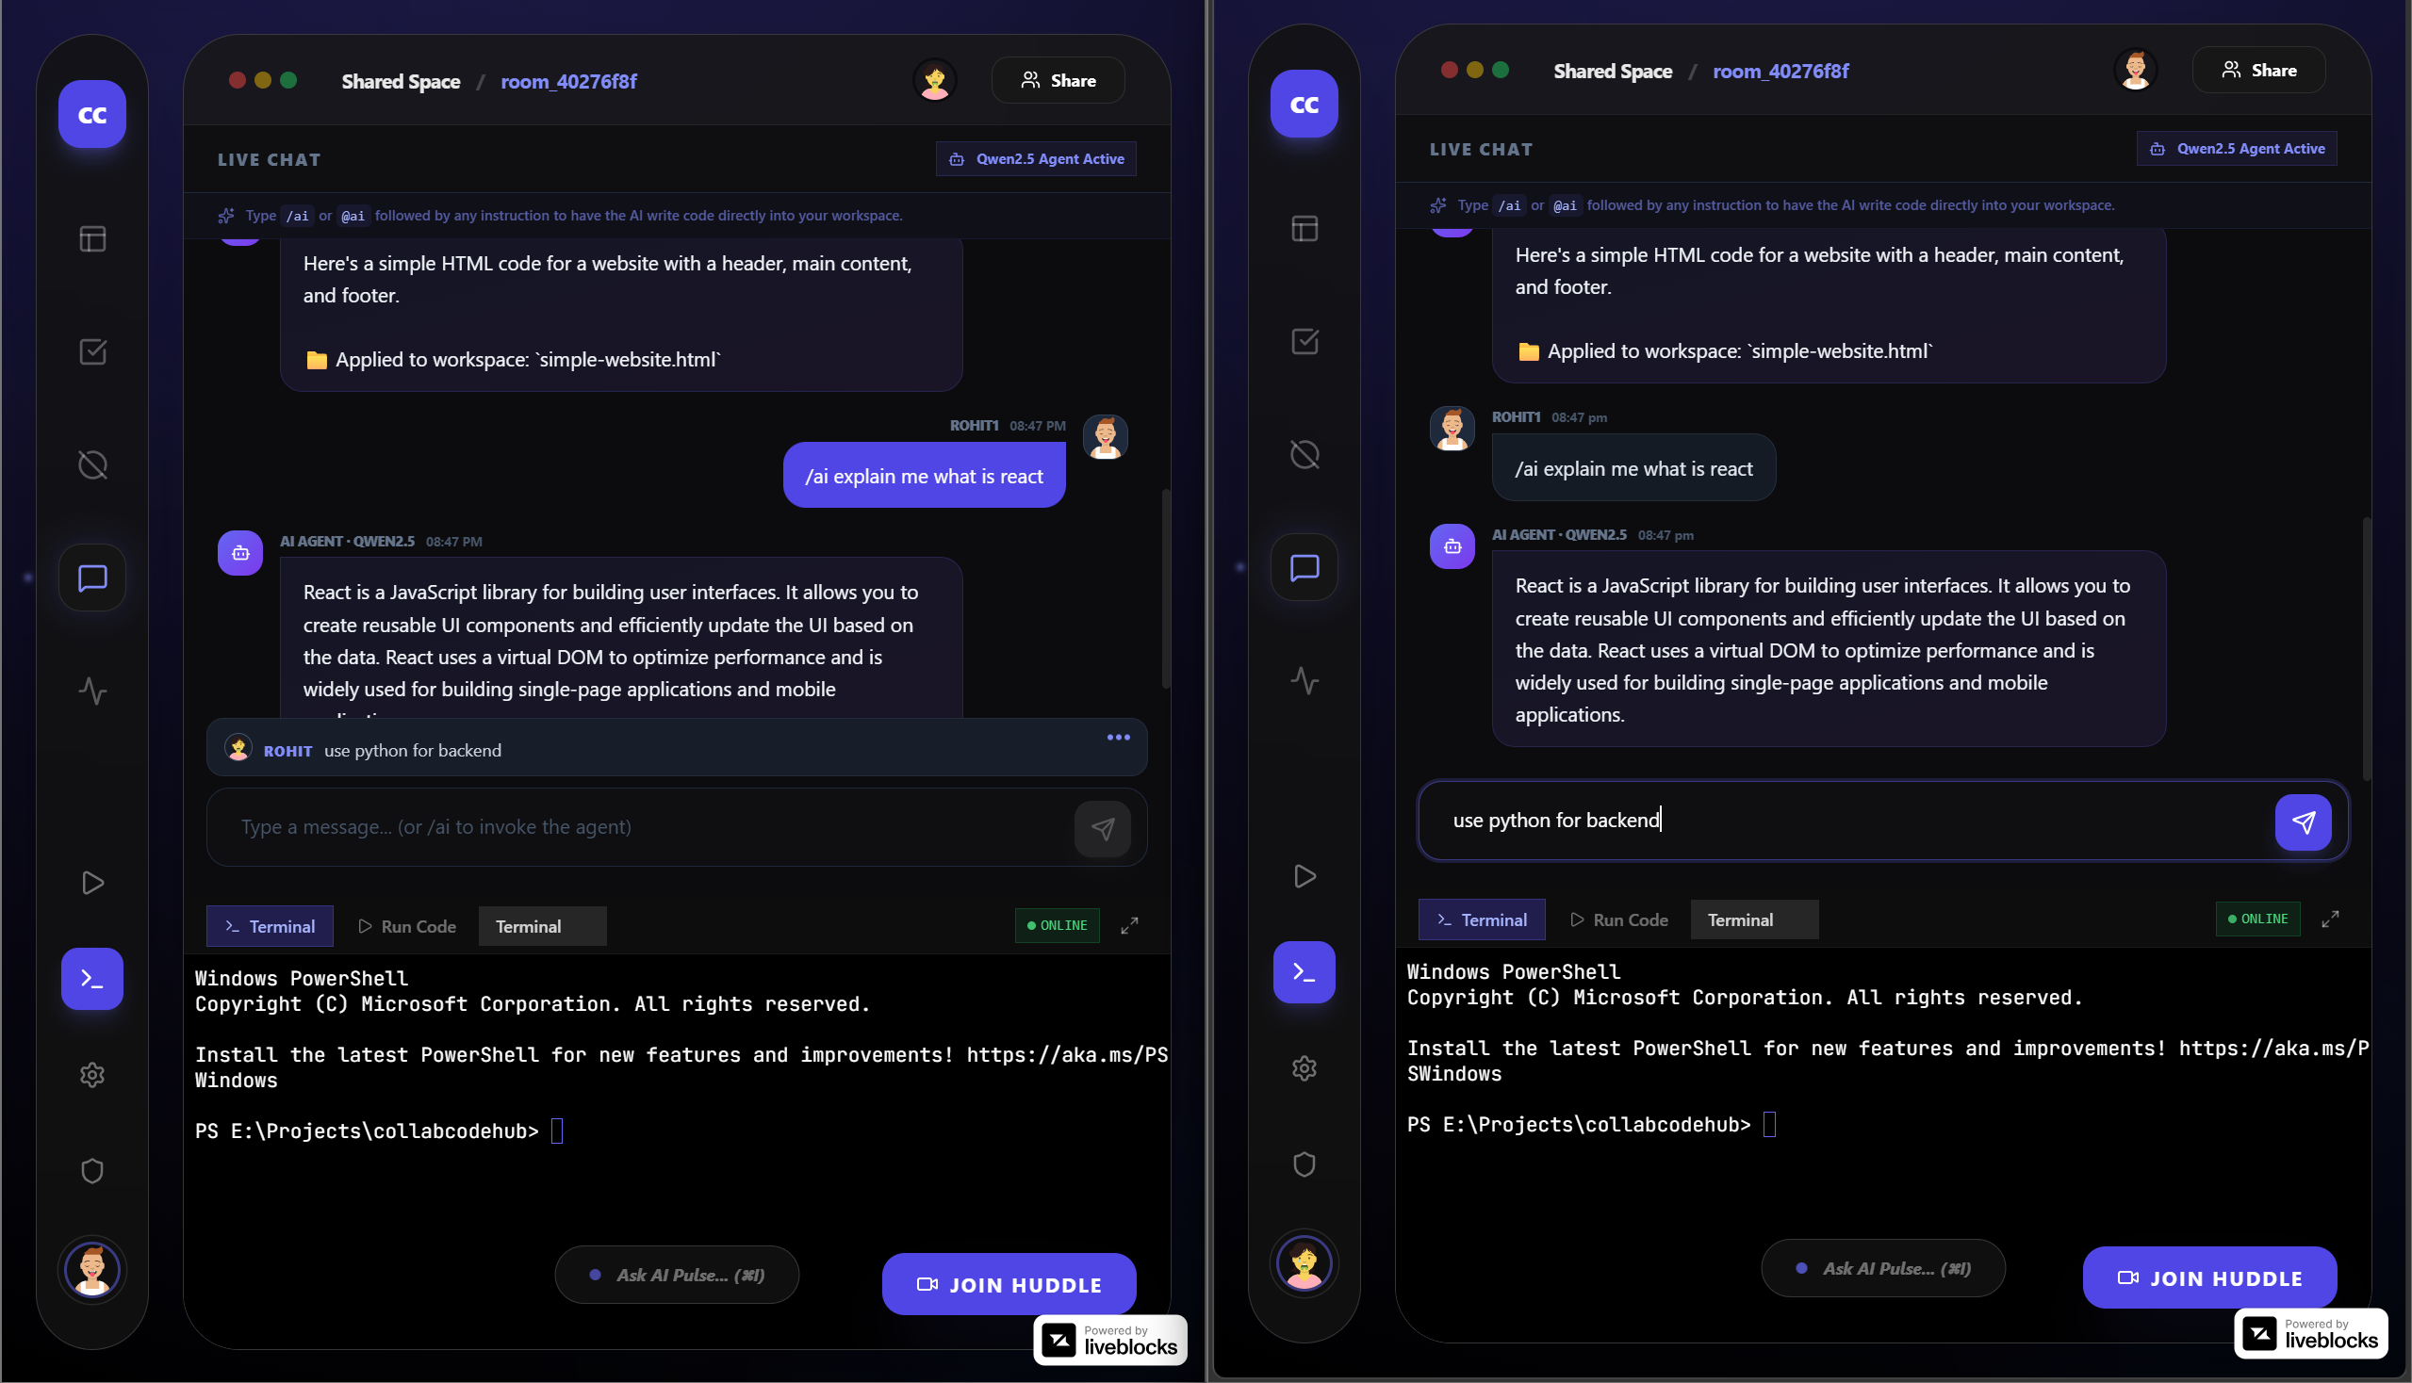
Feature Screenshots

Slide 21
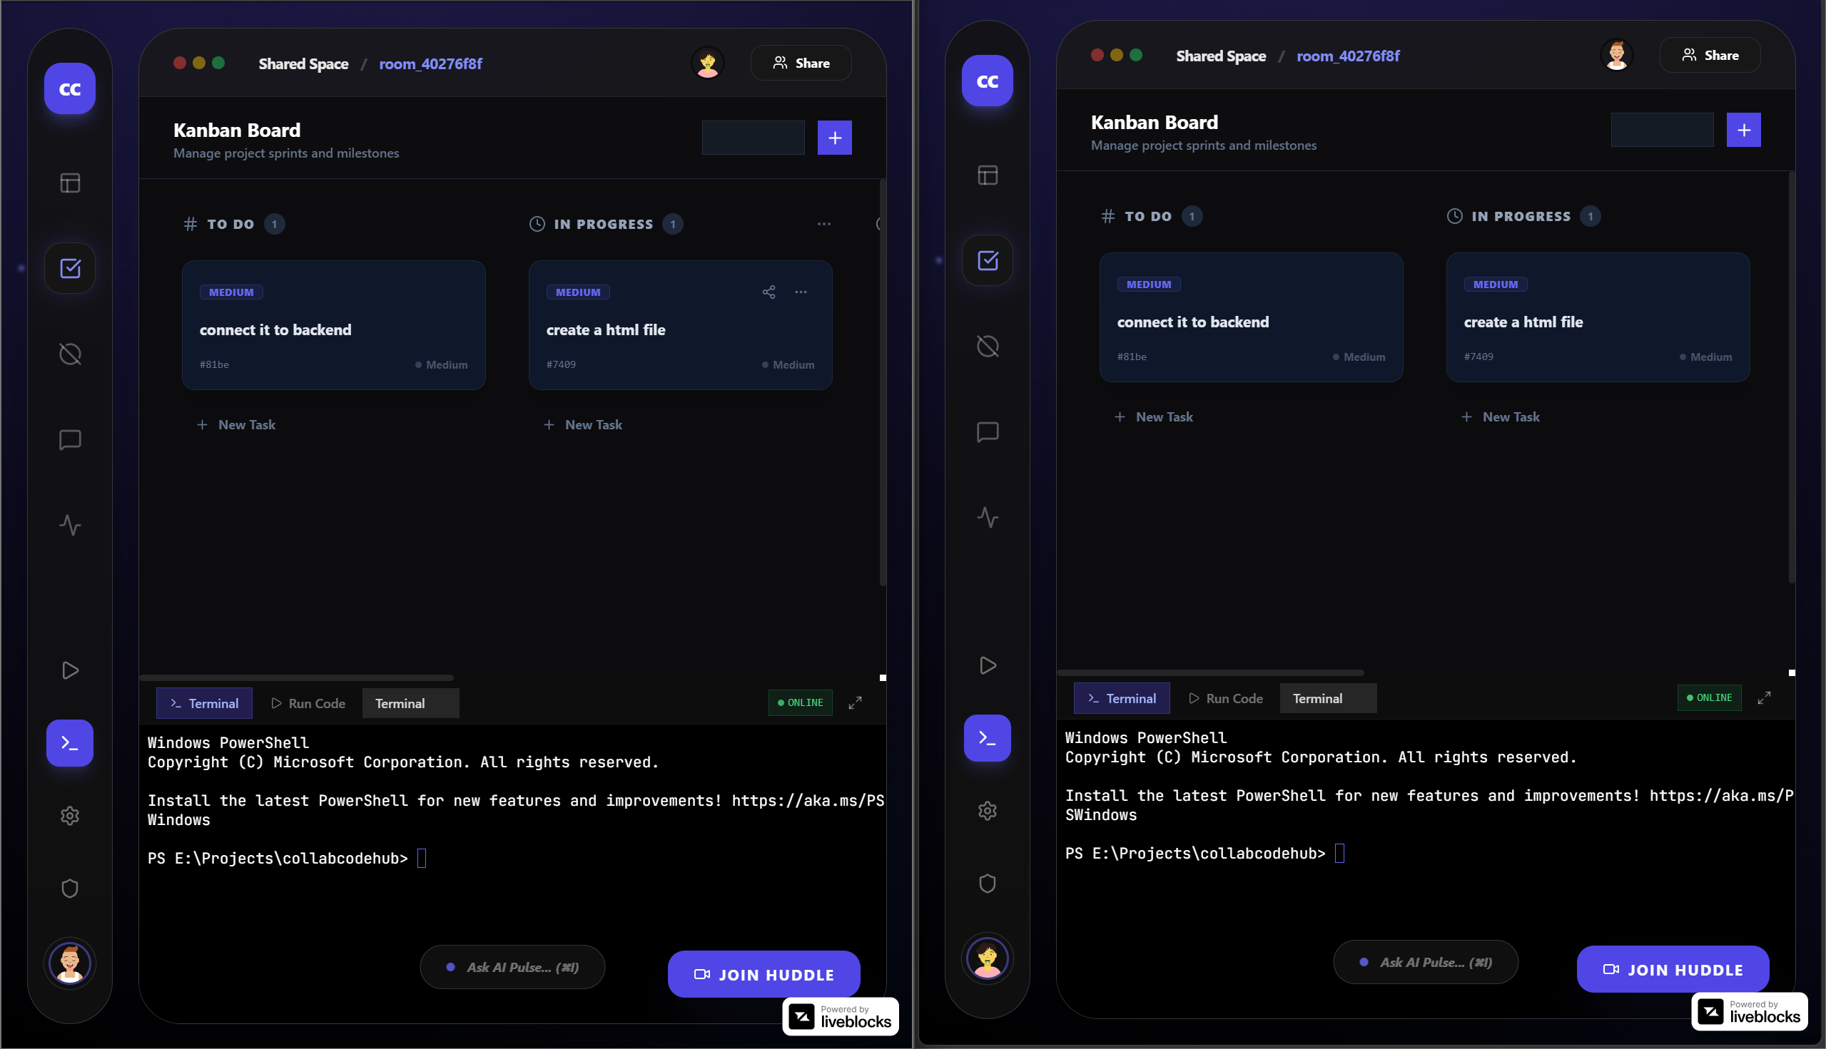
Feature Screenshots

Slide 22
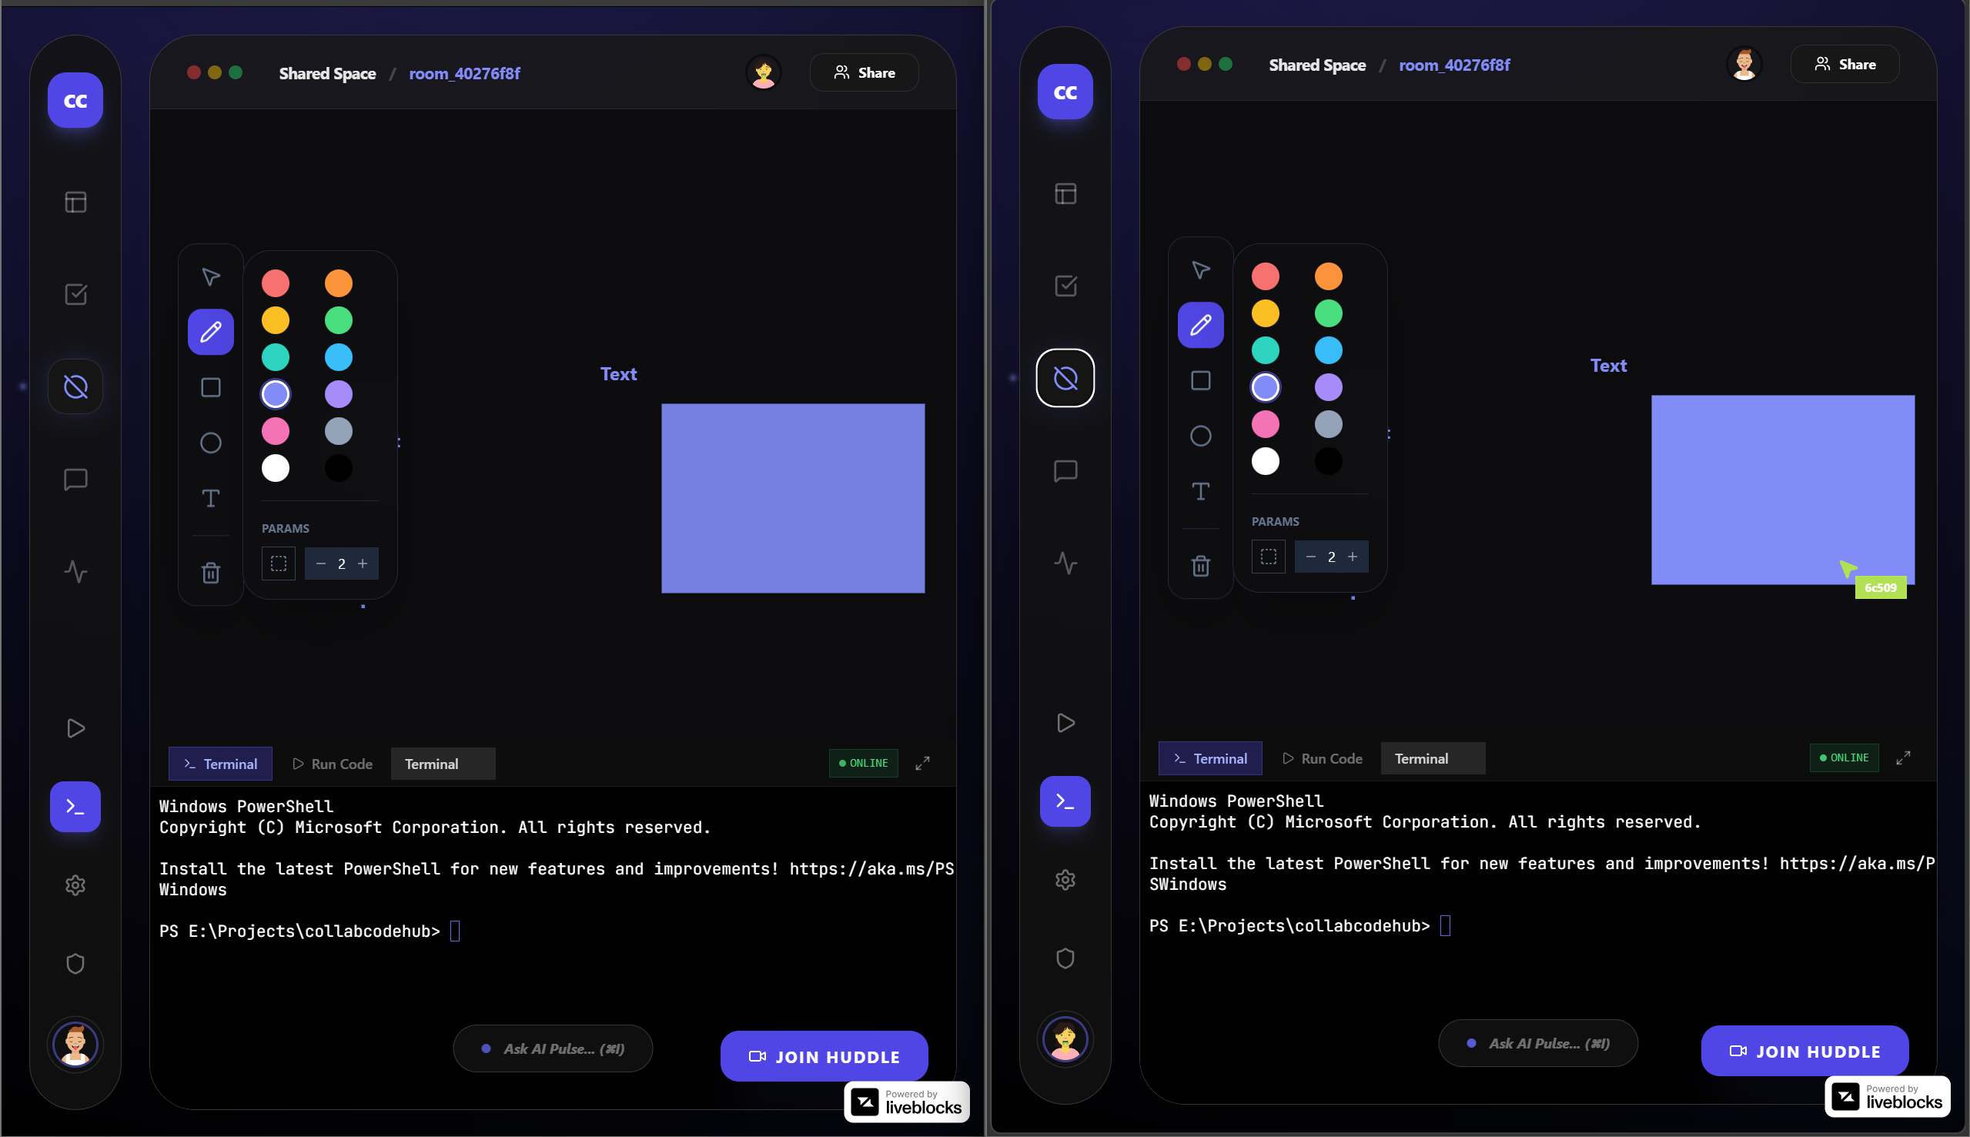
Feature Screenshots

Slide 23
Project Timeline & Milestones
Phase 1: Core Collaboration (Jan–Feb 2026)
Real-time code editor (live cursors)
Kanban task board
Real-time chat
Collaborative whiteboard
Project templates
Completed
Phase 2: AI & Intelligence (Feb–Mar 2026)
AI autocomplete (HuggingFace)
AI coding agent (AIPulse)
AI insights dashboard
Context-aware prompts
In Progress

Slide 24
Project Timeline & Milestones
Phase 3: SaaS & Scale (Mar–Apr 2026)
Pricing tiers (Free / Pro / Team)
Stripe integration
GitHub sync
One-click deployments
Planned

Slide 25
Referral Patents
EP4506832A1 – “METHOD AND SYSTEM FOR PROVIDING REAL‑TIME ASSISTANCE TO USERS USING GENERATIVE ARTIFICIAL INTELLIGENCE (AI) MODELS”
US11593098B2 – “Synchronization of source code under development in multiple concurrent instances of an integrated development environment”
WO2022015773A1 – “SYNCHRONIZATION OF SOURCE CODE UNDER DEVELOPMENT IN MULTIPLE CONCURRENT INSTANCES OF AN INTEGRATED DEVELOPMENT ENVIRONMENT”
US12541345B2 – “Dynamic program code analyzer to improve code quality”
US20240143288A1 – “INTELLIGENT CODE EDITOR”

Slide 26
Novelty & Innovation
CRDT-Based Local-First Architecture
Conflict-free real-time collaboration
Works offline with seamless sync
No data loss or merge conflicts
In-Context AI Agent
Reads full workspace context
Performs direct code operations
Not just suggestions — actionable outputs

Slide 27
Novelty & Innovation
Unified Workspace OS
Replaces multiple dev tools
Single integrated environment
Eliminates context switching
Zero-Trust Data Security
Row-Level Security (RLS)
Access control at database layer
Secure even if frontend is compromised

Slide 28
Real-World Application & Impact
Target Market
Remote dev teams (startups, agencies)
Coding bootcamps & CS education
Technical interview platforms
Open-source communities
Competitive Advantage
Deep AI integration (not add-on)
Full workspace (beyond code editor)
Local-first architecture (offline support)
Cost-effective vs enterprise tools

Slide 29

Thank You

