Slide 1

Aditya Institute of Technology and Management , Tekkali
Batch Members:
1.Ronanki Bhavya Sri-23A51A0519(Team Lead)
2.Batchu Mounika-23A51A0509
3.Kandalam Devaki-23A51A0527
4.Panda Damayanthi-23A51A0547
5.Rasmitha Goudo-23A51A0555

Slide 2
Title
Real-Time Lost and Found Portal with AI

Slide 3
Abstract
This project focuses on building a real-time lost and found system powered by AI. It allows users to upload details of lost or found items and uses AI-based image recognition to match them efficiently. The platform provides faster recovery of items, location tagging, and real-time notifications.

Slide 4
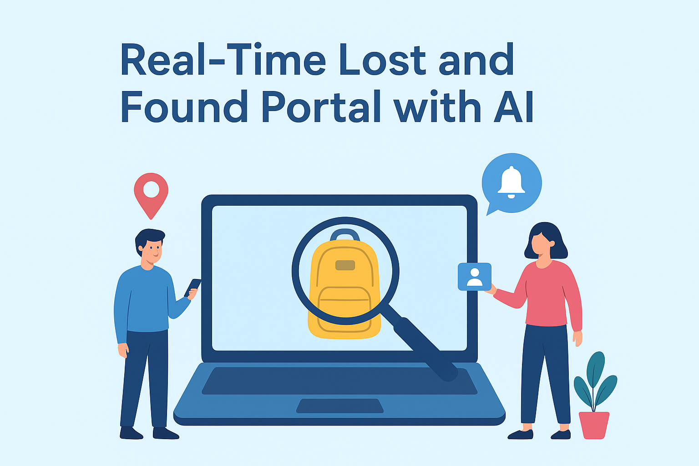
Introduction
Losing items in public places is common, but recovery methods are inefficient. Traditional approaches like notice boards or word of mouth are outdated. A centralized AI-powered platform can solve this by automatically matching lost and found items.

Slide 5

Problem Statement
In public places such as colleges, malls, bus stations, and offices, people frequently lose personal belongings. Existing methods to recover items are slow, inefficient, and rarely successful.

Slide 6
Reason for Problem statement
The main reasons for this problem are:
- Lack of centralized reporting system.
- Manual searching is time-consuming.
- Limited communication between finders and owners.
- No real-time notification system.

Slide 7
Survey for problem statement Frontend & Backend
Frontend: ReactJS / Angular, HTML, CSS, JS
Backend: Node.js / Django / Flask
Database: MySQL / MongoDB
AI/ML: TensorFlow / PyTorch for image recognition
Cloud: AWS / Azure / Google Cloud

Slide 8
Estimated Cost
Estimated cost for development:
- Cloud Hosting: $100 - $300 per month
- AI Model Training: $200 - $500 (one-time)
- Development Tools & Licenses: $100
- Total Approx: $500 - $1000

Slide 9
Applications
Colleges & Universities
Public Transport (Bus/Train Stations)
Shopping Malls & Offices
Events & Gatherings
Online community lost & found portals

Slide 10


