Slide 1


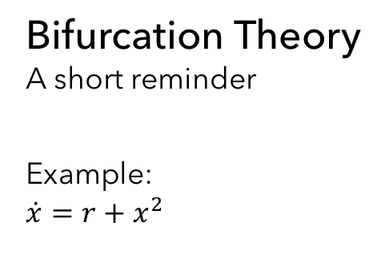





Bifurcation Theory
A short reminder
Example:
$$\dot{x}=r+x^{2}$$
$$\dot{x}$$
$$\dot{x}$$
$$\dot{x}$$
$$x$$
$$x$$
$$x$$
$$r<0$$
$$r=0$$
$$r>0$$

Slide 2





Bifurcation Diagrams
Critical slowing down, Transcritical Bifurcation
$$x$$
$$x$$
$$r$$
$$r$$
$$\dot{x}=r+x^{2}$$
$$\dot{x}=rx−x^{2}$$

Slide 3
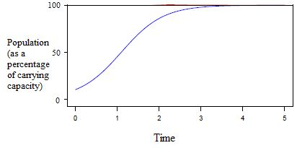
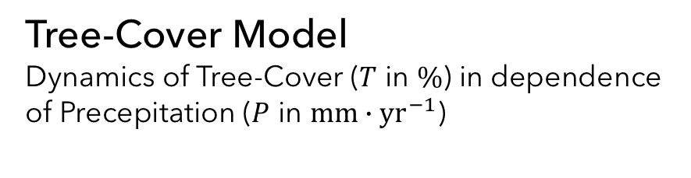
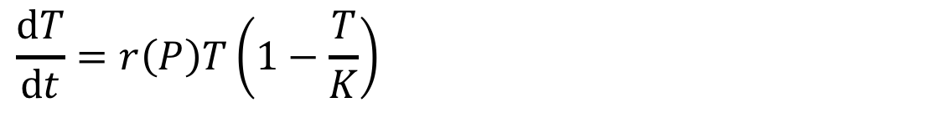
Tree-Cover Model
Dynamics of Tree-Cover ($T$ in $\%$) in dependence of Precepitation ($P$ in $mm∙{\text{yr}}^{−1}$)
$$\frac{\text{d}T}{\text{d}t}=r\left(P\right)T\left(1−\frac{T}{K}\right)$$
Logistic growth
K … maximum Tree-Cover

Slide 4
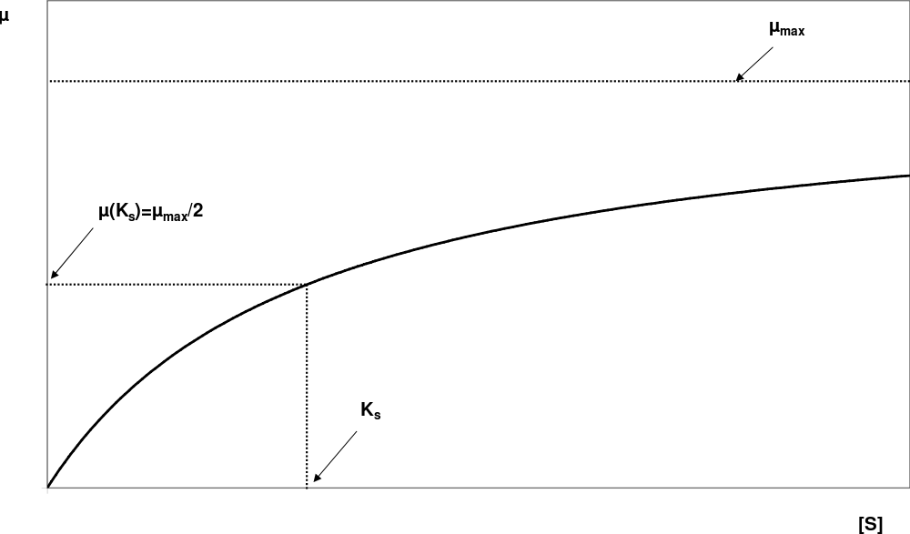
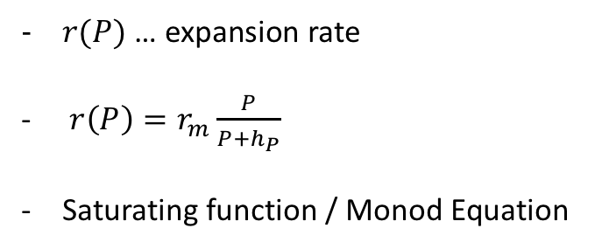
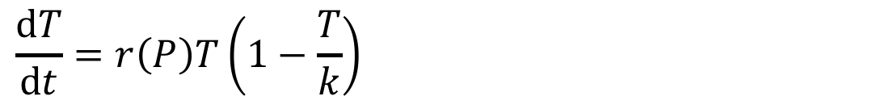
Tree-Cover Model
Expansion rate
$$\frac{\text{d}T}{\text{d}t}=r\left(P\right)T\left(1−\frac{T}{k}\right)$$
$r(P)$ … expansion rate
$r\left(P\right)=r_{m}\frac{P}{P+h_{P}}$
Saturating function / Monod Equation

Slide 5
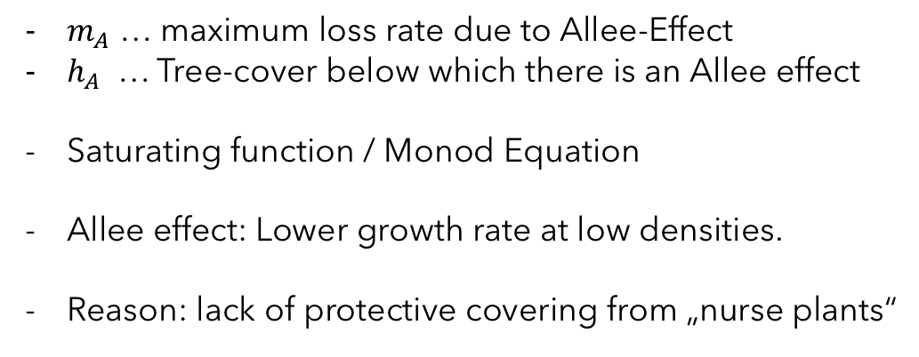
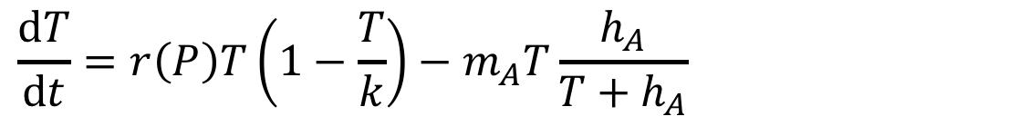
Tree-Cover Model
Allee effect
$$\frac{\text{d}T}{\text{d}t}=r\left(P\right)T\left(1−\frac{T}{k}\right)−m_{A}T\frac{h_{A}}{T+h_{A}}$$
$m_{A}$ … maximum loss rate due to Allee-Effect
$h_{A}$ … Tree-cover below which there is an Allee effect
Saturating function / Monod Equation
Allee effect: Lower growth rate at low densities.
Reason: lack of protective covering from „nurse plants“

Slide 6
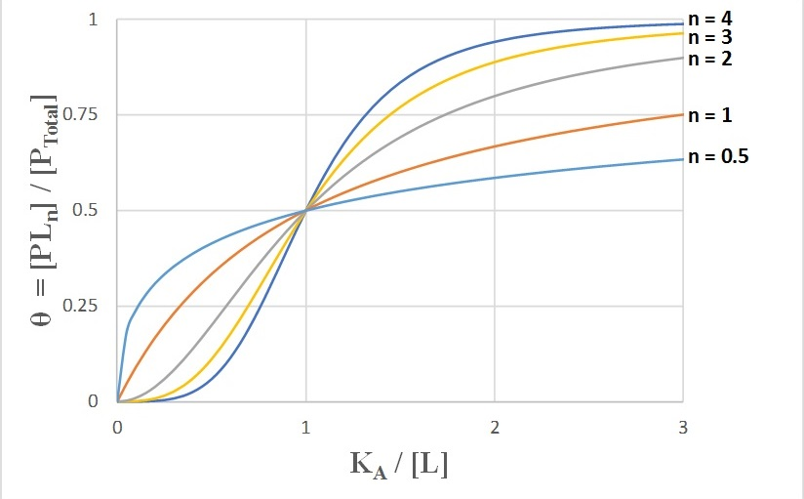
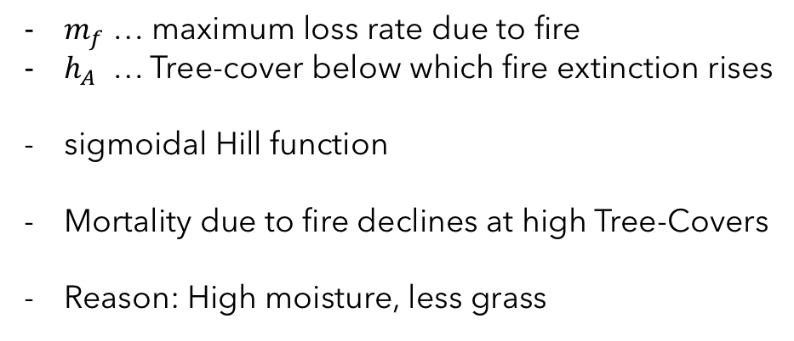
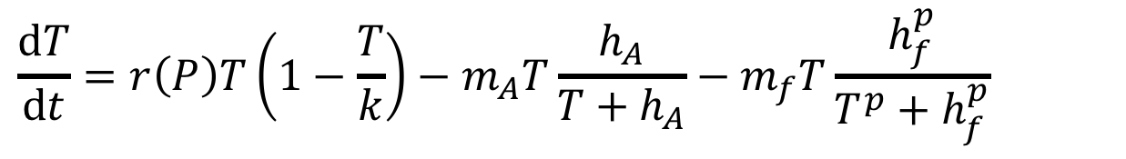
Tree-Cover Model
Fire mortality
$$\frac{\text{d}T}{\text{d}t}=r\left(P\right)T\left(1−\frac{T}{k}\right)−m_{A}T\frac{h_{A}}{T+h_{A}}−m_{f}T\frac{h_{f}^{p}}{T^{p}+h_{f}^{p}}$$
$m_{f}$ … maximum loss rate due to fire
$h_{A}$ … Tree-cover below which fire extinction rises
sigmoidal Hill function
Mortality due to fire declines at high Tree-Covers
Reason: High moisture, less grass

