Slide 1


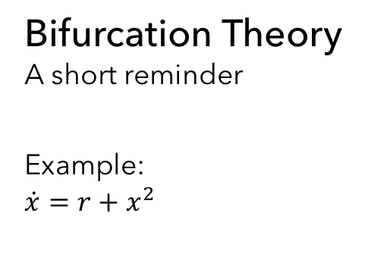





Bifurcation Theory
A short reminder
Example:
$$\dot{x}=r+x^{2}$$
$$\dot{x}$$
$$\dot{x}$$
$$\dot{x}$$
$$x$$
$$x$$
$$x$$
$$r<0$$
$$r=0$$
$$r>0$$

Slide 2





Bifurcation Diagrams
Critical slowing down, Transcritical Bifurcation
$$x$$
$$x$$
$$r$$
$$r$$
$$\dot{x}=r+x^{2}$$
$$\dot{x}=rx−x^{2}$$

