Slide 1
Distributed Messaging Queue
By: Soumodipta Bose , Sudipta Halder, Padam Prakash, Ashutosh Gupta

Slide 2

Introduction
A distributed messaging queue is a system that allows multiple applications on same/different devices to communicate asynchronously with each other.
This project aims to develop a distributed messaging queue system that can be used by various applications to communicate with each other.
Distributed message queues have a wide range of use cases across various industries which includes Microservices architecture , Financial systems , E-commerce etc.

Slide 3
System Design
Message Producer
Message Broker
Message Consumer
Topic or Channel
Protocol
Cluster

Slide 4
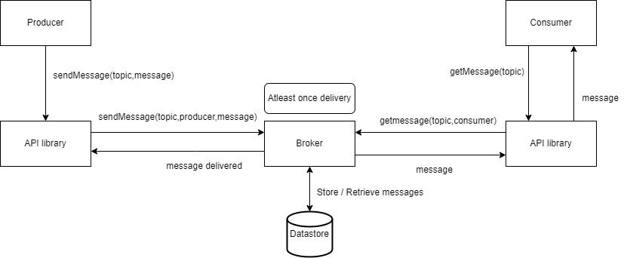
Architecture

Slide 5
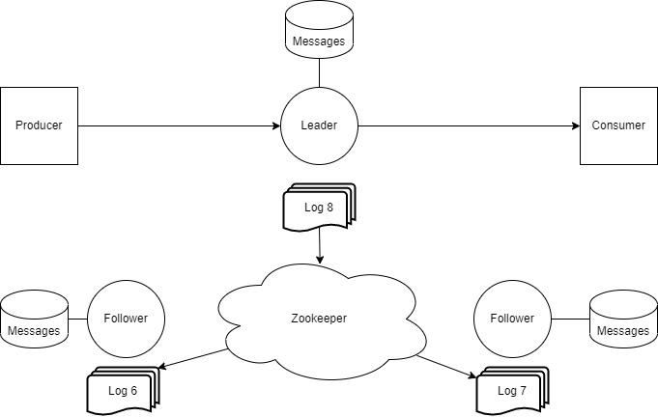

Slide 6
Implementation
A distributed message queue using Python, ZooKeeper and Flask.
The Flask app has endpoints for health checks, clearing the database, publishing messages to topics, and consuming messages from topics.
Implemented At Least once Delivery
Leader Election Algorithm
Replication

Slide 7
Key Features
Implemented the following features:
Reliability
Push based message Delivery
Decoupling
Fault-tolerance
At least once Delivery
Asynchronous communication

Slide 8
Demo
At least once delivery test
Producer consumer variable rate produce consume
Topic and message creation flow
Multi-Broker replication test and code flow

Slide 9
Performance
Throughput
Latency
Reliability
Consistency

Slide 10
Limitations and Challenges
Partition
Consumer group
Scalability

Slide 11
Thank You

