Slide 1
Supervised Contrastive Learning
By Team StatQuest
Padam Prakash
Kushal shah
Soumodipta bose

Slide 2
Contrastive learning
The goal of contrastive representation learning is to learn such an embedding space in which similar sample pairs stay close to each other while dissimilar ones are far apart.
Contrastive learning can be applied to both supervised and unsupervised settings.

Slide 3
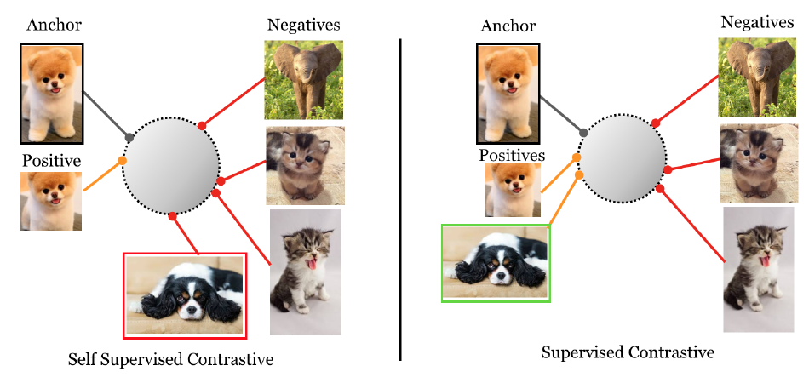

Slide 4
About the paper
The paper extends the self-supervised contrastive approach to the fully-supervised setting, which leverage label information.
It considers many positives per anchor in addition to many negatives as opposed to self-supervised contrastive learning which uses only a single positive.
It analyze two possible versions of the supervised contrastive (SupCon) loss, identifying the best-performing formulation of the loss.

Slide 5
Novelty of The Paper
Paper proposes the first contrastive loss which consistently perform better than cross-entropy on large-scale classification problems.
The loss function can be seen as a generalization of both the triplet and N-pair loss.
The loss function is less sensitive than cross-entropy to a range of hyperparameters.
The gradient of the loss function encourages learning from hard positives and hard negatives.

Slide 6
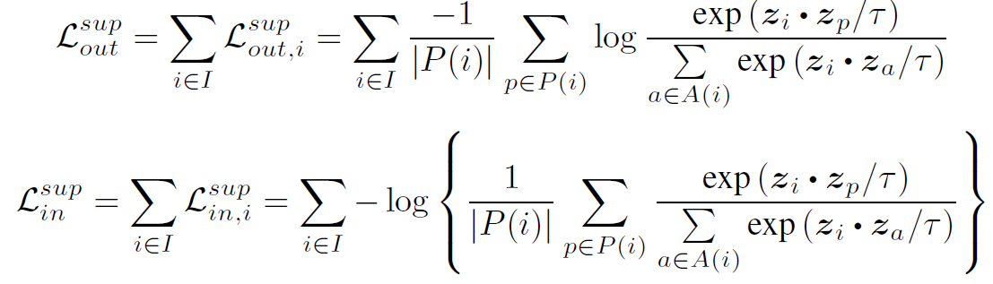
Supervised contrastive losses
Here, P(i) ={p€A(i) : y_{p} = y_{i}} is the set of indices of all positives in the batch distinct from i, and |P(i)| is its cardinality

Slide 7

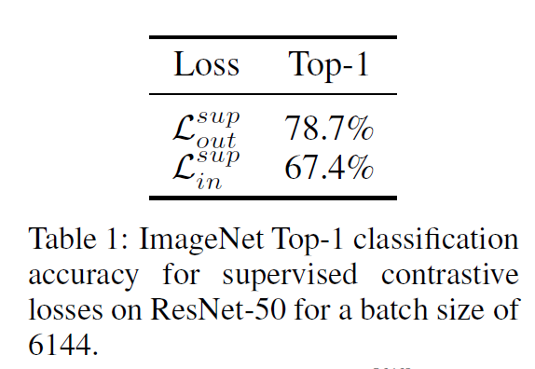
Comparison of the two function
The two loss formulations are not, however, equivalent

Slide 8
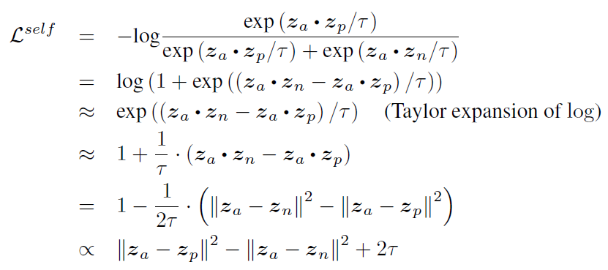
Connection to Triplet Loss and N-pairs Loss
Triplet loss is a special case of the contrastive loss when one positive and one negative are used.
When more than one negative is used, the SupCon loss becomes equivalent to the N-pairs loss.

Slide 9
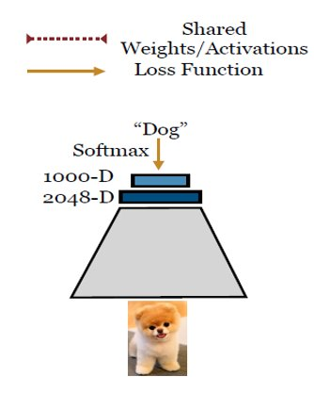
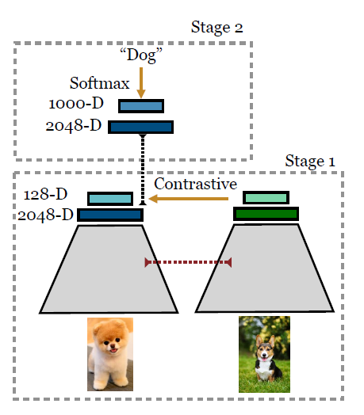
Comparison of Methodology
A) Supervised Cross Entropy B) Supervised Contrastive

Slide 10
Methodology
Given an input batch of data:
apply data augmentation to obtain two copies of the batch.
Both copies are forward propagated through the encoder network to obtain a 2048-dimensional normalized embedding.
During training, this representation is further propagated through a projection network that is discarded at inference time.
The supervised contrastive loss is computed on the outputs of the projection network.
To use the trained model for classification, we train a linear classifier on top of the frozen representations using a cross-entropy loss.

Slide 11
Our Results
Followings are the results of our work
Training Accuracy | Validation Accuracy | Testing Accuracy | Loss Function
95.83 | 95.77 | 70.62 | Supervised Contrastive Loss
97.51 | 67.48 | 67.07 | Cross Entropy Loss

Slide 12
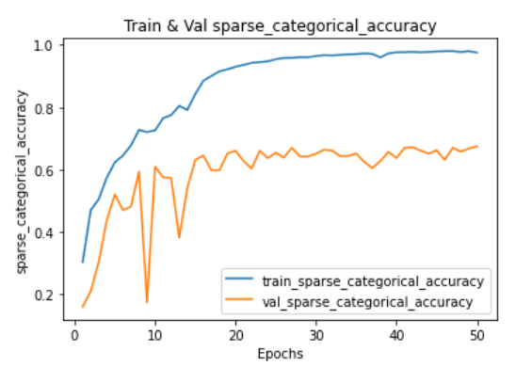
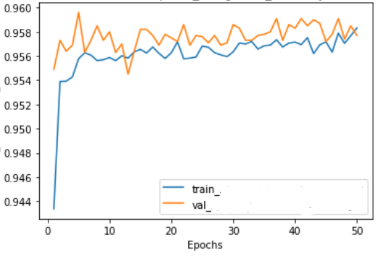
Training and Validation Accuracy Comparison
12
A) Using cross entropy loss B)Using Supervised Contrastive loss

Slide 13
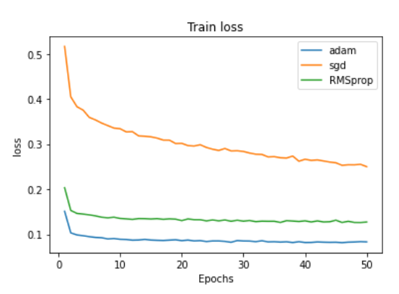
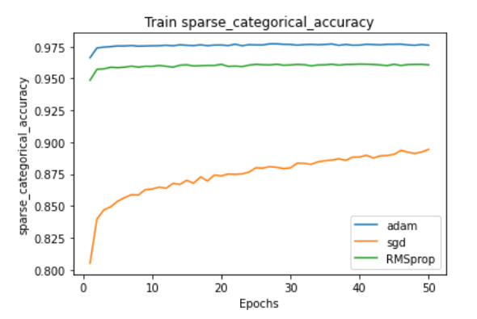
Classifier Accuracy and Loss for Different optimizers

Slide 14
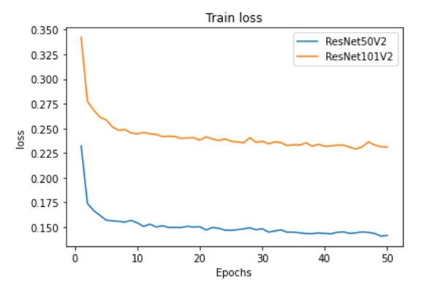
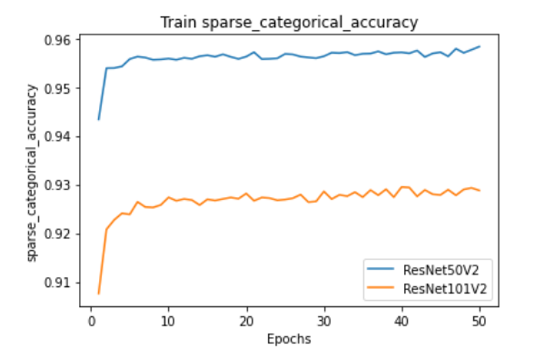
Classifier Accuracy and Loss for different Resnet model
14

Slide 15
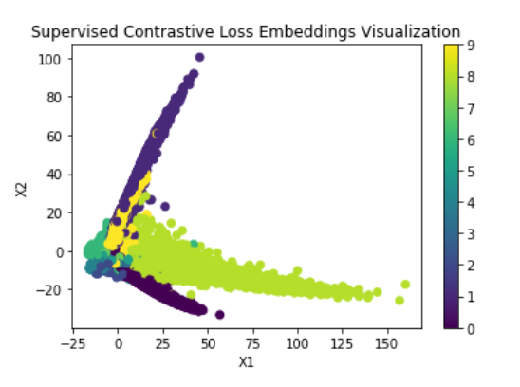
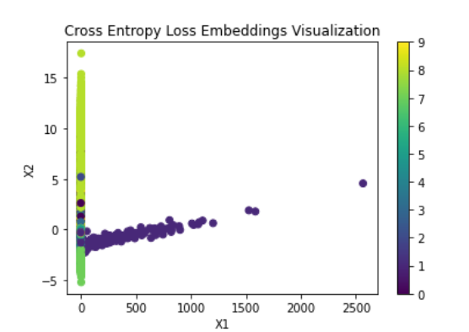
Embedding visualization using PCA
15
It is expected that the embedding trained using supervised contrastive loss will be much more clustered than the embedding trained using regular cross-entropy.

