Slide 1

SMART INDIA HACKATHON 2026
TITLE PAGE
Problem Statement ID – SIH26028
Problem Statement- Title-Dynamic Forecast of Expected
Time of Arrival (ETA) for Coaching Trains
Theme- Smart Automation
PS Category- Software
Team ID-
Team Name - AutoNeX

Slide 2

IDEA TITLE
AutoNex
Proposed Solution
1. LIVE TRACK HEALTH MONITORING
• Vibration sensors, rail temperature sensors, laser gauge width and ultrasonic flaw detectors continuously monitor the track.
• Live sensor readings are compared with healthy-track baseline data to detect structural drift, cracks or abnormalities.
Rail Safety Monitoring System
Yes
Proceed
2. AI-BASED EARLY WARNING
• Detects abnormal track behaviour before it becomes a critical failure.
• Instantly sends alerts to the concerned railway control / maintenance team.
Local train proceeds
safely.
3. REAL-TIME SCENARIO ENGINE
• Uses train speed, distance, emergency braking capability,
track conditions and live kinematics.
• Evaluates multiple real-time scenarios to decide the safest possible train movement.
Live Sensor
Baseline
Scenario Engine
Safety Gap?
Inputs
Comparison
Calculate
Compare live data
kinematics using
Determine if
Vibration,
against healthy
speed, weather, and
safe gap is
temperature, gauge,
track baseline.
braking.
available.
and ultrasonic data.
4. CASCADING DELAY REDUCTION
• Instead of holding a local train for 30-40 minutes for a superfast train, Kavach checks the actual safety gap.
• If safe gap is available → local train proceeds safely →
up to 35 minutes delay saved.
Hold & Re-
No
evaluate
Stop train and re-
evaluate conditions.
5. DYNAMIC SPEED OPTIMIZATION
• When track condition, weather and operational factors are clear, system recommends / allows higher permissible speeds.
• Ensures trains do not run unnecessarily slow and operations remain efficient.
Optimize Speed
Increase speed if
conditions are
Optimal
optimal.

Slide 3
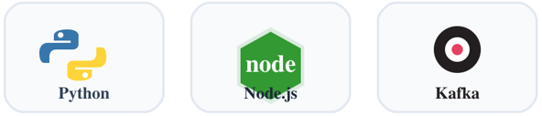
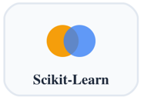
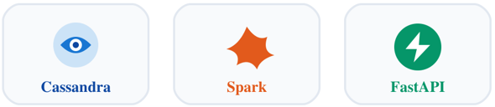
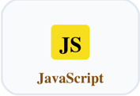
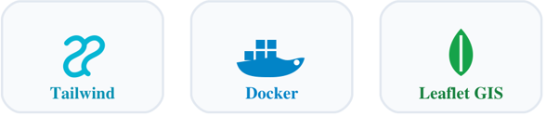
TECHNICAL APPROACH
AutoNex
•IoT & Telemetry: GPS, RFID, Axle Counters, Tachometers & Sensors
•Big Data: Kafka, Flink & Spark
•AI/ML: Scikit-Learn, Gemini RAG, ChromaDB & RDSO Rulebook Engine
•Backend: Node.js, ExpressJS, FastAPI, Cassandra & WebSockets
•Frontend: HTML5, Tailwind CSS, JavaScript, Leaflet.js & Chart.js
•APIs & Cloud: CRIS, NTES, Weather APIs, Docker & Grafana
Technology Stack for Transportation Management
APIs & Cloud
IoT & Telemetry
CRIS
GPS
NTES
RFID
Weather APIs
Axle Counters
Docker
Tachometers
Grafana
Sensors
Frontend
HTML5
Big Data
Tailwind CSS
Technology Stack
Kafka
JavaScript
Flink
Leaflet.js
Spark
Chart.js
Backend
AI/ML
Node.js
Scikit-Learn
ExpressJS
Gemini RAG
FastAPI
ChromaDB
Cassandra
RDSO Rulebook
WebSockets
Engine

Slide 4
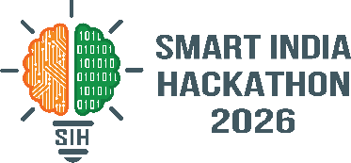
FEASIBILITY AND VIABILITY
Autonex
FEASIBILITY
VIABILITY
• Uses Existing Hardware: Connects directly to field-tested sensors and track relays—no new hardware to build.
• Easy API Integration: Plugs right into Indian Railways' legacy software (COA/FOIS) using standard APIs.
• Proven Tech Stack: Built on established AI and physics models, eliminating core R&D risks.
• Safe Testing: Deploys in "shadow mode" alongside human controllers without disrupting live operations.
• Low CapEx, High ROI: Cheap to deploy because infrastructure exists; saves millions in delay costs.
• Scalable Architecture: Modular software easily expands from one division to all 68 railway zones.
• Government Aligned: Fits directly into the Ministry’s National Rail Plan 2030 digital mandate.

Slide 5
IMPACT AND BENEFITS
AutoNex
BENEFITS
More Control | More Efficiency | Greater Value
1. SAFETY ENHANCEMENT
Early fault detection and instant alerts.
Helps prevent derailments and major accidents.
Result: Fewer risks, safer lives.
2. DELAY REDUCTION
Smarter train movement planning.
Avoids unnecessary holding of trains.
Potentially saves up to 35+ minutes per train in critical cases.
3. OPERATIONAL EFFICIENCY
Dynamic speed optimization.
Better utilization of tracks, trains and resources.
Result: Higher capacity and better network utilization.
4. COST SAVINGS
Less damage and repair cost.
Reduced delay-related operational losses.
Result: Lower maintenance and operational expenses.
5. ENVIRONMENTAL SUSTAINABILITY
Smoother operations and less fuel wastage.
Lower carbon footprint.
Result: Cleaner and greener railway operations.
6. STRONGER NATIONAL GROWTH
Improved logistics and supply-chain efficiency.
Supports tourism, trade and regional development.
Result: A more connected and prosperous India.
IMPACT
Creating a Safer, Smarter and More Reliable Railway Network
1. ON PASSENGERS
Safer journeys with reduced risk of accidents.
On-time arrivals and fewer unexpected delays.
Better travel experience with improved reliability.
2. ON RAILWAYS
Reduced delay losses and better operational efficiency.
Optimized resource utilization — tracks, trains and manpower.
Lower maintenance cost through early fault detection.
3. FOR SOCIETY
Stronger connectivity across cities and regions.
Increased economic activity and job opportunities.
Improved trust in public transport and national infrastructure.
4. FOR ENVIRONMENT
Lower fuel consumption through smoother operations.
Reduced carbon emissions from fewer delays and idle time.
Supports a greener and sustainable transport system.
KEY IMPACT:
Safer People | On-Time India | Stronger Economy | Greener Tomorrow

Slide 6
RESEARCH AND REFERENCES
AutoNex
1. AI, Machine Learning & RAG Models
Google Gemini (1.5 Flash) API
Used for Generative AI, Cab Directives and autonomous decision-making reasoning.
Reference: https://ai.google.dev/
Scikit-Learn (Random Forest & XGBoost)
Used in the Colab scripts for Track Structural Defect Classification and Dispatch Optimization.
Reference: https://scikit-learn.org/stable/
ChromaDB / Vector Database Concept
Utilized for building the Knowledge Base (RAG store) for Railway Statutory Rules.
Reference: https://www.trychroma.com/
3. Third-Party APIs for Telemetry & Dashboarding
Mappls API (MapmyIndia)
Integrated for accurate Indian geographical routing and map visualization.
Reference: https://about.mappls.com/api/
Mapbox API
Used for dynamic and interactive web mapping in the frontend dashboard.
Reference: https://www.mapbox.com/
OpenWeatherMap API
Fetched weather conditions (like dense fog) for the dynamic physics and scenario engine.
Reference: https://openweathermap.org/api
.
4. Backend Frameworks & UI Technologies
FastAPI & Uvicorn
Used for creating the high-performance, concurrent Python REST APIs for the KAVACH backend.
Reference: https://fastapi.tiangolo.com/
Grafana
Utilized for building the real-time Control Room TV Dashboard monitoring.
Reference: https://grafana.com/
TailwindCSS
Implemented for modern, responsive frontend styling.
Reference: https://tailwindcss.com/
5. Indian Railways Statutory Research & Domain References
RDSO Guidelines & Manuals
Research Designs & Standards Organisation manuals for Ultrasonic Flaw Detection (USFD) and Track monitoring.
Reference: https://rdso.indianrailways.gov.in/
IRPWM & G&SR Rulebooks
Indian Railways Permanent Way Manual and General & Subsidiary Rules implemented within the Deterministic Physics Engine.
2. Big Data & Real-Time Data Streaming (Dockerized Microservices)
Apache Kafka & ZooKeeper
Implemented as the high-speed telemetry ingestion engine and central message broker.
Reference: https://kafka.apache.org/
Apache Spark & Apache Flink
Used for real-time stream processing, complex event processing, and big data analytics.
References: https://spark.apache.org/ | https://flink.apache.org/
Apache Cassandra
Employed as the NoSQL storage database for handling large-scale railway telemetry data.
Reference: https://cassandra.apache.org/
Docker
Used for containerizing the entire environment to ensure seamless deployment and scalability.
Reference: https://www.docker.com/

