Slide 1

Analyzing Sequential vs. Parallel Computing Approaches for Futoshiki Puzzle Solutions Presented By: Sourav Raxit Padam Jung Thapa Abhishek Khatri sraxit@uno.edu pthapa@uno.edu akhatri@uno.edu
CSCI 6454:Parallel and Scientific Computing

Slide 2
Introduction
Futoshiki: Futoshiki is a Japanese logic puzzle played on a square grid. The word "Futoshiki" translates to "unequal" in Japanese, which reflects the core mechanic of the puzzle.
Project Goal:Compare sequential and parallel solving approaches for Futoshiki Puzzle

Slide 3
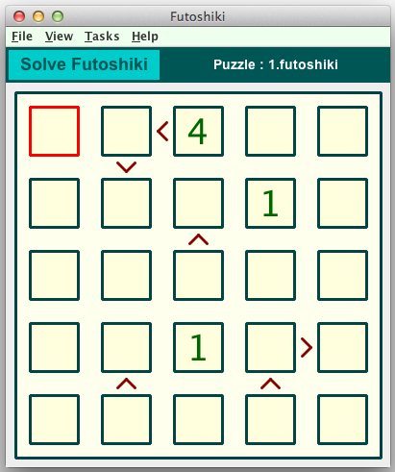
Futoshiki Basics
Grid-based puzzle with numbers and inequality constraints
Objective: Fill the grid while satisfying all constraints
Example of a 5x5 Futoshiki puzzle

Slide 4
Basic Components of Futoshiki
Square grid layout (commonly 5×5)
Numbers 1 through N (where N is grid size)
Inequality symbols (< and >) between cells
Some pre-filled numbers as starting clues

Slide 5
Core Rules of Futoshiki
Fill the grid with numbers 1 to N (N = grid size)
Each row and column must contain unique numbers
Satisfy inequality signs between adjacent cells
No guessing allowed; use logic to deduce placements

Slide 6
Solving Process Overview
Initialize the grid with given numbers
Apply logical deductions based on rules
Use advanced techniques for complex situations
Repeat until the puzzle is solved or unsolvable

Slide 7
Flow Chart of Futoshiki Puzzle
Start
Input Puzzle
Is Puzzle Solved?
Yes
Output:Solution
End
No
Find Candidate Cell
For each possible value in the cell
Temporarily fill cell with value
Check Constraints
Violations?
Yes
Try next value
No
Solve Recursively
Backtrack if no values work
Output: Solution or "No solution"
End

Slide 8
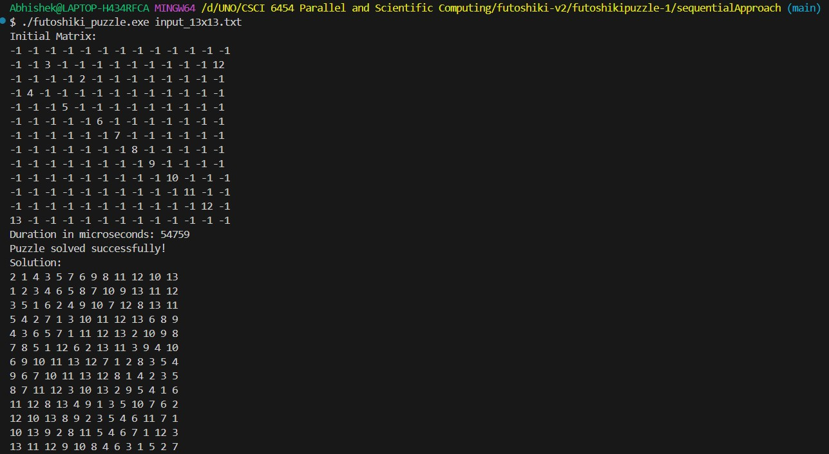
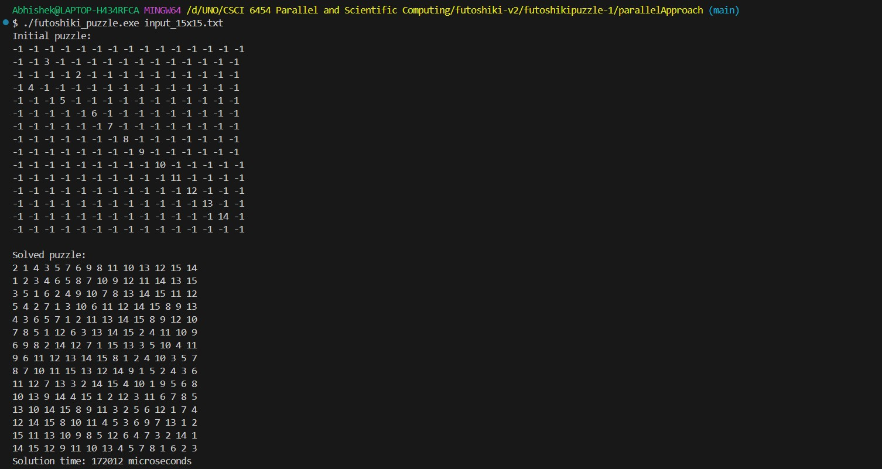
Outputs:

Slide 9
Sequential Approach
Implementation:
Uses a backtracking algorithm with constraint checking
Utilizes object-oriented design with separate classes for Matrix, Constraint, and Solver
Advantages:
Simple to implement and understand
Guaranteed to find a solution if one exists
Suitable for smaller puzzles

Slide 10
Sequential Algorithm Steps
Initialize the puzzle matrix from file input
Load inequality constraints from file
For each empty cell:
Try values from 1 to N (grid size)
Check if the value satisfies:
Row uniqueness
Column uniqueness
All inequality constraints
If valid, recursively solve the rest of the puzzle
If invalid or no solution found, backtrack
Repeat step 3 until the puzzle is solved or all possibilities are exhausted

Slide 11
Parallel Approach with OpenMP
Implementation:
Utilizes OpenMP for shared memory multiprocessing
Parallelizes the recursive solving algorithm
Advantages:
Leverages multi-core processors
Potential for significant speedup on larger puzzles

Slide 12
Parallel Algorithm Overview
Initial setup and puzzle reading (sequential)
Parallel recursive solving:
Multiple threads explore different solution paths simultaneously
Use of task-based parallelism for dynamic workload distribution
Synchronization to check if a solution is found
Backtracking when necessary
Repeat until solved or all possibilities exhausted

Slide 13
OpenMP Implementation Details
Use of #pragma omp parallel to create a team of threads
#pragma omp single to initiate the recursive solving process
#pragma omp task for dynamic creation of parallel tasks
#pragma omp critical for updating shared flag when solution is found
Careful handling of shared matrix and private recursive function variables

Slide 14
Analysis Results: Sequential Approach
Testing of grid sizes from 3x3 to 18x18 using sequential approach.
Execution time trend: as the grid size increases, execution time generally increases.
Grid Size | 1st Trial (µS) | 2nd Trial (µS) | 3rd Trial (µS) | 4th Trial (µS) | 5th Trial (µS) | 6th Trial (µS) | Average (µS)
3*3 | 25 | 26 | 25 | 25 | 27 | 25 | 25.500
4*4 | 28 | 28 | 26 | 28 | 27 | 32 | 28.167
5*5 | 69 | 52 | 59 | 51 | 52 | 60 | 57.167
6*6 | 99 | 126 | 99 | 100 | 98 | 100 | 103.667
7*7 | 197 | 200 | 201 | 200 | 199 | 198 | 199.167
8*8 | 266 | 267 | 267 | 269 | 269 | 275 | 268.833
9*9 | 600 | 703 | 710 | 589 | 590 | 590 | 630.333
10*10 | 2363 | 2362 | 2370 | 2463 | 2348 | 2395 | 2383.500
11*11 | 13740 | 13560 | 13510 | 13596 | 13910 | 13864 | 13696.667
12*12 | 31524 | 33045 | 31686 | 30330 | 29252 | 29571 | 30901.33
13*13 | 53853 | 48826 | 48881 | 54270 | 52504 | 49366 | 51283.33
14*14 | 179101 | 163694 | 171184 | 162652 | 158784 | 161026 | 166073.50
15*15 | 1066239 | 1076347 | 1083707 | 1173863 | 1076398 | 1062886 | 1089906.67
16*16 | 4004203 | 4229001 | 4159062 | 4192158 | 4179283 | 4302343 | 4177675
17*17 | 38926833 | 40011021 | 39338582 | 38983721 | 40296064 | 39273399 | 39471603.33
18*18 | 43192337 | 43106604 | 43040419 | 43009233 | 43364223 | 43304238 | 43169509

Slide 15
Parallel Approach
Grid Size | 1st Trial (µS) | 2nd Trial (µS) | 3rd Trial (µS) | 4th Trial (µS) | 5th Trial (µS) | 6th Trial (µS) | Average (µS)
9*9 | 1127 | 1017 | 1181 | 1278 | 871 | 1055 | 1088.17
10*10 | 1393 | 2710 | 1588 | 2062 | 2377 | 2541 | 2111.83
11*11 | 4025 | 3495 | 8941 | 9244 | 3859 | 5774 | 5889.67
12*12 | 86864 | 138383 | 90654 | 88007 | 49431 | 87608 | 90157.83
13*13 | 9586 | 10969 | 10900 | 14982 | 9679 | 16396 | 12085.33
14*14 | 47024 | 44585 | 43180 | 31580 | 47774 | 30471 | 40769
15*15 | 257184 | 179477 | 173097 | 180050 | 176385 | 258639 | 204138.67
16*16 | 839515 | 753703 | 696370 | 729869 | 680934 | 883445 | 763972.67
17*17 | 6252646 | 6405129 | 6300495 | 6354036 | 6968059 | 6367269 | 6441272.33
18*18 | 7466500 | 7476412 | 7712529 | 7162431 | 7274402 | 7160660 | 7375489
Testing of grid sizes from 9x9 to 18x18 using parallel approach.
Execution time trend: as the grid size increases, execution time generally increases but the performance is better than sequential approach.

Slide 16
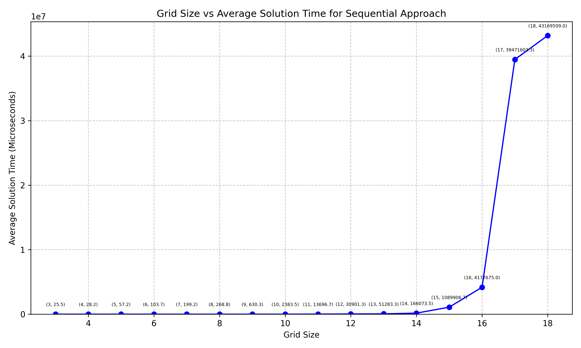
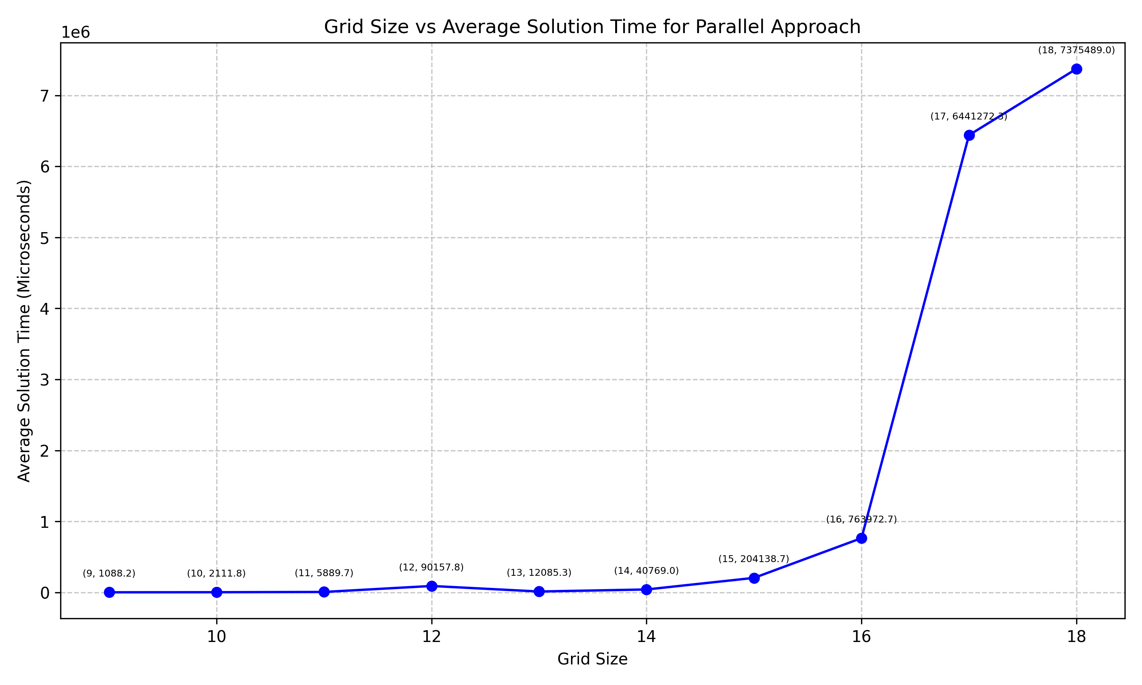
Benchmark Results

Slide 17

Performance Comparison
Grid Size | Sequential (µs) | Parallel (µs) | Speedup Factor
9x9 | 630.333 | 1,088.17 | 0.58x
10x10 | 2,383.500 | 2,111.83 | 1.13x
11x11 | 13,696.667 | 5,889.67 | 2.33x
12x12 | 30,901.33 | 90,157.83 | 0.34x
13x13 | 51,283.33 | 12,085.33 | 4.24x
14x14 | 166,073.50 | 40,769.00 | 4.07x
15x15 | 1,089,906.67 | 204,138.67 | 5.34x
16x16 | 4,177,675.00 | 763,972.67 | 5.47x
17x17 | 39,471,603.33 | 6,441,272.33 | 6.13x
18x18 | 43,169,509.00 | 7,375,489.00 | 5.85x
Performance metric being used: execution time taken to solve the puzzle.
Speed up factor: Calculation is done by taking dividend of execution time of sequential over parallel approach for a particular grid-sized Futoshiki puzzle.
Speedup factor $=\frac{Sequential Execution Time}{Parallel Execution Time}$

Slide 18
Key Insights:
Speedup Factor
Performance Crossover
Maximum Speedup
Anomaly
Scalability
Notes:
Speedup factor: being calculated by dividing the sequential execution time by the parallel execution time
Performance Crossover: Parallel approach is more efficient than the sequential approach when the grid size increases especially when the grid size is greater than 10x10.
Highest speed is when calculating the grid size for 17x17 where the speedup factor is 6.13 times faster than sequential approach.
Anomaly: Unexpected anomaly seen in the 12x12 grid size. Reason: Complexity in the grid size or overheaded multithreading.
Scalability: as the grid size increases, better scalability is shown in the parallel approach, with more significant speedups for larger grids.

Slide 19
Conclusion and Future Work
Sequential approach: Ideal for smaller puzzles and simpler implementations
Parallel approach: Beneficial for larger, more complex Futoshiki puzzles
Future work:
Optimize parallel algorithm for even better performance
Explore GPU acceleration for massive parallelism
Investigate hybrid CPU-GPU approaches for optimal solving

Slide 20
Thank you! Any Queries?

