Slide 1

Department of Artificial Intelligence and Machine Learning
Mini Project
Personalized Exam Question Difficulty Predictor
By P. Dheeraj

Slide 2
Problem Statement
In traditional examination systems, question difficulty is fixed and does not adapt to individual student performance. This leads to:
Some students finding exams too easy
Others finding them too difficult
Ineffective evaluation of knowledge
An automated system is needed to classify question difficulty as:
Easy 😊
Medium ⚖️
Hard 🔥

Slide 3
Objectives
To analyze student performance using Machine Learning
To classify question difficulty (Easy / Medium / Hard)
To preprocess and structure dataset features
To build predictive models
To compare Logistic Regression vs Random Forest
To evaluate model accuracy and performance

Slide 4
Literature Survey
Machine Learning is widely used in:
Educational data mining
Adaptive learning systems
Common techniques:
Logistic Regression
Random Forest
Decision Trees
SVM
Key findings:
Performance data improves prediction accuracy
Ensemble models (Random Forest) handle complex patterns better

Slide 5
Proposed System Overview
Input:
Student performance data (time, score, attempts, accuracy)
Process:
Data preprocessing
Feature extraction
Model training
Prediction
Output:
Difficulty classification (Easy / Medium / Hard)

Slide 6
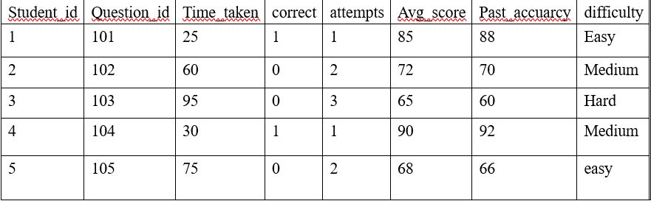
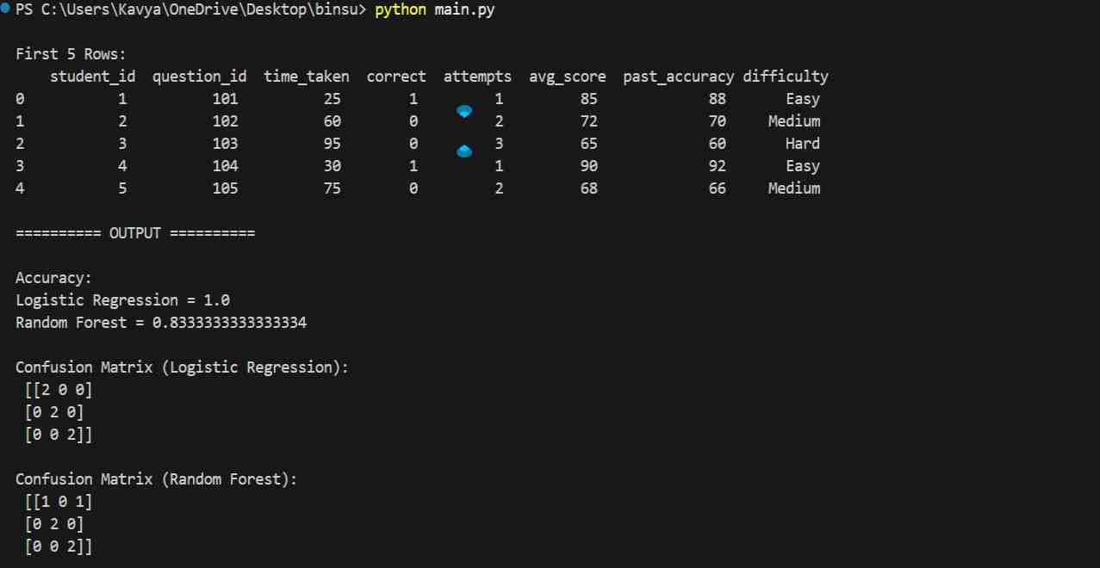
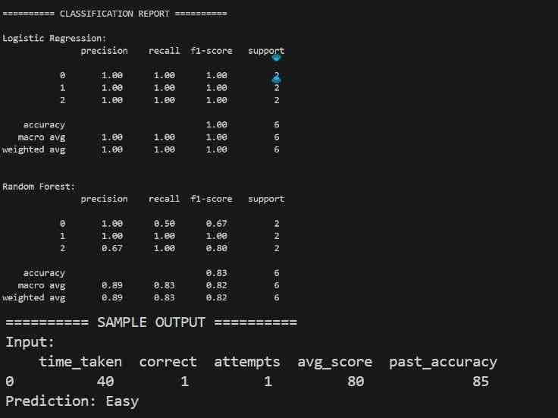
Dataset Details
Dataset used: student_question_data.csv
https://www.kaggle.com/datasets/dheerajpadarthi/personalized-exam-question-difficulty-dataset

Slide 7
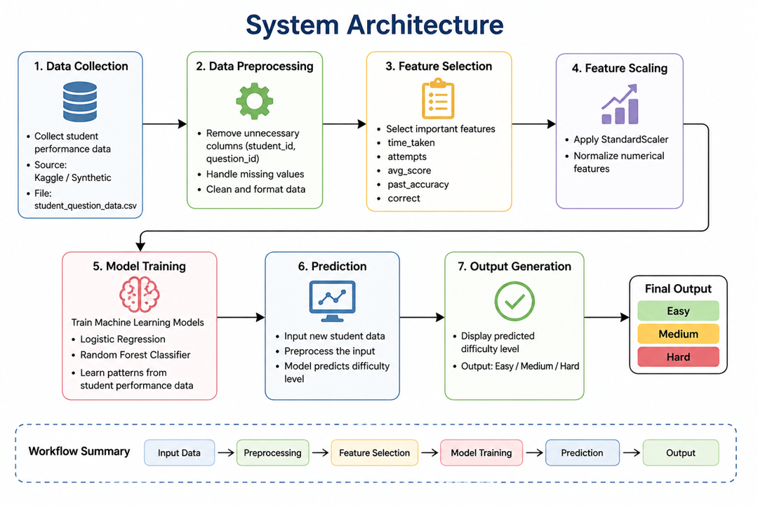
System Architecture
• Data Collection
• Collect student performance dataset from Kaggle / synthetic sources
• Data Preprocessing
• Remove unnecessary columns (student_id, question_id)
• Handle missing values (if any)
• Normalize and scale numerical features
• Feature Selection
• Select important features: time_taken, attempts, avg_score, past_accuracy, correct
• Feature Scaling
• Apply StandardScaler to normalize data
• Model Training
• Train Logistic Regression model
• Train Random Forest model
• Learn patterns from student performance
• Prediction
• Input new student data
• Model predicts difficulty level
• Output Generation
• Display result as Easy / Medium / Hard

Slide 8
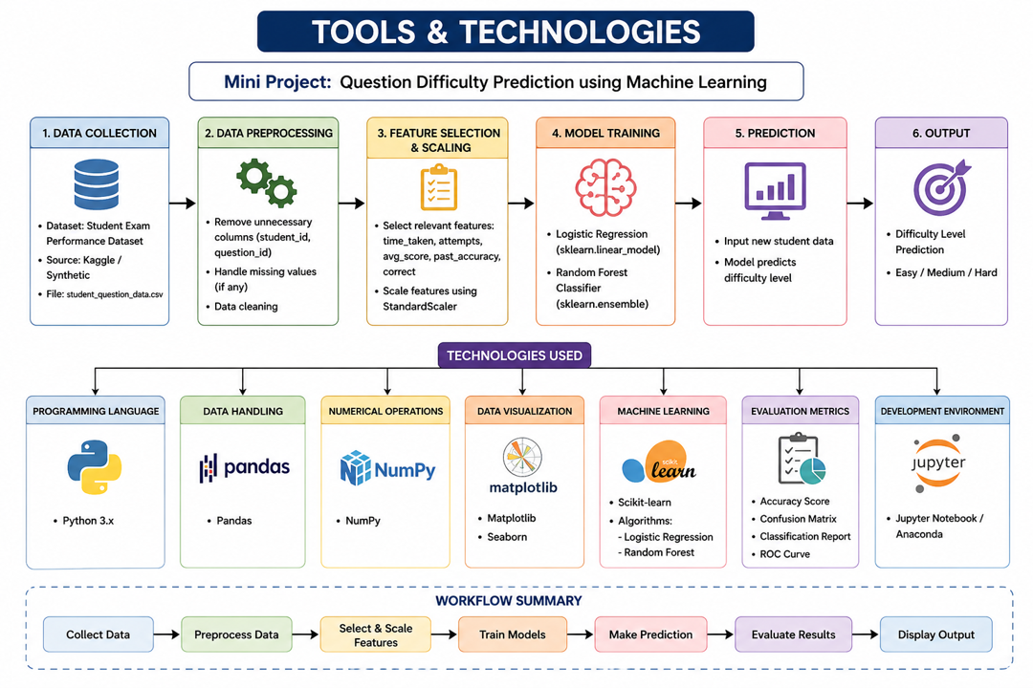
Tools & Technologies

Slide 9
Sample Input & Output
• Input student performance data • Time Taken: 40 • Correct Attempts: 1 • Total Attempts: 1 • Average Score: 80 • Past Accuracy: 85
• Predicted Difficulty Level: Easy
• Input student performance data
• Time Taken: 85
• Correct Attempts: 0
• Total Attempts: 3
• Average Score: 60
• Past Accuracy: 58
• Predicted Difficulty Level: Hard

Slide 10
References
• Kaggle Dataset – Student Exam Performance Dataset
https://www.kaggle.com/datasets/dheerajpadarthi/personalized-exam-questiondifficulty-dataset
• Scikit-learn Documentation – Machine Learning in Python
https://scikit-learn.org/stable/
• Python Official Documentation https://docs.python.org/3/
• Git hub link – https://github.com/padarthidheerajstack/exam-difficulty-predictor
• Pattern Recognition and Machine Learning – Christopher M. Bishop
https://www.oreilly.com/library/view/hands-on-machinelearning/9781492032632/
• UCI Machine Learning Repositoryhttps://archive.ics.uci.edu/ml/index.php

Slide 11
Thank You

