Slide 1

Intra-Class Similarity Guided Feature Distillation: Motivation
Khouloud Saadi
Chair of Data Science, University of Passau, Germany

Slide 2
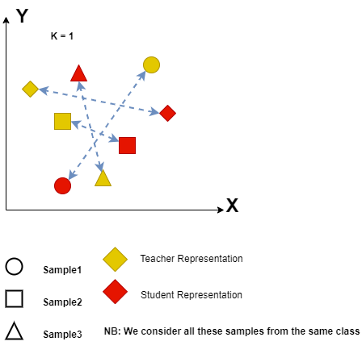
Motivation
In feature distillation, previous work mainly applied an exact matching between the hidden representations of the student and the teacher [1- 2].
As the student has a lower capacity compared to the teacher, it may struggle to mimic its exact hidden representations.

Slide 3
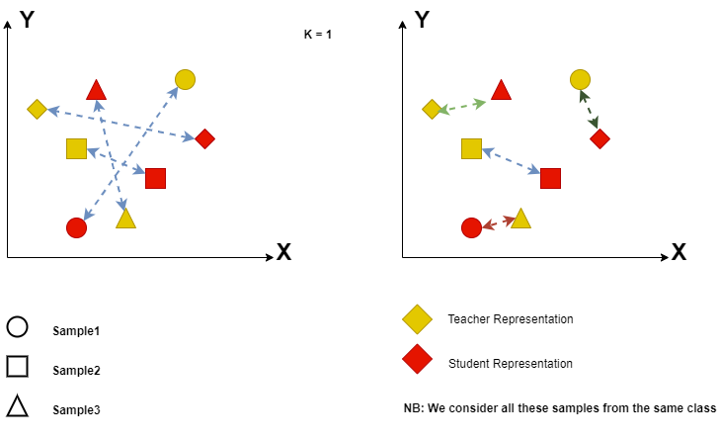
Proposed Approach
We propose a new mapping between the student and teacher hidden representations, where we match each student’s sample representation with its K nearest neighbor teacher’s samples representations that are within the same class.

Slide 4
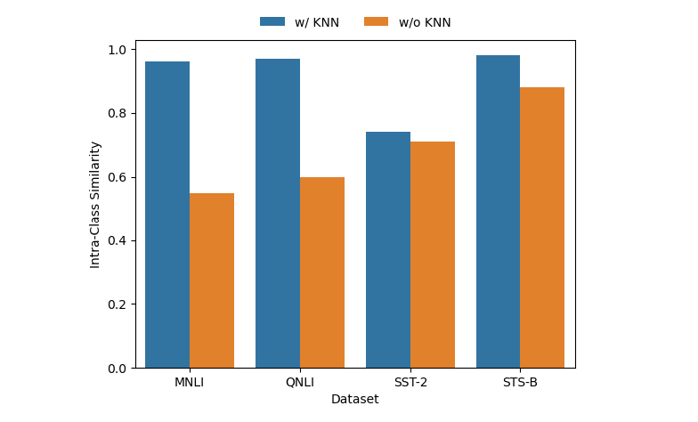
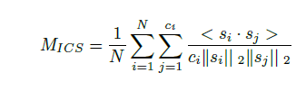
Results
We compute the M_{ICS} (Intra-Class Cosine Similarity).
more compact class embedding.

Slide 5
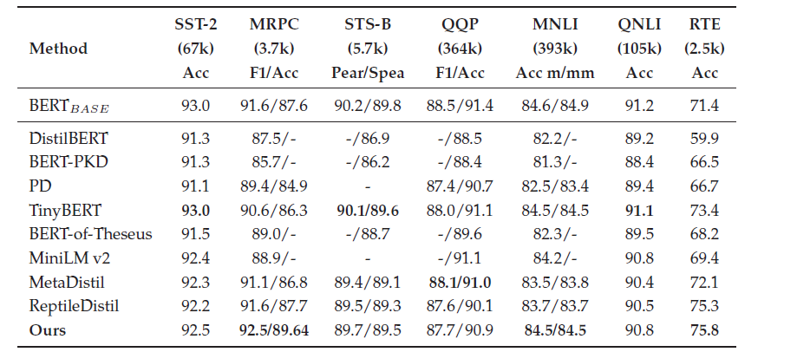
Results

Slide 6
Conclusion and Links
We introduced a new mapping between the hidden representations of the teacher and the student, where each sample representation by the student is mapped to its K nearest neighbors representations by the teacher.
Our approach makes the task easier for the student and helps it to learn more compact samples representations.
Several experiments proved the effectiveness and consistency of our method. It is also worth mentioning that our approach can be added to any KD method in NLP or vision.
Paper Reference: Saadi K., Mitrovic J., and Granitzer M.: ”Intra-Class Similarity-Guided Feature Distillation. ”NeurIPS workshop on Efficient Natural Language and Speech Processing (2023).
Paper Link: https://neurips2023-enlsp.github.io/papers/paper_27.pdf

Slide 7
Intra-Class Similarity Guided Feature Distillation: Motivation
Khouloud Saadi
Chair of Data Science, University of Passau, Germany

