Slide 1


Learn From One Specialized Sub-Teacher: One-to-One Mapping for Feature-Based Knowledge Distillation
Khouloud Saadi¹, Jelena Mitrovic¹, Michael Granitzer¹
¹ University of Passau, CAROLL Research Group, Chair of Data Science, Germany
Khouloud Saadi
@ EMNLP-Findings 2023

Slide 2
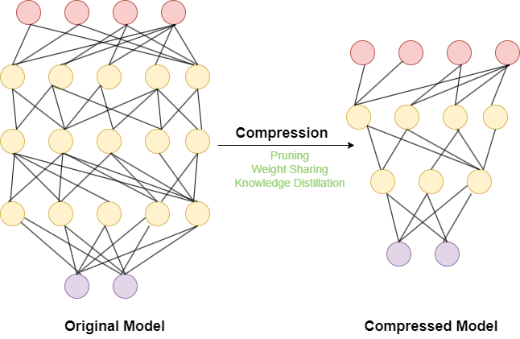
Motivation: What is Model Compression in ML?
Figure 1: Model Compression

Slide 3
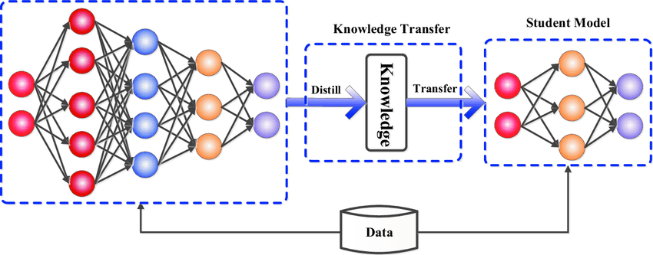
Motivation: What is Knowledge Distillation?
Figure 1: Knowledge Distillation Framework [Gou et al., 2021]

Slide 4
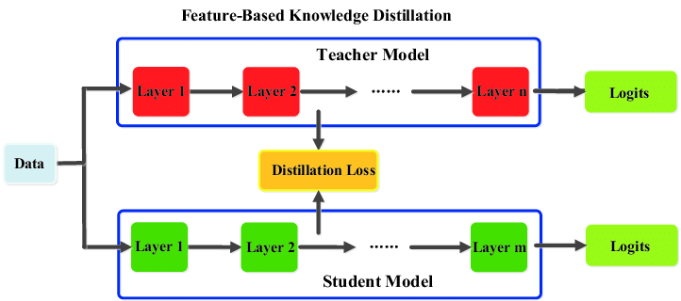
Motivation: What is Feature Distillation?
Figure 3: Feature Distillation[Gou et al., 2021]

Slide 5
Existing Work For Features Distillation
Global Distillation
In [1][2][3], The layer distillation task is tackled as a global task between the teacher-student layers.
Used Loss: MSE or Cosine Distance
In [1], the cosine distance is used as objective function to reduce the gap between the global layer representations of the student and the teacher.
In [2][3], the MSE is used instead.
MSE is sensitive to scale and high dimensionality[4][5].
Cosine distance is sensitive to permutation and high dimensionality[6].

Slide 6
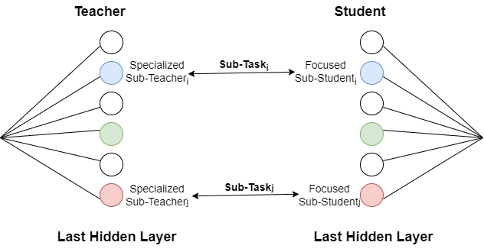
Proposed Approach
One-to-One Mapping Feature Distillation
Local Distillation Instead of Global Distillation
Figure 4: Local Distillation

Slide 7
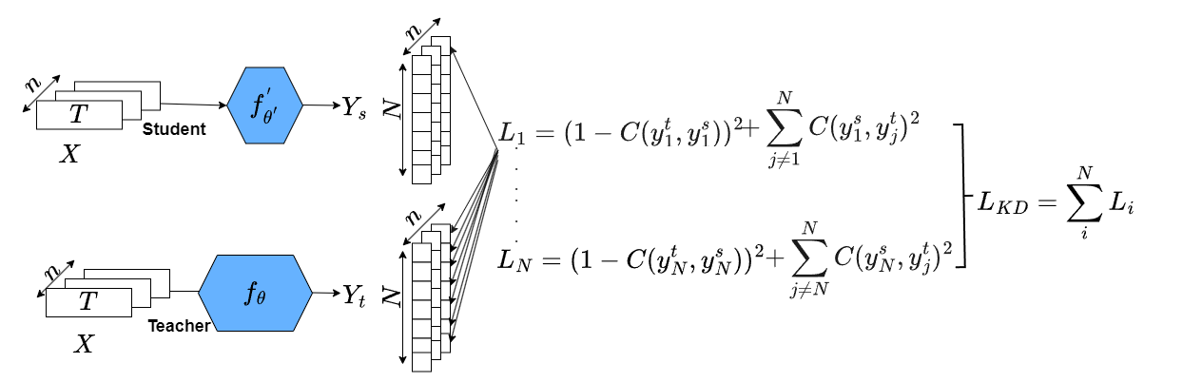
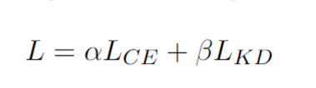
Proposed Approach
One-to-One Mapping Feature Distillation
Per-Batch Correlation Loss instead of MSE or Cosine Distance
Final Training Loss for the Student:

Slide 8
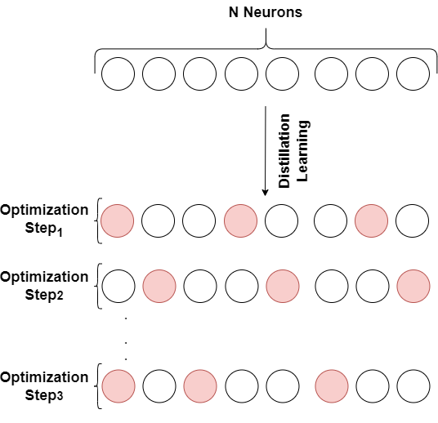
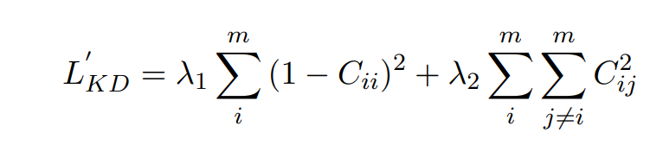
Proposed Approach
Masked One-to-One Mapping
Learn a subset of sub-tasks each step

Slide 9
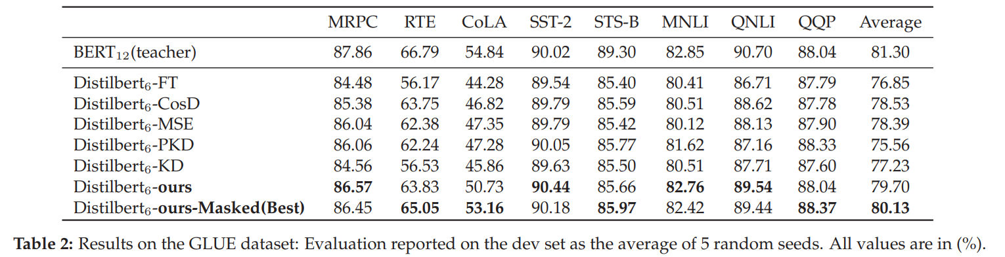
Comparing With Competing Method

Slide 10
Conclusion
We reformulated the global feature distillation problem into N local sub-problems.
We proposed a one-to-one matching between each neuron in the last hidden layer of the teacher, i.e., specialized sub-teacher, and each neuron in the last hidden layer of the student. i.e., focused sub-student.
To achieve this goal, we proposed a local correlation-based loss. Our approach only requires the teacher and the student to have the same last hidden layer size.
We proposed a randomized variant of our approach called Masked One-to-One Mapping where a subset of tasks learnt at each step.
Several experiments proved the effectiveness and consistency of our method. It is also worth mentioning that our approach can be added to any KD method in NLP or vision.
Future work includes exploring the same distillation process with several intermediate layers.

Slide 11
References
[1] Sanh, Victor and Debut, Lysandre and Chaumond, Julien and Wolf, Thomas. DistilBERT, a distilled version of BERT: Smaller, faster, cheaper and lighter. arXiv preprint arXiv:1910.01108, 2019.
[2] Jiao, Xiaoqi and Yin, Yichun and Shang, Lifeng and Jiang, Xin and Chen, Xiao and Li, Linlin and Wang, Fang and Liu, Qun. TinyBERT: Distilling BERT for Natural Language Understanding. In EMNLP, 2020.
[3] S. Sun and Yu Cheng and Zhe Gan and Jingjing Liu. Patient Knowledge Distillation for BERT Model Compression. In EMNLP, 2019.
[4] Khouloud Saadi and Muhammad Taimoor Khan. Effective prevention of semantic drift in continual deep learning. In IDEAL 2022.
[5] Houle, Michael E and Kriegel, Hans-Peter and Koger, Peer and Schubert, Erich and Zimek, Arthur. Can shared-neighbor distances defeat the curse of dimensionality? 22nd International Conference, SSDBM 2010, Heidelberg, Germany.
[6] Schutze, Hinrich and Manning, Christopher D and Raghavan, Prabhakar. Introduction to information retrieval. Cambridge University Press Cambridge 2008.

Slide 12
Learn From One Specialized Sub-Teacher: One-to-One Mapping for Feature-Based Knowledge Distillation
Khouloud Saadi¹, Jelena Mitrovic¹, Michael Granitzer¹
¹ University of Passau, CAROLL Research Group, Chair of Data Science, Germany
Khouloud Saadi
Khouloud.saadi@uni-passau.de
@ EMNLP-Findings 2023

