Slide 1
Flag hoisting using IoT
MINI PROJECT PHASE-1 PRESENTATION
by
Raja Babu Ray 1DS23EE074
Siddeshwar.M.S 1DS23EE100
Vardhan.M 1DS23EE117
Pradyumna.G.N 1DS23EE408
Department of Electrical and Electronics Engineering
Under the Guidance of
Dr. Soni M
Assistant professor
Dept. of E&E Engg.
DSCE, Bengaluru
DAYANANDA SAGAR COLLEGE OF ENGINEERING
1

Slide 2
Introduction/ Project overview
The concept of IoT-based flag hoisting emerges from the growing trend of automation and smart systems in public and institutional infrastructure. Traditionally, flag hoisting is a manual process carried out during ceremonies or daily routines in schools, government buildings, and military establishments. However, with the advancement of the Internet of Things (IoT), there is a push towards automating routine tasks to improve efficiency, reduce human effort, and enhance precision. IoT enables remote control, real-time monitoring, and scheduling through connected devices, making it ideal for applications like flag hoisting where timing and coordination are critical. The integration of sensors, microcontrollers, and wireless communication allows for safe, programmable, and user-friendly systems. This approach aligns with the broader movement towards smart governance and digital infrastructure, offering a modern solution to a traditional practice.
Importance
The IoT-based flag hoisting system is important as it automates a traditional task, ensuring timely, safe, and efficient operation. It reduces manual effort, allows remote control, and enhances reliability through real-time monitoring making it ideal for smart institutions and modern infrastructure.
DAYANANDA SAGAR COLLEGE OF ENGINEERING
2

Slide 3
Literature Review and Gap
[1]. G. Kaur, A. Saini (2020) - “IoT Based Smart Home Automation System”
This paper outlines how IoT can be used to remotely control home appliances using Wi-Fi-enabled microcontrollers. The use of Node MCU, sensors, and relay modules for real-time control demonstrates the feasibility of applying similar architecture for flag hoisting.
(International Journal of Scientific & Engineering Research, Vol. 11, Issue 6)
[2]. P. S. Kulkarni, A. B. Deshmukh (2019) - “IoT Based Automatic Gate Control System”
This work discusses the use of servo motors and limit switches to control gate operations through an IoT interface. The safety and accuracy techniques used are directly applicable to motorized flag hoisting systems.
(International Research Journal of Engineering and Technology, Vol. 6, Issue 4)
[3]. M. A. Khan, S. S. Rizvi (2018) - “Design and Implementation of an IoT Based Smart Irrigation System”
Their system uses sensors and microcontrollers to automate and schedule irrigation. The integration of RTC and automation logic mirrors the approach required for timed flag hoisting.
(IEEE International Conference on Advances in Computing and Communication Engineering)
DAYANANDA SAGAR COLLEGE OF ENGINEERING
3

Slide 4
Gap Analysis
Flag hoisting is traditionally a manual process, often prone to human error, delays, and non-compliance with official protocols. The integration of IoT can automate this task by using sensors, timers, and remote controls to ensure timely and precise flag hoisting and lowering. It allows real-time monitoring, reduces dependence on manual labor, and ensures adherence to flag codes. The gap lies in the lack of automation, monitoring, and smart control in current systems, which IoT can effectively bridge by offering reliable, efficient, and remote-controlled solutions.

Slide 5
Objectives
Automatic flag hoisting using IoT
Rain sensor using
To develop a motorized pulley system for raising and lowering the flag using a microcontroller (e.g., ESP32,)
To enable remote control and scheduling of the hoisting process through a mobile App using Bluetooth connectivity.
DAYANANDA SAGAR COLLEGE OF ENGINEERING
5

Slide 6
Problem Statement/ Motivation
The flag hoisting using IoT project addresses several key problems with the traditional flag hoisting process. Primarily, it solves the issue of manual dependency, where a person must be physically present to raise or lower the flag, which can be inconvenient or unsafe, especially on tall poles or during adverse weather conditions. It also addresses the lack of automation, which often leads to missed timings during important events or ceremonies. Furthermore, the project tackles security concerns, ensuring that only authorized individuals can control the hoisting mechanism. In many institutions, there is also a lack of status monitoring, making it difficult to know if the flag was properly hoisted or not. Lastly, the project reduces human error and brings efficiency, precision, and convenience to the flag hoisting process using modern IoT technology
DAYANANDA SAGAR COLLEGE OF ENGINEERING
6

Slide 7
Technologies and Tools Used
Software
For software, we have used Arduino for programming the esp32 dev v1 board which uses similar programming language of C++
Programming languages
We have used variant of the C++ programming language. The code is written in C++ with an addition of special methods and functions. Moreover, when we create a 'sketch' it is processed and compiled to machine language. Additionally, it is commonly used in projects involving robotics, home automation, and Internet of Things (IoT) applications.
Hardware
we have used universal motor which can be used for both AC and DC supplies to make our project convenient and flag pole, flag stand, flag, pullies are used.
Platforms/ Frameworks
We have used MIT app inventor for building the Bluetooth control app which is used to control the flag.
DAYANANDA SAGAR COLLEGE OF ENGINEERING
7

Slide 8
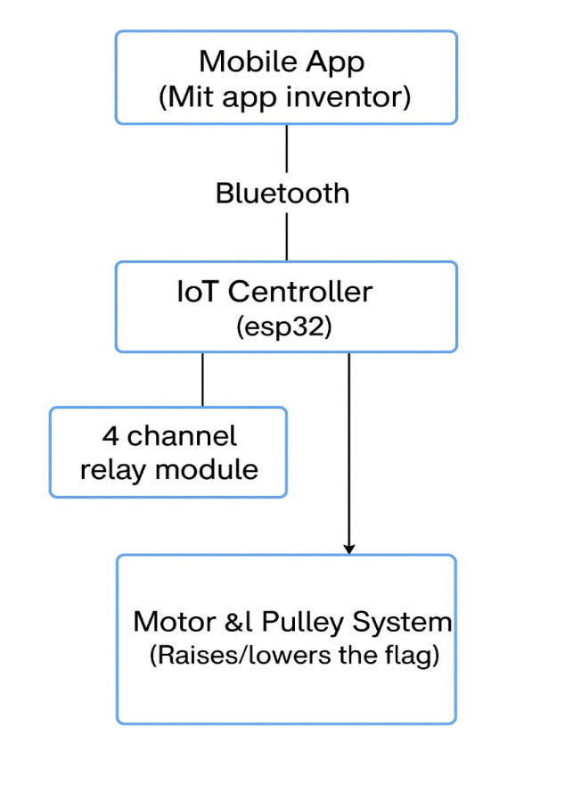
Block Diagram of the project
The block diagram of IoT-based flag hoisting typically includes the following components: a microcontroller (like ESP32) as the central unit, connected to a motor for raising/lowering the flag, a real-time clock (RTC) or scheduling module to trigger actions at specific times, and sensors (e.g., position or limit switches) to detect flag status. It also includes a Bluetooth or GSM module for remote monitoring and control, and a mobile app or web interface to set schedules or receive alerts. Power supply and safety mechanisms complete the system, ensuring reliable and automated flag operation.
DAYANANDA SAGAR COLLEGE OF ENGINEERING
8

Slide 9
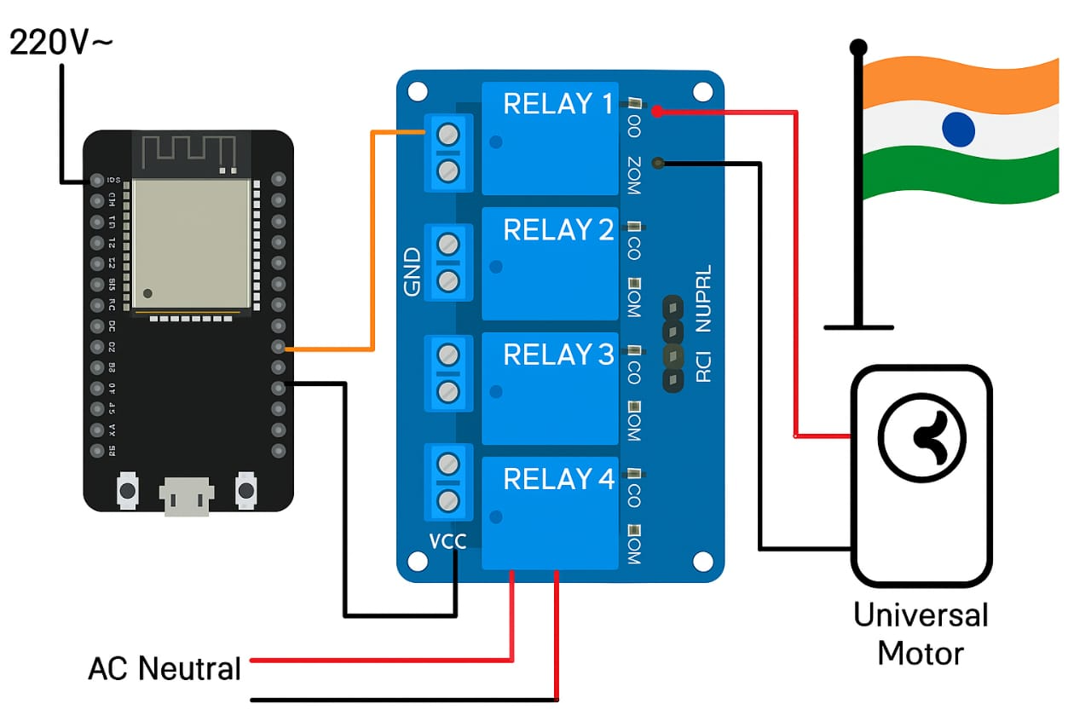
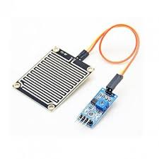
System Architecture
DAYANANDA SAGAR COLLEGE OF ENGINEERING
9

Slide 10
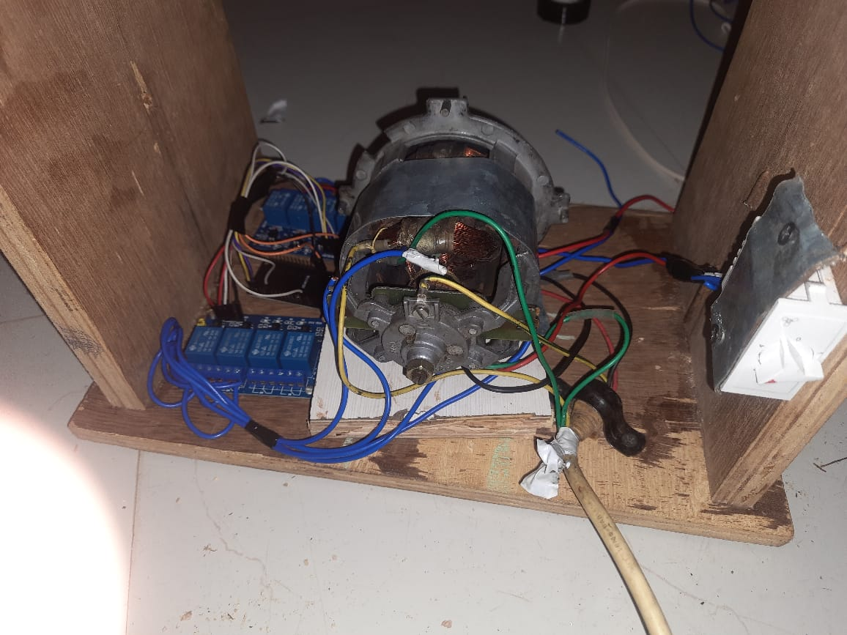
Snapshot of final model
Fig.1. Prototype of snapshot
DAYANANDA SAGAR COLLEGE OF ENGINEERING
10

Slide 11
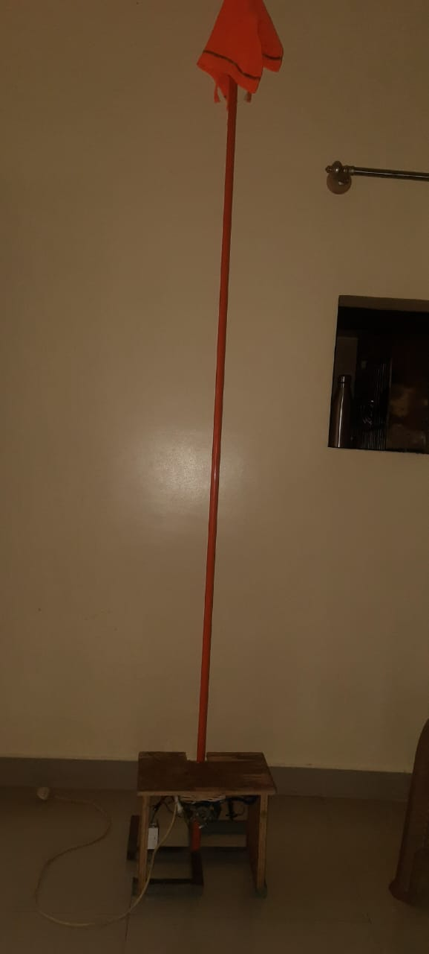
Results and Discussion
Fig.2 Prototype Snapshot
DAYANANDA SAGAR COLLEGE OF ENGINEERING
11

Slide 12

SDG (Sustainable Development Goal)
1. SDG 9 -Industry, Innovation, and Infrastructure
Promotes the use of innovative technologies and smart infrastructure.
Encourages IoT and automation adoption in public and institutional spaces, showcasing technological progress.
DAYANANDA SAGAR COLLEGE OF ENGINEERING
12

Slide 13
Conclusion
The IoT-based flag hoisting system demonstrates an effective integration of automation, wireless communication, and real-time control to modernize a traditional ceremonial process. By using components such as ESP32, motor drivers, limit switches, and real-time clocks, the system ensures safe, accurate, and scheduled hoisting of flags with minimal human intervention.
This project not only reduces manual effort but also enhances reliability, precision, and remote accessibility. It aligns with the principles of smart infrastructure, supports energy-efficient operation, and reflects real-world applications of IoT in civic and institutional automation. Overall, it stands as a valuable step toward smarter, more sustainable public services and provides a solid foundation for further IoT innovations.
DAYANANDA SAGAR COLLEGE OF ENGINEERING
13

Slide 14
Publications
We are Going With Patent process
DAYANANDA SAGAR COLLEGE OF ENGINEERING
14

Slide 15
References
Kaur, P., & Sharma, R. (2018). Smart Flag Hoisting Using IoT. Proceedings of the International Conference on Intelligent Computing and Control Systems (ICICCS), IEEE
Raj, R., & Singh, A. (2021). IoT-Based Automation System Using ESP8266 and Sensors. International Journal of Engineering Research & Technology (IJERT), 10(06), 250–254.
Patil, S., & Khandekar, S. (2020). Smart Automation Using IoT: A Review. International Research Journal of Engineering and Technology (IRJET), 7(4), 1429–1433.
Ahmed, S., & Rao, P. (2019). Real-Time Embedded Systems for Automation Using IoT. International Journal of Advanced Research in Computer Science, 10(2), 567–572.
DAYANANDA SAGAR COLLEGE OF ENGINEERING
15

Slide 16
Any Questions ?
DAYANANDA SAGAR COLLEGE OF ENGINEERING
16

Slide 17


