Slide 1
(An Autonomous Institute affiliated to Visvesvaraya Technological University (VTU), Belagavi,
Approved by AICTE and UGC, Accredited by NAAC with 'A' grade & ISO 9001-2015 Certified Institution)
Shavige Malleshwara Hills, Kumaraswamy Layout, Bengaluru- 560 111. India
“Design and Implementation of a Multi-Factor Smart Security System with Cybersecurity Integration”
MINI PROJECT PHASE-3 PRESENTATION
by
Group: 14
NAME: USN:
VARSHA H 1DS23EE118
N HEMANTH 1DS24EE406
NANDAN A P 1DS24EE407
PRADYUMNA G NADIGER 1DS24EE408
Department of Electrical and Electronics Engineering
Under the Guidance of
Dr. RahulKumar J
Assistant Professor
DAYANANDA SAGAR COLLEGE OF ENGINEERING
1

Slide 2
Introduction/ Project overview
Security is a growing concern due to increasing unauthorized access and cyber threats.
This project presents a Multi-Factor Smart Security System using password and fingerprint authentication for enhanced protection.
The system uses ESP32 with a camera module to send real-time alerts via a web platform.
The owner can remotely approve or deny access, ensuring better control and safety.
The system provides real-time monitoring with image capture for improved surveillance.
DAYANANDA SAGAR COLLEGE OF ENGINEERING
2

Slide 3
Objectives
To design and develop a multi-factor authentication system using password and fingerprint verification.
To implement a smart security system using ESP32 for efficient control and processing.
To integrate a camera module for real-time image capture during access attempts.
To enable remote access control, allowing the owner to approve or deny entry.
To enhance overall security, reliability, and user control compared to traditional systems.
DAYANANDA SAGAR COLLEGE OF ENGINEERING
3

Slide 4
Literature Review
Title | Author | Year | Literature gap
Smart IoT based Integrated Home Security System | Malti Bansal, Navodit Adarsh, Nitin Kumar, Monika Meena. | 2020 | Keypad and RFID reader
Smart Home Security System using IoT and ESP8266 | Pavan Kumar Sattaru(2023), Rajasree Channagiri, Khasim vali Burugula. | 2023 | Multifactor access
IoT-Integrated Door Sensor Solution for Enhancing Smart Home Security | Ishwari Kakade, Renuka Wadetwar, Kritika Nimje. | 2024 | Web based platform
DAYANANDA SAGAR COLLEGE OF ENGINEERING
4

Slide 5
Problem Statement/ Motivation
Traditional security systems rely on single-factor authentication (password/key), making them vulnerable to unauthorized access.
Existing systems lack real-time monitoring and do not provide immediate alerts to users during security breaches.
Many smart security solutions do not include user-controlled access, reducing reliability in critical situations.
There is a need for an integrated system that combines multi-factor authentication with real-time alerts and remote access control for improved security.
DAYANANDA SAGAR COLLEGE OF ENGINEERING
5

Slide 6
Technologies and Tools Used
Programming languages : The programming language used is C program.
Hardware : Keypad, finger print sensor, LCD display and ESP32- cam.
DAYANANDA SAGAR COLLEGE OF ENGINEERING
6

Slide 7
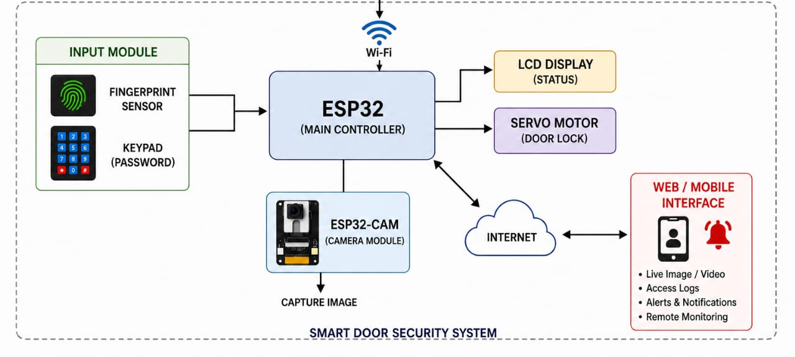
Block Diagram of the project
DAYANANDA SAGAR COLLEGE OF ENGINEERING
7

Slide 8
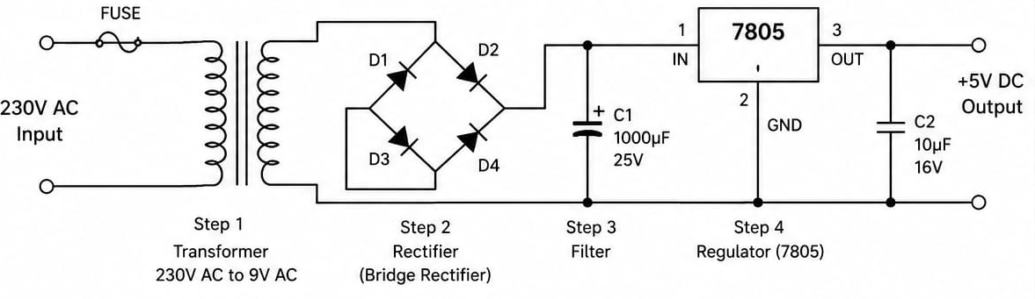
Block Components
1. 230v AC to 5v DC conversion
The 230V AC supply is first reduced to a low AC voltage using a transformer.
The rectifier converts this AC voltage into pulsating DC using diodes.
A filter capacitor smoothens the pulsating DC by removing ripples.
A voltage regulator (7805) converts it into a constant 5V DC.
This stable 5V DC is used to power electronic devices like microcontrollers.

Slide 9
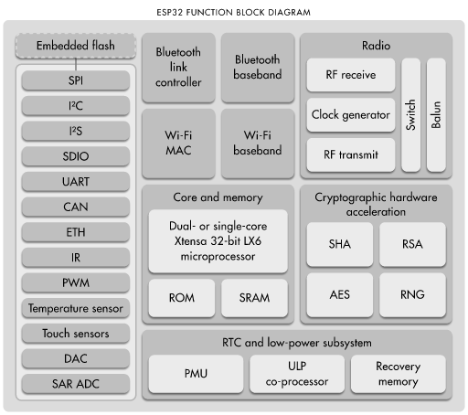
2.ESP-32 Architecture
The ESP32 a highly used in IOT applications. At its core, it contains a dual- or single-core Xtensa 32-bit LX6 microprocessor along with ROM and SRAM, which handle program execution and data storage. It supports multiple communication interfaces like SPI, I²C, I²S, UART, CAN, and Ethernet, allowing it to connect easily with sensors and external devices. The chip has built-in Wi-Fi and Bluetooth modules, consisting of MAC, baseband, and RF sections (receiver, transmitter, clock generator, and antenna switch), enabling wireless communication. It also includes cryptographic hardware acceleration such as AES, RSA, SHA, and RNG for secure data processing. For analog and sensing tasks, it provides peripherals like ADC, DAC, temperature sensor, touch sensors, and PWM. Additionally, the RTC and low-power subsystem with PMU and an ultra-low-power (ULP) co-processor helps in power saving during sleep modes. Overall, this architecture makes the ESP32 a powerful, compact, and energy-efficient controller for embedded and IoT systems.

Slide 10
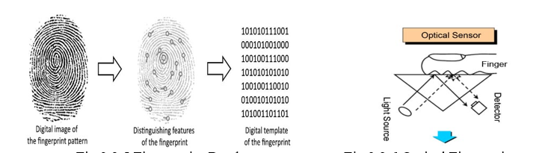
3.Fingerprint sensor
An optical sensor works by shining light from a source onto the finger placed on a glass surface. Due to the principle of Total Internal Reflection, light behaves differently at the fingerprint’s ridges and valleys—ridges absorb or scatter light while valleys reflect it more effectively. A detector captures this pattern of reflected light, producing a bright and dark image that represents the fingerprint. In contrast, a capacitive sensor uses an array of tiny electrodes to measure electrical changes. When a finger is placed on the sensor, the ridges come closer to the electrodes and create higher capacitance, while the valleys remain slightly farther and produce lower capacitance. These variations in capacitance are measured and converted into a digital image of the fingerprint.

Slide 11
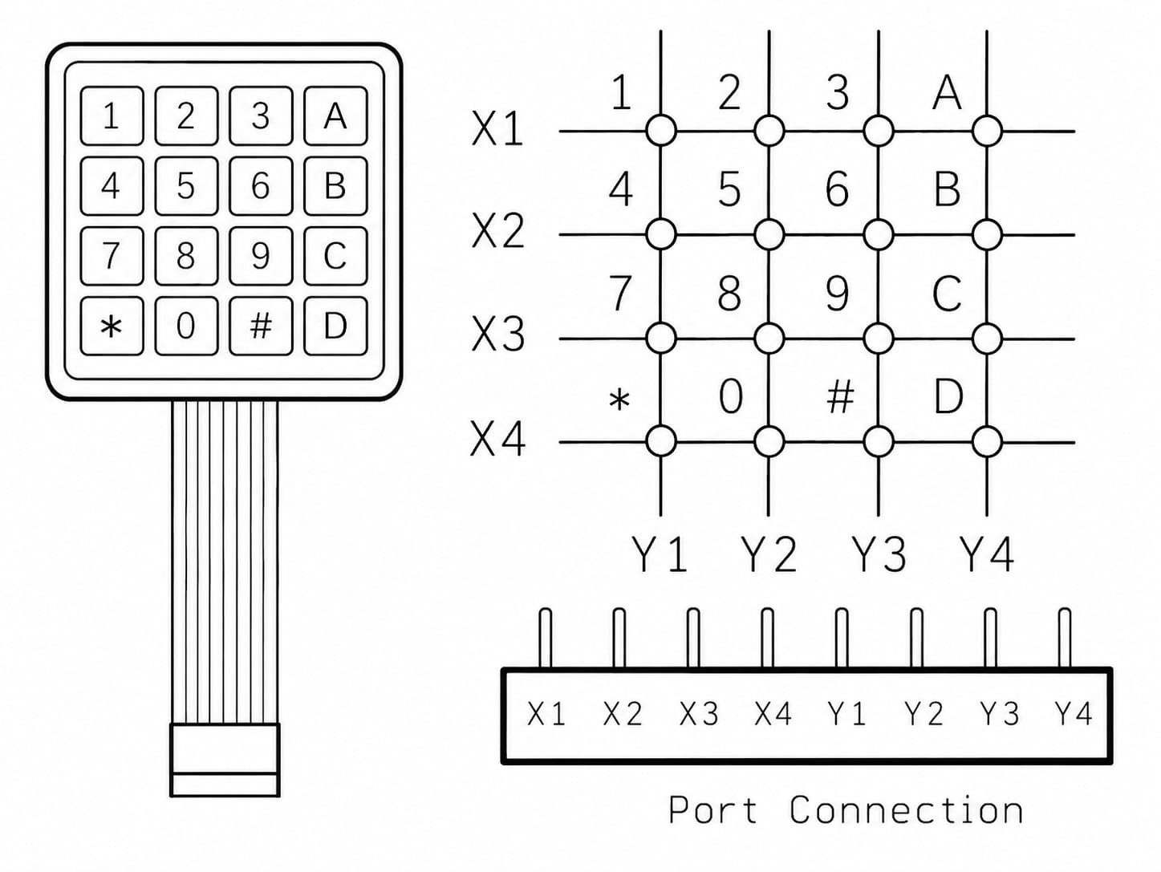
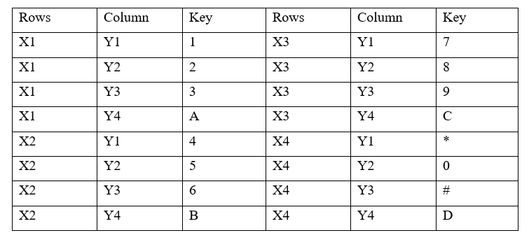
4. Keypad
The keypad is arranged in a 4×4 matrix with rows (X1–X4) and columns (Y1–Y4).
Each key lies at the intersection of one row and one column.
When a key is pressed, it connects a specific row and column.
The microcontroller scans rows and columns to detect which key is pressed.

Slide 12
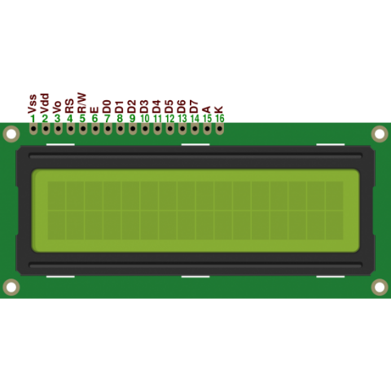
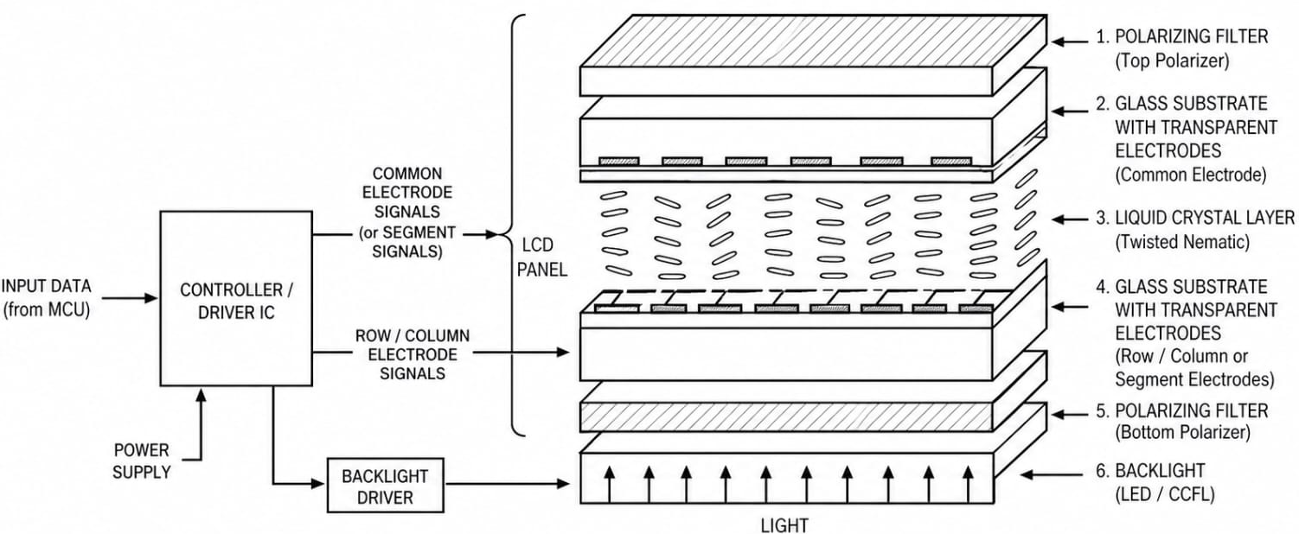
5. LCD display
An LCD works based on the property of liquid crystals to control light.
In modules like the 16x2 LCD Display, a backlight provides a constant light source, and the liquid crystal layer is placed between two polarizing filters.
When no voltage is applied, the crystals allow light to pass through, making the screen appear bright. When an electric voltage is applied, the orientation of the crystals changes, blocking light and forming dark characters on the screen.

Slide 13
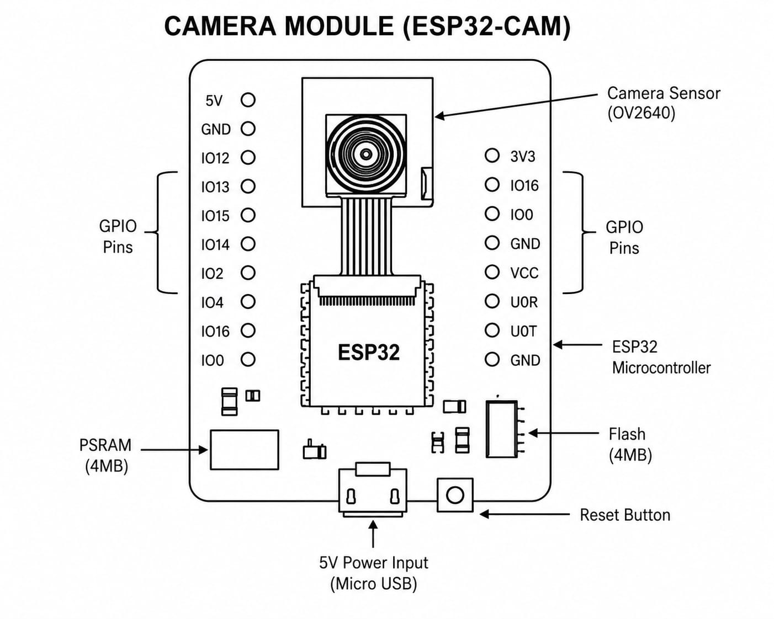
6. ESP-32 Cam
Captures images using the OV2640 camera sensor and sends data to the ESP32 microcontroller.
ESP32 processes the image and stores it temporarily in PSRAM/Flash memory.
Data can be transmitted wirelessly via Wi-Fi or used for display/processing applications.

Slide 14
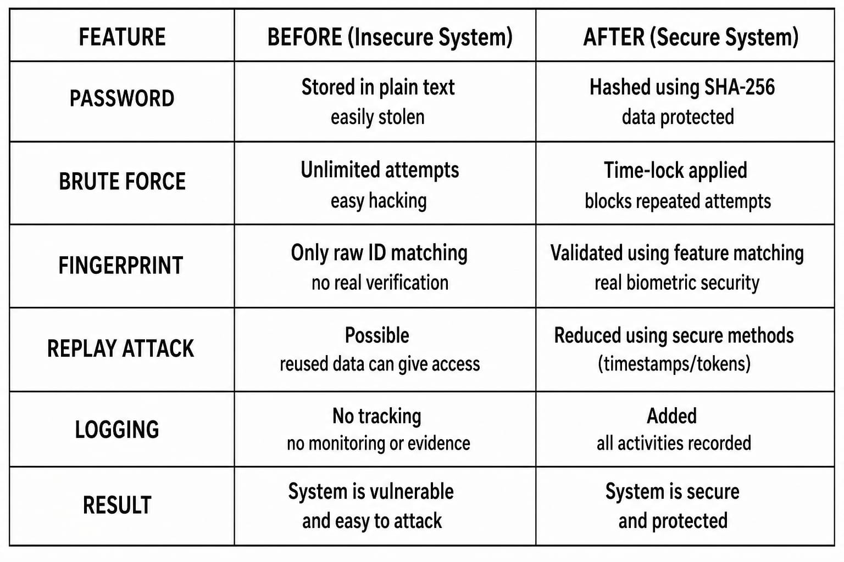
Impact of cyber security

Slide 15


Identification of Relevant SDG (Sustainable Development Goal)
SDG 9 - Industry, Innovation and Infrastructure
Promotes innovation by developing an IOT-based smart security solution that enhances technological infrastructure and supports modern digital systems.
SDG 11 - Sustainable Cities and Communities
Improves safety and security in homes and buildings.
DAYANANDA SAGAR COLLEGE OF ENGINEERING
15

Slide 16
Conclusion
Using this system, we can reduce cyber threats by enabling secure communication and controlled access.
It helps in building a smart home environment with advanced security features.
The system ensures safe and monitored entry through real-time alerts and image capture.
It allows the owner to control access remotely, improving convenience and safety.
Overall, it provides a secure, intelligent, and reliable solution for modern security needs.

Slide 17
References
Malti Bansal,Navodit Adarsh, Nitin Kumar, Monika Meena. “Smart IoT based Integrated Home Security System” Delhi technological university- 2020
Pavan Kumar Sattaru,Rajasree Channagiri, Khasim vali Burugula. “Smart Home Security System using IoT and ESP8266”. 5th International Conference on Smart Systems and Inventive Technology-2023
Ishwari Kakade,Renuka Wadetwar, Kritika Ni,mje. “IoT-Integrated Door Sensor Solution for Enhancing Smart Home Security”. Indian institute of Information technology-2024

Slide 18
Any Questions ?
DAYANANDA SAGAR COLLEGE OF ENGINEERING
18

Slide 19


