Slide 1
Java Development

Slide 2
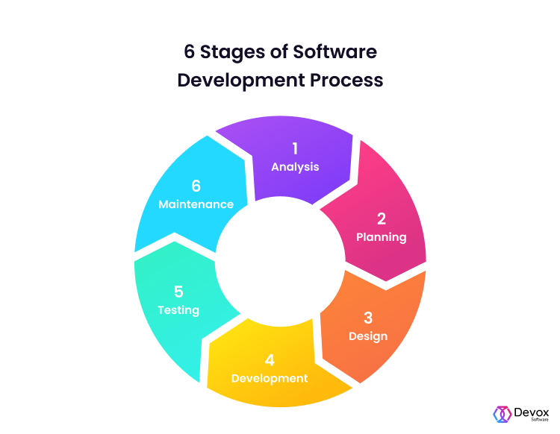
Software development lifecycle(SDLC)

Slide 3
SDLC Methodologies
Waterfall method
Agile method

Slide 4
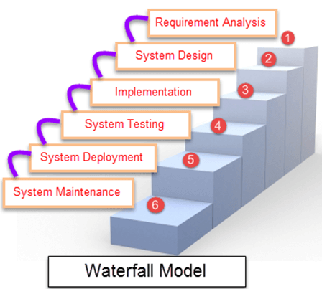
Waterfall Method
Waterfall Model is a sequential model that divides software development into pre-defined phases.
Each phase must be completed before the next phase can begin with no overlap between the phases.
Each phase is designed for performing specific activity during the SDLC phase.

Slide 5
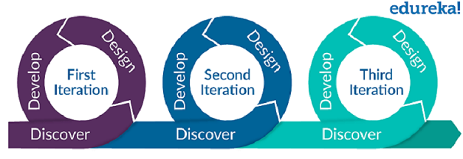
AGILE Methodology
Agile methodology is a practice that promotes continuous iteration of development and testing throughout the software development life cycle of the project.
Both development and testing activities are concurrent, unlike the Waterfall model.

Slide 6
Project Development Phases - Tools
Planning:
Jira
Trello
Asana
Design:
Preparing the HLD and LLD documents.
Prepare High level prototypes
Implementation
IDEs:
Eclipse
IntelliJ IDEA
NetBeans
VCS:
Git
SVN
CVS
Perforce
IBM Rational Team Concert
Build Management
Build Tools:
Apache Ant
Maven
Gradle
CI tools:
Jenkins
Traves CI
Org own build mgmt tool
Code Analysis Tools
PMD
SonarQube
FindBugs
HCL Appscan
Whitesource scan
Testing:
Unit Testing
Integration Testing
Automation
Test coverage
Tools/Frameworks:
Junit
Mocito
Deployments
On-primise
Cloud deployments
Hybrid
Public

Slide 7
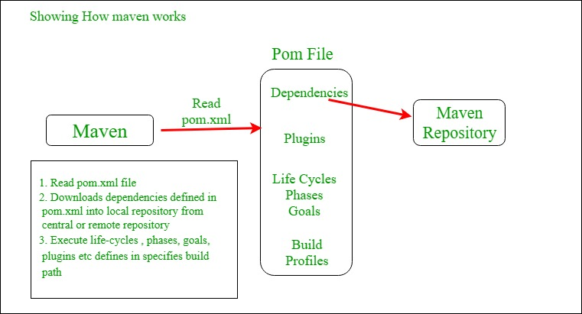
How Maven works:

Slide 8
Ant vs Maven
Ant | Maven
Ant doesn't has formal conventions, so we need to provide information of the project structure in build.xml file. | Maven has a convention to place source code, compiled code etc. So we don't need to provide information about the project structure in pom.xml file.
Ant is procedural, you need to provide information about what to do and when to do through code. You need to provide order. | Maven is declarative, everything you define in the pom.xml file.
No lifecycle | It has lifecycle
tool | framework
Less preferred than Maven | More preferred than Ant

Slide 9
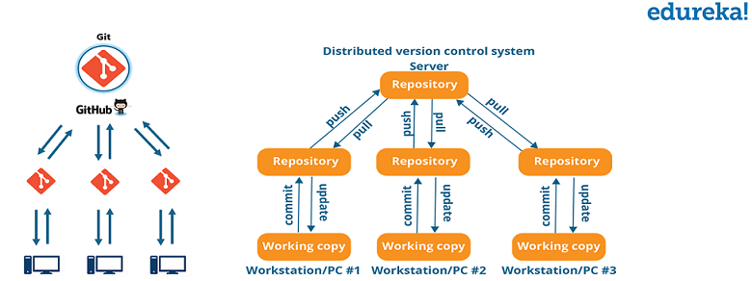
Continuous Development –

Slide 10
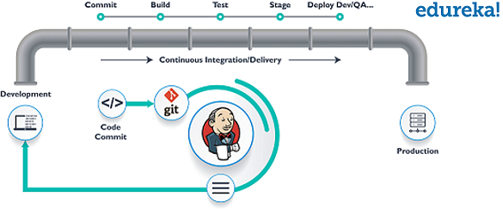
Continuous Integration –

Slide 11
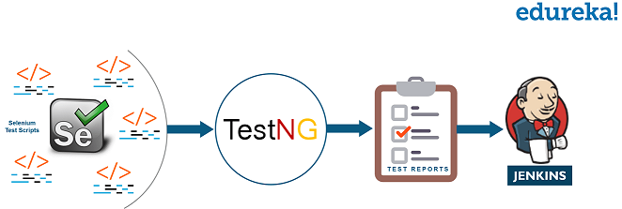
Continuous Testing –

Slide 12
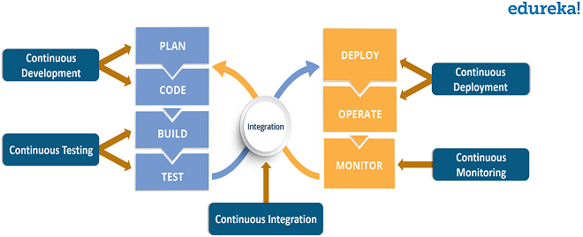
Dev-ops

Slide 13

Thank You

