Slide 1
Maven

Slide 2
What is Maven?
Maven is a powerful project management tool that is based on POM (Project object Model).
It is used for:
Builds Java-based projects
Manage dependency
Simplify the build process like ANT. But is is more advanced than ANT.
Make developer work easy
Encouraging better development practices
Maven extends Ant to let you download dependencies
Maven ensures that project JARs and libraries are downloaded automatically.

Slide 3
Maven Installation
Prerequisites:
Java should be installed.
Download:
Download MAVEN from below official website
https://maven.apache.org/download.cgi
Installation Instructions:
https://maven.apache.org/install.html

Slide 4
Install maven on Windows
Set an environment variable JAVA_HOMEto JDK installation path. I am using JDK 8, so JAVA_HOME is pointing to C:\Program Files\Java\jdk1.8.0_172.
Download the latest maven binary zip from Apache Maven site. When I created this tutorial, the latest version was apache-maven-3.6.1-bin.zip
Unzip the archive and move it to Program Files. In my case, C:\Program Files\apache-maven\maven-3.6.1
Set the environment variables M2_HOME and M2 using system properties for maven. M2_HOME=C:\Program Files\apache-maven\maven-3.6.1 M2=%M2_HOME%\bin
Verify maven installation now by typing mvn --version in the command prompt.

Slide 5
Install maven on Linux
I am assuming JDK is installed correctly in your LINUX.
You can use wget or visit the link from a browser to download the binary tar file. Download the binary apache-maven-3.6.1-bin.tar.gz file from Maven site to /tmp/ folder. There may be a different version there, but the steps are the same.
Navigate to the folder where you want to install. I prefer installing in /opt/, so run cd /opt/ in the terminal.
Now extract the archive using sudo tar -xvzf /tmp/apache-maven-3.6.1-bin.tar.gz. This will extract and move the content to /opt/apache-maven-3.6.1/bin
Set M2_HOME and PATH to maven bin by modifying the /etc/environment file. Use the below code as an example, you can use nano or vi text editors. Make sure you do not change any existing values, you only append :/opt/apache-maven-3.6.1/bin for PATH and M2_HOME="/opt/apache-maven-3.6.1"
PATH="/usr/local/sbin:/usr/local/bin:/usr/sbin:/usr/bin:/sbin:/bin:/usr/games:/usr/local/games:/usr/lib/jvm/jdk-1.8.0_172/bin:/opt/apache-maven-3.6.1/bin"
JAVA_HOME="/usr/lib/jvm/jdk-1.8.0_172"
M2_HOME="/opt/apache-maven-3.6.1"
After making changes in the environment file, update the maven command
sudo update-alternatives --install "/usr/bin/mvn" "mvn" "/opt/apache-maven-3.6.1/bin/mvn" 0
sudo update-alternatives --set mvn /opt/apache-maven-3.6.1/bin/mvn
Now, you need to verify that the installation was successful by running mvn -v in the terminal.

Slide 6
Install maven on Mac
Make sure JDK is installed. I advise making use of brew cask for mac. Install brew in Mac and then install cask if not installed. Now, you can install JDK by running brew cask install java8 for jdk8 or for the latest version of JDK.
Once JDK is installed, you can use brew search maven to find the latest version of available maven and then install the right version using brew install, for example brew install maven@3.5 will install maven-3.5.
Now type mvn -v to verify that the installation was successful.
Alternatively, you can also download the binary zip or tar from official maven site, extract them, move it to a correct directory and then add /bin to the PATH.

Slide 7
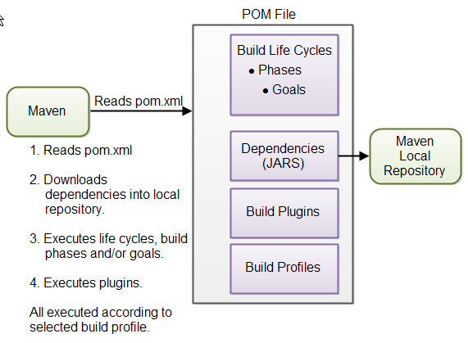
Operational Steps Of Maven
First Maven goes through the POM .xml file.
The dependencies are loaded into the local repository.
Goes through the built-in life cycles of Maven as shown below:
Default: Takes care of the deployment of the project.
Clean: Removes any errors, thereby cleaning the project, and removing the artifact produced from the previous process of the build.
Site: Takes care of the documentation of the project.

Slide 8
Convention over configuration
By default,
The source code is assumed to be in ${basedir}/src/main/java
Resources in ${basedir}/src/main/resources
Tests are assumed to be in ${basedir}/src/test
A project is assumed to produce a JAR (Java Archive) file.
Maven assumes that you want to compile byte code to ${basedir}/target/classes dir and then create a distributable .jar file in ${basedir}/target

Slide 9
What is pom.xml in maven?
Every project is uniquely identified by a set of attributes like name, groupId, artifactId, version.
Use of pom.xml has several advantages.
Dependency Management:You can declare the exact library names, versions, etc in the pom.xml file.
Remote Repositories: You can specify the remote repository where the project build will be uploaded and the repository from where dependencies will be downloaded.
Universal reuse of build logic: Maven plugins contain logic for custom builds and custom operations which can be reused.
Tool portability / Integration: Maven is now well supported in all major IDEs like Eclipse, NetBeans, and IntelliJ.
Easy searching of project Artifacts: Tools like Nexus allow you to index and search the contents of a repository using the information stored in the POM

Slide 10
What is pom.xml in maven?
Super POM
Minimal POM
Project. - root element
modelVersion. - Maven version number
groupId. - id of the group project
artifactId. - id of the artifact (project)
Version. - version of the artifact under project group
These three values form the project's fully qualified artifact name. This is in the form of <groupId>:<artifactId>:<version>

Slide 11
POM xml
If no configuration provided MAVEN use its default values to configure and build. Default packaging type is “jar”.
If no repository specified it make use its Super POM repository details to download dependency jars.
when Maven sees the dependencies in the minimal POM, it would know that these dependencies will be downloaded from https://repo.maven.apache.org/maven2 which was specified in the Super POM

Slide 12
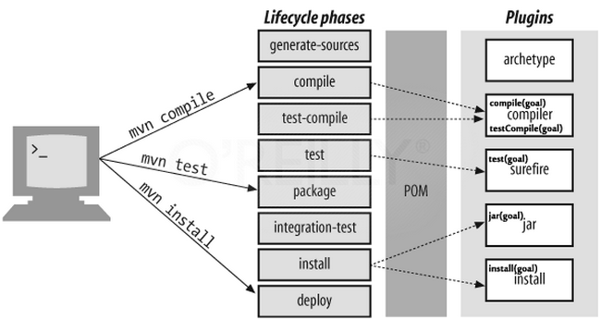
Build lifecycle, phases and goals in maven
Clean Lifecycle (mvn clean)
Default Lifecycle (mvn clean install)
Site Lifecycle (mvn site)

Slide 13
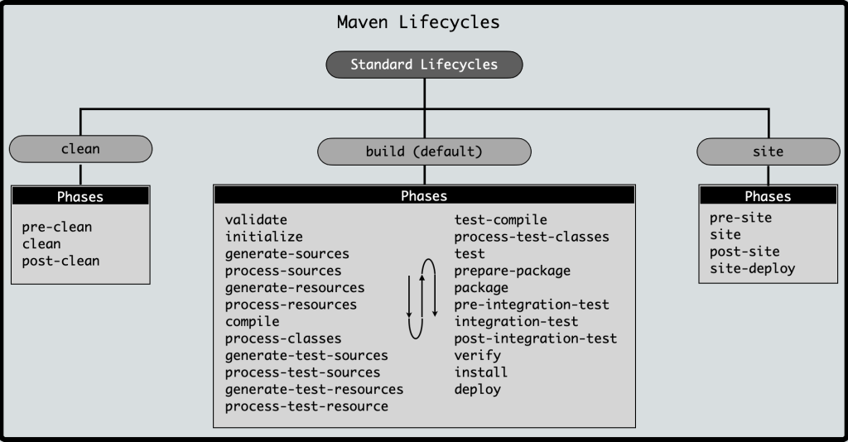
Maven Phases:

Slide 14
What is maven archetype?
An archetype is a Maven project templating toolkit
Think of archetypes as a template for creating a project structure and they include best practices.
There are several official archetypes and many more from the communities.
For example,
maven-archetype-webapp
maven-archetype-plugin
maven-archetype-simple

Slide 15
inheritance
Elements in the POM that are merged are the following:
dependencies
developers and contributors
plugin lists (including reports)
plugin executions with matching ids
plugin configuration
Resources
Use relativepath to specify the parent pom.xml
Aggregations:
<project>
<modelVersion>4.0.0</modelVersion>
<groupId>com.mycompany.app</groupId>
<artifactId>my-app</artifactId>
<version>1</version>
<packaging>pom</packaging>
<modules>
<module>my-module</module>
</modules>
</project>
<parent>
<groupId>com.mycompany.app</groupId>
<artifactId>my-app</artifactId>
<version>1</version>
</parent>

Slide 16
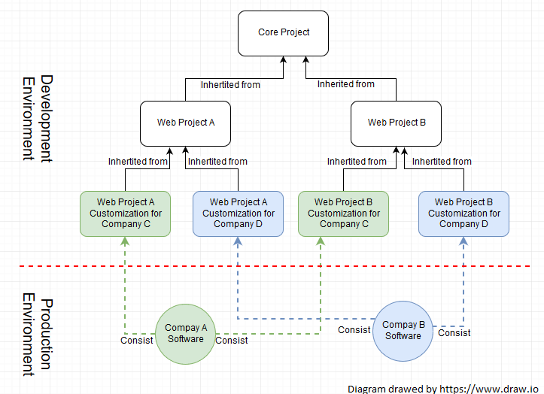
inheritance

Slide 17
Project Interpolation and Variables
<version>${project.version}</version>
Inheritance can be applied here
${project.groupId}, ${project.version}, ${project.build.sourceDirectory}
project.basedir
project.baseUri
maven.build.timestamp

Slide 18
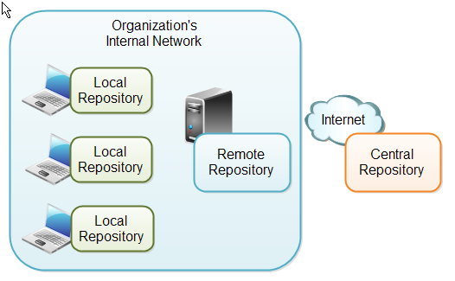
What is a Maven Repository?

Slide 19
Maven repositories
1. Maven central repository
All artifacts in a project get downloaded from maven central repository. Unless you specify a custom repo in ~/.m2/settings.xml.
Maven Central Repository Search – https://search.maven.org/
Maven Central Repository URL – https://repo.maven.apache.org/maven2
2. Custom maven remote repository
Quite often you will need to use libraries that are not hosted in the maven central repository but hosted in a different repo (organization own repo).
ou need to specify these remote repositories in the pom.xml. You can also specify them in ~/.m2/settings.xml as well, but this will not be covered here.
<repositories>
<repository>
<id>jcenter-snapshots</id>
<name>jcenter</name>
<url>https://jcenter.bintray.com/</url>
</repository>
</repositories>

Slide 20
Maven repositories
3. Maven local repository (.m2)
Maven downloads dependencies (jar, war, pom files, and plugins) from remote or central repositories and caches them in the local machine.
The place where it shows is .m2/repository
Note - don’t recommend customizing the default location of the local repo.

Slide 21
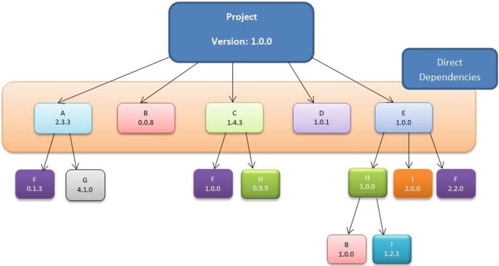
Dependency Management in Maven
Dependency management is a core feature of maven.
t is powerful enough to manage dependencies from a simple single project to a complex multi-module project.
There are basically 2 types of dependencies that maven manages,
direct dependencies
transitive dependencies

Slide 22
What are direct dependencies?
Dependencies that are directly declared in pom.xml are known as direct dependencies. For example, to use undertow, I need to add it’s dependencies in pom.xml.
<dependency>
<groupId>io.undertow</groupId>
<artifactId>undertow-core</artifactId>
<version>${undertow.version}</version>
</dependency>

Slide 23
What are transitive dependencies?
<dependency>
<groupId>io.undertow</groupId>
<artifactId>undertow-parser-generator</artifactId>
<scope>provided</scope>
</dependency>
<dependency>
<groupId>org.jboss.logging</groupId>
<artifactId>jboss-logging</artifactId>
</dependency>
<dependency>
<groupId>org.jboss.logging</groupId>
<artifactId>jboss-logging-processor</artifactId>
<scope>provided</scope>
</dependency>
Even though you only added undertow-core in the pom.xml. but the undertow-core has dependencies on several other dependencies. Maven resolves dependencies of dependencies, this is known as transitive dependencies.
undertow-core/pom.xml

Slide 24
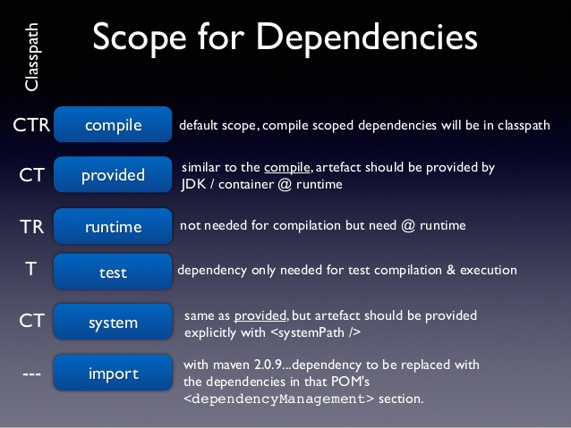
Dependency scope in maven

Slide 25
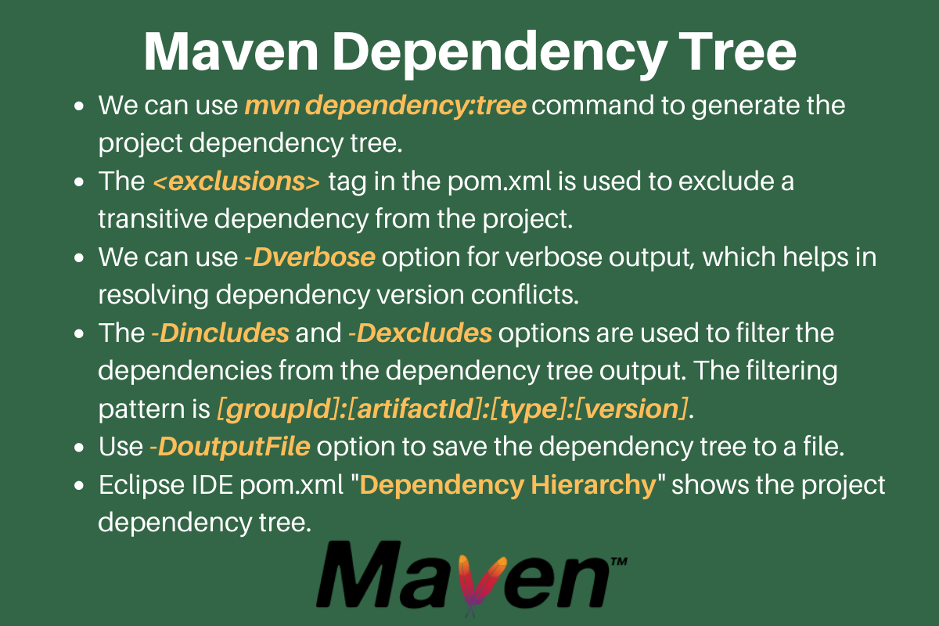
Maven dependency tree

Slide 26
Maven project conversion
Convert normal java project to MAVENIZED one
Eclipse :
Select eclipse project and right click -> maven -> convert to maven project
Import existing MAVEN project into eclipse
Eclipse :
open eclipse –orkspace -> select file -> import -> Existing maven project ->choose project path from your local machine -> click finish

Slide 27
THANK YOU

