Slide 1
Maven

Slide 2
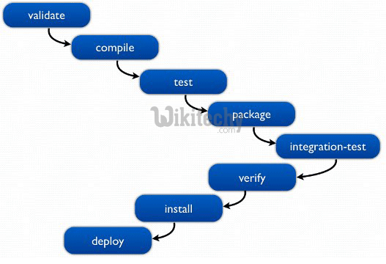
Maven - Commands
Syntax: mvn plugin-prefix:goal
validate - validate the project is correct and all necessary information is available
compile - compile the source code of the project
test - test the compiled source code using a suitable unit testing framework. These tests should not require the code be packaged or deployed
Package - take the compiled code and package it in its distributable format, such as a JAR.
verify - un any checks on results of integration tests to ensure quality criteria are met
install - install the package into the local repository, for use as a dependency in other projects locally
Deploy - done in the build environment, copies the final package to the remote repository for sharing with other developers and projects.
Dependency:tree – list out the dependency list as tree format
mvn dependency:analyze –
to identify the unused declared
To identify used undeclared dependencies which can help to reduce the project size.
mvn site:site – Generate the documentation for given project (site directory created under target directory)

Slide 3
Maven – Q&A
How to check maven version?
How to get maven help?
What is target directory in maven?
What is site directory under target directory in maven?
What is “mvn -o package” and what it does?
What is “mvn -q package” ?
What is “mvn -X package” ?
What is “mvn -DskipTests package” ?

Slide 4
