Slide 1

Java Debugging

Slide 2
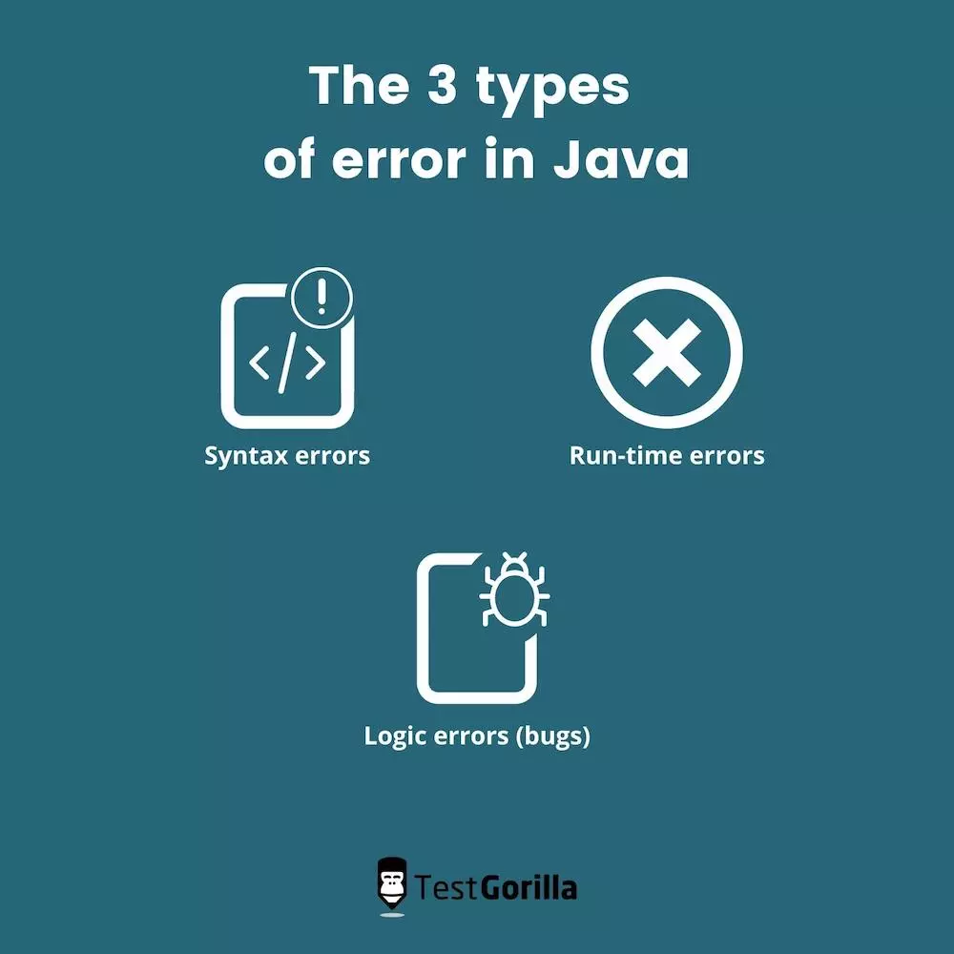
Types of ERRORS in JAVA

Slide 3
Finding Bugs:
How to find bugs?
To find bugs, you need to:
Be clear about your expectations.
Check the results you get.
Compare your expectations and the actual result to see what is missing.
How to Understand Why Bugs Occur
After finding a bug, you need to figure out why the code is behaving the way it does. Doing this helps you build an efficient system.
‌‌Instead many developers will just google and use the answers they get directly from StackOverflow.
How to Fix or Remove Bugs
‌‌After finding and understanding the cause of a bug, we have to fix that bug. Sometimes, once you understand what the bug is, you'll simply find a solution without stress.
However, there are times when our understanding yields no solution no matter how hard we try.
Ask questions on StackOverflow – not to waste time.

Slide 4

How can we deal with bugs?
There are three major ways to deal with bugs:
Prebugging: the reduction of bugs before they're created
Debugging: identifying, fixing, and removing bugs once you find them
Post-debugging: expecting unexpected or unknown bugs

Slide 5
What is Prebugging?
“If debugging is the process of removing bugs, then programming must be the process of putting them in.”
If we introduce bugs to a program through programming, that means we need to guide ourselves to reduce the number of bugs we introduce. I call this process of guiding ourselves "Prebugging".

Slide 6
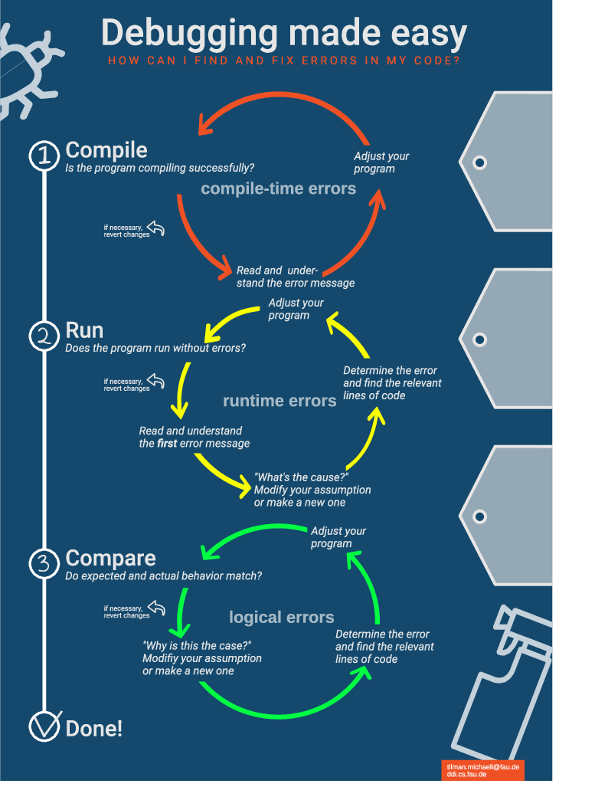
What is Prebugging? ..Continue

Slide 7
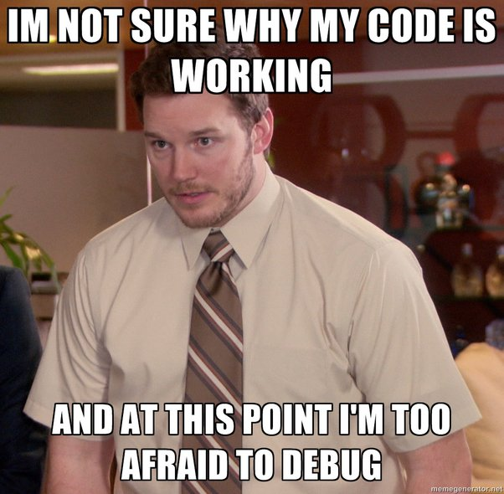
Why is My code not working?

Slide 8
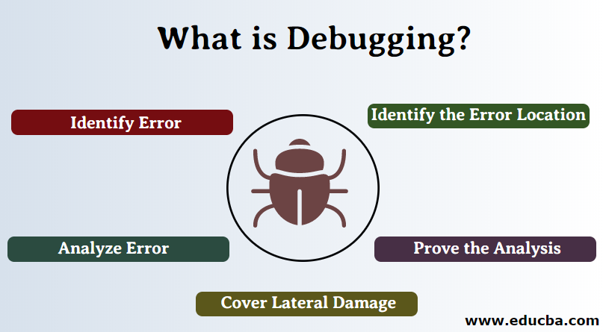
What is debugging?
Debugging, in computer programming and engineering, is a multistep process that involves
identifying a problem
isolating the source of the problem
and then either correcting the problem or determining a way to work around it.
The final step of debugging is to test the correction or workaround and make sure it works.

Slide 9

Different debugging methods
Using Breakpoints
Print Debugging (log4j – print whole dataset when debug enabled)
Remote Debugging
Memory-dump Debugging
When a program crashes the system creates a snapshot of the memory and the data it holds at that specific time. This is called the memory dump
It can help developers to understand when and where the process crashed.

Slide 10
Reduce the number of bugs – some ways
Write program specs
Learn to really understand the tools you use
Learn to type accurately (compile time & Runtime)
Familiarize yourself with error messages and their probable solutions.‌‌
Always make sure you have setups that are stable for most of the tools you use.‌‌

Slide 11
Learn the basic of the tools you use often
What kind of argument does this take?
What does this return? ‌‌
What happens if an invalid argument is supplied?

Slide 12
Plan Before Coding
Everybody now seems to feel that programming is always about "Code, Code, code, Search, Debug".
Ask yourself before hop into the coding:
What we expect to take as inputs as well as the structure and features of such inputs.‌‌
What we expect to do with the inputs.‌‌
What we expect to return or do in the end in relation to the inputs or other things.‌‌
What we expect to do if the expected inputs are not given.
In short, planning the inputs, processes, and outputs of a function or program doesn't only help you reduce bugs but also helps you write efficient tests.

Slide 13
Continue…..
Syntax Errors
Logic/Semantic Errors
Compilation Errors
Resource Errors
💥 Don't use it if you don't understand It
💥 Learn to type accurately

Slide 14
What is Post-debugging?
Use error tracking tools to identify and fix errors before deploying to the production servers.

Slide 15
How can I avoid bugs in Java?
Unfortunately, bugs can't be avoided altogether, but some errors are more avoidable than others. Some steps you can take to prevent easily avoidable bugs whilst programming are:
Type accurately. Many bugs are caused by simple typos.
Listen to your Integrated Development Environment (but not too much). Most IDEs will offer hints if something is up with your code. Overly confident IDEs can autofill code, so keep an eye out for this, too.
Break up your code. As your code grows, so does the possibility of bugs, so keep methods short and give each class only one responsibility where you can.
Reuse existing code. Leveraging tried and tested code might just be the easiest path to bug avoidance, and it saves time, too.

Slide 16
Tips for Debugging in Production
Ensure All Software Components are Installed and Running
Stop Using Various Latest Technologies
Have Precise Logging Details
Document All External Dependencies
Make Good Use of Breakpoints
Don’t Be Afraid to Ask for Help
Run the Test Suite on all Target Platforms

Slide 17
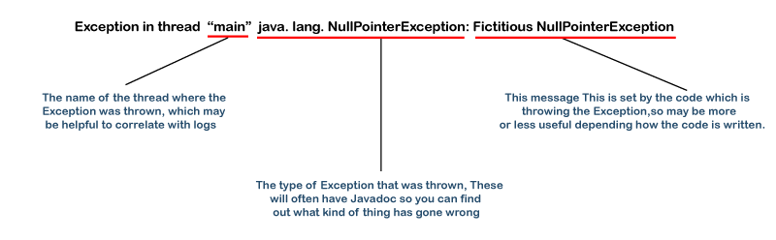
Java Stack Trace – Explained
In simple terms, a stack trace is a list of the method calls that the application was in the middle of when an Exception was thrown.
StackTrace:
Exception in thread "main" java.lang.NullPointerException: Fictitious NullPointerException
at ClassName.methodName1(ClassName.java:lineNumber)
at ClassName.methodName2(ClassName.java:lineNumber)
at ClassName.methodName3(ClassName.java:lineNumber)
at ClassName.main(ClassName.java:lineNumber)

Slide 18
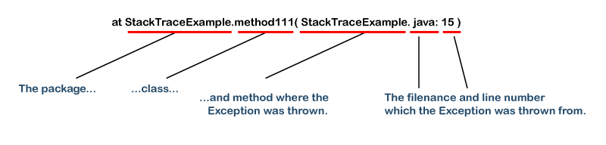
Java Stack Trace - Explained

Slide 19
Java StackTrace – Example explained
public class StackTraceExample
{
public static void main(String args[])
{ demo(); }
static void demo()
{ demo1(); }
static void demo1()
{ demo2(); }
static void demo2()
{ demo3(); }
static void demo3()
{ Thread.dumpStack();
}
}

Slide 20
Java StackTrace – with library code
More daunting example with library code
Usually stack traces are much more complex than the two examples above. Here's an example (it's a long one, but demonstrates several levels of chained exceptions):
javax.servlet.ServletException: Something bad happened at com.example.myproject.OpenSessionInViewFilter.doFilter(OpenSessionInViewFilter.java:60) at org.mortbay.jetty.servlet.ServletHandler$CachedChain.doFilter(ServletHandler.java:1157) at com.example.myproject.ExceptionHandlerFilter.doFilter(ExceptionHandlerFilter.java:28) at org.mortbay.jetty.servlet.ServletHandler$CachedChain.doFilter(ServletHandler.java:1157) at com.example.myproject.OutputBufferFilter.doFilter(OutputBufferFilter.java:33) at org.mortbay.jetty.servlet.ServletHandler$CachedChain.doFilter(ServletHandler.java:1157) at org.mortbay.jetty.servlet.ServletHandler.handle(ServletHandler.java:388) at org.mortbay.jetty.security.SecurityHandler.handle(SecurityHandler.java:216) at org.mortbay.jetty.servlet.SessionHandler.handle(SessionHandler.java:182) at org.mortbay.jetty.handler.ContextHandler.handle(ContextHandler.java:765) at org.mortbay.jetty.webapp.WebAppContext.handle(WebAppContext.java:418) at org.mortbay.jetty.handler.HandlerWrapper.handle(HandlerWrapper.java:152) at org.mortbay.jetty.Server.handle(Server.java:326) at org.mortbay.jetty.HttpConnection.handleRequest(HttpConnection.java:542) at org.mortbay.jetty.HttpConnection$RequestHandler.content(HttpConnection.java:943) at org.mortbay.jetty.HttpParser.parseNext(HttpParser.java:756) at org.mortbay.jetty.HttpParser.parseAvailable(HttpParser.java:218) at org.mortbay.jetty.HttpConnection.handle(HttpConnection.java:404) at org.mortbay.jetty.bio.SocketConnector$Connection.run(SocketConnector.java:228) at org.mortbay.thread.QueuedThreadPool$PoolThread.run(QueuedThreadPool.java:582) Caused by: com.example.myproject.MyProjectServletException at com.example.myproject.MyServlet.doPost(MyServlet.java:169) at javax.servlet.http.HttpServlet.service(HttpServlet.java:727) at javax.servlet.http.HttpServlet.service(HttpServlet.java:820) at org.mortbay.jetty.servlet.ServletHolder.handle(ServletHolder.java:511) at org.mortbay.jetty.servlet.ServletHandler$CachedChain.doFilter(ServletHandler.java:1166) at com.example.myproject.OpenSessionInViewFilter.doFilter(OpenSessionInViewFilter.java:30) ... 27 more Caused by: org.hibernate.exception.ConstraintViolationException: could not insert: [com.example.myproject.MyEntity] at org.hibernate.exception.SQLStateConverter.convert(SQLStateConverter.java:96) at org.hibernate.exception.JDBCExceptionHelper.convert(JDBCExceptionHelper.java:66) at org.hibernate.id.insert.AbstractSelectingDelegate.performInsert(AbstractSelectingDelegate.java:64) at org.hibernate.persister.entity.AbstractEntityPersister.insert(AbstractEntityPersister.java:2329) at org.hibernate.persister.entity.AbstractEntityPersister.insert(AbstractEntityPersister.java:2822) at org.hibernate.action.EntityIdentityInsertAction.execute(EntityIdentityInsertAction.java:71) at org.hibernate.engine.ActionQueue.execute(ActionQueue.java:268) at org.hibernate.event.def.AbstractSaveEventListener.performSaveOrReplicate(AbstractSaveEventListener.java:321) at org.hibernate.event.def.AbstractSaveEventListener.performSave(AbstractSaveEventListener.java:204) at org.hibernate.event.def.AbstractSaveEventListener.saveWithGeneratedId(AbstractSaveEventListener.java:130) at org.hibernate.event.def.DefaultSaveOrUpdateEventListener.saveWithGeneratedOrRequestedId(DefaultSaveOrUpdateEventListener.java:210) at org.hibernate.event.def.DefaultSaveEventListener.saveWithGeneratedOrRequestedId(DefaultSaveEventListener.java:56) at org.hibernate.event.def.DefaultSaveOrUpdateEventListener.entityIsTransient(DefaultSaveOrUpdateEventListener.java:195) at org.hibernate.event.def.DefaultSaveEventListener.performSaveOrUpdate(DefaultSaveEventListener.java:50) at org.hibernate.event.def.DefaultSaveOrUpdateEventListener.onSaveOrUpdate(DefaultSaveOrUpdateEventListener.java:93) at org.hibernate.impl.SessionImpl.fireSave(SessionImpl.java:705) at org.hibernate.impl.SessionImpl.save(SessionImpl.java:693) at org.hibernate.impl.SessionImpl.save(SessionImpl.java:689) at sun.reflect.GeneratedMethodAccessor5.invoke(Unknown Source) at sun.reflect.DelegatingMethodAccessorImpl.invoke(DelegatingMethodAccessorImpl.java:25) at java.lang.reflect.Method.invoke(Method.java:597) at org.hibernate.context.ThreadLocalSessionContext$TransactionProtectionWrapper.invoke(ThreadLocalSessionContext.java:344) at $Proxy19.save(Unknown Source) at com.example.myproject.MyEntityService.save(MyEntityService.java:59) <-- relevant call (see notes below) at com.example.myproject.MyServlet.doPost(MyServlet.java:164) ... 32 more Caused by: java.sql.SQLException: Violation of unique constraint MY_ENTITY_UK_1: duplicate value(s) for column(s) MY_COLUMN in statement [...] at org.hsqldb.jdbc.Util.throwError(Unknown Source) at org.hsqldb.jdbc.jdbcPreparedStatement.executeUpdate(Unknown Source) at com.mchange.v2.c3p0.impl.NewProxyPreparedStatement.executeUpdate(NewProxyPreparedStatement.java:105) at org.hibernate.id.insert.AbstractSelectingDelegate.performInsert(AbstractSelectingDelegate.java:57) ... 54 more

Slide 21
How should I deal withStacktraces/Exceptions?
At first, find out what is causing the Exception.
find out what the cause of that exception is
Most of the time it will be caused by incorrect code.
Example 1:
If (){
a.toString();
}
Example 2:
nt mult(Integer a,Integer b) {
try {
int result = a/b return result;
} catch (Exception e) { System.err.println("Error: Division by zero!"); return 0; }

Slide 22
THANK YOU

