Slide 1
Source Code Analysis tools & Java clean code

Slide 2
What is SAST ?
Source code analysis tools, also known as Static Application Security Testing (SAST) Tools,
can help analyze source code or compiled versions of code to help find security flaws.
SAST tools can be added into your IDE. Such tools can help you detect issues during software development.
Few open-source code analysis tools are :
FindBugs
SonarQube
PMD

Slide 3
Eclipse compiler – Errors/warnings
Eclispe->preferences->java->Errors/warnings
Change the preference for each activity (undocumented empty block, redundant null check..etc)
After making the changes you can export the pref and share same with your team members to maintain clean java code/production ready code.
File->export->preferences->select “java code style” and “java compiler pref” and proceed.
Other team members can use import option to import exported preferences and start with java code.

Slide 4
Approach – Clean code
Section 1 : Understand clarity of code (unity Tests)
Section 2: Focus on four principles of simple design
Section 3: Get started with refactoring
Section 4: Understand TDD
Why do we need to care about Clean Code?
Ans :
We need to care about Clean Code because it eventually shows the programmers capability of writing a well maintainable piece of code that is easily understood by other developers that are going to work wit
In real life when a programmer works on a codebase there is a high chance that at some point of time, other programmers also work on the same codebase that code.

Slide 5
Characteristics of Clean Code
Simple: As said above, the code should be made as simple as possible.
Maintainable: It should be maintainable in the long run as many different developers can work on that code.
Testable: It should be easily testable and less prone to errors.
Readable: Last but not least, it should be easily readable.
What are the symptoms of bad code (Unclean code)?
Hard to read code
Unnecessarily complex
Not easily testable
Hard to modify

Slide 6
How to write Clean Code in Java?
Structure
Proper Naming
Source File structure
Whitespaces and Identation
Method parameters
Avoid Hardcoding
Code comments

Slide 7
Structure:
Project Structure is the way of organising different utilities of your projects such as source files, data, configurations, tests, etc.
src
├── main
│ ├── java
│ └── resources
└── test
├── java
└── resources

Slide 8
Proper Naming – File Structure
Proper Naming:
If you want to create a variable for counting, name it 'counter' instead of naming it 'c' or something like that.
You should always avoid naming variables with a single character like 'a', 'b', 'c', etc.
In Java, we have to name
Variables
Classes
methods, hence, we should always give them a name that they can relate to.
Source File Structure:
Normally the elements placed in the source file are in the following order:
Package statement
Import statements
All static imports
All non-static imports
Exactly one top-level class
Class variables
Instance variables
Constructors
Methods

Slide 9
Whitespaces and Indentation
In this function, whitespaces and indentation are not taken care of.
While in this function, whitespaces and indentation are properly taken cared.
public int sum(int num1,int num2,int num3){ int sum=num1+num2+num3; return sum;}
public int sum (int num1, int num2, int num3) { int sum = num1 + num2 + num3; return sum; }

Slide 10
Method Parameters
Most of the time we create methods that have parameters, but sometimes we add so many parameters to a single method that it leads to confusion.
The idea here is simple: avoid adding more than 3 (sometimes 4-5 parameters should allowed) parameters if possible as it can create unnecessary confusion for other developers or programmers who are going to deal with that code in future.
You can also go for refactoring, if possible, like we have done in the example given below:
//try same example in eclipse for demo
In Programming, Refactoring is a technique used for restructuring an existing code without modifying the external behaviour of code.
// before private void employeeDetails(String name, String age, String awards, String ctc, String experience). // after private void employeeDetails(String name, Details employeeDetails).

Slide 11
Avoid Hardcoding
Instead of hard coding maintain your static data in config/property files.
Incase of future if at all want changes something, you no need to modify java class, as modifying the java class needs compilation.

Slide 12
Code Comments
In Java, two kinds of comments are allowed: Documentation comments and Implementation comments. Let us see them in detail.
Documentation/JavaDoc Comments
Here, The target audience is the users of codebase
The details added here are generally implementation free and focus mostly on the specification purposes.
Implementation/Block Comments
Here, The target audience is the developers that work on the codebase
The details added here are generally specific to implementation.
It is a good practice to use JavaDoc comments for most of the classes, interfaces, public and protected methods, etc.

Slide 13
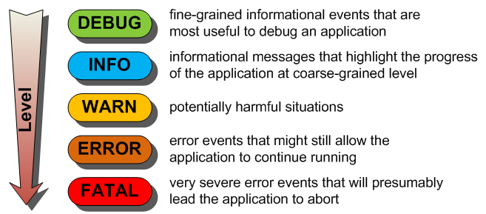
Logging
Logging is one of the most important factors in clean coding.
A well logged code is easy to debug and can save hours of work for a developer.
One should always try to avoid excessive logging because it can lead to a decreased performance.
Open-source Frameworks:
Log4j
Logback

Slide 14
SOLID
Single Responsibility Principle : In java classes, interfaces, methods should be defined in such a way that it should have a single responsibility.
Open/Closed Principle: our code should be easy to extend but good enough that no modification is required in our code.
Liskov Substitution Principle: This principle states that the objects of a superclass should be replaceable with the objects of its subclasses but without causing the application to break.
Interface Segregation Principle: Dividing the software into many independent parts or interfaces.
Dependency Inversion Principle: In simple words, High-level(complex) modules, which provide complex logic to your software should be easily reusable and they should not get affected by the changes in the low-level modules which generally provide utility features.

Slide 15
DRY&KISS
DRY:
DRY is an acronym that stands for "Don't Repeat Yourself”.
KISS :
As the words of this acronym suggests, this principle states that the code should be made as simple as possible which is of course to avoid the understanding confusions (Keep it simple, Stupid)
f this principle is followed properly, the whole code eventually becomes easy to understand

Slide 16
FindBugs
FindBugs is an open source tool used to perform static analysis on Java code.
It basically look 200+ common bug patterns to find the bugs in the java source code.
Official website - http://findbugs.sourceforge.net/
FindBugs Eclipse Plugin:
The IDE installation of the FindBugs Plugin is pretty straightforward - – you just need to use the software update feature in Eclipse, with the following update site: http://findbugs.cs.umd.edu/eclipse.
Open eclipse -> windows-> install new software-> enter the findbugs site url mentioned above and click add.
Follow the commands on the software update screen and finish the installation
Note - To make sure that FindBugs is properly installed in your Eclipse environment, then, look for the option labeled FindBugs under Windows -> Preferences -> Java.

Slide 17
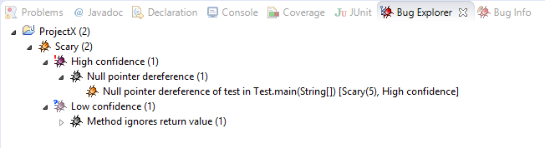
Reports Browsing
In order to launch a static analysis on a project using the FindBugs Eclipse plugin, you need to right-click the project in the package explorer, then, click on the option labeled find bugs.
After launch, Eclipse shows the results under the Bug Explorer window as shown in the screenshot below:
As of version 2, FindBugs started ranking bugs with a scale from 1 to 20 to measure the severity of defects:
Scariest: ranked between 1 & 4.
Scary: ranked between 5 & 9.
Troubling: ranked between 10 & 14.
Of concern: ranked between 15 & 20.

Slide 18
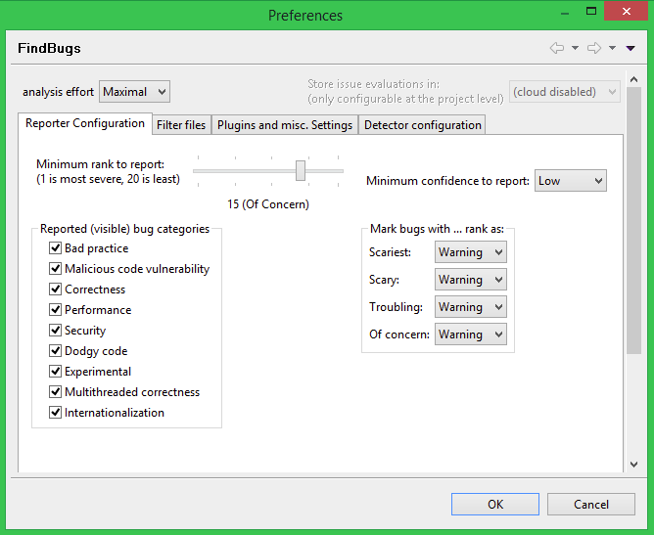
Eclipse Configuration
FindBugs plugin makes it easy to customize the bugs analysis strategy, by offering various ways to filter warning and limit the strictness of the results.
You can check the configuration interface by going to Window -> Preferences -> Java -> FindBugs:

Slide 19
SonarQube
SonarQube, is a self-managed, automatic code review tool that systematically helps you deliver Clean Code.
As a core element of our Sonar solution, SonarQube integrates into your existing workflow and detects issues in your code to help you perform continuous code inspections of your projects.
The tool analyses 30+ different programming languages and integrates into your CI pipeline and DevOps platform to ensure that your code meets high-quality standards.

Slide 20
Windows Installation
Pre-requisite:
Java 1.8 or above as per the version of the sonarqube (Make sure to install it on your system)
Download Sonarqube
Download SonarQube: In this article, we will install 8.4.1 version of sonarqube
Download the latest stable version and extract the .zip on to the local system.
Extract the sonarqube binaries and navigate to the directly and run the below command
If you get the java error then make sure JAVA_HOME is set properly or manually update the wrapper.conf file which is present under conf folder of sonarqube installation directory to point to your java
D:\DevOps\sonarqube-6.7.3\bin\windows-x86-64 StartSonar.bat
Username: admin
Password:admin
wrapper.java.command=C:\Program Files\Java\jdk-14.0.2\bin\java Once the SonarQube is up, go to the browser : http://localhost:9000 to access SonarQube dashboard.

Slide 21
MacOS Installation
Installation of SonarQube/Sonar-Scanner:
Set SonarQube environment Variable:
Enter vim ~/.bash_profile in the terminal to configure the sonar path. {version } can be replaced with the installed current version.
Start SonarQube
Login to SonarQube
brew install sonar brew install sonar-scanner
export SONAR_HOME=/usr/local/Cellar/sonar-scanner/{version}/libexec export SONAR=$SONAR_HOME/bin export PATH=$SONAR:$PATH
brew services start sonarqube
Enter http://localhost:9000 in the browser to enter the following page.

Slide 22
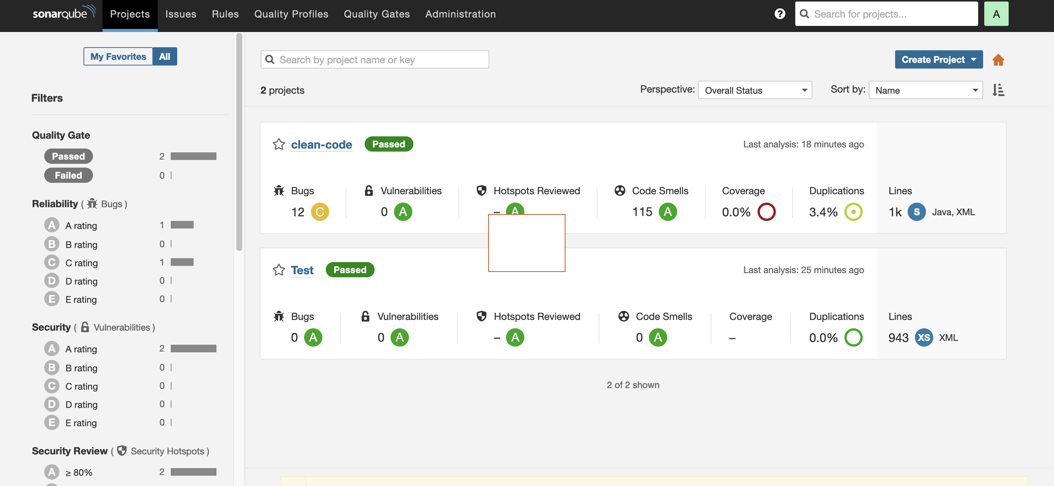
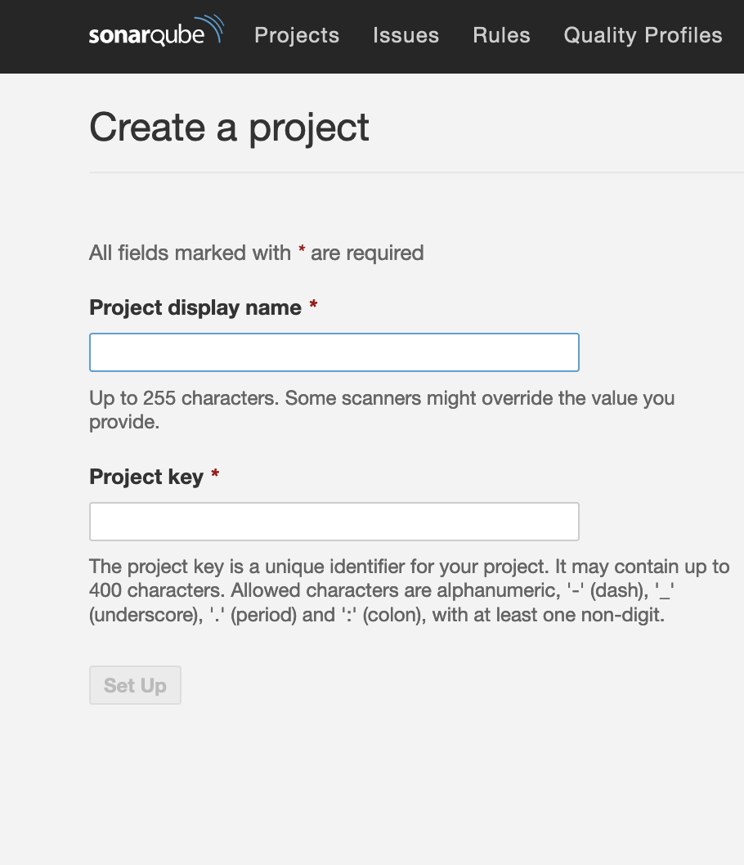
SonarQube - Dashboard

Slide 23
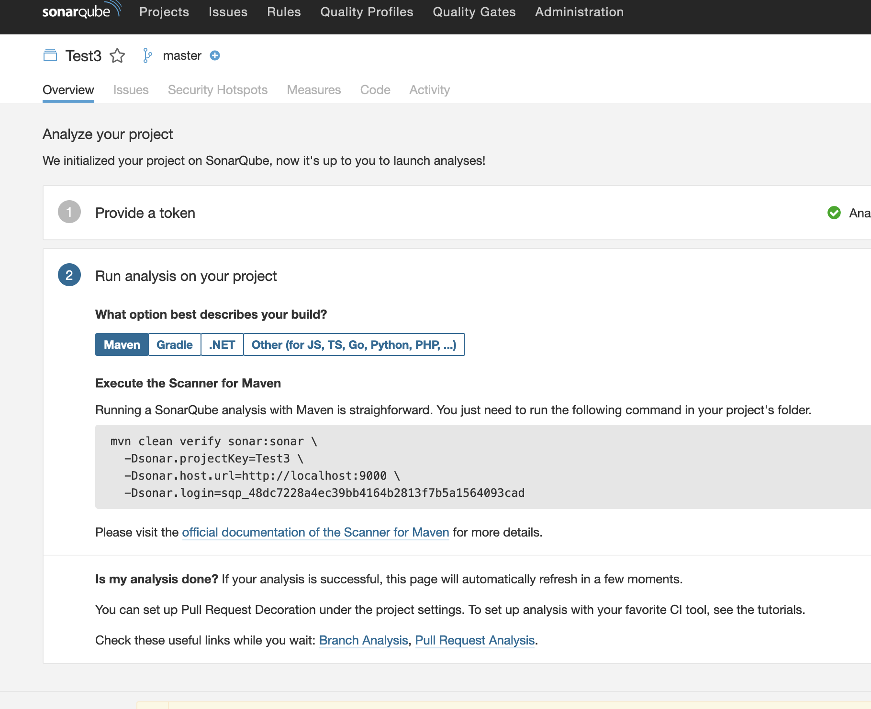
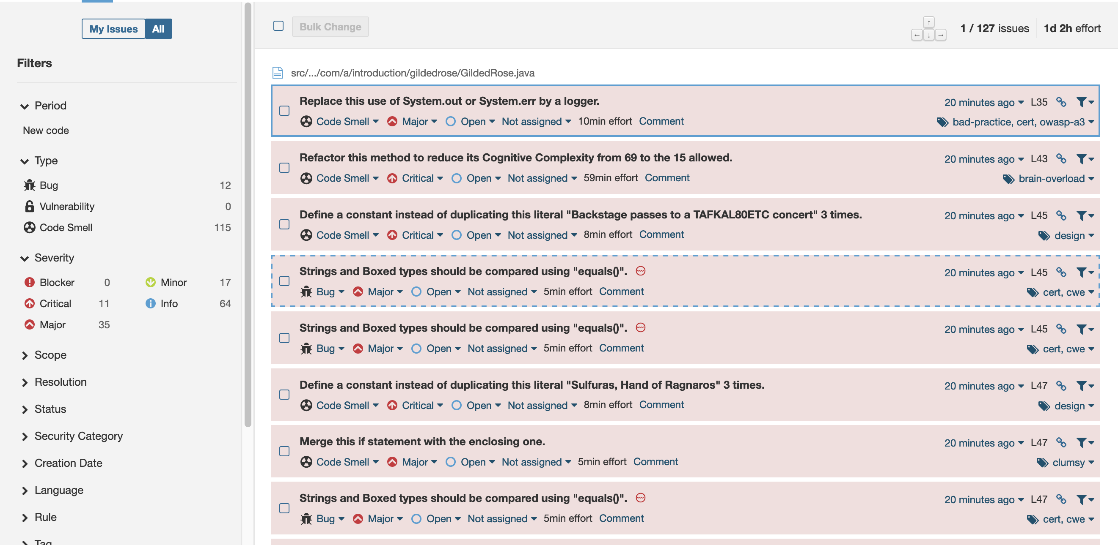
SonarQube - Dashboard

