Slide 1
Sports Info Solutions Analytics Challenge 2021
Sachin Narayan¹ & Padmanabhan Ayyaswamy²
1 Florida State University, USA
2 Indian Institute of Technology Madras, India

Slide 2
What are we going to answer??
Which route combinations were most popular in the NFL in 2020?
Of these route combinations, which perform best against each coverage type?

Slide 3
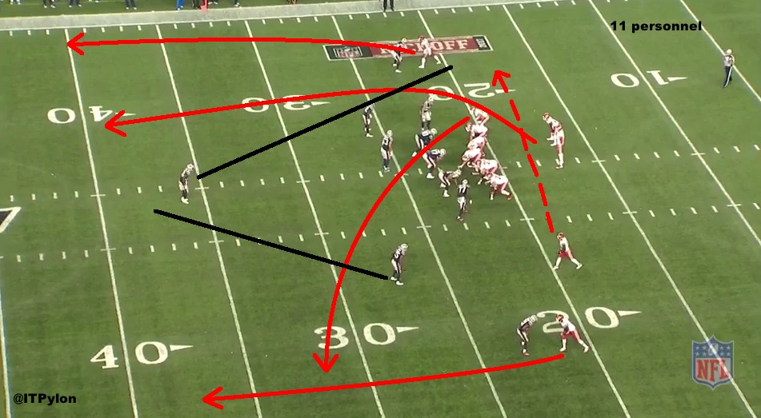
Popular Route Combinations

Slide 4
Assumptions & Considerations
Only eligible receivers who were running a route in the play were considered for the route combination of that play. Therefore, we removed all rows that had a “Null Route” column, thereby eliminating most rush plays .
The “OnFieldPosition” was the feature that was considered for the route combination instead of the “RosterPosition” because players with a certain roster position could play on the field in a different position.
For ex. Randall Cobb and Sammy Watkins who are Wide Receivers on the roster, played as Tight Ends during certain plays in the Chiefs x Texans game on GW1.

Slide 5
Position and route encoding
The “OnFieldPosition” and the “Route” categorical variables from the data are converted to numerical variables.
The encoded values of all the “OnFieldPosition” and few of the “Route” (due to space constrain) variables are shown in the tables on the right side.
The encoding is intentionally initialized from 1 instead of 0 for easier implementation of route combinations.
Route | Encoded Value (r)
Blocking | 11
Screen - Bubble | 22
Run Fake | 23
Screen - Quick | 28
Slant | 7
Player position | Encoded value (p)
SWR | 1
TE | 2
B | 3
WR | 4
QB | 5

Slide 6
Encoded Route-Position feature (rp)
The data is sorted in sequential manner using the following features: 'GameID','EventID','SideOfCenter','Order_OutsideToInside.‘ This sorting helps in rearranging the data based on the player on-field position for every play in every game.
The encoded Route and OnFieldPosition variable are converted to string type and concatenated to form a new feature (‘rp’) for establishing the route combination.
The maximum value of the encoded on-field positions is 5. Hence, the on-field position feature is added after Route (r+p) while concatenating them to avoid mismatch in decoding the route combination.
Route (r) | OnField position (p) | rp (Route+position)
23 | 3 | 223
5 | 4 | 54

Slide 7
Route Combination per play definition
The sorted data has unequal length of on-field positions per play (both in terms of number of players and positions).
Hence, we came up with an idea to extract the list of number of positions per play.
Based on the above list, we create a new Dataframe with the list consisting of all the routes in that particular play for every play in all the games.
Now, every element (rp) in that list of a play is concatenated with ‘- (hyphen)’ delimiter.
Route (r) | OnField position (p) | Encoded route position (rp) | Route Combination
11 | 4 | 114 | 114-111-221-233
11 | 1 | 111
22 | 1 | 221
23 | 3 | 233

Slide 8
Decoding route combinations
Route Combination - 121-132-24-74-173 (GameID: 2843, EventID: 345)
rp | Decoded Route | Decoded Position
121 | Swing - Right (12) | SWR (1)
132 | Corner (13) | TE (2)
24 | Curl (2) | WR (4)
74 | Slant (7) | WR (4)
173 | Flat - Left (17) | B (3)
Based on the encoding methods explained in the previous slides, decoding can be performed for a given encoded route combination
Examples of decoding for a route combination of a play with GameID and EvenID is shown in the tables on the right.
Route Combination - 132-93-305 (GameID: 2911 , EventID: 305)
rp | Decoded Route | Decoded Position
132 | Corner (13) | TE (2)
93 | Swing - Left (9) | B (3)
305 | Wheel (30) | QB (5)

Slide 9
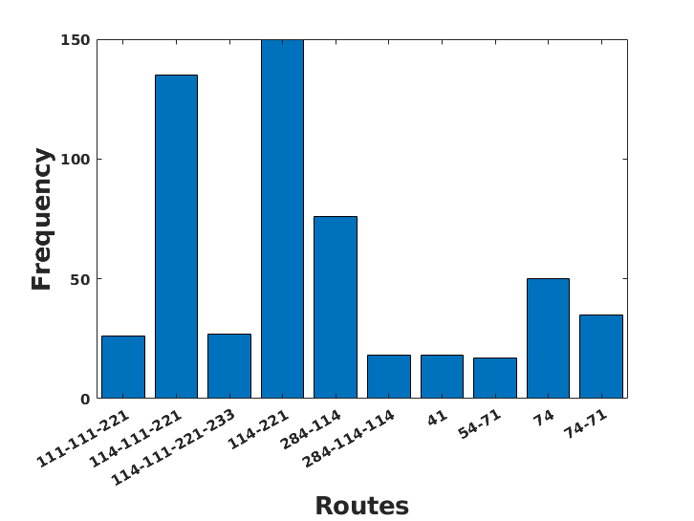
Popular route combinations
The encoded route combination of every play in the NFL 2020 season is converted to string data type.
This string data is plotted as frequency (number of occurrence) for the entire data.
The bar plot of top ten most used route combined is shown in the Figure on the right.
It is observed that “114-221” is the most popular route with 150 occurrence. The decoding of the “114-221” route is shown in the table:
Route Combination – 114-221
rp | Decoded Route | Decoded Position
114 | Blocking (11) | WR (4)
221 | Screen – Bubble (22) | SWR (1)

Slide 10
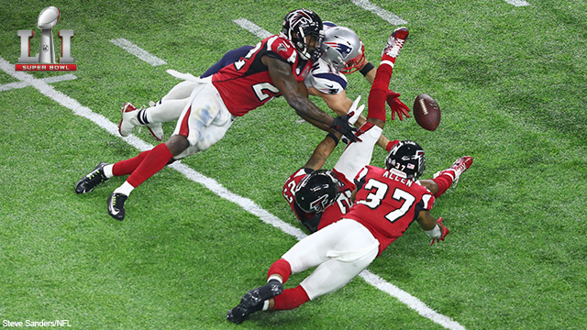
Popular Route Combos Vs Coverages

Slide 11
Assumptions & Considerations
Only valid coverages schemes in the play were considered. Therefore, we removed all rows that had a “Null Coverage schemes” column, thereby eliminating most rush plays .
Based on the previous route combination results, the data with No route combinations are removed.
The main features of the data is the ‘Expected Points Added (EPA)’ and ‘Coveragescheme,’ which will be used for calculating the best route combinations for every coverage scheme. Hence, other redundant features are removed.

Slide 12
Mean EPA metric
The data is sorted in sequential manner using the following features: 'frequency','CoverageScheme','EPA'. (Frequency denotes the number of route occurrences obtained from previous problem results).
This sorting helps in rearranging the data based on EPA for the every coverage scheme and popular route combinations in every play.
Now, the mean EPA is calculated for every coverage scheme in each route. The value of the EPA ranges from -8 to 8. Hence, the higher mean EPA would imply more success of that route combination against a particular coverage.

Slide 13
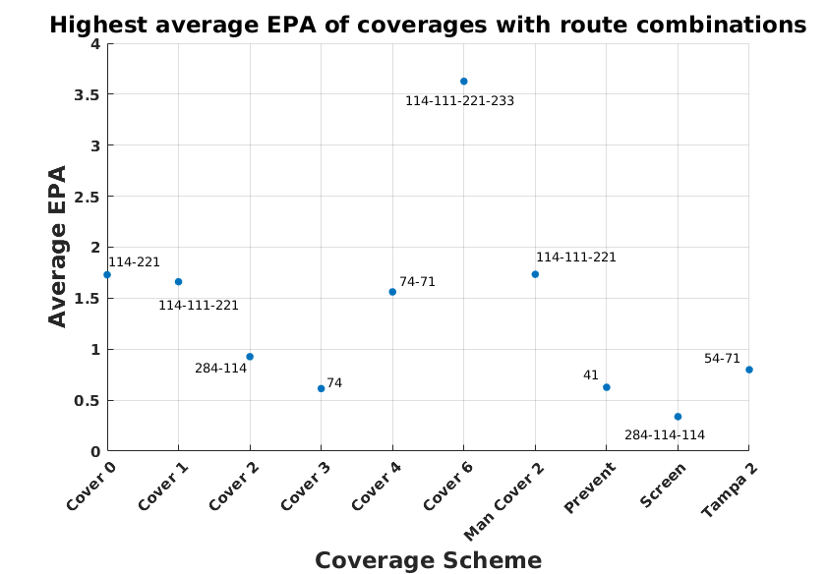
Best route combination for coverage schemes
The mean EPA is the metric that we are using to compute successful route.
Higher the mean EPA, higher is the probability of success of a play.
The highest mean EPA (high success rate) of the route combinations with respect to coverage schemes is shown in the Figure on right.

Slide 14
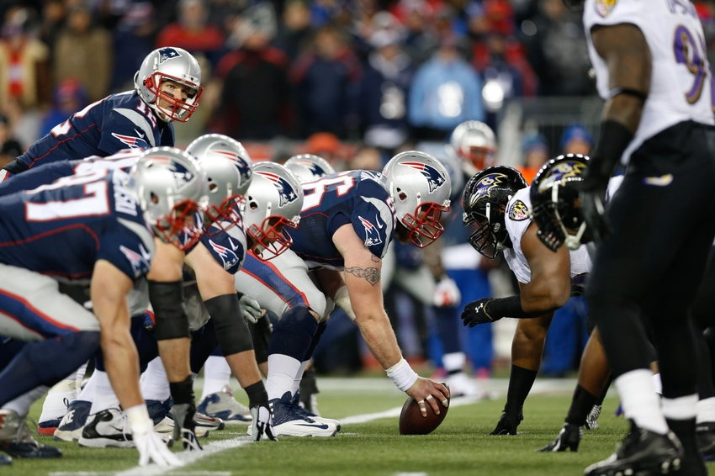
Results!!

Slide 15
Q1: Popular route combinations
Based on our analysis, we determined that the ten popular route combinations (per our definition) of NFL 2020 season are as follows:
Route Combinations | Frequency in NFL 2020 season
114-221 | 150
114-111-221 | 135
284-114 | 76
74 | 50
74-71 | 35
114-111-221-233 | 27
114-111-221 | 26
41 | 18
284-114-114 | 18
54-21 | 17

Slide 16
Q2: Best popular route for each coverage
Based on our analysis, we determined that the best popular route combinations (per our definition) for each coverage are as follows:
Coverage Scheme | Route combination
Cover 0 | 284-114
Cover 1 | 284-114-114
Cover 2 | 111-111-221
Cover 3 | 24-21-24
Cover 4 | 114-111-221-233
Cover 6 | 74
Man Cover 2 | 202
Prevent | 114-111-221
Screen | 114-111-221
Tampa 2 | 74-71

Slide 17
Limitations & Future scope
It’s difficult to draw novel conclusions from a single season’s data to find the best route combinations for every coverage. In the future, we will look into whether our conclusions hold for the previous seasons.
Further, it would be amazing to observe our conclusions with the player coordinates data to determine more precise route combinations and also the popular ones among them.
We would like to look at our conclusions with our own version of EPA estimate (requiring more in-depth game data).

Slide 18
Thank you!

