Slide 1
District-level coverage and unmet need for medical and traditional circumcision among men aged 15-49 years in sub-Saharan Africa - Updates
Imperial College London
03/03/2022

Slide 2
Outline
1. Motivation
2. Methods
3. Data and progress thus far
4. Results – sub-national circumcision coverage (?)
5. Model Validation and Hyperparameter Exploration
6. Limitations
7. Coming Up

Slide 3
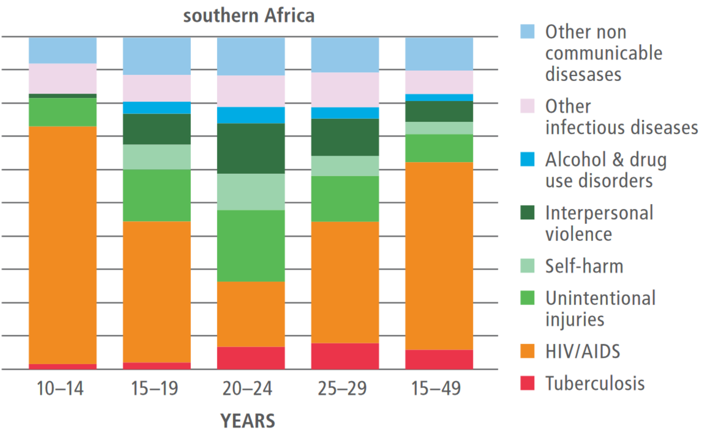
Motivation – VMMC
HIV remains largest cause of years of life lost for 10-49 year old men in eastern and southern Africa.
Voluntary Male medical circumcision (VMMC) reduces the rate of male-to-female HIV incidence by 60%.
Efficient, cost-effective, one-time procedure for preventing HIV transmission.
Notes:
Based on the Global Burden of Disease Study 2013
Also evidence to suggest it lowers the risks of HIV incidence for men who have sex with men
4. Potential entry point for adolescent boys to engage in health-seeking behaviour.
Meaning more likely to take preventative measures, be aware of possible HIV status, seek treatment

Slide 4
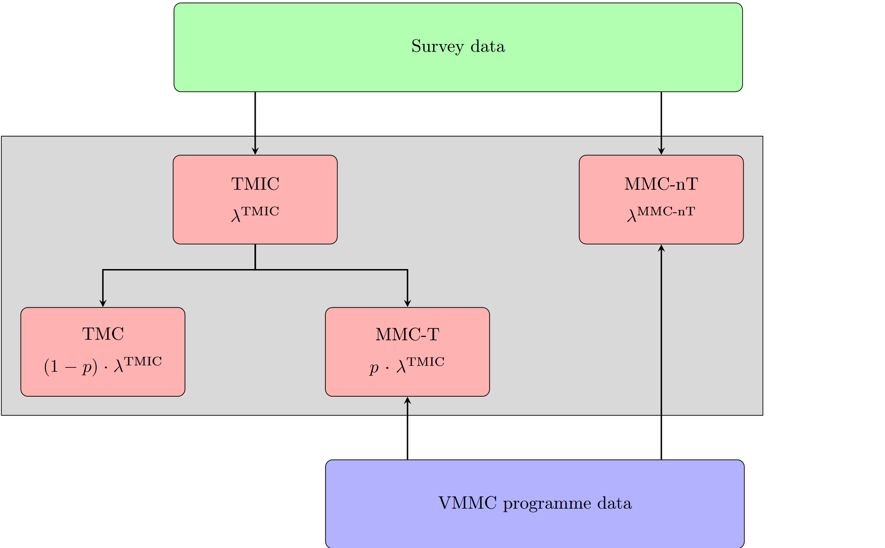
Methods – Model & Data
Bayesian competing risks time-to-event model
Stratified by time, space, age (groups) and circumcision type
Data:
Household surveys (2003 – 2019), assembled from major survey series (DHS, PHIA MICS, AIS), collecting self-reported circumcision status
Coverage post-2018 projected assuming continuation of estimated age-specific rates, with probabilistic uncertainty
Notes:
Model allows for the use of VMMC data as well, but hasn't been expanded to do so yet

Slide 5
Methods – Model & Data
Bayesian competing risks time-to-event model
Stratified by time, space, age (groups) and circumcision type
Data:
Household surveys (2003 – 2019), assembled from major survey series (DHS, PHIA MICS, AIS), collecting self-reported circumcision status
Coverage post-2018 projected assuming continuation of estimated age-specific rates, with probabilistic uncertainty
Notes:
Model allows for the use of VMMC data as well, but hasn't been expanded to do so yet

Slide 6
Methods - Aggregation
Samples drawn from model fit, weighted by population and aggregated, to produce estimates for less granular regions (e.g. District to Province aggregation).
Computed posterior summary statistics for coverage, circumcision incidence and probability of being circumcised.
Done for all strata, for both discrete ages and “binned” age groups.
Notes:
You need to weight by population when you are aggregating as areas/age groups have an unequal distribution of population, so you multiply, aggregate, then normalise by dividing

Slide 7
Results – Countries Modelled
So far, 28 SSA Countries modelled, 19 aggregated:
Eastern Africa (10/10):
Burundi, Ethiopia, Kenya, Malawi, Mozambique, Rwanda, Tanzania, Uganda, Zambia, Zimbabwe
Middle Africa (5/2):
Angola, Cameroon, Chad*, The Congo*, Gabon*
Southern Africa (4/4):
Eswatini, Lesotho, Namibia, South Africa
Western Africa (9/3)
Benin*, Burkina Faso, Côte d'Ivoire, Guinea*, Mali*, Niger*, Senegal*, Sierra Leone*, Togo
Notes:
Split into UN subregions, asterisk denotes countries which are modelled but not aggregated for
13/15 VMMC priority countries included (BWA and SSD missing)

Slide 8
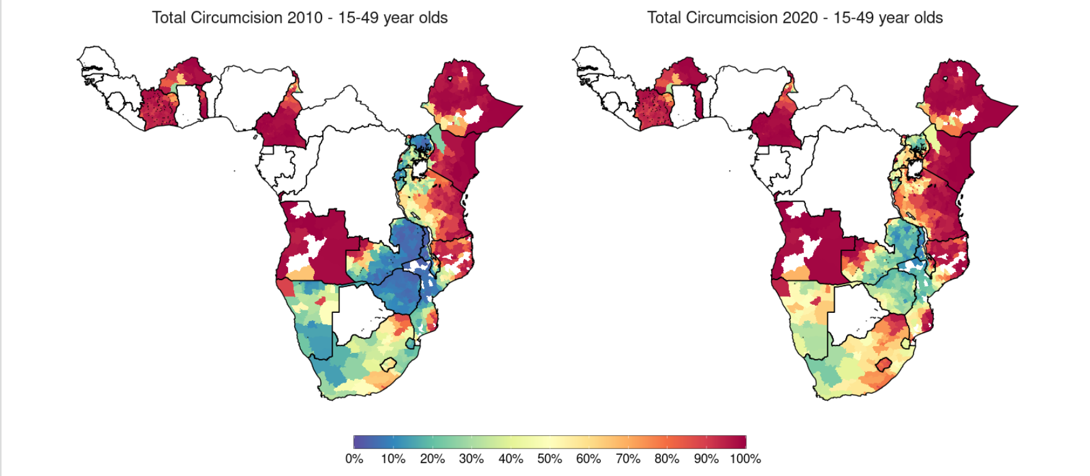
Results – Total Circumcision Change since 2010
Notes:
Comments:

Slide 9
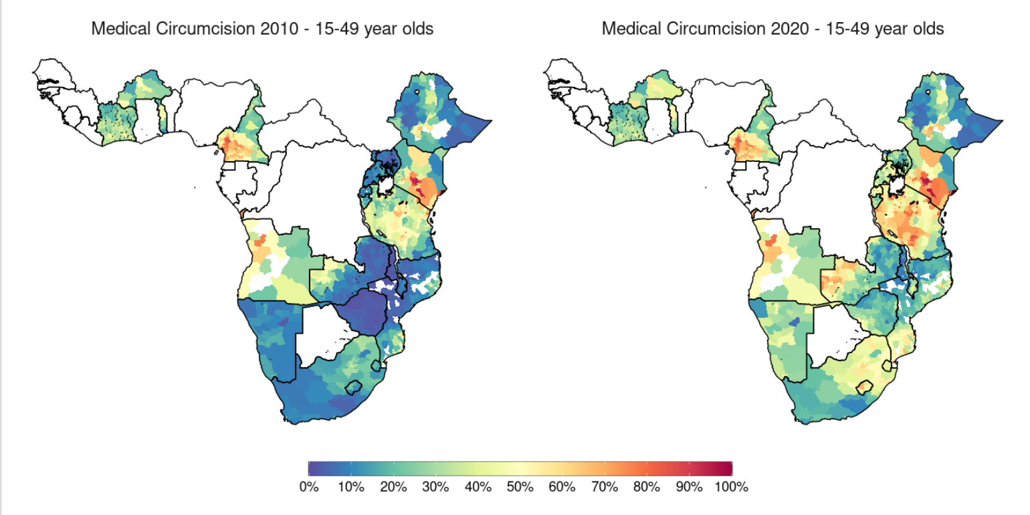
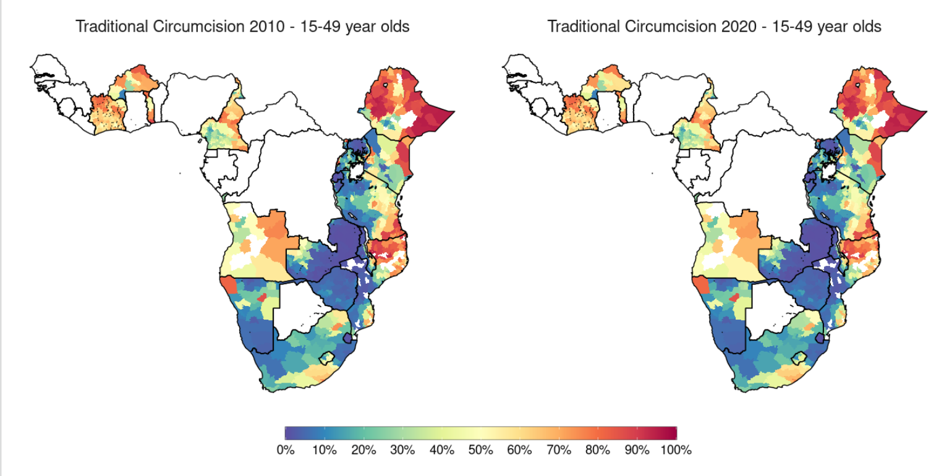
Results – MC Breakdown
Notes:
Comments:

Slide 10
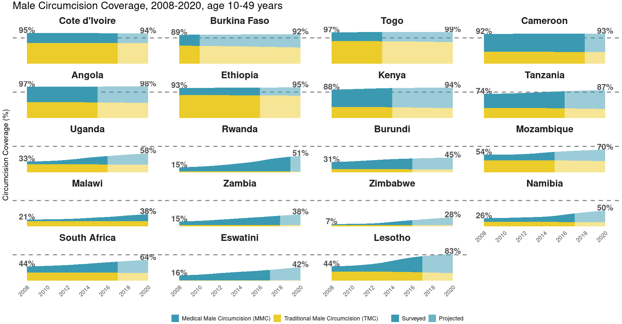
Results - Targets
Notes:
Target of 80% reached by 9 of 19 countries. Out of 13 (of 15) VMMC priority countries present here, only 4 (ETH, KEN, TZA, LSO) exceed this target (the first three (certainly the first two) of these had at least relatively high levels of TMC to begin with), and LSO, although having the largest increase (39%) in coverage of any country, is very small in comparison to some other countries
However, some still saw large increases in MC coverage, and country averages belie significant heterogeneity in circumcision coverage in some countries
(as shown for ZMB in next slide)
Why has coverage gone down in CIV and CMR??

Slide 11
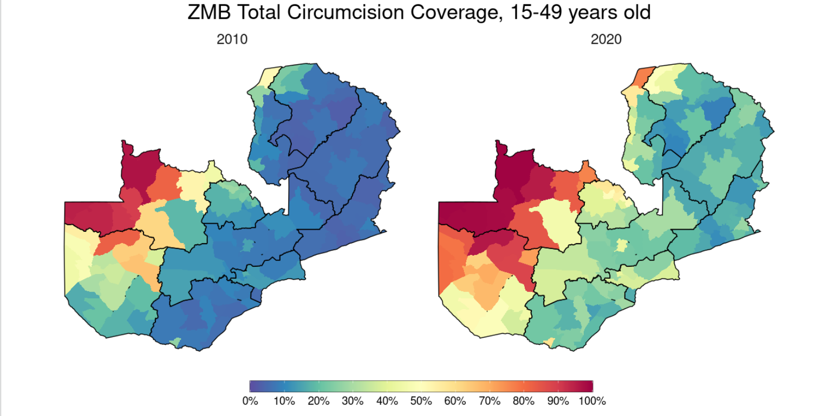
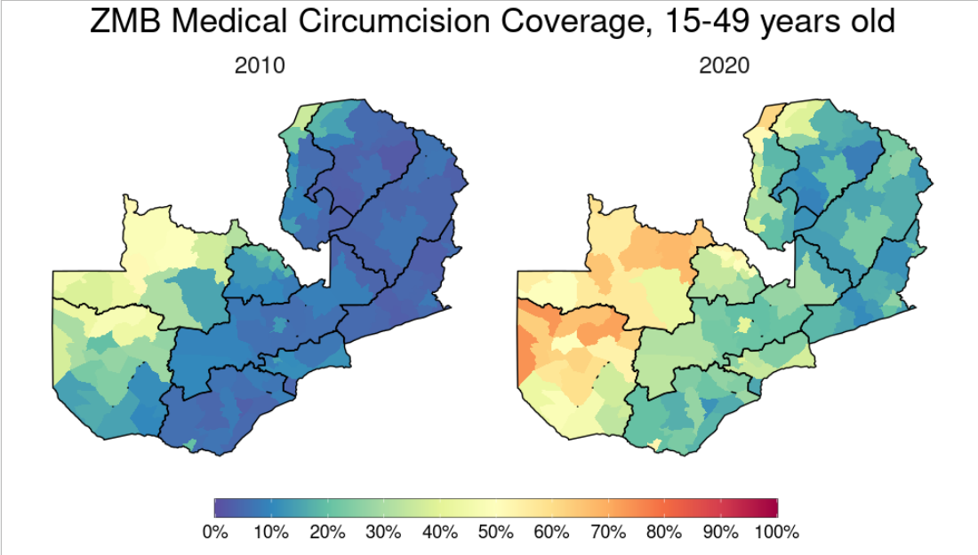
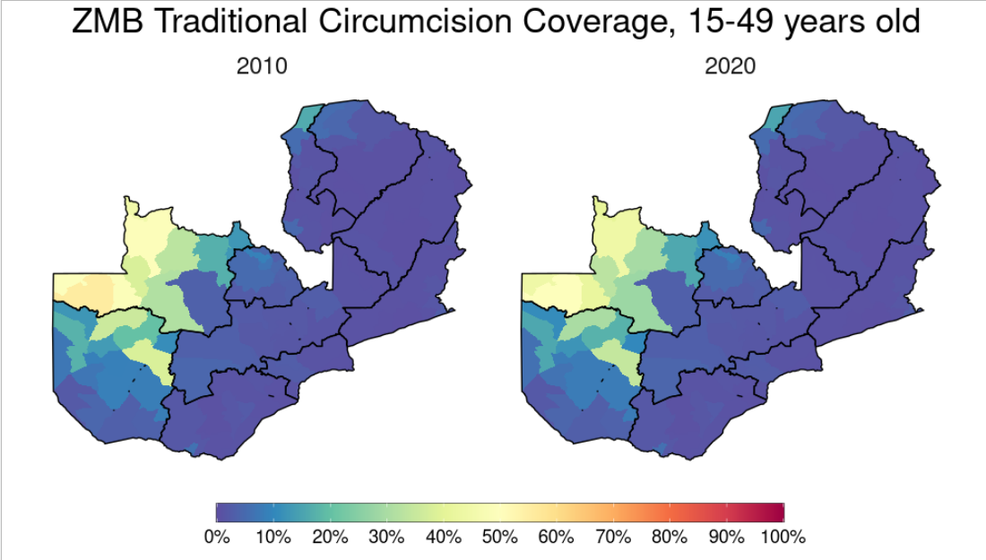
Results – ZMB
Notes:
ZMB had highest district-level discrepancy in MC coverage (Mungwi (0.0884) vs Mwinilunga (0.996))
Although it had mean of 38% coverage, 14 of it's 116 districts had more than 80% coverage for 15-49
Note how MMC for ZMB has increased in regions where TMC is not generally practiced, and also how TMC seems to have slightly decreased in some regions, may point to conversion of TMC to MMC-T in the region (here we've had to assume all MMC was MMC-nT, and vice versa for TMC)

Slide 12
Results – Countries Modelled
Can compare modelling results to survey points and DMPPT2 results, which are available for 10 modelled countries
While DMPPT2 results available for BWA, currently no survey model
Countries for which models generally agree:
Kenya
Mozambique
Malawi
Namibia
Eswatini

Slide 13
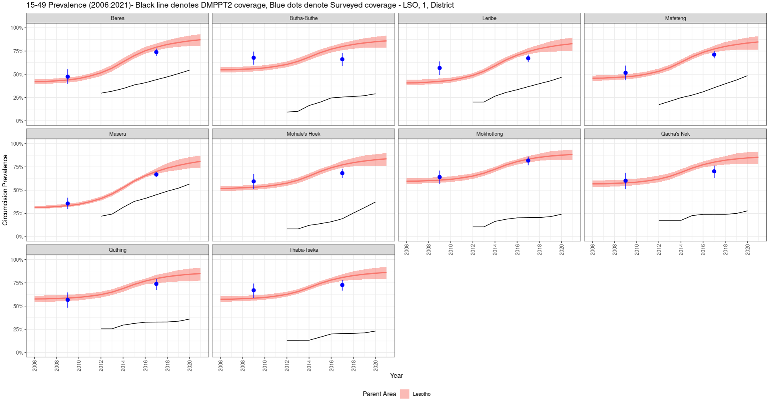
Verification – Comparison with DMPPT2
Countries with large national difference between models
Lesotho: Survey model (last survey 2017) much higher than DMPPT2 coverage
Notes:
Last survey for RWA was in 2019

Slide 14
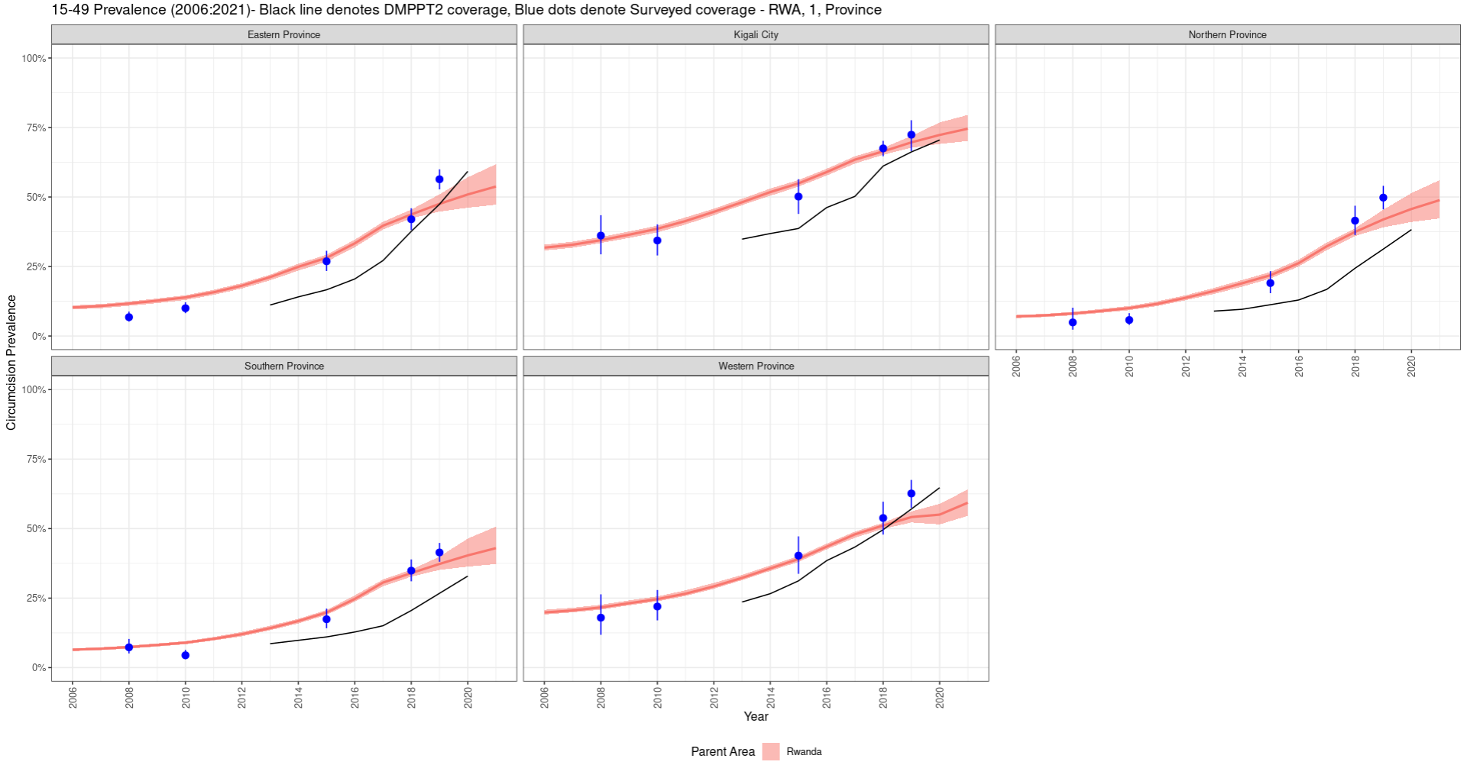
Verification – Comparison with DMPPT2
Countries with large national difference between models
Rwanda: Survey model also systematically higher than DMPPT2 coverage (to lesser extent), converging for latter years
Notes:
Last survey for RWA was in 2019

Slide 15
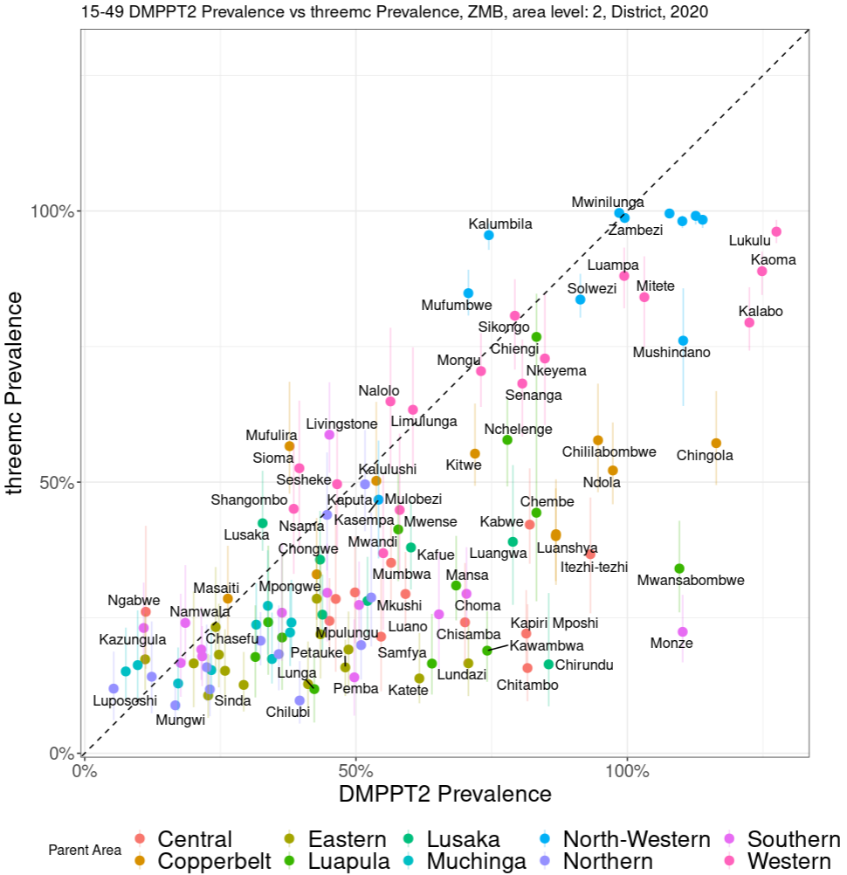
Verification – Comparison with DMPPT2
Countries with large national difference between models
Zambia: DMPPT2 generally higher than survey model, especially for later years, suggests inputted number of circumcisions far larger than surveys suggest
Notes:
Last survey for ZMB also 2017
Also note how some regions have > 100% circumcision, could be that our population for the
region is wrong, but more likely that people are travelling from other regions to here for
circumcision, and/or the VMMC data has been misreported

Slide 16
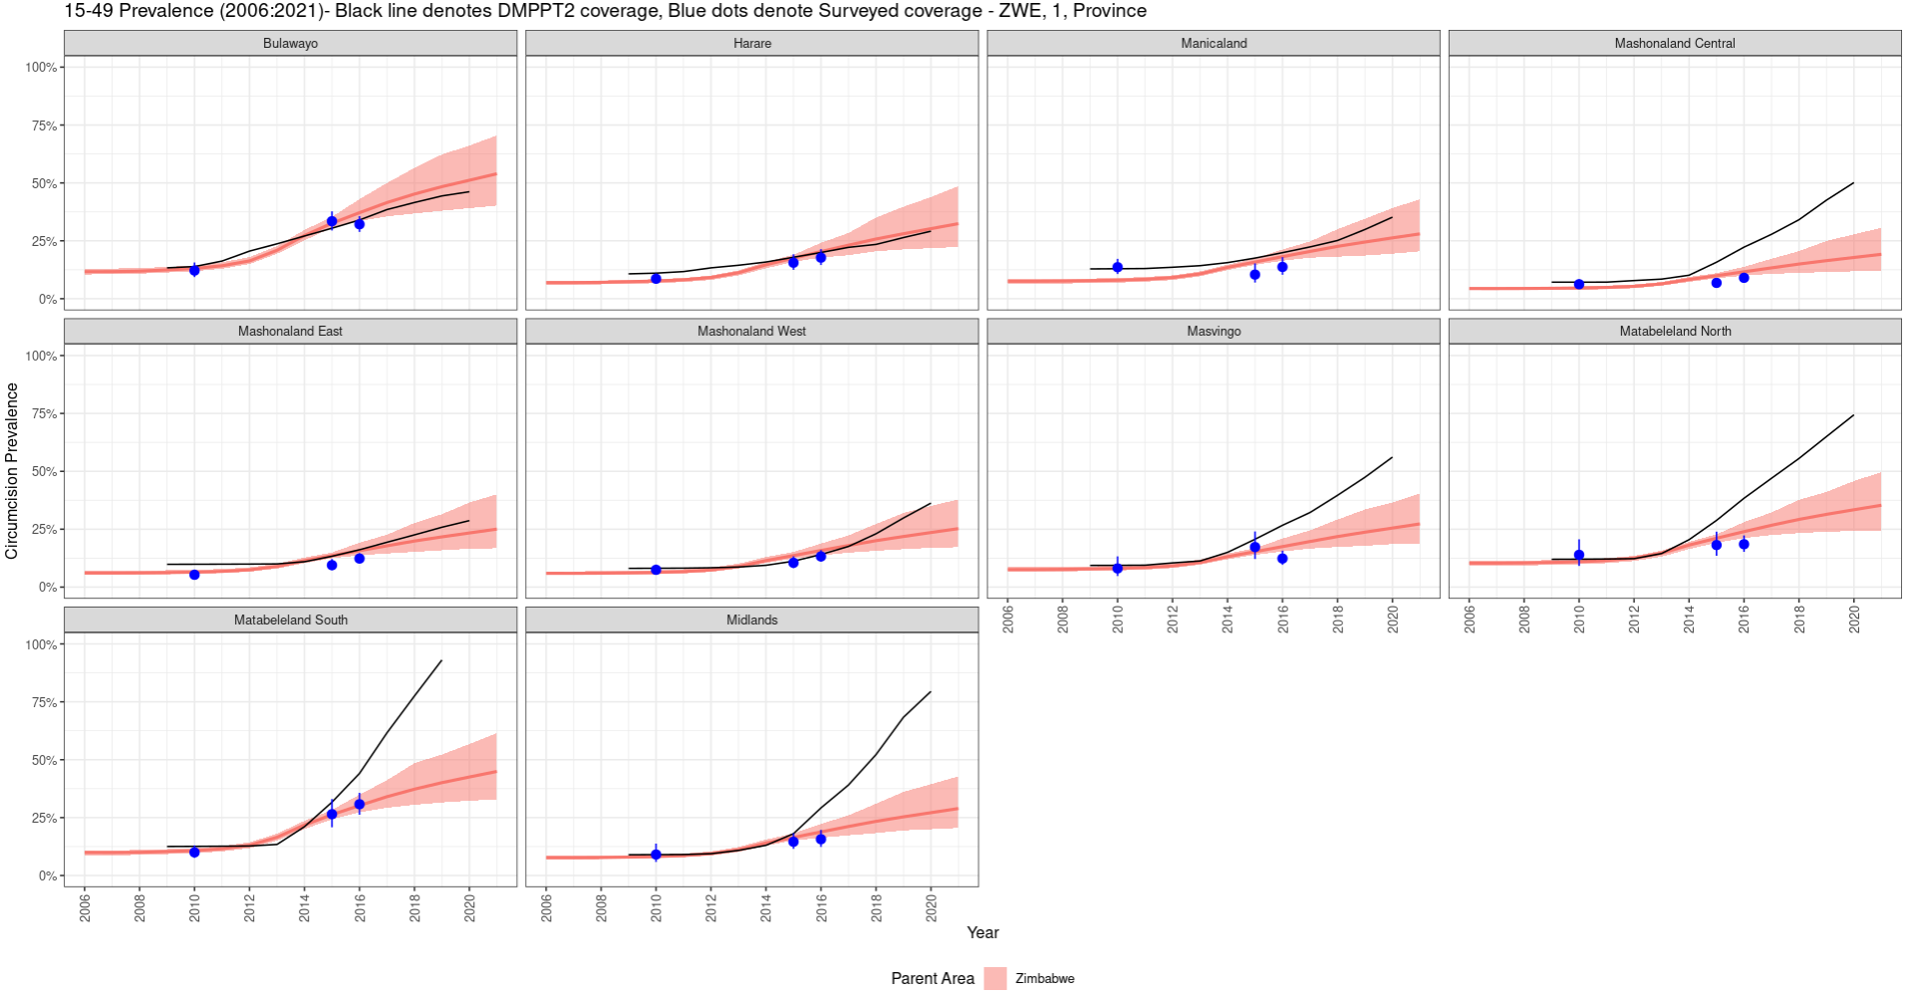
Verification – Comparison with DMPPT2
Countries with similar national levels, but sharp differences in some regions
Zimbabwe: nationally similar, but last survey was in 2016 and since then some provinces have seen extremely high increase in MC (presumably MMC) in DMPPT2 results
Notes:
Last survey for ZWE was in 2016, so it is conceivable that VMMC has ramped up as DMPPT2 suggests

Slide 17
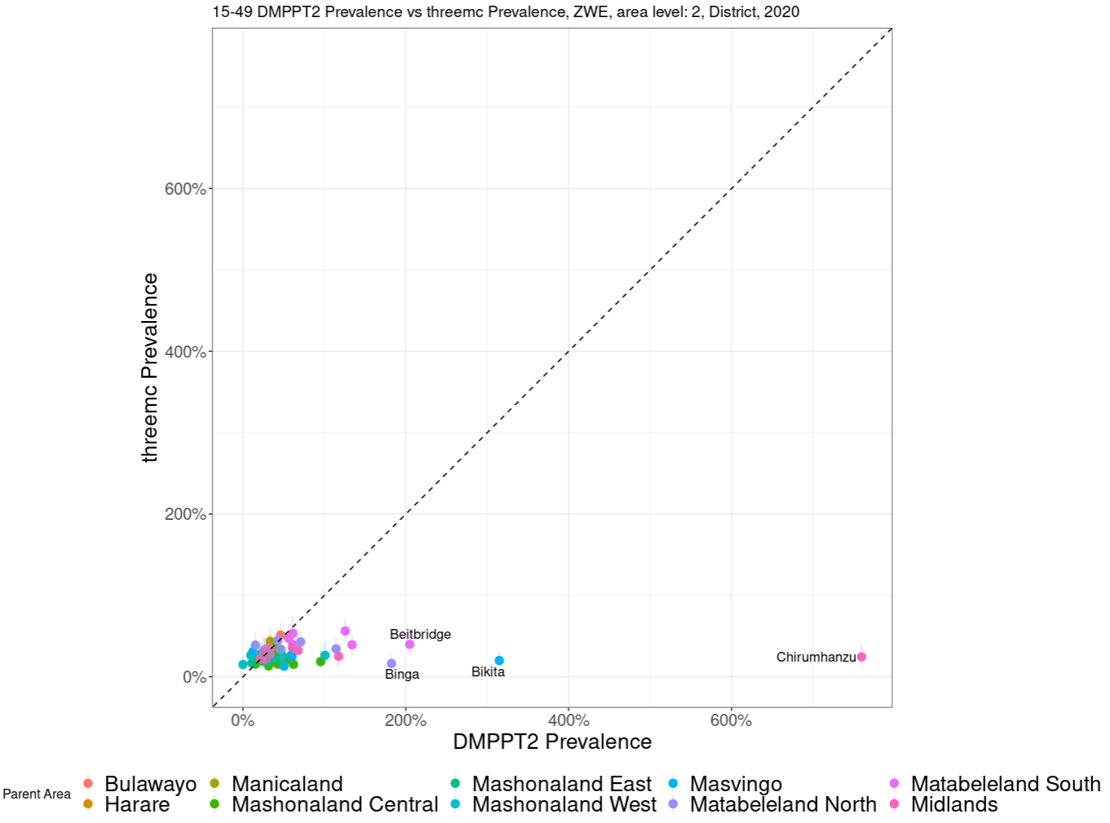
Verification – Comparison with DMPPT2
Countries with similar national levels, but sharp differences in some regions
Zimbabwe: nationally similar, but last survey was in 2016 and since then some provinces have seen extremely high increase in MC (presumably MMC) in DMPPT2 results
Notes:
Many regions have similar coverage in both models. However, incredibly large coverage for Chirumhanzu!

Slide 18
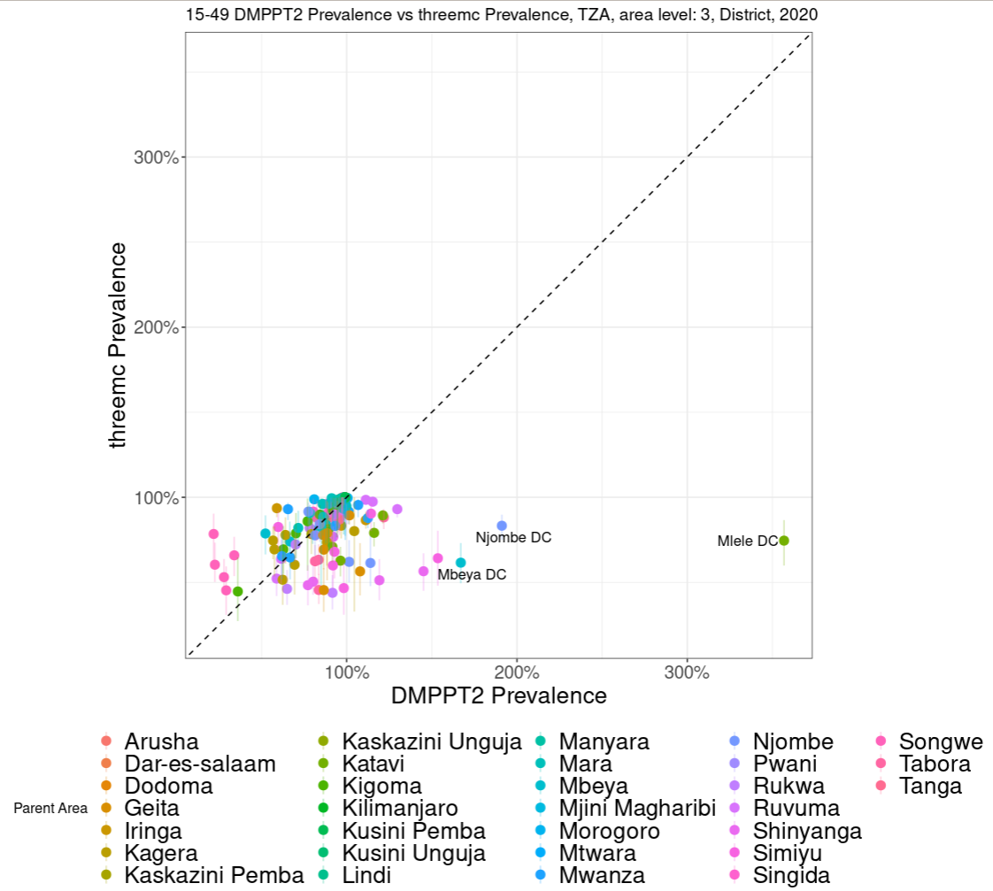
Verification – Comparison with DMPPT2
Countries with similar national levels, but sharp differences in some regions
Tanzania: Similar to ZWE, nationally similar, since last survey (2016) some districts have much higher coverage for DMPPT2. Several districts reported by DMPPT2 to have > 100% coverage.

Slide 19
Thank You! Any Questions?

