Slide 1
Searching: Binary Trees and Hash Tables
Chapter 12

Slide 2
Chapter Contents
12.1 Review of Linear Search and Binary Search
12.2 Introduction to Binary Trees
12.3 Binary Trees as Recursive Data Structures
12.4 Binary Search Trees
12.5 Case Study: Validating Computer Logins
12.6 Threaded Binary Search Trees (Optional)
12.7 Hash Tables

Slide 3
Chapter Objectives
Look at ways to search collections of data
  Begin with review of linear and binary search
Introduce trees in general and then focus on binary trees, looking at some of their applications and implementations
See how binary trees can be viewed as recursive data structures and how this simplifies algorithms for some of the basic operations
Develop a class to implement binary search trees using linked storage structure for the data items
(Optional) Look briefly at how threaded binary search trees facilitate traversals
Introduce the basic features of hash tables and examine some of the ways they are implemented

Slide 4
Linear Search
Collection of data items to be searched is organized in a list
x₁, x₂, … x_{n}
  Assume = = and < operators defined for the type
Linear search begins with item 1
  continue through the list until target found
  or reach end of list

Slide 5
Linear Search
Vector based search function
template <typename t>
void LinearSearch (const vector<t> &v,
const t &item,
boolean &found, int &loc)
{ found = false; loc = 0;
for ( ; ; )
{ if (found || loc == v.size()) return;
if (item == x[loc]) found = true;
else loc++; }
}

Slide 6
Linear Search
Singly-linked list based search function
template <typename t>
void LinearSearch (NodePointer first,
const t &item,
boolean &found, int &loc)
{ found = false; locptr = first;
for ( ; ; )
{ if (found || locptr ==) return;
if (item == locptr->data)
found = true;
else
loc++; }
}
In both cases, the worst case computing time is still O(n)

Slide 7
Binary Search
Binary search function for vector
template <typename t>
void LinearSearch (const vector<t> &v,
const t &item,
boolean &found, int &loc)
{ found = false;
int first = 0; last – v.size() - 1;
for ( ; ; )
{ if (found || first > last) return;
loc = (first + last) / 2;
if (item < v[loc])
last = loc + 1;
else if (item > v[loc])
first = loc + 1;
else /* item == v[loc] */ found = true;
}
}

Slide 8
Binary Search
Usually outperforms a linear search
Disadvantage:
  Requires a sequential storage
  Not appropriate for linked lists (Why?)
It is possible to use a linked structure which can be searched in a binary-like manner

Slide 9
Binary Search Tree
Consider the following ordered list of integers
Examine middle element
Examine left, right sublist (maintain pointers)
(Recursively) examine left, right sublists
13
28
35
49
62
66
80

Slide 10
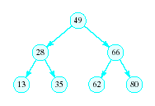
Binary Search Tree
Redraw the previous structure so that it has a treelike shape – a binary tree

Slide 11
Trees
A data structure which consists of
  a finite set of elements called nodes or vertices
  a finite set of directed arcs which connect the nodes
If the tree is nonempty
  one of the nodes (the root) has no incoming arc
  every other node can be reached by following a unique sequence of consecutive arcs

Slide 12
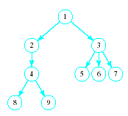
Trees
Tree terminology
Root node
Children of the parent (3)
Siblings to each other
Leaf nodes

Slide 13
Binary Trees
Each node has at most two children
Useful in modeling processes where
  a comparison or experiment has exactly two possible outcomes
  the test is performed repeatedly
Example
  multiple coin tosses
  encoding/decoding messages in dots and dashes such as Mores code

Slide 14
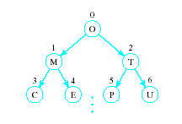

Array Representation of Binary Trees
Store the i^{th} node in the i^{th} location of the array

Slide 15
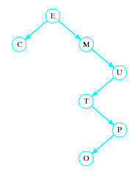
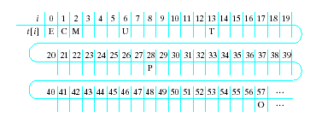
Array Representation of Binary Trees
Works OK for complete trees, not for sparse trees

Slide 16
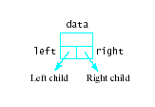

Linked Representation of Binary Trees
Uses space more efficiently
Provides additional flexibility
Each node has two links
  one to the left child of the node
  one to the right child of the node
  if no child node exists for a node, the link is set to NULL

Slide 17
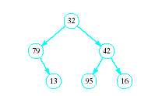
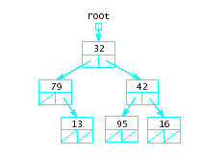
Linked Representation of Binary Trees
Example

Slide 18
Binary Trees as Recursive Data Structures
A binary tree is either empty …
or
Consists of
  a node called the root
  root has pointers to two
  disjoint binary (sub)trees called …
    right (sub)tree
    left (sub)tree
Anchor
Inductive step
Which is either empty …
or …
Which is either empty …
or …

Slide 19
Tree Traversal is Recursive
If the binary tree is empty then
do nothing
Else
N: Visit the root, process data
L: Traverse the left subtree
R: Traverse the right subtree
The "anchor"
The inductive step

Slide 20
Traversal Order
Three possibilities for inductive step …
Left subtree, Node, Right subtree
the inorder traversal
Node, Left subtree, Right subtree
the preorder traversal
Left subtree, Right subtree, Node
the postorder traversal

Slide 21
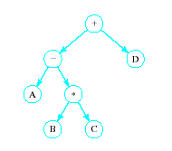
Traversal Order
Given expression
A – B * C + D
Represent each operand as
  The child of a
  parent node
Parent node,
representing
the corresponding
operator

Slide 22
Traversal Order
Inorder traversal produces infix expression
A – B * C + D
Preorder traversal produces the prefix expression
+ - A * B C D
Postorder traversal produces the postfix or RPN expression
A B C * - D +

Slide 23

ADT Binary Search Tree (BST)
Collection of Data Elements
  binary tree
  each node x,
    value in left child of x value in x in right child of x
Basic operations
  Construct an empty BST
  Determine if BST is empty
  Search BST for given item

Slide 24
ADT Binary Search Tree (BST)
Basic operations (ctd)
  Insert a new item in the BST
    Maintain the BST property
  Delete an item from the BST
    Maintain the BST property
  Traverse the BST
    Visit each node exactly once
    The inorder traversal must visit the values in the nodes in ascending order
View BST class template, Fig. 12-1

Slide 25
BST Traversals
Note that recursive calls must be made
  To left subtree
  To right subtree
Must use two functions
  Public method to send message to BST object
  Private auxiliary method that can access BinNodes and pointers within these nodes
Similar solution to graphic output
  Public graphic method
  Private graphAux method

Slide 26
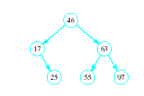

BST Searches
Search begins at root
  If that is desired item, done
If item is less, move down
left subtree
If item searched for is greater, move down right subtree
If item is not found, we
will run into an empty subtree
View search()

Slide 27
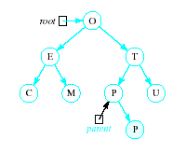
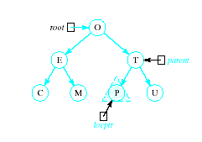
Inserting into a BST
Insert function
  Uses modified version of search to locate insertion location or already existing item
  Pointer parent trails search pointer locptr, keeps track of parent node
  Thus new node can be attached to BST in proper place
View insert() function
R

Slide 28
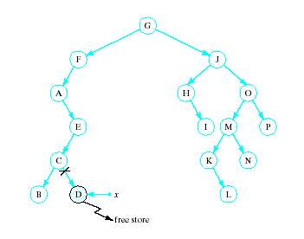
Recursive Deletion
Three possible cases to delete a node, x, from a BST
1. The node,
x, is a leaf

Slide 29
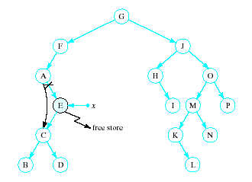
Recursive Deletion
2. The node, x has one child

Slide 30
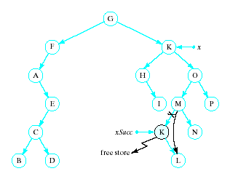
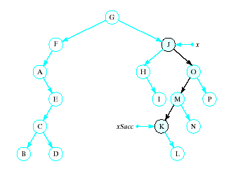
Recursive Deletion
x has two children
Delete node pointed to by xSucc as described for cases 1 and 2
Replace contents of x with inorder successor
K
View remove() function

Slide 31
BST Class Template
View complete binary search tree template, Fig. 12.7
View test program for BST, Fig. 12.8

Slide 32
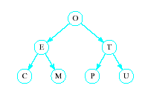
Problem of Lopsidedness
Tree can be balanced
  each node except leaves has exactly 2 child nodes

Slide 33
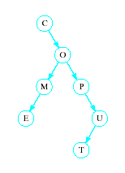
Problem of Lopsidedness
Trees can be unbalanced
  not all nodes have exactly 2 child nodes

Slide 34
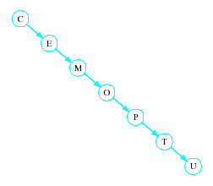
Problem of Lopsidedness
Trees can be totally lopsided
  Suppose each node has a right child only
  Degenerates into a linked list
Processing time affected by "shape" of tree

Slide 35
Case Study: Validating Computer Logins
Consider a computer system which logs in users
  Enter user name
  Enter password
  System does verification
The structure which contains this information must be able to be searched rapidly
  Must also be dynamic
  Users added and removed often

Slide 36
Case Study: Validating Computer Logins
Design
  Create class, UserInfo which contains ID, password
  Build BST of UserInfo objects
  Provide search capability for matching ID, password
  Display message with results of validity check
View source code, Fig. 12.9

Slide 37
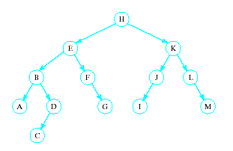
Threaded Binary Search Trees
Use special links in a BST
  These threads provide efficient nonrecursive traversal algorithms
  Build a run-time stack into the tree for recursive calls
Given BST

Slide 38
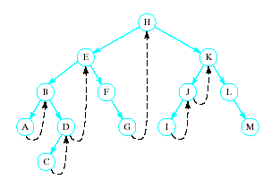
Threaded Binary Search Trees
Note the sequence
of nodes visited
  Left to right
A right threaded BST
  Whenever a node, x, with null right pointer is encountered, replace right link with thread to inorder successor of x
  Inorder successor of x is its parent if x is a left child
  Otherwise it is nearest ancestor of x that contains x in its left subtree

Slide 39
Threaded Binary Search Trees
Traversal algorithm
1. Initialize a pointer, ptr, to the root of tree
2. While ptr != null
  a. While ptr->left not null
  replace ptr by ptr->left
  b. Visit node pointed to by ptr
  c. While ptr->right is a thread do following
  i. Replace ptr by ptr->right
  ii. Visit node pointed to by ptr
  d. Replace ptr by ptr->right
  End while

Slide 40
Threaded Binary Search Trees
Additional field, rightThread required
public:
DataType data;
bool rightThread;
BinNode * left;
BinNode * right;
// BinNode constructors
// Default -- data part is default DataType value
// -- right thread is false; both links are null
BinNode()
: rightThread(false, left(0), right(0) { }
//Explicit Value -- data part contains item; rightThread
// -- is false; both links are null
BinNode (DataType item)
: data(item), rightThread(false), left(0), right(0) { }
}; // end of class BinNode declared

Slide 41
Hash Tables
Recall order of magnitude of searches
  Linear search O(n)
  Binary search O(log₂n)
  Balanced binary tree search O(log₂n)
  Unbalanced binary tree can degrade to O(n)

Slide 42
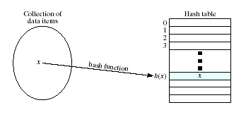
Hash Tables
In some situations faster search is needed
  Solution is to use a hash function
  Value of key field given to hash function
  Location in a hash table is calculated

Slide 43
Hash Functions
Simple function could be to mod the value of the key by some arbitrary integer
int h(int i)
{ return i % someInt; }
Note the max number of locations in the table will be same as someInt
Note that we have traded speed for wasted space
  Table must be considerably larger than number of items anticipated

Slide 44
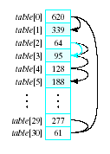
Hash Functions
Observe the problem with same value returned by h(i) for different values of i
  Called collisions
A simple solution is linear probing
  Linear search begins at
  collision location
  Continues until empty
  slot found for insertion

Slide 45
Hash Functions
When retrieving a value
linear probe until found
  If empty slot encountered
  then value is not in table
If deletions permitted
  Slot can be marked so
  it will not be empty and cause an invalid linear probe

Slide 46
Hash Functions
Strategies for improved performance
  Increase table capacity (less collisions)
  Use different collision resolution technique
  Devise different hash function
Hash table capacity
  Size of table must be 1.5 to 2 times the size of the number of items to be stored
  Otherwise probability of collisions is too high

Slide 47
Collision Strategies
Linear probing can result in primary clustering
Consider quadratic probing
  Probe sequence from location i is
  i + 1, i – 1, i + 4, i – 4, i + 9, i – 9, …
  Secondary clusters can still form
Double hashing
  Use a second hash function to determine probe sequence

Slide 48
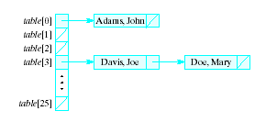
Collision Strategies
Chaining
  Table is a list or vector of head nodes to linked lists
  When item hashes to location, it is added to that linked list

Slide 49
Improving the Hash Function
Ideal hash function
  Simple to evaluate
  Scatters items uniformly throughout table
Modulo arithmetic not so good for strings
  Possible to manipulate numeric (ASCII) value of first and last characters of a name

