Slide 1
Sorting
Chapter 13

Slide 2
Chapter Contents
13.1 Some O(n²) Sorting Schemes
13.2 Heaps, Heapsort, and Priority Queues
13.3 Quicksort
13.4 Mergesort
13.5 Radix Sort

Slide 3
Chapter Objectives
Describe the three kinds of sorting methods
  Selection, exchange, and insertion
Look at examples of each kind of sort that are O(n²) sorts
  Simple selection, bubble, and insertion sorts
Study heaps, show how used for efficient selection sort, heapsort
  Look at implementation of priority queues using heaps
Study quicksort in detail as example of divide-and-conquer strategy for efficient exchange sort
Study mergesort as example of sort usable with for sequential files
Look at radix sort as example of non-comparison-based sort

Slide 4
Sorting
Consider list
x₁, x₂, x₃, … x_{n}
We seek to arrange the elements of the list in order
  Ascending or descending
Some O(n²) schemes
  easy to understand and implement
  inefficient for large data sets

Slide 5


Categories of Sorting Algorithms
Selection sort
  Make passes through a list
  On each pass reposition correctly some element

Slide 6


Categories of Sorting Algorithms
Exchange sort
  Systematically interchange pairs of elements which are out of order
  Bubble sort does this
Out of order, exchange
In order, do not exchange

Slide 7
Bubble Sort Algorithm
1. Initialize numCompares to n - 1
2. While numCompares != 0, do following
a. Set last = 1 // location of last element in a swap
b. For i = 1 to numPairs
if x_{i} > x_{i + 1}
Swap x_{i} and x_{i} ₊ ₁ and set last = i
c. Set numCompares = last – 1
End while

Slide 8
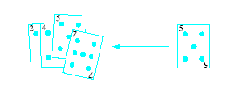
Categories of Sorting Algorithms
Insertion sort
  Repeatedly insert a new element into an already sorted list
  Note this works well with a linked list implementation
All these have computing time O(n²)

Slide 9
Algorithm for Linear Insertion Sort
For i = 2 to n do the following
a. set NextElement = x[i] and
x[0] = nextElement
b. set j = i
c. While nextElement < x[j – 1] do following
set x[j] equal to x[j – 1]
increment j by 1
End wile
d. set x[j] equal to nextElement
End for

Slide 10
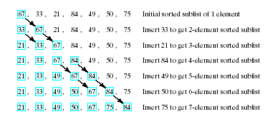
Example of Insertion Sort
Given list to be sorted
67, 33, 21, 84, 49, 50, 75
  Note sequence of steps carried out

Slide 11
Improved Schemes
We seek improved computing times for sorts of large data sets
Chapter presents schemes which can be proven to have average computing time
O( n log₂n )
Must be said, no such thing as a universally good sorting scheme
  Results may depend just how out of order list is

Slide 12
Comparisons of Sorts
Sort of a randomly generated list of 500 items
  Note: times are on 1970s hardware
Algorithm | Type of Sort | Time (sec)
Simple selection Heapsort Bubble sort 2 way bubble sort Quicksort Linear insertion Binary insertion Shell sort | Selection Selection Exchange Exchange Exchange Insertion Insertion Insertion | 69 18 165 141 6 66 37 11

Slide 13
Indirect Sorts
Possible that the items being sorted are large structures
  Data transfer/swapping time unacceptable
Alternative is indirect sort
  Uses index table to store positions of the objects
  Manipulate the index table for ordering

Slide 14
Heaps
A heap is a binary tree with properties:
It is complete
  Each level of tree completely filled
  Except possibly bottom level (nodes in left most positions)
It satisfies heap-order property
  Data in each node >= data in children

Slide 15
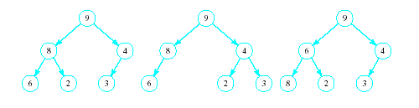
Heaps
Which of the following are heaps?
A
B
C

Slide 16
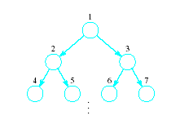
Implementing a Heap
Use an array or vector
Number the nodes from top to bottom
  Number nodes on each row from left to right
Store data in i^{th} node in i^{th} location of array (vector)

Slide 17
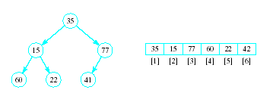
Implementing a Heap
Note the placement of the nodes in the array

Slide 18
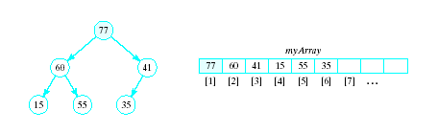
Implementing a Heap
In an array implementation children of i^{th} node are at myArray[2*i] and
myArray[2*i+1]
Parent of the i^{th} node is at mayArray[i/2]

Slide 19
Basic Heap Operations
Constructor
  Set mySize to 0, allocate array
Empty
  Check value of mySize
Retrieve max item
  Return root of the binary tree, myArray[1]

Slide 20
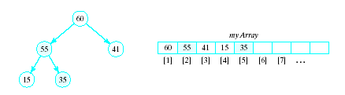
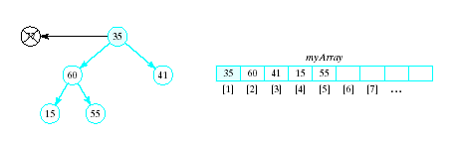
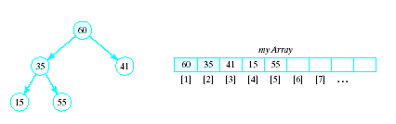
Basic Heap Operations
Delete max item
  Max item is the root, replace with last node in tree
  Then interchange root with larger of two children
  Continue this with the resulting sub-tree(s)
Result called a semiheap

Slide 21
Percolate Down Algorithm
1. Set c = 2 * r
2. While r <= n do following
a. If c < n and myArray[c] < myArray[c + 1]
Increment c by 1
b. If myArray[r] < myArray[c]
i. Swap myArray[r] and myArray[c]
ii. set r = c
iii. Set c = 2 * c
else
Terminate repetition
End while

Slide 22
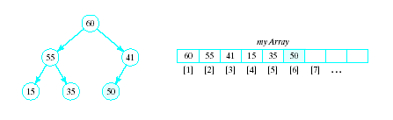
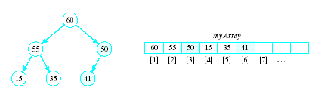
Basic Heap Operations
Insert an item
  Amounts to a percolate up routine
  Place new item at end of array
  Interchange with parent so long as it is greater than its parent

Slide 23
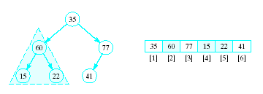
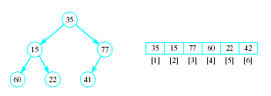
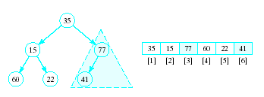
Heapsort
Given a list of numbers in an array
  Stored in a complete binary tree
Convert to a heap
  Begin at last node not a leaf
  Apply percolated down to this subtree
  Continue

Slide 24
Heapsort
Algorithm for converting a complete binary tree to a heap – called "heapify"
For r = n/2 down to 1:
Apply percolate_down to the subtree
in myArray[r] , … myArray[n]
End for
Puts largest element at root

Slide 25
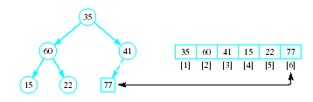
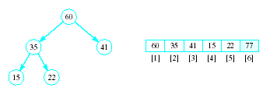
Heapsort
Now swap element 1 (root of tree) with last element
  This puts largest element in correct location
Use percolate down on remaining sublist
  Converts from semi-heap to heap

Slide 26
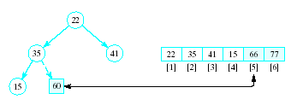
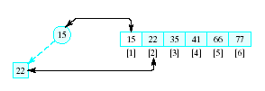
Heapsort
Again swap root with rightmost leaf
Continue this process with shrinking sublist

Slide 27
Heapsort Algorithm
1. Consider x as a complete binary tree, use heapify to convert this tree to a heap
2. for i = n down to 2:
a. Interchange x[1] and x[i]
(puts largest element at end)
b. Apply percolate_down to convert binary
tree corresponding to sublist in
x[1] .. x[i-1]

Slide 28
Heap Algorithms in STL
Found in the <algorithm> library
  make_heap() heapify
  push_heap() insert
  pop_heap() delete
  sort_heap() heapsort
Note program which illustrates these operations, Fig. 13.1

Slide 29
Priority Queue
A collection of data elements
  Items stored in order by priority
  Higher priority items removed ahead of lower
Operations
  Constructor
  Insert
  Find, remove smallest/largest (priority) element
  Replace
  Change priority
  Delete an item
  Join two priority queues into a larger one

Slide 30
Priority Queue
Implementation possibilities
  As a list (array, vector, linked list)
  As an ordered list
  Best is to use a heap
  Basic operations have O(log₂n) time
STL priority queue adapter uses heap
  Note operations in table of Fig. 13.2 in text, page 766

Slide 31
Quicksort
A more efficient exchange sorting scheme than bubble sort
  A typical exchange involves elements that are far apart
  Fewer interchanges are required to correctly position an element.
Quicksort uses a divide-and-conquer strategy
  A recursive approach
  The original problem partitioned into simpler sub-problems,
  Each sub problem considered independently.
Subdivision continues until sub problems obtained are simple enough to be solved directly

Slide 32
Quicksort
Choose some element called a pivot
Perform a sequence of exchanges so that
  All elements that are less than this pivot are to its left and
  All elements that are greater than the pivot are to its right.
Divides the (sub)list into two smaller sub lists,
Each of which may then be sorted independently in the same way.

Slide 33
Quicksort
If the list has 0 or 1 elements,
return. // the list is sorted
Else do:
Pick an element in the list to use as the pivot.
Split the remaining elements into two disjoint groups:
  SmallerThanPivot = {all elements < pivot}
  LargerThanPivot = {all elements > pivot}
Return the list rearranged as:
Quicksort(SmallerThanPivot),
pivot,
Quicksort(LargerThanPivot).

Slide 34
Quicksort Example
Given to sort:
75, 70, 65, , 98, 78, 100, 93, 55, 61, 81,
Select, arbitrarily, the first element, 75, as pivot.
Search from right for elements <= 75, stop at first element <75
Search from left for elements > 75, stop at first element >=75
Swap these two elements, and then repeat this process
84
68

Slide 35
Quicksort Example
75, 70, 65, 68, 61, 55, 100, 93, 78, 98, 81, 84
When done, swap with pivot
This SPLIT operation placed pivot 75 so that all elements to the left were <= 75 and all elements to the right were >75.
  View code for split() template
75 is now placed appropriately
Need to sort sublists on either side of 75

Slide 36
Quicksort Example
Need to sort (independently):
55, 70, 65, 68, 61 and
100, 93, 78, 98, 81, 84
Let pivot be 55, look from each end for values larger/smaller than 55, swap
Same for 2nd list, pivot is 100
Sort the resulting sublists in the same manner until sublist is trivial (size 0 or 1)
View quicksort() recursive function

Slide 37
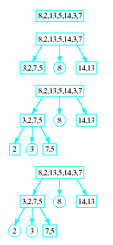
Quicksort
Note visual example of
a quicksort on an array
etc. …

Slide 38
Quicksort Performance
O(log₂n) is the average case computing time
  If the pivot results in sublists of approximately the same size.
O(n²) worst-case
  List already ordered, elements in reverse
  When Split() repetitively results, for example, in one empty sublist

Slide 39
Improvements to Quicksort
Quicksort is a recursive function
  stack of activation records must be maintained by system to manage recursion.
  The deeper the recursion is, the larger this stack will become.
The depth of the recursion and the corresponding overhead can be reduced
  sort the smaller sublist at each stage first

Slide 40
Improvements to Quicksort
Another improvement aimed at reducing the overhead of recursion is to use an iterative version of Quicksort()
To do so, use a stack to store the first and last positions of the sublists sorted "recursively".

Slide 41
Improvements to Quicksort
An arbitrary pivot gives a poor partition for nearly sorted lists (or lists in reverse)
Virtually all the elements go into either SmallerThanPivot or LargerThanPivot
  all through the recursive calls.
Quicksort takes quadratic time to do essentially nothing at all.

Slide 42
Improvements to Quicksort
Better method for selecting the pivot is the median-of-three rule,
  Select the median of the first, middle, and last elements in each sublist as the pivot.
Often the list to be sorted is already partially ordered
Median-of-three rule will select a pivot closer to the middle of the sublist than will the “first-element” rule.

Slide 43
Improvements to Quicksort
For small files (n <= 20), quicksort is worse than insertion sort;
  small files occur often because of recursion.
Use an efficient sort (e.g., insertion sort) for small files.
Better yet, use Quicksort() until sublists are of a small size and then apply an efficient sort like insertion sort.

Slide 44
Mergesort
Sorting schemes are either …
  internal -- designed for data items stored in main memory
  external -- designed for data items stored in secondary memory.
Previous sorting schemes were all internal sorting algorithms:
  required direct access to list elements
    not possible for sequential files
  made many passes through the list
    not practical for files

Slide 45
Mergesort
Mergesort can be used both as an internal and an external sort.
Basic operation in mergesort is merging,
  combining two lists that have previously been sorted
  resulting list is also sorted.

Slide 46
Merge Algorithm
1. Open File1 and File2 for input, File3 for output
2. Read first element x from File1 and
first element y from File2
3. While neither eof File1 or eof File2
If x < y then
a. Write x to File3
b. Read a new x value from File1
Otherwise
a. Write y to File3
b. Read a new y from File2
End while
4. If eof File1 encountered copy rest of of File2 into File3. If eof File2 encountered, copy rest of File1 into File3

Slide 47


Binary Merge Sort
Given a single file
Split into two files

Slide 48


Binary Merge Sort
Merge first one-element "subfile" of F1 with first one-element subfile of F2
  Gives a sorted two-element subfile of F
Continue with rest of one-element subfiles

Slide 49



Binary Merge Sort
Split again
Merge again as before
Each time, the size of the sorted subgroups doubles

Slide 50


Binary Merge Sort
Last splitting gives two files each in order
Last merging yields a single file, entirely in order
Note we always are limited to subfiles of some power of 2

Slide 51

Natural Merge Sort
Allows sorted subfiles of other sizes
  Number of phases can be reduced when file contains longer "runs" of ordered elements
Consider file to be sorted, note in order groups

Slide 52


Natural Merge Sort
Copy alternate groupings into two files
  Use the sub-groupings, not a power of 2
Look for possible larger groupings

Slide 53

Natural Merge Sort
Merge the corresponding sub files
EOF for F2, Copy remaining groups from F1

Slide 54



Natural Merge Sort
Split again,
alternating groups
Merge again, now two subgroups
One more split, one more merge gives sort

Slide 55
Natural Merge Sort
Note Split algorithm for natural merge sort, page 785 of text
Note Merge algorithm for natural merge sort, page 785 of text
Note Mergesort algorithm which uses the Split and Merge routines, page 786 of text
Worst case for natural merge sort O(n log₂n)

Slide 56
Radix Sort
Based on examining digits in some base-b numeric representation of items (or keys)
Least significant digit radix sort
  Processes digits from right to left
  Used in early punched-card sorting machines
Create groupings of items with same value in specified digit
  Collect in order and create grouping with next significant digit

