Slide 1
Predicting developer salaries
The Vikings

Slide 2
Business Overview
Africa's tech sector is booming, leading to increased job opportunities.
However, salary information in the industry is limited.
To address this, a project aims to create a platform predicting developer salaries and providing salary comparisons across regions.

Slide 3
Challenges
African salaries
Lack of platforms available that accurately predict developer salaries in Africa
Focus on developers
Few platforms optimize on developer information only, but rather, most generalize for all professions
Accuracy of prediction
Most other platforms use average salaries from regions where developers earn more than in Africa
Lack of material
Lack of up-to-date resources that assist developers to prepare themselves for both technical and non-technical interviews and to build their portfolio.

Slide 4
PROPOSED Solutions
ACCOUNT FOR REGIONAL DIFFERENCES
FOCUS ON DEVELOPERS
Develop a platform that considers regional differences when predicting salaries
To develop a platform that takes in 10 different features, representing the developer description to make predictions
PROVIDE A RANGE OF SALARY
PROVIDE MATERIAL
The proposed solution will provide a range of salaries which is a more accurate method of prediction than a single figure
Provide adequate material to build their portfolio and prepare for interviews

Slide 5



Project objectives
Job seekers
Employers
Recruitment agencies
To enable Jobseekers to ask for competitive salaries during contract negotiations.
To assist employers in offering fair compensation to their employees.
Assist Recruitment agencies offer accurate salary estimates to their clients.

Slide 6
Project success metrics
RMSE (ROOT MEAN SQUARE ERROR)
This is a measure of the average difference between a statistical model's predicted values and the actual values.
ACCURACY
This is the ratio of the number of correct predictions to the total number of input samples.
A test accuracy of 70% will be considered a success

Slide 7
The data used
The data comes from the Stack Overflow annual developer survey for 2022.
It contains 73,268 responses and 79 features, i.e 79 data points about each developer.

Slide 8
Insights from the data

Slide 9
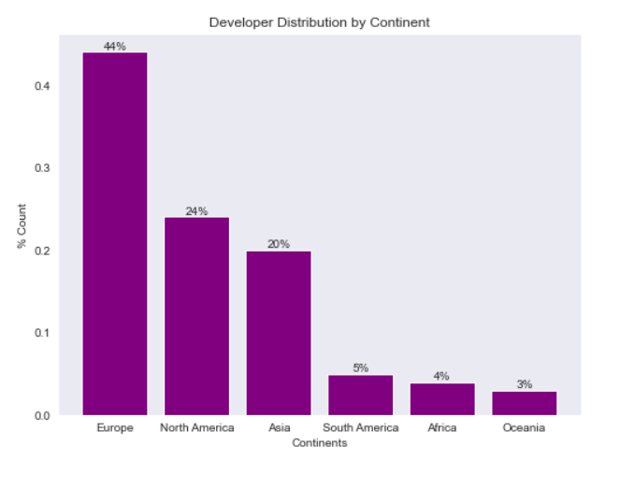
Developer distribution by continent
Europe has the highest number of developers, which is almost twice the number of developers in the next continent
Africa only had 4% of respondents in the survey.
Oceania had the least number of respondents.

Slide 10
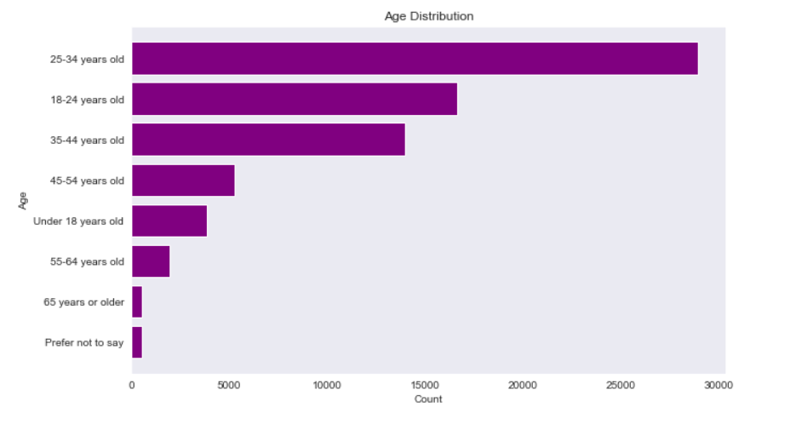
Age distribution
Most developers are below 34 years old.
There is a significant number of developers under 18 years old.
Software development is mostly a youthful profession.

Slide 11
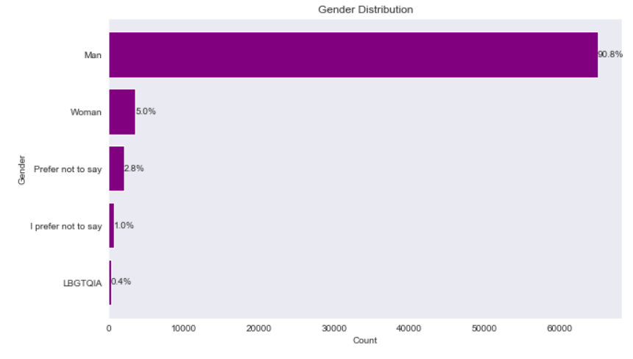
Gender distribution
A majority or respondents in the survey were male.
This could indicate that tech space is a male dominated field.

Slide 12
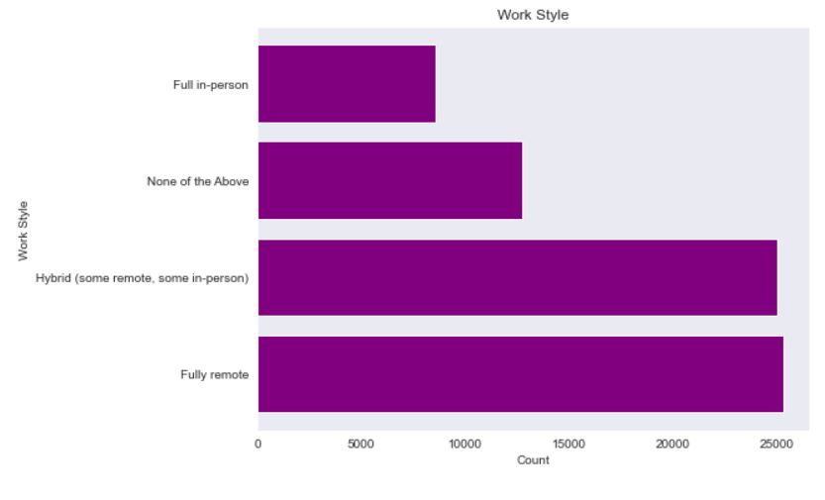
Remote vs onsite
The most popular work style was seen to be fully remote
A fully in person work style was found to be the least popular.

Slide 13
MODEL EVALUATION

Slide 14
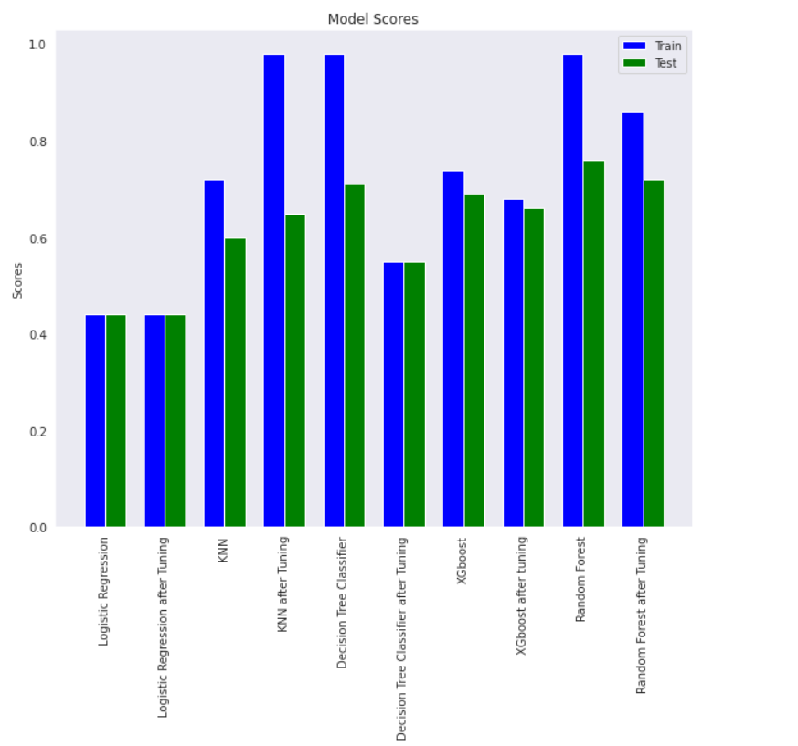
The best model was model 10:
(Tuned Random Forest)
It obtained an accuracy score of 72% which is above the target set for this project.

Slide 15
conclusion
ABSTRACT
We based our research on market trends and social media
DESIGN
We believe people need more products specifically dedicated to this niche market
RESEARCH
Minimalist and easy to use

Slide 16
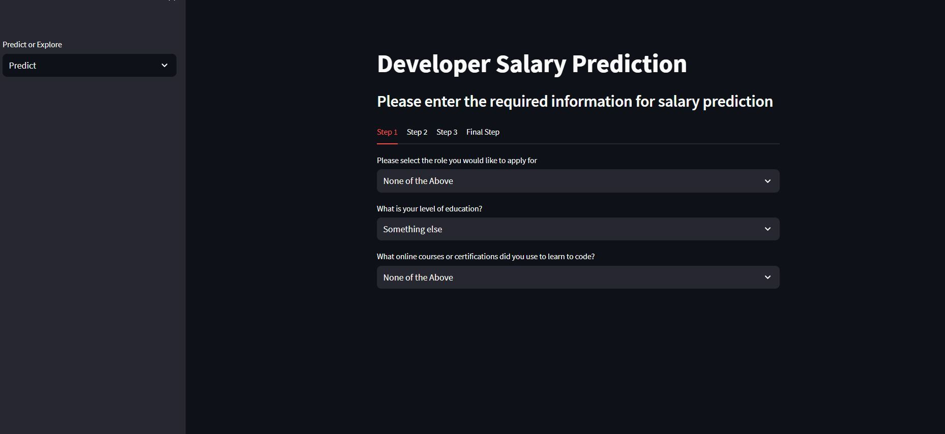
Deployment web app

Slide 17
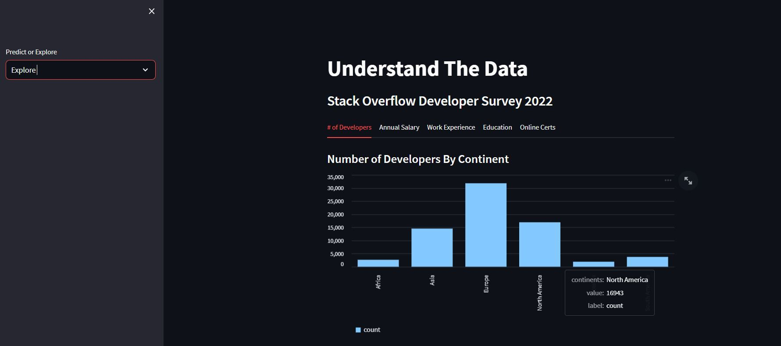
Deployment web app

Slide 18
recommendations
At Contoso, we believe in giving 110%. By using our next-generation data architecture, we help organizations virtually manage agile workflows. We thrive because of our market knowledge and great team behind our product. As our CEO says, "Efficiencies will come from proactively transforming how we do business.”

Slide 19








MEET THE TEAM
TAKUMA HAYASHI
MIRJAM NILSSON​
FLORA BERGGREN​
RAJESH SANTOSHI
President
Chief Executive Officer
Chief Operations Officer
VP Marketing
GRAHAM BARNES
ROWAN MURPHY
ELIZABETH MOORE
ROBIN KLINE
VP Product
SEO Strategist
Product Designer
Content Developer

Slide 20
THANK YOU
The Vikings​
GitHub Repository:
https://github.com/paddyokore/developer-salary-prediction/tree/master

