Slide 1
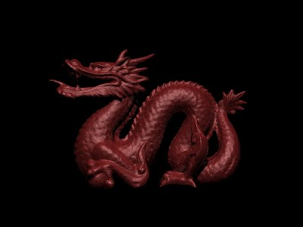
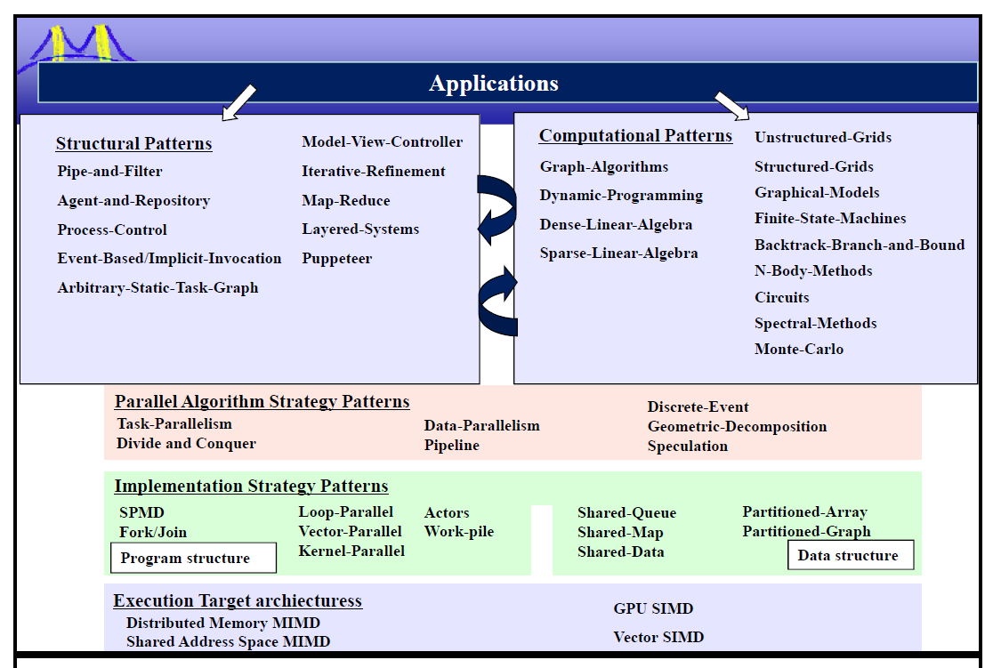
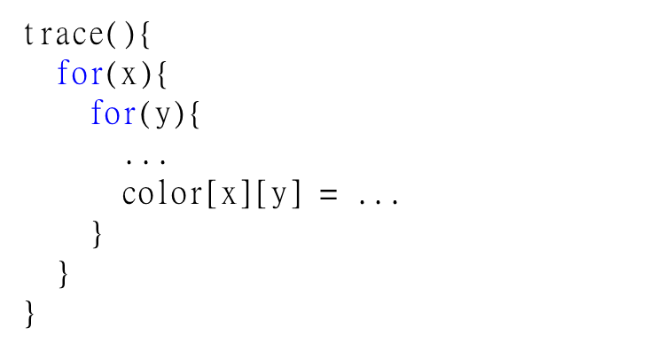
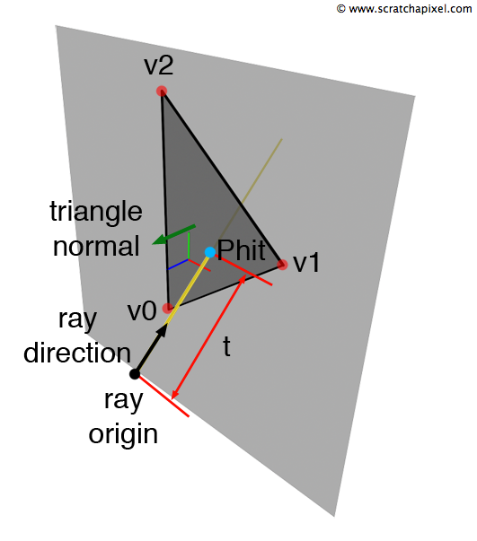
Parallel Ray Tracing
Paden Tomasello
Joint UG work with Huiming Han, Zhiyuan Xu, Chien-Yu Chiou in “Engineering Parallel Software” with Prof. Keutzer
Ray Tracing
Algorithmic Improvements
Generates realistic image with accurate lighting and shadow
Real world: light rays leave a light source and enter into eye
Ray Trace:
Send a ray from a camera
Check for intersections with objects
Reflect toward light source. If blocked, create shadow
Reflections are recursive
Axis-Aligned Bounding Box (AABB) Tree
Similar to quad-tree but in three dimensions
Vastly improves performance when dealing with many triangles
Removed Redundant Computation
Pre-calculate normal vectors of triangles
Stanford Dragon
Task Parallelism for each Ray
OpenMP with AABB
OpenMP Scale Plot (Guided)
Data Parallelism: Intersections
Fastest time: 1.14 seconds
13.4 minutes
References
Colors/Ray turned into aligned vectors arrays
SSE Vector Arithmetic
Dot and Cross Products
Scalar Multiplication
Addition
Summary
UC Berkeley CS184/284 Slides
Raytracing
BSP and AABB Tree
UC Berkeley CS194 Slides
OPL
Optimization pattern
Wikipedia Ray tracing image
http://en.wikipedia.org/wiki/Ray_tracing_%28graphics%29
Serial Code: over 8 hours. Optimized to 1.14 seconds.
Serial => parallel, more thread + more cache
Data in array increases spatial locality access speed
AABB tree reduce computation + memory access
SSE instructions reduce number of computations
Notes:
Please put in notes here to explain poster so that someone else could summarize what your poster is about

