Slide 1


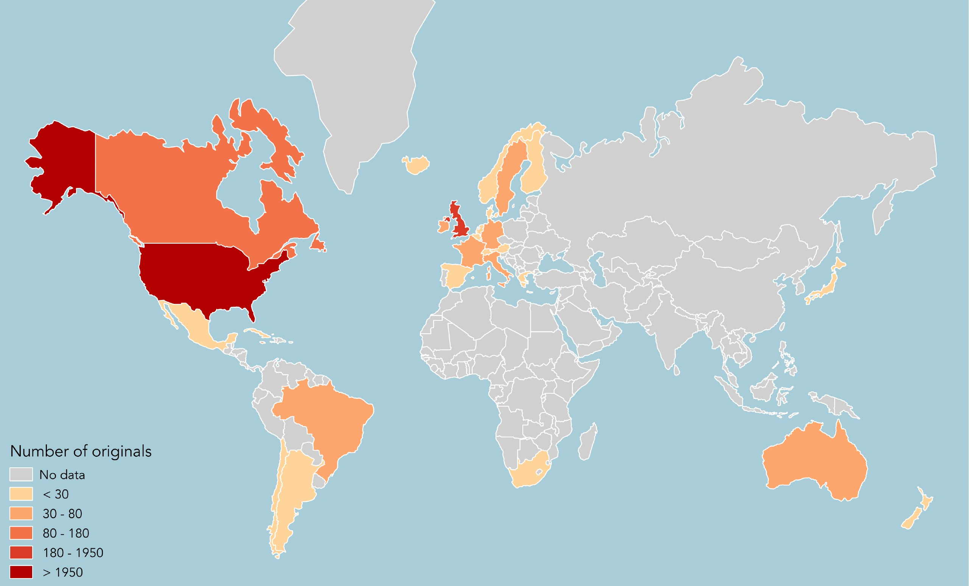
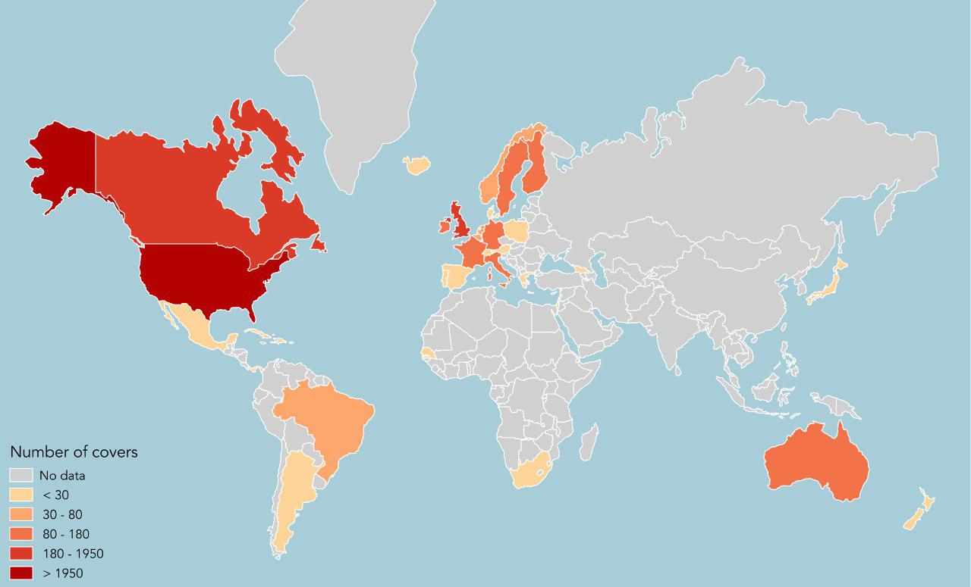
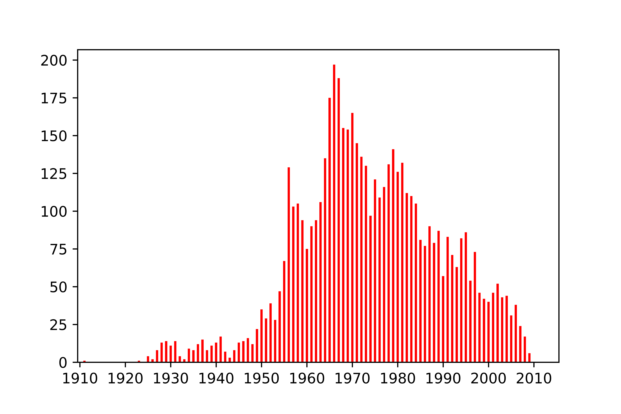
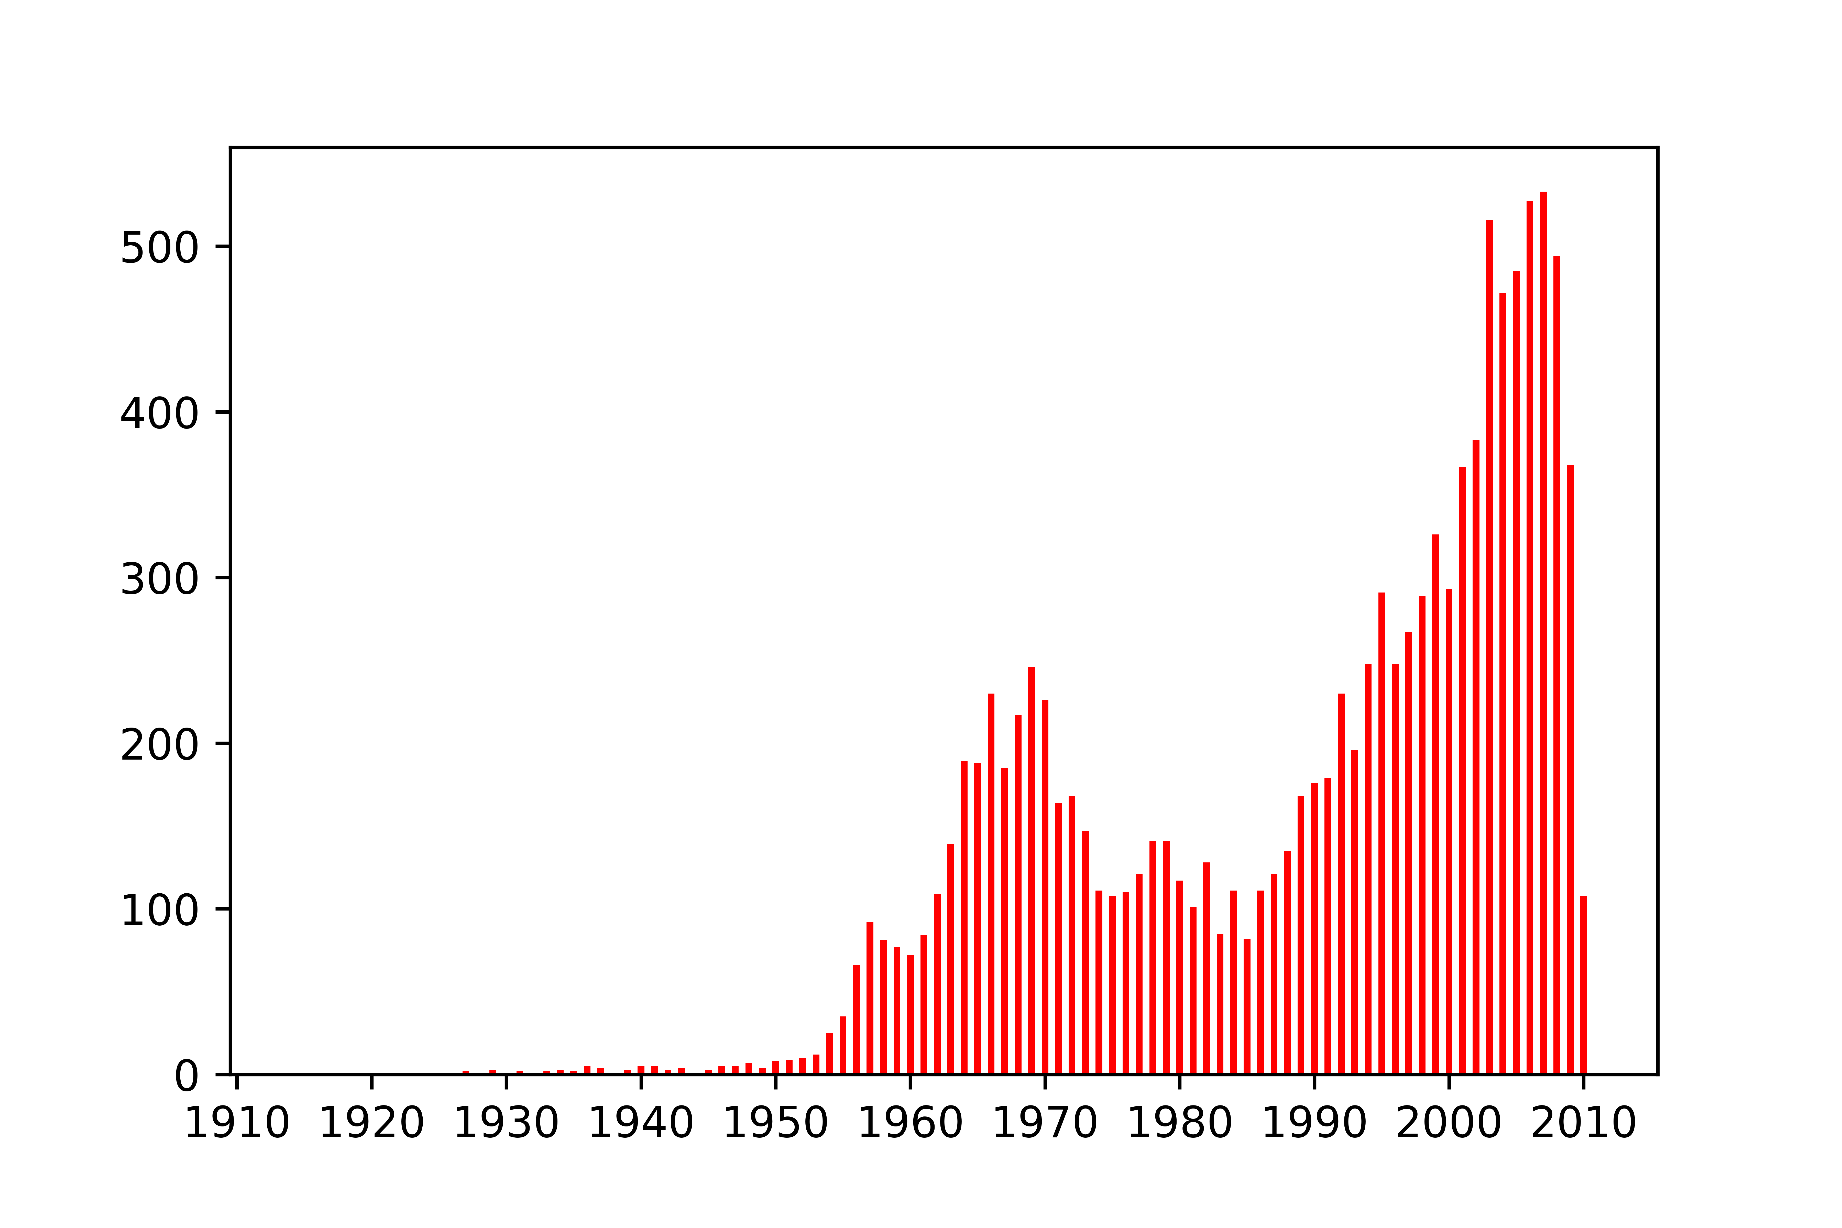
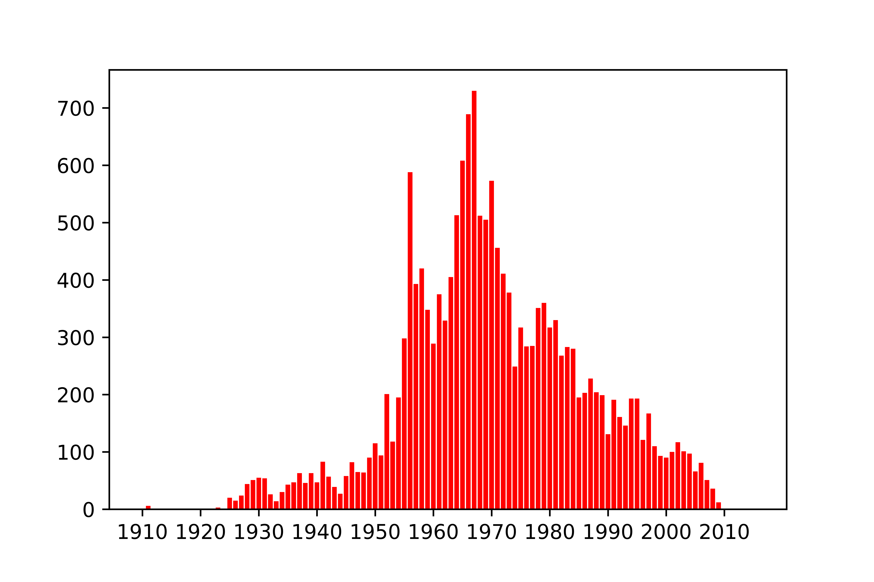
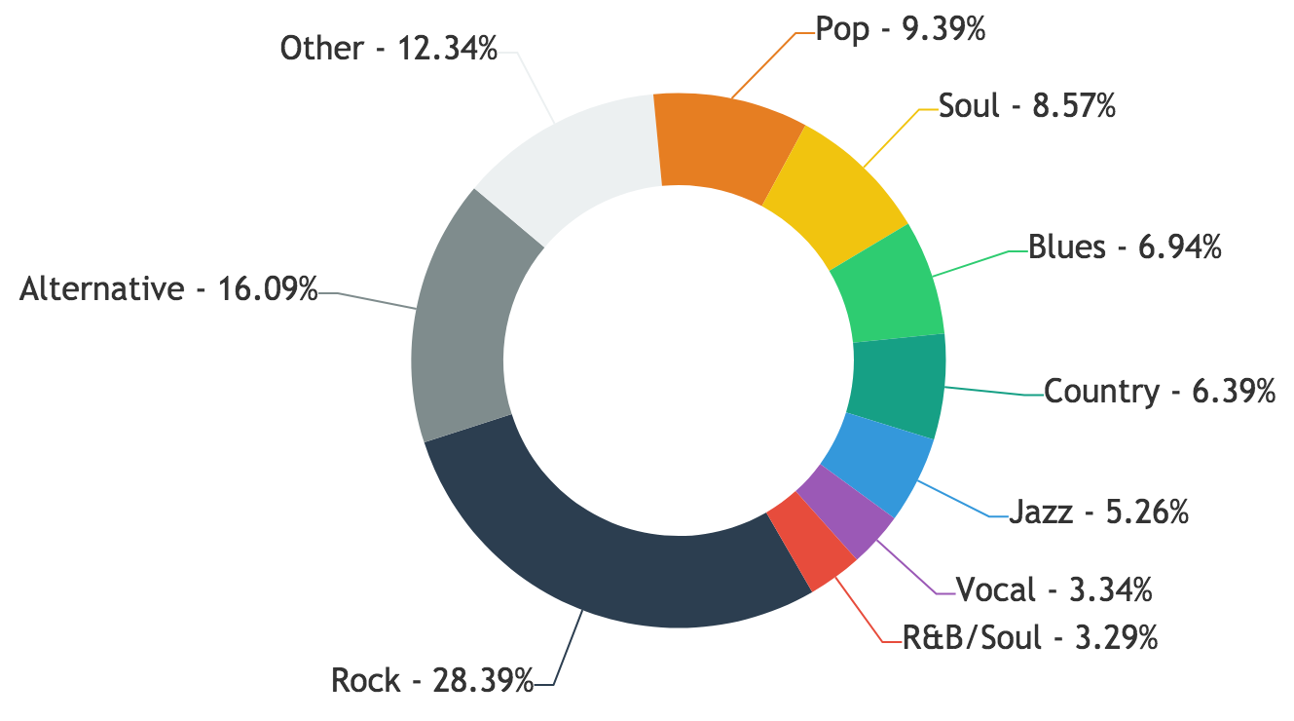
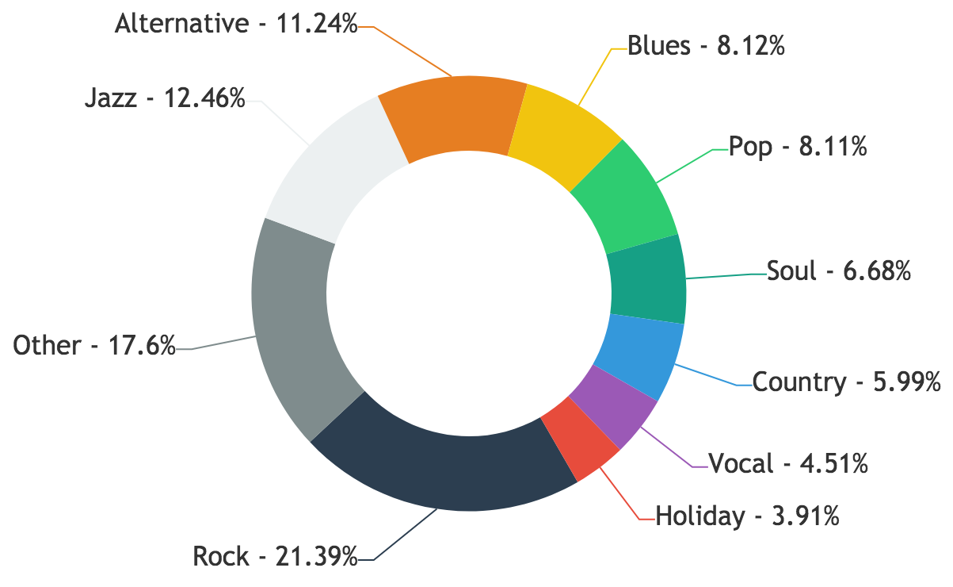
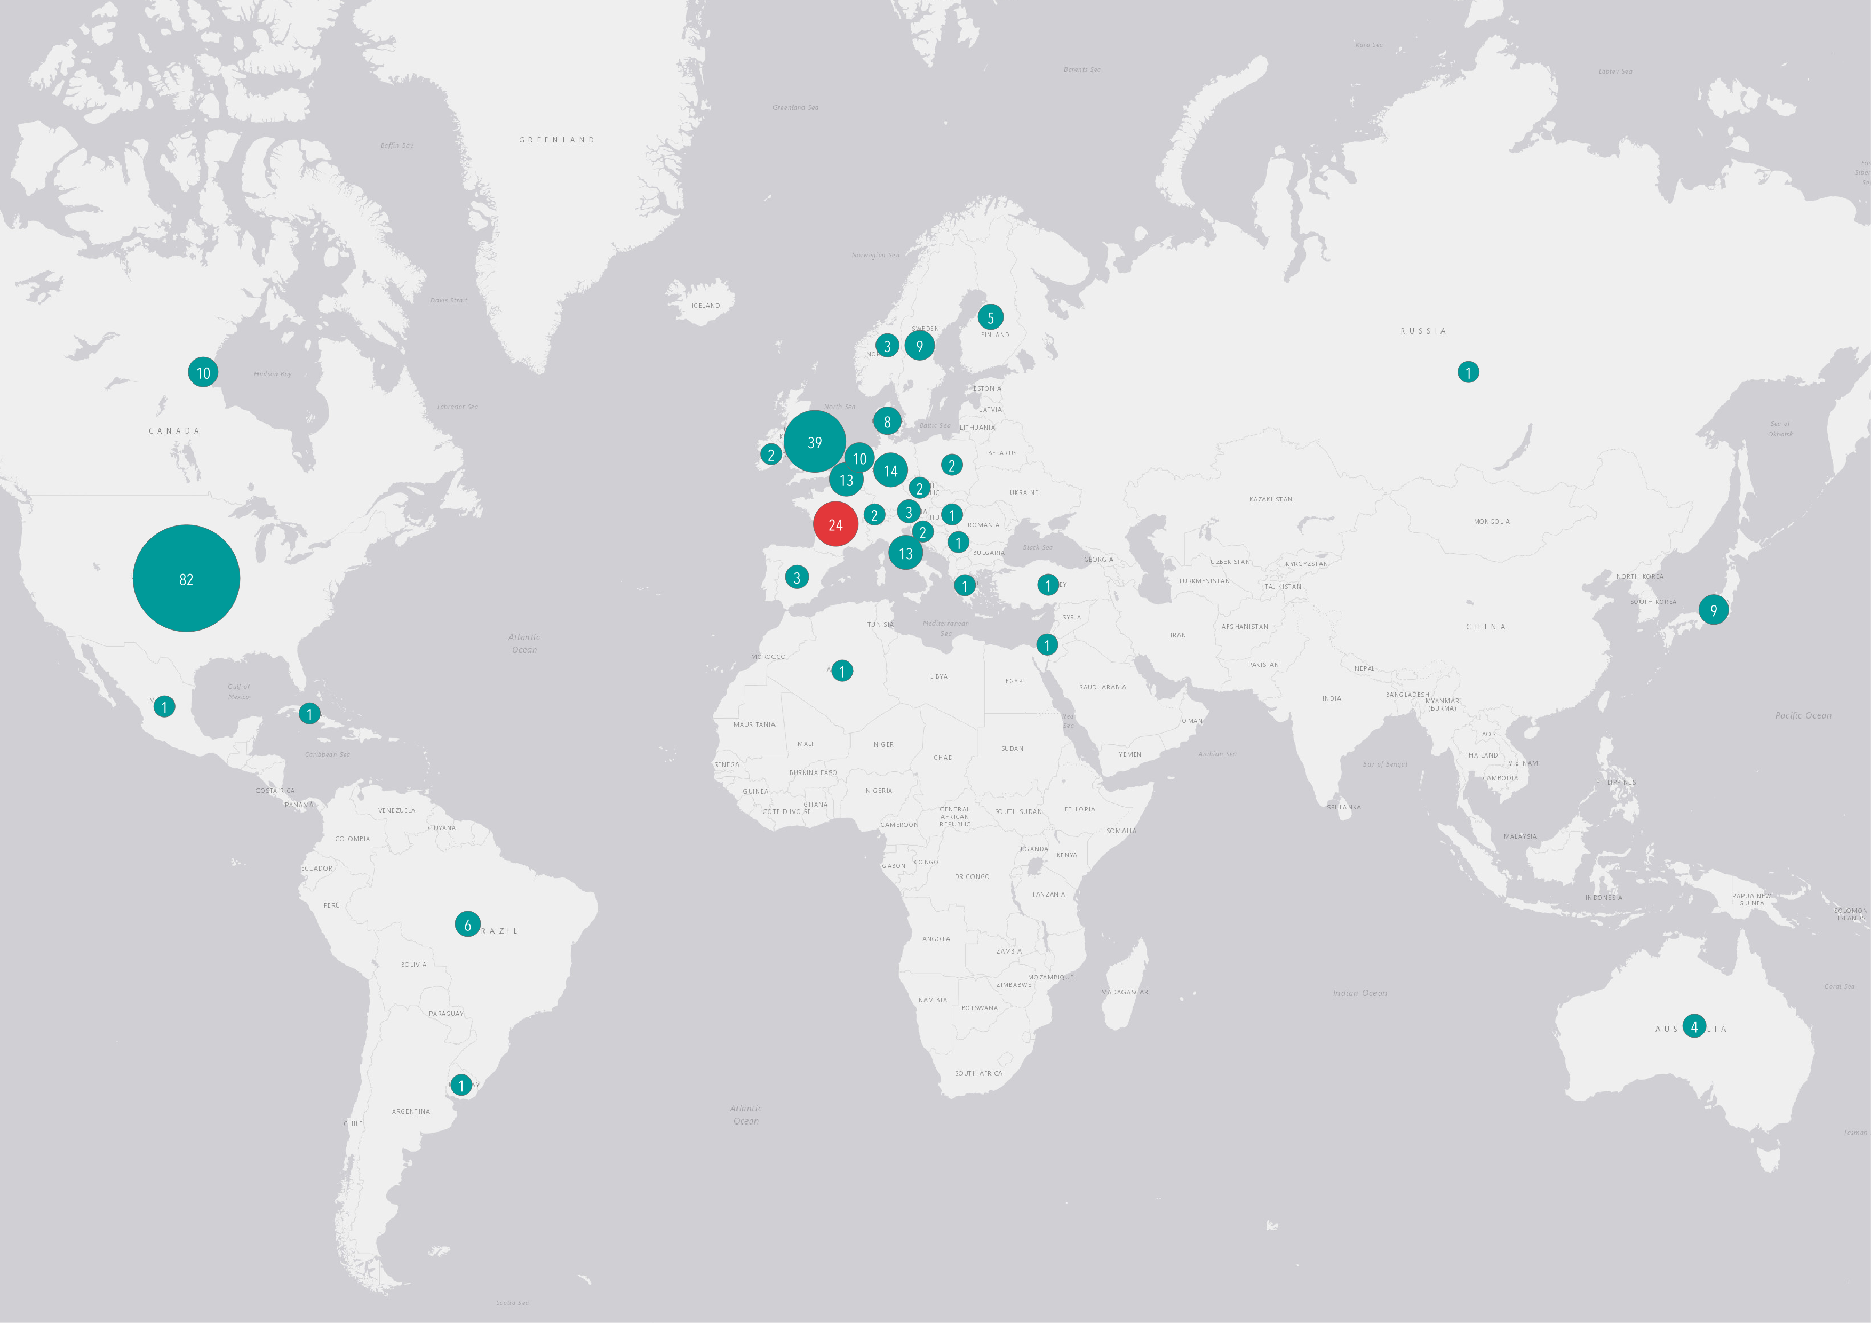
Applied Data Analysis Project 2017
Pierre-Antoine Desplaces, Anaïs Ladoy, Lou Richard
My Way of seeing music covers
Everybody knows the definition of a cover song as a new performance of a previously recorded song, by someone other than the original artist or composer.
Something that is quite unknown is how the concept of cover version started. Actually, this phenomena started in the 1950’s when record companies tried to reach out to more people by a way of reproducing original songs such that those were more appealing to a particular demography. If we go back to the racial segregation period in the United States, there were black radio stations and white radio stations. Covers versions were recorded by White artists and then diffused on white radio stations, without acknowledgement or financial compensation for the original (black) artists and it was clearly a "racist tool" as said the singer-songwriter Don McLean.
Through a spatial and time analysis of cover songs history, our goal is to explore cultural or social underlying patterns and how it is diffused in a globalized world. To do so, we used the Second Hand Song dataset which contains a non-exhaustive list of songs and their covers and additional information that we could gather from similar sources.
General stats
Location
17’541 songs
5’420 artists
5’659 originals
11’882 covers
From 1911 to 2015
52 countries
21 languages
33 genres
From the two maps, we observe that the repartition for cover songs and original songs are very similar, which makes our data consistent. However, it is skewed as a large majority of songs are located in Europe and Northern America.
Repartition of original songs
Repartition of cover songs
TOP 10 MOST COVERED SONGS
1. Silent Night, 1961 42
Chet Atkins
2. White Christmas, 1942 36
Bing Crosby
3. Unchained Melody, 1955 25
Les Baxter
4. O Holy Night, 1958 24
Tennessee Ernie Ford
5. Georgia On My Mind, 1930 22
Hoagy Carmichael
6. I'll Be Home For Christmas, 1943 21
Bing Crosby
7. The Christmas Song, 1946 20
Nat King Cole
8. Have Yourself A Merry Little Christmas, 1967 20
Barbra Streisand and Yves Montand
9. Over The Rainbow, 1939 18
Judy Garland
10. The Way You Look Tonight, 1936 17
Fred Astaire and Ginger Rogers
65% of covers are recorded in a different country from the original one
THE DATA
Taking data from the Second Hand Song, Million Song and Last FM datasets, and by web-scraping missing informations mainly from the SHS website, we finally obtained a complete dataset to analyze different factors :
Country
Year
Genre
Time
Distribution of originals
For original songs
Genres
Distribution of covers
We first established a genre hierarchy. Then, using the lastFM tags associated with each song, we deducted its main tag and assigned the parent genre to the song. This allowed us to study the genre distribution and correlation across covers.
For cover songs
Number of covers of originals recorded in that year
90% of covers are in a different genre than the original song
80% of covers are recorded more than 10 years after the original
SONG STORY
My Way is a song popularized in 1969 by Frank Sinatra, with lyrics written by Paul Anka. She had a huge success, spending 75 weeks in the UK Top 40, record which still stands.
Nevertheless, few people know that the original song music is French, performed in 1967 by Claude François.
The lyrics of My Way are related to those of the original one, Comme d’Habitude, in terms of structure but differs totally in meaning. The French one deals with the routine of a relationship and the English one with looking back without regret at the end of a lifetime.
LANGUAGE | SONGS
English | 171
Instrumental | 52
French | 14
Dutch | 9
German | 9
Spanish | 9
Italian | 5
Finnish | 4
Japanese | 2
Arabic | 1
Croatian | 1
Danish | 1
Portuguese | 1
Russian | 1
Welsh | 1
280 covers
>100 artists
15 languages
33 countries
My Way is a perfect illustration of how culture spread around the world as the song travelled in 33 different countries and was covered by more than 100 different artists including Sid Vicious, Elvis Presley, Aretha Franklin and Nina Simone.

