Slide 1


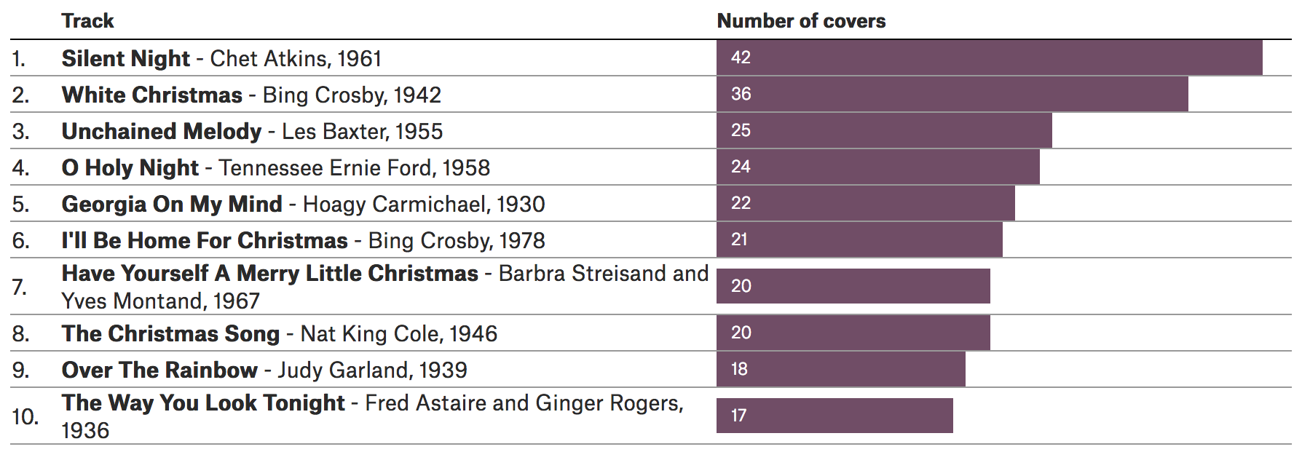
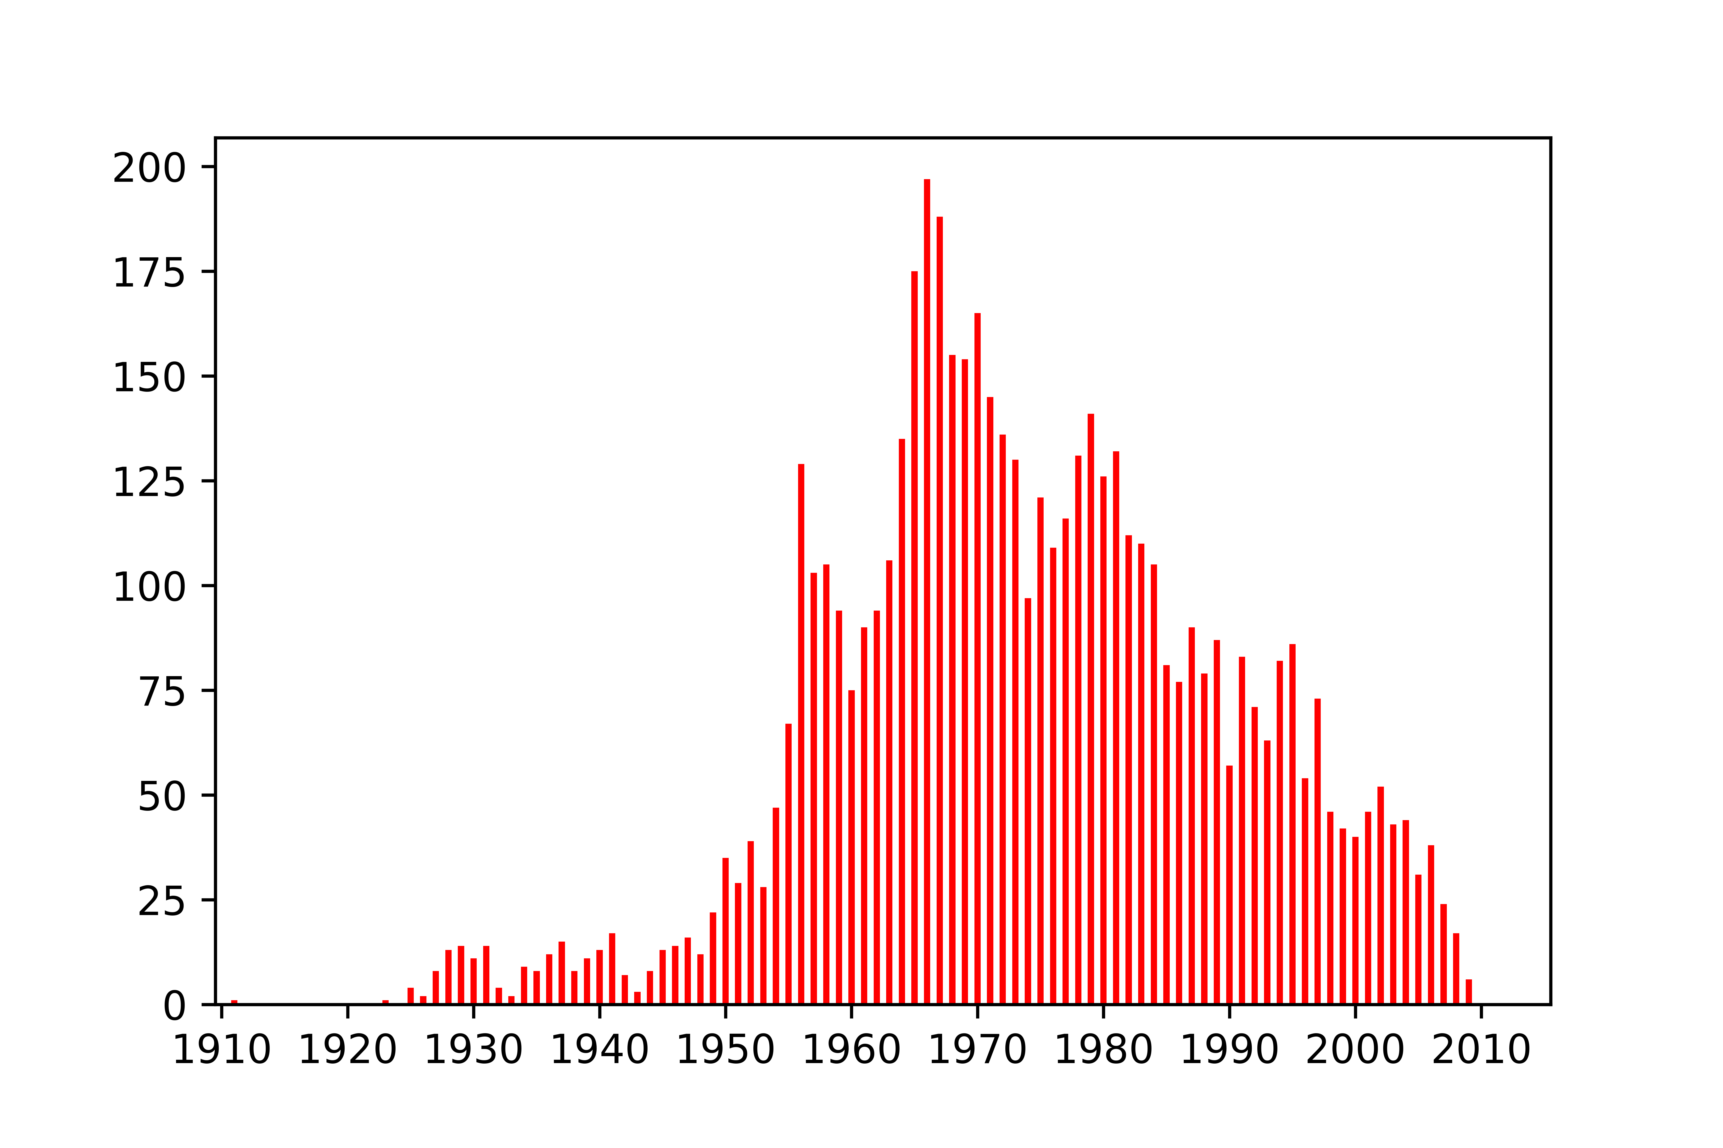
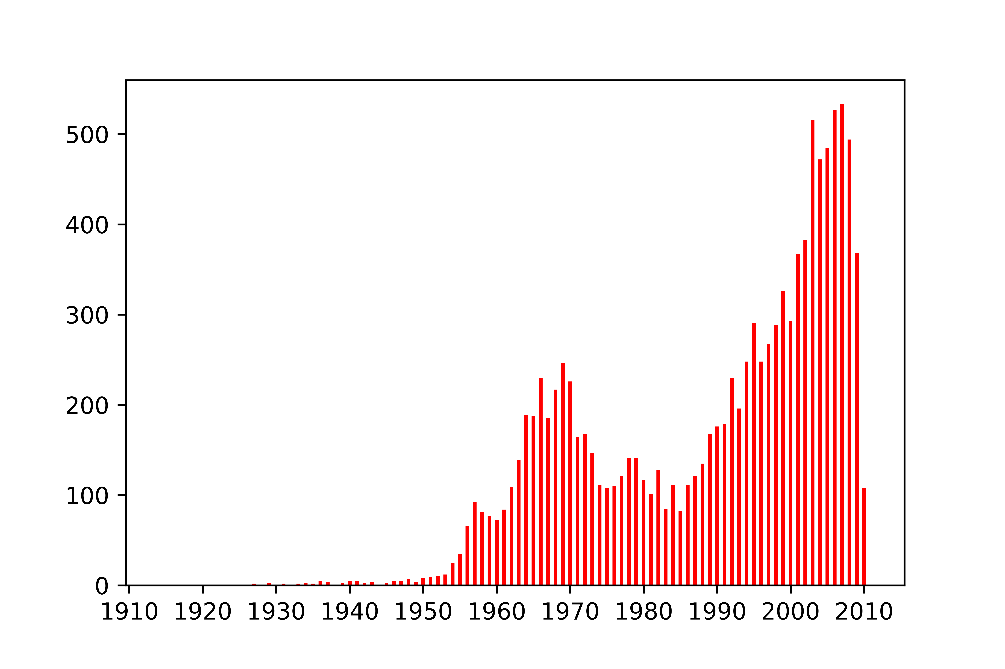
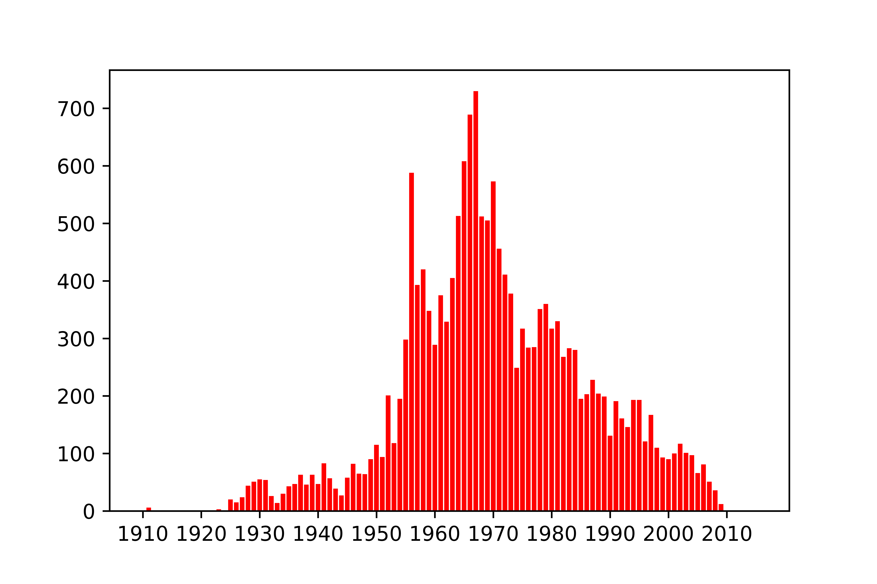
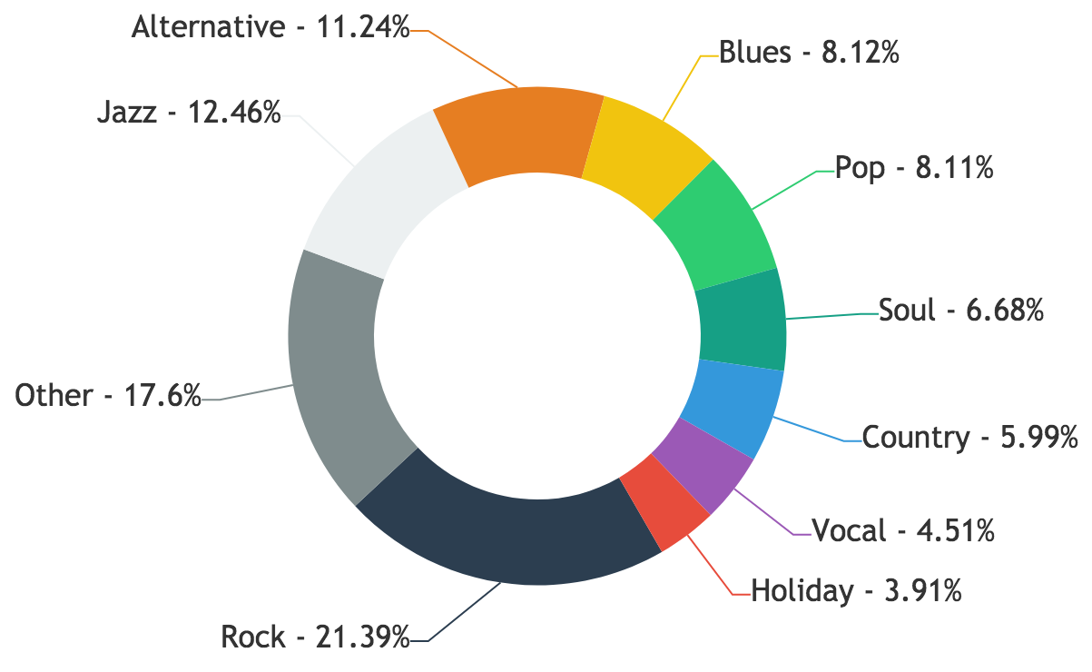
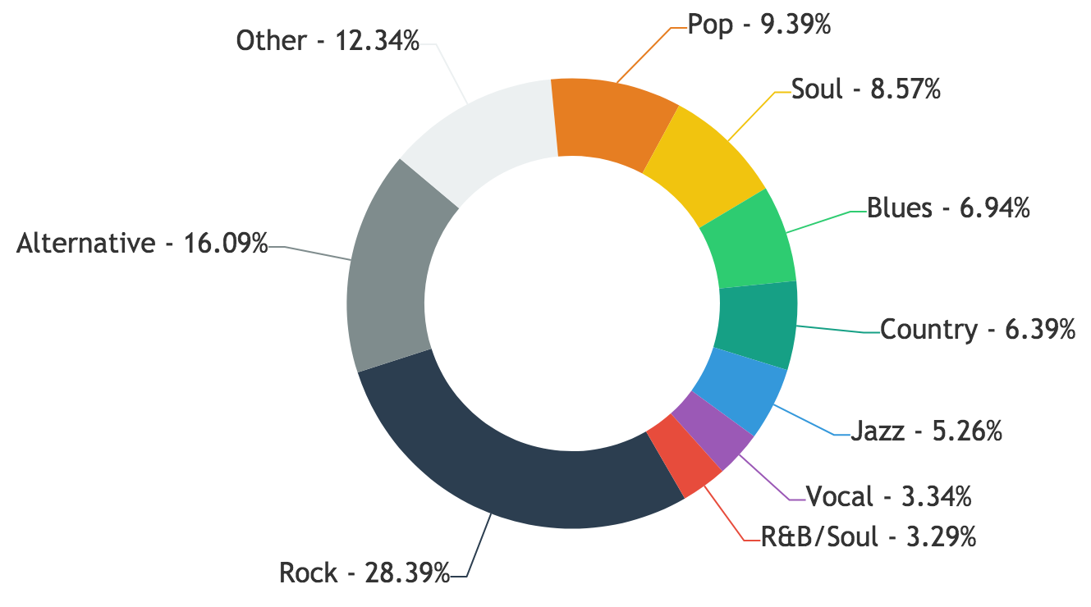
Applied Data Analysis Project 2017
Pierre-Antoine Desplaces, Anaïs Ladoy, Lou Richard
My Way of seeing covers
General stats
Location
17541 songs
5420 artists
5659 cliques
From 1911 to 2015
52 countries
21 languages
33 genres
65% of covers are recorded in a different country from the original one
Time
TOP 10 SONGS
Silent Night, 1961, Chet Atkins, 42
White Christmas, 1942, Bing Crosby, 36
Unchained Melody, 1955, Les Baxter, 25
O Holy Night, 1958, Tennessee Ernie Ford, 24
Georgia On My Mind, 1930, Hoagy Carmichael, 22
I'll Be Home For Christmas, 1943, Bing Crosby, 21
The Christmas Song, 1946, Nat King Cole, 20
Have Yourself A Merry Little Christmas, 1967, Barbra Streisand;Yves Montand, 20
Over The Rainbow, 1939, Judy Garland, 18
The Way You Look Tonight, 1936, Fred Astaire and Ginger Rogers, 17
Distribution of originals
Genres
Distribution of covers
For cover songs
For original songs
Number of covers of originals recorded in that year
90% of covers are in a different genre than the original song
80% of covers are recorded more than 10 years after the original
Song story

