Slide 1


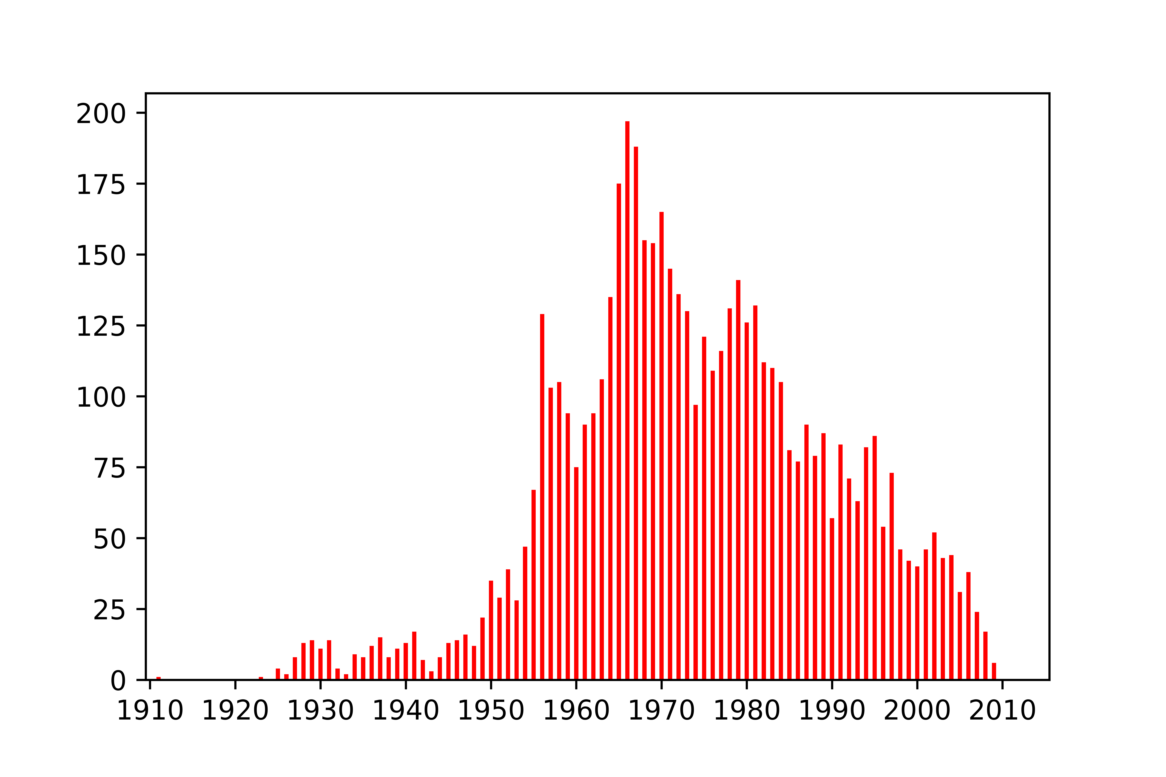
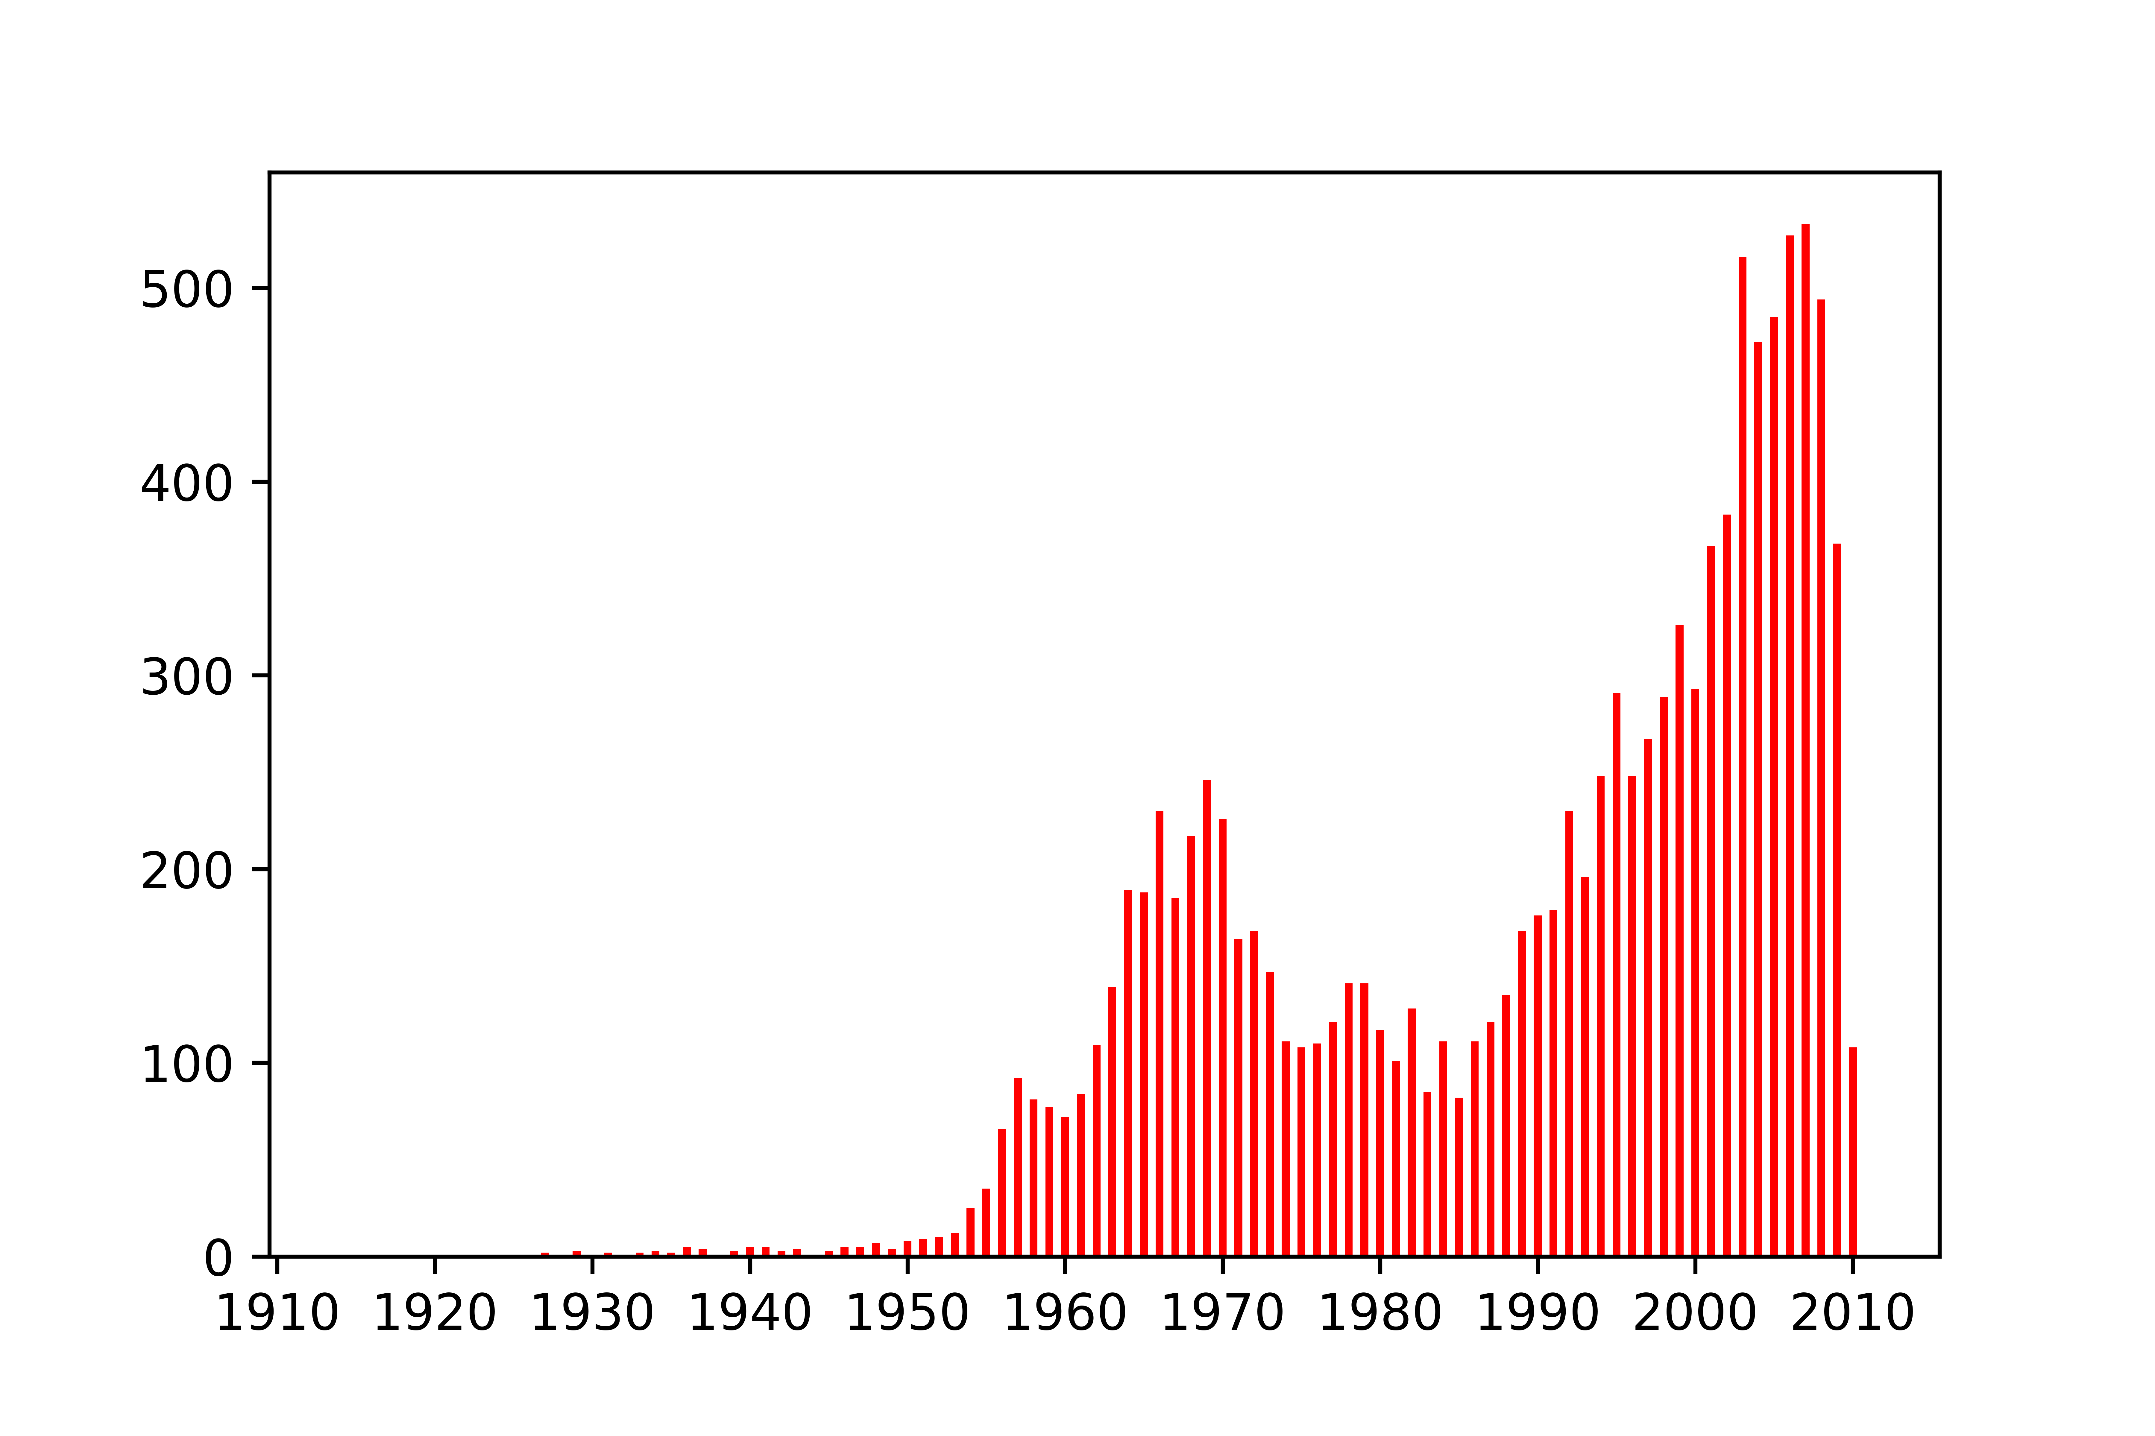
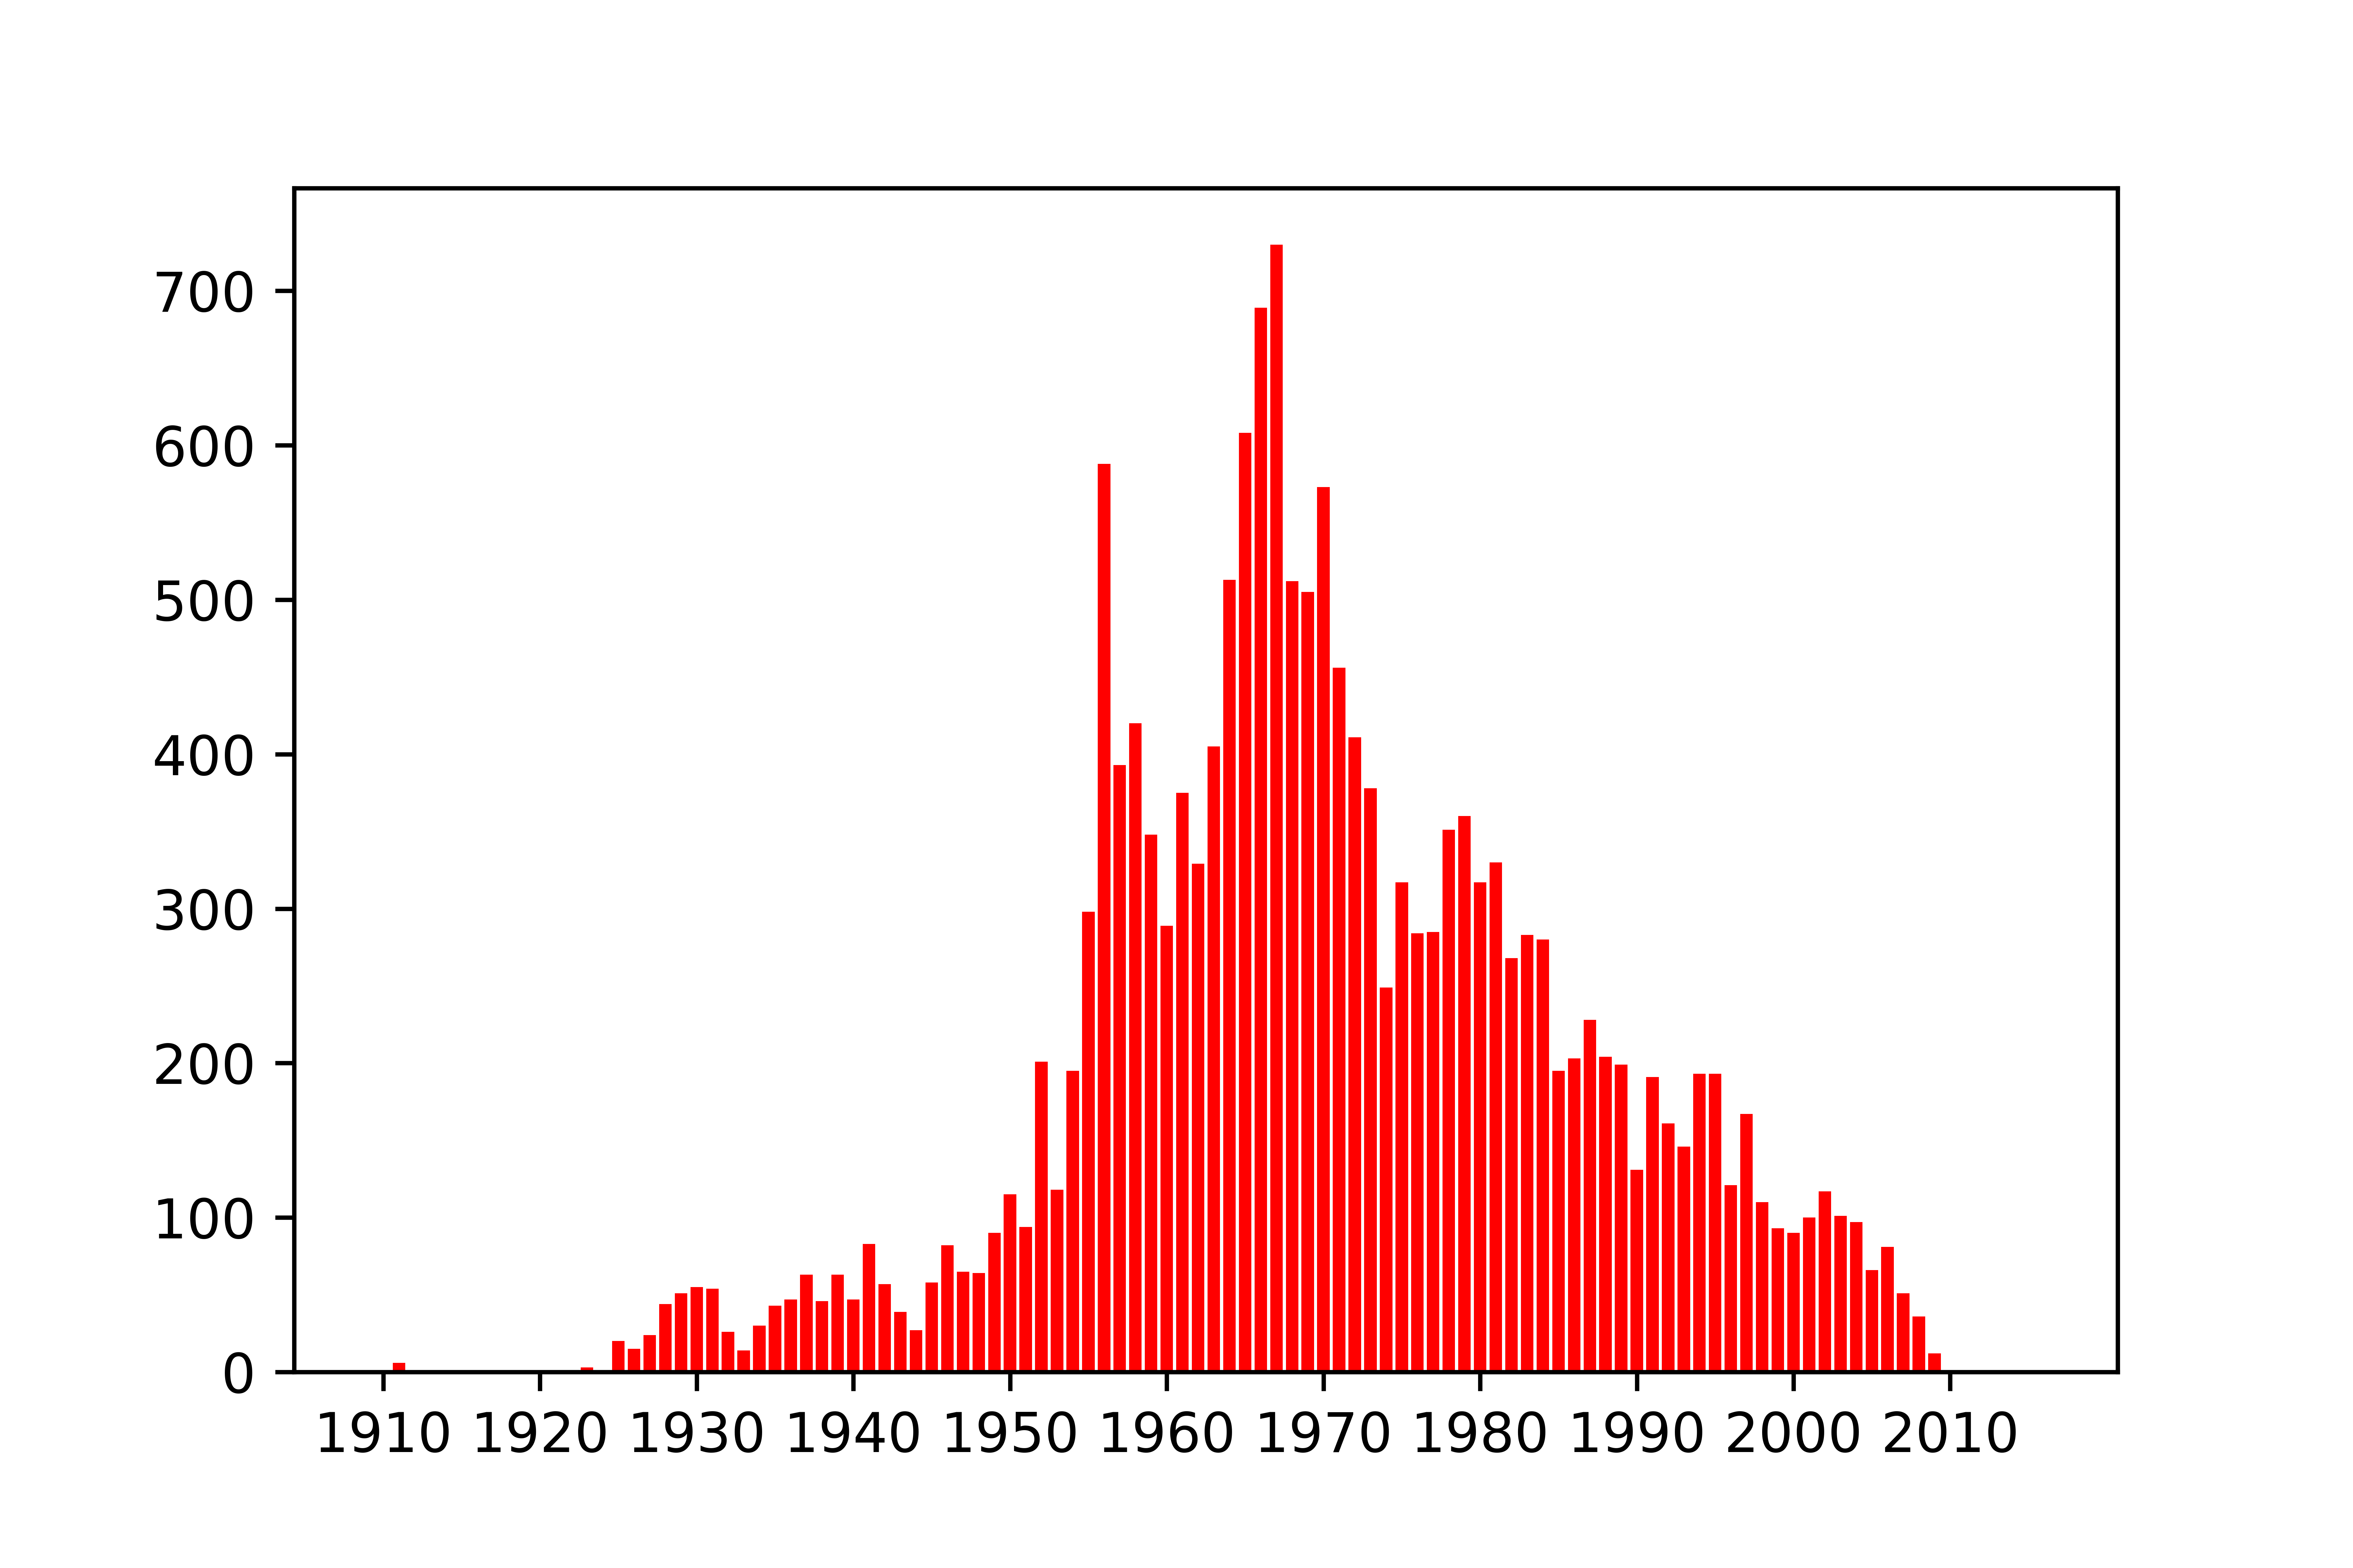
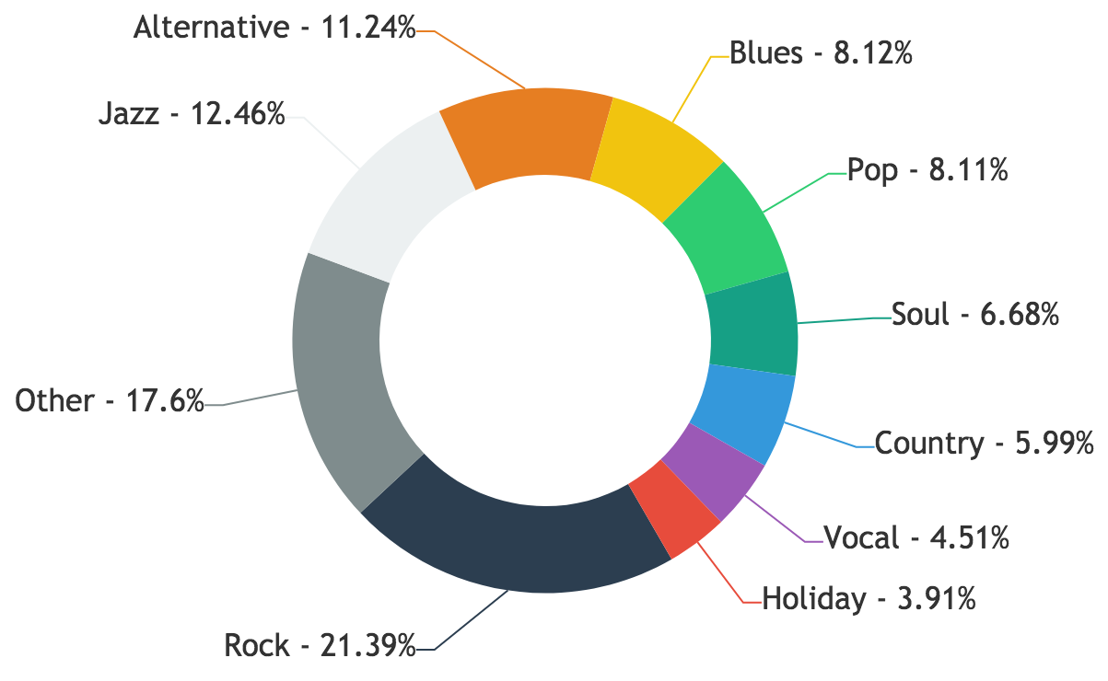
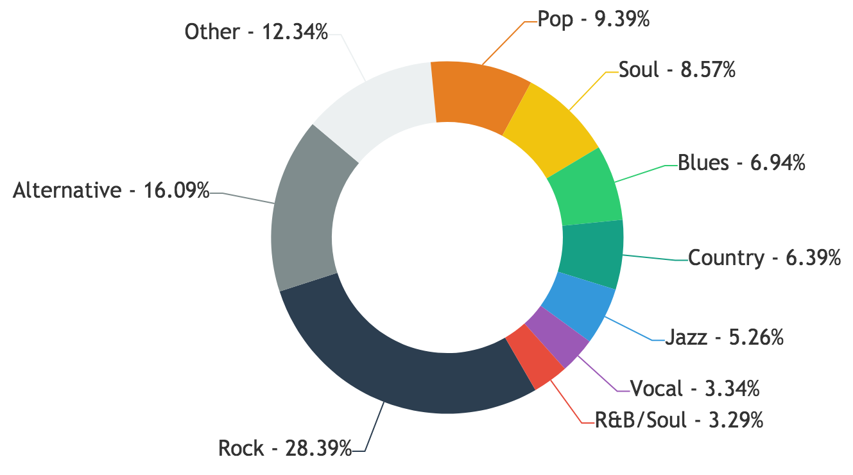
Applied Data Analysis Project 2017
Pierre-Antoine Desplaces, Anaïs Ladoy, Lou Richard
My Way of seeing covers
General stats
Location
Time
Distribution of originals
Genres
Distribution of covers
For cover songs
For original songs
Number of covers of originals recorded in that year
90% of covers are in a different genre than the original song
80% of covers are recorded more than 10 years after the original
Song story

