Slide 1
Algorithmic Thinking
Chandan J.

Slide 2
Algorithm
A set of finite rules or instructions to be followed in calculations or other problem-solving operations
Place of Usage : Computer Science, Mathematics, Operations Research, Artificial Intelligence, Data Science

Slide 3
Set of Rules to get the expected Result
Input
Output
What is Algorithm ??

Slide 4
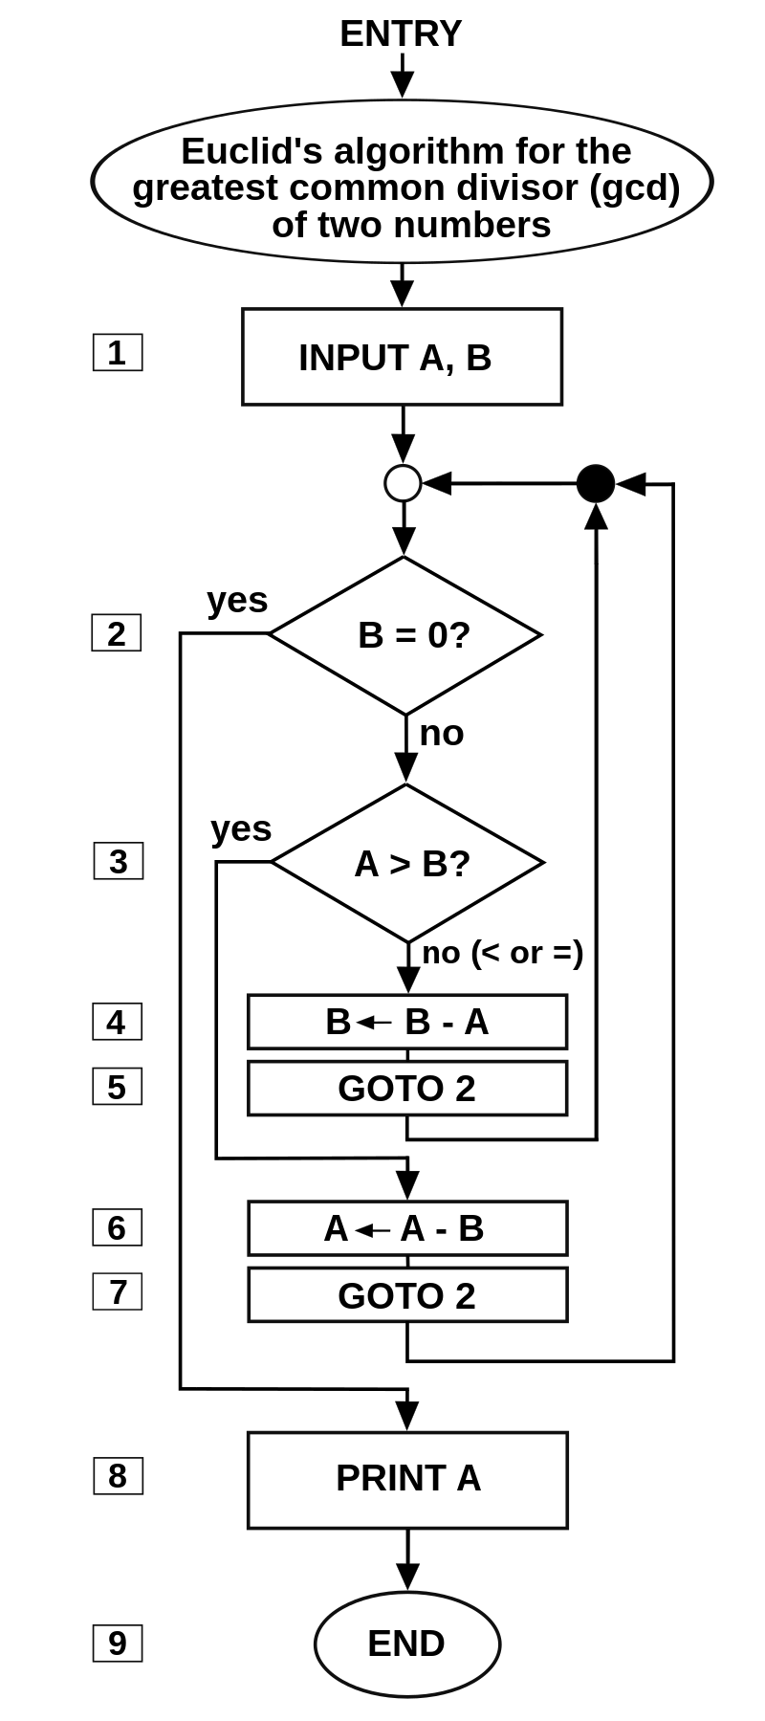

Slide 5
Well Defined IP
Well Defined OP
Characteristics of Algorithm
Clear & Unambiguous
Finite
Language Independent
Feasible
Characteristics of Algorithm

Slide 6
Advantages of Algo
Easy to understand
Stepwise representation of Solution
Easy to Convert to Program

Slide 7
Disadvantages of Algo
Time Consuming
For a complex problem, its difficult
Difficult for branching and looping

Slide 8
Algorithm 1: Add two numbers entered by the user
Step 1: Start
Step 2: Declare variables num1, num2 and sum.
Step 3: Read values num1 and num2.
Step 4: Add num1 and num2 and assign the result to sum.
sum←num1+num2
Step 5: Display sum
Step 6: Stop

Slide 9
Algorithm 2: Find the factorial of a number
Step 1: Start
Step 2: Declare variables n, factorial and i.
Step 3: Initialize variables
factorial ← 1
i ← 1
Step 4: Read value of n
Step 5: Repeat the steps until i = n
5.1: factorial ← factorial*i
5.2: i ← i+1
Step 6: Display factorial
Step 7: Stop

Slide 10
Algorithm 3: Find the Fibonacci series till the term less than 1000
Step 1: Start
Step 2: Declare variables first_term,second_term and temp.
Step 3: Initialize variables first_term ← 0 second_term ← 1
Step 4: Display first_term and second_term
Step 5: Repeat the steps until second_term ≤ 1000
5.1: temp ← second_term
5.2: second_term ← second_term + first_term
5.3: first_term ← temp
5.4: Display second_term
Step 6: Stop

Slide 11
Time Complexity
Algorithms are procedures or instructions (set of steps) that tell a computer what to do and how to do it.
How to Compare 2 Algorithms??
Time complexity represents the number of times a statement is executed.
The Big O notation is a language we use to describe the time complexity of an algorithm.
Big O notation expresses the run time of an algorithm in terms of how quickly it grows relative to the input

Slide 12
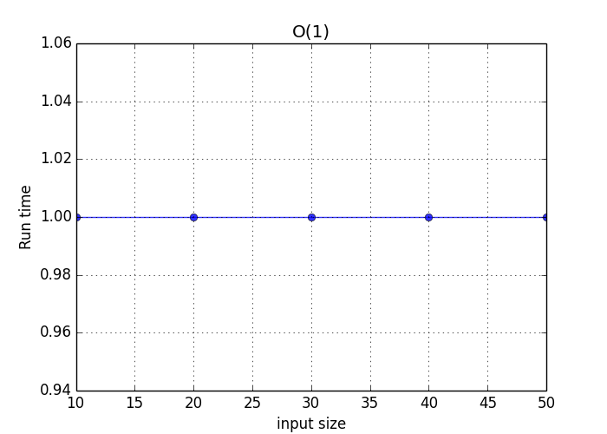
Constant Time Complexity O(n) : An algorithm has constant time complexity if it takes the same time regardless of the number of inputs

Slide 13
Example :
var_arr = [ 1,2,3,4,5]
var_arr[2]

Slide 14
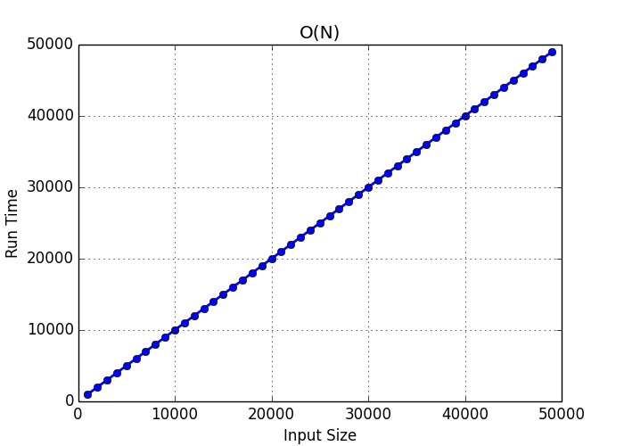
Linear Time Complexity O(n) : running time increases at most linearly with the size of the input.

Slide 15
Example
Var1 = [................]
Sum = 0
For i in var1:
sum+=i

Slide 16
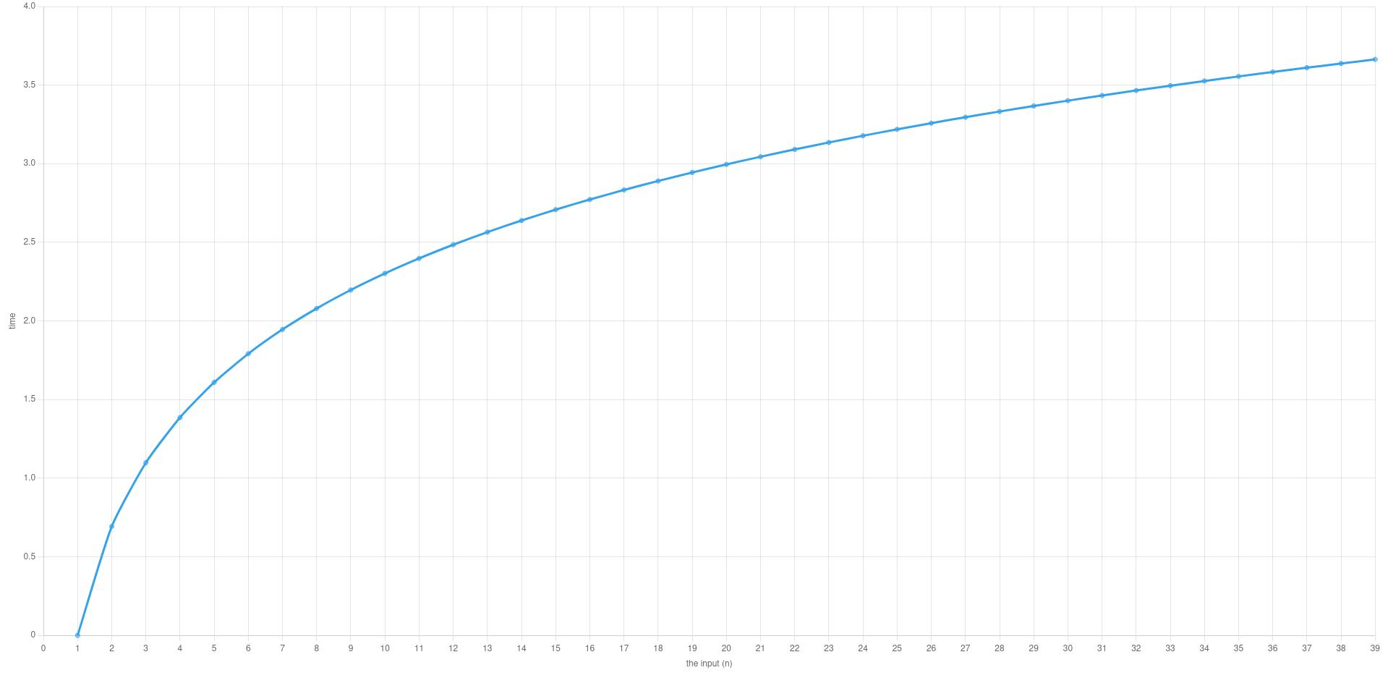
Logarithmic time complexity : O(log n) - if the time it takes to run the algorithm is proportional to the logarithm of the input size n

Slide 17
Example
Binary Search of Sorted Numbers :

Slide 18
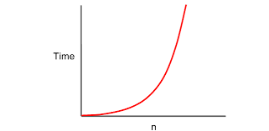
Quadratic Time Complexity O(n^2) : it takes to run grows directly proportional to the square of the size of the input

Slide 19
Example
N = len(var_list[])
For i in range(n):
For j in range(n):
……………

Slide 20
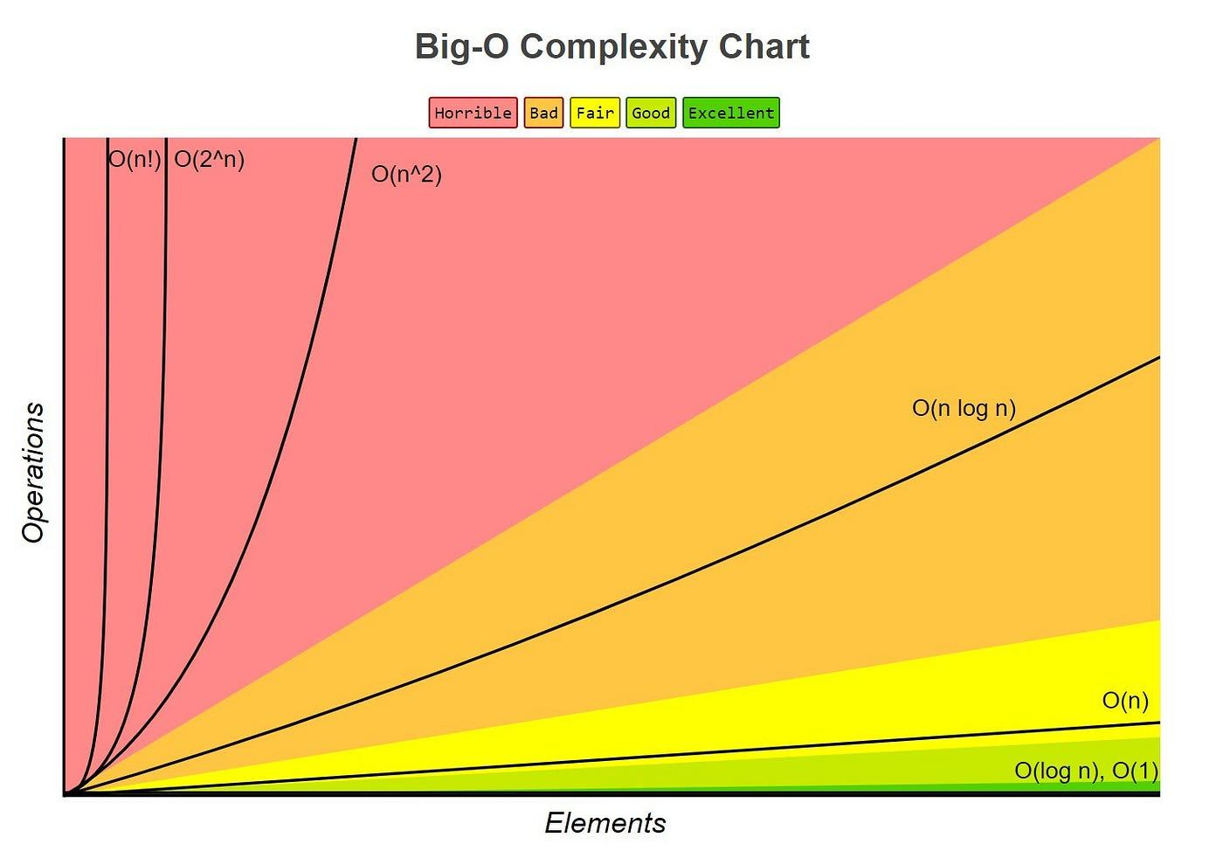
Overall

Slide 21
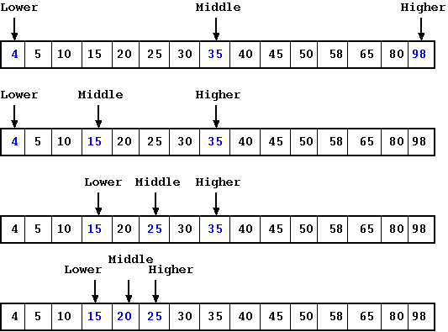
Binary Search

Slide 22
# Binary Search in python
def binarySearch(array, x, low, high):
# Repeat until the pointers low and high meet each other
while low <= high:
mid = low + (high - low)//2
if array[mid] == x:
return mid
elif array[mid] < x:
low = mid + 1
else:
high = mid - 1
return -1
array = [3, 4, 5, 6, 7, 8, 9]
x = 4
result = binarySearch(array, x, 0, len(array)-1)
if result != -1:
print("Element is present at index " + str(result))
else:
print("Not found")

Slide 23
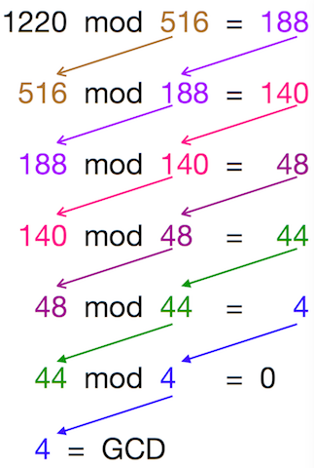
Euclid’s Algo

Slide 24
function gcd(a, b):
if b = 0
return a
else
return gcd(b, a mod b)

Slide 25
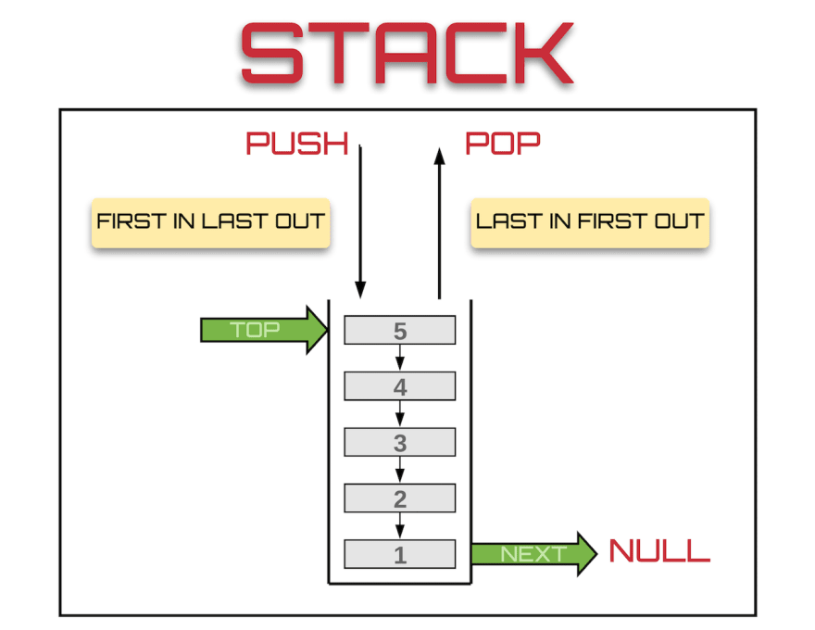
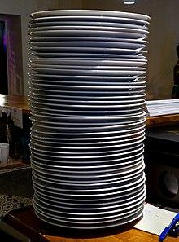
Stack

Slide 26
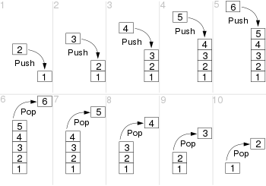

Slide 27
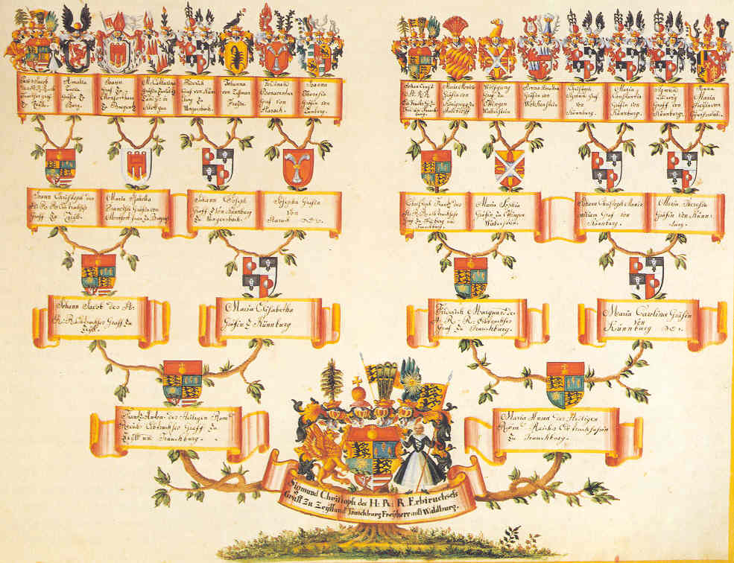

Slide 28
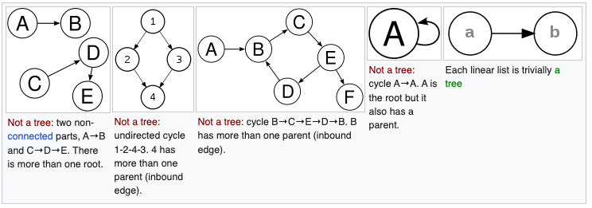
Tree

Slide 29
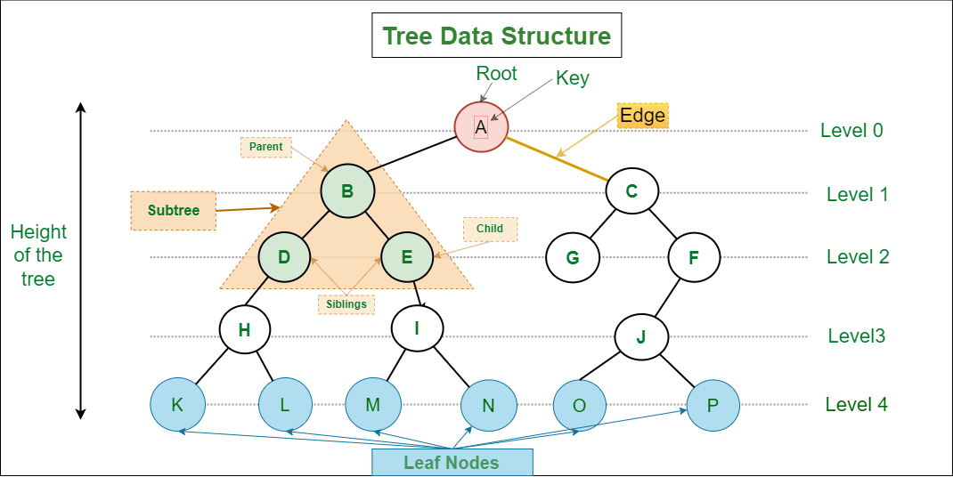
Tree : A tree data structure is a hierarchical structure that is used to represent and organize data in a way that is easy to navigate and search.

Slide 30
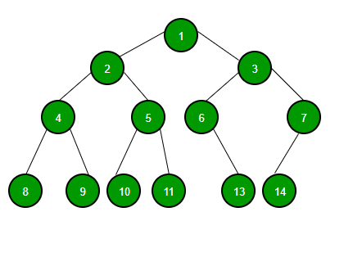
Binary Tree : tree data structure where each node has at most 2 children. Since each element in a binary tree can have only 2 children, we typically name them the left and right child.

Slide 31
Binary Search Tree
The left subtree of a node contains only nodes with keys lesser than the node’s key
The right subtree of a node contains only nodes with keys greater than the node’s key.
The left and right subtree each must also be a binary search tree.

Slide 32
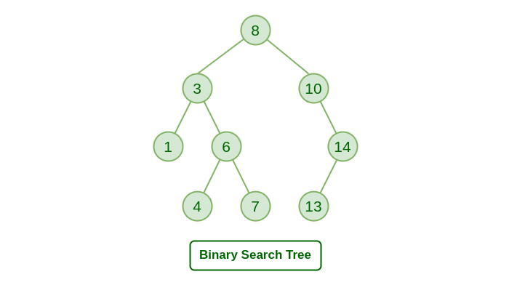
BST …

Slide 33
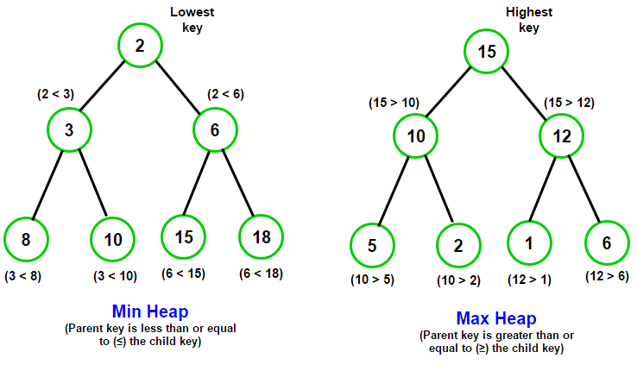
Heap : A Heap is a special Tree-based data structure in which the tree is a complete binary tree.

Slide 34
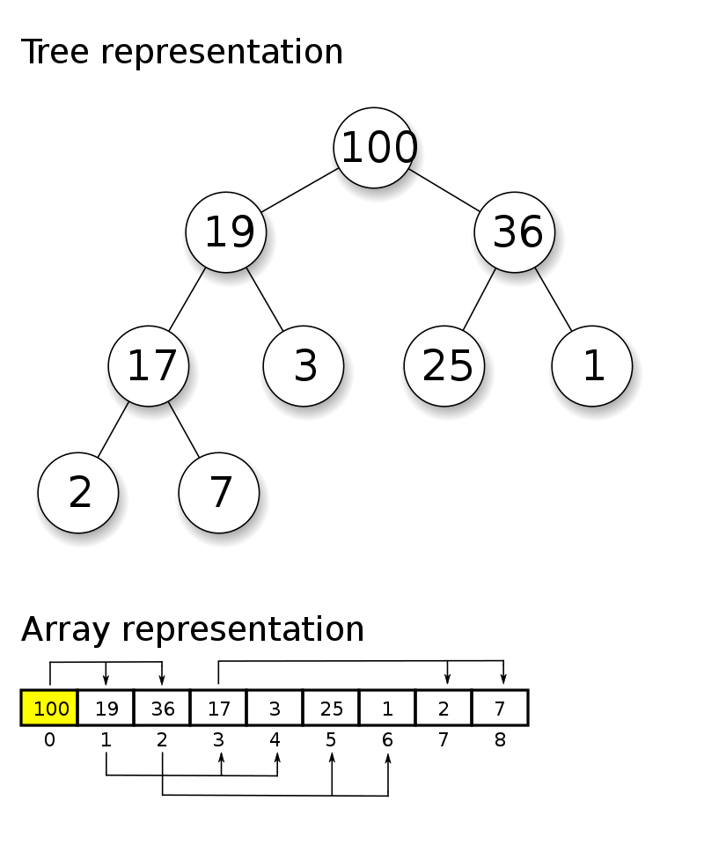
Heap

Slide 35
Stack v/s Heap
Stack provides static memory allocation, i.e., it is used to store the temporary variables.
It is a linear data structure means that elements are stored in the linear manner, i.e., one data after another.
It is used to access the local variables.
The size of the stack memory is limited which is dependent on the OS.
As it is a linear data structure, so data is stored in the contiguous blocks.
Heap provides dynamic memory allocation. By default, all the global variables are stored in the heap.
It is hierarchical data structure means that the elements are stored in the form of tree.
It is used to access the global variables by default.
The size of the memory is not limited.
As it is hierarchical data structure, so elements are stored in the random manner.

Slide 36
Stack v/s Heap contd..
In stack, the allocation and deallocation are automatically managed.
The implementation of stack can be done in three forms using array, linked list and dynamic memory.
The main issue that occurs with a stack is the shortage of memory because the memory size cannot be changed at the runtime. The size of the stack is determined at the compile time.
It is of fixed size.
In heap, the memory is manually managed.
The implementation of heap can be done in two forms using arrays and trees.
The main issue that occurs with a heap is the memory fragmentation. Here, memory fragmentation means that the memory gets wasted.
It is flexible to use as the size of the heap can vary as per our needs.

Slide 37
Stack v/s Heap contd..
The access time in stack is faster.
The size of the stack memory is decided by the operating system.
The scope of the variable cannot be changed.
The access time in heap is slower.
The size of the heap memory is decided by the programmers.
The scope of the variable can be changed.

Slide 38
Best Practices in Coding
Don't repeat yourself - DRY Code
Naming Convention
Comments : No comment is better than bad comment
Nice Article in WIKI

Slide 39
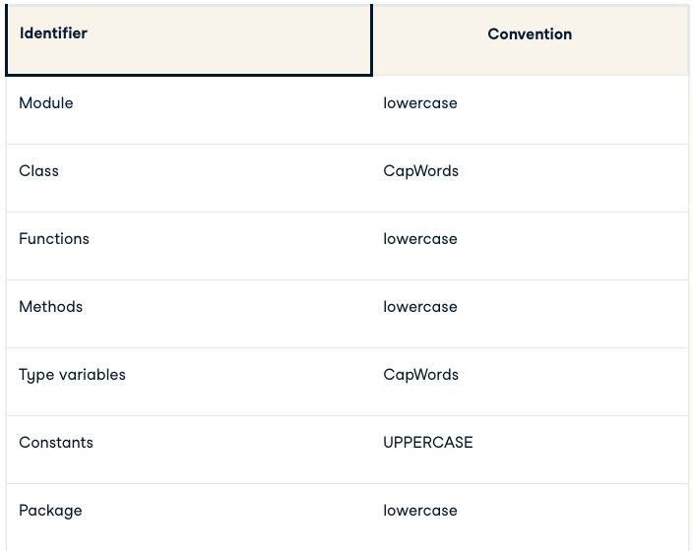
Naming Convention

Slide 40
Thank You

