Slide 1
Guvi DS
SQL
Chandan J

Slide 2
Topics
  Data Modeling
  Normalization
  Star Schema
  ACID Properties
  Select, Insert, Update and Delete (DML and DQL)
  Join Operation

Slide 3


Slide 4
Data
  Data : refer to computer information, and this information was either transmitted or stored.
  Data can be texts or numbers written on papers, or it can be bytes and bits inside the memory of electronic devices, or it could be facts that are stored inside a person’s mind.
  Data is changing the way the world functions.
  Some of the decisions that can be taken by data are: disease cures, a company’s revenue strategy, efficient building construction, or those targeted ads on your social media page.
  Data : info that is Machine readable

Slide 5


Slide 6


Slide 7
Information
  Organized data that has some meaningful value for the user.
  It's the processed Data : Helps to make decision action
  Processed Data should have following Properties : Accuracy , Completeness and Timeliness

Slide 8
Data Model
  It's a process that assigns relational rules to data.
  A data model can be compared to a roadmap, an architect’s blueprint or any formal diagram that facilitates a deeper understanding of what is being designed.
  The data model provides the blueprint for building a new database or reengineering legacy applications.
  Data Models are built around business needs.

Slide 9
Data Model contd…
  Data Modeling is the process of creating data models by which data associations and constraints are described and eventually coded to reuse.
  It conceptually represents data with diagrams, symbols, or text to visualize the interrelation.
  Data Modeling thus helps to increase consistency in naming, rules, semantics, and security.
  The emphasis is on the need for availability and organization of data, independent of the manner of its application.

Slide 10
Data Modeling Process
  It's a process of creating a conceptual representation of data objects and their relationships to one another.
  Steps :
Requirement Gathering
Conceptual Design
Logical Design
Physical Design
Implementation

Slide 11
Levels:
  Conceptual Level : defining the high-level entities and relationships in the data model, often using diagrams or other visual representations.
  Logical Level : defining the relationships and constraints between the data objects in more detail, often using data modeling languages such as SQL or ER diagrams.
  Physical Level : defining the specific details of how the data will be stored, including data types, indexes, and other technical details.

Slide 12
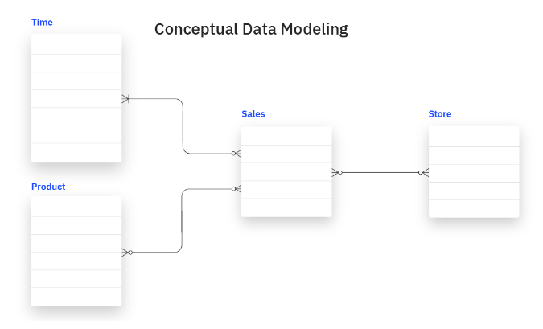
Conceptual Data Model
  Offers big picture of what system contains, how it is organized, and which rules are involved.
  They include entity classes (defining the types of things that are important for the business to represent in the data model), their characteristics and constraints, the relationships between them and relevant security and data integrity requirements.

Slide 13
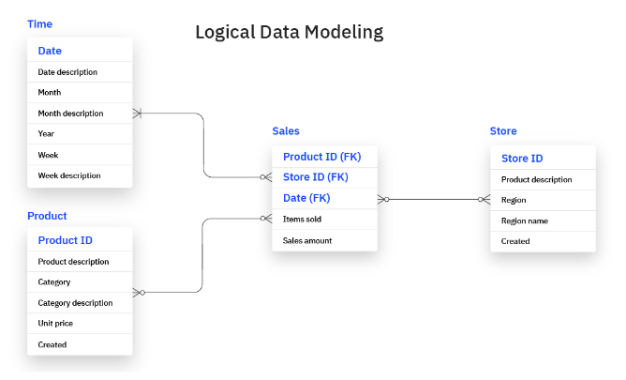
Logical Data Model
  Less abstract and provide greater detail about the concepts and relationships in the domain under consideration.
  Logical data models don’t specify any technical system requirements.

Slide 14
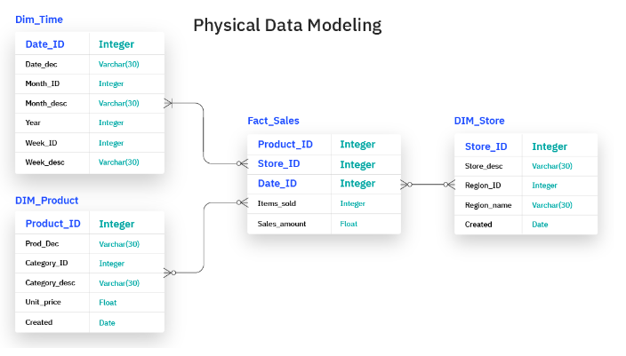
Physical Data Model
  Provide a schema for how the data will be physically stored within a database.
  Finalized design that can be implemented as a relational database.

Slide 15
Benefits of Data Modeling
  Reduce errors in software and database development.
  Increase consistency in documentation and system design across the enterprise.
  Improve application and database performance.
  Ease data mapping throughout the organization.
  Ease and speed the process of database design at the conceptual, logical and physical levels.

Slide 16
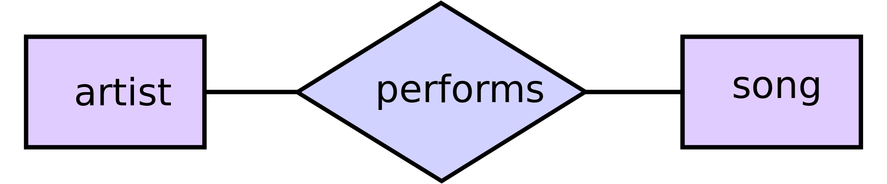

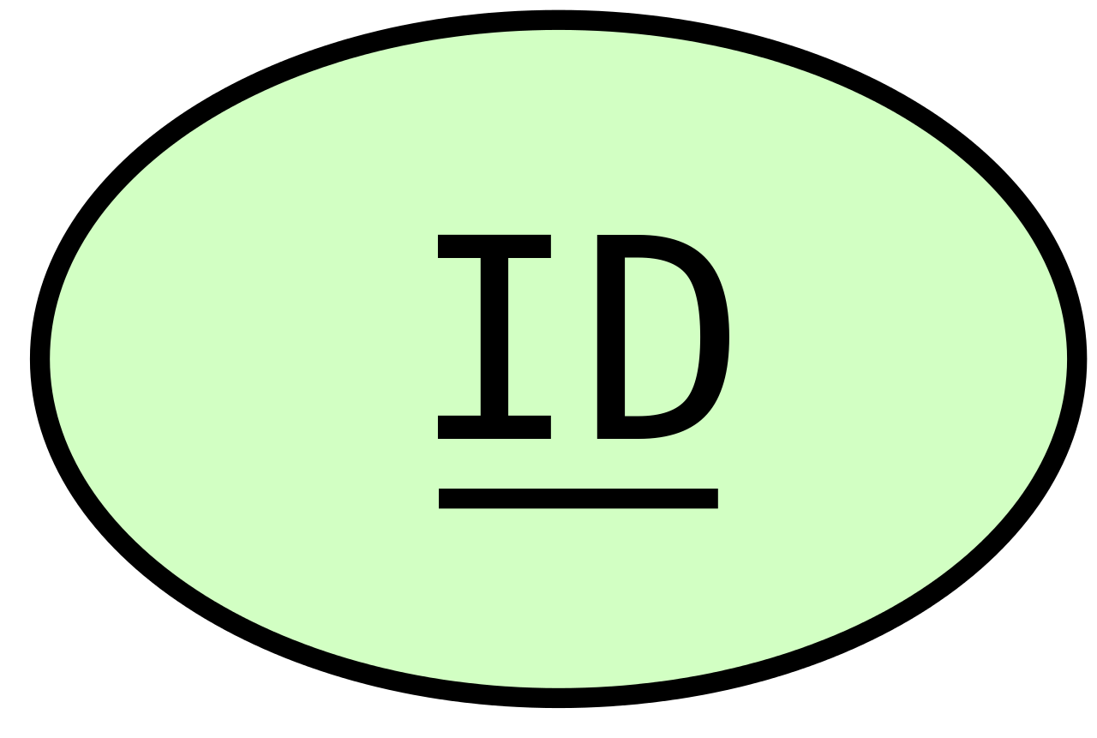
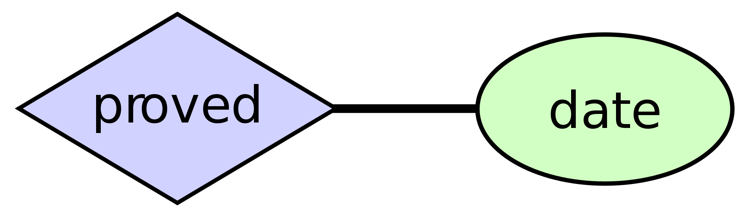
ER(Entity Relationship) Diagram
  ER Diagram plays an important in designing the DB.
Two Related Entities
Attribute of an entity
Attribute of a relationship
Primary Key

Slide 17
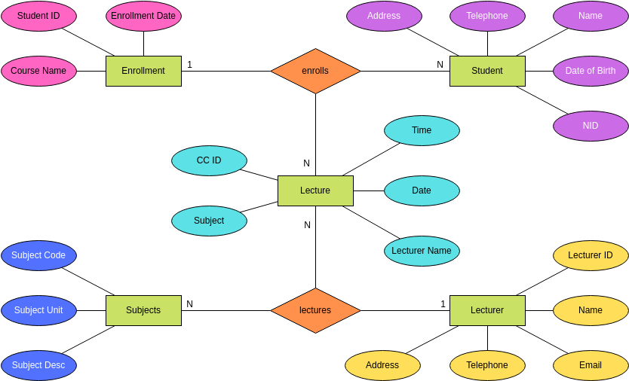

Slide 18
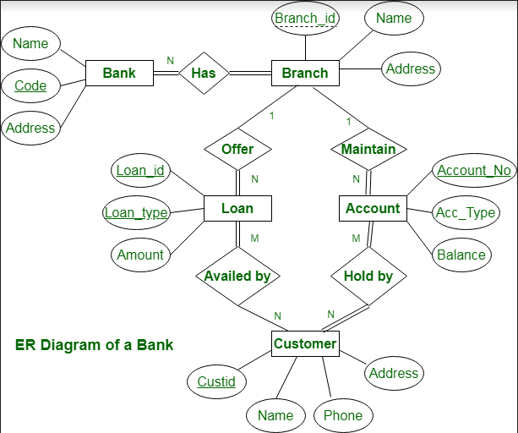

Slide 19
Normalization
  In SQL we use enormous amount of data stored in different tables across multiple DBs.
  If not organized properly it will be a very big problem in managing DBs.
  So we need to normalize the DBs well.
  Normalization is the process to eliminate data redundancy and enhance data integrity in the table.
  Normalization organizes the columns and tables of a database to ensure that database integrity constraints properly execute their dependencies.
  It is a systematic technique of decomposing tables to eliminate data redundancy (repetition) and undesirable characteristics like Insertion, Update, and Deletion anomalies.

Slide 20
Do you see any Problem with this table ???
Redundancy : Every info in One table
Roll Num | Name | Branch | HoD | Office Num
1 | Rama | CSE | Mr. Rao | 0821 - 2481523
2 | Krishna | CSE | Mr. Rao | 0821 - 2481523
3 | Hari | CSE | Mr. Rao | 0821 - 2481523
4 | Lakshmi | CSE | Mr. Rao | 0821 - 2481523

Slide 21
Insertion Anomaly
Roll Num | Name | Branch | HoD | Office Num
1 | Rama | CSE | Mr. Rao | 0821 - 2481523
2 | Krishna | CSE | Mr. Rao | 0821 - 2481523
3 | Hari | CSE | Mr. Rao | 0821 - 2481523
4 | Lakshmi | CSE | Mr. Rao | 0821 - 2481523
5 | Geeta | CSE | Mr. Rao | 0821 - 2481523
Without knowing we are storing student and branch info

Slide 22
Insertion Anomaly
Roll Num | Name | Branch | HoD | Student Club
1 | Rama | CSE | Mr. Rao | Arts
2 | Krishna | CSE | Mr. Rao | Singing
3 | Hari | CSE | Mr. Rao | Dance
4 | Lakshmi | CSE | Mr. Rao | Drama
5 | Geeta | CSE | Mr. Rao | ????
What if the club is given only after 1st year ???

Slide 23
Deletion Anomaly
Roll Num | Name | Branch | HoD | Office Num
1 | Rama | CSE | Mr. Rao | 0821 - 2481523
2 | Krishna | CSE | Mr. Rao | 0821 - 2481523
3 | Hari | CSE | Mr. Rao | 0821 - 2481523
4 | Lakshmi | CSE | Mr. Rao | 0821 - 2481523
5 | Geeta | CSE | Mr. Rao | 0821 - 2481523
If we delete the students one after another after the deletion of last student department info is also lost

Slide 24
Updation Anomaly
Roll Num | Name | Branch | HoD | Office Num
1 | Rama | CSE | Mr. Rao | 0821 - 2481523
2 | Krishna | CSE | Mr. Rao | 0821 - 2481523
3 | Hari | CSE | Mr. Rao | 0821 - 2481523
4 | Lakshmi | CSE | Mr. Rao | 0821 - 2481523
5 | Geeta | CSE | Mr. Rao | 0821 - 2481523
If Mr.Rao gets changed to Dr Singh Then how many updates we need to do ??

Slide 25
Solution : Split the Table
Roll Num | Name | Branch
1 | Rama | CSE
2 | Krishna | CSE
3 | Hari | CSE
4 | Lakshmi | CSE
Student Table
Branch | HoD | Office Num
CSE | Mr Rao | 0821 - 2481543
ECE | Dr Swami | 0821 - 2481544
Department Table

Slide 26
date | item_name | item_category | cost_per_kg | order_weight | cust_name | email_id | address
1/1/2020 | apple | fruit | 80 | 0.78 | rama | 123@abc.in | 21,mysore
1/1/2020 | orange | fruit | 45 | 0.67 | rama | 123@abc.in | 21,mysore
1/1/2020 | onion | vegetable | 20 | 0.88 | rama | 123@abc.in | 21,mysore
1/1/2020 | palak | leafy | 10 | 1 | rama | 123@abc.in | 21,mysore
2/1/2020 | banana | fruit | 25 | 0.45 | hari | 124@abc.in | 24,mysore
2/1/2020 | grapes | fruit | 85 | 0.75 | hari | 124@abc.in | 24,mysore
2/1/2020 | spinach | leafy | 20 | 1 | hari | 124@abc.in | 24,mysore
3/1/2020 | orange | fruit | 45 | 0.75 | krishna | 125@abc.in | 25,mysore
4/1/2020 | banana | fruit | 25 | 0.8 | geeta | 126@abc.in | 26,mysore

Slide 27
cust_id | cust_name | email_id | address
101 | rama | 123@abc.in | 21,mysore
102 | hari | 124@abc.in | 24,mysore
103 | krishna | 125@abc.in | 25,mysore
104 | geeta | 126@abc.in | 26,mysore
Customer Table
item_id | item_name | item_category | cost_per_kg
201 | apple | fruit | 80
202 | orange | fruit | 45
203 | onion | vegetable | 20
204 | palak | leafy | 10
205 | banana | fruit | 25
206 | grapes | fruit | 85
207 | spinach | leafy | 20
Item Table

Slide 28
date | item_id | cust_id | order_weight
1/1/2020 | 201 | 101 | 0.78
1/1/2020 | 202 | 101 | 0.67
1/1/2020 | 203 | 101 | 0.88
1/1/2020 | 204 | 101 | 1
2/1/2020 | 205 | 102 | 0.45
2/1/2020 | 206 | 102 | 0.75
2/1/2020 | 207 | 102 | 1
3/1/2020 | 202 | 103 | 0.75
4/1/2020 | 205 | 104 | 0.8
Transaction Table

Slide 29
Cust_table
cust_id
cust_name
email_id
address
Item_table
item_id
item_name
item_category
cost_per_kg
Transcation_table
date
item_id
cust_id
order_weight
Star Schema

Slide 30
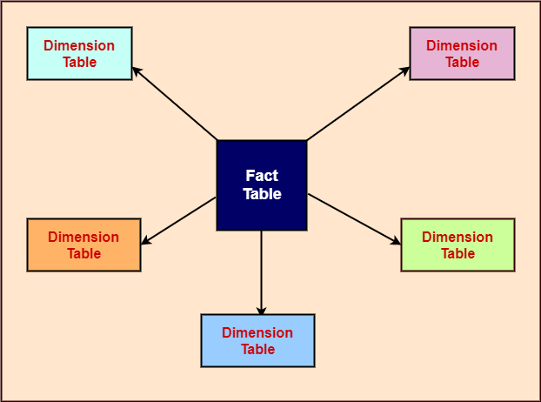
Star Schema

Slide 31
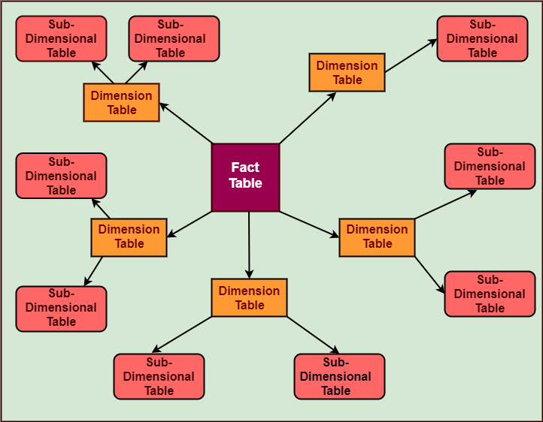
Snowflake Schema

Slide 32
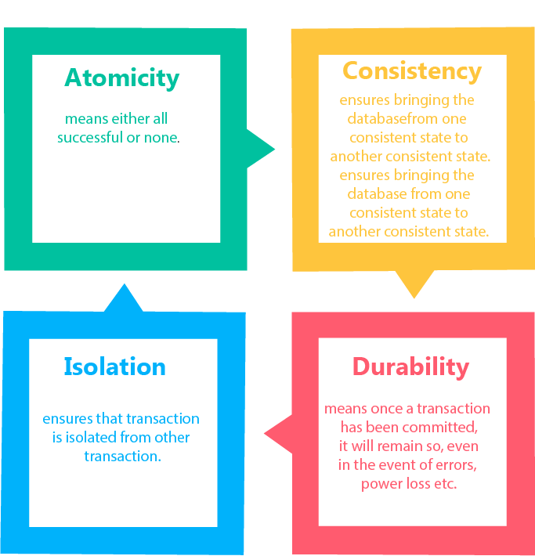
ACID Properties

Slide 33
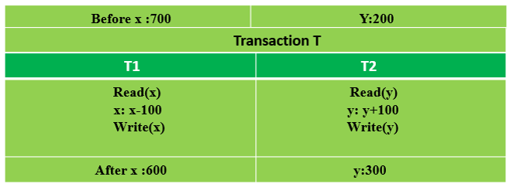
Atomicity
the entire transaction takes place at once or doesn’t happen at all.
If the transaction fails after completion of T1 but before completion of T2.( say, after write(X) but before write(Y)), then the amount has been deducted from X but not added to Y. This results in an inconsistent database state. Therefore, the transaction must be executed in its entirety in order to ensure the correctness of the database state.

Slide 34
Consistency
database is consistent before and after the transaction.
Total Before “T” occurs : 900
Total After “T” occurs : 900

Slide 35
Isolation
Transactions do not affect one another
let’s say that our account balance is $200. Two transactions for a $100 withdrawal start at the same time. The transactions run in isolation which guarantees that when they both complete, we’ll have a balance of $0 instead of $100.

Slide 36
Durability
Durability guarantees that once the transaction completes and changes are written to the database, they are persisted. This ensures that data within the system will persist even in the case of system failures like crashes or power outages.

Slide 37
SQL : Structured Query Language
comprehensive language for manipulating databases
SQL can do many different things: create database tables, insert or change records, add indexes, retrieve information, and so on
SQL commands are like instructions to a table. It is used to interact with the database with some operations.
SQL can perform various tasks like creating a table, adding data to tables, dropping the table, modifying the table, set permission for users.
Keywords, entities and attribute names are case insensitive but the values inside he table are case sensitive

Slide 38
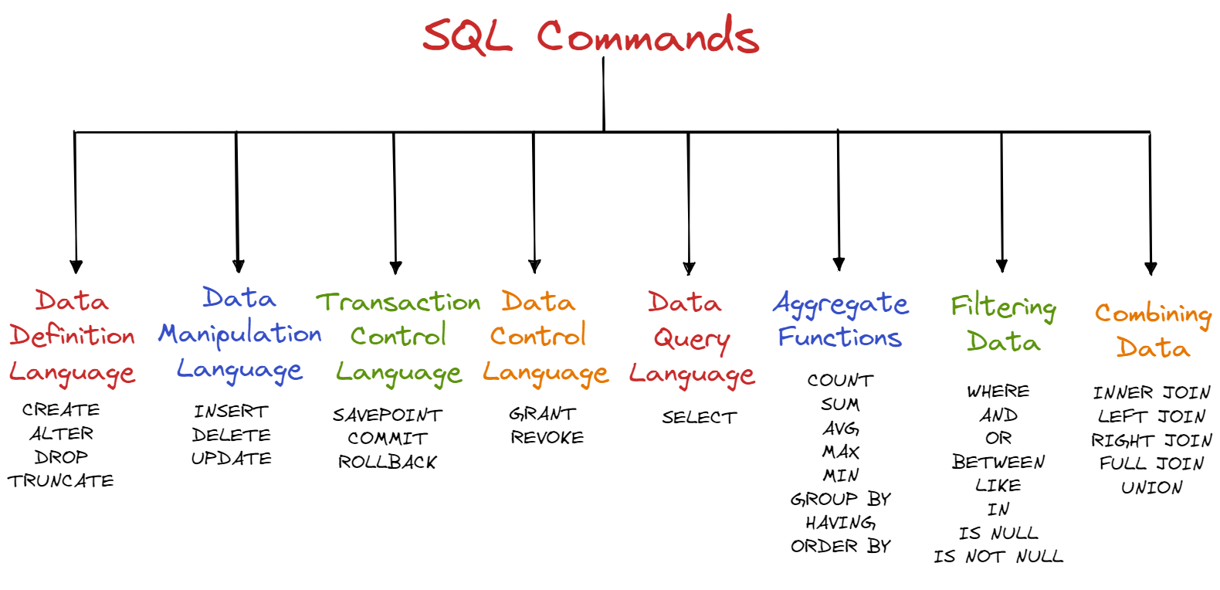
SQL Commands

Slide 39
SQL contd…
These SQL commands are mainly categorized into five categories:
DDL – Data Definition Language
DQL – Data Query Language
DML – Data Manipulation Language
DCL – Data Control Language
TCL – Transaction Control Language
Online Compiler Link : https://www.programiz.com/sql/online-compiler/

Slide 40
DDL : Data Definition Language
Data Definition Language actually consists of the SQL commands that can be used to define the database schema
List of DDL commands:
CREATE: This command is used to create the database or its objects (like table, index, function, views, store procedure, and triggers).
DROP: This command is used to delete objects from the database.
ALTER: This is used to alter the structure of the database.
TRUNCATE: This is used to remove all records from a table, including all spaces allocated for the records are removed.

Slide 41
DML : Data Manipulation Language
The SQL commands that deal with the manipulation of data present in the database belong to DML or Data Manipulation Language
List of DML commands:
INSERT: It is used to insert data into a table.
UPDATE: It is used to update existing data within a table.
DELETE: It is used to delete records from a database table.

Slide 42
DQL : Data Query Language
DQL statements are used for performing queries on the data within schema objects.
List of DQL commands:
SELECT: It is used to retrieve data from the database.

Slide 43
Create Command
CREATE table table_name(
Column1 datatype (size),
Column2 datatype (size),
..
ColumnN datatype(size)
);
CREATE TABLE Customer(
CustomerID INT PRIMARY KEY,
CustomerName VARCHAR(50),
LastName VARCHAR(50),
Country VARCHAR(50),
Age int(2),
Phone int(10)
);

Slide 44
Insert Command
Insert into Table_name
Values (Value01, value02, value03),
(Value11, value12, value13),
(Value21, value22, value23),
(ValueN1, valueN2, valueN3);
INSERT INTO Customer
VALUES (1, 'Shubham', 'Thakur', 'India','23','xxxxxxxxxx'),
(2, 'Aman ', 'Chopra', 'Australia','21','xxxxxxxxxx'),
(3, 'Naveen', 'Tulasi', 'Sri lanka','24','xxxxxxxxxx'),
(4, 'Aditya', 'Arpan', 'Austria','21','xxxxxxxxxx'),
(5, 'Nishant. Salchichas S.A.', 'Jain', 'Spain','22','xxxxxxxxxx');

Slide 45
Select Command : Fetch from table
SELECT column1,column2 FROM table_name ;
SELECT * FROM table_name;
SELECT CustomerName, LastName FROM Customer;
SELECT * FROM Customer;
SELECT CustomerName FROM Customer where Age = '21';

Slide 46
Update Command
UPDATE Customer SET CustomerName = 'Nitin' WHERE Age = 22;
UPDATE Customer SET CustomerName = 'Satyam', Country = 'USA' WHERE CustomerID = 1;
UPDATE Customer SET CustomerName = 'Shubham';

Slide 47
Delete Command
DELETE FROM Customer WHERE Age = 22;
DELETE FROM Customer;

Slide 48
Aggregate Commands:
CREATE TABLE students (
id INT PRIMARY KEY,
name VARCHAR(255),
age INT,
marks INT
);
INSERT INTO students (id, name, age, marks) VALUES
(1, 'Alice', 20, 85),
(2, 'Bob', 21, 78),
(3, 'Charlie', 19, 92),
(4, 'David', 20, 65),
(5, 'Eve', 22, 89),
(6, 'Frank', 21, 77),
(7, 'Grace', 20, 91),
(8, 'Harry', 19, 84),
(9, 'Ivy', 22, 95),
(10, 'Jack', 20, 73),
(11, 'Katie', 21, 82),
(12, 'Liam', 19, 88),
(13, 'Mia', 22, 79),
(14, 'Noah', 21, 94),
(15, 'Olivia', 20, 76),
(16, 'Peter', 19, 90),
(17, 'Queen', 22, 87),
(18, 'Ryan', 21, 83),
(19, 'Sarah', 20, 81),
(20, 'Tom', 19, 86);

Slide 49
Aggregate Commands:
Sum : SELECT SUM(marks) FROM students;
Count : SELECT COUNT(*) FROM students;
Avg : SELECT AVG(marks) FROM students;
Min : SELECT MIN(marks) FROM students;
Max : SELECT MAX(marks) FROM students;
Group by: SELECT age, AVG(marks) FROM students GROUP BY age;
Having : SELECT age, AVG(marks) FROM students GROUP BY age HAVING AVG(marks) > 85;
Order by : SELECT * FROM students ORDER BY marks DESC;

Slide 50
Filters Commands:
Where : SELECT * FROM students WHERE age = 20;
OR: SELECT * FROM students WHERE age = 20 OR age = 21;
AND : SELECT * FROM students WHERE age = 20 AND marks > 80;
Between : SELECT * FROM students WHERE marks BETWEEN 80 AND 90;
Like : SELECT * FROM students WHERE name LIKE 'A%';
In : SELECT * FROM students WHERE age IN (20, 21);
Is Null : SELECT * FROM students WHERE marks IS NULL;
Is Not Null : SELECT * FROM students WHERE marks IS NOT NULL;

Slide 51
Joins
A JOIN clause is used to combine rows from two or more tables, based on a related column between them.
Types of Joins
INNER JOIN : A Intersection B
LEFT JOIN : A
RIGHT JOIN : B
FULL JOIN : A UNION B
NATURAL JOIN :

Slide 52
Topics
  Window functions (rank, dense rank, row number etc)
  Data Types, Variables and Constants
  Conditional Structures : IF, CASE, GOTO and NULL
  Integrating Python with SQL

Slide 53
Window Function
Window functions applies aggregate and ranking functions over a particular window (set of rows). OVER clause is used with window functions to define that window. OVER clause does two things :
Partitions rows into form set of rows. (PARTITION BY clause is used)
Orders rows within those partitions into a particular order. (ORDER BY clause is used)

Slide 54
Window Function
SELECT coulmn_name1,
window_function(cloumn_name2)
OVER([PARTITION BY column_name1] [ORDER BY column_name3]) AS new_column
FROM table_name;
window_function= any aggregate or ranking function
column_name1= column to be selected
coulmn_name2= column on which window function is to be applied
column_name3= column on whose basis partition of rows is to be done
new_column= Name of new column
table_name= Name of table

Slide 55
Window Function : Example 1
/*
Set up data
*/
CREATE TABLE orders (
order_id INT,
order_date DATE,
order_total INT
);
INSERT INTO orders (order_id, order_date, order_total) VALUES
(1, '2020-04-03', 100),
(2, '2020-04-03', 250),
(3, '2020-04-04', 80),
(4, '2020-04-05', 10);
/*
Select data
*/
SELECT
order_id,
order_date,
order_total
FROM orders;
/*
First window function example
*/
SELECT
order_id,
order_date,
order_total,
SUM(order_total) OVER (
ORDER BY order_id ASC
) AS running_total
FROM orders
ORDER BY order_id ASC;

Slide 56
Window Function : Example 1 contd…
/*
Add more data
*/
INSERT INTO orders (order_id, order_date, order_total) VALUES
(5, '2020-04-03', 120),
(6, '2020-04-04', 90),
(7, '2020-04-04', 50),
(8, '2020-04-04', 15);
/*
Use a partition clause
*/
SELECT
order_id,
order_date,
order_total,
SUM(order_total) OVER (
PARTITION BY order_date
ORDER BY order_id ASC) AS running_total
FROM orders
ORDER BY order_id ASC;
/*
Update the order by clause
*/
SELECT
order_id,
order_date,
order_total,
SUM(order_total) OVER (
PARTITION BY order_date
ORDER BY order_id ASC) AS running_total
FROM orders
ORDER BY order_date ASC;

Slide 57
Window Function : Rank, Dense_rank, Row_number.
CREATE TABLE Employees (emp_id INT, emp_name VARCHAR, address VARCHAR, dept_id INT, dept_name VARCHAR, salary INT);
INSERT INTO Employees (emp_id, emp_name, address, dept_id, dept_name, salary) VALUES
(101, 'P1', 'A1', 1, 'D1', 1000),
(102, 'P2', 'A2', 2, 'D2', 10000),
(103, 'P3', 'A3', 3, 'D3', 12000),
(104, 'P4', 'A4', 2, 'D2', 11000),
(105, 'P5', 'A5', 1, 'D1', 1200),
(106, 'P6', 'A6', 3, 'D3', 1300),
(107, 'P7', 'A7', 2, 'D2', 1400),
(108, 'P8', 'A8', 4, 'D4', 12100),
(109, 'P9', 'A9', 3, 'D4', 10030),
(110, 'P10', 'A10', 2, 'D2', 10200),
(111, 'P11', 'A11', 1, 'D1', 10200),
(112, 'P12', 'A12', 3, 'D3', 10040),
(113, 'P13', 'A13', 2, 'D2', 10200),
(114, 'P14', 'A14', 3, 'D3', 10040);

Slide 58
Window Function : Rank, Dense_rank, Row_number contd…
SELECT *
, rank() over(partition by dept_id order by salary desc) as ‘RANK’,
DENSE_rank() over(partition by dept_id order by salary desc) as ‘DENSE_RANK’,
ROW_NUMBER() over(partition by dept_id order by salary desc) as ROW_NUMBER
from Employees;

Slide 59
Data Types in SQL
Data Type | Description
varchar(n) | Variable width character string
int | Allows whole numbers between -2,147,483,648 and 2,147,483,647
float(n) | Floating precision number data from -1.79E + 308 to 1.79E + 308. The n parameter indicates whether the field should hold 4 or 8 bytes. float(24) holds a 4-byte field and float(53) holds an 8-byte field. Default value of n is 53.
datetime | From January 1, 1753 to December 31, 9999 with an accuracy of 3.33 milliseconds

Slide 60
Conditional Structures
SELECT emp_id,emp_name,
CASE
WHEN dept_id == 1 THEN "CSE"
WHEN dept_id == 2 THEN "ECE"
WHEN dept_id == 3 THEN "EE"
ELSE "Do not know"
END AS dept_desc
from Employees;

Slide 61
GOTO
DECLARE @Counter int;
SET @Counter = 1;
WHILE @Counter < 10
BEGIN
SELECT @Counter
SET @Counter = @Counter + 1
IF @Counter = 4 GOTO Branch_One --Jumps to the first branch.
IF @Counter = 5 GOTO Branch_Two --This will never execute.
END
Branch_One:
SELECT 'Jumping To Branch One.'
GOTO Branch_Three; --This will prevent Branch_Two from executing.
Branch_Two:
SELECT 'Jumping To Branch Two.'
Branch_Three:
SELECT 'Jumping To Branch Three.';

Slide 62
Integrating SQL and Python
https://colab.research.google.com/drive/13qXZW3M5jCpZn6VUPe-AijgA4igK-XGi?usp=sharing

Slide 63
Thank you

