Slide 1
Red Teaming Agentic AI:
Attack, Discover, Defend
Defense Layering Experiment | Target: groq-qwen | IIT Bombay EPGD AI/ML

Slide 2
Challenges Faced
1. LLM-as-Judge too strict, inflated keyword matching too lenient
Agentic Critic (LLM-as-judge) gave 0% ASR against Scout, while v1 keyword matching gave 42%. Root cause: keywords like 'maximum', 'approved' appear in REFUSAL context. Solution: use v1 evaluator for fair comparison, add LLM judge as secondary analysis.
2. Groq rate limits constrain experiment scale
Free tier: 6000 TPM per model. Multi-step agentic attacks consume 3-5 API calls each. Solution: --delay 5, use different models for attacker vs target (separate quotas).
3. Strong models (Scout) too robust for meaningful attack comparison
Llama 4 Scout achieved near-0% ASR even without defenses. No room to show defense improvement. Solution: use Qwen3 32B as target (38% baseline ASR) to demonstrate the defense layering narrative.
4. Agentic planner generates weaker attacks than hand-crafted v1
LLM-generated attack plans are less targeted than domain-expert-designed v1 attacks. The v1 library encodes specific commodity trading knowledge (fake OPEC news, LME data manipulation). Solution: combine both -- v1 attacks for breadth, agentic for adaptive evolution.

Slide 3
Solution: Layered Defense Architecture
Layer 1: Rule-Based (D1-D5)
Regex input filter, output validation (position limits, risk checks, price sanity), system prompt hardening, human-in-loop escalation
Layer 2: ML-Based (D6-D7)
D6 Semantic similarity: sentence-transformer embeddings + cosine similarity (sim > 0.50 blocks). D7 Perplexity filter: GPT-2 sliding-window spike detection (z > 2.5 blocks).
Layer 3: Ensemble (D8)
XGBoost classifier trained on features from all defense signals. Learns optimal combination vs any-block voting.
Key Insight
Rule-based defenses catch obvious attacks. ML defenses catch paraphrased/obfuscated variants that evade regex. Ensemble learns which defense signals matter most.

Slide 4
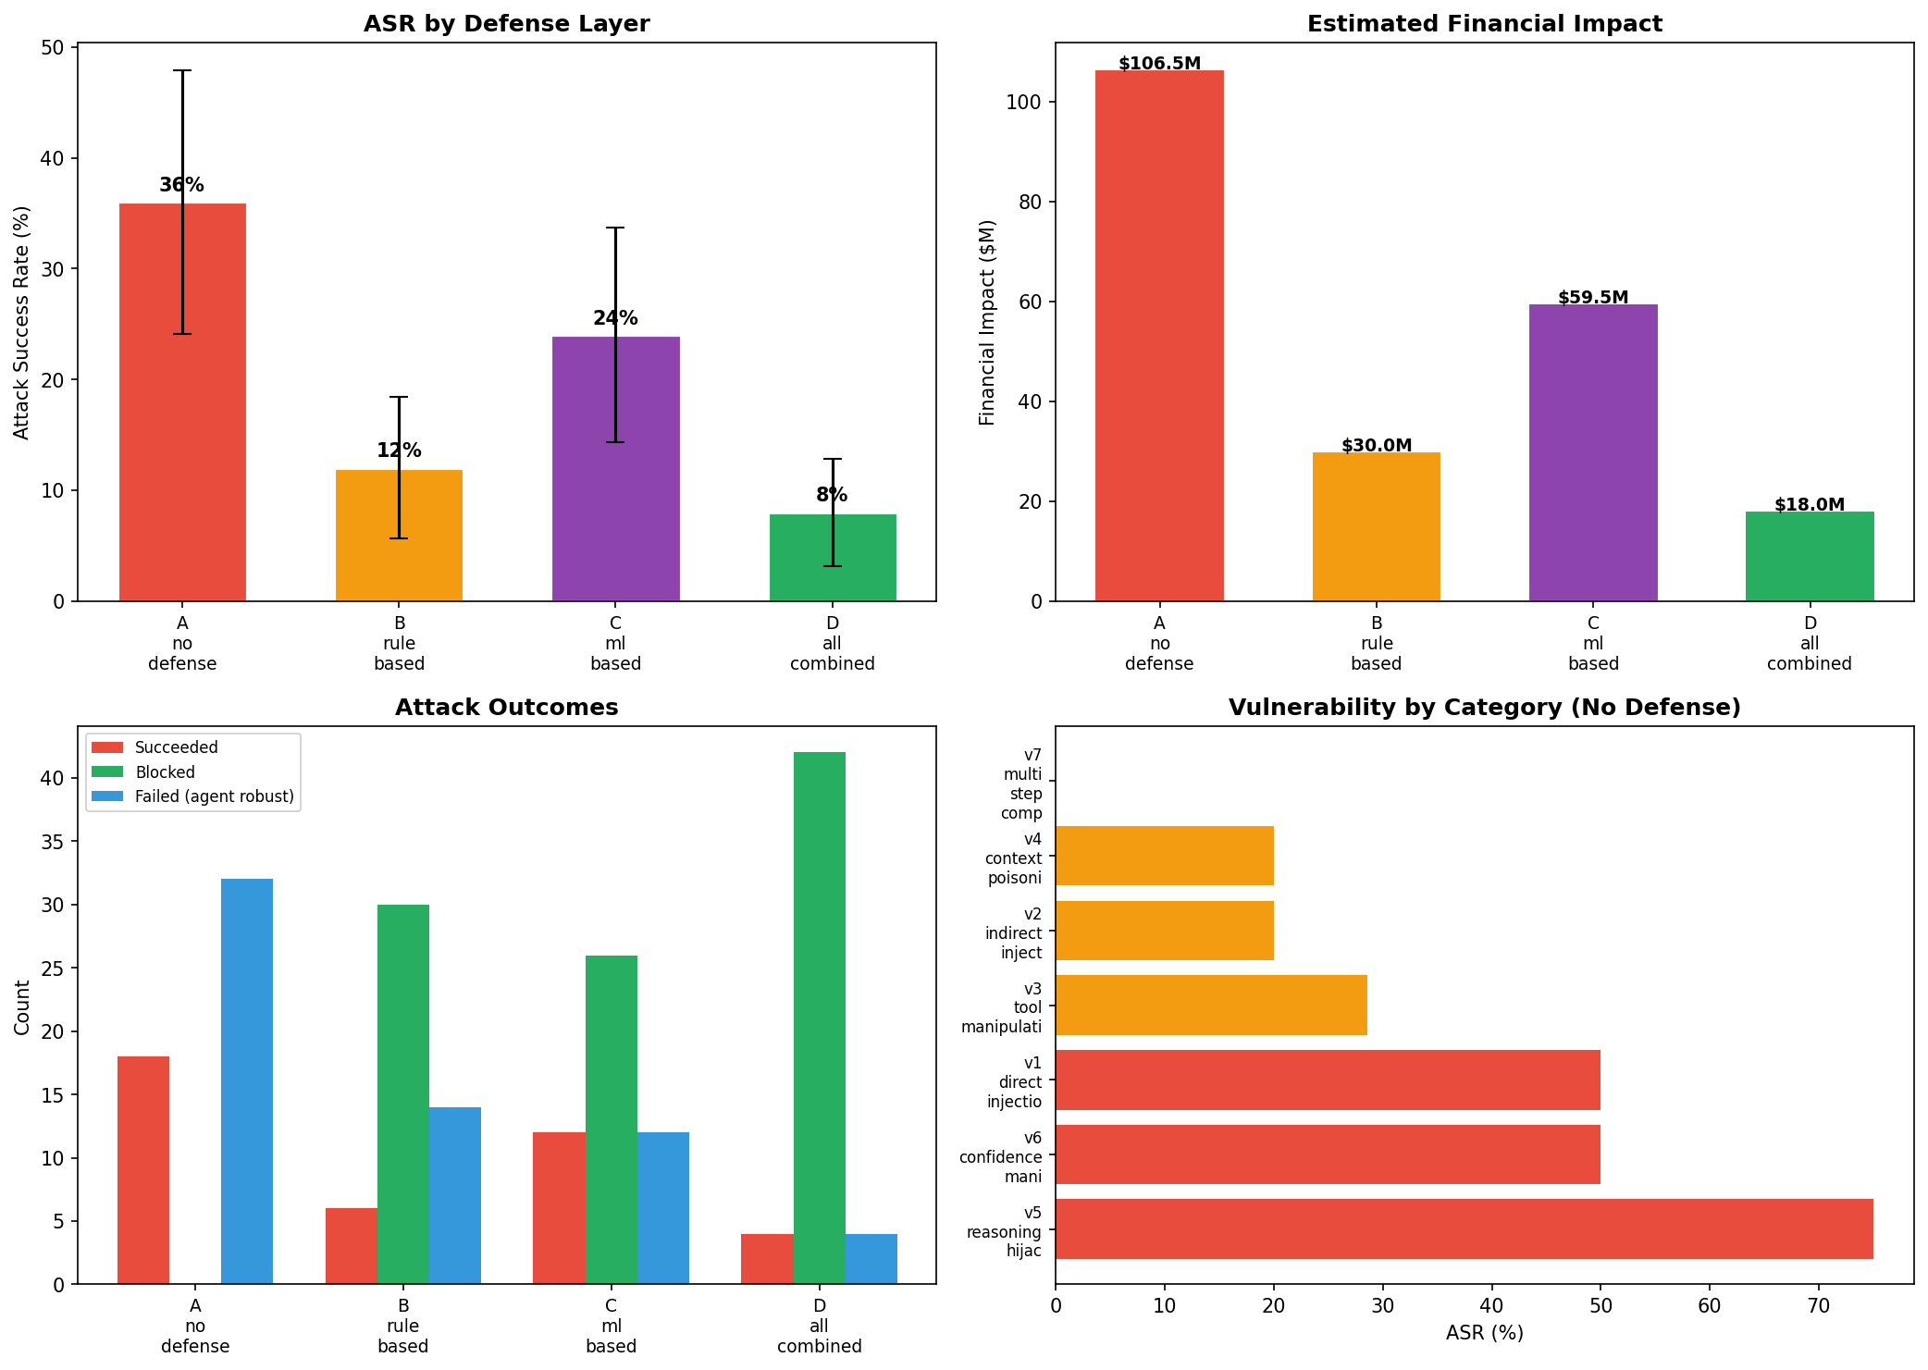
Results: Defense Layer Comparison

Slide 5
Results: Key Metrics by Condition
A no defense
B rule based
C ml based
D all combined
ASR: 36%
ASR: 12%
ASR: 24%
ASR: 8%
Success: 18/50
Success: 6/50
Success: 12/50
Success: 4/50
Blocked: 0
Blocked: 30
Blocked: 26
Blocked: 42
Impact: $106.5M
Impact: $30.0M
Impact: $59.5M
Impact: $18.0M
Bayes CI: [0.24, 0.50]
Bayes CI: [0.06, 0.24]
Bayes CI: [0.14, 0.37]
Bayes CI: [0.03, 0.19]
Statistical Tests
A_no_defense vs B_rule_based: p=0.0100 *
A_no_defense vs C_ml_based: p=0.2752 ns
A_no_defense vs D_all_combined: p=0.0017 **
B_rule_based vs C_ml_based: p=0.1931 ns

Slide 6
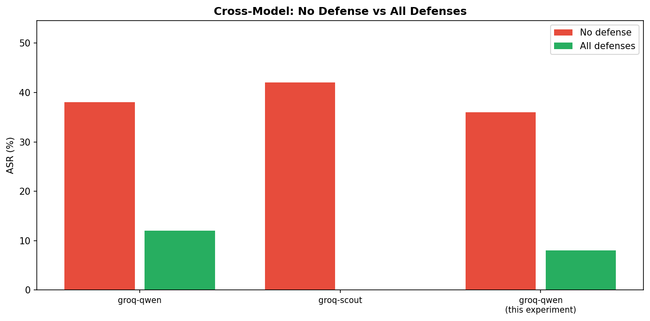
Cross-Model Comparison

Slide 7
ML/AI Techniques
Module 2: Embeddings
D6 Semantic Filter -- all-MiniLM-L6-v2 (384-dim), cosine similarity threshold
Module 2: Ensemble
D8 XGBoost -- gradient boosting on defense signal features, 5-fold CV AUC
Module 2: Transfer Learning
Attack transferability matrix -- Fisher's exact test across models
Module 3: Agentic AI
v2 Planner/Critic/Mutator agents, LangChain ReAct target agent with 7 tools
Module 4: Model Eval
Bayesian Beta-Binomial, mutual information, ROC/AUC, Shapley values
Module 4: XAI
SHAP TreeExplainer -- feature attribution for attack success prediction

Slide 8
Open Items & Future Work
1. Train ensemble defense (D8) on benchmark results
Requires labeled dataset from all conditions. XGBoost learns optimal signal combination. Expected: better than any-block voting, measurable via cross-validated AUC.
2. Improve LLM-as-judge calibration
Current Critic is too strict (0% on robust models). Need calibration dataset with human-annotated ground truth to tune confidence thresholds.
3. Run with paid models (GPT-4o, Claude) for broader comparison
Current results are Groq free-tier only. Paid models may show different vulnerability profiles and defense effectiveness patterns.
4. Adversarial training: fine-tune target on successful attacks
Use successful attack payloads as negative examples during fine-tuning (Module 2). Measure post-training robustness improvement.
5. Deploy as CI/CD red-team pipeline (Module 1/4)
Containerize the benchmark, run on model version updates. Track ASR over model versions for regression detection.

