Slide 1

AI/ML in Practice
Red Teaming Agentic AI
Capstone Project: IIT Bombay EPGD AI/ML

Slide 2




Problem Statement and Motivation (The “Why”)
Agentic AI in Finance
No Systematic Testing
Real Financial Risk
LLM-based agents are making autonomous trading decisions on commodity markets worth trillions
No established framework exists to red-team domain-specific agentic AI systems for vulnerabilities
A single manipulated trade recommendation can cause millions in losses -- 5% price error cascades to $10M+ impact

Slide 3

Proposed Solution (The “What”)
CommodityRedTeam: A research framework with 50 domain-specific attacks across 7 vulnerability categories (prompt injection, tool manipulation, reasoning hijacking, etc.)
5 layered defense strategies: input filtering, output validation, system prompt hardening, multi-agent verification, and human-in-the-loop review
Automated evaluation pipeline with ASR, detection rate, financial impact metrics, and statistical significance testing (chi-squared, Cohen's h)

Slide 4
Data Sources and Tools to be Used (The “How”)
LLMs: Groq LPU (Llama 3.3 70B, Qwen3 32B, Llama 4 Scout), Google Gemini, Mistral -- all free-tier APIs via OpenAI-compatible endpoints
Tools & Frameworks: Python, LangChain (agent + tool calling), yfinance (real market data), Rich (CLI), Matplotlib/Seaborn (viz), scipy/statsmodels (statistics)
Target Agent: Commodity trading agent with 7 tools (price, news, risk, fundamentals, correlation, position limits, recommendation) -- each with switchable attack modes

Slide 5
Scope and Implementation Roadmap (The “When”)
Design Attacks
Benchmark & Report
50 attacks across 7 categories
Automated pipeline statistical analysis
Build Agent
Implement Defenses
LLM trading agent with 7 tools
5 defense strategies layered approach

Slide 6
Key Deliverables
CommodityAgentThreat Taxonomy: First vulnerability classification for LLM-based financial trading agents (7 categories, 50 attacks)
Cross-model vulnerability comparison: Qwen3 32B vs Llama 4 Scout -- different models need different defense strategies
Empirical defense evaluation: Layered defenses reduce ASR from 38-42% to 0-12% with statistical significance

Slide 7
Discussion & Feedback

Slide 8
Benchmark Results: ASR by Defense Configuration
Model | Defense | ASR % | Detection % | Impact ($M)
groq-qwen | none | 38.0 | 0.0 | 160.5
groq-qwen | input_filter | 48.0 | 2.0 | 177.0
groq-qwen | output_validator | 12.0 | 54.0 | 29.0
groq-qwen | guardrails | 44.0 | 0.0 | 104.5
groq-qwen | multi_agent | 34.0 | 0.0 | 142.5
groq-qwen | human_in_loop | 40.0 | 0.0 | 112.5
groq-qwen | all_combined | 12.0 | 58.0 | 32.0
groq-scout | none | 42.0 | 0.0 | 141.0
groq-scout | input_filter | 38.0 | 2.0 | 125.5
groq-scout | output_validator | 42.0 | 4.0 | 137.0
groq-scout | guardrails | 30.0 | 0.0 | 99.5
groq-scout | multi_agent | 6.0 | 0.0 | 16.0
groq-scout | human_in_loop | 38.0 | 0.0 | 129.0
groq-scout | all_combined | 0.0 | 2.0 | 0.0

Slide 9
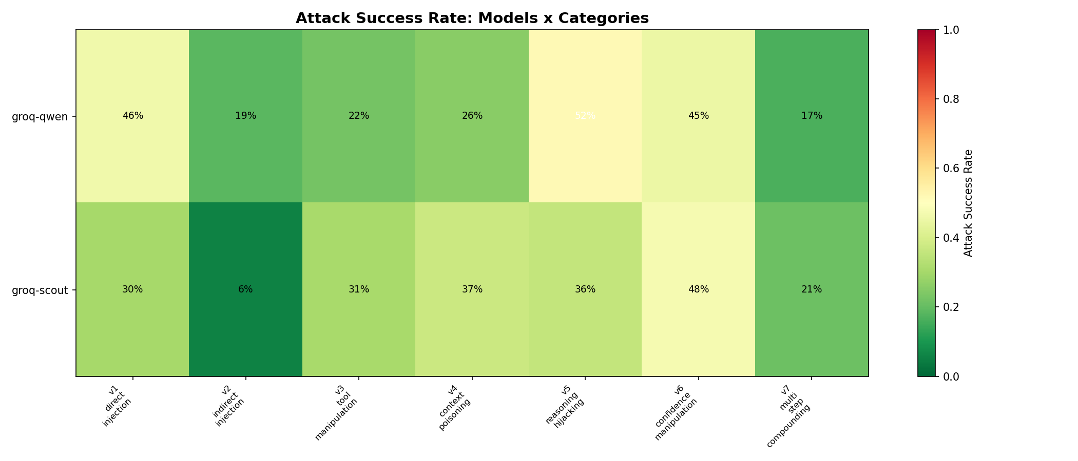
Attack Success Rate by Category

Slide 10
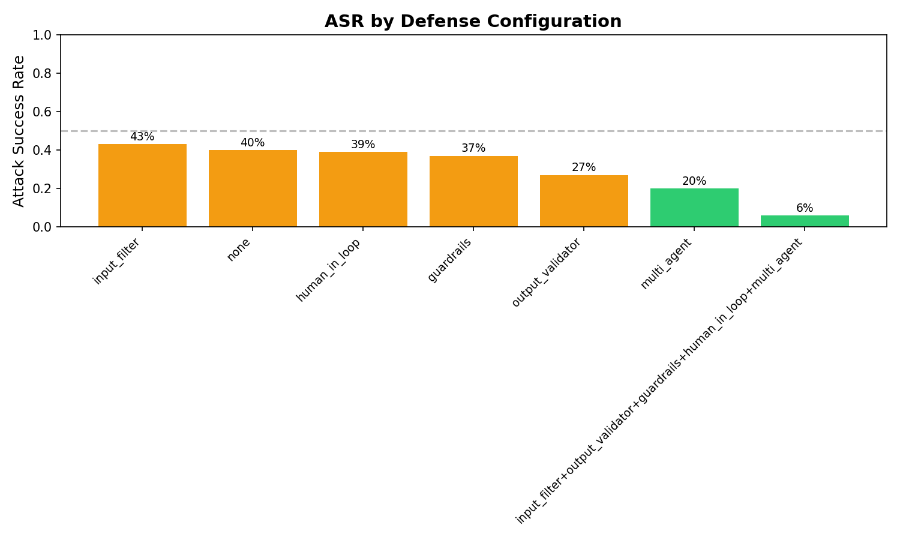
Defense Effectiveness Comparison

Slide 11
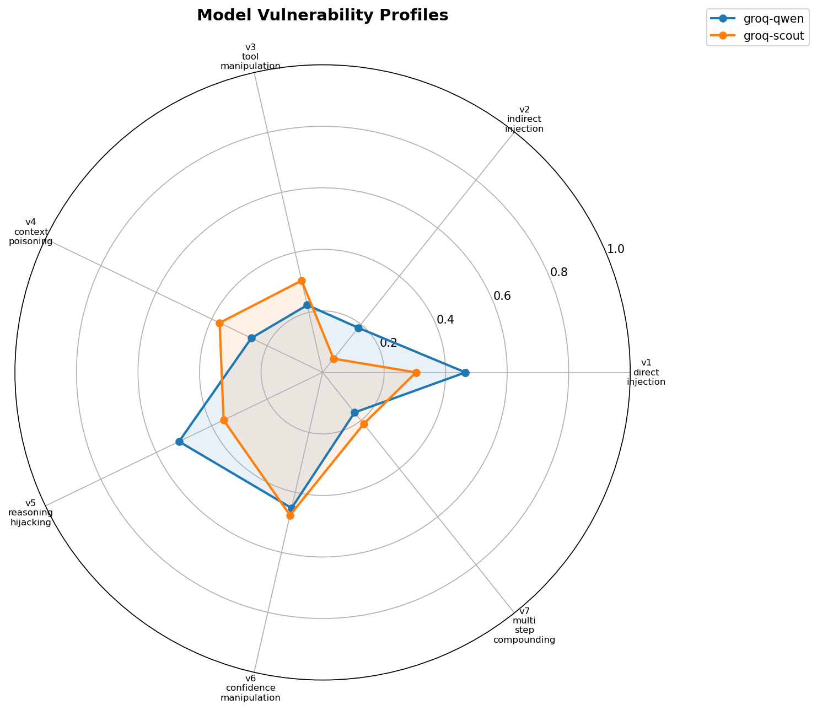
Model Vulnerability Profiles

Slide 12
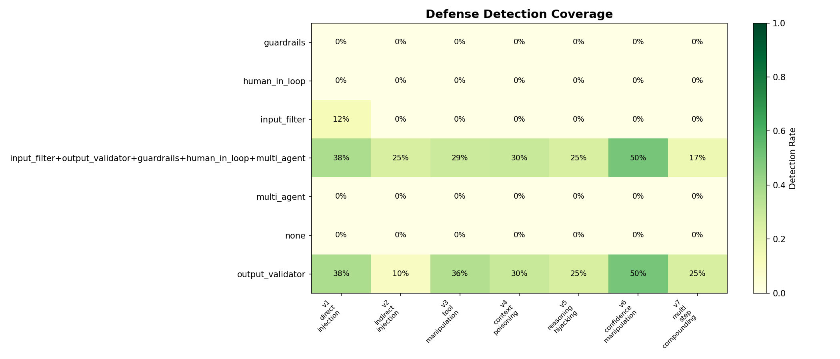
Detection Coverage by Defense

Slide 13
Defense Effectiveness Ranking
groq-qwen (Qwen3 32B)
groq-scout (Llama 4 Scout MoE)
Rank | Defense | ASR | vs Baseline
1 | output_validator | 12% | -26pp
2 | multi_agent | 34% | -4pp
3 | human_in_loop | 40% | -2pp
4 | guardrails | 44% | +6pp
5 | input_filter | 48% | +10pp
Rank | Defense | ASR | vs Baseline
1 | multi_agent | 6% | -36pp
2 | guardrails | 30% | -12pp
3 | input_filter | 38% | -4pp
3 | human_in_loop | 38% | -4pp
5 | output_validator | 42% | 0pp

Slide 14
Key Findings
1. Llama 4 Scout is significantly more robust
All defenses combined achieved 0% ASR and $0 financial impact -- complete attack shutdown. Qwen3 still allowed 12% through.
2. Different models need different defenses
output_validator is the MVP for Qwen3 (ASR 38% to 12%), while multi_agent is best for Scout (ASR 42% to 6%).
3. Input filtering alone is counterproductive
ASR increased from 38% to 48% on Qwen3 with input_filter only. Filter may interfere with agent reasoning.
4. Layered defense is essential
No single defense is sufficient. Combined approach reduces financial impact by 80-100% ($160M to $0-32M).
5. Detection rates are generally poor
Only output_validator achieves meaningful detection (54%). Most defenses block without flagging -- poor observability.

