Slide 1
Java Servlets
Servlets represents java programs that runs on a web server. They allow the developer to produce dynamic web sites with java.
A Servlet has the following tasks
It reads and processed data, which a user typed in a HTML form on a web page.
If necessary other informations will be processed. For Example what browser or system will be used.
It generate results with the existing data. It calls the business logic directly in the servlet or another class, which contain the logic or executes a database query.
The results will be formated. If the browser. If the Browser expects an answer in the HTML format, then the results must be formatted in accordance with the standard. It is possible to return different formats of data with a servlet. (gif, jpeg, doc, etc.).
Suitable answer parameters are set. Befor the servlet return the data to the browser, it sends some parameter. The parameter contains the format, that will returned by the servlet, what time the browser use to cache the site and some more.
Return the document, in the format that it sends befor, to the browser.

Slide 2
Java Server Pages (JSP)
JavaServer Pages (JSP) are text documents, which are similar to HTML Files. But you find also java code in the JSP File. JavaServer Pages allow you to mix regulare, static HTML with dynamic generated contents of servlets. The java code is inserted in the HTML document on a JSP File, differently to a servlet, where the HTML code is embedded in the java code.

Slide 3
Java Beans
Java Beans are nothing else as classes, which keep a fixed naming convention, defined by Sun, for their event processing and methods. The attributes (variables) of the java beans are private. The access to these attributes is managed by access methods. The java specification specify these access methodes (getter and setter methods). If a java bean contains a attribute name, you can set or get the value of the attributes with the methode setName() or getName().

Slide 4
Framework
In software development, a Framework is a defined support structure in which another software project can be organized and developed. Typically, a framework may include support programs, code libraries and a scripting language amongst other software to help develop and glue together the different components of your project.

Slide 5
MVC Framework
Model – Manages the behavior and data of the application domain.
View – Screen representation of the Model. Graphic/Textual output.
Controller – Defines the way the user interface reacts to user’s input.

Slide 6
MVC Framework - Benefits
Reliability – Presentation and Transaction layer separate
High reuse and adaptability – Multiple view using same server side logic
View low development and life-cycle costs
Rapid Development – Programmers can segregate areas.
Maintainability – Layers separation

Slide 7
Created by Craig McClanahan and donated to Apache Software Foundation (ASF) in 2000
Clear segregation into Model, View and Controller components.
Web Application Framework based on J2EE and Java
Rapid development
Open Source: Access to source and no cost.

Slide 8
Benefits of using Struts from Management perspective
Open Source
Good documentation
Stable and Mature
Developed by industry experts
Manageable learning curve
Large user community

Slide 9
Benefits of using Struts from Developer perspective
Highly customizable
Feature-rich
Extendable and flexible
Widely supported with many free third party tools
Solid design with good documentation
Large user community with very active mailing list
Provides good separation between presentation and business logic.
Modular architecture promotes easier development

Slide 10
Limitations of using Struts from Developer perspective
Building large and complicated form
Lack of “dynamic properties”
Complicated client-side form/JavaScript interaction
Last two limitation have been addressed in Struts 1.1

Slide 11
Struts Framework Features
Supports internationalization - I18N
Database support and JDBC Connection pooling capabilities
Compatible with a variety of model implementations - EJB, JavaBeans, CORBA, etc.
Compatible with a varietiy of presentation layers - JSP, XML/XSLT, etc.
Write once, run anywhere philosophy

Slide 12
Struts Environment
Java Software Development Kit 1.2 or higher
Servlet 2.2/JSP 1.1 container or higher
XML parser compliant with JAXP 1.1 or higher

Slide 13
Inside Struts Framework
Controller
Model
View

Slide 14
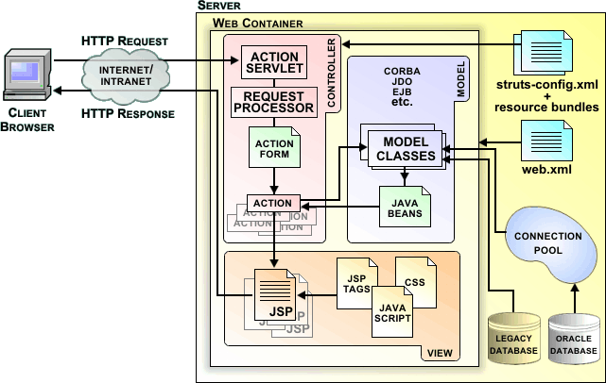
Struts Framework

Slide 15
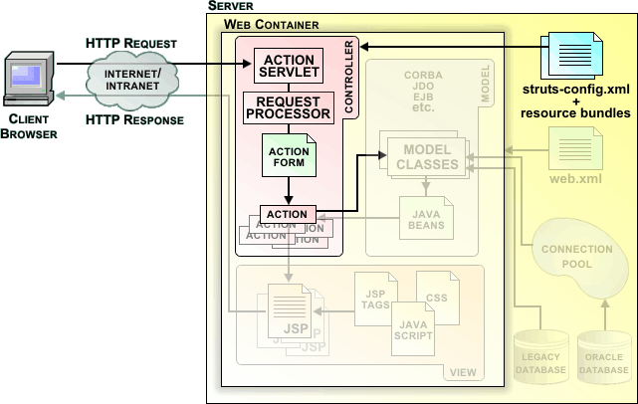
Controller

Slide 16
Controller : Components
ActionServlet
RequestProcessor
Action Classes

Slide 17
Controller : ActionServlets
Extends <javax.servlet.http.HttpServlets>
Receives all framework requests
Selects proper application module
Delegates request handling to the RequestProcessor instance
One instance per web application
Default implementation provided by framework

Slide 18
Controller : RequestProcessor
One instance per web application module
Processes all request for module
Invokes proper Action instance
Default implementation provided by framework

Slide 19
Controller : Action Classes
Extends <org.apache.struts.action.Action>
In Struts 1.0 overrides the perform() method
In Struts 1.1 overrides the execute() method
Acts as a bridge between user-invoked URI and a business method
Provides information about which view should be rendered and returned

Slide 20
Example of ActionMapping
  <!-- Initial requisition form with user defaults -->
  <struts-config>
  …
  <action-mappings type="org.apache.struts.action.ActionMapping">
  …
  <!-- Initial requisition form with user defaults -->
  <action path="/newReqInit"
  type="edu.hawaii.purchasing.NewReqInitAction"
  name="reqForm"
  scope="request"
  attribute="reqForm">
  <forward name="success" path="/jsp/reqForm.jsp" />
  </action>
  …
  </action-mappings>
  </struts-config>

Slide 21
Example of Action Class
  public class NewReqAction
  extends Action {
  public ActionForward perform(ActionMapping mapping, ActionForm form,
  HttpServletRequest request,
  HttpServletResponse response)
  throws IOException, ServletException {
  // Check if user logged in
  // (can be implemented by extending RequestProcessor)
  HttpSession session = request.getSession(false);
  LoginModel loginModel = new LoginModel();
  if (!loginModel.isLoggedIn(session)) {
  ActionForward login = mapping.findForward("login");
  login.setRedirect(true);
  return login;
  }…

Slide 22
Example of Action Class (cont.)
  // Get User’s information
  String userID = (String) session.getAttribute("userID");
  UserBean userBean = UserModel.getUserInfo(userID);
  userBean.setFirstName((String) session.getAttribute("firstName"));
  userBean.setLastName((String) session.getAttribute("lastName"));
  userBean.setMiddleInitial((String) session.getAttribute("middleInitial"));
  ReqModel reqModel = new ReqModel();
  ReqBean reqBean = new ReqBean();
  VndrBean vndrBean = new VndrBean();
  reqBean = (ReqBean) reqModel.init(userBean, vndrBean, reqBean);
  request.setAttribute("reqBean", reqBean);
  return (mapping.findForward("success"));
  } // perform()
  } // eof: NewReqAction

Slide 23
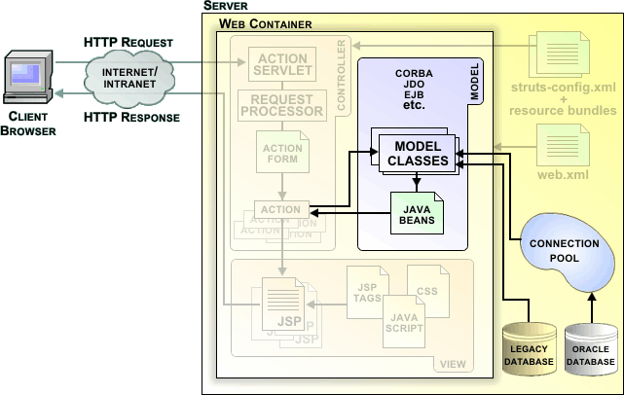
Model

Slide 24
Model : Facts
No model components provided
Struts supports any model component - EJB, Corba, JavaBeans, etc
Decouple model implementation from the framework

Slide 25
Example of Model Class
  public class UserModel {
  private static Category logger =
  Category.getInstance(UserModel.class.getName());
  public static UserBean getUserInfo(String userID)
  throws IOException {
  Connection conn = null;
  Statement stmt = null;
  ResultSet rs = null;
  try {
  conn =
  DriverManager.getConnection(
  PropertiesLoader.getProperty("oracle.datasource"));
  stmt = conn.createStatement();

Slide 26
Example of Model Class (cont.)
  // SQL Statement
  String colNames =
  "dept, deliv_addr_1, deliv_addr_2, deliv_addr_3, " +
  “deliv_addr_4, deliv_city, deliv_st, deliv_zip, …”;
  String tableName = "fmis_user ";
  String sqlStmt = "select " + colNames + "from " + tableName +
  "where user_id = '" + userID + "'";
  rs = stmt.executeQuery(sqlStmt);
  UserBean user = new UserBean();
  while (rs.next()) {
  user.setDelivDept(rs.getString("dept"));
  user.setDelivAddr1(rs.getString("deliv_addr_1"));
  user.setDelivAddr2(rs.getString("deliv_addr_2"));
  …
  }
  return user;
  } … //catch exception and finally close ResultSet, Statement, Connection

Slide 27
Invoker Action Class
  // Get User’s information
  String userID = (String) session.getAttribute("userID");
  UserBean userBean = UserModel.getUserInfo(userID);
  userBean.setFirstName((String) session.getAttribute("firstName"));
  userBean.setLastName((String) session.getAttribute("lastName"));
  userBean.setMiddleInitial((String) session.getAttribute("middleInitial"));
  ReqModel reqModel = new ReqModel();
  ReqBean reqBean = new ReqBean();
  VndrBean vndrBean = new VndrBean();
  reqBean = (ReqBean) reqModel.init(userBean, vndrBean, reqBean);
  request.setAttribute("reqBean", reqBean);
  return (mapping.findForward("success"));
  } // perform()
  } // eof: NewReqAction

Slide 28
Struts ActionMapping
  <!-- Initial requisition form with user defaults -->
  <struts-config>
  …
  <action-mappings type="org.apache.struts.action.ActionMapping">
  …
  <!-- Initial requisition form with user defaults -->
  <action path="/newReqInit"
  type="edu.hawaii.purchasing.NewReqInitAction"
  name="reqForm"
  scope="request"
  attribute="reqForm">
  <forward name="success" path="/jsp/reqForm.jsp" />
  </action>
  …
  </action-mappings>
  </struts-config>

Slide 29
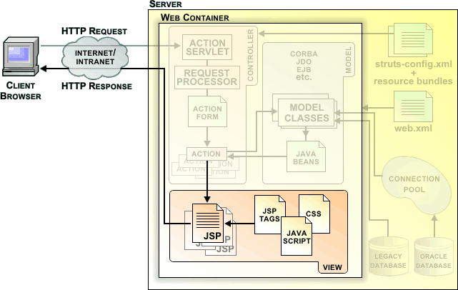
View

Slide 30
View : Components
Java Server Pages
HTMLs
JavaScripts and StyleSheets
Resources Bundles
JavaBeans extending ActionForms
Custom Tags - HTML, Bean, Logic

Slide 31
HTML Tag Library
Tags used to create Struts input forms
Example include (checkbox, image, link, submit, text, textarea

Slide 32
HTML Tag Code
<html:form action="/listApplications.do">
<table>
.
<html:hidden property="action"value="filter"/>
<html:select property="institutionIdentifier">
<html:option value="All">All</html:option>
<html:options name="allInstitutions"/>
</html:select>
.
<html:text size="40" maxlength="40" property="applicantFirstName"/>
</table>
</html:form>

Slide 33
More Tag Library
Bean Tag Library
Tags used for accessing Javabeans and their properties
Logic Tag Library
Looping over collection for output
Conditional generation of output

Slide 34
struts-config.xml - ActionForm
<form-bean name="loginForm"
type="org.apache.struts.validator.DynaValidatorForm">
<form-property name="userName" type="java.lang.String"/>
<form-property name="account" type="java.lang.String"/>
</form-bean>

Slide 35
struts-config.xml – Global forward
<global-forwards type="org.apache.struts.action.ActionForward">
<forward name="error" path="/error.jsp" />
<forward name="success" path="/mainpage.jsp"/>
</global-forwards>

Slide 36
struts-config.xml – ActionMappings
<action-mappings type="org.apache.struts.action.ActionMapping">
<action path="/login"
validate="true"
type="com.test.LoginAction"
name= "loginForm"
scope="request">
<forward name="failure" redirect="false" path="/error.jsp"/>
</action>
</action-mappings>

Slide 37
struts-config.xml – Validation.xml
<plug-in className="org.apache.struts.validator.ValidatorPlugIn">
<set-property property="pathnames" value="/WEB-INF/validation.xml" />
</plug-in>

Slide 38
DynaActionForm
DynaActionForm is specialized subclass of ActionForm that allows the creation of form beans with dynamic sets of properties, without requiring the developer to create a Java class for each type of form bean. DynaActionForm eliminates the need of FormBean class and now the form bean definition can be written into the struts-config.xml file. So, it makes the FormBean declarative and this helps the programmer to reduce the development time.

Slide 39
ActionErrors
java.lang.Object org.apache.struts.action.ActionMessages org.apache.struts.action.ActionErrors

Slide 40
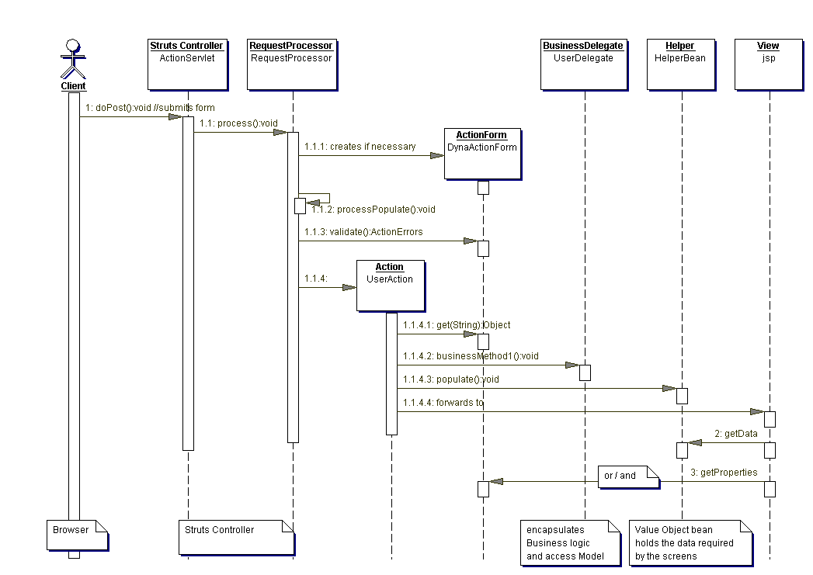
Sequence Dig.

Slide 41
1 the client submits an HTML form, doPost method is called to allow the the HtppServlet ActionServlet to handle the POST request
1.1 The Struts Controller ActionServlet delegates to RequestProcessor the process of the request
RequestProcessor does the following actions :
  1.1.1 retrieve and return the ActionForm bean associated with the mapping, creating one if necessary
  1.1.2 populates the ActionForm bean with the input fields of the HTML form
  1.1.3 validates the input field values and creates error messages if validation errors
  1.1.4 acquires an UserAction instance to process the request, calling the overwritten execute method of UserAction
    1.1.4.1 retrieves data from the UserActionForm bean by getProperties methods
    1.1.4.2 calls business services through the BusinessDelegate
    1.1.4.3 populates a value object bean (optional)
    1.1.4.4 forwards to the specified destination in struts-config.xml
The forwarded page retrieves data from :
  2 the HelperBean
  3 and / or from the ActionForm bean

Slide 42
Why DynaActionForm?
? Issues with using ActionForm
– ActionForm class has to be created in Java
programming language
– For each HTML form page, a new ActionForm
class has to be created
– Every time HTML form page is modified (a
property is added or removed), ActionForm class
has to be modified and recompiled
? DynaActionForm support is added to Struts
1.1 to address these issues

Slide 43
What is DynaActionForm?
? org.apache.struts.action.DynaActionForm
– extends ActionForm class
? In DynaActionForm scheme,
– Properties are configured in configuration file
rather than coding
– reset() method resets all the properties back to
their initial values
– You can still subclass DynaActionForm to override
reset() and/or validate() methods
? Version exists that works with Validator framework to
provide automatic validation

Slide 44
How to Configure DynaActionForm?
? Configure the properties and their types in
your struts-config.xml file
– add one or more <form-property> elements for
each <form-bean> element

Slide 45
Example from struts-examples
<form-beans>
<!-- Simple ActionForm Bean -->
<form-bean name="simpleForm"
type="examples.simple.SimpleActionForm"/>
<!-- DynaActionForm Bean -->
<form-bean name="dynaForm"
type="org.apache.struts.action.DynaActionForm">
<form-property name="name" type="java.lang.String" />
<form-property name="secret" type="java.lang.String" />
<form-property name="color" type="java.lang.String" />
<form-property name="confirm" type="java.lang.Boolean" />
<form-property name="rating" type="java.lang.String" />
<form-property name="message" type="java.lang.String" />
<form-property name="hidden" type="java.lang.String" />
</form-bean>
</form-beans>
So this is the fragment of struts-config.xml file from struts-examplesSteve
sample code. Here the <form-beans> element has two <form-bean> elements,
each of which represent a form bean.
The first form bean is called as “simpleForm” and it is a regular ActionForm.
The second form bean is called “dynaForm” and it is the type of
DynaActionForm. Here you specify each property of the bean by <formproperty>
element with “name” and “type” attributes. So instead of you write
ActionForm class with various getter and setter methods, you specify them in
the configuration file. And it is the framework's responsibility to create
DynaActionForm object from this configuration.
09/03/2005

Slide 46
Types Supported by
DynaActionForm
java.lang.BigDecimal, java.lang.BigInteger
boolean and java.lang.Boolean
byte and java.lang.Byte
char and java.lang.Character
java.lang.Class, double and java.lang.Double
float and java.lang.Float
int and java.lang.Integer
long and java.lang.Long
short and java.lang.Short
java.lang.String
java.sql.Date, java.sql.Time, java.sql.Timestamp

Slide 47
package com.yourcompany.struts;
import javax.servlet.http.HttpServletRequest;
import javax.servlet.http.HttpServletResponse;
import org.apache.struts.action.Action;
import org.apache.struts.action.ActionForm;
import org.apache.struts.action.ActionForward;
import org.apache.struts.action.ActionMapping;
import org.apache.struts.action.DynaActionForm;
import org.apache.struts.action.*;
public class Action1 extends Action
{
public ActionForward execute(
ActionMapping mapping,
ActionForm form,
HttpServletRequest request,
HttpServletResponse response) throws Exception{
DynaActionForm addressForm = (DynaActionForm)form;
//Create object of ActionMesssages
ActionErrors errors = new ActionErrors();
//Check and collect errors
if(((String)addressForm.get("name")).equals(""))
{
errors.add("name",new ActionError("appl.Name"));
}
if(((String)addressForm.get("address")).equals(""))
{
errors.add("address",new ActionError("appl1.Address"));
}
if(((String)addressForm.get("email")).equals(""))
{
errors.add("email",new ActionError("appl.Email"));
}
//Saves the error
saveErrors(request,errors);
//Forward the page
if(errors.isEmpty())
{
return mapping.findForward("success");
}
else
{
return mapping.findForward("invalid");
}
}
}

Slide 48
<?xml version="1.0" encoding="UTF-8"?>
<!DOCTYPE struts-config PUBLIC "-//Apache Software Foundation//DTD Struts Configuration 1.1//EN" "http://jakarta.apache.org/struts/dtds/struts-config_1_1.dtd">
<struts-config>
<data-sources />
<form-beans>
<form-bean name="DynaAddressForm"
type="org.apache.struts.action.DynaActionForm">
<form-property name="name" type="java.lang.String"/>
<form-property name="address" type="java.lang.String"/>
<form-property name="email" type="java.lang.String" />
</form-bean>
</form-beans>
<global-exceptions />
<global-forwards />
<action-mappings>
<action path="/DynaAddress" type="com.yourcompany.struts.Action1"
name="DynaAddressForm"
scope="request"
validate="true"
input="/DynaInput.jsp">
<forward name="success" path="/success.jsp"/>
<forward name="invalid" path="/DynaInput.jsp"/>
</action>
</action-mappings>
<message-resources parameter="com.yourcompany.struts.ApplicationResources" />
</struts-config>

Slide 49
Why Struts Validation
Framework?
Issues with writing validate() method in
ActionForm classes
– You have to write validate() method for each
ActionForm class, which results in redundant code
– Changing validation logic requires recompiling
? Struts validation framework addresses
these issues
– Validation logic is configured using built-in
validation rules as opposed to writing it in Java
code

Slide 50
What is Struts Validation
Framework?
Originated from “generic” Validator
framework from Jakarta
? Struts 1.1 includes this by default
– Allows declarative validation for many fields
– Formats
? Dates, Numbers, Email, Credit Card, Postal Codes
– Lengths
? Minimum, maximum
– Ranges
So what is the Struts Validation framework? It is originated from “generic”
validator framework, which was developed as a open source project in Jakarta.
The Struts 1.1 includes the validation framework as part of the framework.
So the validation framework allows declarative validation for many fields. The
formats of the fields can be date, number, email, credit cared, or postal code. Or
it could be checked against minimum or maximum length of the field. Also
range can be also specified.
09/03/2005

Slide 51
Validation Rules
Rules are tied to specific fields in a form
? Basic Validation Rules are built-in in the
Struts 1.1 core distribution
– e.g. “required”, “minLength”, “maxLength”, etc.
? The built-in validation rules come with
Javascript that allows you to do client side
validation
? Custom Validation rules can be created and
added to the definition file.
– Can also define regular expressions

Slide 52
Things to do in order to use
Validator framework
Configure Validator Plug-in
? Configure validation.xml file (and validationrules.
xml file)
? Extend Validator ActionForms or Dynamic
ActionForms
? Set validate=”true” on Action Mappings
? Include the <html:javascript> tag for client
side validation in the form's JSP page

Slide 53
How to Configure Validator Plugin
Validator Plug-in should be configured in
the Struts configuration file
– Just add the following <plug-in> element
<plug-in className="org.apache.struts.validator.ValidatorPlugIn">
<set-property property="pathnames"
value="/WEB-INF/validator-rules.xml,
/WEB-INF/validation.xml"/>
</plug-in>
The validator plugin should be configured in struts-config.xml file. Configuing
the validator plugin is rather easy as shown above.

Slide 54
Two Validator Configuration Files
validation-rules.xml
– Contains global set of validation rules
– Provided by Struts framework
? validation.xml
– Application specific
– Provided by application developer
– It specifies which validation rules from validationrules.
xml file are used by a particular ActionForm
– No need to write validate() code in ActionForm
class

Slide 55
Built-in (basic) Validation Rules
required, requiredif
? minlength
? maxlength
? mask
? byte, short, integer, long, float, double
? date, range, intRange, floatRange
? creditCard, email

Slide 56
<form-validation>
<global>
<validator name="required"
classname="org.apache.struts.validator.FieldChecks"
method="validateRequired"
methodParams="java.lang.Object,
org.apache.commons.validator.ValidatorAction,
org.apache.commons.validator.Field,
org.apache.struts.action.ActionErrors,
javax.servlet.http.HttpServletRequest"
msg="errors.required">
<javascript><![CDATA[
function validateRequired(form) {
var isValid = true;
...
</javascript>
</validator>
This slide shows fragment of the validation-rules.xml file that specifies the
validation rule of “required”.
09/03/2005

Slide 57
validation-rules.xml: Built-in
“minlength” validation rule
<validator name="minlength"
classname="org.apache.struts.validator.FieldChecks"
method="validateMinLength"
methodParams="java.lang.Object,
org.apache.commons.validator.ValidatorAction,
org.apache.commons.validator.Field,
org.apache.struts.action.ActionErrors,
javax.servlet.http.HttpServletRequest"
depends=""
msg="errors.minlength">
<javascript><![CDATA[
function validateMinLength(form) {
var isValid = true;
var focusField = null;
...
</javascript>
</validator>
This slide shows the validation rule of “minlength”.
09/03/2005

Slide 58
validation.xml: logonForm (from struts-examples sample code)
<form-validation>
<!-- ========== Default Language Form Definitions ===================== -->
<formset>
<form name="logonForm">
<field property="username"
depends="required, minlength,maxlength">
<arg0 key="prompt.username"/>
<arg1 key="${var:minlength}" name="minlength"
resource="false"/>
<arg2 key="${var:maxlength}" name="maxlength"
resource="false"/>
<var>
<var-name>maxlength</var-name>
<var-value>16</var-value>
</var>
<var>
<var-name>minlength</var-name>
<var-value>3</var-value>
</var>
</field>
This is the validation.xml file fro

Slide 59
Data-Source
<data-sources>
<data-source>
<set-property property="autoCommit" value="false"/>
<set-property property="description" value="Configuration"/>
<set-property property="driverClass" value="sun.jdbc.odbc.JdbcOdbcDriver"/>
<set-property property="maxCount" value="4"/>
<set-property property="minCount" value="2"/>
<set-property property="password" value=""/>
<set-property property="url" value="jdbc:odbc:dbdemo"/>
<set-property property="user" value=""/>
</data-source>
</data-sources>

Slide 60
<data-sources>
<data-source type=“org.apache.commons.dbcp.BasicDataSource”>
<set-property property="driverClassName" value=“com.microsoft.jdbc.sqlserver.SQLServerDriver"/>
<set-property property="password" value=""/>
<set-property property="url" value=“jdbc:microsoft:sqlserver://localhost:1433"/>
<set-property property="user" value=""/>
</data-source>
</data-sources>

Slide 61
<data-sources>
<data-source type=“org.apache.commons.dbcp.BasicDataSource”>
<set-property property="driverClassName" value=“com.mysql.jdbc.Driver"/>
<set-property property="password" value=""/>
<set-property property="url" value=“jdbc:mysql://localhost/database"/>
<set-property property="user" value=""/>
</data-source>
</data-sources>

Slide 62
<data-sources>
<data-source type="org.apache.commons.dbcp.BasicDataSource">
<set-property
property="driverClassName"
value="oracle.jdbc.driver.OracleDriver" />
<set-property
property="url"
value="jdbc:oracle:thin:@host:1521:datbase" />
<set-property
property="username"
value="me" />
<set-property
property="password"
value="xxxxx" />
<set-property
property="maxActive"
value="10" />
<set-property
property="maxWait"
value="5000" />
<set-property
property="defaultAutoCommit"
value="false" />
<set-property
property="defaultReadOnly"
value="false" />
<set-property

Slide 63
Exception Handling
<action path=”/userRegistration”
type=”strutsTutorial.UserRegistrationAction”
name=”userRegistrationForm”
input=”/userRegistration.jsp”>
<exception type=”java.sql.SQLException”
key=”userRegistration.sql.exception”
path=”/userRegistrationException.jsp” />
<forward name=”success” path=”/regSuccess.jsp” />
<forward name=”failure” path=”/regFailure.jsp” />
</action>
Notice that you add the exception handler by using the exception element (highlighted above).

Slide 64
Advantage Of Tiles
Evaluation criteria
I will evaluate each solution based on the criteria below. The criteria are not mutually exclusive. For a specific situation and particular application, you must always balance between the strengths and weaknesses of each solution with respect to these factors.

Slide 65
Page number
A solution should strive to minimize the number of HTML and JSP pages. As the page number increases, the complexity of developing, managing, and maintaining an application increases drastically.
Code repetition
Under most circumstances, repetition is bad. The more repeated HTML and JSP code, the more difficult it is to develop and maintain an application. A simple change can result in a cascade of changes in many different pages with unpredictable consequences. A concrete and practical way of attaining reuse is to avoid code repetition.

Slide 66
Layout control
While code repetition is bad, repetition of layout logic and code can be worse. Spreading the logic and behavior of view component organization over several JSPs can be a recipe for disaster. Attaining reuse of templating and layout logic is a better form of reuse than only reusing view components. Thus, you can achieve a higher level of reuse with effective layout control.

Slide 67
Complexity
Complexity brings increased development and maintenance costs, making a more complex solution less suitable. Complexity grows fast as well, and what might originally look simple and innocuous can quickly turn into a big mess as you add more pieces.

Slide 68
Solutions
I'll evaluate several solutions using a basic example of JSPs with common view components, like header and footer. I'll present these solutions in order of increasing complexity, and then I'll measure in detail each one against the evaluation criteria

Slide 69
Tile Insertion
<tiles:insert page=“/siteLayout.jsp” flush=“true”>
<tiles:put name=“ “ value=“ “/>
<tiles:put name=“ “ value=“ “/>
</ tiles:insert>

Slide 70
Creating a Definition
<logic-notPresent name=“ “ scope=“Appl”>
<tiles-definition id=“” page=“siteLayO.jsp”>
<tiles:put name=“ “ value=“ “/>
<tiles:put name=“ “ type=“ “ value=“ “/>
<tiles:put name=“ “ value=“ “/>
<tiles:put name=“ “ value=“ “/>
</tiles-definition>
</logic-notPresent

Slide 71
<jsp:include page=“layout“/>
<tiles:insert beanName=“” beanScope=“ “>
<tiles:put name=“ “ value=“ “/>
<tiles:put name=“ “ value=“ “/>
</tiles:insert>

Slide 72
XML Def
<tiles-definition>
<definition name=“X” path=“/layout”>
<tiles:put name=“ “ value=“ “/>
</tiles-definition>

Slide 73
<tiles:insert definition=“”>
<tiles:put name=“ “ type=“ “>
</ tiles:insert >

Slide 74
Extending Def
<definition name=“ “ extends=“ “>
</>

