Slide 1

K-HOUR
AJAX
Prepared by:-
Pan Dhoni

Slide 2
History
In the 1990s, web browsers and web sites lacked the sophistication to provide a quick and responsive user experience. Online form entry could be tedious, since all the requested information had to be entered and then submitted to the web server. The form data was validated and if there were problems, the same form was again presented to the user. The flow of information and the resulting experience was choppy and disconnected, reflecting the stateless nature of HTTP.

Slide 3
Asynchronous loading of content really became practical when Java applets were introduced in the first version of the Java language in 1995. These allow compiled client-side code to load data asynchronously from the web server after a web page is loaded. In 1999, Microsoft created the XMLHTTP ActiveX control in Internet Explorer 5, which is now supported by Mozilla, Safari and other browsers as the native
XMLHttpRequest object. The utility of background HTTP requests to the server and asynchronous web technologies remained fairly obscure until Google made a wide deployment of Ajax with Gmail(2004) and Google Maps(2005).
The term "Ajax" was coined in 2005. Jesse James Garrett thought of the term "Ajax" while in the shower, when he realized the need for a shorthand term to represent the suite of technologies he was proposing to a client.
On April 5, 2006 the World Wide Web Consortium (W3C) released the first draft specification for the object in an attempt to create an official web standard.

Slide 4
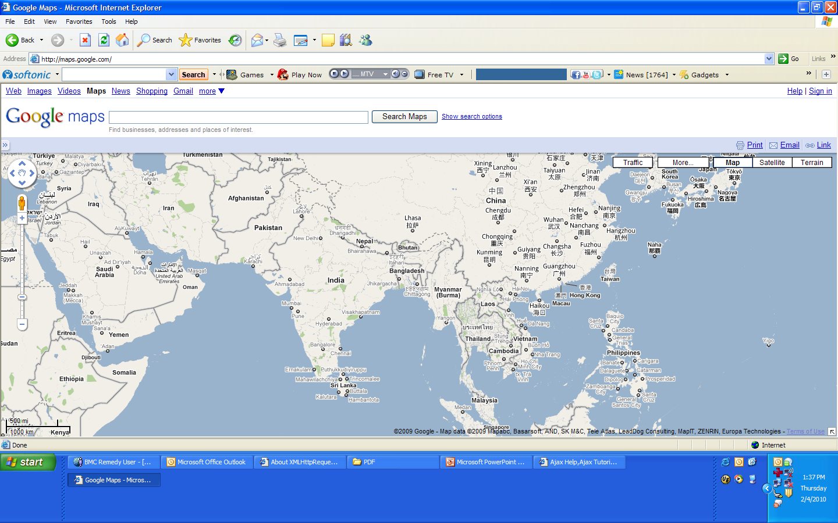

Slide 5
WHAT IS AJAX?
Ajax is new technologies for the development of web application. Ajax stands for Asynchronous JavaScript and XML. Ajax is used to fetch the data from web server without refreshing the whole page.
Ajax helps you in making your web application more interactive by retrieving small amount of data from web server and then showing it on your application.
You can use Ajax with any server side technologies such as JSP, Servlets, Perl, .NET, ASP etc.

Slide 6
Benefits of AJAX
Ajax can be used for creating rich, web-based applications that look and works like a desktop application
Ajax is easy to learn. Ajax is based on JavaScript and existing technologies like XML, CSS, DHTML. etc. So, its very easy to learn Ajax
Ajax can be used to develop web applications that can update the page data continuously without refreshing the whole page
More responsiveness
Client Server Balance
Asynchronous balance
Network efficiency

Slide 7
Understanding technology behind AJAX
Ajax is not a single technology, but it is a combination of many technologies. These technologies are supported by modern web browsers. Following are techniques used in the Ajax applications.
JavaScript:
JavaScript
is used to make a request to the web server. Once the response is returned by the web server, more JavaScript can be used to update the current page. DHTML and CSS is used to show the output to the user. JavaScript is used very heavily to provide the dynamic behavior to the application.
Asynchronous Call to the Server:
Most of the Ajax application used the XMLHttpRequest object (Communicate with a server in the background, Update a web page with new data without reloading the page) to send the request to the web server. These calls are Asynchronous and there is no need to wait for the response to come back. User can do the normal work without any problem.

Slide 8
Continue..
XML:
Extensible Markup Language (XML) is a simple, very flexible text format derived from Standard Generalized Markup Language (SGML). Originally designed to meet the challenges of large-scale electronic publishing, XML is also playing an increasingly important role in the exchange of a wide variety of data on the Web and elsewhere.
XML provides syntax for specifying document structure. The Document Type Definition (DTD) provides XML parsers a set of rules with which they can validate the document.
XML may be used to receive the data returned from the web server. JavaScript can be used to process the XML data returned from the web server easily.

Slide 9
<? Xml version=“1.0”?>
<messages>
<message>
<to>you@gmail.com</to>
<from>me@gmail.com</from>
<subject>Ajax K-Hour</subject>
<text>Today, I am presenting the Ajax Technology</text>
</message>
<!—Below Empty Tag-- >
<message/>
</messages>

Slide 10
DTD for validation
<! ELEMENT messages(message+)>
<! ELEMENT message(from, to, subject, text)>
<! ELEMENT (#PCDATA)>
…
<!ATLEAST messages from CDATA #Required>
Parser: DOM (Document Object Model)—Tree Based, SAX (Simple API for XML)—Event Driven

Slide 11
Why Ajax become popular
GMail – http://mail.google.com
Google Suggest - http://www.google.com/webhp?complete=1&hl=en
Outlook Web Access – Comes as part of Exchange Server (Available from 1998 – XmlHttpRequest ActiveX object in IE4)
Start.com portal
Google Maps - http://maps.google.com/
MSN Virtual Earth - http://virtualearth.msn.com/, http://my.msn.com
Flickr Photo Sharing website – http://www.flickr.com

Slide 12
Ajax and N-Tier
Presentation Layer
Ajax Interface
Ajax Proxy
XMLHttpRequest
Business Layer
Data Layer
Data Store

Slide 13
How Ajax Works?
When user first visits the page, the Ajax engine is initialized and loaded. From that point of time user interacts with Ajax engine to interact with the web server. The Ajax engine operates asynchronously while sending the request to the server and receiving the response from server. Ajax life cycle within the web browser can be divided into following stages:
User Visit to the page: User visits the URL by typing URL in browser or clicking a link from some other page.
Initialization of Ajax engine:
When the page is initially loaded, the Ajax engine is also initialized. The Ajax engine can also be set to continuously refresh the page content without refreshing the whole page.
Event Processing Loop:
* Browser event may instruct the Ajax engine to send request to server and receive the response data
* Server response - Ajax engine receives the response from the server. Then it calls the JavaScript call back functions
* Browser (View) update - JavaScript request call back functions is used to update the browser. DHTML and css is used to update the browser display.

Slide 14
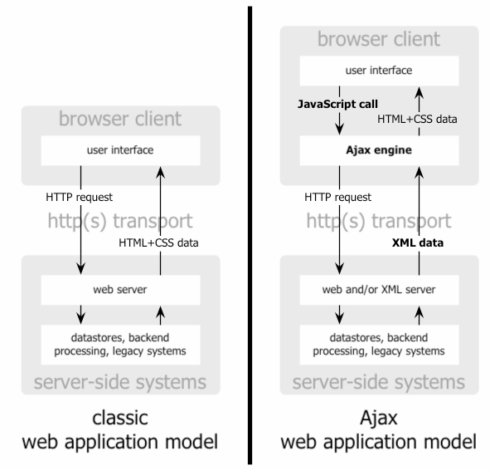

Slide 15
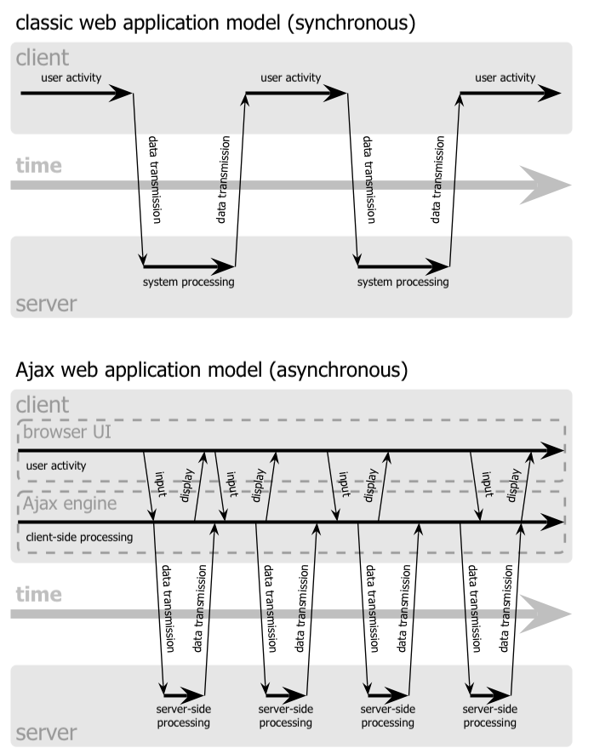

Slide 16
AJAX on mobile
Pocket PC and Smart phone Devices (2003 and later) support AJAX.
Opera Software has released Opera Platform SDK, a kit for developing and running software on mobile phones. This SDK will allow development of AJAX based rich mobile applications. In addition the Opera Platform SDK will help developers adapt existing content and web applications to run on mobile phones.
By storing an AJAX application on the mobile phone and allowing XML-communication with a Web-server, the traditional bandwidth constraints become less of an issue. This also enables transparent updating of information pushed to the mobile phone.
With increasing processor power and wireless network speeds
AJAX is sure to play an important role in enhancing mobile user experience.

Slide 17
Ajax on Google suggest
Asynchronously access Google database
Query for matching results
Return results for user
Drop down list of auto complete list

Slide 18
Ajax issues
What if user disables JavaScript?
(Between 6 to 10 Percent site have JavaScript disabled, It will be overhead for developer to gracefully inform the potential customer that JavaScript need to be enabled or gracefully inform them that service will not available if they will disable the JavaScript).
Back Button?
(Leads to a page expire, to solve this issue use navigational link like www.spout.com)
Security issue, Complexity for Web Designer/ Developer
Type Aheads?
(Avoid just searching on KeyUp event)

Slide 19
<html>
<head>
<title>Simple AJAX Demo</title>
<script language="javascript">
var req;
function convertToString()
{
var num = document.getElementById("num");
var url = "/AdavanceProj/SimpleAJAXResponse?num=" + escape(num.value);
if(window.XMLHttpRequest)
{
req = new XMLHttpRequest();
}
else if(window.ActiveXObject)
{
req = new ActiveXObject("Microsoft.XMLHTTP");
}
req.open("Get",url,true);
req.onreadystatechange = callback;
req.send(null);
}
function callback()
{if( req.readyState==4 )
{
if( req.status==200 )
{
var strNum = document.getElementById("numstring");

Slide 20
strNum.value = req.responseText;
}
}
}
function clear()
{
var num = document.getElementById("num");
num.value = "";
}
function focusIn()
{
document.getElementById("num").focus( );
}
</script>
</head>
<body onload="focusIn();">
Enter the Number here: <input type="text" id="num" name="num" onkeyup="convertToString();">
<br><br>
Equivalent String: <input type="text" size="20" readonly id="numstring">
</body>
</html>

Slide 21
import java.io.IOException;
import java.rmi.ServerException;
import javax.servlet.http.*;
public class SimpleAJAXResponseServlet extends HttpServlet {
public void doGet( HttpServletRequest request, HttpServletResponse response ) throws ServerException, IOException {
String number = request.getParameter("num");
String strRepr = null;
if(number != null){
switch(Integer.parseInt(number)){
case 0:
strRepr = "Zero";
break;

Slide 22
case 1:
strRepr = "One";
break;
case 2:
strRepr = "Two";
break;
case 3:
strRepr = "Three";
break;
case 4:
strRepr = "Four";
break;
case 5:
strRepr = "Five";
break;
case 6:
strRepr = "Six";
break;
case 7:
strRepr = "Seven";
break;
case 8:
strRepr = "Eight";
break;
case 9:
strRepr = "Nine";
break;
default:
strRepr = "Sorry, no conversion available for the number "+number+".";
}
//Set up the response
response.setContentType("text/xml");
response.setHeader("Cache-Control", "no-cache");
response.getWriter().write(strRepr);
}
else{
response.setContentType("text/xml");
response.setHeader("Cache-Control", "no-cache");
response.getWriter().write("?");
}
}
}

Slide 23
Last Thoughts
Think about the possibilities that giving users almost “live” feedback when they interact with the web application you’ve designed and develop.
Forget about the traditional post back model for a brief moment and venture into the world of the rich interactive web.
The biggest innovations seem to be coming from the web. The web travels at a million miles and hour. Look at the recent global disasters and how fast news about them came flying through the web. Through blogs, as well as online news websites.
The web is connecting the world and making our world smaller than it already is.

Slide 24
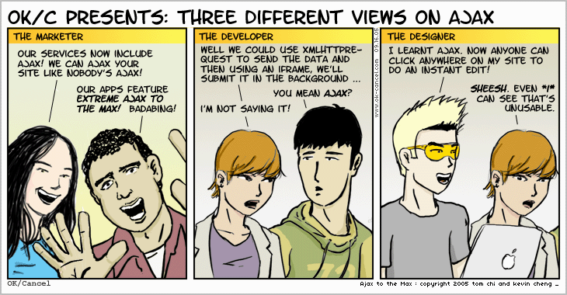

Slide 25
REFERENCES
Head First Ajax
Rebecca M Riordan (O’REILLY)
Ajax in Action
Dave Crane, Eric Pascarello, Darren James Publisher: Manning
Professional Ajax
Nicholas C. Zakas, Jeremy McPeak, Joe Fawcett Publisher: Wiley

Slide 26
Thank You

