Slide 1
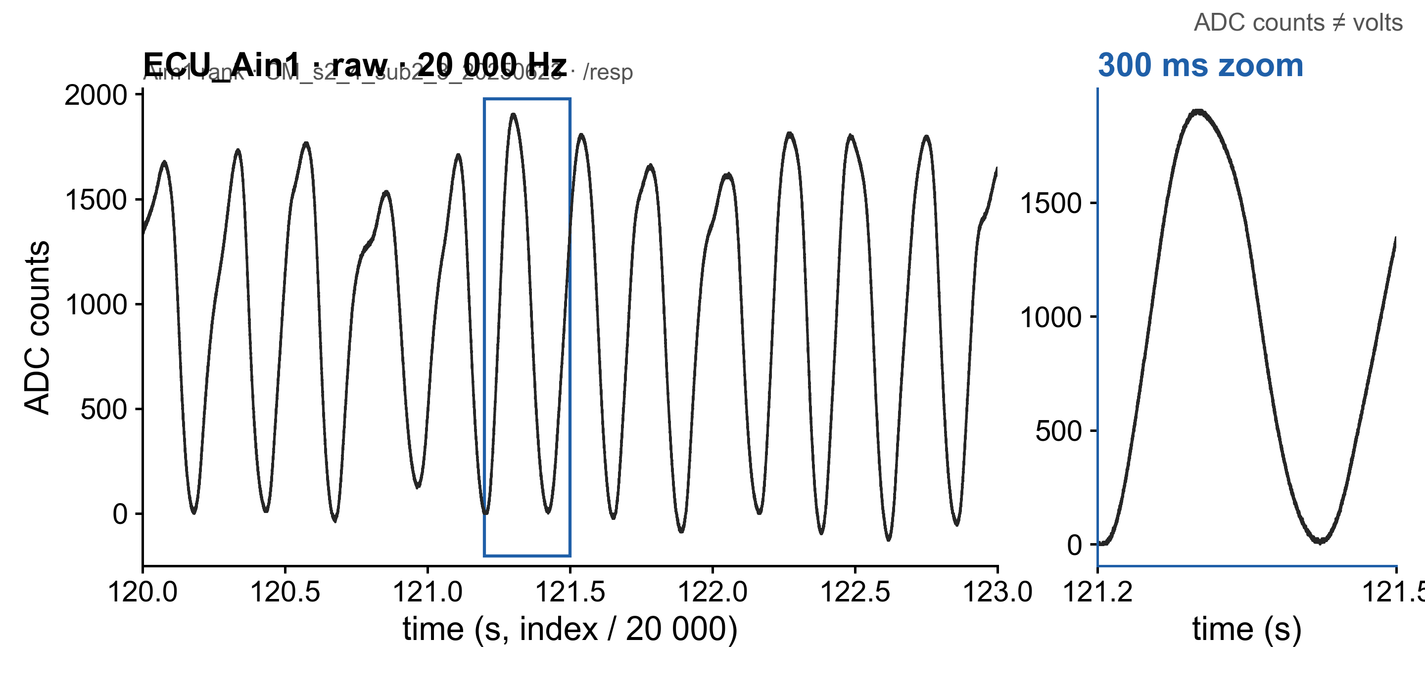
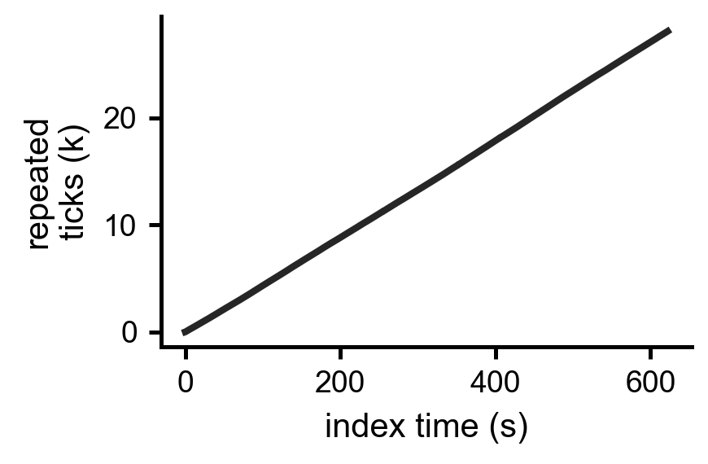
From Trodes recording to respiration H5
Trodes .rec
trodesexport -analogio
ECU_Ain1.dat + timestamps.dat
H5 /resp
separate export step (not run by the converter)
20,000 Hz · signed int16 ADC counts
Aim1: wireless *_merged.rec · BLA pilot: tethered plain .rec
Aim1 valence: /resp (N,1), float64
Aim1 rank: /resp (N,), float32
Cohort 2: /analog/…ECU_Ain1 + /timestamps
Aim1 merged: repeated-timestamp filler; index time ~+0.22%

Slide 2
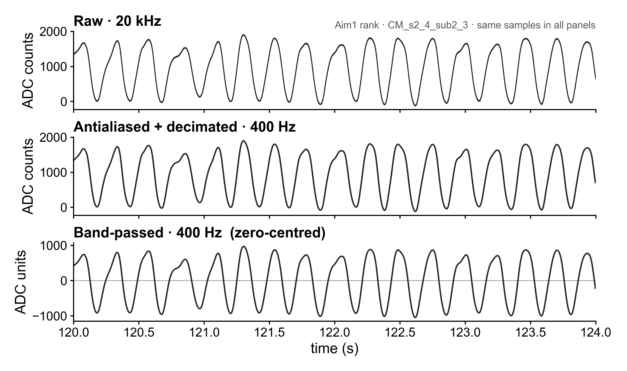
20 kHz raw signal → 400 Hz respiration
LP: Butterworth order 4
f_c = 200 Hz; filtfilt
D = 20,000 / 400 = 50
resample_poly(1, 50)
BP: 0.1–20 Hz; zero phase
t[n] = n / 400
cached: workbench_cache/*.npz

Slide 3
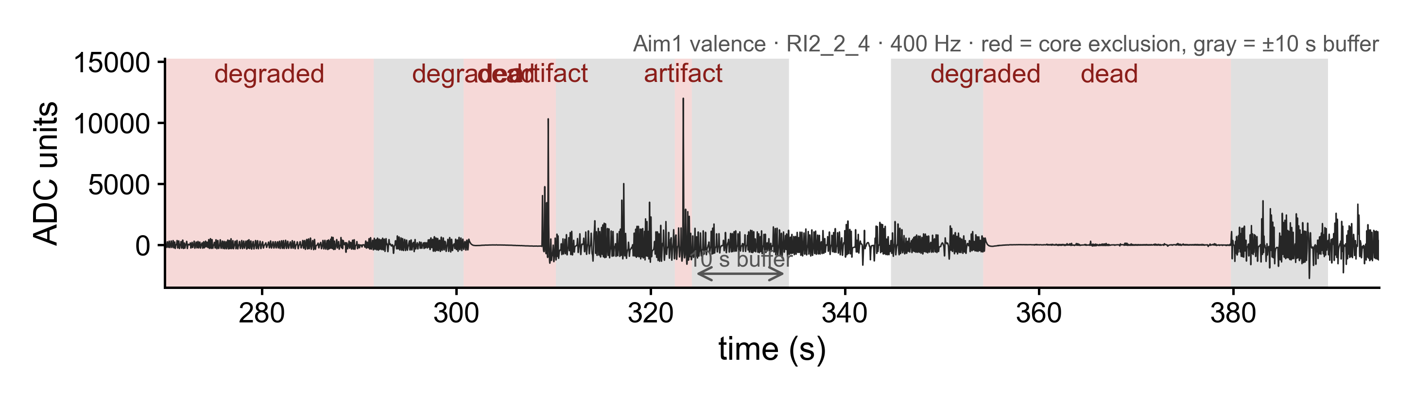
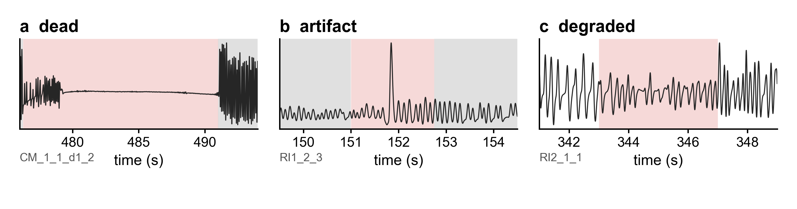
Which signal is excluded? Frozen QC screen
1 s blocks · hop 0.25 s
r_k = P95_k − P5_k
m = median_k(r_k)
rel_k = r_k / m
full_k = (max_k − min_k) / m
dead: rel < 0.10
artifact: rel > 8 OR full > 5
degraded: median₂₁(rel) < 0.50
dead/artifact: ±10 s buffer
31.2 min excluded · 262.8 min retained · 22/30 recordings affected
FROZEN QC ≠ DETECTOR VALIDITY

Slide 4
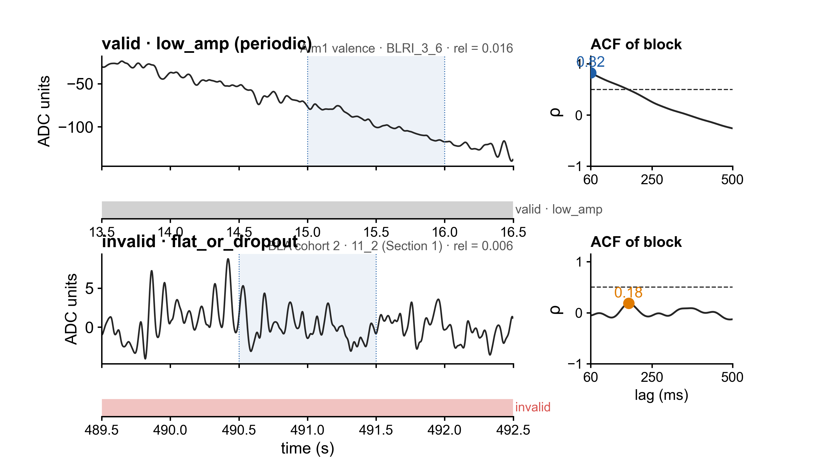
Detector validity: flat dropout or quiet breathing?
1 s / 0.25 s
rel > 8 → artifact (±0.25 s)
rel < 0.03 → test periodicity
max ρ(60–500 ms) < 0.5 → dropout
otherwise keep + low_amp
rel < 0.15 → low_amp
valid run ≥ 1 s
validity segmentation → peak detection per valid segment

Slide 5
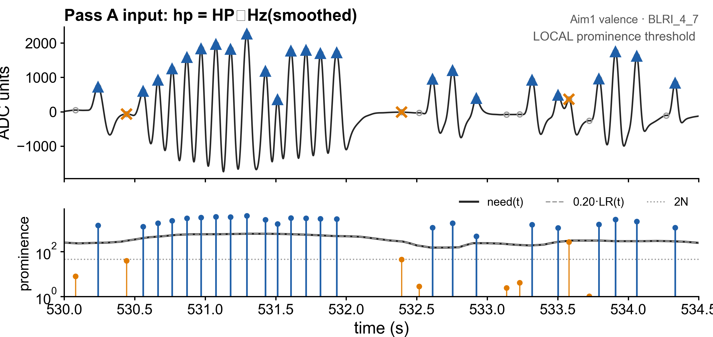
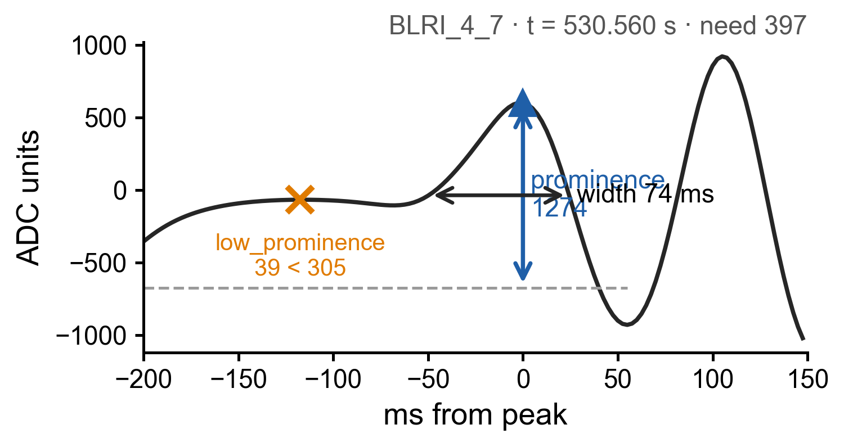
Adaptive candidate peaks: prominence, not peak height
5-point centered mean · 400 Hz
12.5 ms effective window
LR(t) = P90 − P10 over 1 s
LR every 0.1 s → interpolate
need(t) = max(0.20 LR(t), 2N)
prominence ≥ need
width ≥ 15 ms (6 samples)
spacing ≥ 60 ms (24 samples)
prominence horizon: ±0.5 s

Slide 6
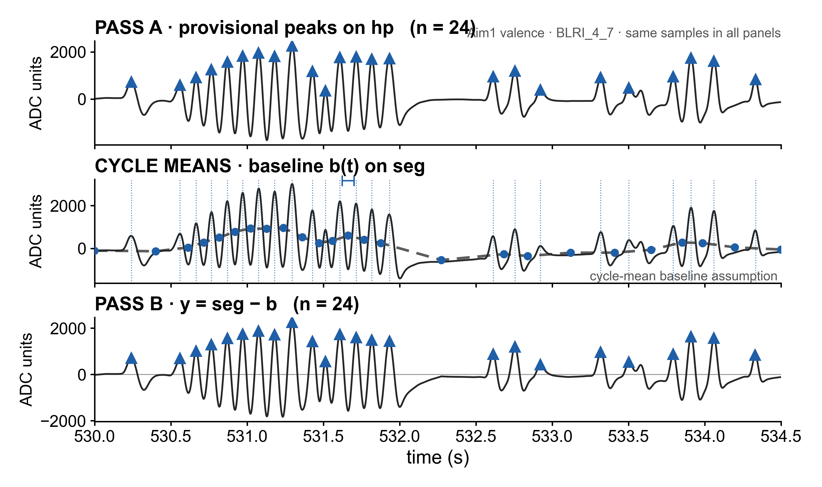
Two passes: provisional cycles → local baseline
hp = HP_1Hz(seg)
pk_A = select_peaks(hp)
m_ab = [1/(b−a)] Σ_(i=a)^(b−1) seg[i]
center = (a+b)/2
b(t) = linear interpolate(m_ab)
y(t) = seg(t) − b(t)
pk_B = select_peaks(y; scale=hp)

Slide 7
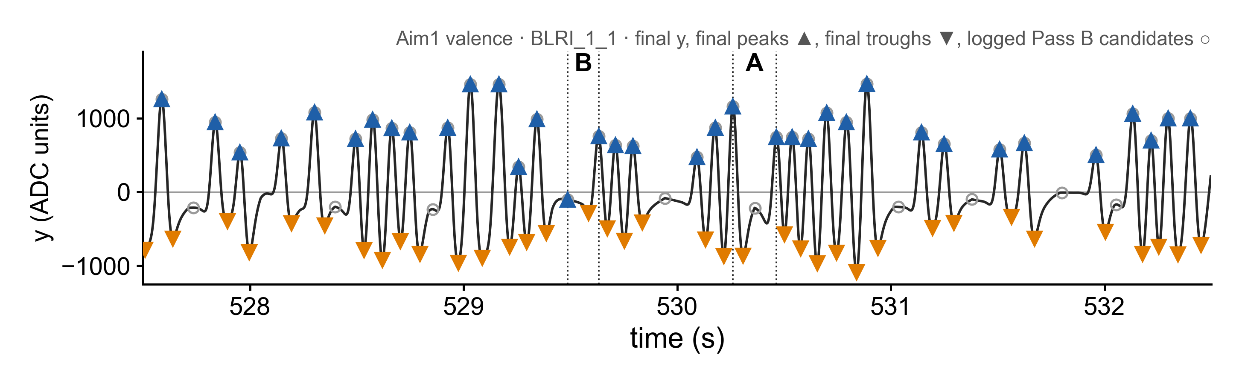
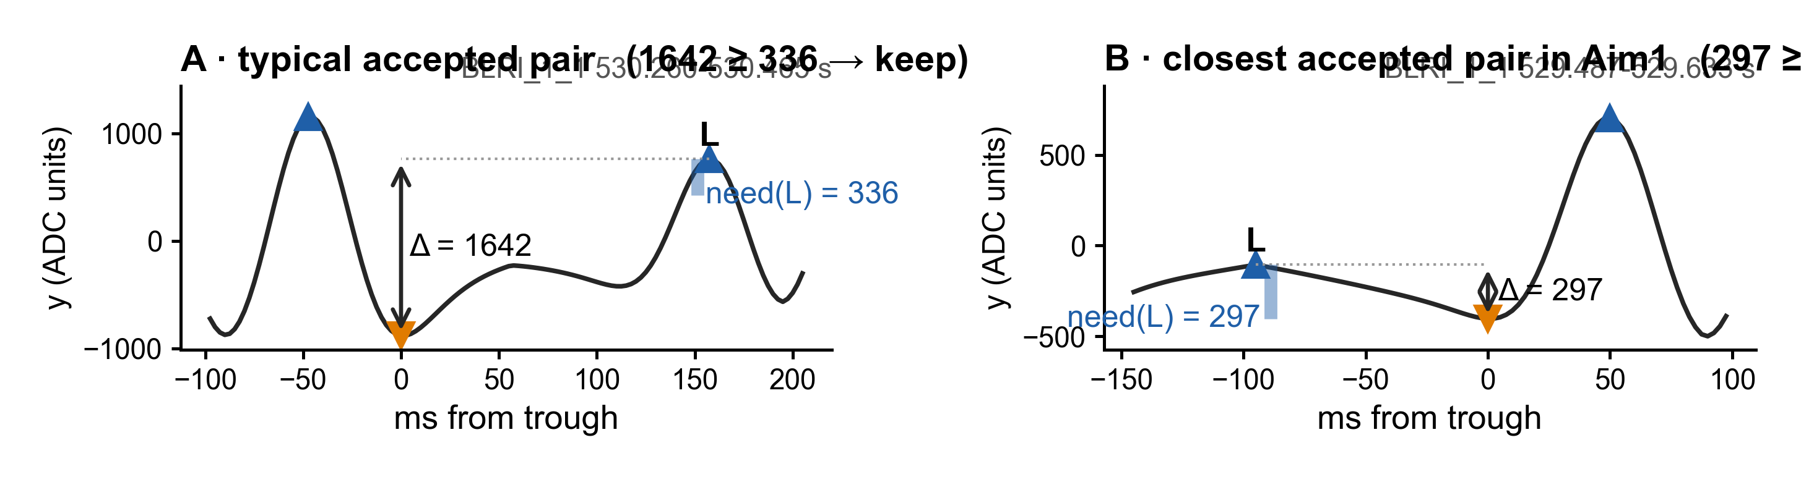
Trough validation: which peaks survive?
t_i = argmin_(p_i < t < p_(i+1)) y[t]
L = lower(p_i, p_(i+1))
Δ_i = y[L] − y[t_i]
keep if Δ_i ≥ need(L)
otherwise remove L; repeat
recompute baseline + troughs
peaks · troughs · baseline · valid mask · rejected reasons

Slide 8
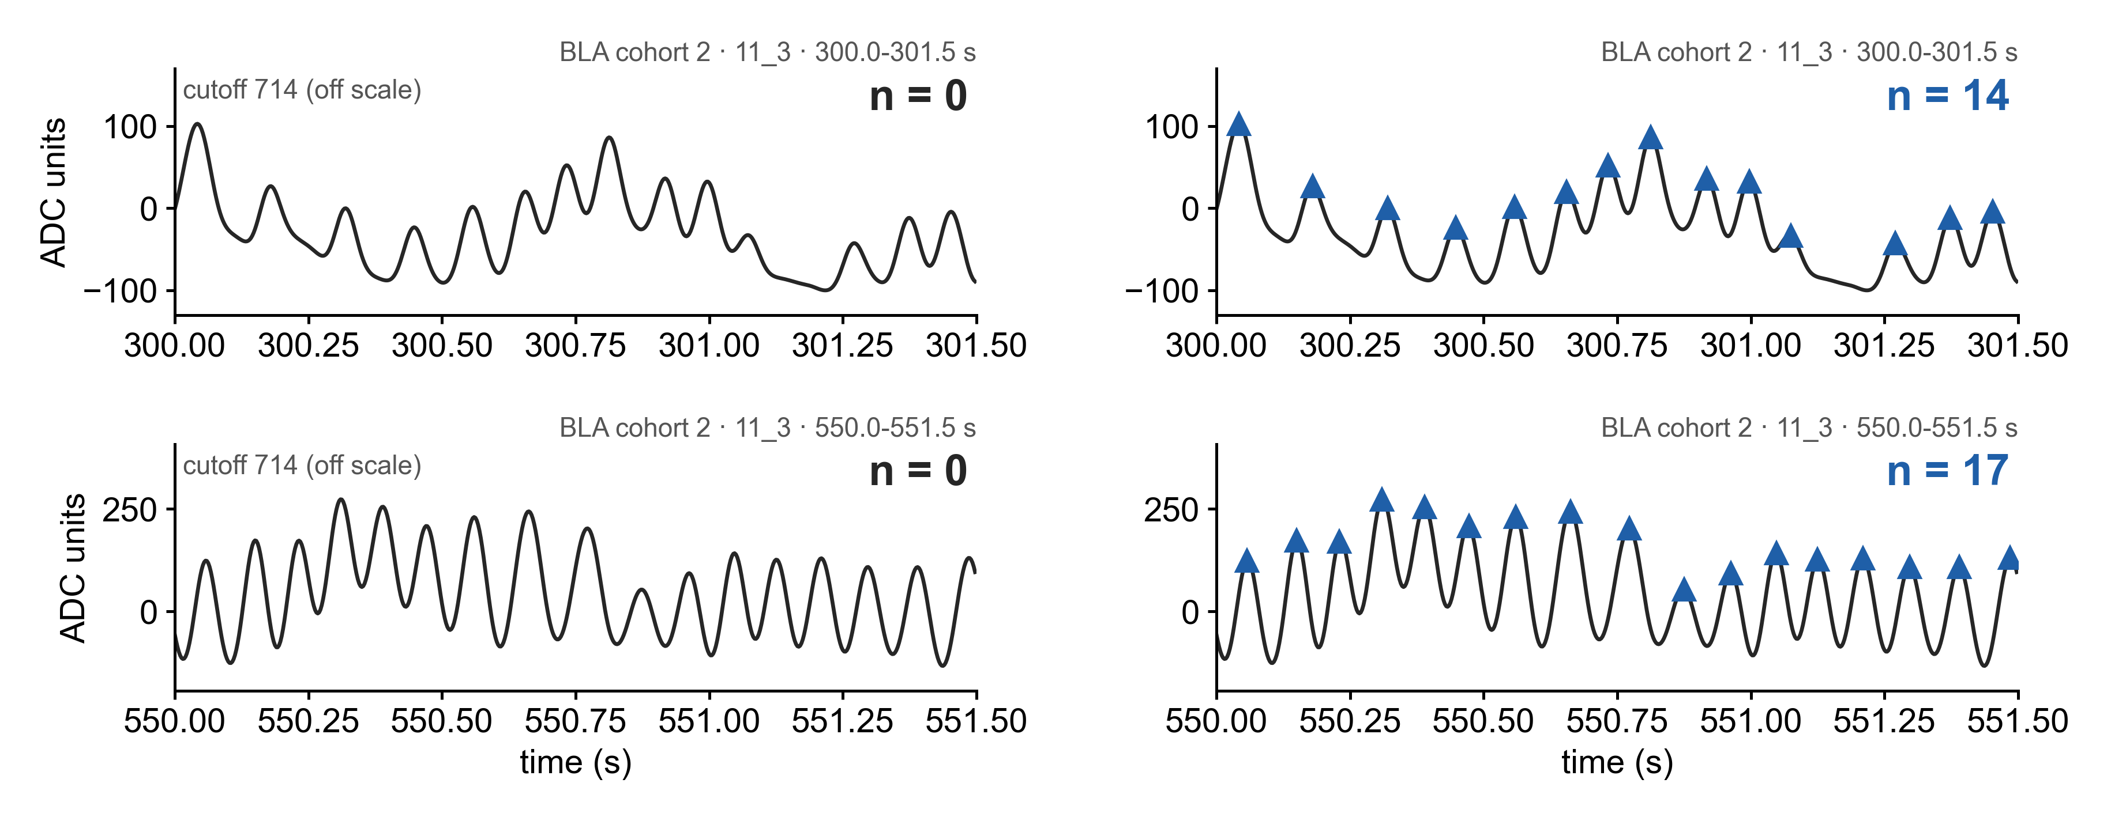
OLD vs NEW: same signal, different peaks
OLD · BreathMetrics
NEW · adaptive detector
OLD: session-wide mean + SD/2 cutoff vs NEW: local prominence + noise floor · 11_3 OLD cutoff ≈714; local breath amplitudes ≈100–260; transient ≈35,600
BLA cohort 2 · 11_3, third window: OLD 0 → NEW 13
Aim1: 30 sessions | 262.8 min analyzed | 111,872 peaks | 7.10 Hz
Algorithm outputs; no hand-labeled accuracy claim

