Slide 1
From valence and rank codes to circuit mechanisms - data update
Sequioa Smith
12/5/2025

Slide 2
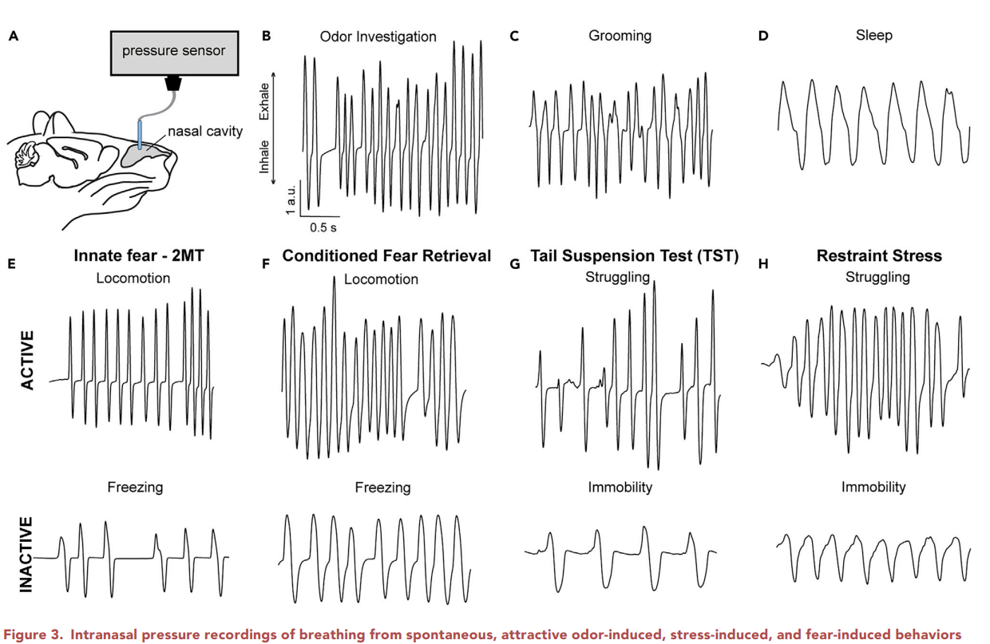
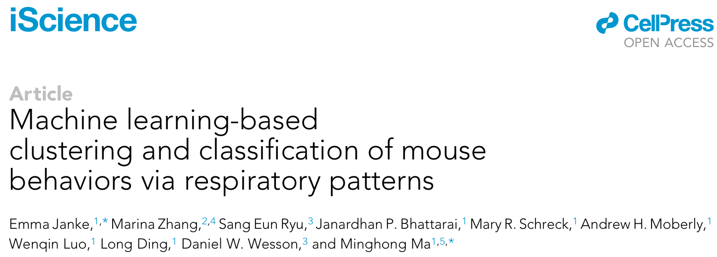
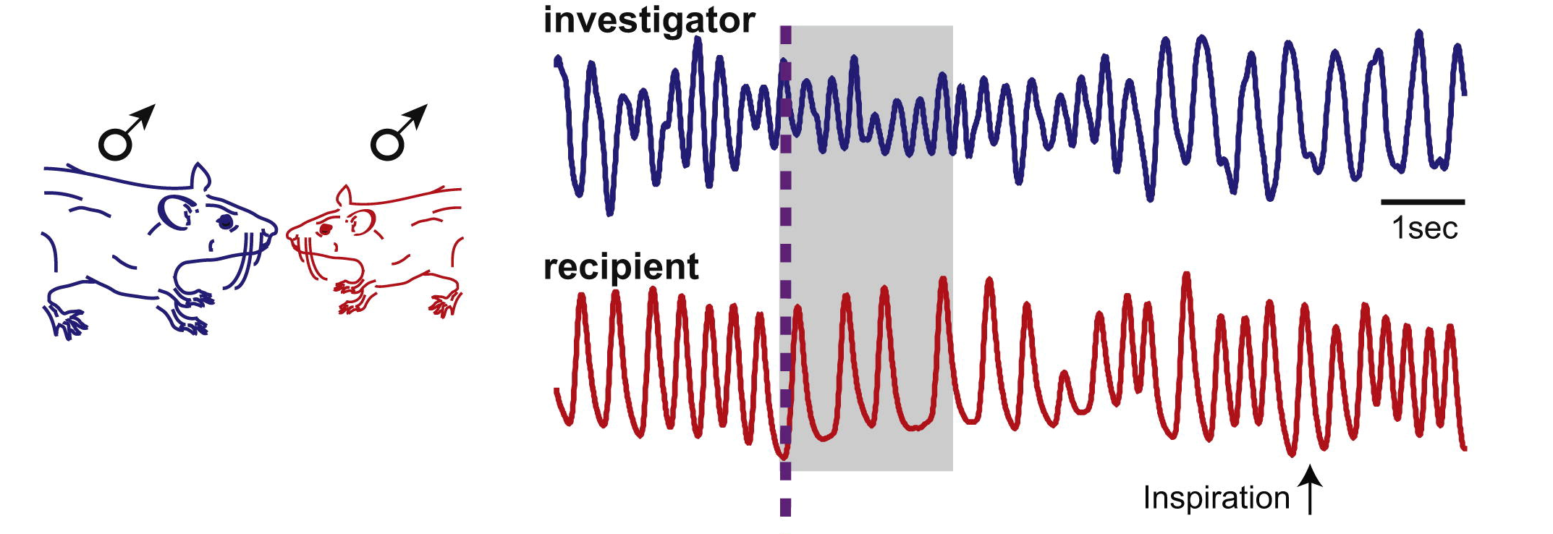
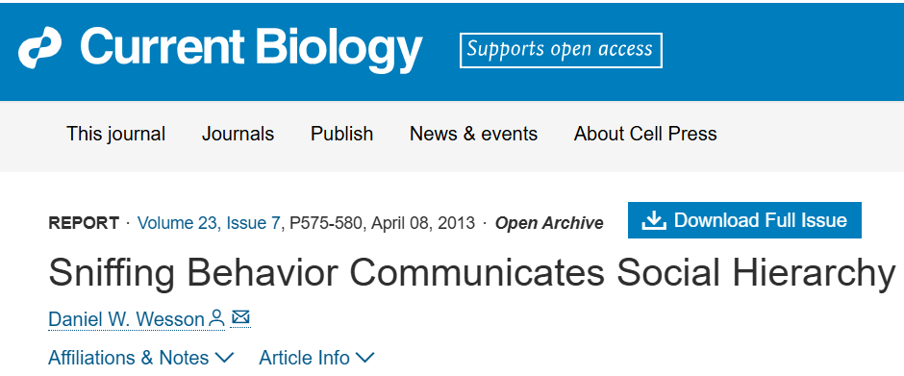
Respiration reflects internal and behavioral states
Sniffing reflects social interactions and rank in rats (dominant vs subordinate).
Subordinates suppress sniffing when approached by dominants.
Persists without olfaction
Gap: Only tested during short encounters (30 min), not long-term stable hierarchies.
Machine learning classified behaviors from respiratory patterns.
Respiration closely tracks behavioral states across tasks.
Gap: Focused on odor-driven and stress contexts, not considering social interactions.
Notes:
Studies have shown that respiration patterns are tightly linked to both behavior and social context.
For example, Dr. Wesson found that subordinate rats reduce sniffing when approached by dominant rats.
Importantly, these changes persist even in the absence of olfactory input. Only tested during short encounters (30 min), not long-term stable hierarchies.
More recently, machine learning approaches have demonstrated that different behaviors — like grooming, freezing, or odor investigation — can be classified directly from respiratory patterns.

Slide 3
Can respiration and behavioral patterns predict social valence and social rank?

Slide 4
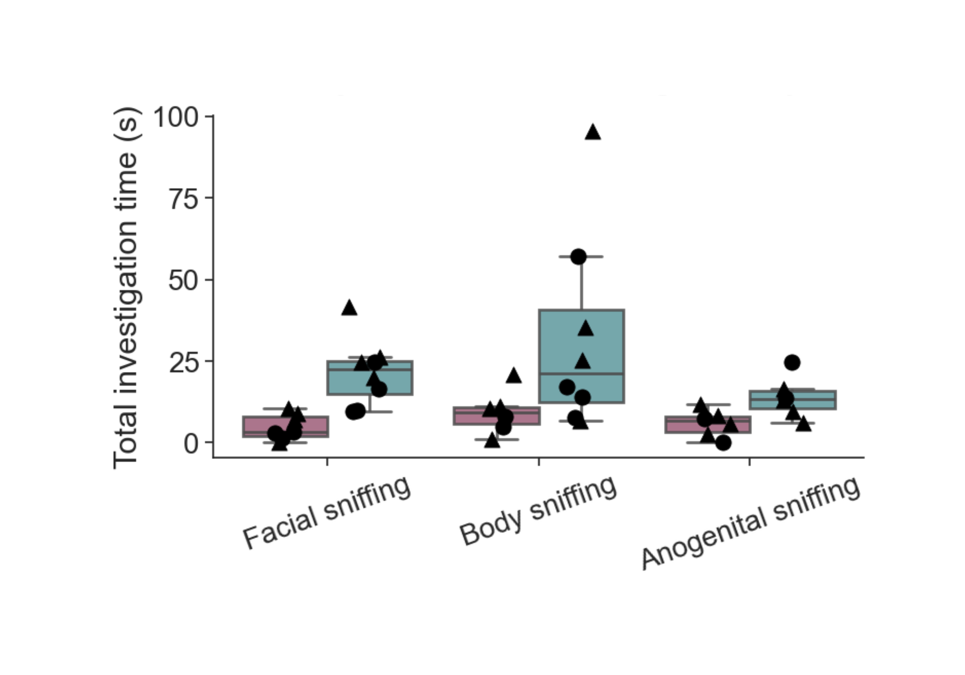
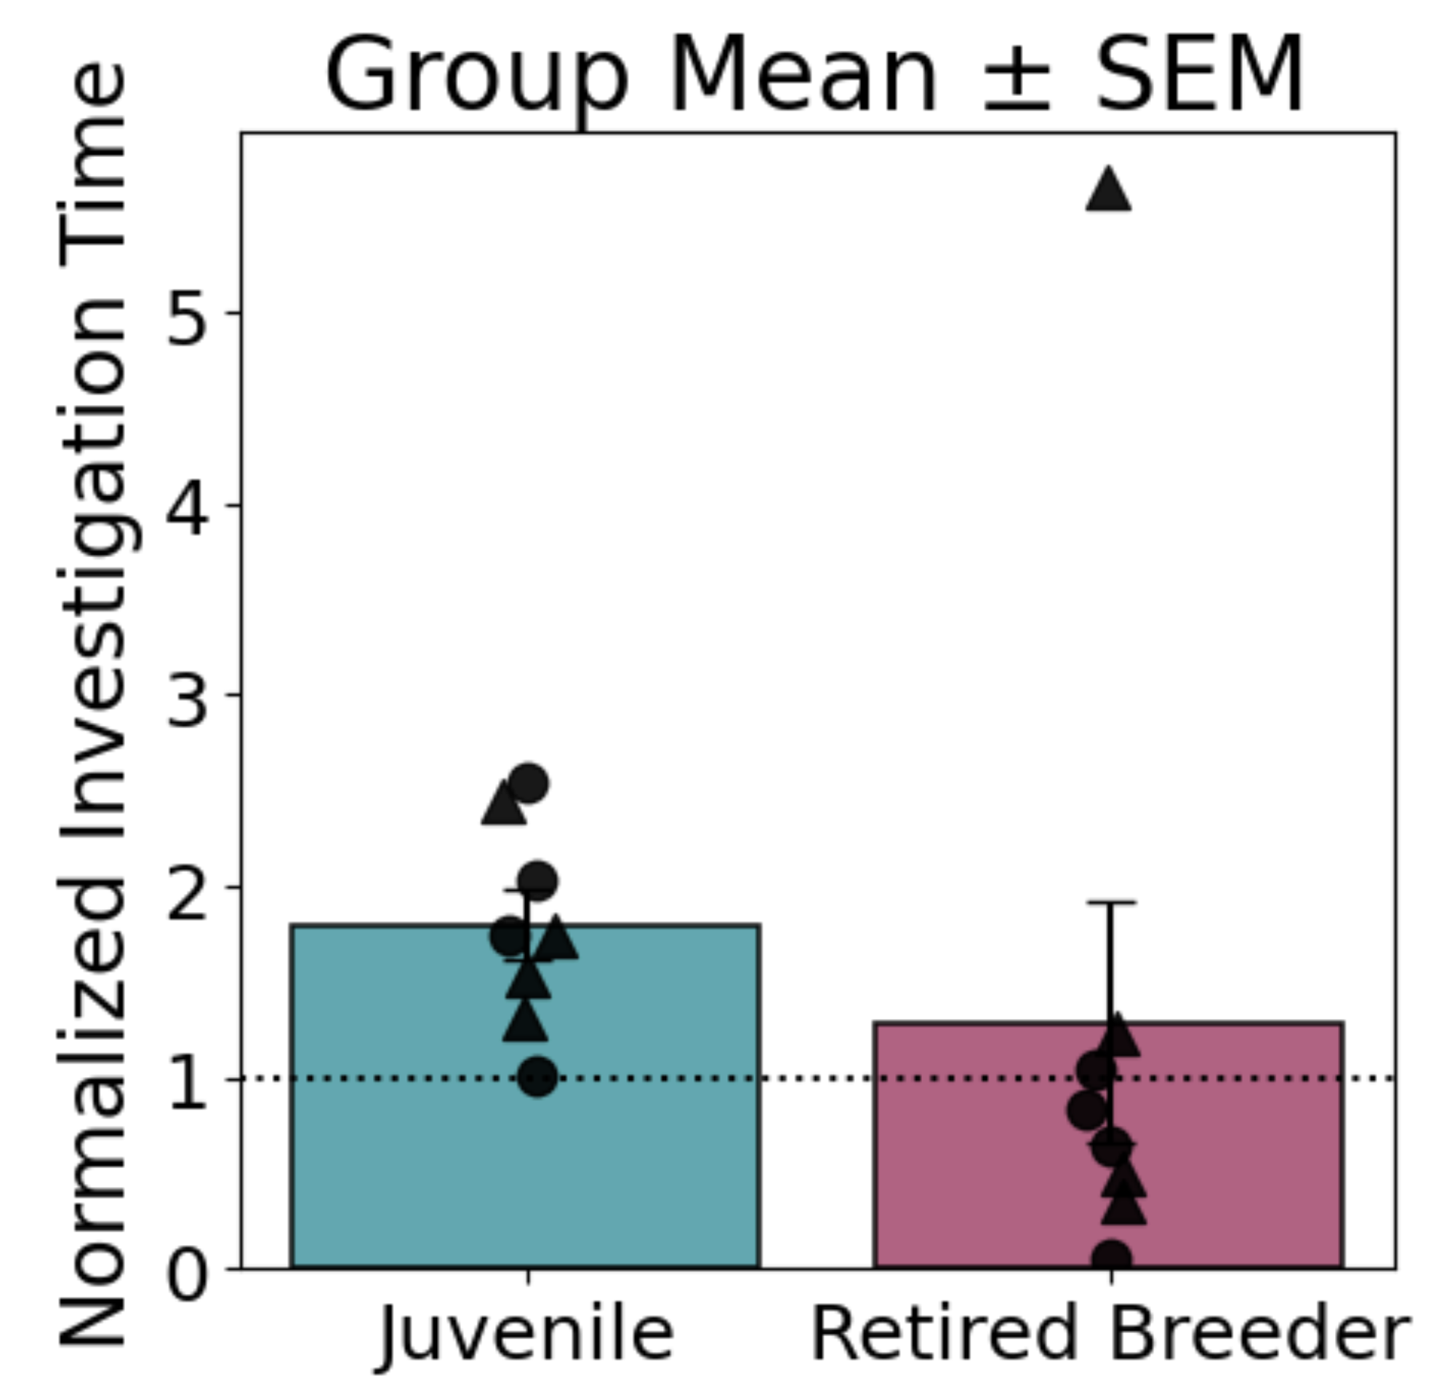
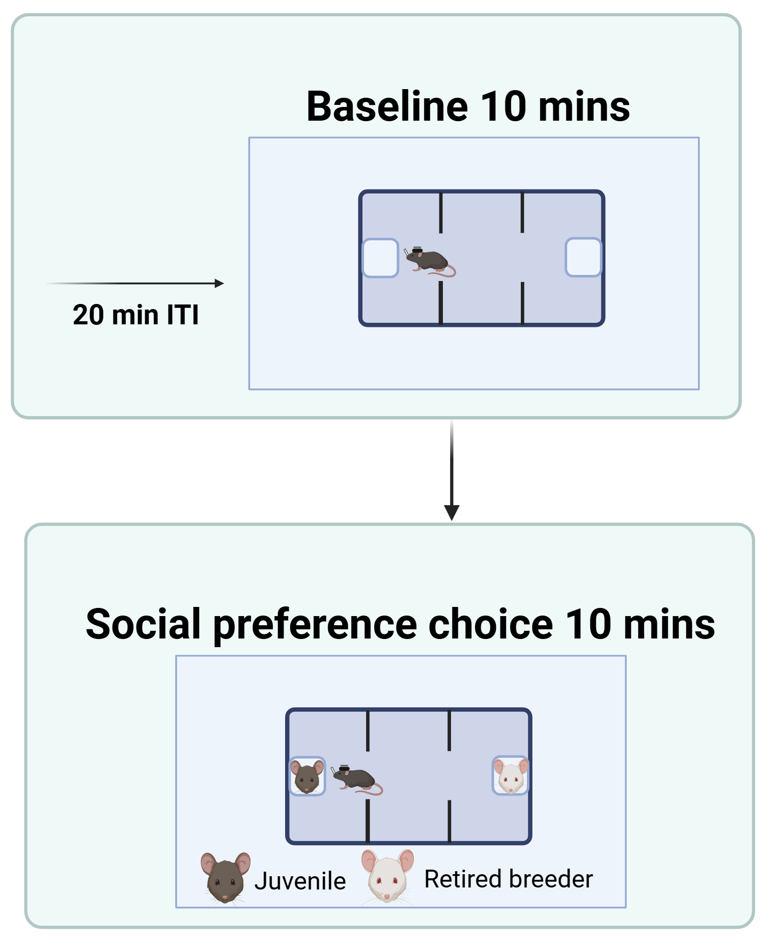
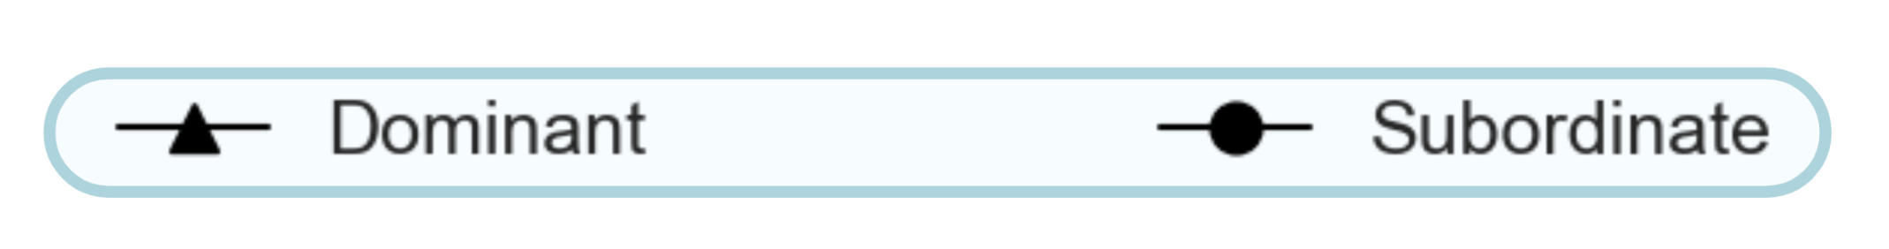
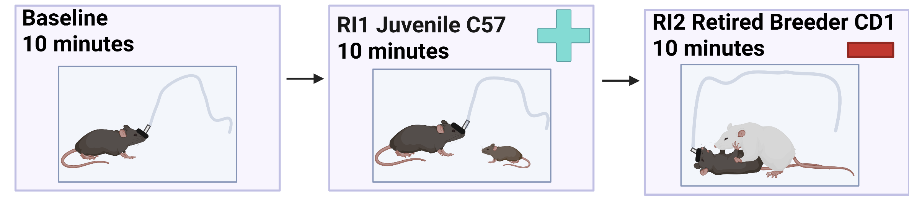
Subject mice socialize less in response to negative social agents
How does social valence affect behavior and is that dependent on rank?
Mice increase investigation with a juvenile
Do mice prefer juvenile or retired breeder after resident intruder assay?
n=4 Dominant
n=4 Subordinate
Juvenile condition: p = 0.004, n = 8
Retired Breeder condition: p > 0.05, n = 8
Notes:
Valence assignment is accompanied by observable changes in behavior

Slide 5
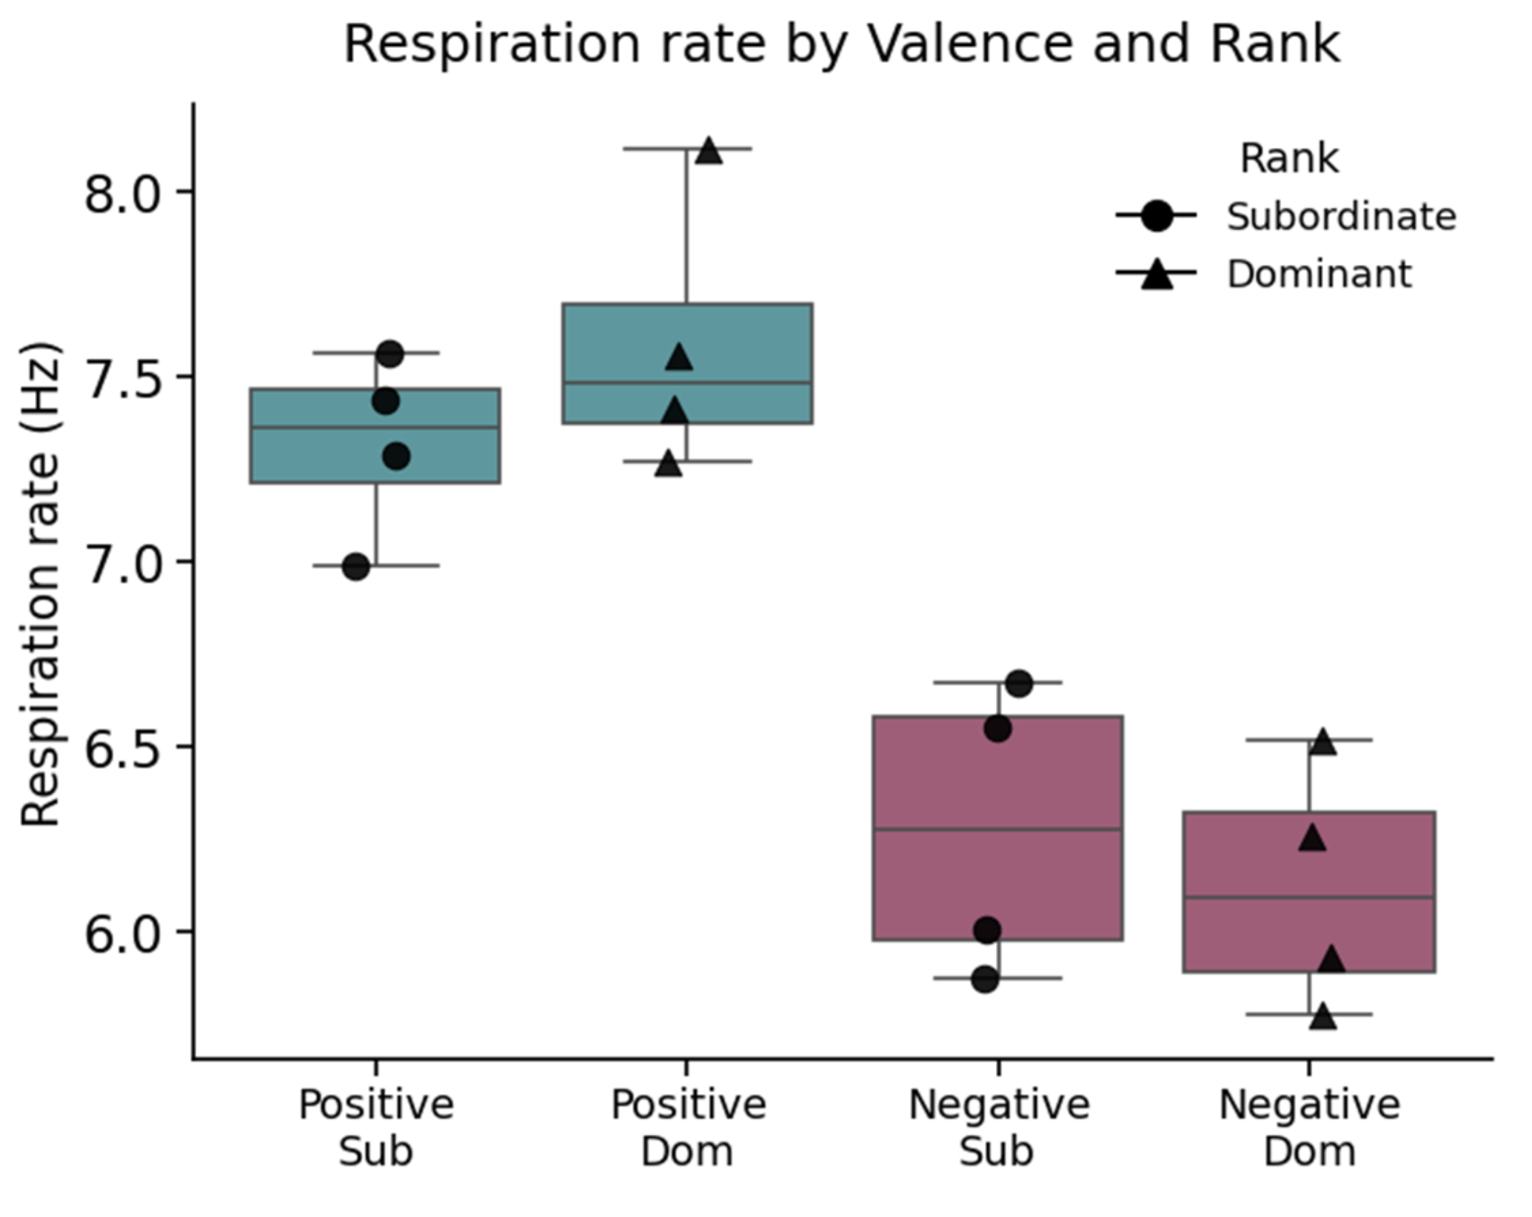
Does respiration frequency signal valence of social context and does this align with rank?

Slide 6
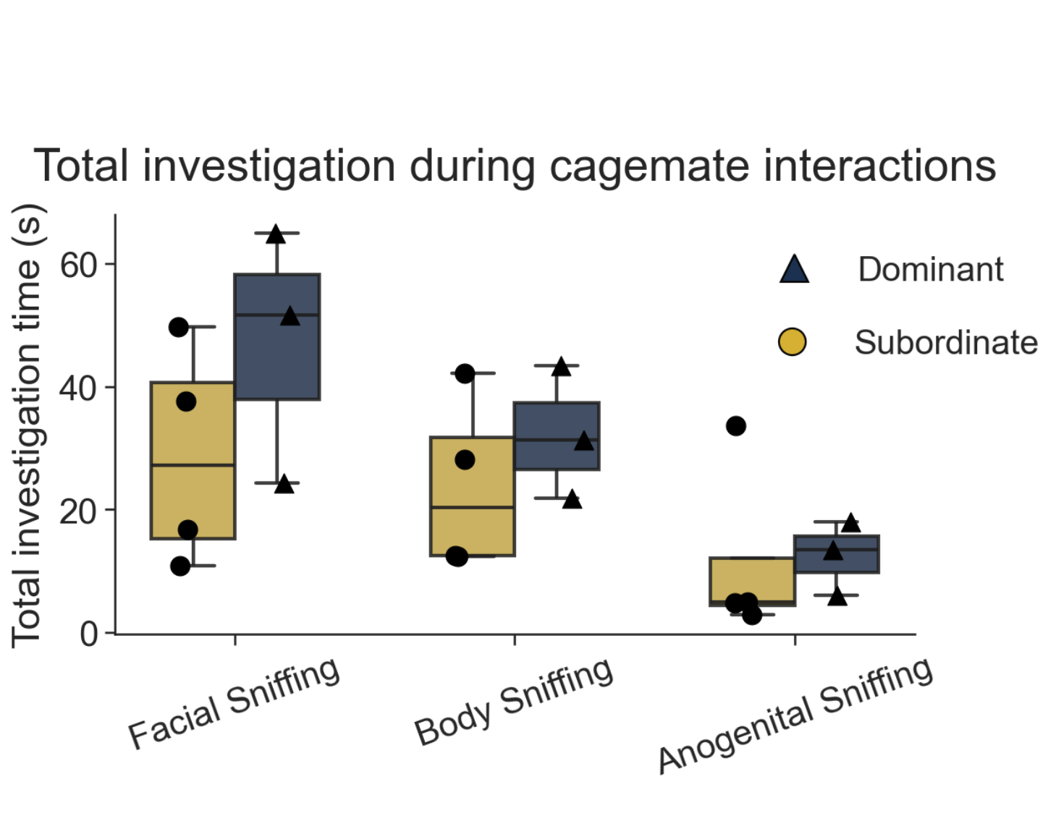
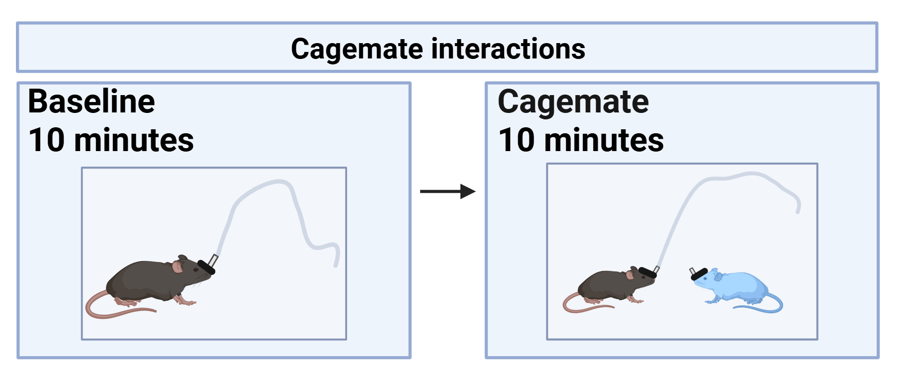
Dominants have more investigation time
n=3
n=4

Slide 7
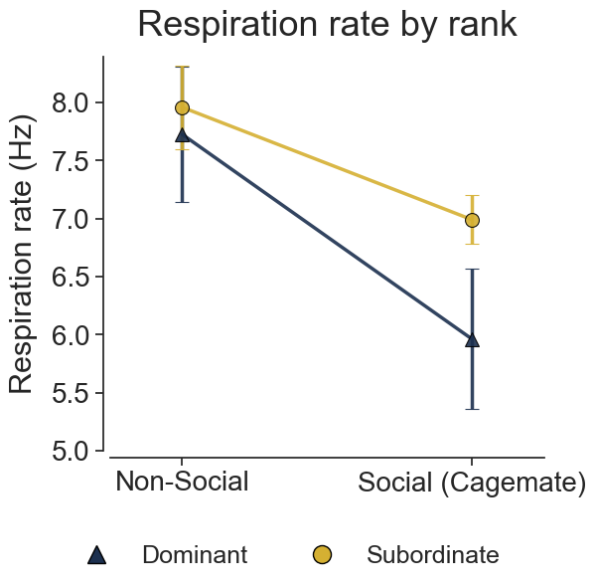
Dominant mice have more variability in respiration rate
n=4
n=4

Slide 8
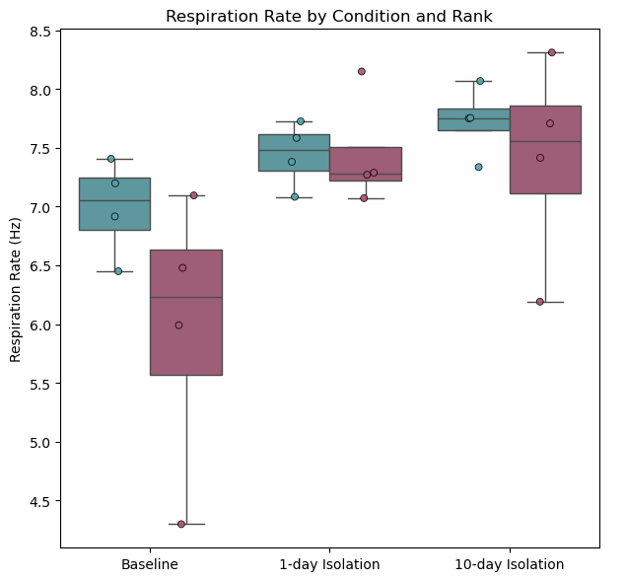
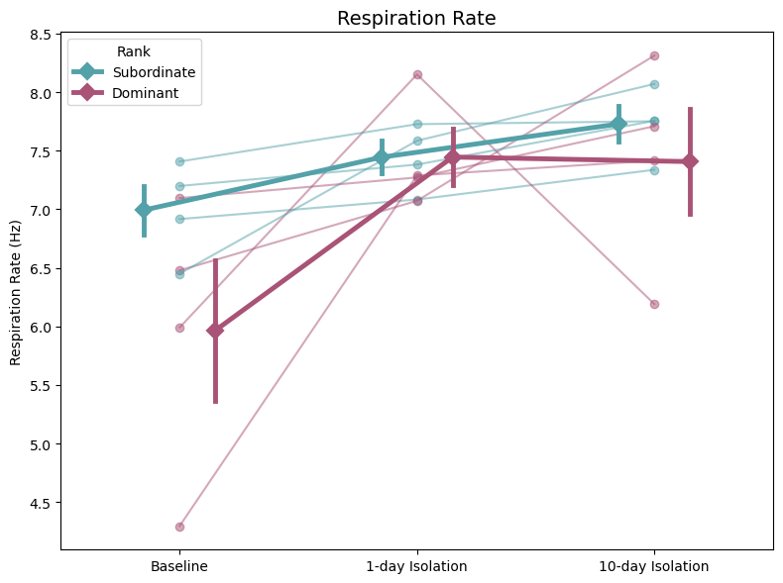
Isolation increases respiration rate replot with new color gray/yellow

Slide 9
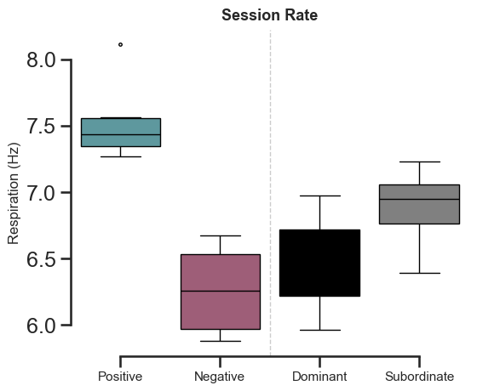
Session rates across trial types

Slide 10
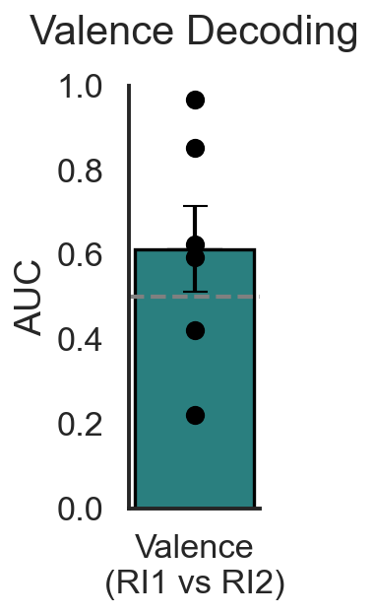
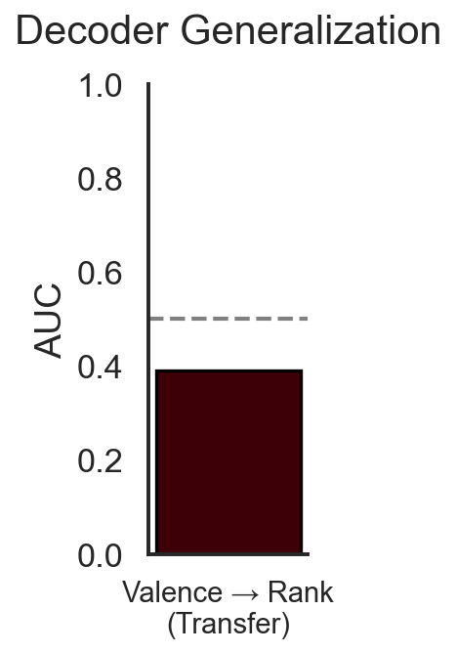
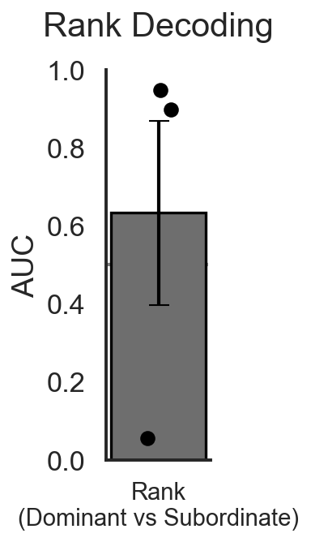
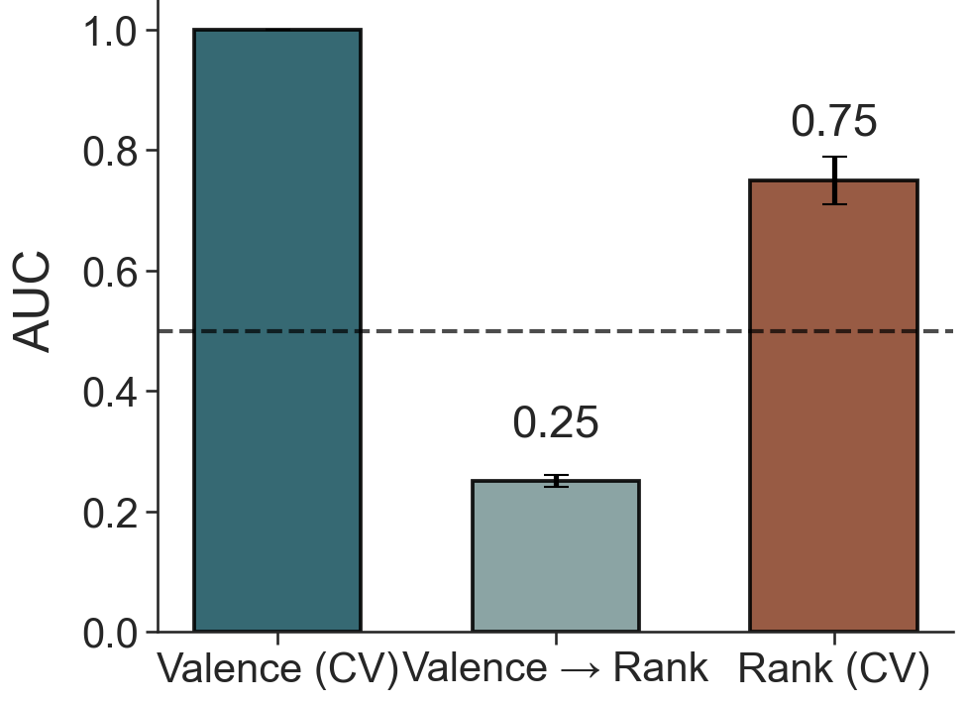
A model trained on valence trials doesn’t generalize to rank
We train a separate model to classify rank

Slide 11
A model trained on valence trials doesn’t generalize to rank
Aggregated to 38 session-level entries. Conditions: {'BL': 8, 'CM': 8, 'RI1': 8, 'BLRI': 7, 'RI2': 7} Ranks: {'Dominant': 19, 'Subordinate': 19}

Slide 12
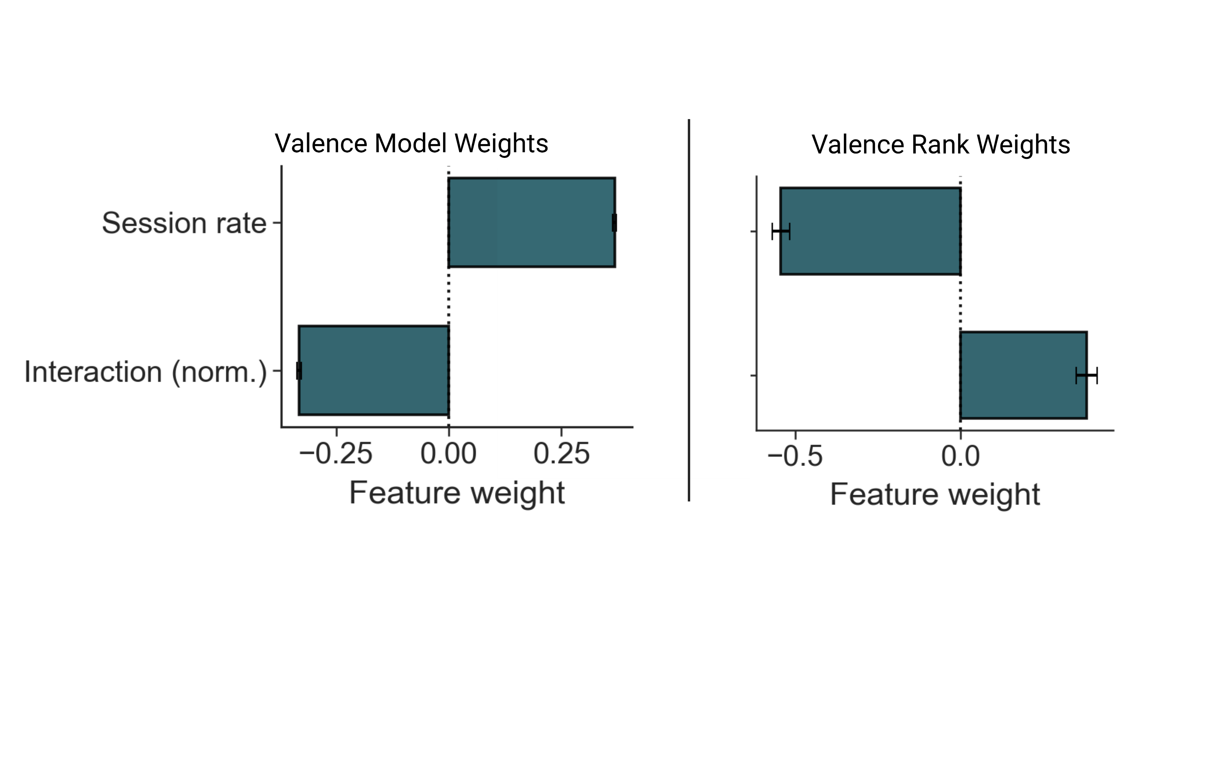

Slide 14
What circuits drive these behavioral and physiological signatures?

Slide 15
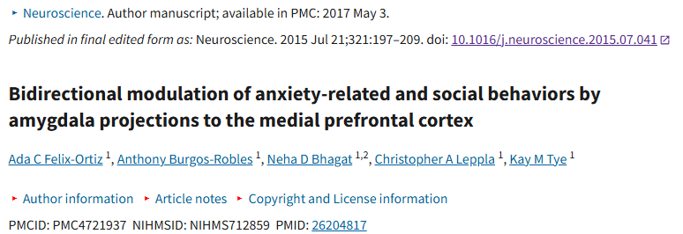
BLA→mPFC circuit regulates social & anxiety behavior

Slide 16
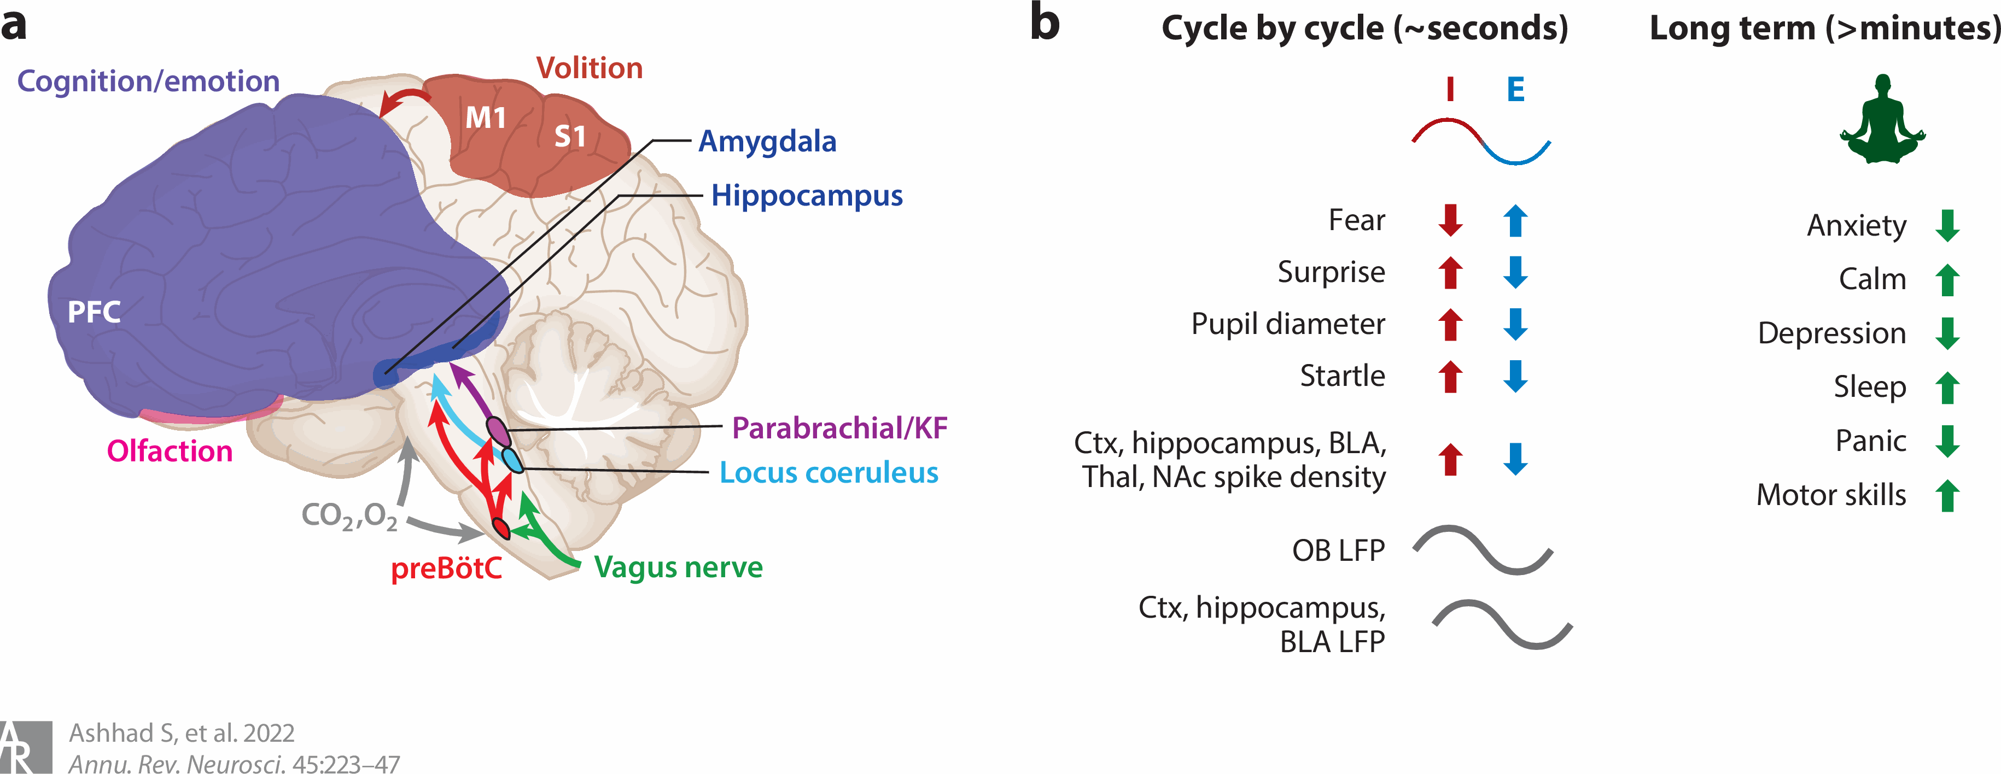
Our emotional and cognitive states affect breathing
Notes:
Breathing isn’t just a reflex—it is continuously shaped by our emotional and cognitive state. On the left, you can see how many higher-order brain regions project into the breathing rhythm generator: the PFC, amygdala, hippocampus, and olfactory areas all send top-down signals to the preBötzinger complex. This means changes in social context, threat, or motivation can directly alter respiratory dynamics.
On the right, we see how rapidly breathing shifts with internal state. Cycle-by-cycle, fear and surprise immediately change inhalation and exhalation patterns, and neural activity in regions like the cortex, hippocampus, BLA, and NAc phase-locks to the breath.
Over longer time scales, breathing also reflects broader emotional states—like anxiety, calmness, sleep, or panic.
So respiration becomes a window into internal state. And in social behavior, where emotional valence and familiarity shift moment-to-moment, respiratory patterns can reveal how the brain is interpreting and responding to the social environment.
This is the motivation for using respiration as a physiological readout in my valence and cagemate experiments.
On the left, you can see that forebrain regions like the prefrontal cortex, amygdala, and hippocampus don’t just influence behavior — they’re also modulated by the act of breathing itself. Signals from olfaction, the vagus nerve, and brainstem respiratory centers project back up to these higher-order areas. So breathing is constantly feeding information into circuits that regulate affect and decision-making.
On the right, the authors show two timescales. Cycle by cycle, every single breath can entrain neural activity across many regions — including cortex, hippocampus, the BLA, thalamus, and nucleus accumbens. This means that the timing of inhalation and exhalation shapes local field potentials and even spike density in these circuits. Over longer timescales, breathing patterns can influence emotional states such as anxiety, calmness, or panic, and even affect plasticity through breathing practices.
Together, this figure makes the point that breathing isn’t just a downstream readout — it is an active rhythm that coordinates multiple brain networks involved in emotion, cognition, and social behavior.
And this is why respiration is such a powerful window into internal state in my social interaction experiments.

Slide 17
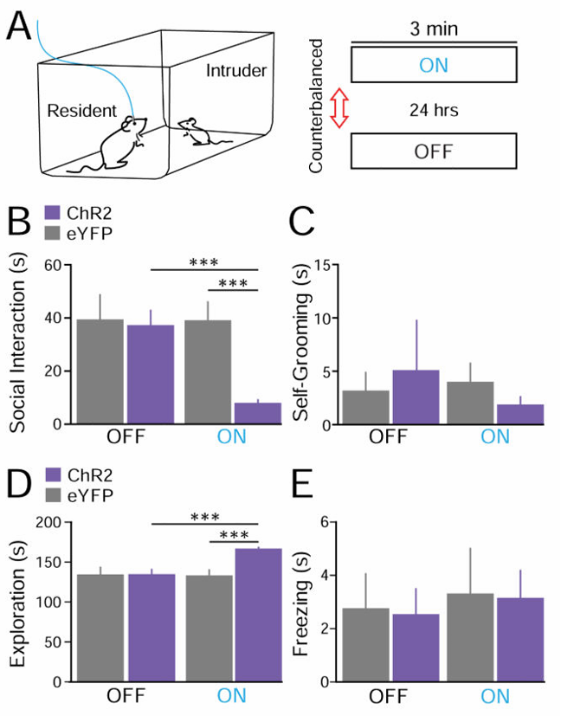
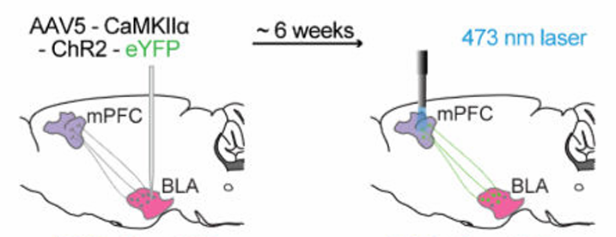
BLA→mPFC activation increases avoidance and freezing behaviors

Slide 18
Does activation of BLA→mPFC terminals alter respiration dynamics during juvenile affiliative interactions in the resident–intruder assay?
Hypothesis: Activation BLA→mPFC input during juvenile intruder interactions will:
1. Decrease the respiration rate
2. Decrease affiliative investigation (social interaction time)

Slide 19
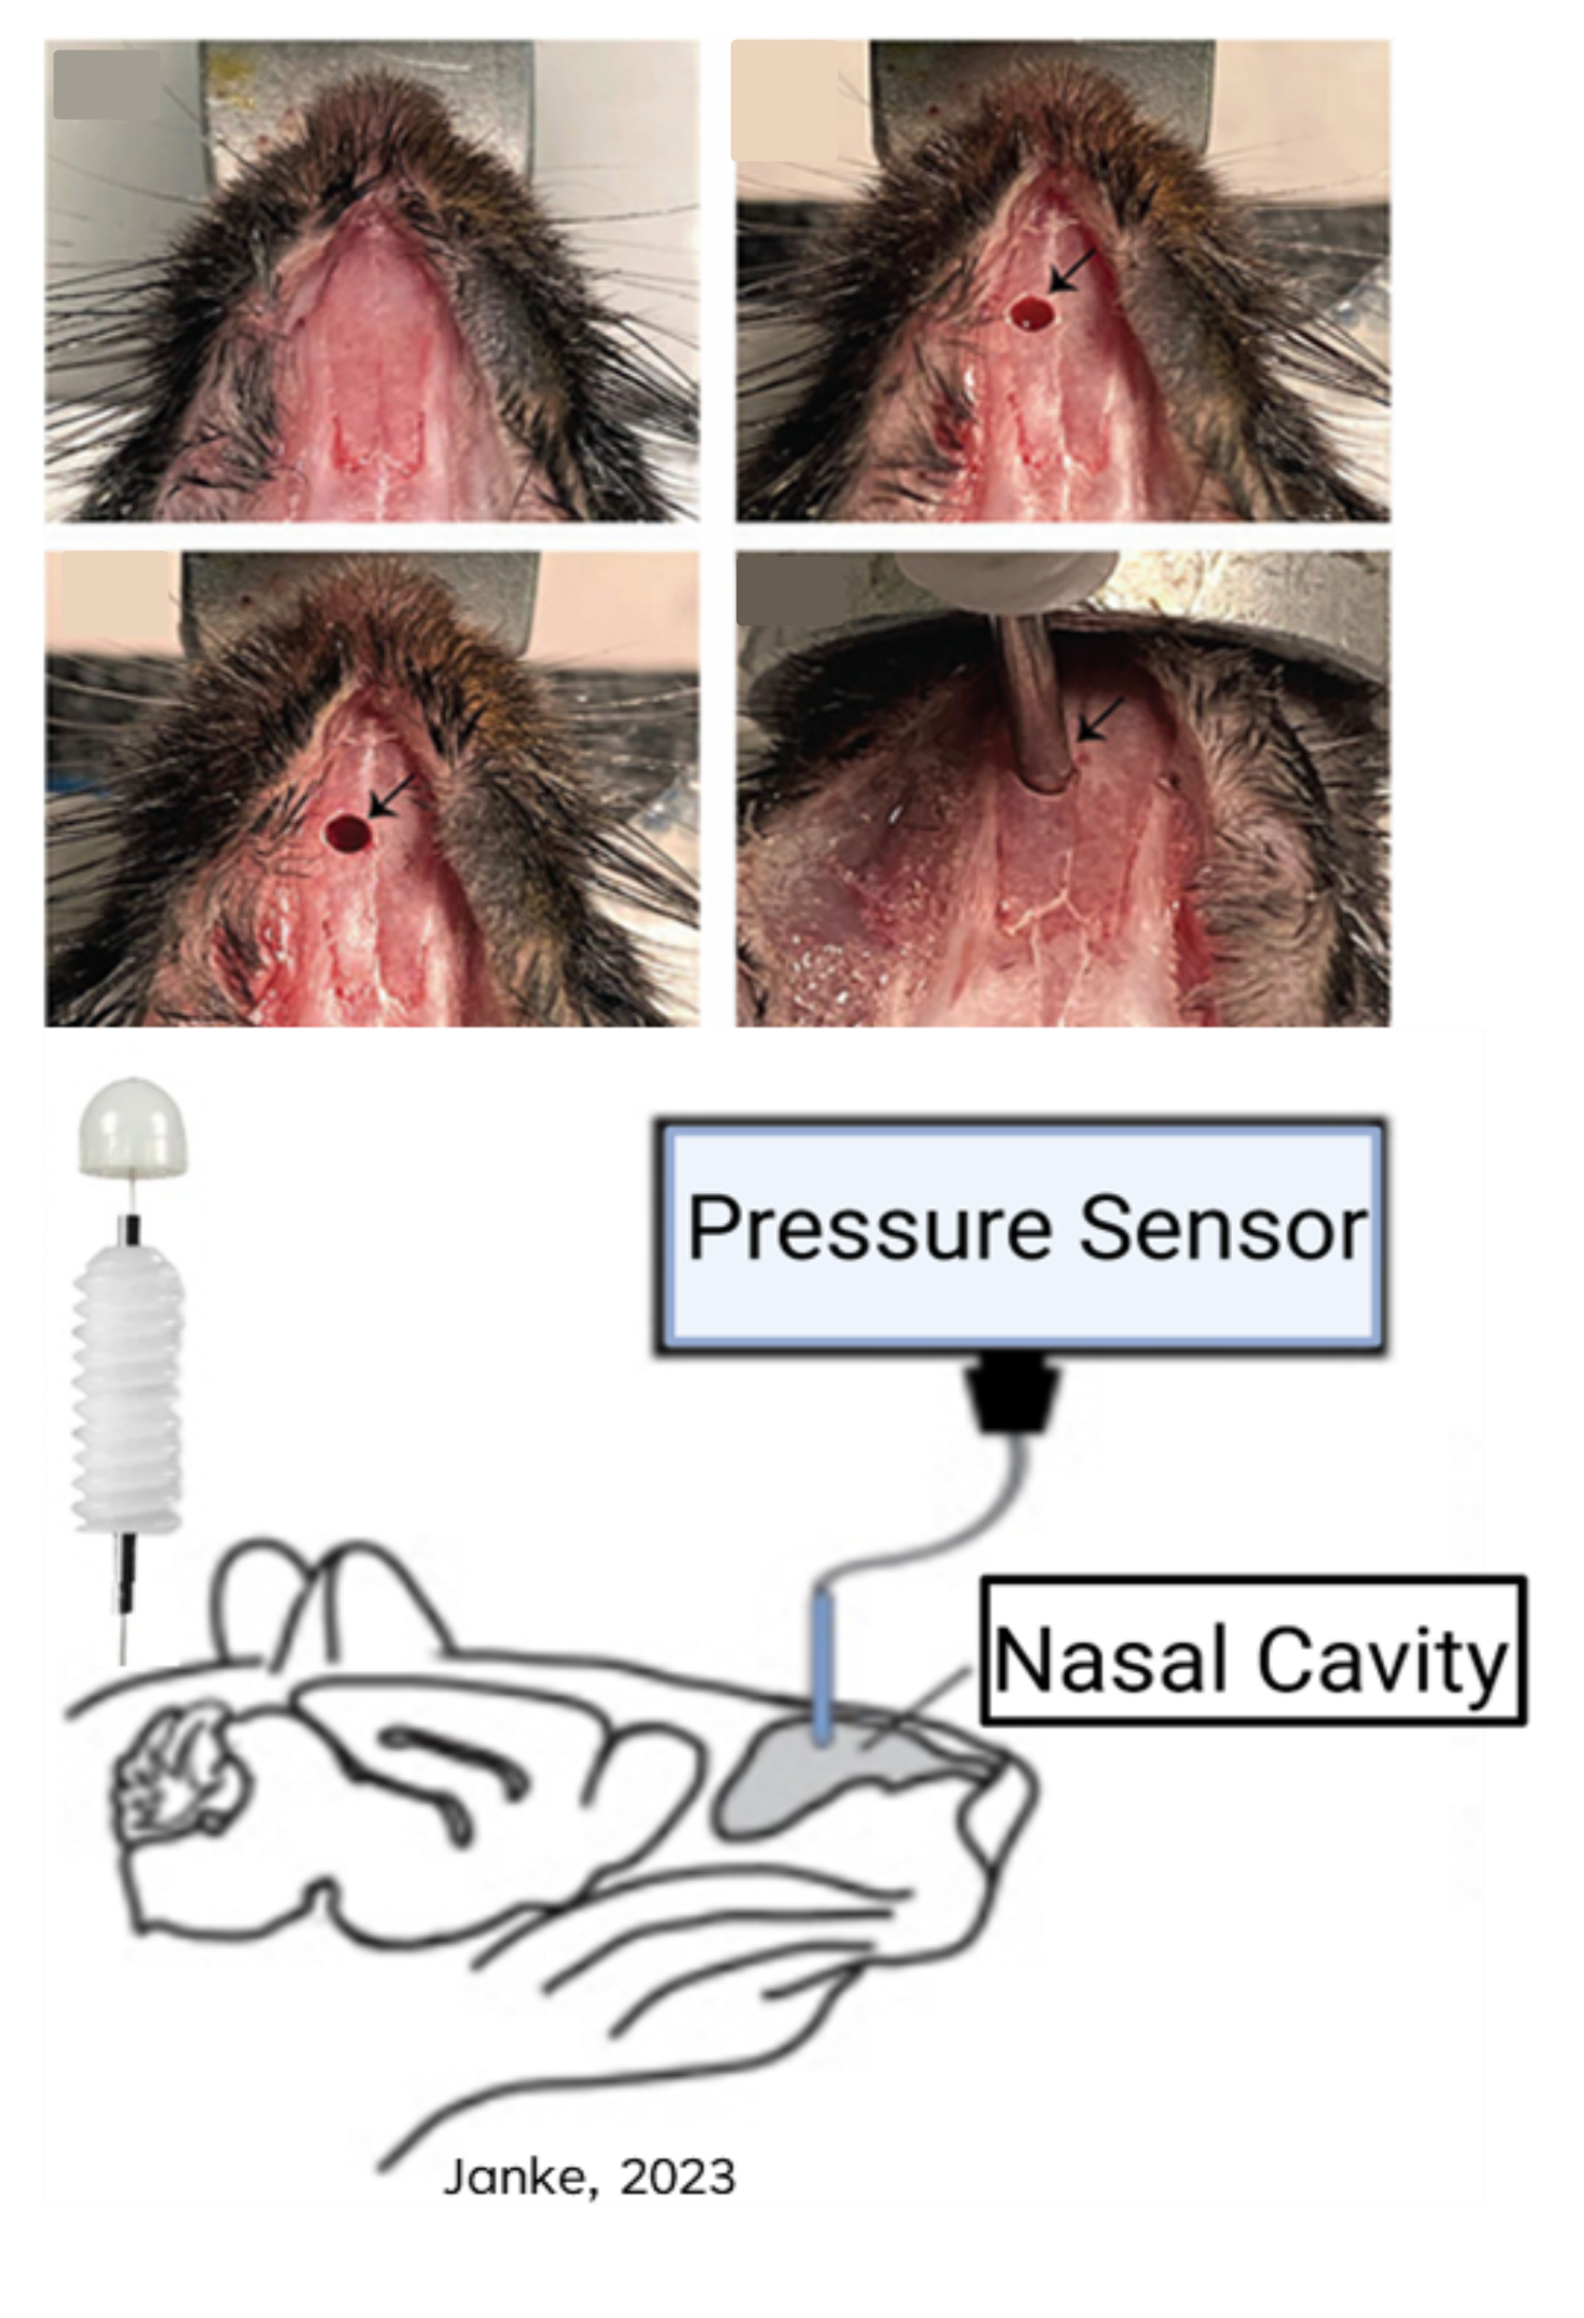
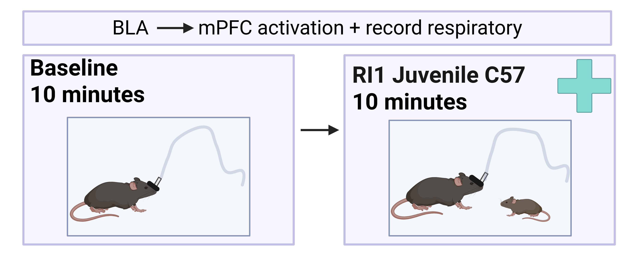
Experimental Design
Deliver 5-ms pulses 5 mW at a frequency of 20 Hz
~3 weeks

Slide 20
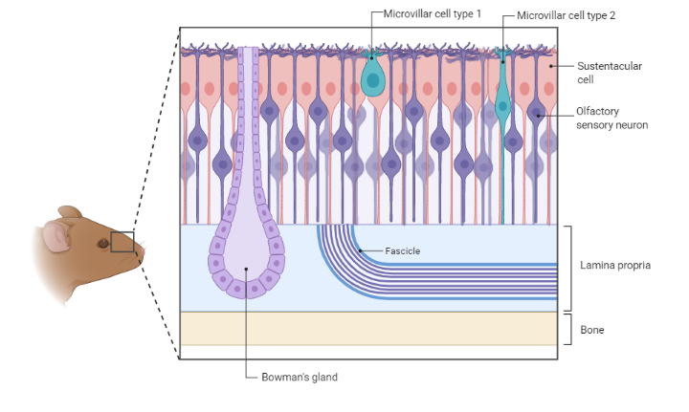
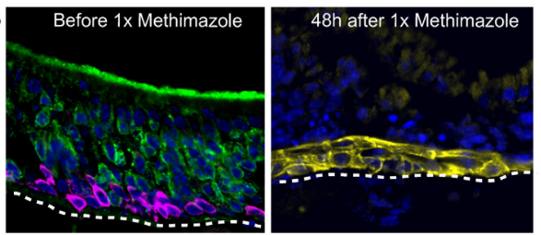
MOE Ablation
Main olfactory epithelium critical for smell
Methimazole selectively ablates the olfactory sensory neurons

Slide 21
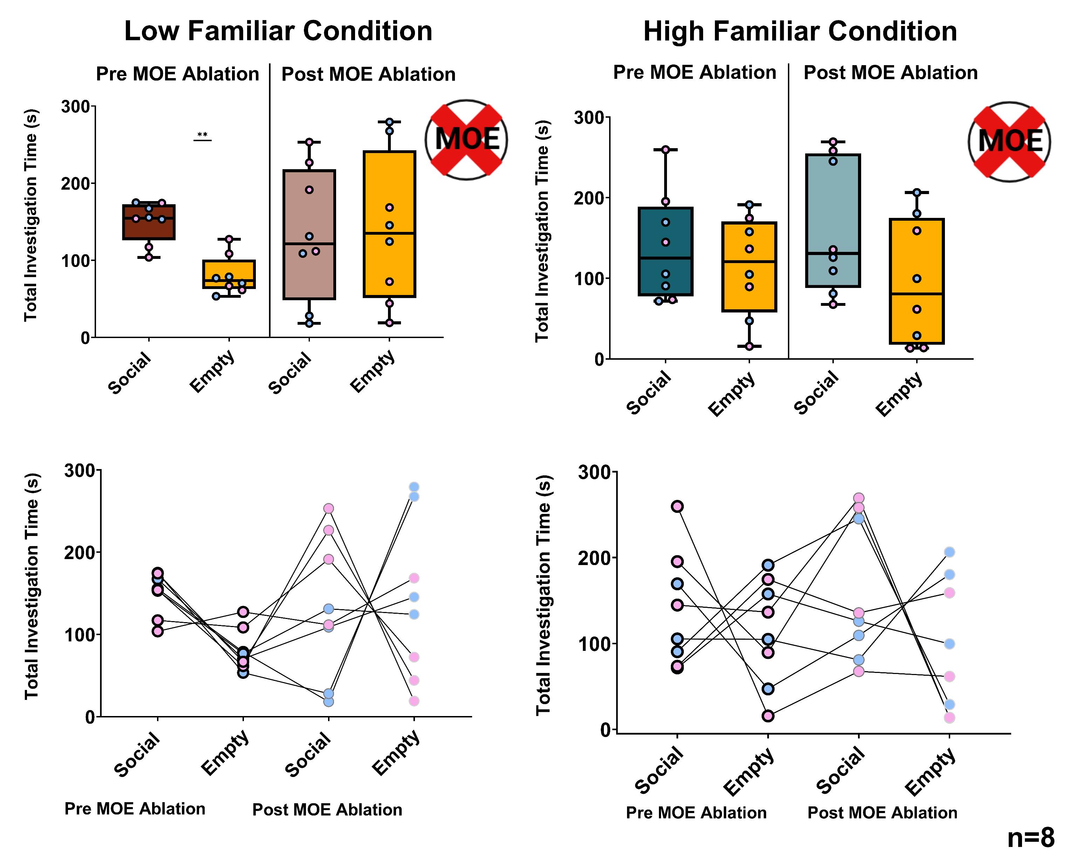
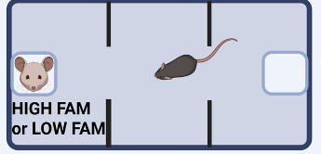
Sociability Phase

Slide 22
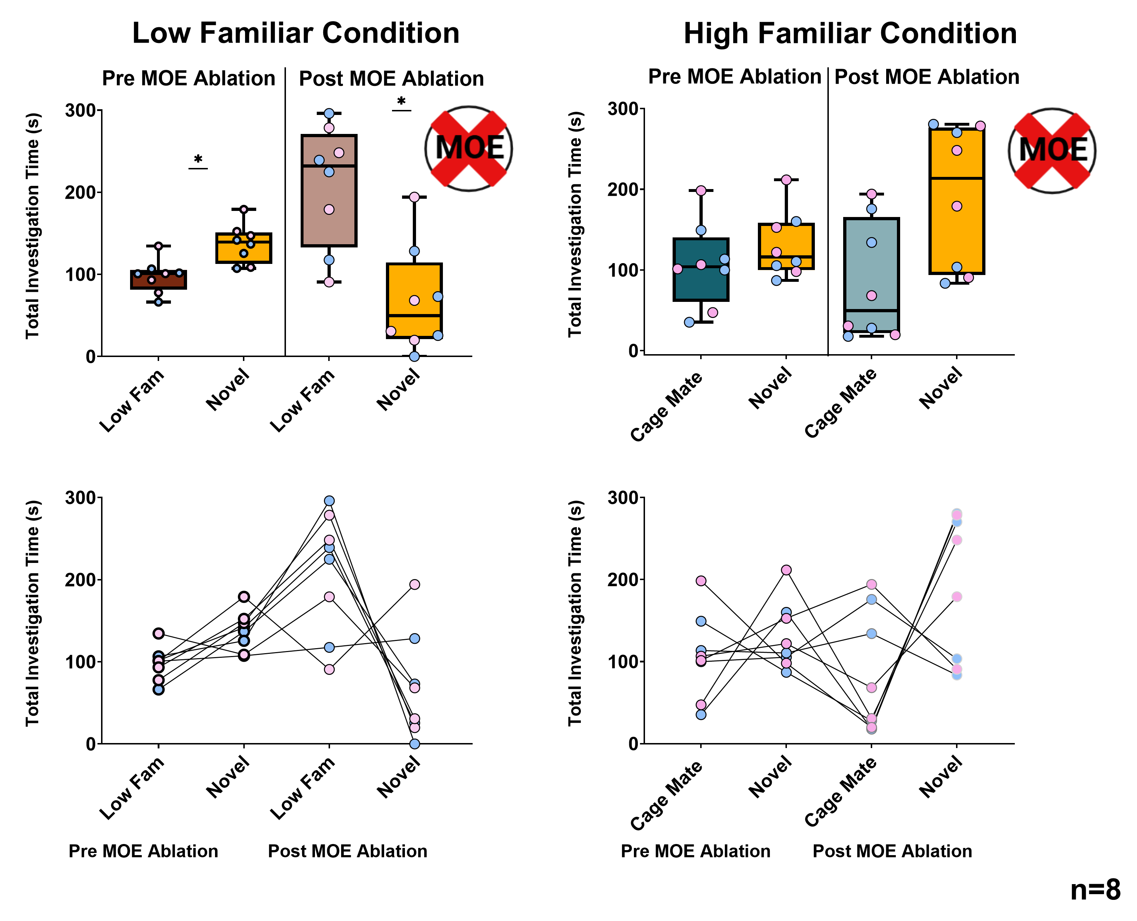
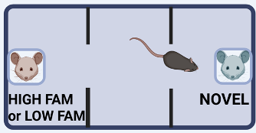
Recognition Phase

