Slide 1
Can polar coordinates make round videos smaller?
What we measured on real Telegram circles, and what the literature says
7 September 2026 · https://github.com/padington/polar-codec

Slide 2
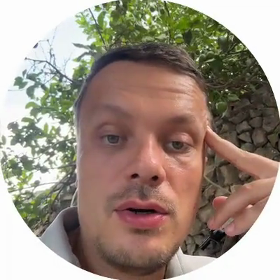
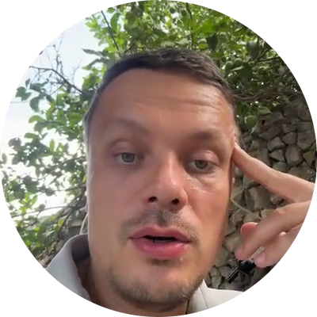
What a Telegram circle really is
A circle message is an ordinary square video file (300 to 400 px a side).
The corners are simply white. The app draws a round mask on top.
So the codec (the program that shrinks video; H.264 here) already compresses a square with a circle inside.
→
the file on disk
what you watch

Slide 3
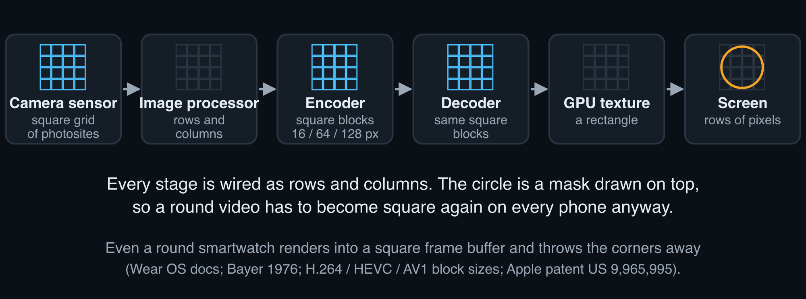
Where everything is square, and why
Sensors, encoders, decoders, GPUs and screens are all wired in rows and columns.
The circle exists only as a mask. Any polar file would be unpacked back to a square on every phone.
Sources: research bibliography, lens 3 (Bayer filter; H.264/HEVC/AV1 block sizes; Wear OS frame buffer; Apple display patent).

Slide 4
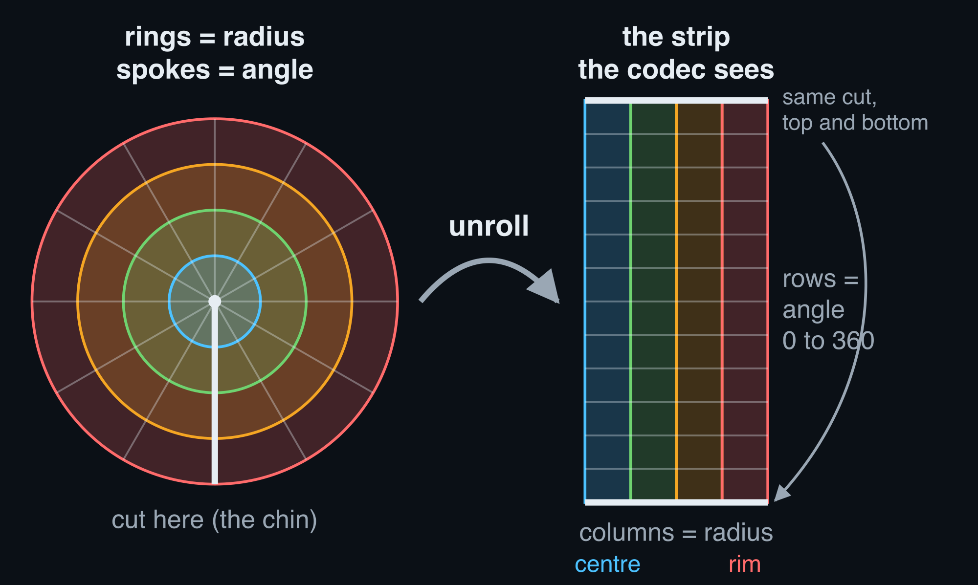
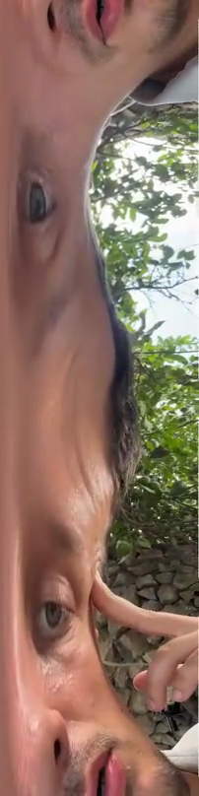
The polar idea: unroll the disc into a strip
Cut the circle at the chin and unroll it: every row is one angle, every column one distance from the centre.
Hope: a tilt of the head (the picture spinning about the centre) becomes a plain vertical shift, and codecs love shifts.
a real circle
its real strip (202 x 808)

Slide 5
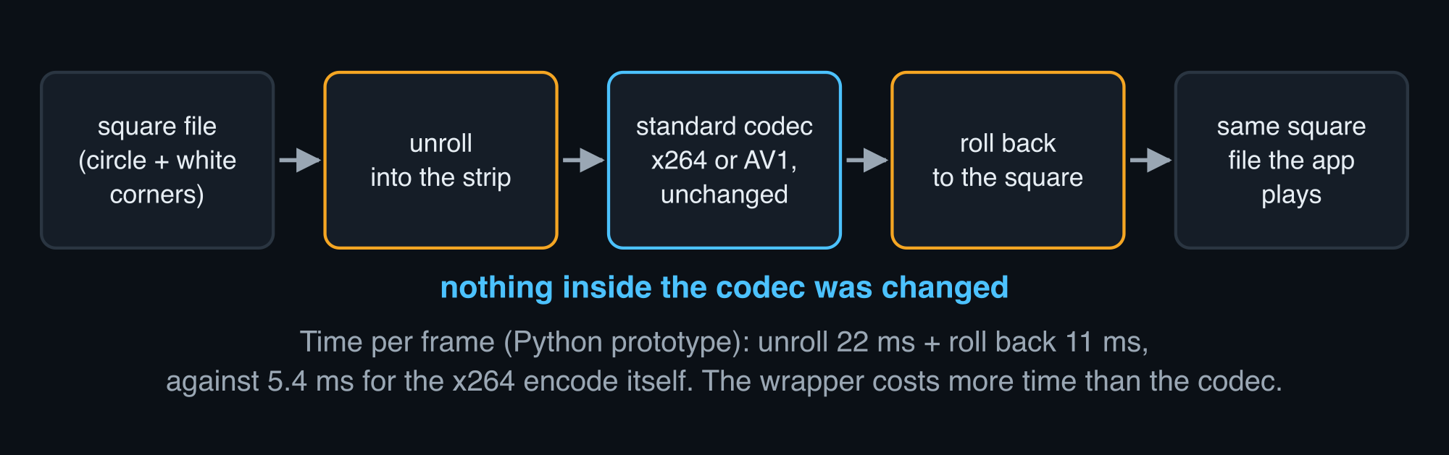
What we built
Unroll, hand the strip to an unchanged standard codec, roll it back.
Nothing inside the codec was touched, so any gain or loss comes from the geometry alone.

Slide 6
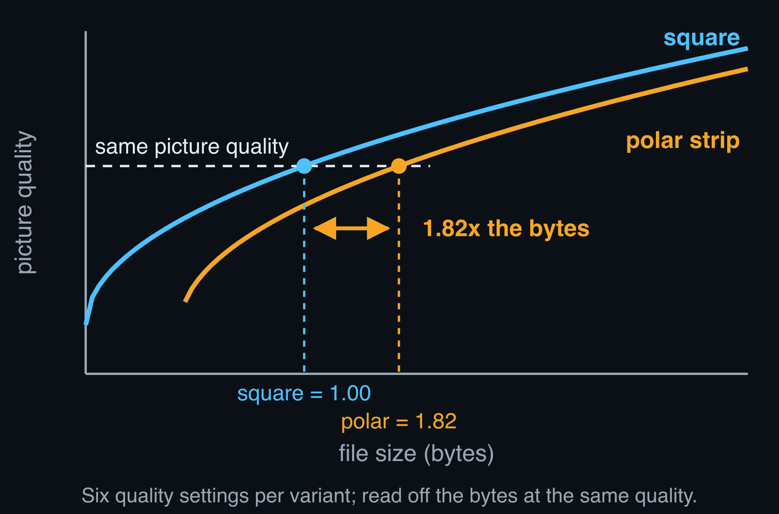
How we judged: same picture quality, count the bytes
PSNR = a closeness-to-the-original score in dB; about 1 dB is a visible step.
Bytes at equal quality = file size read off at the same PSNR inside the circle.
A 30-s circle at our middle quality setting (about 0.5 Mbit/s): square 1.8 MB, elliptical 2.5 MB, polar 3.3 MB.

Slide 7
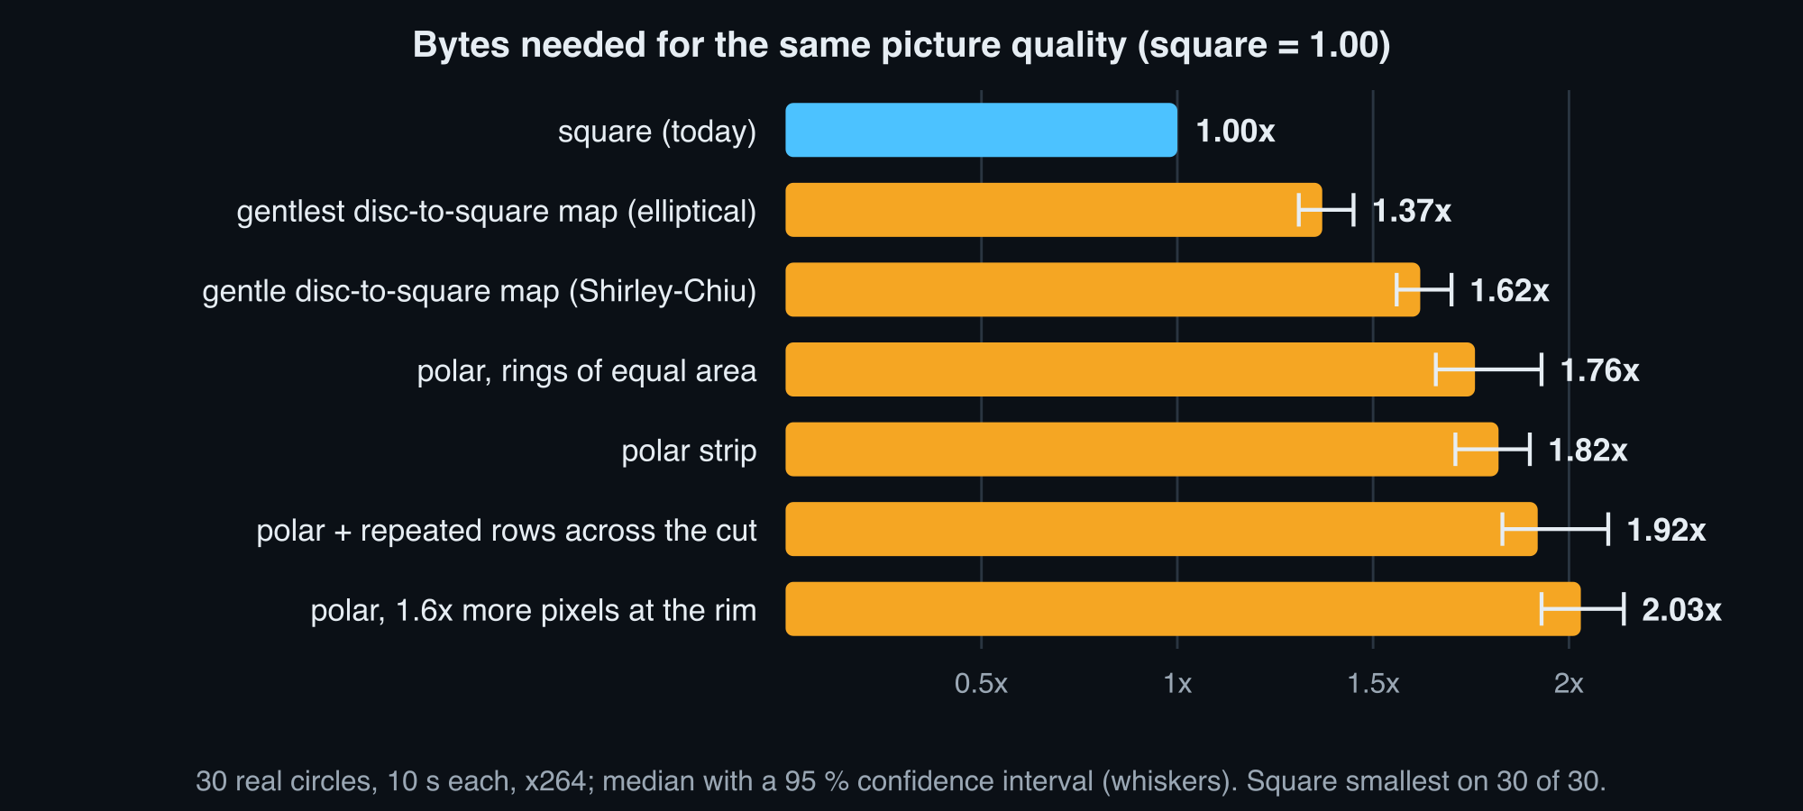
Result: the square is the smallest, every time
Polar strip needs 1.82x the bytes, the gentlest disc-to-square map 1.37x. Square smallest on 30 of 30 clips.

Slide 8
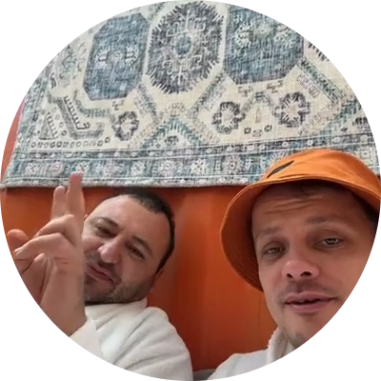

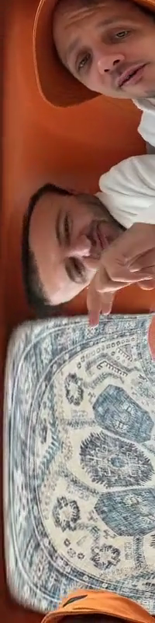
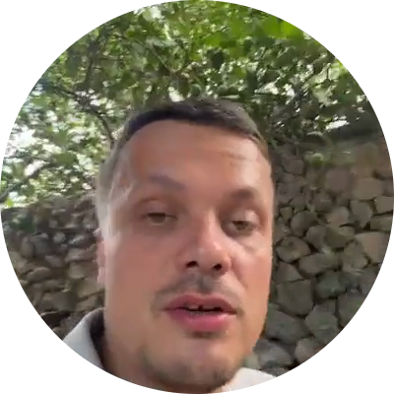
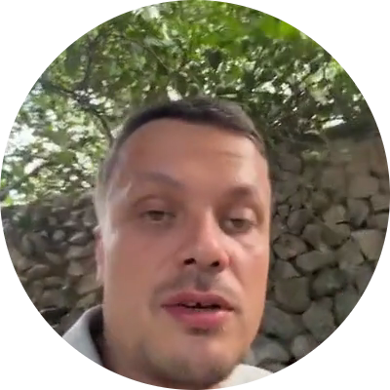
See it: original, square, polar, and the strip
Original, square re-encode, polar round trip. The strip is the internal form, not what you watch.
original clip not published
gallery clip: square (left) vs polar (right)
original (5 s)
square re-encode
polar round trip
the strip: internal form, not what you watch
Stills only. The moving versions play in the HTML deck: docs/slides/index.html, slide 8.

Slide 9
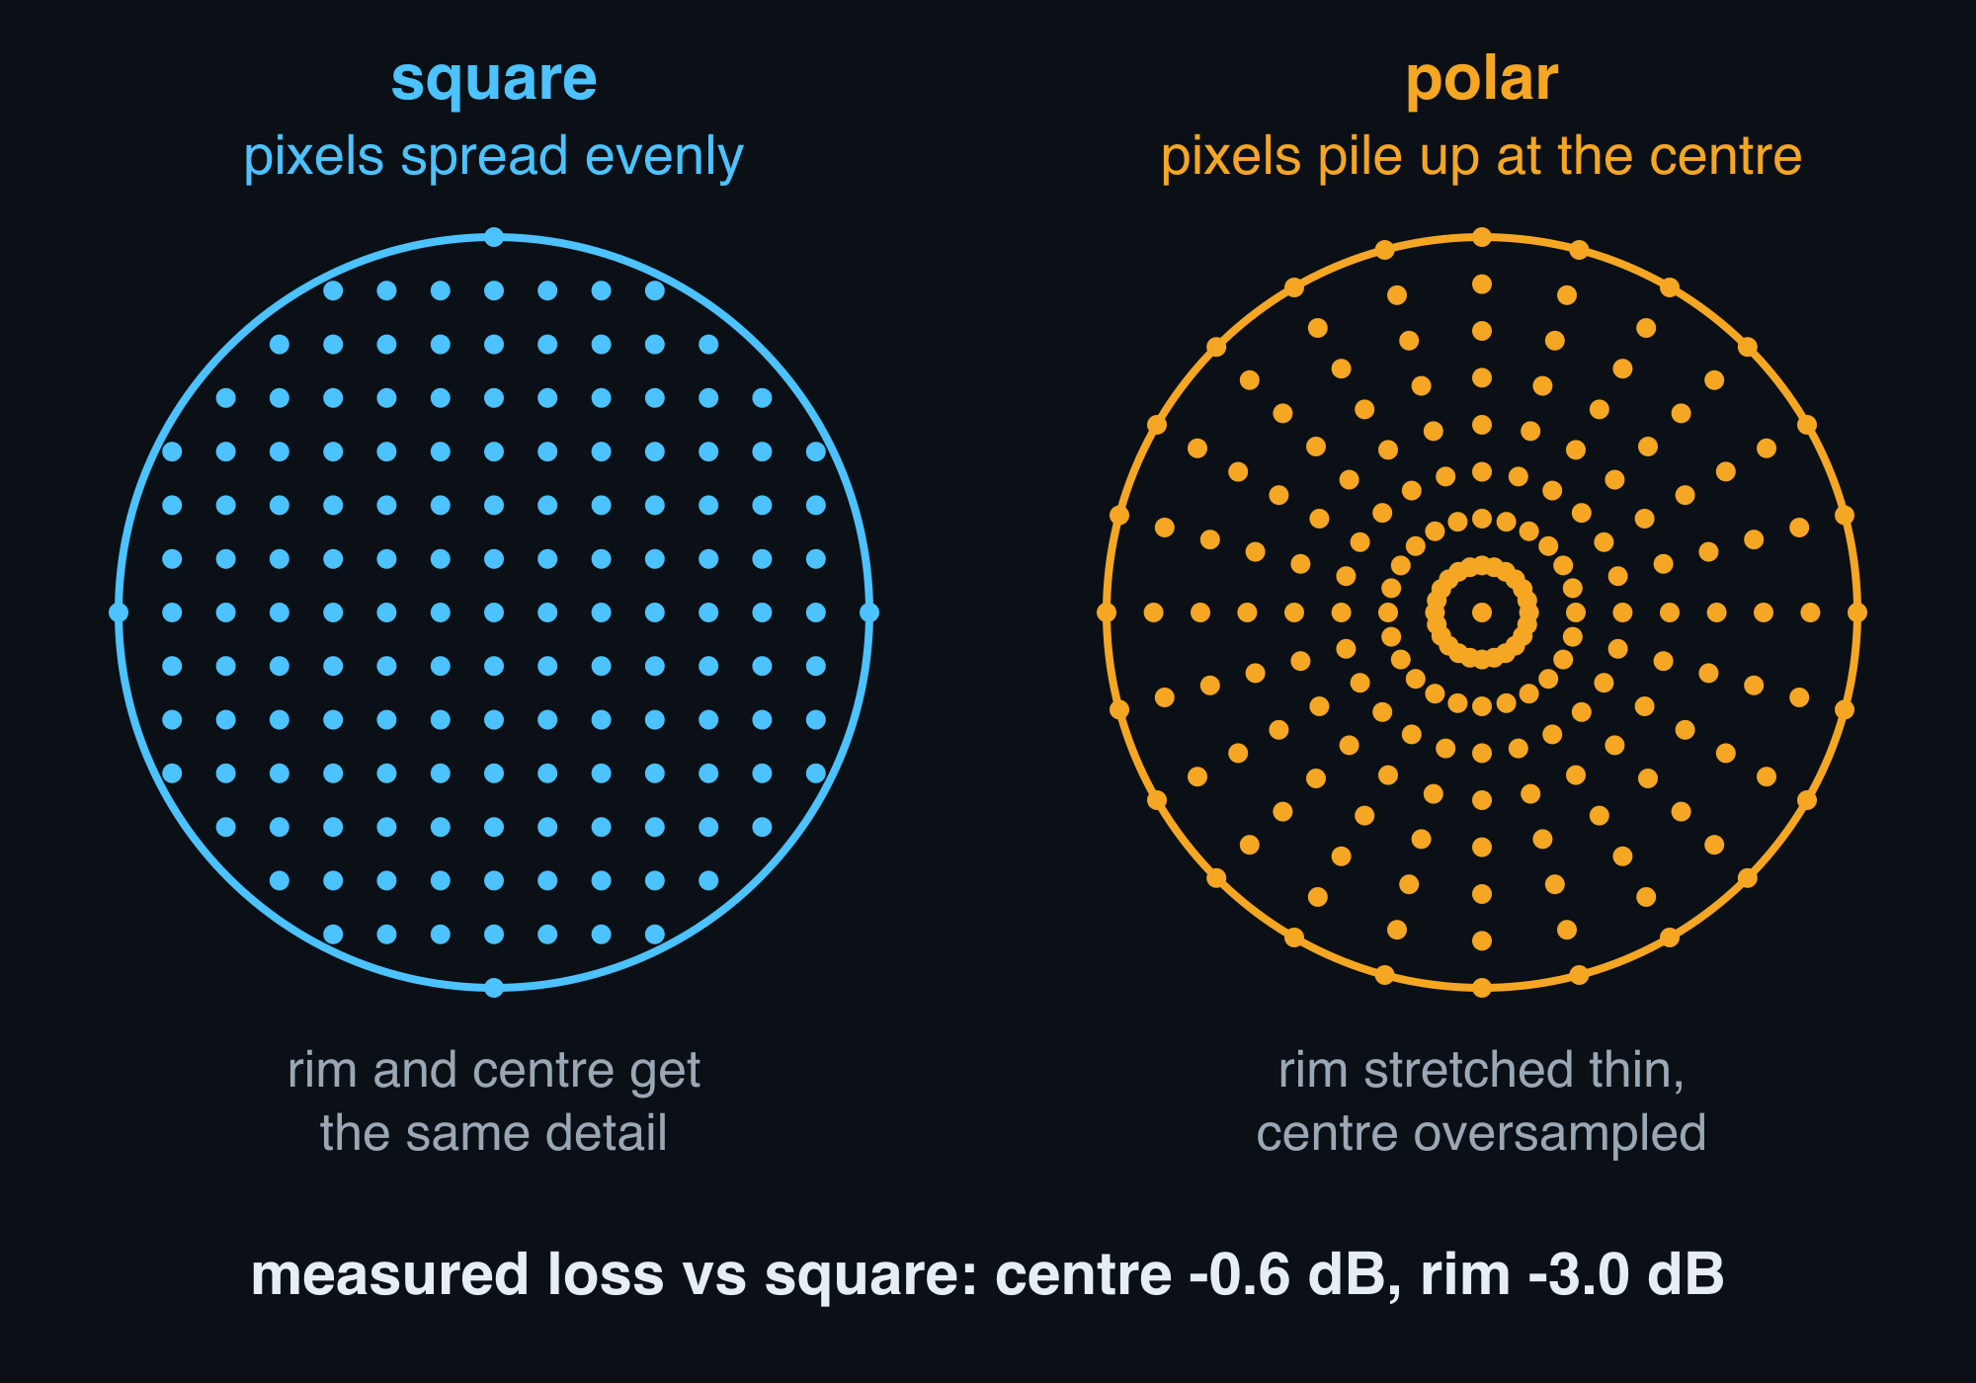
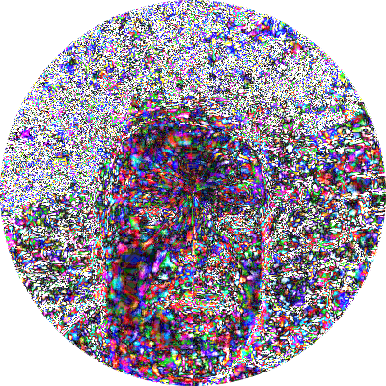
Why it loses #1: the rim is starved, the centre is flooded
A polar strip has one column per radius, so the outer ring gets far fewer pixels than in the square and the centre gets too many.
Measured: rim -3.0 dB, centre only -0.6 dB.
error map of one clip (brighter = bigger error): a ring at the rim

Slide 10
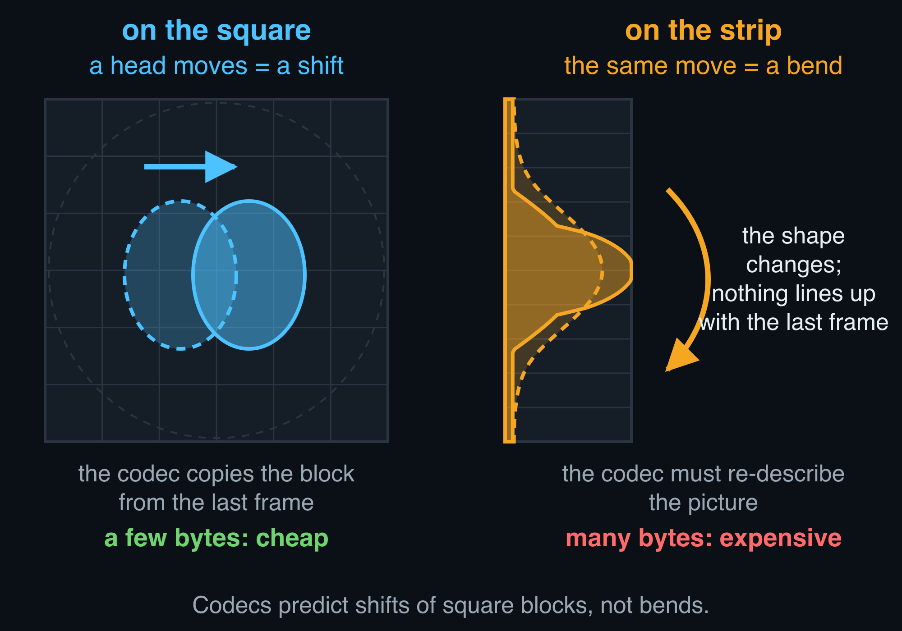
Why it loses #2: motion becomes a warp
Codecs predict each block as a shift of the last frame. On the strip an ordinary sideways move is a bend, so prediction fails.
Also: the white corners are already almost free (flat blocks cost nearly nothing).

Slide 11
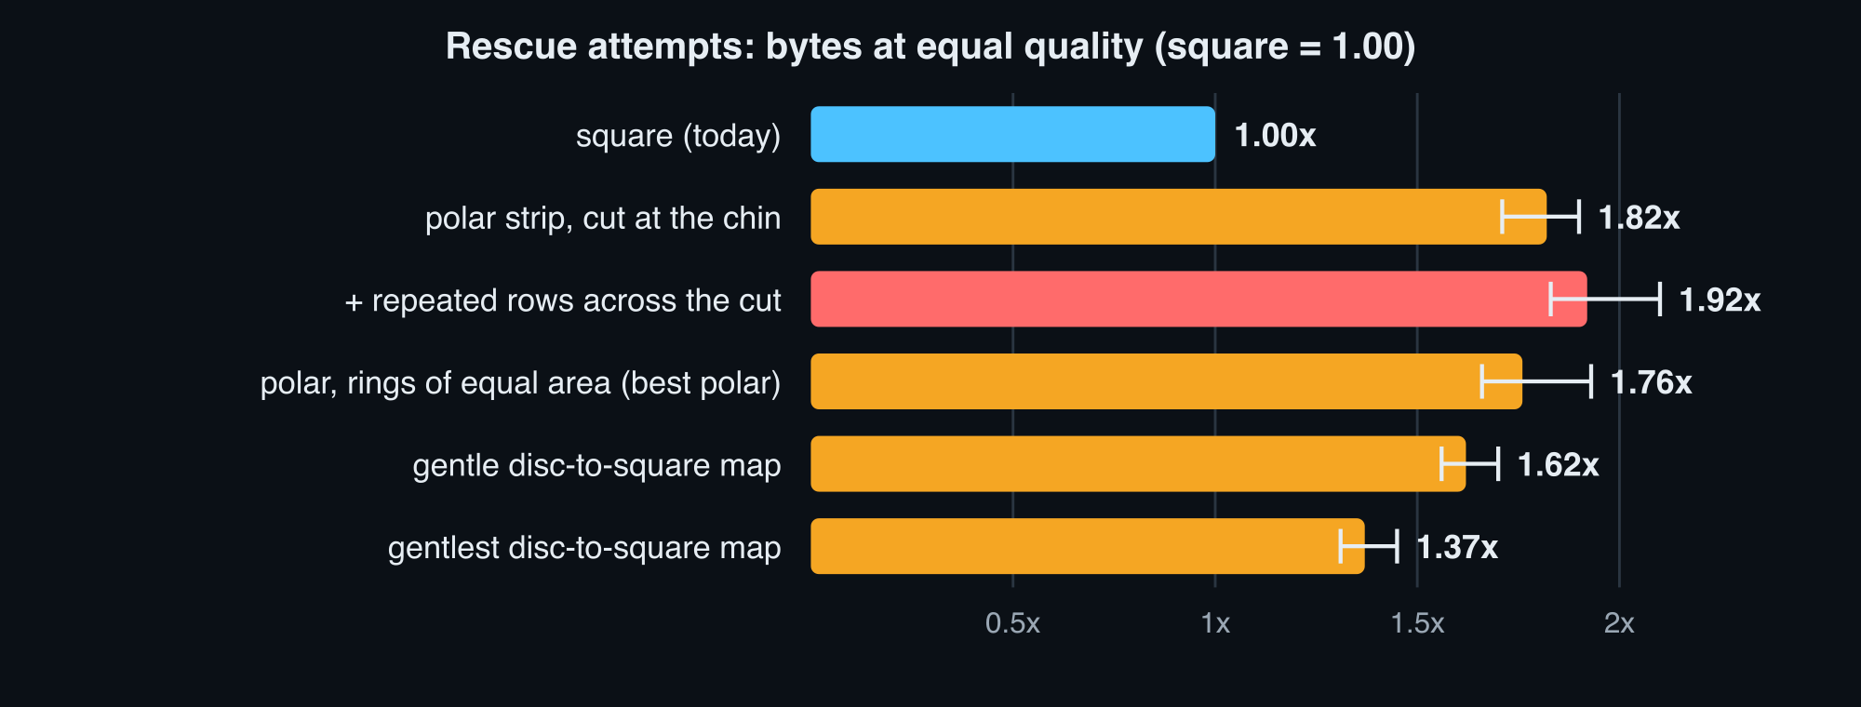
What we tried to rescue it
Repeating a few rows across the cut (guard rows): worse, 1.92x. Cutting at the chin hides the visible seam, saves no bytes. Rings of equal area: best polar, still 1.76x. Gentler disc-to-square maps: 1.62x and 1.37x.

Slide 12
Other ways to unroll the disc
Six canvases, 12 clips, both codecs: ellipses inflated half-way and all the way, a squircle, an angle-preserving conformal map, and a centre-tile hybrid. The less warped the canvas, the cheaper it is; the least warped is the square.
shape (corners removed) | H.264 (x264) | AV1
elliptical, half-way (disc fills 85 % of the frame) — 25 % | +21.5 % | +9.0 %
elliptical, three quarters — 50 % | +24.0 % | +9.6 %
elliptical, disc stretched to the full square — 100 % | +35.0 % | +17.3 %
FG-squircular (squircle rings instead of ellipses) — 100 % | +36.3 % | +17.3 %
conformal (the only angle-preserving map) — 100 % | +53.5 % | +35.2 %
hybrid: exact centre tile + polar rim packed below — 100 % | +79.8 % | not run
Ceiling: whitening the real corners does not shrink the file (-0.3 to +2.5 %), and the corner region plus the disc edge is worth at most 1.9 to 8.5 % — the cheapest shape already costs +21.5 %.
No shape wins on any clip under either codec, and the sweep's own trend points back to the square.
Positive = more bytes than the plain square at the same quality inside the circle (BD-rate, median over 12 clips of 10 s, 6 quality settings). results/batch4_shapes (x264) and results/batch4_shapes_svtav1 (SVT-AV1); the ceiling is the corner-cost oracle in results/batch4_shapes/shapes_report.md, section 3.

Slide 13

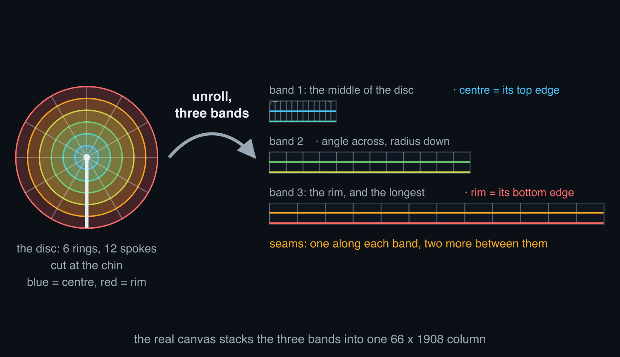

Polar in three bands (polar_strip)
How it's built: Cut the disc into three rings and unroll each to its own length, so the rim band gets the most pixels; stack the three strips.
Hope: No starved rim, no flooded centre.
What happened: Bytes vs the square: +76.0 % under x264, not run under AV1; the seams cost more than the rim gains.
a real circle
its real canvas (66 x 1908) — top 200 rows, 2x
Middle: the disc's 6 rings and 12 spokes drawn where this map actually puts them (sampled from the map itself, docs/slides/shape_schematics.py). Right: clip 535868 at t = 2.0 s. Bytes vs the plain square at equal quality inside the circle (BD-rate, median over results/batch2, 30 clips of 10 s, x264).

Slide 14
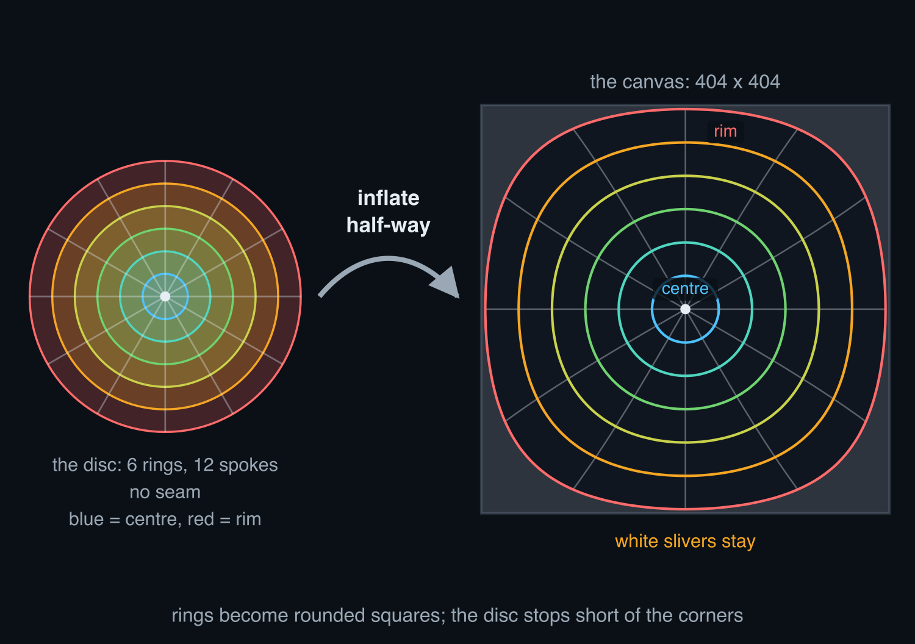

Elliptical, half-way (ellip_p50)
How it's built: The disc is inflated towards the corners, but only half way, so thin white slivers stay.
Hope: Less warp than the full stretch, and most of the corners gone.
What happened: Bytes vs the square: +21.5 % under x264, +9.0 % under AV1; the cheapest canvas of the whole sweep.
a real circle
its real canvas (404 x 404)
Middle: the disc's 6 rings and 12 spokes drawn where this map actually puts them (sampled from the map itself, docs/slides/shape_schematics.py). Right: clip 535868 at t = 2.0 s. Bytes vs the plain square at equal quality inside the circle (BD-rate, median over results/batch4_shapes (x264) and results/batch4_shapes_svtav1 (SVT-AV1), 12 clips of 10 s).

Slide 15
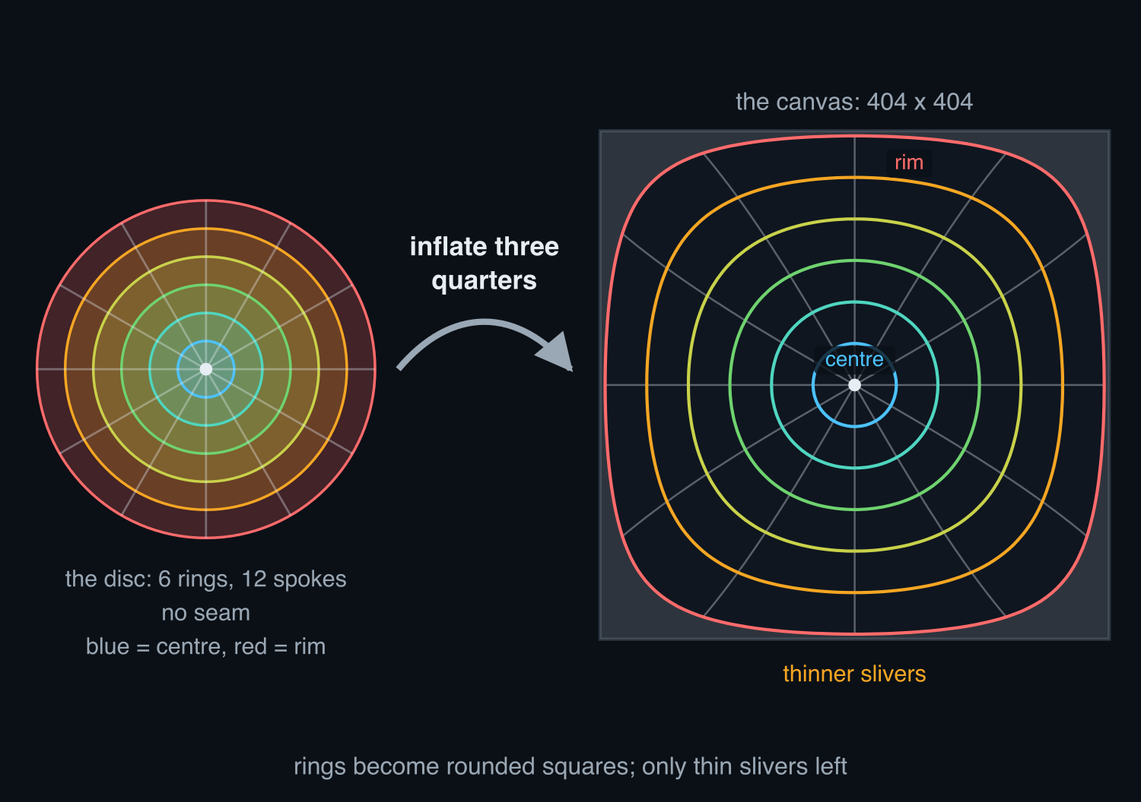

Elliptical, three quarters (ellip_p75)
How it's built: The same inflation pushed three quarters of the way: the slivers shrink, the warp grows.
Hope: Trading a little more warp for fewer white corners should pay.
What happened: Bytes vs the square: +24.0 % under x264, +9.6 % under AV1; it does not: half way was cheaper.
a real circle
its real canvas (404 x 404)
Middle: the disc's 6 rings and 12 spokes drawn where this map actually puts them (sampled from the map itself, docs/slides/shape_schematics.py). Right: clip 535868 at t = 2.0 s. Bytes vs the plain square at equal quality inside the circle (BD-rate, median over results/batch4_shapes (x264) and results/batch4_shapes_svtav1 (SVT-AV1), 12 clips of 10 s).

Slide 16
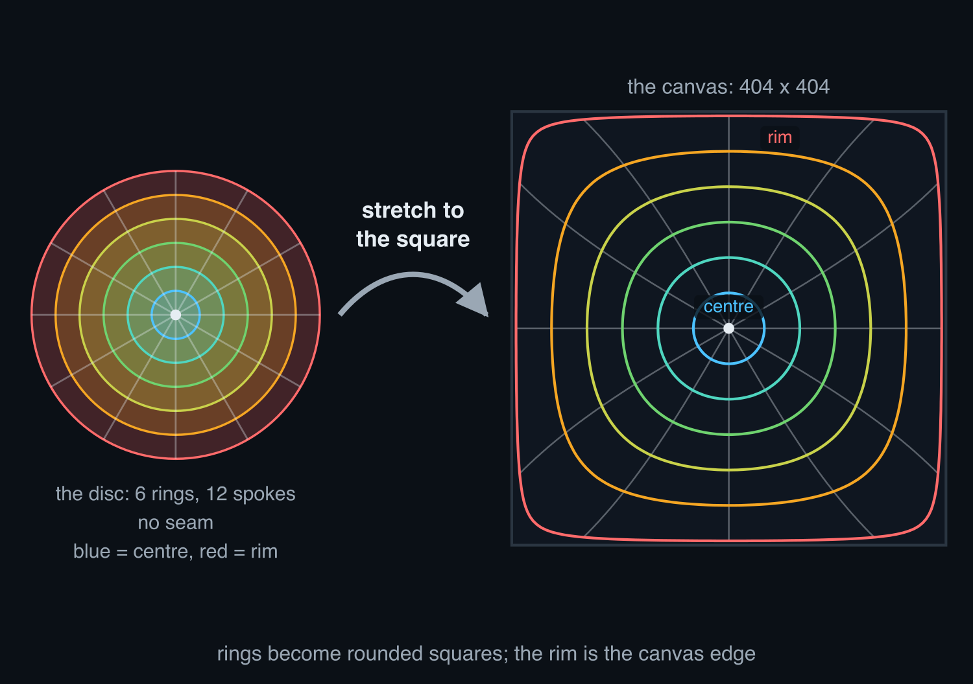
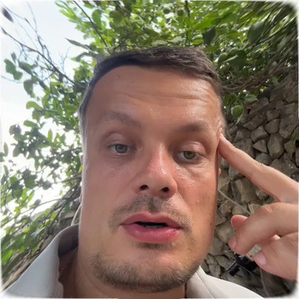
Elliptical, full (ellip_full)
How it's built: The disc is stretched to fill the square, like a round cloth pulled over a square table; rings become rounded squares.
Hope: No white corners left to encode at all.
What happened: Bytes vs the square: +35.0 % under x264, +17.3 % under AV1; the warp costs far more than the corners saved.
a real circle
its real canvas (404 x 404)
Middle: the disc's 6 rings and 12 spokes drawn where this map actually puts them (sampled from the map itself, docs/slides/shape_schematics.py). Right: clip 535868 at t = 2.0 s. Bytes vs the plain square at equal quality inside the circle (BD-rate, median over results/batch4_shapes (x264) and results/batch4_shapes_svtav1 (SVT-AV1), 12 clips of 10 s).

Slide 17
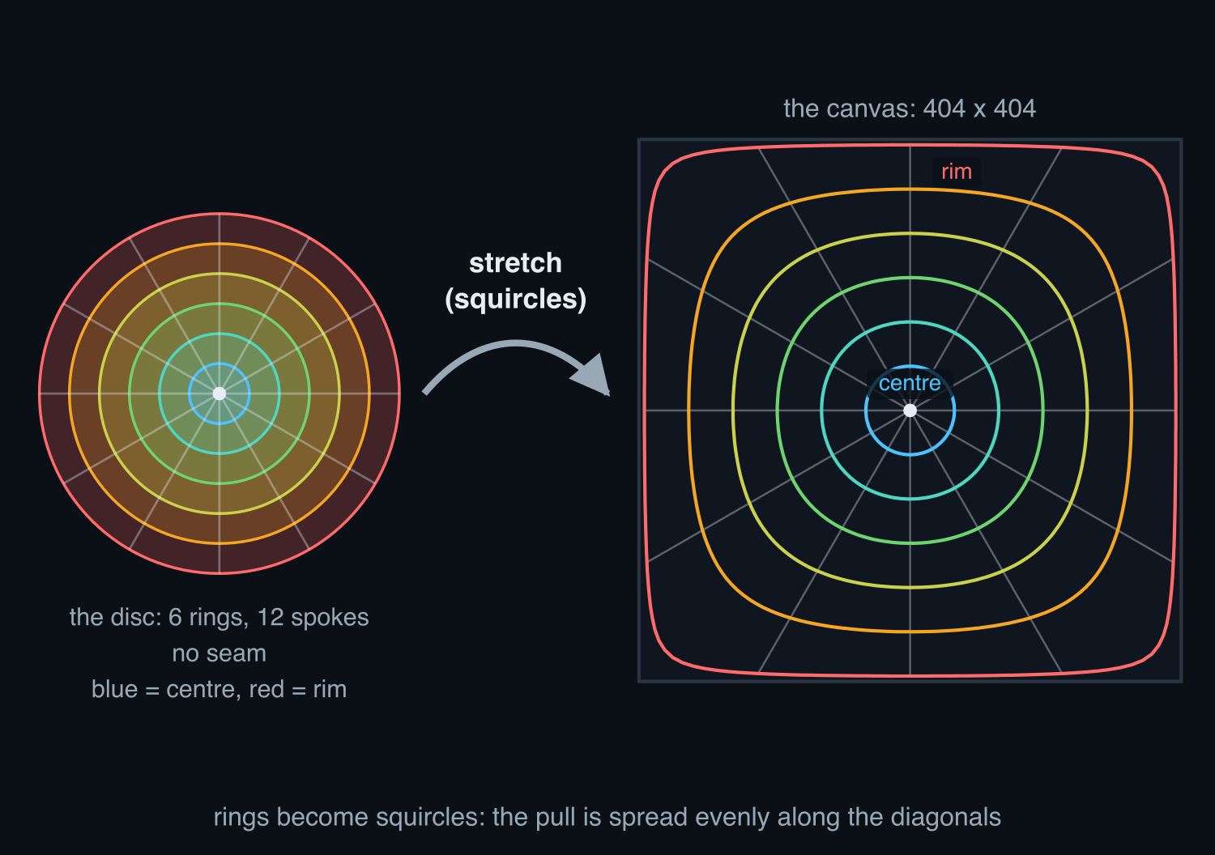
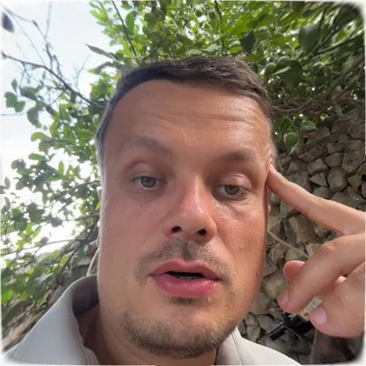
FG-squircular (fgsq_full)
How it's built: The same full stretch, spread differently: rings become squircles, so the pull is shared evenly along the diagonals.
Hope: A more even warp should cost less than the elliptical one.
What happened: Bytes vs the square: +36.3 % under x264, +17.3 % under AV1; it is a shade worse.
a real circle
its real canvas (404 x 404)
Middle: the disc's 6 rings and 12 spokes drawn where this map actually puts them (sampled from the map itself, docs/slides/shape_schematics.py). Right: clip 535868 at t = 2.0 s. Bytes vs the plain square at equal quality inside the circle (BD-rate, median over results/batch4_shapes (x264) and results/batch4_shapes_svtav1 (SVT-AV1), 12 clips of 10 s).

Slide 18
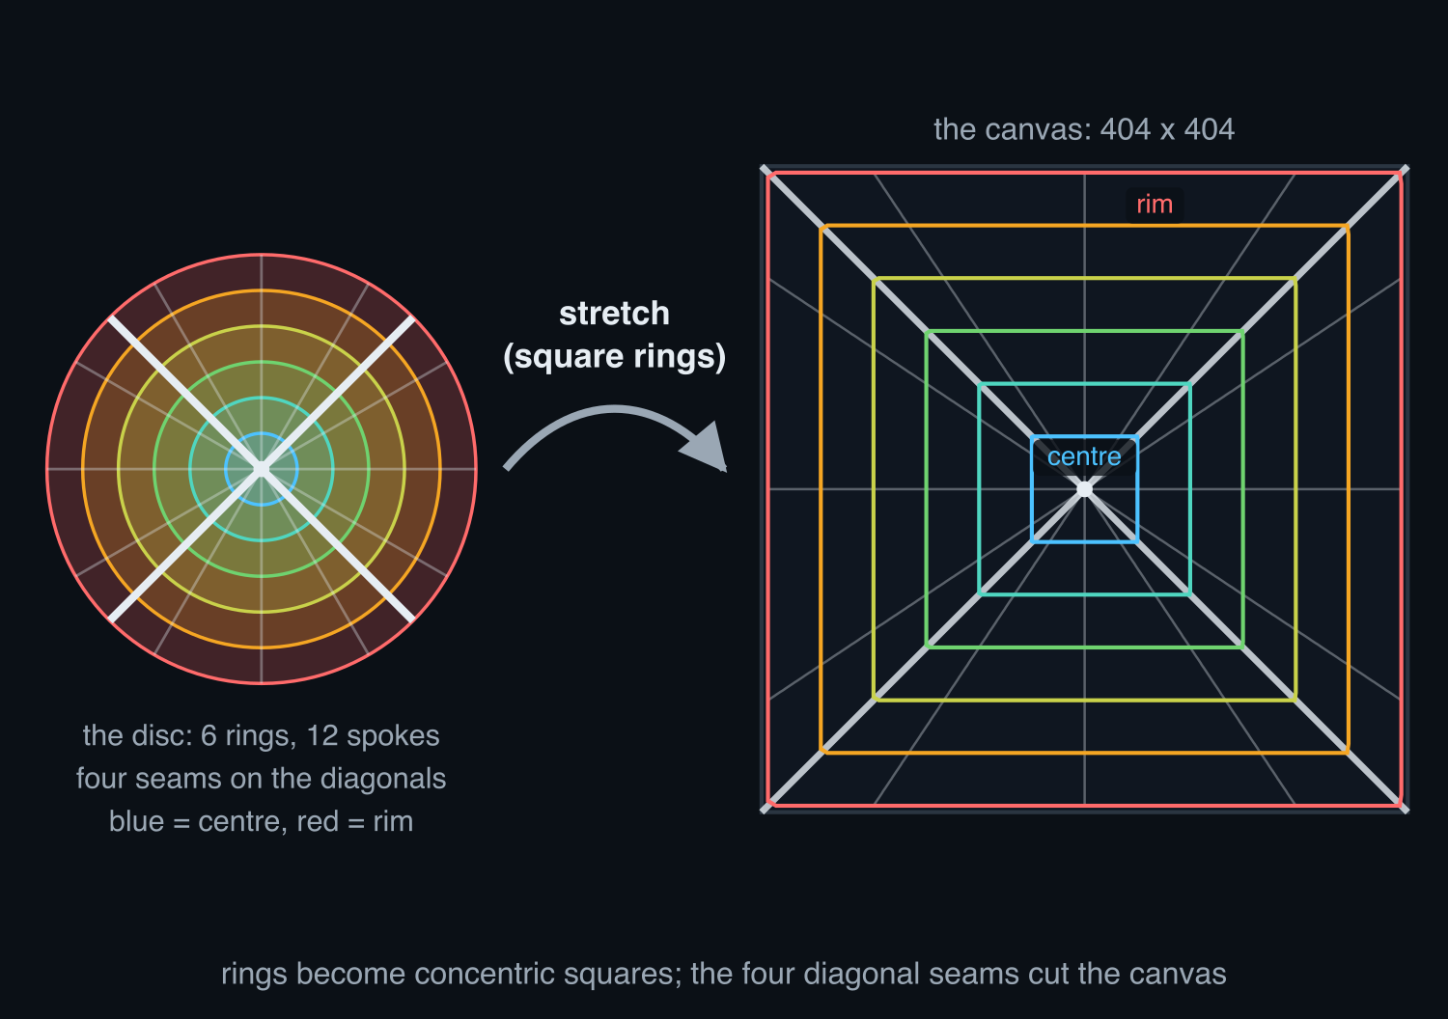
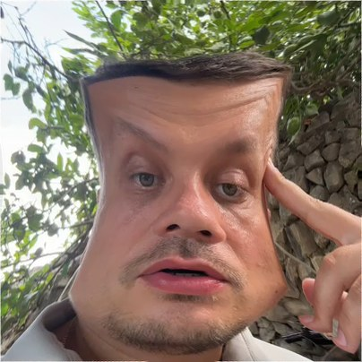
Shirley-Chiu concentric (sc_full)
How it's built: Each quarter of the disc is pulled into one side of the square: rings become concentric squares, with four seams along the diagonals.
Hope: Equal areas: every pixel carries the same amount of picture.
What happened: Bytes vs the square: +61.9 % under x264, not run under AV1; the seams and the shear are expensive.
a real circle
its real canvas (404 x 404)
Middle: the disc's 6 rings and 12 spokes drawn where this map actually puts them (sampled from the map itself, docs/slides/shape_schematics.py). Right: clip 535868 at t = 2.0 s. Bytes vs the plain square at equal quality inside the circle (BD-rate, median over results/batch2, 30 clips of 10 s, x264).

Slide 19
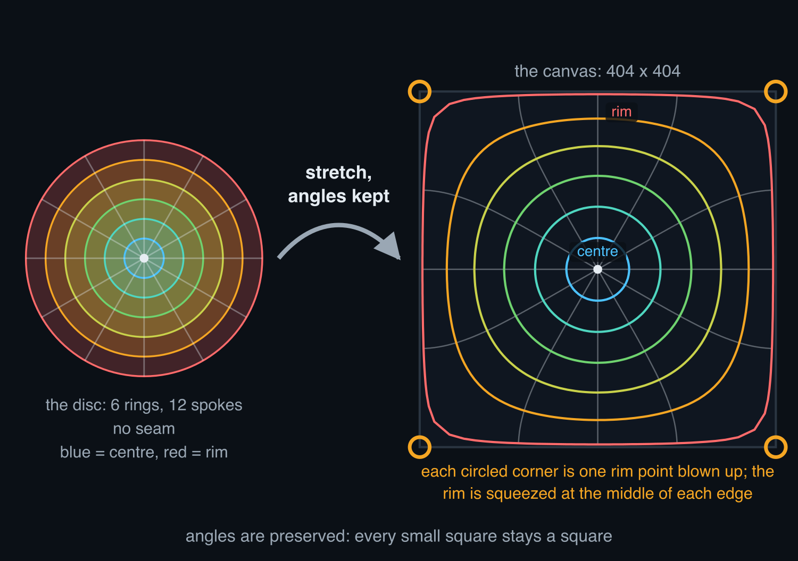
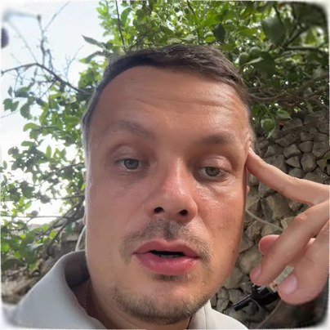
Conformal, angle-preserving (conformal_full)
How it's built: The only map that keeps angles: every small square stays a square, so local motion stays a shift. The price: four rim points balloon into the corners.
Hope: Angles kept, so the codec's motion search still works.
What happened: Bytes vs the square: +53.5 % under x264, +35.2 % under AV1; the blown-up corners eat the gain.
a real circle
its real canvas (404 x 404)
Middle: the disc's 6 rings and 12 spokes drawn where this map actually puts them (sampled from the map itself, docs/slides/shape_schematics.py). Right: clip 535868 at t = 2.0 s. Bytes vs the plain square at equal quality inside the circle (BD-rate, median over results/batch4_shapes (x264) and results/batch4_shapes_svtav1 (SVT-AV1), 12 clips of 10 s).

Slide 20
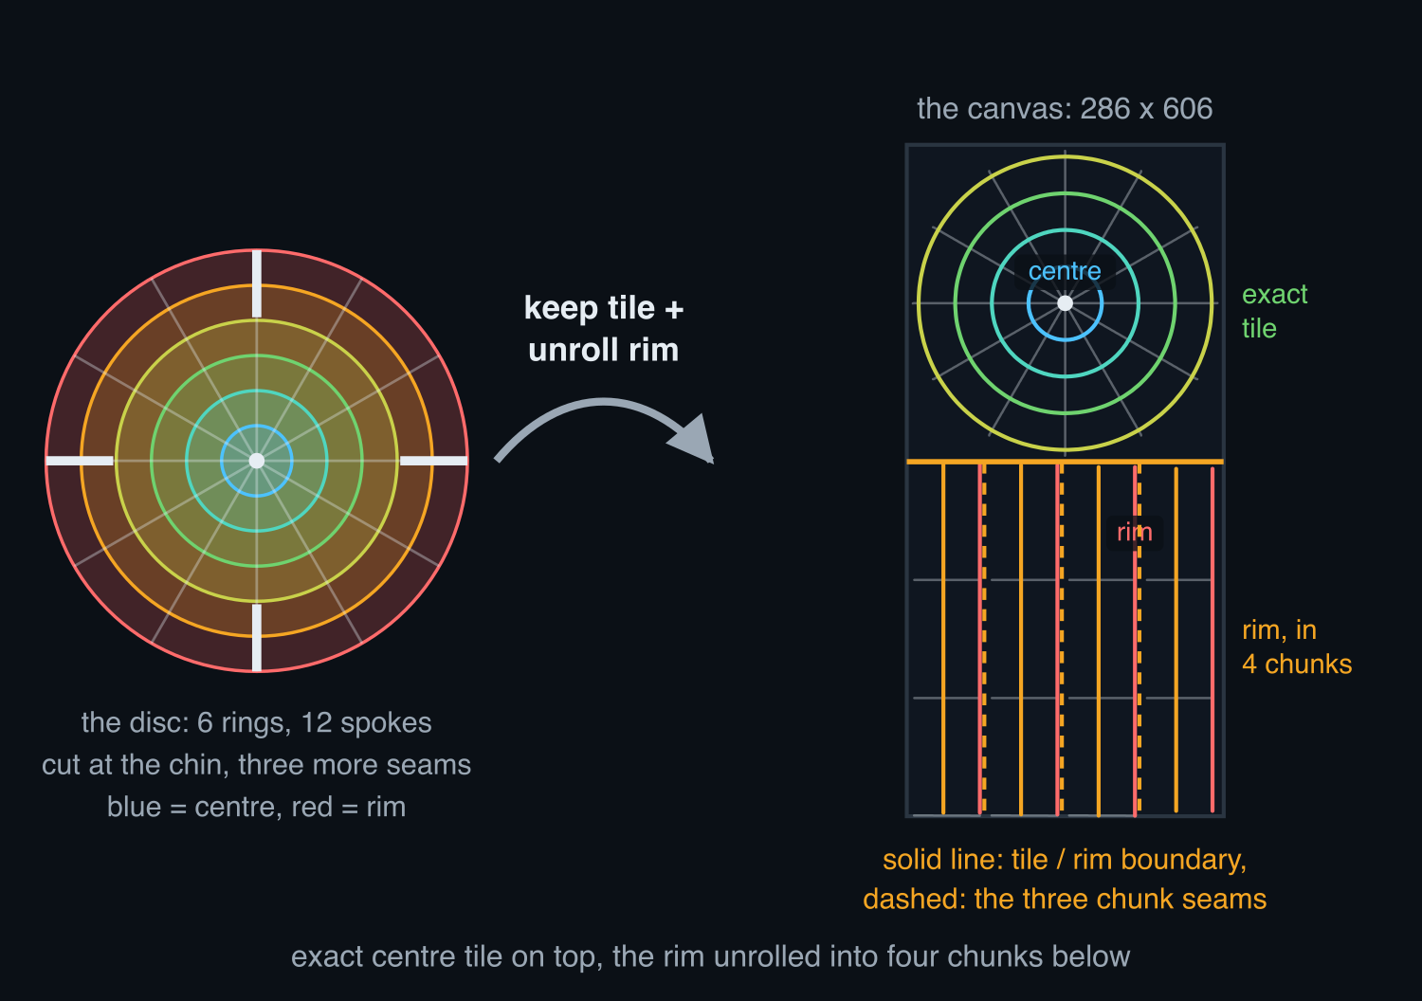
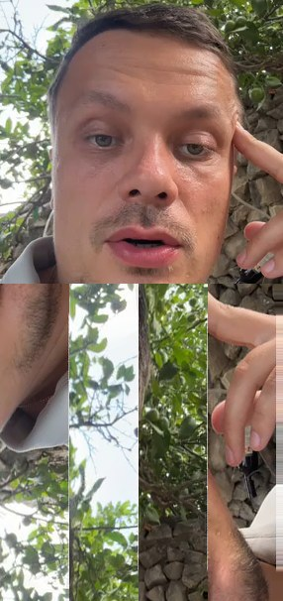
Centre tile plus rim strip (hybrid_center)
How it's built: The middle of the disc is kept as an untouched square tile; the rim is unrolled and packed below it in four chunks.
Hope: The face stays exact, only the rim is warped.
What happened: Bytes vs the square: +79.8 % under x264, not run under AV1; the worst canvas of the sweep.
a real circle
its real canvas (286 x 606)
Middle: the disc's 6 rings and 12 spokes drawn where this map actually puts them (sampled from the map itself, docs/slides/shape_schematics.py). Right: clip 535868 at t = 2.0 s. Bytes vs the plain square at equal quality inside the circle (BD-rate, median over results/batch4_shapes (x264) and results/batch4_shapes_svtav1 (SVT-AV1), 12 clips of 10 s).

Slide 21
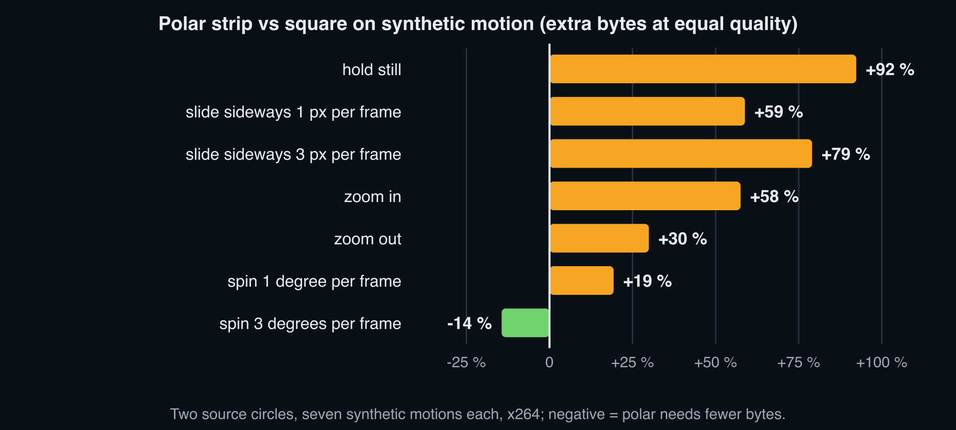
Synthetic motion: polar wins only on a fast spin
Spinning 3 degrees per frame: -14 %. Everything people actually do (hold still, sway, lean in) costs more. Real circles are shaky and sideways, not spinning.

Slide 22
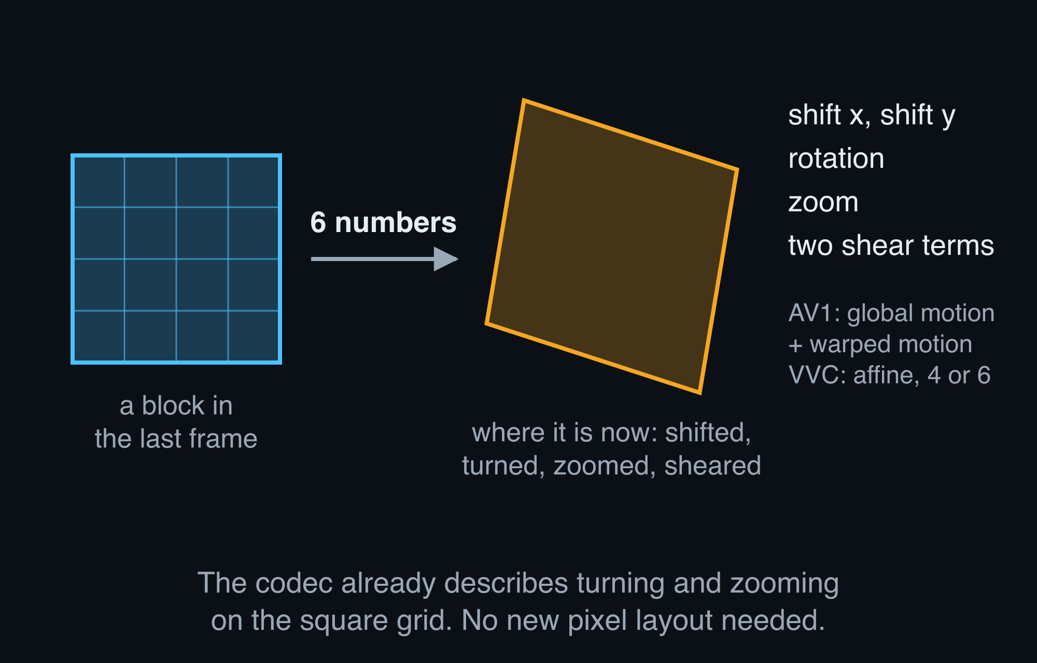
Where rotation and zoom already pay: inside the codec
Newer codecs (AV1, VVC) already describe turn, zoom and shift with 4 to 6 numbers per block, on the square grid.
Literature: about 1 % saved on average, 10 to 20 % only on rotation-heavy footage.
Visionular libaom study; Parker et al. 2017; Li et al. 2018; Zhang et al. 2019; Yang et al. 2021.

Slide 23
AV1 result: the gap narrows, the verdict holds
Same 30 circles under AV1 (SVT-AV1, and libaom with its rotation and zoom tools switched on and off). The square still wins on every real clip; polar keeps an edge only on a fast spin.
 | H.264 (x264) | AV1
polar strip, real clips: bytes vs square | 1.82x | 1.76x
gentlest disc-to-square map, real clips | 1.37x | 1.19x
polar strip, fast spin (3 degrees per frame) | -14 % | -34 % (SVT-AV1)
polar on fast spin with AV1's turn-and-zoom tools off / on (libaom) |  | -32 % / -21 %
plain square on fast spin with those tools off (libaom) |  | +20 % more bytes
AV1 closes part of the gap on the square, but at fast spin polar still wins; at realistic motion it still loses.
Negative = polar needs fewer bytes than the square at the same quality. results/batch2_svtav1 (SVT-AV1 preset 6, PSNR tuning, 30 clips x 3 variants x 6 settings) and results/aom_ablation (libaom on the synthetic clips, global + warped motion on vs off).

Slide 24
What others tried: polar in video (1 of 2)
Log-polar = polar with rings that widen toward the rim, like the eye's retina.
Weiman 1990, log-polar video
the saving came from dropping rim detail, not from geometry.
Li et al. 2021, log-polar strip into a standard codec
it flickers; a straighter warp was cheaper.
Eichenseer & Kaup 2014-2019, fisheye video
straightening curved lines helped, about 1 dB.
Numbers and links: docs/research/polar-coding-literature.md, lens 1.

Slide 25
What others tried: polar in video (2 of 2)
Vishwanath et al. 2018, 360-degree video
a rotation model helps only on far more warped pictures.
Ahmmed et al. 2016, fully bendable motion
small gain, and only on round wide-angle footage.
Schwarz & Behnke 2025, telepresence
a quality map in a stock codec beat warping the pixels.
Six sources, none beat the square grid.
Numbers and links: docs/research/polar-coding-literature.md, lens 1.

Slide 26
What others tried: polar for still images (1 of 2)
Log-polar retina sensors (Sandini, Berton 2006)
fewer pixels toward the rim; never became a product.
Iris rubber-sheet format, ISO 19794-6 (2005)
the saving came from cropping; dropped in 2011.
Solar Orbiter Metis camera (2020)
works because the Sun's corona is ring-shaped; a face is not.
Numbers and links: docs/research/polar-coding-literature.md, lens 2.

Slide 27
What others tried: polar for still images (2 of 2)
JPEG 2000 region of interest (Christopoulos 2000)
mark the disc as important on the square: nearly free.
Foveated wavelet coding (Wang & Bovik 2001)
centre weighting pays only at extreme compression.
Polar iris statistics (Uhl group 2009)
polar pictures stretch differently along and across rings; stock codec tables fit badly.
Six sources, none beat the square grid.
Numbers and links: docs/research/polar-coding-literature.md, lens 2.

Slide 28
Should we build a polar still-image coder first?
Still-only test = the same pipeline with motion prediction switched off.
it would show
it cannot show
• the share of the +82 % that is pure resampling
• how much depends on where the centre sits
• motion, where most of the bytes go
• still tests exaggerate geometry effects
Verdict: no new coder; switch off motion prediction in the existing pipeline instead.

Slide 29
Three ways to use polar maths from here
1. Polar as the stored picture
2. Polar motion inside a codec
3. Centre-weighted quality on the square
1.82x the bytes. Closed.
Measured: AV1's own turn-and-zoom tools leave polar a 21 % edge on a fast spin only, and real circles do not spin. Not worth building.
More bits on the face, fewer on the rim. Works today.
Recommendation: drop the polar file format; test the quality map on the same 30 clips.

Slide 30
Appendix: the numbers
variant | bytes vs square | 95 % interval | quality at the same bytes (dB) | canvas pixels vs square
square (today) | 1.00 | - | 0 | 1.00
gentlest disc-to-square map (elliptical) | 1.37 | 1.31 to 1.45 | -1.7 | 1.02
elliptical map, fewer pixels | 1.35 | 1.29 to 1.41 | -1.8 | 0.80
gentle disc-to-square map (Shirley-Chiu) | 1.62 | 1.56 to 1.70 | -2.5 | 1.02
polar, rings of equal area | 1.76 | 1.66 to 1.93 | -2.8 | 0.79
polar strip | 1.82 | 1.71 to 1.90 | -3.2 | 1.02
polar + repeated rows across the cut | 1.92 | 1.83 to 2.10 | -3.4 | 1.10
polar, 1.6x more pixels at the rim | 2.03 | 1.93 to 2.14 | -3.5 | 1.60
polar, half the pixels | 2.09 | 1.84 to 2.25 | -4.8 | 0.51
control: resampling only | 1.12 | 1.09 to 1.16 | -0.8 | 1.00
control: inverse warp on the square | 1.12 | 1.08 to 1.16 | -0.8 | 1.00
control: 1.6x pixels only | 1.32 | 1.28 to 1.35 | -1.3 | 1.60
Medians over 30 clips, x264, PSNR inside the disc. Quality at the same bytes = median PSNR gap at each clip's square bitrate at the middle quality setting.

Slide 31
Appendix: method and links
30 real circles (300, 384, 400 px), first 10 s, x264 tuned for PSNR, six quality settings per variant.
Metric: PSNR and SSIM (a second quality score) inside the disc; bytes at equal quality (BD-rate) per clip, then the median with a 95 % interval (the range the true median is 95 % likely to fall in).
Controls isolate resampling, the inverse warp and the pixel budget from the codec's own loss.
AV1 pass: the same clips and synthetic motions under SVT-AV1 (PSNR tuning, same masks and settings per variant); libaom with its global and warped motion switched on and off.
Links
Repository
Canvas overview sheet: test disc
Canvas overview sheet: real frame
Benchmark report
AV1 comparison (gap tables)
Galleries (best / worst clips)
Synthetic motion report
Bibliography (checked sources)
Plain-words explainer

