Slide 1

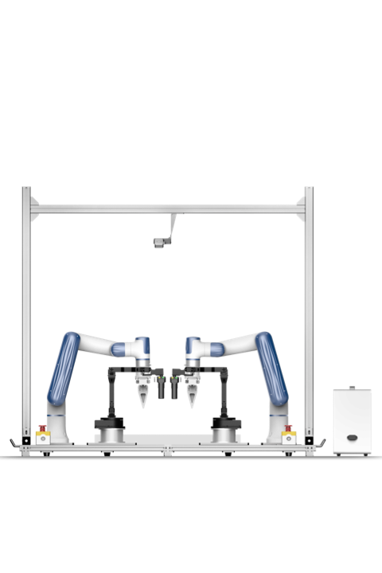
DESIGN AND SIMULATION OF A DUAL-ARM ROBOTIC MANIPULATOR WITH COORDINATE MOTION CONTROL IN NVIDIA OMNIVERSE
Mini Project – Final Viva
Presented by
Perugu Venkata Aditya
Mechanical Engineering (Digital Manufacturing)
Project Guide
Dr. Hari Krishnan R, Asst. Professor – III
School of Mechanical Engineering, SASTRA Deemed to be University
Notes:
Introduce yourself, the project title and guide. This project builds a digital twin of a dual-arm manipulator in NVIDIA Isaac Sim (Omniverse) with ROS2 control.

Slide 2
Agenda
1
Introduction & Problem Statement
8
ROS2 Integration & Action Graphs
2
Objective
9
Results: Validation & Control
3
Tools & Technologies
10
Hardware vs Simulation Comparison
4
Digital Twin Concept
11
Accuracy Analysis
5
Methodology & Architecture
12
Challenges & Fixes
6
CAD Design & Kinematics
13
Future Work
7
URDF & Isaac Sim Implementation
14
Demo Videos & Conclusion
Notes:
Walk through the structure of the talk.

Slide 3
Introduction & Problem Statement
Dual-arm manipulators mimic human two-handed work – assembly, handling and collaborative manufacturing tasks.
Testing control code directly on hardware is slow, risky and costly (collisions, gravity collapse, wear).
A digital twin – a physics-accurate virtual copy – allows safe, repeatable, real-time experiments.
NVIDIA Omniverse / Isaac Sim provides GPU physics (PhysX) and native ROS2 connectivity.
Problem
No validated virtual model of the dual-arm robot existed for safe control development.
Need
A twin whose joint motion and end-effector pose match the real robot.
Solution
CAD → URDF → Isaac Sim → ROS2 pipeline, validated against hardware.
Notes:
Explain why a digital twin is useful before touching real hardware.

Slide 4
Objective
Develop a digital twin of the dual-arm manipulator for control, validation and training using ROS2 and a virtual environment.
Real-Time Simulation & Control
Command both arms and the mobile base live through ROS2 topics.
Validation & Performance Optimisation
Compare twin vs hardware to quantify accuracy and tune physics.
Training & Development Platform
Safe sandbox to develop IK, monitoring and learning-based control.
Notes:
State the three outcomes of the project.

Slide 5
Tools & Technologies
SolidWorks
SW2URDF
URDF
NVIDIA Isaac Sim
3D CAD of the dual-arm with accurate dimensions
Exports links, joints, mass, inertia to URDF
XML robot description: links, joints, limits, dynamics
Omniverse robotics simulator – the digital twin
PhysX Engine
ROS2
Action Graphs
MATLAB
GPU rigid-body physics; Physics Inspector for joints
Middleware: topics, nodes, real-time messaging
Visual OmniGraph logic for joint and base control
External control / future IK experiments
Notes:
Each tool has a role in the pipeline.

Slide 6
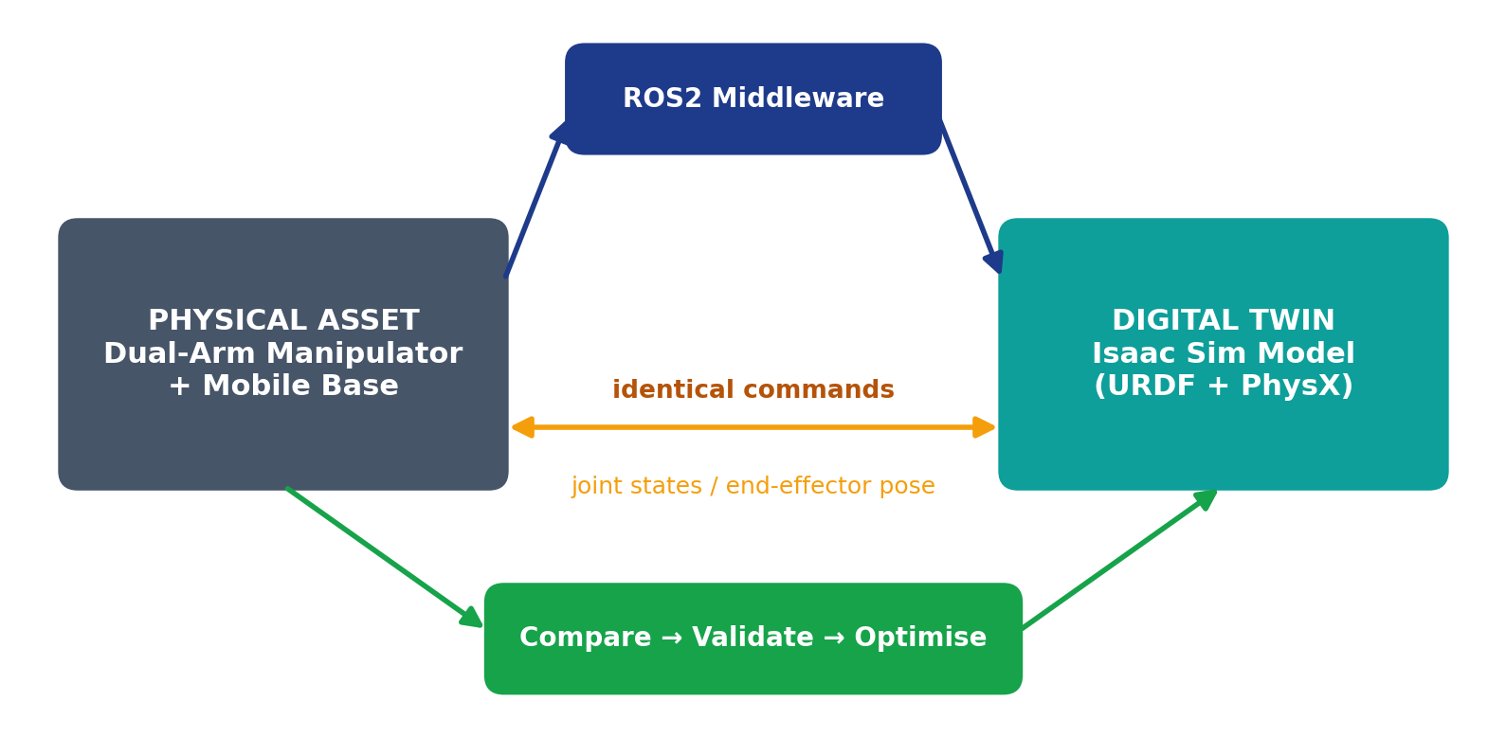
Digital Twin Concept
Physical asset and virtual model receive identical commands.
ROS2 acts as the shared communication layer.
Joint states and end-effector poses are logged on both sides.
Differences drive model tuning (mass, inertia, damping).
Once validated, the twin supports safe testing and training.
Notes:
A twin mirrors the asset and exchanges data both ways.

Slide 7
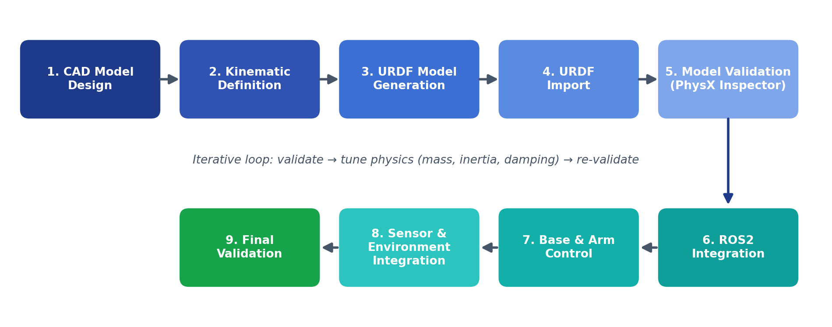
Methodology
Methodology workflow – CAD design to final validation with an iterative physics-tuning loop
Notes:
Ten-step workflow from CAD to final validation.

Slide 8
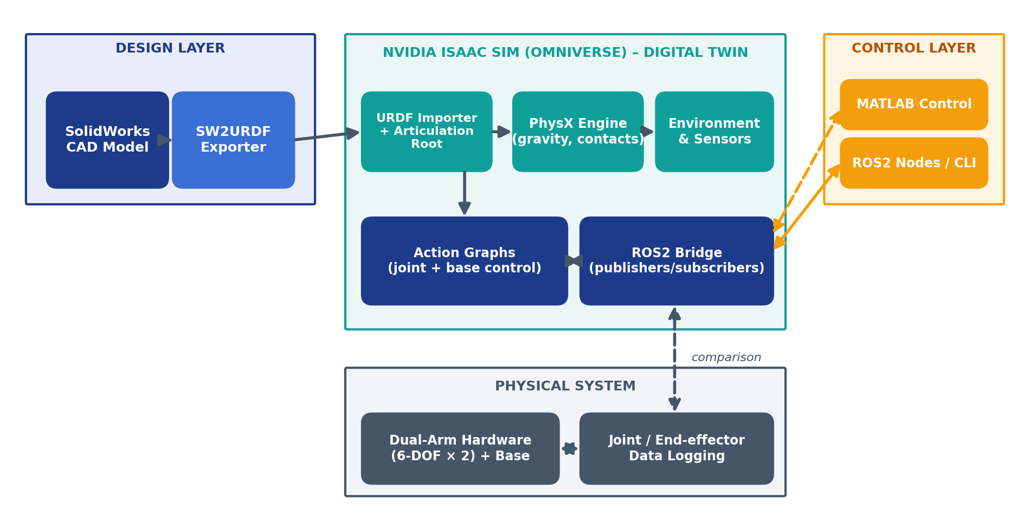
System Architecture
Design layer: SolidWorks → SW2URDF export.
Simulation layer: Isaac Sim with PhysX, action graphs and ROS2 bridge.
Control layer: ROS2 nodes / MATLAB publish commands.
Physical layer: real dual-arm robot supplies comparison data.
Notes:
Layered view: design, simulation, control and physical system.

Slide 9
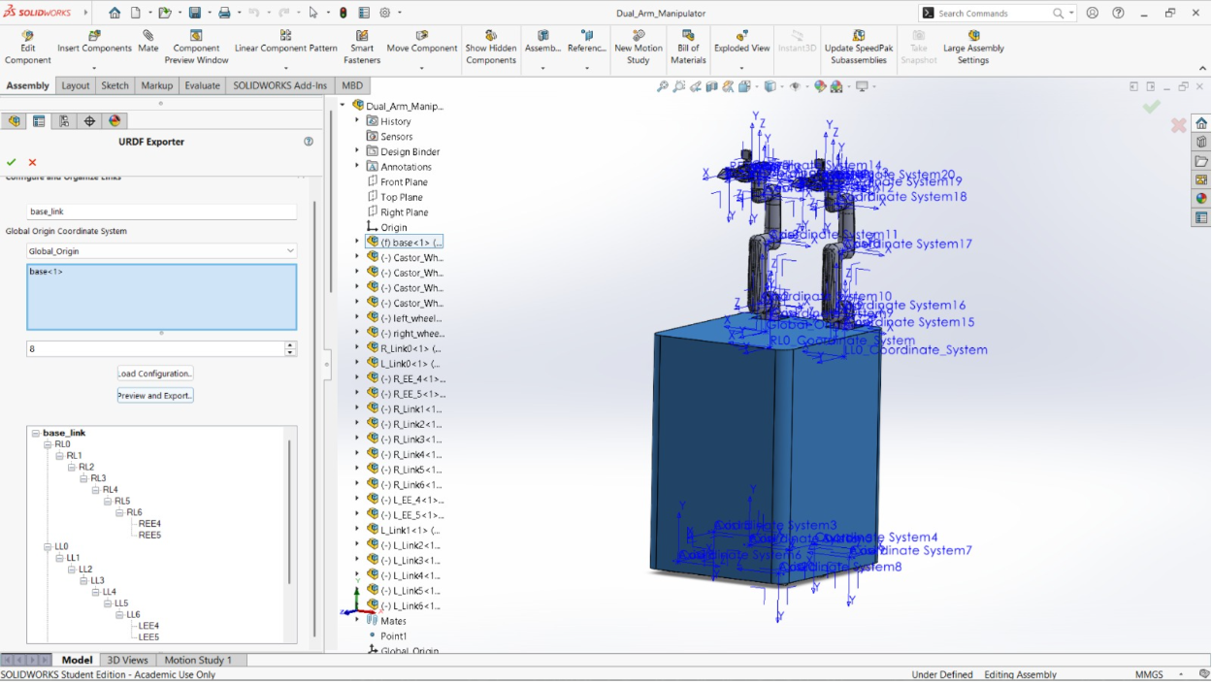
CAD Model Design in SolidWorks
Dual-arm manipulator modelled with accurate dimensions.
Parts organised as links; mating defines joints.
Coordinate axes fixed on every link for export.
Mass properties and inertia read from the model.
Model checked before URDF conversion.
Dual-arm manipulator assembly with coordinate axes fixed for each link
Notes:
Accurate dimensions drive correct kinematics.

Slide 10
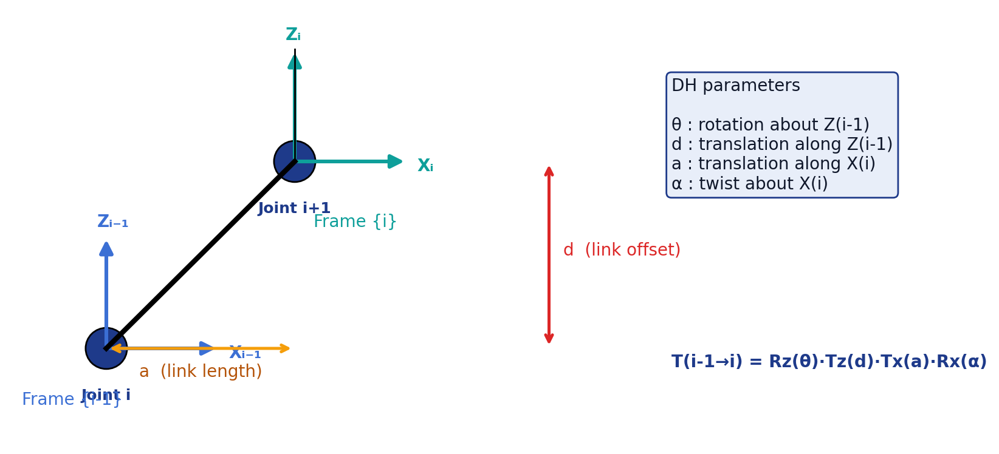
Kinematic Definition – DH Convention
Links and joints assigned for both arms.
Frames defined with the Denavit–Hartenberg convention.
Each arm: 6 revolute joints (RL1–RL6, LL1–LL6).
Homogeneous transforms chain base → end-effector.
Frame choice directly affects URDF joint axes.
Notes:
Explain the four DH parameters and the transform.

Slide 11
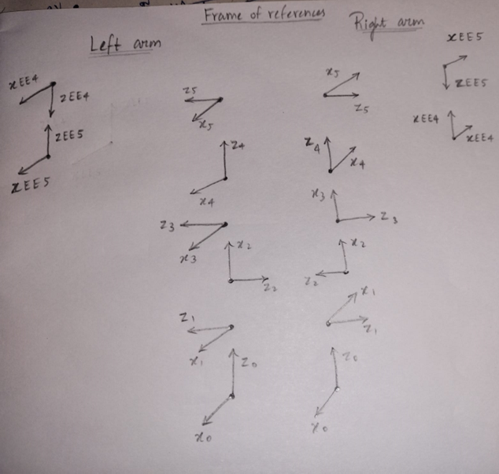
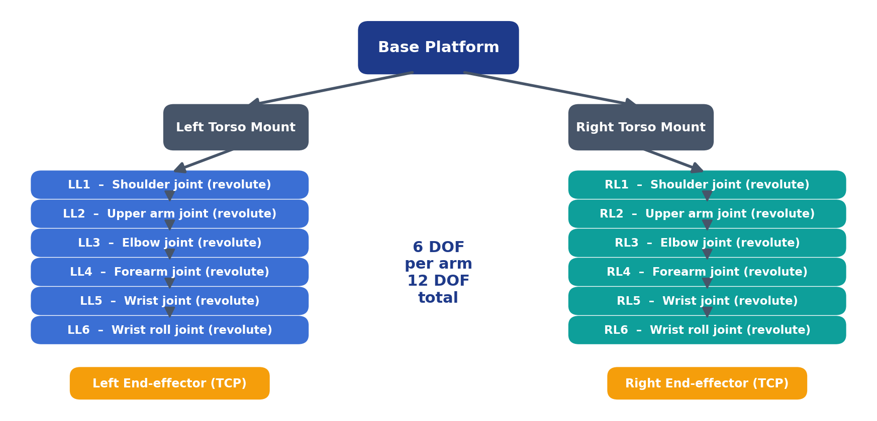
Frames of Reference & Kinematic Chain
Frames of reference – left and right arm
Kinematic tree: 12 revolute joints in total
Notes:
Hand-drawn frames were converted into the kinematic tree.

Slide 12
URDF Model Generation (SW2URDF)
Link mass
Illustrative URDF structure
kg per link
<link name="link_1">
<inertial>
<mass value="..."/>
<inertia ixx="..." iyy="..." izz="..."/>
</inertial>
</link>
<joint name="RL1" type="revolute">
<parent link="base"/><child link="link_1"/>
<axis xyz="0 0 1"/>
<limit lower=".." upper=".."
velocity=".." effort=".."/>
<dynamics damping=".." friction=".."/>
</joint>
Inertia
Ixx … Izz tensor
Joint type
revolute / fixed
Joint limits
position, velocity, effort
Dynamics
friction & damping
Notes:
Parameters defined per link and joint.

Slide 13
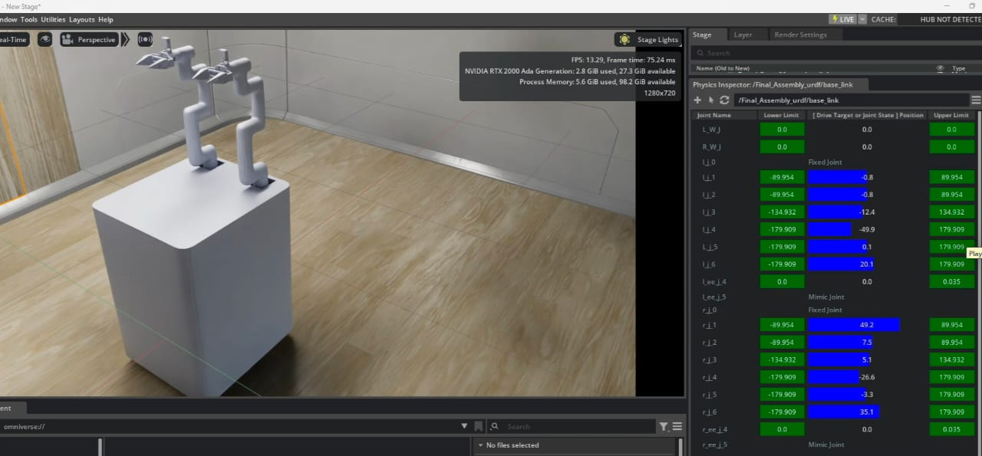
Isaac Sim Import & PhysX Validation
Imported URDF into Isaac Sim.
Configured the Articulation Root.
Verified joint motion with Physics Inspector.
Checked limits, drive stiffness and damping.
Environment creation and sensor integration completed.
Imported model with joint drives in the Physics Inspector
▶ Video: Arm Movement
▶ Video: Base Movement
Notes:
Importing is not enough – verify joints one by one.

Slide 14
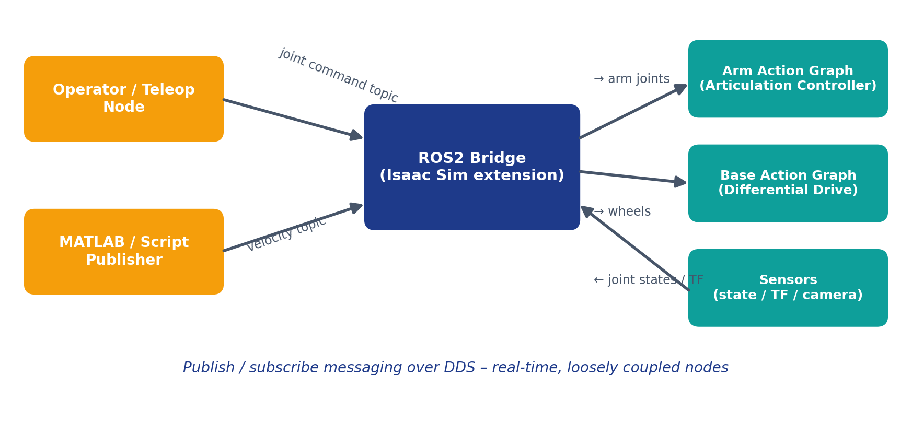
ROS2 Integration
ROS2 bridge enables communication between control nodes and the digital twin.
Joint-command topics drive both arms.
Velocity topics drive the mobile base.
Joint states / TF flow back for logging.
Real-time, loosely coupled design.
Notes:
Pub/sub messaging links control nodes to the twin.

Slide 15
Action Graphs – Joint & Base Control
Arm control graph
On Playback Tick
ROS2 Subscribe
Joint State
Articulation
Controller
Left / Right
Arm Joints
Base control graph
On Playback Tick
ROS2 Subscribe
Twist
Differential
Controller
Base Wheels
Separate graphs for joint-level control and base movement.
Environment and sensors added to the same stage.
Notes:
OmniGraph visual programming.

Slide 16
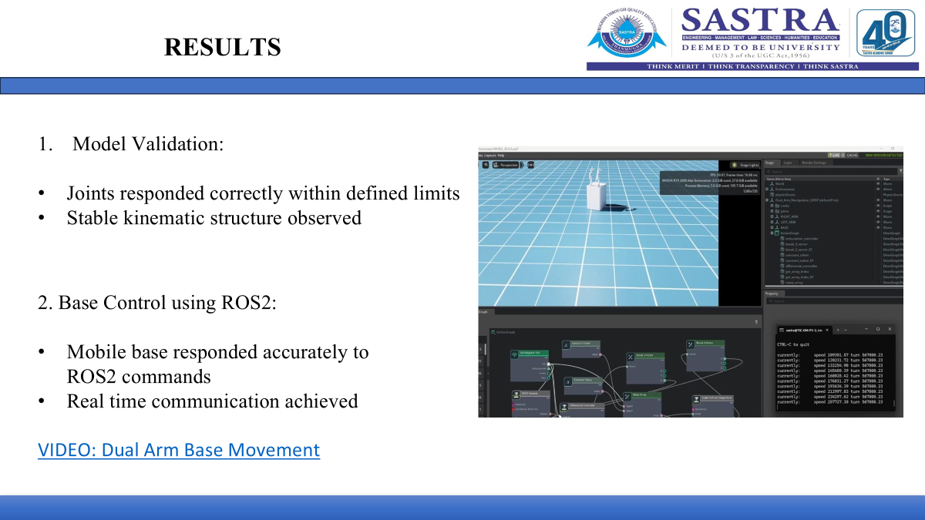
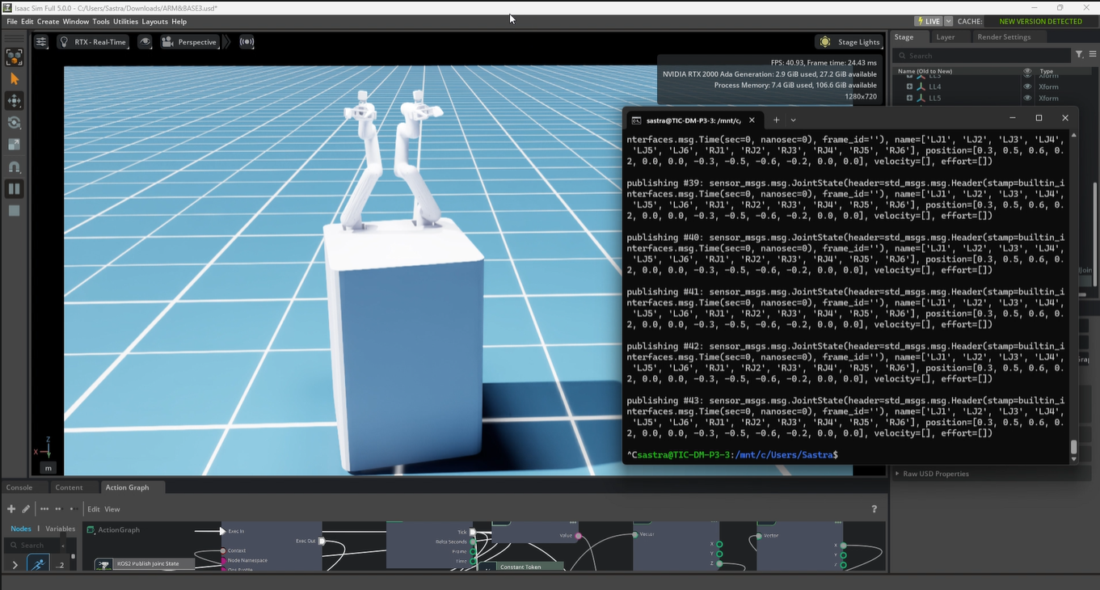
Results – Model Validation & Control
Model validation & action graph
Arm control via ROS2 commands
Joints responded correctly within defined limits; stable kinematic structure.
Mobile base responded accurately to ROS2 commands; real-time communication achieved.
Both arms controlled successfully with ROS commands; joint-level control validated.
▶ Video: Both Arms + Base
▶ Video: Base Movement
Notes:
Joints within limits, stable chain, ROS2 control works.

Slide 17
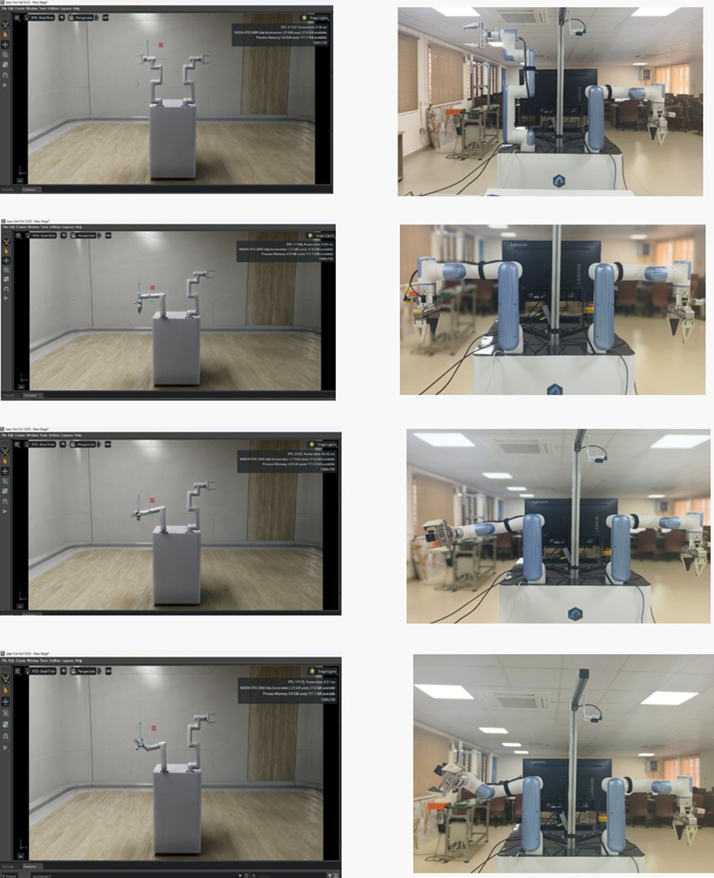
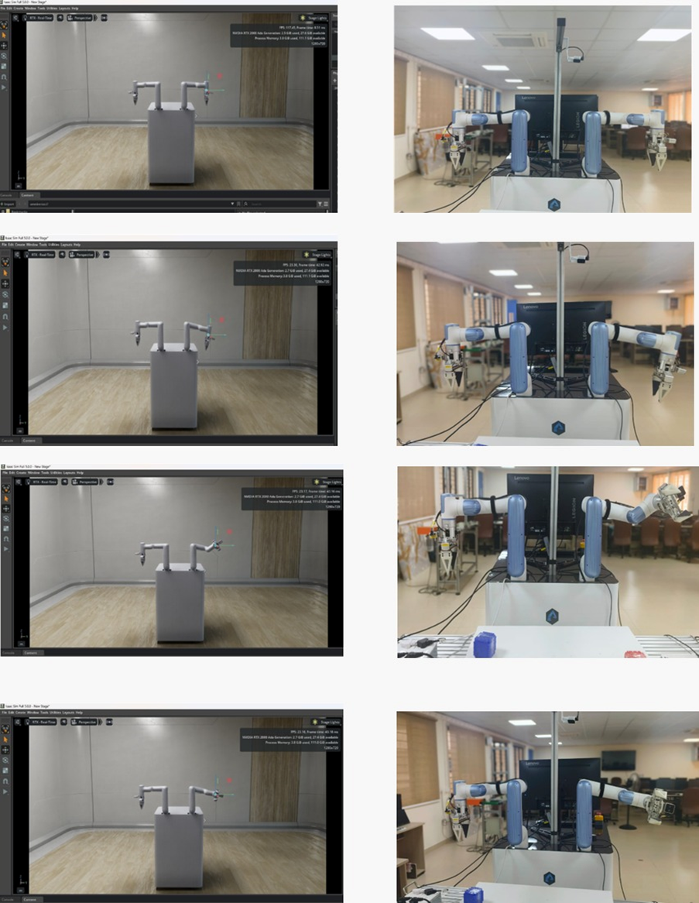
Hardware vs Simulation – Arm Orientations
Identical input commands to real robot and twin.
Joint parameters recorded in both environments.
End-effector positions compared.
Orientation showed strong similarity.
Twin reliably replicates physical behaviour.
Left arm
Right arm
Notes:
Same commands, matching poses.

Slide 18
Joint Parameters & End-Effector Data
Right arm (RL1–RL6)
Left arm (LL1–LL6)
Trial | HW X | HW Y | HW Z | SW X | SW Y | SW Z
1 | -1.53 | -205.74 | 847.99 | -7.81 | -181.55 | 840.80
2 | 96.84 | -354.61 | 411.85 | 95.18 | -355.70 | 427.09
3 | 186.12 | -353.36 | 438.07 | 160.43 | -352.75 | 430.43
4 | 187.17 | -335.04 | 526.30 | 161.72 | -334.56 | 517.56
5 | 80.86 | -377.43 | 454.59 | 83.85 | -365.75 | 464.83
Trial | HW X | HW Y | HW Z | SW X | SW Y | SW Z
1 | -118.00 | -344.00 | 409.00 | -114.00 | -336.00 | 427.00
2 | -119.50 | -317.69 | 351.99 | -114.00 | -319.11 | 369.00
3 | -207.68 | -334.72 | 442.61 | -179.00 | -330.00 | 432.00
4 | -207.62 | -314.48 | 534.65 | -179.00 | -310.00 | 521.00
5 | -104.12 | -364.66 | 465.22 | -103.74 | -347.17 | 469.43
HW = hardware robot, SW = simulation. Joint-angle vectors for every trial are listed in the project report.
Mean absolute deviation (5 trials)
Right arm: X 12.4 mm · Y 7.6 mm · Z 9.8 mm
Left arm: X 13.4 mm · Y 7.2 mm · Z 12.7 mm
Notes:
All positions in mm.

Slide 19
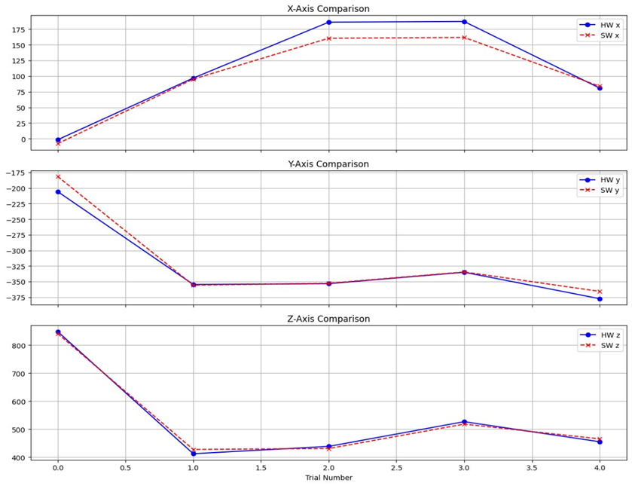
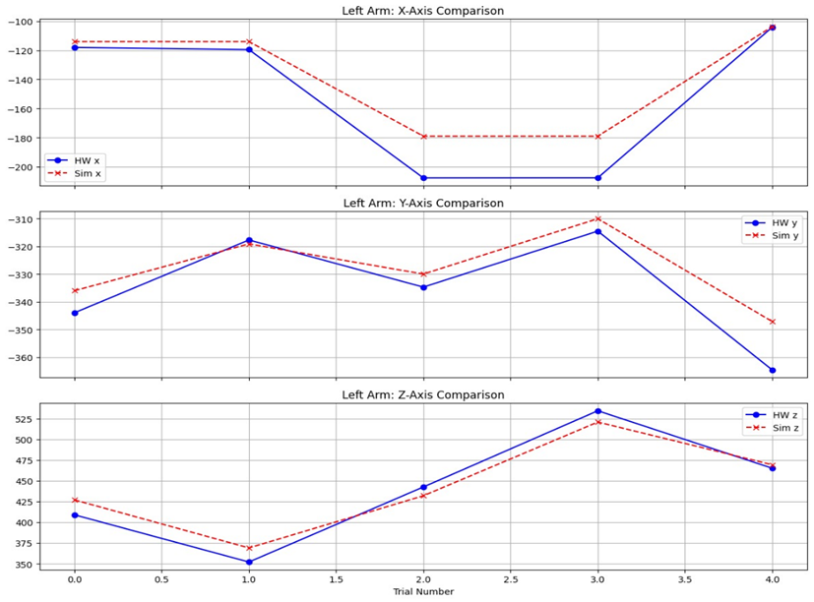
End-Effector Trajectory Comparison
Right arm – X, Y, Z comparison
Left arm – X, Y, Z comparison
Tight trajectory matching; X peak gap at Trials 2–3 (hardware higher).
Y-axis very precise; Z-axis curves almost overlap.
Hardware reads lower X than simulation until Trial 4.
Y-axis parallel and synchronised; Z converges by final trial.
Notes:
Hardware vs simulation across trials.

Slide 20
Accuracy Calculation – Worked Example
1. Euclidean positional error
Right arm – Trial 2
HW = (96.84, −354.61, 411.85) mm
SW = (95.18, −355.70, 427.09) mm
E = √(2.75 + 1.18 + 232.25) = 15.36 mm
R = 552.1 mm
Accuracy = 100 × (1 − 15.36/552.1)
= 97.2 %
E = √[(x_hw−x_sw)² + (y_hw−y_sw)² + (z_hw−z_sw)²]
2. Reach magnitude
R = √[x_hw² + y_hw² + z_hw²]
3. Percentage accuracy
Accuracy (%) = 100 × (1 − E / R)
Notes:
Trial 2, right arm.

Slide 21
Accuracy Results
Trial | Right (%) | Left (%)
01 | 97.02 | 96.39
02 | 97.22 | 96.33
03 | 95.88 | 95.10
04 | 96.26 | 97.00
AVG | 96.60 | 96.20
Both arms exceed 96 % average accuracy. The lowest value (95.1 %, left arm, Trial 3) coincides with the largest X offset in the trajectory plots.
Notes:
Average 96.6 % (right) and 96.2 % (left).

Slide 22
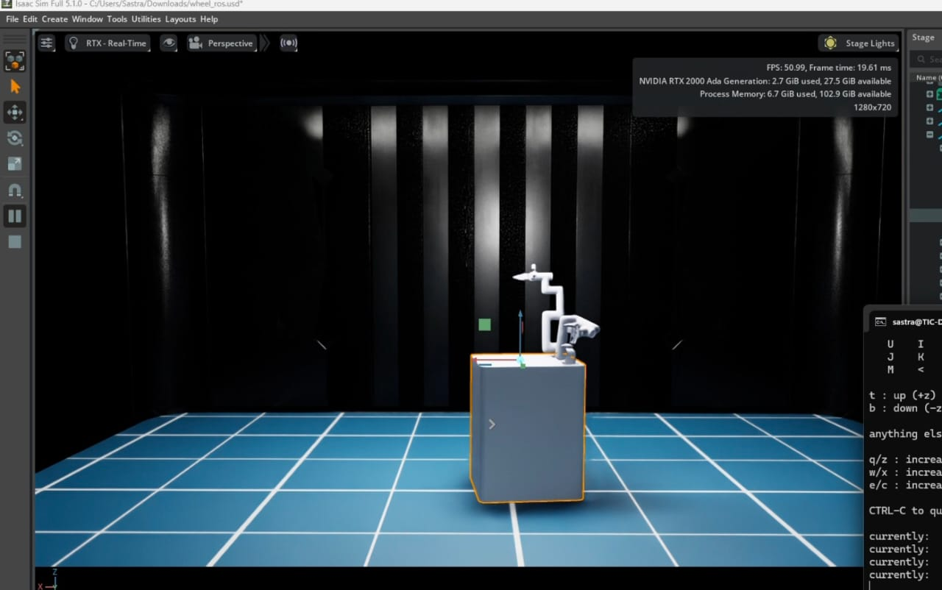
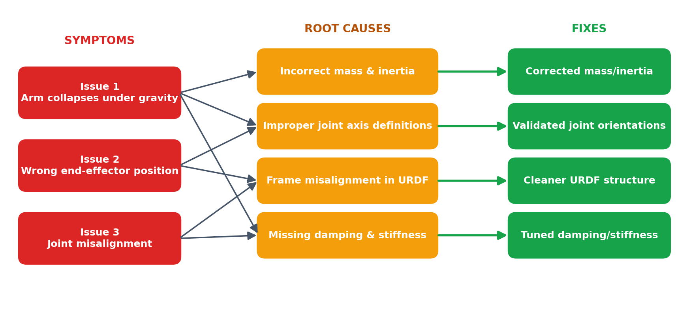
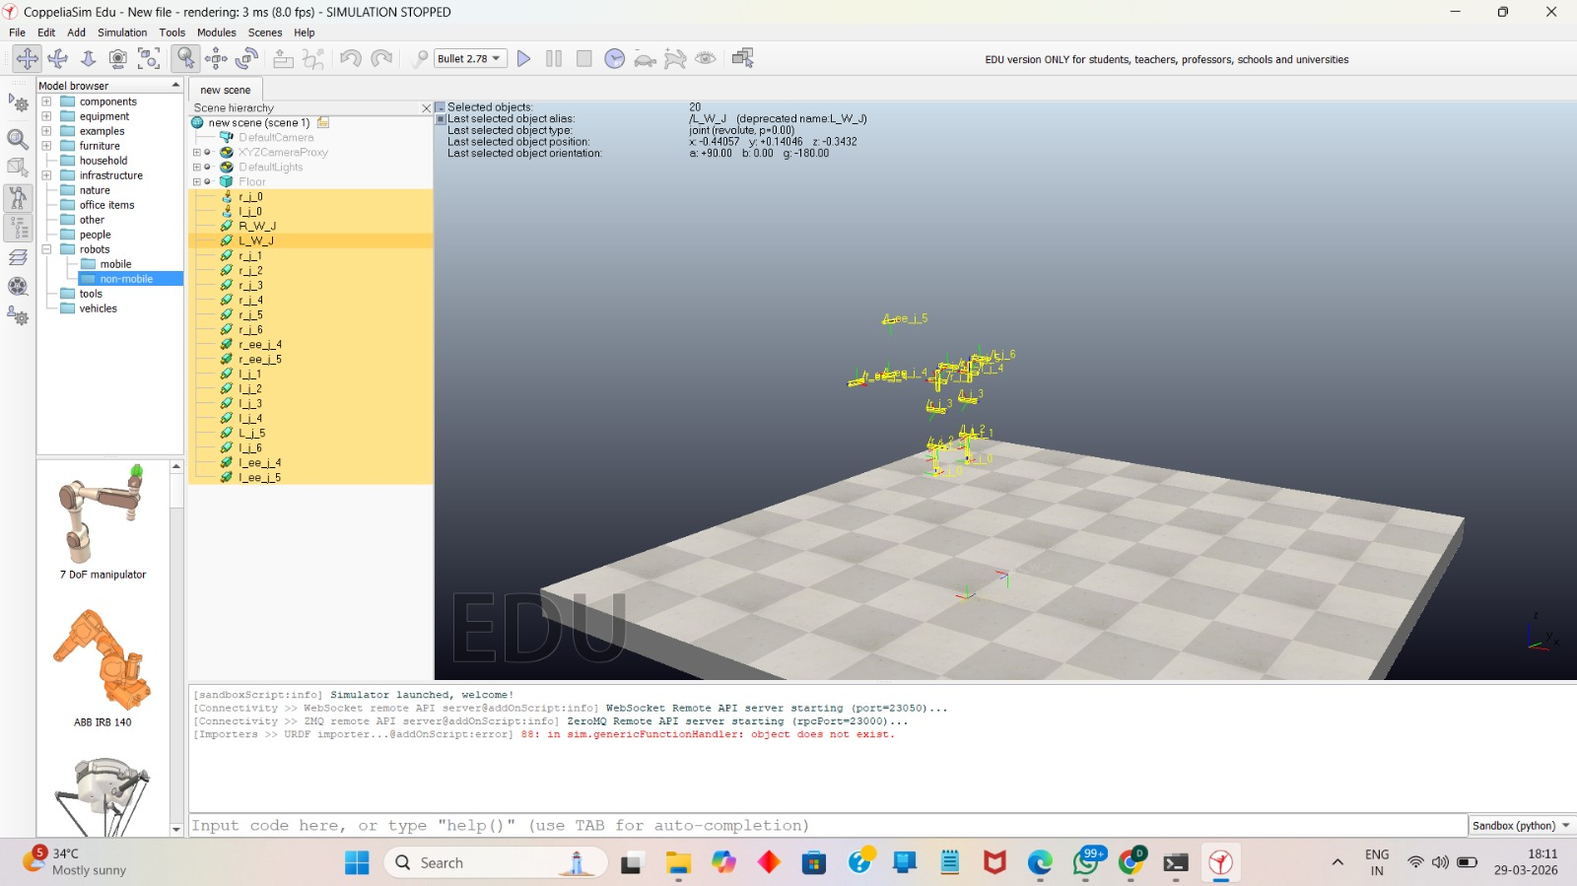
Challenges Faced & Fixes
Learning: correct mass/inertia, joint axes and damping are essential for a stable twin.
▶ Video: Falling Arms
Notes:
Physics tuning was the main lesson.

Slide 23
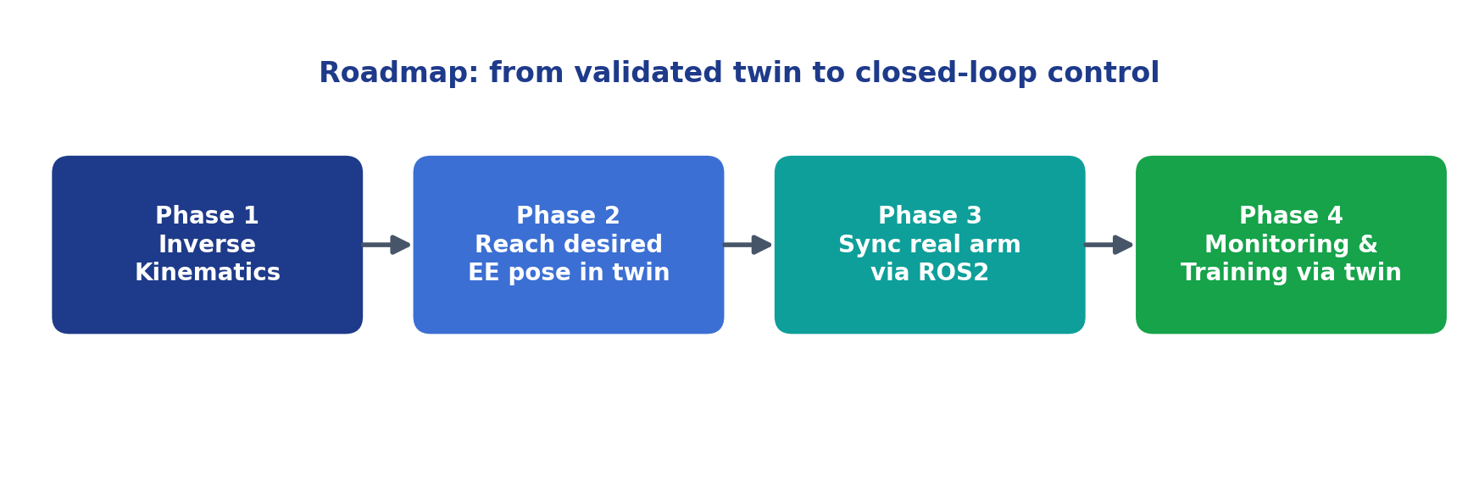
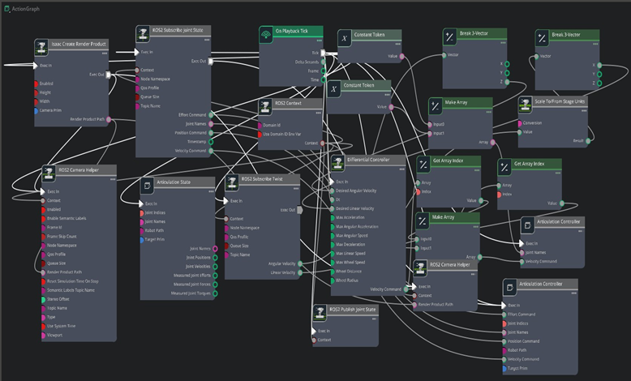
Future Tasks
Implement inverse kinematics so the twin reaches a desired end-effector position.
Synchronise the actual dual-arm manipulator with the simulation via ROS2.
Enable monitoring and control/training through the digital twin.
▶ Video: MATLAB Control
Notes:
Inverse kinematics, real sync, monitoring.

Slide 24
Demo Videos
1. Dual Arm Base Movement
Mobile base driven by ROS2 commands
▶ Watch video
2. Arm Movement
Joint-level arm control in Isaac Sim
▶ Watch video
3. Both Arms and Base Movement
Coordinated arms + base motion
▶ Watch video
4. Falling Arms
Gravity collapse before physics fixes
▶ Watch video
5. MATLAB Control
MATLAB-based control experiment
▶ Watch video
Notes:
Click a button to open the video (Google Drive).

Slide 25
Conclusion & Thank You
96.6 %
96.2 %
12 DOF
Right-arm average accuracy
Left-arm average accuracy
Two 6-joint arms controlled via ROS2
A validated digital twin of the dual-arm manipulator was built in Isaac Sim using a CAD → URDF → ROS2 pipeline.
Twin and hardware agree closely in orientation and end-effector position.
The platform is ready for IK, hardware synchronisation and training.
Thank you!
Perugu Venkata Aditya
Mechanical Engineering (Digital Manufacturing)
Guide: Dr. Hari Krishnan R
Notes:
Close with results and thank the guide.

